Slide 1
4 highest buildings consumers of electricity
in 2014
251 MWh
Electricity Consumption
223 MWh
168 MWh
152 MWh
Franchise Tax Board (DGS)
Cal Tech
HQ
(CAL TECH)
Richmond
Lab
(CDPH)
Veteran’s Home
(CDVA)

Slide 2

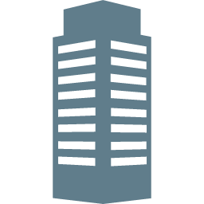

Annual Electricity Consumption
Cal Tech HQ
246 Homes

Slide 3
How can we help employees
reduce consumption?

Slide 4
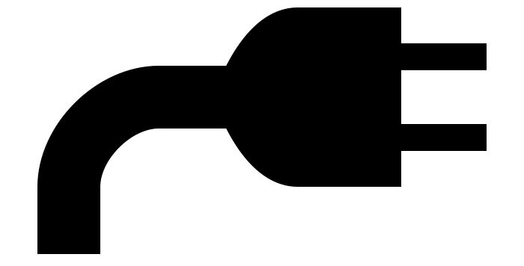
NudgeSMS
Improve energy conservation through text messaging inside an agency

Slide 5


Slide 6
Credits
Icons made by Freepik from www.flaticon.com is licensed CC BY 3.0
Plug-In icon by Edward Boatman from the Noun Project
Smartphone by Martin Jordan from the Noun Project

