Slide 1

How can we help reduce electrical consumption in buildings?

Slide 2
We involve the people that work inside
them 8 hours a day

Slide 3
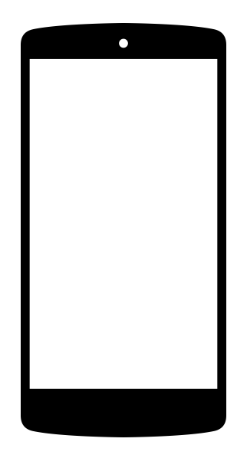
Step 1: Anyone can register from their phone.
I’m in bldg 127983
Thx for registering. You are all set!

Slide 4
Step 2: Employees get a weekly update of their electricity consumption
Your bldg consumed 4.5 MWh of electricity this week.
Good job! That is 10% better than the same week last year

Slide 5
Step 3: Nudge employees to improve their ranking
We’re shooting for 15% this week. Remember to turn off lights!

Slide 6
Step 4: Measure real reduction in electricity use
4.5 MWh
Let’s get to number 1: remember to turn off lights around you.
4 MWh
3.5 MWh
Electricity Consumption
Week 1
Week 2
Week 3

Slide 7
Try it out!
Register by texting your bldg #
to
(760) 452-8548
(see bldg numbers below)

