Slide 1
Window size: optimising the facade with AutoMOO
Passive cooling, lecture 1 of 4 · Assignment 4, part 1

Slide 2
Agenda
Why window size is a cooling question
The design summer: Annex 80 Copenhagen 2041–2060
Daylight as a constraint: EN 17037 sDA
Multi-objective optimisation and the Pareto front
Setting up AutoMOO in IDA ICE
Assignment part 1

Slide 3
Where we are in the cooling assignment
Part 1
Window size
AutoMOO
Part 2
Venting hatch
jet theory, draught
Part 3
Ceiling fans
peak periods
Part 4
Shutters
heat wave
Step 1 of the cooling strategy: reduce solar gains while keeping daylight and view out.
Each part builds on the model from the previous part. Keep one IDA ICE file per part.

Slide 4
Why window size is a cooling question
Part 1

Slide 5
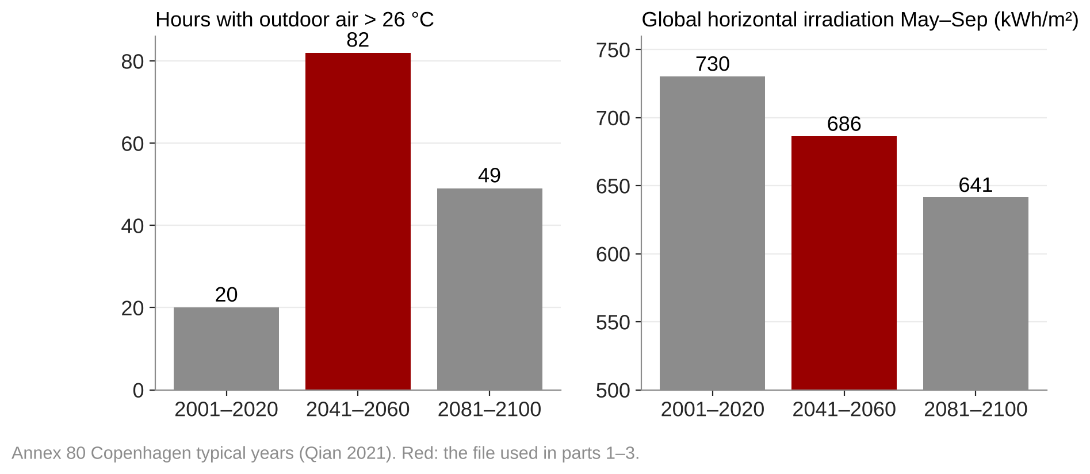
The 2050 typical year is the design summer
Parts 1–3 use 5A_Copenhagen_TMY_2041-2060.epw
82 h above 26 °C outdoors, against 20 h in 2001–2020
2041–60 has more summer sun than 2081–2100 (686 vs 641 kWh/m²), so it is the more critical file for solar gains
Notes:
Numbers computed from the Annex 80 EPW files in the project folder (make_figures.py). Hours counted over the full year; May–Sep GHI summed from column 14.

Slide 6
A window trades daylight and winter sun against summer heat
Solar gain
Daylight
Heating
Scales with window area × g-value × irradiance
Drives cooling demand and overheating
Scales with window area × light transmittance LT
Constraint: sDA300,50% ≥ 50 % (EN 17037)
A window loses more heat than the wall it replaces
but collects winter sun on the south facade
Glazings in the course model
Glazing | U (W/m²K) | g | LT | Selectivity LT/g
Pilkington S3 (reference) | 0.6 | 0.49 | 0.71 | 1.4
Suncool 70/35 | – | 0.34 | 0.63 | 1.9
Suncool 66/33 | – | 0.32 | 0.59 | 1.8
Notes:
Glazing values from the Assignment 04 solution file and 'Advice for parametric run.pptx'. Fill in the U-values of the Suncool panes from the datasheet (keep U ≤ 0.6 W/m²K).

Slide 7
Multi-objective optimisation
Part 1

Slide 8
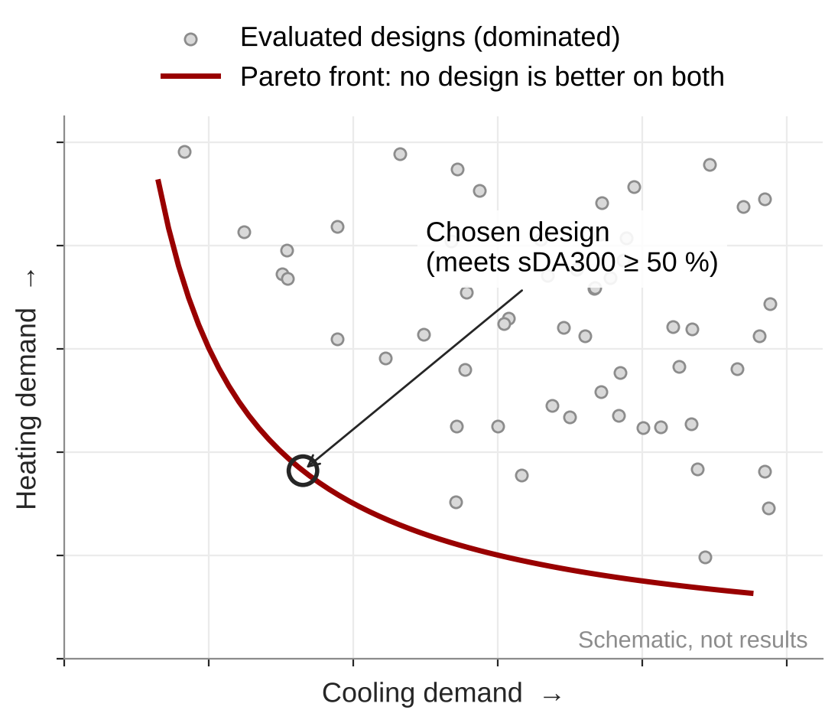
A Pareto front shows the best trade-offs
Two objectives: minimise cooling demand and heating demand
One constraint: sDA300 ≥ 50 %
A design is dominated if another design is better on both
The front is the set of non-dominated designs
You choose on the front, using what the model leaves out: view, glare, cost, the other rooms

Slide 9
Setting up AutoMOO in IDA ICE
Variables
window height and width
IDA ICE runs
genetic algorithm
Objectives
min cooling, min heating
Constraint
sDA300 ≥ 50 %
Pareto front
pick a design
Variables
Simulation
Keep it fast
Window height, sill at 0.9 m
Window width
Optional: glazing type, overhang depth
Whole range must fit in the wall
Type: custom + climate-based daylight
Keep generated models: yes
Set each output's role: objective or constraint
Relax the tolerance, set a max. time step
Limit the outputs
Test with a few runs first
Notes:
Hints taken from the assignment draft, part 1. See also 'How to - IDA ICE parametric daylight run.pdf' in the course folder.

Slide 10
Demo: AutoMOO on the 4 × 4 m centre zone
TO DEVELOP
Screenshots from IDA ICE: parametric run dialog, choosing AutoMOO, setting objective and constraint roles.
Pareto plot export and how to read the chosen design back into the model.
Single-zone model: 4 × 4 m, 2.5 m high, U = 0.1 W/m²K, facing north or south.

Slide 11
Assignment part 1
Q1.1
reference: sDA, cooling, heating, N and S
Q1.2
AutoMOO study, Pareto front
Q1.3
choose a design, repeat table
Q1.4
reflect
Hand in
Q1.1/Q1.3 table for north and south
Pareto figure with your chosen design marked
5–10 lines of reflection
Notes:
Teacher check only, not for the slides: facade chapter worked example gives south optimum g 0.32, 1.2 m overhang, 1.1 m window height, sDA 53 %, cooling 19.6 kWh/m² (−63 %); north 1.4 m, sDA 59 %, 15.1 kWh/m² (−27 %).

Slide 12
Questions to discuss
Why is the optimal south window smaller than the north one?
What did the optimisation leave out: view out, glare, the other rooms, future weather, cost?
Your window was optimised for the 2050 typical year. Would it change for the heat-wave year?

