Slide 1
Venting hatches without draught
Passive cooling, lecture 2 of 4 · Assignment 4, part 2

Slide 2
Agenda
Why ventilative cooling needs hatches
Hatch types and requirements
Jet theory: ceiling jet and floor flow
Draught criteria: ISO 7730 DR and ASHRAE 55 ankle draught
From a draught limit to an ACH limit
Ventilative cooling in IDA ICE, limited by draught
Assignment part 2

Slide 3
Where we are in the cooling assignment
Part 1
Window size
AutoMOO
Part 2
Venting hatch
jet theory, draught
Part 3
Ceiling fans
peak periods
Part 4
Shutters
heat wave
Step 3 of the cooling strategy: remove heat with outdoor air, without draught.
Carry your north and south windows from part 1 into the whole-house model.

Slide 4
Why hatches
Part 2

Slide 5
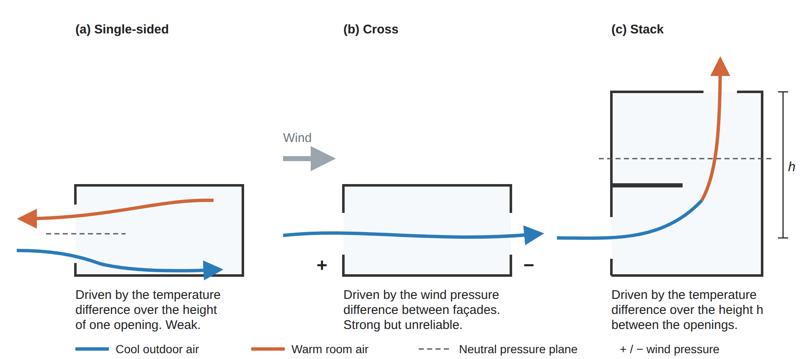
Ventilative cooling needs large airflows
Cooling P = ṁ · cp · ΔT: a small summer ΔT needs 4–10 ACH
The risk is not the hot afternoon but the evening, night and shoulder season, when outdoor air is 8–12 K below the room
Fixed frameless windows need a separate opening: the hatch
Notes:
Figure from the ventilative cooling chapter draft (cooling/drafts/ventilation-modes.png).

Slide 6
Hatch types: where does the cold air go?
High, bottom-hung
Low opening
Side-hung
Air attaches to the ceiling as a wall jet
Mixes before it reaches people
Cold air spreads along the floor
Highest draught risk at the ankles
Thermal jet that drops
Treat as a low opening with a larger K
Every hatch must
Keep out rain and burglars
Allow night opening
Add little heat loss when closed
Fire escape if it replaces a window: width > 0.5 m, height > 0.6 m, width + height > 1.5 m, sill ≤ 1.2 m (BR18)

Slide 7
A closed hatch must insulate like a wall
170 mm
60 mm
0.07
Gas-filled foam (λ 0.020) for U = 0.12 W/m²K, as two panels (120 + 45 mm)
Vacuum panel (λ 0.007) for the same U, at about 25 × the cost
W/m²K for a hatch integrated in a prefab facade (2D Comsol), Ψ = 0.005 W/mK
In IDA ICE (Q2.2)
Model the hatch as a window with frame fraction 0.999 and frame U = hatch U
Report the house's mean U-value and heating demand before and after
Notes:
Numbers from lecture 16.2 Venting hatches. Two panels because one thick panel blocks the opening and cannot rotate.

Slide 8
Jet theory
Part 2

Slide 9
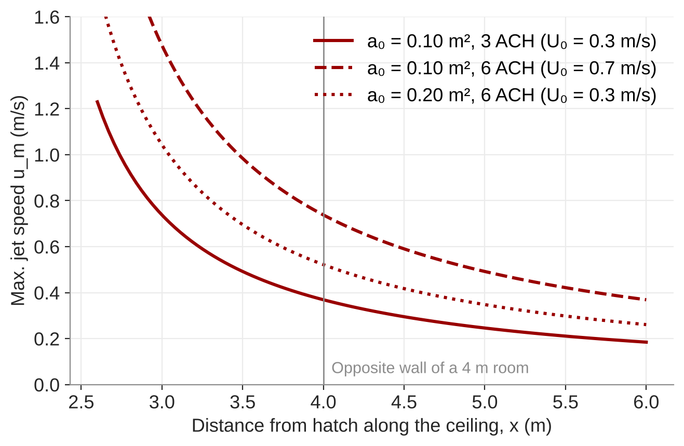
High hatch: a ceiling wall jet, if it stays up
Max. jet speed, Ka ≈ 7, x₀ ≈ −2 m
u_m = K_a · U₀ · √a₀ / (x + x₀)
U₀ = q₀ / a₀: same airflow through a larger opening gives a slower jet
Conservative: take the speed where the jet turns down at the opposite wall
Large ΔT and weak driving force: the cold jet drops off the ceiling
Argue with Ar = g β ΔT h₀ / U₀²
Notes:
Svidt, Heiselberg & Nielsen (2000), Table 1: Ka ≈ 7, x0 ≈ −2 m. Only valid well away from the hatch. Heiselberg (2006): the supply acts as a jet for ΔT < 5 K and/or Δp > 4–6 Pa.

Slide 10
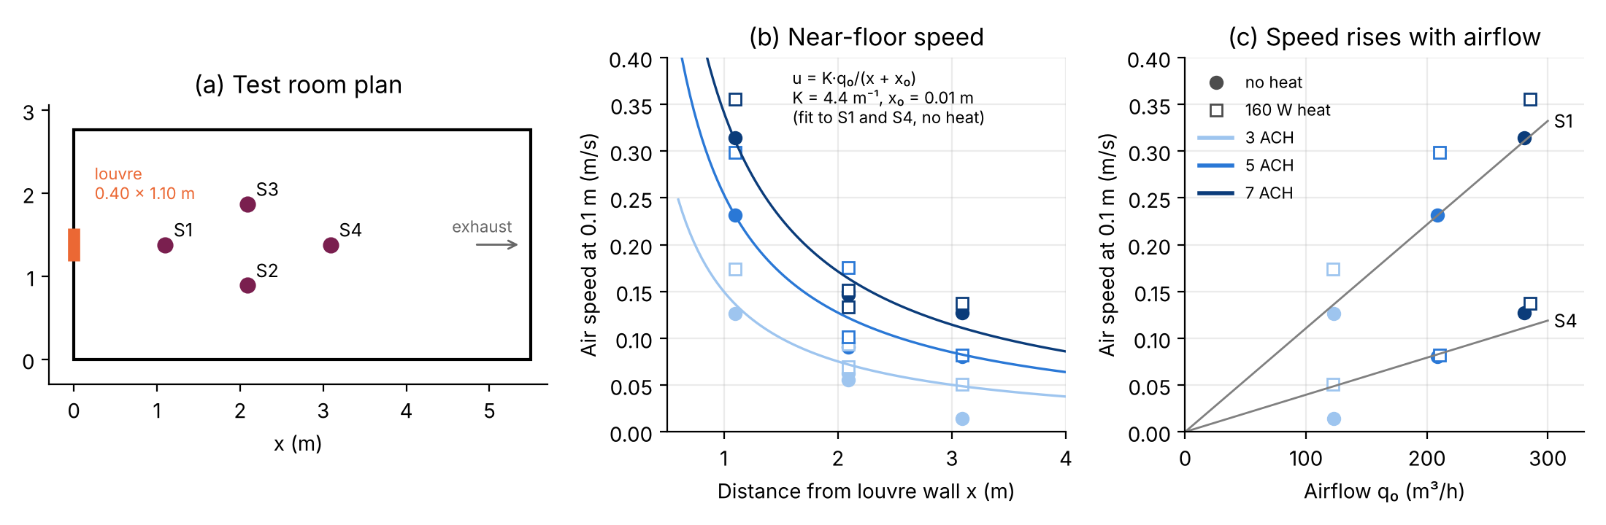
Low opening: cold air spreads along the floor
Bugenings et al. (2025) louvre data, K fitted to 4.4 1/m. Figure from cooling/drafts/flow-element.

Slide 11
Low opening: the floor flow element
Nielsen et al. (2000), radial floor flow
u(x) = K · q₀ / x
Quick check
40 m³ zone at 5 ACH: q₀ = 0.056 m³/s
K = 4.4 1/m gives u = 0.24 m/s at 1 m
K = 10 1/m gives 0.56 m/s
K ≈ 4–5 1/m near isothermal (4.4 fitted to the Bugenings louvre)
K up to about 10 1/m with a large ΔT
Evaluate at 0.1 m above the floor, 1 m from the wall
q₀ in m³/s

Slide 12
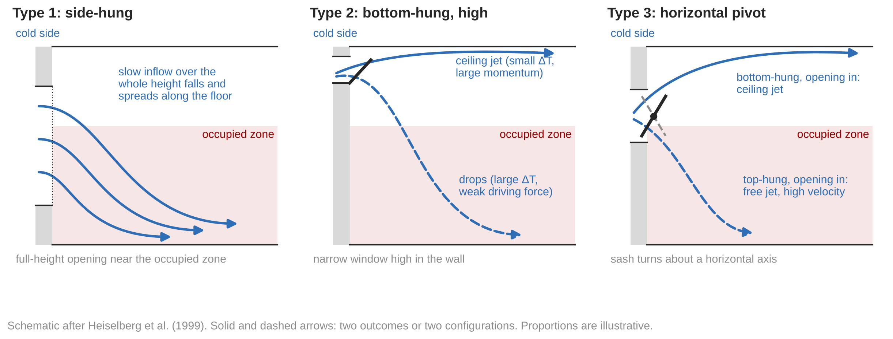
Three windows in the Aalborg lab
After Heiselberg et al. (1999). Test room 8 × 6 × 3 m; the windows sit in an insulated wall to a cooled room.
Notes:
Heiselberg, Dam, Sørensen, Nielsen & Svidt (1999). Characteristics of air flow through windows. HybVent Forum '99, Sydney. AAU Indoor Env. Eng. No. 103. The paper has photos of the three windows (Fig. 3); the drawing here is ours. No window dimensions are given in the paper.

Slide 13
Where the cold air lands depends on the window
Single-sided
Cross and stack
Types 1 and 2: air reaches the floor 0.5–1.5 m from the window and spreads as a stratified layer
Even small openings give high velocities in the occupied zone
Type 3: little air at small angles; it runs down the wall and only reaches the floor at large angles
Types 1 and 2: a thermal jet that reaches the floor
Type 3, bottom-hung opening in: ceiling jet that separates furthest from the wall, so the lowest velocities
Type 3, top-hung opening in: free jet into the occupied zone, very high velocities
Design consequence: throw the cold air upwards, above the occupied zone, and let it mix before it falls.
Notes:
Heiselberg, Dam, Sørensen, Nielsen & Svidt (1999). Characteristics of air flow through windows. HybVent Forum '99, Sydney. AAU Indoor Env. Eng. No. 103.

Slide 14
The discharge coefficient is not a constant
Orifice equation for an opening
q = C_d · A · √(2Δp / ρ)
Why it matters
A constant Cd, such as IDA ICE's default 0.65, can give serious errors in the predicted airflow
Check your hatch airflow by hand (Q2.8)
Measured for the side-hung window (type 1)
Isothermal: Cd does not depend on Δp, but does depend on the opening area
With a temperature difference: Cd is a function of the Archimedes number and the opening area
Cd above 1 at small angles: the geometric opening area is hard to define
Notes:
Heiselberg, Dam, Sørensen, Nielsen & Svidt (1999). Characteristics of air flow through windows. HybVent Forum '99, Sydney. AAU Indoor Env. Eng. No. 103. Cd measured for type 1 (side-hung) only; the paper gives Cd as plots, not tables. IDA ICE default Cd = 0.65 (lecture 16.1).

Slide 15
A side-hung window as a flow element
0.81 × 1.38 m
0.04 / 0.10 m²
4–20 1/m
Side-hung window, sill 1 m above the floor
Opening area a₀ at 5° and 15°
K_w, rising with Ar′ and a₀
Max. floor velocity, measured slope −1.0 in log-log
u_x = K_w · q₀ / (x + x₀)
The cold air drops as a thermal jet, then spreads radially along the floor
x₀ is negative: the virtual origin lies in front of the window, down to about −3 m
An opening with K ≈ 5 1/m and small x₀ would cut occupied-zone velocities
Notes:
Nielsen, Dam, Sørensen, Svidt & Heiselberg (2000). Characteristics of buoyant flow from open windows in naturally ventilated rooms. ROOMVENT 2000, 825–830. Velocities in the 1999 paper (Fig. 11): ΔT 4.5–8.5 K, 99–389 m³/h, 0–5 m from the wall.

Slide 16
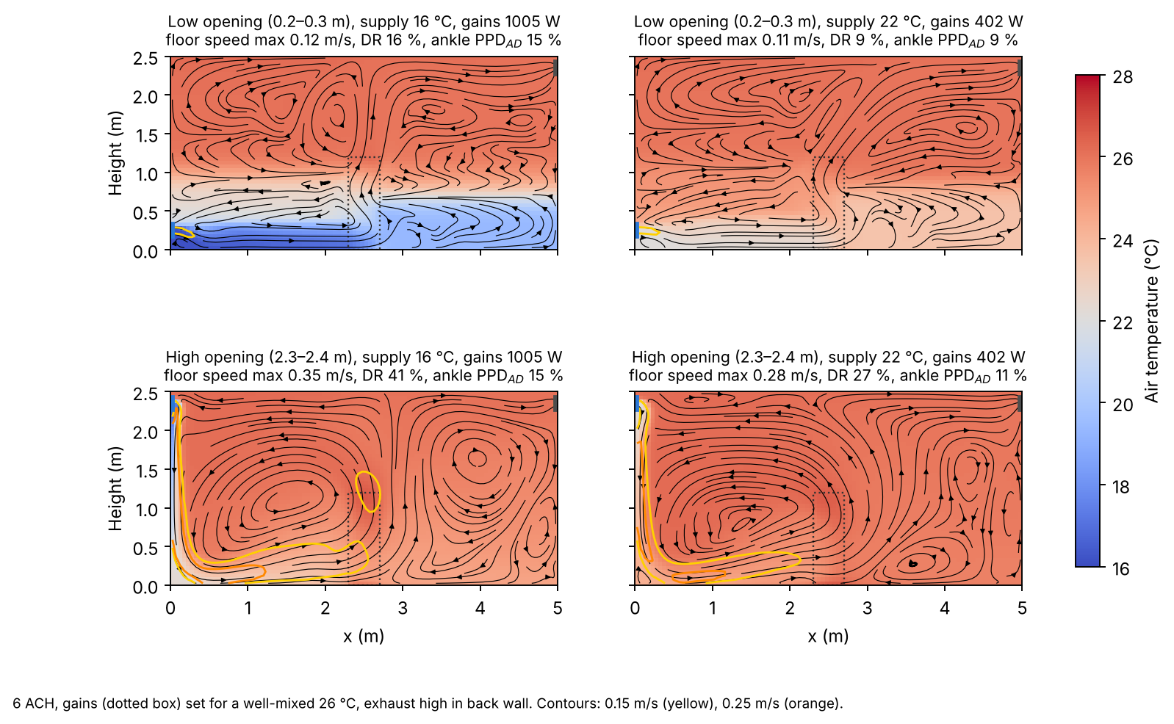
Opening height decides where the cold air goes
Course 2D CFD model (room_cfd.py), 6 ACH, gains set for a well-mixed 26 °C. Teaching model, not mesh-converged.
Notes:
From the CFD thread. Low opening keeps cold air on the floor; high opening mixes it but the jet can still drop at the far wall.

Slide 17
Draught criteria
Part 2

Slide 18
Two ways to judge draught
ISO 7730 draught rate
DR = (34 − tₐ)(v − 0.05)^0.62 (0.37 v Tu + 3.14)
ASHRAE 55-2020 ankle draught (Liu et al. 2017)
PPD_AD = 100 · eᶻ / (1 + eᶻ), z = −2.58 + 3.05 v − 1.06 TS
Tu = 40 % if unknown
DR ≤ 20 % is acceptable (category II)
Local air temperature and speed at the ankle
No 'feet factor': use DR as it stands
Limit PPD_AD ≤ 20 %
Equals v_ankle < 0.35 TS + 0.39 m/s
TS = whole-body thermal sensation: a cool body tolerates less air speed
Notes:
Do not apply the 0.82 'feet factor': it was a misread correlation coefficient. Use plain ISO 7730 DR and the ASHRAE 55 ankle model.

Slide 19
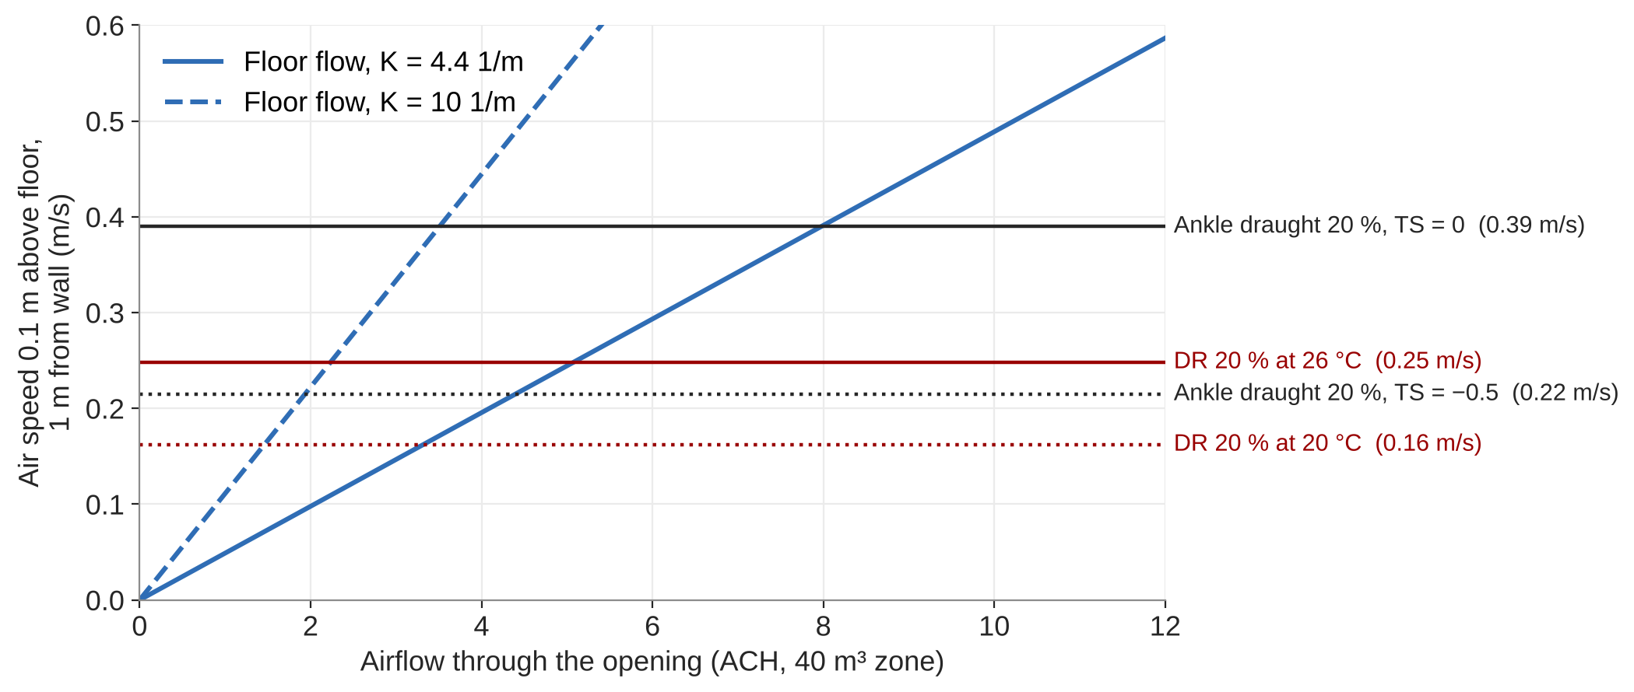
From a draught limit to an ACH limit
Low opening, 40 m³ zone
DR 20 % at 26 °C reached at about 5 ACH with K = 4.4, about 2 ACH with K = 10
Ankle model at TS = 0: about 8 and 3.5 ACH
Repeat for your hatch and plot max. ACH against ΔT (Q2.4)
Notes:
Computed in make_figures.py: v = K q0 / x at x = 1 m; DR solved for 20 % with Tu = 40 %. Compare with the Roth et al. (2023) chart in lecture 16.2 (CBE/ankle curve).

Slide 20
Ventilative cooling in IDA ICE
Part 2

Slide 21
Three runs, one limit
Q2.5
cross-ventilation through hatches
Q2.6
add stack via roof skylight, PI on critical zone
Q2.7
cap ACH at your draught limit
Q2.8 (optional)
hand calc. vs IDA ICE airflow
IDA ICE hints
Hourly airflow per opening is in the zone results; convert to ACH with the zone volume
Limit with the max. opening fraction, or a limiter on the opening signal that depends on outdoor temperature
Check afterwards that the peak ACH stays under your limit

Slide 22
Demo: hatch control and ACH limiter in IDA ICE
TO DEVELOP
Screenshots: hatch as a window object, opening control macro, skylight PI controller on the critical zone.
How to read 'Air flow through openings' and convert to ACH.
Optional: compare jet theory with the IDA ICE flow element for one evening hour.

Slide 23
Assignment part 2
Hand in
Hatch cross section with dimensions, free area and Cd
Hatch U-value and heating penalty
Jet calculation for 2 K and 10 K, with the work shown
ACH-limit chart against ΔT
Hours above adaptive category II for Q2.5–Q2.7

