Slide 1
Ceiling fans for peak periods
Passive cooling, lecture 3 of 4 · Assignment 4, part 3

Slide 2
Agenda
How a fan cools people
Cooling effect from air speed (SET)
Choosing and placing a fan
Cooling fan efficiency
Peak-period operation
Cooling COP against air-conditioning
Assignment part 3

Slide 3
Where we are in the cooling assignment
Part 1
Window size
AutoMOO
Part 2
Venting hatch
jet theory, draught
Part 3
Ceiling fans
peak periods
Part 4
Shutters
heat wave
Step 4 of the cooling strategy: ventilative cooling cannot go below the outdoor temperature.
A fan lets occupants accept a higher temperature, at a fraction of the power of air-conditioning.

Slide 4
How a fan cools
Part 3

Slide 5
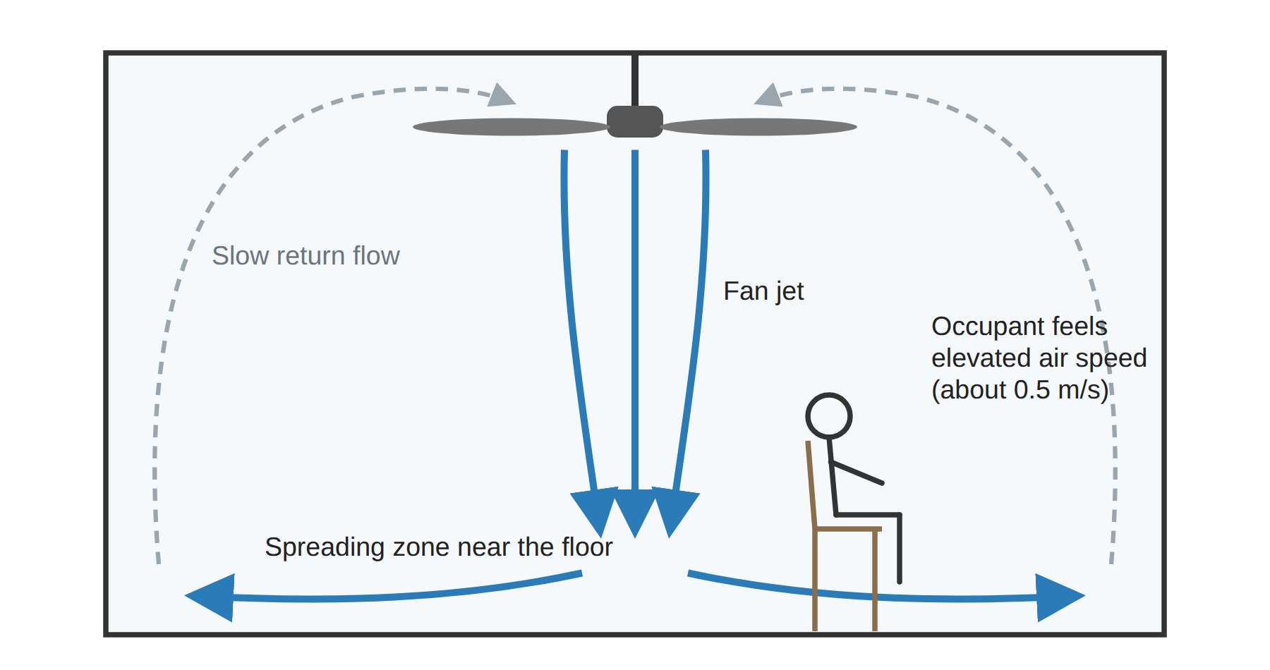
A fan cools people, not the room
Higher air speed raises convective and evaporative heat loss
The air temperature does not drop
So the fan only helps when someone is in the room

Slide 6
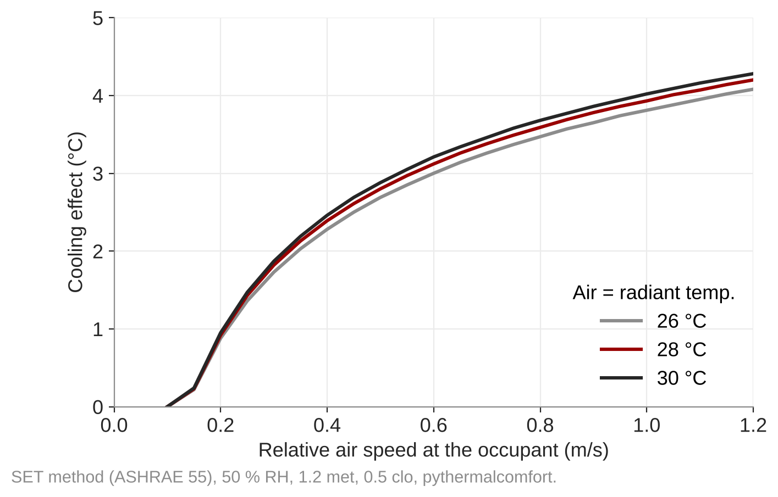
Cooling effect rises steeply up to about 0.5 m/s
0.5 m/s gives 2.8 °C at 28 °C, 50 % RH, 1.2 met, 0.5 clo
Above about 0.8 m/s extra speed buys little
CBE design guide uses about 2 °C at 0.5 m/s as a design value
Use pythermalcomfort cooling_effect()
Notes:
Computed with pythermalcomfort 3.x cooling_effect (SET method, ASHRAE 55).

Slide 7
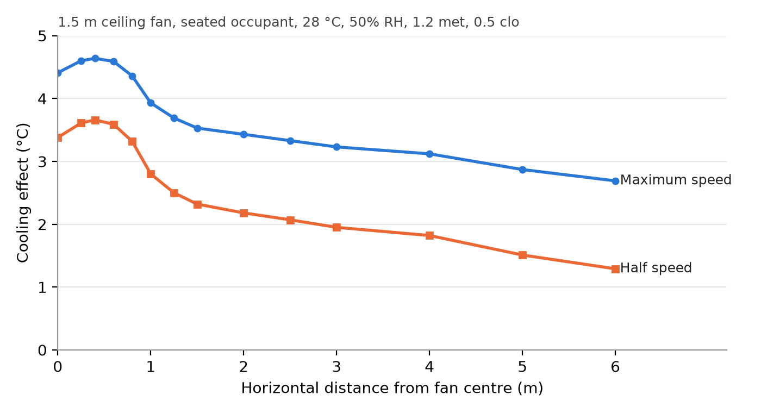
The effect is local: sit within one diameter
Largest within about 0.4 D of the centre
Drops sharply at the edge of the jet
Half speed costs about 1 °C under the fan, but saves far more power
Place the fan over the bed or the sofa
Notes:
Figure from the ceiling fans chapter (Raftery et al. 2019 air speeds, 1.5 m fan).

Slide 8
Choosing a fan
Part 3

Slide 9
Choosing and placing a fan
Size
Mounting
Datasheet
Diameter 0.2–0.4 × √(floor area)
One fan per roughly square cell
Aspect ratio up to 1.5:1
Blades ≥ 2.1 m above floor (CBE); 2.3 m in EN 60335-2-80 [to confirm]
≈ 0.2 D below the ceiling
≥ 0.45 m from walls
Airflow and power at each speed
Watch CFM vs m³/h
DC motors use far less power
Room-average air speed for seated occupants (Raftery et al. 2019); D, R, C in m
S_F = 4Q / (πD²) S_O,avg = S_F (0.25 + 0.99 D/R − 0.06 C/D + 0.11 D/1.7 + 0.024)
Notes:
What does a 2.5 m ceiling mean for blade height and ceiling clearance? Good class discussion. The 2.3 m value in EN 60335-2-80 is still to be confirmed by Christian.

Slide 10
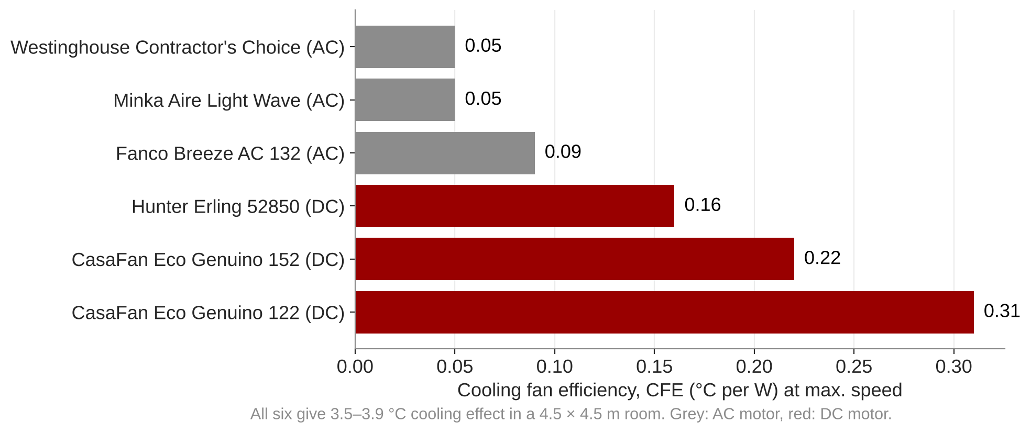
Compare fans by cooling per watt
CFE = cooling effect / fan power (ASHRAE 216)
Six fans give 3.5–3.9 °C, but CFE differs six-fold
Choose by power at the speed you need, not by max. airflow
Notes:
Data from table tab-cfe in the ceiling fans chapter.

Slide 11
Operation and cooling COP
Part 3

Slide 12
Run the fan only in peak periods
Occupied hour?
T_op > cat. II limit?
or your own threshold
Fan on
count hour and kWh
Recount hours
T_op − CE vs limit
Fan hours come from your part 2 results
Fan power counts only in fan hours
Recount the hours above category II with CE subtracted, or with the limit raised by CE
Notes:
The old PMV script charged 15 W in every hour and gave identical results with and without fans; it is retired until fixed.

Slide 13
Cooling COP: what the fan saves an air-conditioner
Ideal cooling demand in IDA ICE at two setpoints, over the fan hours
COP_fan = [Q_cool(T_sp) − Q_cool(T_sp + CE)] / E_fan
5–8
10–100 ×
The fan removes no heat
Compare primary energy
When do fans run compared with the electricity price?
SEER of a split air-conditioner
HVAC savings over fan energy (CBE guide)

Slide 14
Worked example: one fan in a row-house bedroom
TO DEVELOP
Pick a real DC fan, read Q and P per speed from the datasheet.
S_F → S_O,avg → CE at 28 °C → CFE per speed; mark the most efficient speed.
Show the two-setpoint IDA ICE run for COP_fan on one zone.

Slide 15
Assignment part 3
Q3.1
choose a fan
Q3.2
air speed and CE
Q3.3
CFE per speed
Q3.4
peak-period hours, kWh
Q3.5
cooling COP
Hand in
Table of air speed, CE, power and CFE per speed
Fan hours, kWh, and hours above category II with and without fans
COP_fan with the calculation, 5–10 lines comparing with AC

