Slide 1
Shutters and fans in a heat wave
Passive cooling, lecture 4 of 4 · Assignment 4, part 4

Slide 2
Agenda
Heat waves in future Copenhagen
The Annex 80 heat-wave files
External shutters and their control
Shutters in IDA ICE
Fans on top
Assignment part 4 and wrap-up

Slide 3
Where we are in the cooling assignment
Part 1
Window size
AutoMOO
Part 2
Venting hatch
jet theory, draught
Part 3
Ceiling fans
peak periods
Part 4
Shutters
heat wave
Step 5 of the cooling strategy: in a heat wave, close external shutters during the day.
The hatches keep ventilating while the shutters are closed.

Slide 4
Heat waves
Part 4

Slide 5
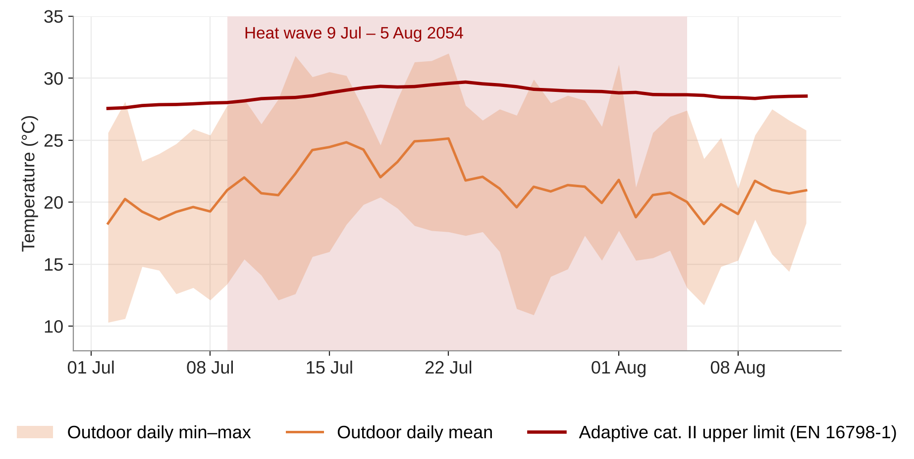
The 2054 heat wave: four weeks near the comfort limit
5A_Copenhagen_HW_Midterm_MostSevere_2054.epw (Annex 80, MPI-REMO RCP8.5). Limit θc + 3 °C with θc = 0.33 θrm + 18.8.

Slide 6
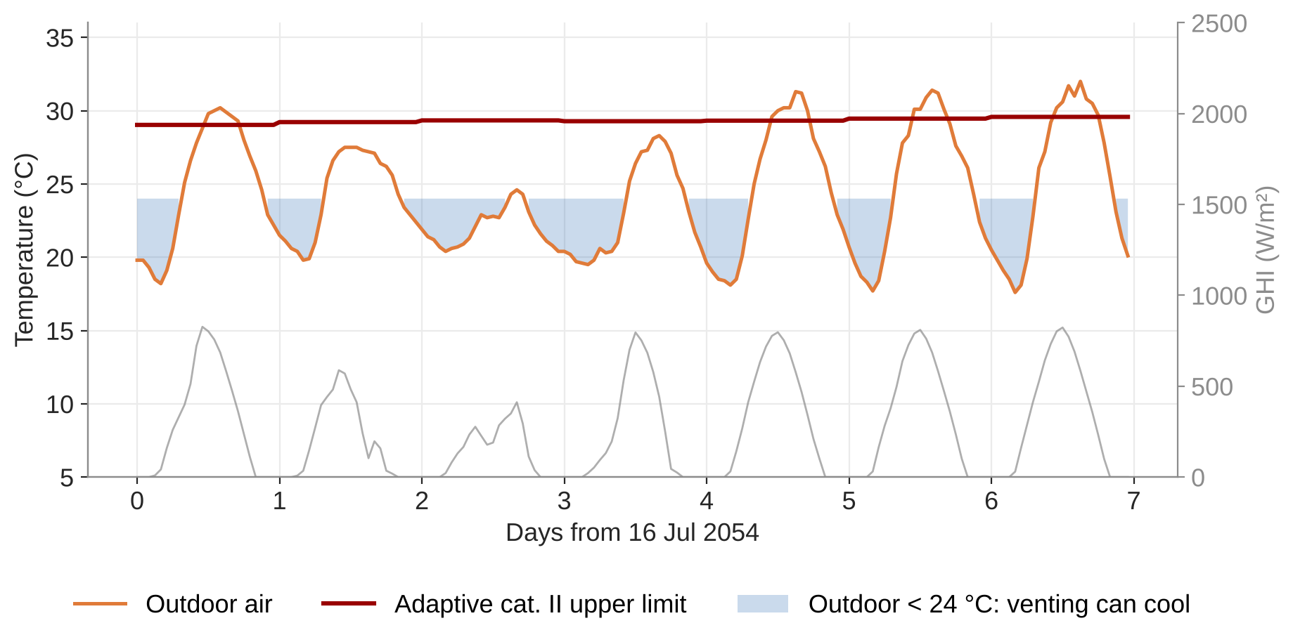
Hot days, but the nights still cool
32.0 °C
14 days
11 °C
28–30 °C
Outdoor maximum
above 28 °C
Coldest night in the heat wave
Adaptive cat. II upper limit
Notes:
Warmest week 16–22 July 2054: 87 of 168 hours below 24 °C outdoors, so night venting through the hatches still works. Computed in make_figures.py.

Slide 7
Which heat-wave file?
Annex 80 Copenhagen file | Use? | Why
HW_Midterm_MostSevere_2054 | Yes | 9 Jul – 5 Aug, max 32.0 °C. Hand out a cleaned file: a few corrupt GHI/DHI hours
HW_Midterm_MostIntense_2055 | Optional | For comparison
HW_Midterm_Longest_2045 | No | No solar radiation on 1–14 August, in the middle of the heat wave
Files are full years: annual results are meaningless
Extract the heat-wave period only

Slide 8
What the literature says
Question for the class: what would external shutters and hatches have changed in that study?
Farahani et al. (2021), Finnish apartments in IDA ICE
Heat-wave summers: about 10,000 Kh above 27 °C (2018) and 14,000 Kh (synthetic 2050)
Orientation, blinds and site shading helped little
Openable windows were the most effective passive measure in the new building
Only a split AC unit removed overheating everywhere
Notes:
Farahani et al. 2021, Appl. Sci. 11:3972 (doi 10.3390/app11093972), summarised in cooling-background-inventory.md.

Slide 9
Shutters
Part 4

Slide 10
External shutters block almost all solar gain
Gain
Cost
Airflow
Solar factor multiplier about 0.05–0.1
Stops the gain before it enters
Daylight and view out
So keep them for the hottest days
Shutters close the window as an opening
The hatch must be a separate opening
South, east and west windows. Decide about north and argue for it.

Slide 11
A shutter control rule
Incident solar
> 150–200 W/m² on the window
and room
above a temperature threshold
Close
otherwise open
Think like an occupant
Would they accept closed shutters in the morning, or at weekends?
Who overrides the automation, and when?

Slide 12
Demo: shutters in IDA ICE
TO DEVELOP
External shading device with low solar factor and its own control (schedule, solar radiation, zone temperature).
Check the shutter does not also close the hatch.
Extract the heat-wave period; plot outdoor, zone operative and adaptive limit for the warmest week.

Slide 13
Fans on top
Part 4

Slide 14
Report the heat wave step by step
Heat wave, critical zone | Hours > cat. II | Max T_op (°C) | Warmest night (°C) | Fan kWh
Part 2 hatches only |  |  |  | –
+ shutters |  |  |  | –
+ shutters + fans
Warmest night = mean operative temperature 23–07
Fans: recount the hours with the cooling effect from part 3

Slide 15
Wrap-up: the whole cooling assignment
Which of the four steps gave the largest cut in overheating hours per krone? Which was free?
Where in the year does your hatch hit its draught limit, and would occupants close it anyway?
A fan with a COP of 50 sounds better than any air-conditioner. What does the comparison leave out?
Shutters solve the heat wave but darken the home. How would you hand the decision to the occupants?
Is the house safe to live in during the heat wave without active cooling?

