Slide 1
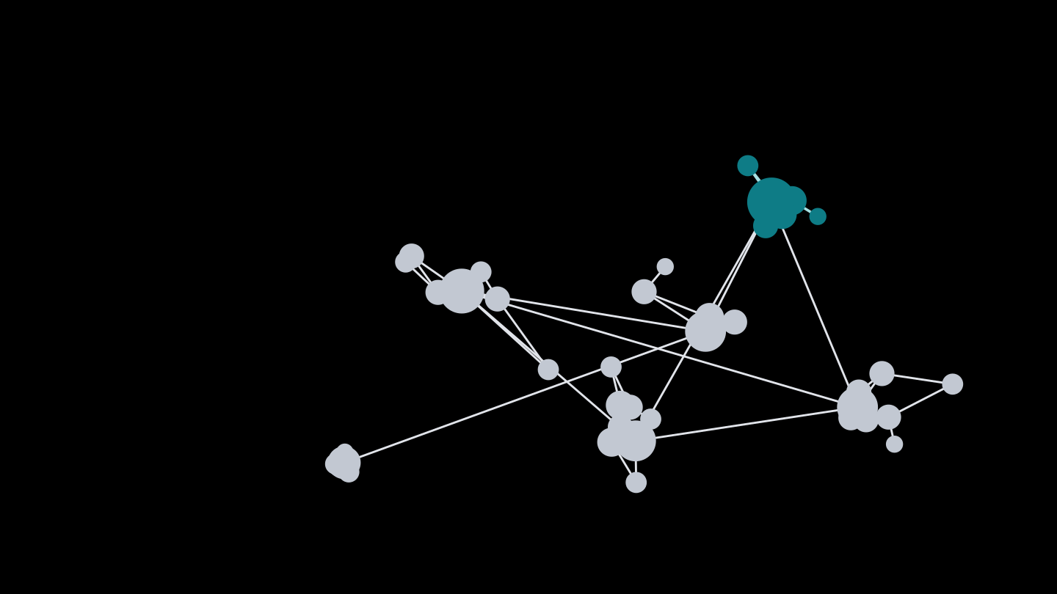
ESCALATE TRAINING PROGRAM · SUMMER 2026
How the Internet
is organized
Week 1: the building blocks of Internet structure, and your first steps on NRP.
PLENARY
INSTRUCTOR
SENIOR MENTORS
PROGRAM CONTACT
Tue Jun 16 · 12:00 PT
kc claffy
Ricky Mok
Bradley Huffaker
Rocky Chang
Alex Ma
Supported by the NSF ESCALATE project · OAC-2519416
Notes:
Welcome to Week 1. The picture on the right is an AS-level graph of the Internet — each dot is an autonomous network, sized by its customer cone, and the teal cluster is the kind of densely connected core we'll learn to analyze. This whole program is about learning to see structure like this in real, global-scale data. Plenary is Tuesday at noon Pacific; it won't be recorded, but all materials are posted and there's a hands-on hour plus mentor help for anyone who can't make it.

Slide 2
WEEK 1 · BUILDING BLOCK 1 / 10
WELCOME
A ten-week program in Internet measurement
You'll take the small-data assignments of a graduate measurement course and scale them to global datasets, learning to run them on research supercomputing along the way. Every assignment also becomes a section of your own reusable training module, the program's main deliverable.
10
9 + 1
≤ 24
Aug 18–21
weeks, Jun 15 – Aug 21
weeks remote, then on-site
participants in the pilot cohort
hackathon at SDSC
Milestone-structured, not letter-graded: you progress as you complete each block. Full-time runs ~10–40 hrs/week; part-time participants hit the same milestones on a longer schedule.
ESCALATE Training Program · Summer 2026
Notes:
Quick orientation. Nine weeks remote, then a four-day in-person hackathon at the San Diego Supercomputer Center, August 18–21. It's a pilot cohort of up to 24. We don't grade with letters — milestones gate progression, and mentors certify them in weekly one-on-ones.

Slide 3
WEEK 1 · BUILDING BLOCK 1 / 10
WHO YOU'LL WORK WITH
Your team
kc claffy leads the program. Three senior mentors build new modules and help you work through them, and build your own.
Bradley Huffaker
Ricky Mok
Rocky Chang
Senior mentor · modules & topology
Senior mentor · measurement & data
Senior mentor · modules, networking & analysis
Program Contact Alex Ma System Admins Ethan Lee · Victoria Nguyen
Day-to-day coordination, mentor contact, and announcements happen on Mattermost. That's the primary channel. Program questions: training-program-info@caida.org.
ESCALATE Training Program · Summer 2026
Notes:
kc leads; Brad, Ricky, and Jennifer are senior mentors who are actively building the modules and will help you through them — and help you create your own. Alex Ma handles admin and is your point of contact. Join Mattermost as soon as you can; that's where everything day-to-day happens.

Slide 4
WEEK 1 · BUILDING BLOCK 1 / 10
WHERE THIS COMES FROM
Built on a measurement course — scaled up
UCSD CSE 291-E
CAIDA ETP
the starting point
the same ideas, at global scale
Small datasets that fit on a laptop
Global datasets too big for any laptop
One snapshot, one notebook at a time
Months of data, sharded across parallel jobs
ESCALATE Training Program · Summer 2026
Notes:
This program reuses the assignment backbone of a graduate measurement course, CSE 291-e, but the whole point is scale: we take exercises that fit on a laptop and push them to global datasets that don't. That's why you need NRP and Expanse. And unlike the original course, this is hands-on infrastructure training — we're not running a critical-reading seminar.

Slide 5
WEEK 1 · BUILDING BLOCK 1 / 10
WHERE THIS COMES FROM
Built on a measurement course — scaled up (cont.)
UCSD CSE 291-E
CAIDA ETP
the starting point
the same ideas, at global scale
Concepts: ASes, BGP, registries, traceroute, telescopes
Run on NRP and Expanse research supercomputing
This is hands-on infrastructure training, not a paper-reading seminar. The focus is running real pipelines on production systems.
ESCALATE Training Program · Summer 2026

Slide 6
WEEK 1 · BUILDING BLOCK 1 / 10
THE RHYTHM
How each week runs
Plenary hour
Hands-on hour
One hour, synchronous — lecture and discussion of the week's building block. Tue Jun 16 at 12:00 PT for Week 1.
A second hour for hands-on help with the infrastructure — getting unstuck on NRP, Expanse, and the assignment.
ESCALATE Training Program · Summer 2026
Notes:
Two hours of contact a week: a plenary hour for the concepts, and a hands-on hour for infrastructure help. Around that, each week has its topics, its datasets and tools, a scaled assignment, and a module milestone. Optional background reading is provided each week, but there are no graded summaries and we won't be running paper discussions in the plenary.

Slide 7
WEEK 1 · BUILDING BLOCK 1 / 10
THE RHYTHM
How each week runs (cont.)
Every week brings:
Topics — the concepts behind the week's building block.
Datasets & tools — what's introduced that week.
A scaled assignment — often a small version to learn the data, then a large version that needs NRP or Expanse.
A module milestone — each assignment doubles as a section of your own training module.
ESCALATE Training Program · Summer 2026

Slide 8
WEEK 1 · BUILDING BLOCK 1 / 10
WHERE THIS LEADS
The question everything builds toward
Can we find evidence of degradation in connectivity, routing changes, or traffic drops in a given country — and tell whether it traces to a subsea cable fault, a cyber incident, a geopolitical event, or just a routine outage?
Answering this rigorously takes every building block in the program — registries, BGP, AS relationships, traceroute, geolocation, telescope data. Weeks 1–8 build the blocks; weeks 9–10 fuse them into a forensic answer.
ESCALATE Training Program · Summer 2026
Notes:
This is the capstone question — our north star for ten weeks. The hard part isn't 'is the country offline'; it's detecting and attributing partial degradation when nothing is fully down, and saying with calibrated confidence whether it's a cable, a cyber event, politics, or something routine. Every dataset we learn is one instrument for answering it.

Slide 9
WEEK 1 · BUILDING BLOCK 1 / 10
MAKING IT CONCRETE
What “degradation” means, measurably
“Degradation” has to become signals we can observe. Each kind of evidence lives in a different dataset you'll learn to work with.
Latency
Path diversity
Delay shifts on paths into a region
Fewer / changed routes to a country's prefixes
traceroute · RIPE Atlas · Ark
BGP — RouteViews, RIS
ESCALATE Training Program · Summer 2026
Notes:
To answer the capstone question we turn 'degradation' into four observable signals — latency, path diversity, reachability, traffic volume — and each maps to a dataset family we'll cover in a later week. Today is the foundation: the AS structure that all of these signals are anchored to.

Slide 10
WEEK 1 · BUILDING BLOCK 1 / 10
MAKING IT CONCRETE
What “degradation” means, measurably (cont.)
Reachability
Traffic volume
Prefixes withdrawn or origin changed
Dips or anomalies in observed traffic
BGP + registries
UCSD network telescope
ESCALATE Training Program · Summer 2026

Slide 11
WEEK 1 · BUILDING BLOCK 1 / 10
THE ARC
Ten building blocks — you start here
1
2
3
4
5
Internet structure & ASNs
BGP at scale
Registries: WHOIS/IRR/RPKI
AS relationships & cones
Traceroute, topology, cables
6
7
8
9
10
Geolocation
Network telescope
Data fusion (IYP)
Degradation forensics
SDSC hackathon
Weeks 1–8 build one block at a time; weeks 9–10 integrate them into a full forensic pipeline.
ESCALATE Training Program · Summer 2026
Notes:
Here's the whole arc. Each week is one building block, deliberately ordered so later weeks depend on earlier ones. We're in block 1: Internet structure and ASNs. By week 9 you'll be fusing all of these; week 10 is the in-person hackathon.

Slide 12
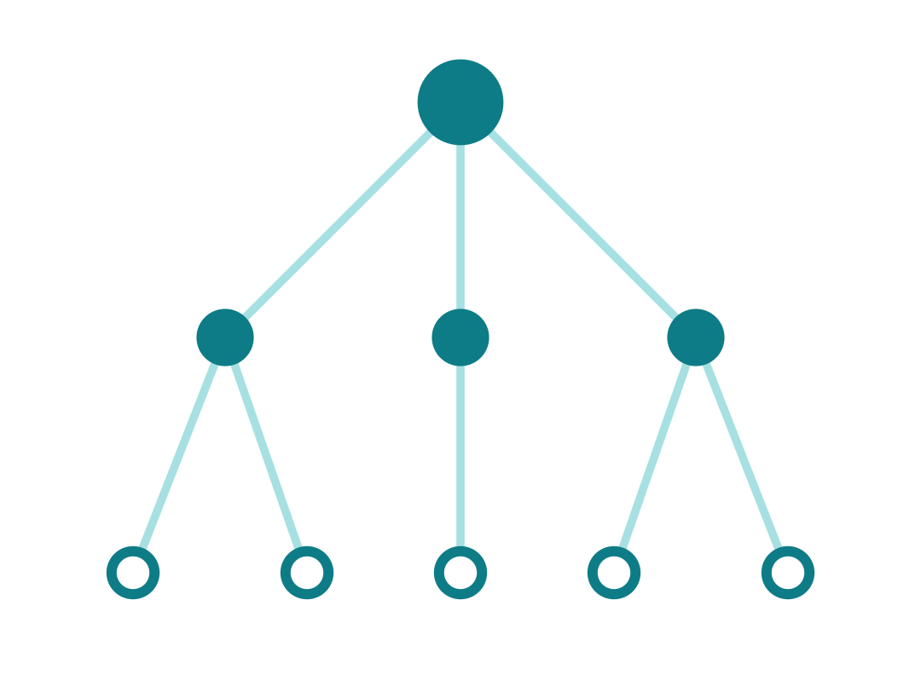
PART ONE
01
Autonomous Systems &
the shape of the Internet
customer cone of one AS · node size = reach
how the Internet divides into networks, and how we measure their reach
Notes:
Part one is the conceptual foundation: what an autonomous system is, how the Internet is carved into them, and how we quantify a network's reach with its customer cone. The little tree on the right is exactly that — one AS at the top and the networks underneath it that depend on it.

Slide 13
WEEK 1 · BUILDING BLOCK 1 / 10
HOW IT ALL FITS TOGETHER
The Internet's narrow waist
Applications
Countless applications on top, countless link technologies on the bottom — and one thin layer in the middle that lets any app run over any medium. That thin waist is the Internet Protocol (IP).
web · email · video · messaging
IP
Link & physical
fiber · Wi-Fi · cellular · subsea cable
ESCALATE Training Program · Summer 2026
Notes:
A mental model worth keeping all program: the hourglass. Many applications at the top, many physical technologies at the bottom, and a single thin waist — IP — connecting any app to any medium. Around that waist sit four jobs: addressing, routing, naming, and trust. Each is something we can measure, and each can fail in ways that show up as degradation.

Slide 14
WEEK 1 · BUILDING BLOCK 1 / 10
HOW IT ALL FITS TOGETHER
The Internet's narrow waist (cont.)
Four jobs keep it working:
Addressing — who you are (IP)
Routing — how to reach you (BGP)
Naming — names → addresses (DNS)
Authentication — proving who you reached (certificates)
ESCALATE Training Program · Summer 2026

Slide 15
WEEK 1 · BUILDING BLOCK 1 / 10
THE FOUR JOBS — AND HOW THEY BREAK
Every job is something we can measure
Addressing
Routing
Each host/network has IP addresses, handed down from IANA to the registries.
BGP advertises which networks can reach which address blocks.
Fails as Spoofing — forging the source of traffic
Fails as Hijacks & leaks — traffic sent the wrong way
ESCALATE Training Program · Summer 2026
Notes:
Each of the four jobs is observable, and each has a characteristic failure. You don't need the details today — the point is that the plumbing is measurable, and its failures are exactly the kind of evidence the capstone question asks about. There's a reference appendix at the end of the deck that goes a level deeper on each job for anyone reading on their own.

Slide 16
WEEK 1 · BUILDING BLOCK 1 / 10
THE FOUR JOBS — AND HOW THEY BREAK
Every job is something we can measure (cont.)
Naming
Authentication
DNS turns names into addresses through a chain of servers.
Certificates prove you reached who you intended.
Fails as Cache poisoning — wrong answers returned
Fails as Mis-issuance — a forged identity accepted
ESCALATE Training Program · Summer 2026

Slide 17
WEEK 1 · BUILDING BLOCK 1 / 10
INTERNET STRUCTURE · ASNs
Autonomous Systems & ASNs
An Autonomous System (AS) is an independently operated network — a set of IP prefixes under one routing policy.
Organization
Each AS has a globally unique ASN, allocated by a Regional Internet Registry.
AS
AS
AS
one org, several ASNs
ESCALATE Training Program · Summer 2026
Notes:
The atom of Internet structure is the autonomous system — one network, one routing policy, one globally unique number. Registries hand out those numbers, and a single organization often holds several. CAIDA infers which org owns which ASN from WHOIS, and that AS-to-Org dataset is one of the two you'll work with this week.

Slide 18
WEEK 1 · BUILDING BLOCK 1 / 10
INTERNET STRUCTURE · ASNs
Autonomous Systems & ASNs (cont.)
One organization may operate many ASNs — e.g. separate networks per region or service tier.
CAIDA infers an ASN → organization mapping from registry WHOIS records — the AS-to-Org dataset you'll use this week.
ESCALATE Training Program · Summer 2026

Slide 19
WEEK 1 · BUILDING BLOCK 1 / 10
INTERNET STRUCTURE · REACH
Customer cones
Networks connect through provider-to-customer (p2c) links — the customer pays for transit.
An AS's customer cone is itself plus everything reachable by following p2c links: its customers, their customers, and so on.
size = number of ASNs in the cone
EXAMPLES
Tier-1 transit — Lumen, Cogent: ~tens of thousands
Regional ISP — hundreds to a few thousand
Stub network — a campus or firm: cone of 1 (itself)
ESCALATE Training Program · Summer 2026
Notes:
The customer cone is the week's key metric. Follow only provider-to-customer links downward from an AS, and everything you reach is its cone; the number of ASNs is a simple measure of reach. It matters for the capstone because if a whole country depends on a handful of large cones, that's concentrated risk — and we quantify exactly that in week 4.

Slide 20
WEEK 1 · BUILDING BLOCK 1 / 10
INTERNET STRUCTURE · REACH
Customer cones (cont.)
Cone size (the count of ASNs) is a coarse proxy for a network's reach and influence.
When most of a country's networks reach the rest of the Internet through just a few big providers, nearly all its ASNs sit inside a handful of customer cones — so a fault, outage, or shutdown in one of those cones can affect much of the country at once. That concentration is our first lens on degradation risk, deepened in Week 4.
ESCALATE Training Program · Summer 2026

Slide 21
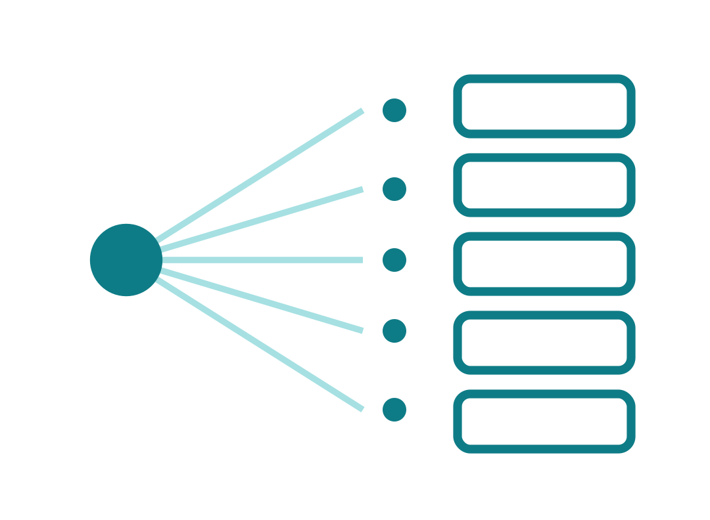
PART TWO
02
First steps on NRP
one analysis, many parallel jobs
the data is too big for your laptop. Meet the infrastructure
Notes:
Part two: the infrastructure. The reason this program exists is that real measurement datasets don't fit on a laptop, so we learn to run analyses on shared research computing — often the same job fanned out across many parallel workers, as on the right.

Slide 22
WEEK 1 · BUILDING BLOCK 1 / 10
WHY YOUR LAPTOP ISN'T ENOUGH
Two systems you'll learn to use
The datasets are global and span months. You'll learn two complementary research cyberinfrastructures — both NSF-funded.
NRP / Nautilus
SDSC Expanse
The National Research Platform
A supercomputer at SDSC
Kubernetes-based; you start with JupyterHub
Batch HPC scheduled with Slurm
Interactive notebooks, then parallel jobs
For the heavy longitudinal jobs (many snapshots)
ESCALATE Training Program · Summer 2026
Notes:
Two systems. NRP — the National Research Platform, also called Nautilus — is Kubernetes-based; you'll meet it through JupyterHub, move from interactive notebooks to parallel jobs, and your work lives in our namespace, caida-nids. Expanse is a traditional supercomputer at SDSC, scheduled with Slurm, for the heaviest longitudinal jobs starting around week 4. This week is all NRP.

Slide 23
WEEK 1 · BUILDING BLOCK 1 / 10
WHY YOUR LAPTOP ISN'T ENOUGH
Two systems you'll learn to use (cont.)
The datasets are global and span months. You'll learn two complementary research cyberinfrastructures — both NSF-funded.
NRP / Nautilus
SDSC Expanse
The National Research Platform
A supercomputer at SDSC
Work lives in a namespace (ours: caida-nids)
Big memory and storage for whole datasets
Where Week 1 happens
Introduced from Week 4 onward
ESCALATE Training Program · Summer 2026

Slide 24
WEEK 1 · BUILDING BLOCK 1 / 10
ACTION REQUIRED · WEEK 1 SETUP
Get onto NRP
1
Visit nrp.ai Go to nrp.ai (see CAIDA's “How to access NRP” guide).
2
Log in Click Log In, pick your organization, and authenticate.
3
Request namespace access Email training-program-info@caida.org with the exact address you logged in with, and we'll add you to caida-nids.
ESCALATE Training Program · Summer 2026
Notes:
This is the one thing to do before Tuesday. Five steps: visit nrp.ai, log in with your institution, email us the exact address you used so we can add you to the caida-nids namespace, then open JupyterHub and start a server with the default options. Do it early so we have time to fix any access issues. And join Mattermost.

Slide 25
WEEK 1 · BUILDING BLOCK 1 / 10
ACTION REQUIRED · WEEK 1 SETUP
Get onto NRP (cont.)
4
Open JupyterHub Once added, sign in to the NRP JupyterHub (jupyterhub-west).
5
Start your server Accept the preset options, scroll down, and click Start.
Also: join Mattermost and message @ealee, @macat, or @vin011 to join the cohort channel, and send your GitHub username so we can grant access to the assignment repos and the course syllabus (github.com/CAIDA/etp-2026-overview). Hit a snag? Reply on Mattermost. We'll have it sorted out as soon as possible.
ESCALATE Training Program · Summer 2026

Slide 26
WEEK 1 · BUILDING BLOCK 1 / 10
ASSIGNMENT 1 · DUE END OF WEEK 1
nids-asn-introduction
On NRP's JupyterHub, work through how ASNs are distributed across networks and the customer-cone concept — your conceptual and environmental warm-up for everything that follows.
MODULE MILESTONE
Document your onboarding experience as written feedback on the module — you're also its first evaluator.
Run and modify the notebook on NRP
REPOSITORY
github.com/CAIDA/
nids-asn-introduction
Parse CAIDA's AS-to-Org and customer-cone data
Sort ASNs into tiers by cone size
Finish all notebook tasks and questions
ESCALATE Training Program · Summer 2026
Notes:
Your first assignment is an existing module, nids-asn-introduction, run entirely on NRP. It walks through ASN distribution and customer cones and ends with you tiering ASes by cone size. Finish every task and question. Because you're the pilot cohort, your milestone is also to document the onboarding experience as feedback — you're the module's first real evaluators.

Slide 27
WEEK 1 · BUILDING BLOCK 1 / 10
WHAT YOU'LL WORK WITH
The two datasets in this module
AS-to-Organizations
AS Customer Cone (Serial-1)
Maps ASNs to the organizations that hold them — org name, country, source registry, and member ASNs — inferred from WHOIS.
For each AS, the list of ASNs in its customer cone, derived from observed BGP paths. Cone size is the count of those ASNs.
stored as as2org.jsonl
file 20260501.ppdc-ases.txt.bz2
ESCALATE Training Program · Summer 2026
Notes:
Two datasets. AS-to-Org maps numbers to the organizations behind them, from WHOIS, delivered as JSON-lines. The customer cone dataset, serial-1, lists each AS's cone; you'll download the May 2026 ppdc-ases file. The format is simple, shown at the bottom: each line is an AS followed by its cone members, so the cone size is just the number of tokens minus one.

Slide 28
WEEK 1 · BUILDING BLOCK 1 / 10
WHAT YOU'LL WORK WITH
The two datasets in this module (cont.)
ppdc-ases format — first token is the AS, the rest are its cone (size = tokens − 1):
# 23's cone size is 3: {23, 4, 1}
23 23 4 1
# 1's cone size is 1: just itself
1 1
ESCALATE Training Program · Summer 2026

Slide 29
WEEK 1 · BUILDING BLOCK 1 / 10
BEFORE NEXT WEEK
This week, in five steps
Complete the NRP setup before the next plenary.
OPTIONAL BACKGROUND
Fontugne et al., “The (Thin) Bridges of AS Connectivity” (PAM 2018) — the AS-hegemony idea behind the dependency lens. Context, not a graded summary; it returns in Week 9.
Sign in on Github and get added to the ETP Github team.
Attend the plenary Tue Jun 16, 12:00 PT — or catch up: it's not recorded, but materials are posted.
Use the hands-on hour and mentors for help with the infrastructure.
Questions Mattermost (fastest) · training-program-info@caida.org
Finish Assignment 1 (nids-asn-introduction) by end of week.
ESCALATE Training Program · Summer 2026
Notes:
To wrap: five things this week. Setup before Tuesday, join Mattermost, come to the plenary or catch up afterward, lean on the hands-on hour and your mentor, and finish Assignment 1. The reading is optional background — the AS-hegemony paper gives context for the dependency idea and comes back in week 9; there's no summary to write. Fastest way to reach us is Mattermost.

Slide 30
APPENDIX · FOR SELF-STUDY
A
How the plumbing works,
a bird's-eye view
addressing · routing · naming · authentication — four quick slides, not covered live; here so the deck stands on its own
Notes:
These appendix slides expand the four jobs from the narrow-waist section. They aren't part of the live plenary — they're reference for anyone who wants the next level of detail on their own.

Slide 31
APPENDIX · ADDRESSING
Addressing, a bird's-eye view
An IP address identifies and locates a network interface — but it isn't a stable identity: it's reassigned, shared via NAT/CGNAT, and moves with the device. Announced as prefixes (CIDR, e.g. /24).
IPv4 is 32-bit (~4.3B addresses) and long exhausted — stretched by NAT / CGNAT and address transfer markets.
ESCALATE Training Program · Summer 2026

Slide 32
APPENDIX · ADDRESSING
Addressing, a bird's-eye view (cont.)
IPv6 is 128-bit and effectively unlimited, but adoption is uneven by region — which shapes what measurement can see.
IANA
5 RIRs
The allocation chain is hierarchical; WHOIS / IRR records say who holds what — the basis for AS-to-Org inference.
Operators (LIRs)
Announced prefixes
ESCALATE Training Program · Summer 2026
Notes:
Appendix detail on addressing. Addresses are locators handed out in a hierarchy from IANA to the RIRs to operators, who announce them as prefixes. IPv4 scarcity and uneven IPv6 adoption both matter for measurement coverage. WHOIS/IRR is what lets CAIDA infer which org holds which ASN.

Slide 33
APPENDIX · ROUTING
Routing, a bird's-eye view
BGP is the inter-domain routing protocol: each AS announces its prefixes and the AS-path to reach them.
Path-vector: announcements carry the full AS-path; an AS rejects any path already containing its own number (loop prevention).
Best-path selection is policy-first — local preference (business relationship) outranks AS-path length. Routes are not shortest-path.
ESCALATE Training Program · Summer 2026

Slide 34
APPENDIX · ROUTING
Routing, a bird's-eye view (cont.)
Relationships are “valley-free”: a path climbs customer→provider, crosses one peer link at the top, then descends provider→customer — never back uphill, so it peaks once with no “valley.”
provider
peer
p2p
p2c
No built-in authentication → hijacks & route leaks; RPKI + ROV authorize the origin AS (partial defense).
customers
ESCALATE Training Program · Summer 2026
Notes:
Appendix detail on routing. BGP is path-vector: ASes advertise full AS-paths and reject loops. Crucially, route choice is policy-first — local preference encodes business relationships and outranks path length, so paths are valley-free, not shortest. With no native authentication, hijacks and leaks are possible; RPKI and route-origin validation give partial protection.

Slide 35
APPENDIX · NAMING
Naming, a bird's-eye view
Resolving a name to an address — a delegated, cached hierarchy
Stub resolver
Recursive resolver
Root
TLD (.com, .ae)
Authoritative
Your stub resolver asks a recursive resolver, which walks (if total cache miss) root → TLD → authoritative and caches each answer for its TTL.
Record types carry different facts: A/AAAA (addresses), NS (delegation), MX (mail), CNAME (aliases).
ESCALATE Training Program · Summer 2026
Notes:
Appendix detail on naming. A stub resolver hands off to a recursive resolver that walks the delegated hierarchy and caches by TTL. Different record types carry different facts. Caching is why DNS is fast and why changes lag. DNSSEC adds integrity to detect poisoning, but it isn't universally deployed.

Slide 36
APPENDIX · NAMING
Naming, a bird's-eye view (cont.)
Caching makes DNS fast — but changes and outages propagate only as caches expire.
DNSSEC signs records so resolvers can detect tampering such as cache poisoning; deployment remains partial.
ESCALATE Training Program · Summer 2026

Slide 37
APPENDIX · AUTHENTICATION
Authentication, a bird's-eye view
Certificates: a chain that validates up to a root your device trusts
Root CA
Intermediate CA
Site certificate
Your browser trusts it
TLS encrypts the connection; identity rests on an X.509 certificate chain that validates up to a CA in your device's trust store.
The client checks the signatures, that the name matches, and that the certificate is unexpired and unrevoked.
ESCALATE Training Program · Summer 2026
Notes:
Appendix detail on trust. TLS gives encryption; certificates give identity, validated up a chain to a trusted root. Clients check signatures, name match, and validity. Certificate Transparency logs make mis-issuance detectable. The last point ties it back: forged trust plus DNS or BGP manipulation is an impersonation event — the kind of thing the program's forensic question must distinguish from benign causes.

Slide 38
APPENDIX · AUTHENTICATION
Authentication, a bird's-eye view (cont.)
Certificate Transparency logs publicly record issued certs, so mis-issuance can be caught after the fact.
Combine a forged cert with DNS poisoning or a BGP hijack and a site can be impersonated. Studies of incidents might have to rule out this scenario.
ESCALATE Training Program · Summer 2026

Slide 39
APPENDIX · GLOSSARY
Reference glossary (A–N)
Ark — CAIDA’s Archipelago active-measurement platform; distributed monitors run large-scale traceroute/topology measurements.
AS hegemony — Fontugne et al.’s metric for the fraction of paths toward a destination (or within a scope) that traverse a given AS; high values flag critical dependencies.
AS-to-Org (as2org) — CAIDA’s dataset inferring which organization operates each AS (grouping sibling ASNs), derived from WHOIS/registry data.
ASN — Autonomous System Number: the globally unique 16-/32-bit identifier an RIR assigns to an AS (a network under one routing policy).
BGP — Border Gateway Protocol: the Internet’s inter-domain, policy-driven path-vector routing protocol.
Cache poisoning — injecting forged records into a resolver’s cache so it serves attacker-controlled answers (e.g., the Kaminsky attack). The naming-layer failure.
customer cone — the set of ASes and prefixes an AS can reach using only provider→customer links; a coarse proxy for transit reach.
Expanse — an NSF/SDSC batch-scheduled HPC supercomputer for large longitudinal jobs.
IANA — Internet Assigned Numbers Authority: top-level coordinator of IP space, ASNs, and protocol parameters; delegates to the RIRs.
IRR — Internet Routing Registry: distributed databases where operators publish routing policy and authorized announcements, used to build prefix filters.
IYP — Internet Yellow Pages: an open Neo4j knowledge graph fusing BGP, DNS, registry and other datasets into queryable linked entities.
JupyterHub — a multi-user server provisioning per-user browser-based Jupyter notebooks.
LIR — Local Internet Registry: an organization (usually an ISP) that receives address space from an RIR and assigns it to end users.
Mis-issuance — a CA issuing a certificate for a domain to the wrong party (error or compromise), enabling impersonation; surfaced via Certificate Transparency.
NAT / CGNAT — Network Address Translation / Carrier-Grade NAT: rewriting addresses and ports to share scarce public IPv4; CGNAT adds a second, ISP-side translation tier.
Nautilus — the Kubernetes hypercluster that operates NRP; workloads run as containers/pods.
network telescope — a darknet — monitored, globally routed but unused IP space whose only inbound traffic is unsolicited (scans, backscatter from spoofed-source DDoS, malware), giving a view of malicious/anomalous activity. CAIDA operates the UCSD network telescope.
NRP — National Research Platform: NSF-funded distributed cyberinfrastructure federating university compute/GPU/storage, accessed via Kubernetes and JupyterHub.
ESCALATE Training Program · Summer 2026

Slide 40
APPENDIX · GLOSSARY
Reference glossary (P–X)
PAM — Passive and Active Measurement Conference.
ppdc-ases — CAIDA’s customer-cone data file: each line lists an AS followed by the ASNs in its Serial-1 customer cone.
recursive resolver — a DNS server that resolves a name end-to-end for a client by querying root, TLD, and authoritative servers and caching the results.
RIPE Atlas — RIPE NCC’s global network of thousands of probes running active measurements (ping, traceroute, DNS).
RIR — Regional Internet Registry: one of five regional bodies (ARIN, RIPE NCC, APNIC, LACNIC, AFRINIC) allocating address space and ASNs.
Route hijacks & leaks — a hijack announces a prefix you don’t hold; a leak re-advertises routes beyond policy (e.g., one provider’s routes to another). Both misdirect traffic.
RouteViews / RIS — public BGP route-collector projects (U. Oregon RouteViews; RIPE NCC Routing Information Service) archiving BGP data from many peers.
ROV — Route Origin Validation: checking a BGP route’s origin AS against RPKI ROAs and marking it valid / invalid / unknown; invalids may be filtered. Partially deployed.
RPKI — Resource Public Key Infrastructure: a PKI that cryptographically binds prefixes/ASNs to their holders through signed Route Origin Authorizations (ROAs).
Serial-1 — CAIDA AS Relationships dataset; one of CAIDA’s customer-cone computation methods, based on inferred AS relationships.
Slurm — the HPC workload manager / batch scheduler used on Expanse.
Spoofing — forging a packet’s source IP address; underpins reflection/amplification DoS. The addressing-layer failure.
stub network — an AS with no customers of its own (cone = itself), typically an edge or enterprise network.
valley-free — the BGP path-validity rule under the Gao–Rexford model: a path climbs customer→provider links, crosses at most one peer link at the apex, then descends provider→customer links, and never ascends again — no AS carries transit for free between its providers or peers.
WHOIS — the protocol and databases for looking up the registrant of an IP block, ASN, or domain.
X.509 — the standard public-key certificate format (CA-signed binding of identity to key) that TLS uses to authenticate servers.
ESCALATE Training Program · Summer 2026

