Slide 1

ESCALATE TRAINING PROGRAM · SUMMER 2026
BGP Control Plane Measurement
Week 2: from the global routing table to who owns and who reaches the Internet’s address space.
PLENARY
INSTRUCTOR
SENIOR MENTORS
PROGRAM CONTACT
Tue Jun 23 · 12:00 PT
kc claffy
Ricky Mok · Bradley Huffaker · Rocky Chang
Alex Ma
Supported by the NSF ESCALATE project · OAC-2519416
Notes:
Infrastructure-hour lab background for the nids-bgp-control-plane assignment. Three tasks: origin AS / address attribution, customer-cone reach, and ranking joined to organizations.

Slide 2
THE ARC
WEEK 2 · BUILDING BLOCK 2 / 10
Ten building blocks — you are here
1
2
3
4
5
Internet structure & ASNs
BGP at scale
Registries: WHOIS / IRR / RPKI
AS relationships & cones
Traceroute, topology, cables
6
7
8
9
10
Geolocation
Network telescope
Data fusion (IYP)
Degradation forensics
SDSC hackathon
Weeks 1–8 build one block at a time; weeks 9–10 integrate them into a full forensic pipeline.
ESCALATE Training Program · Summer 2026
Notes:
This lab is Block 2, BGP at scale. Task 2 (customer cones) borrows from Block 4 — flagged on the cone slide as a forward-pointer; the full relationships/cones treatment lands in Block 4.

Slide 3
LAST WEEK · RECAP
WEEK 2 · BUILDING BLOCK 2 / 10
From topology to address space
Block 1 mapped Internet structure — ASes, ASNs, and how they interconnect.
THIS WEEK BUILDS ON IT
You worked the topology view: who connects to whom.
We read the global routing table to attribute every prefix to an origin AS — then to the cone that reaches it.
We deferred the next question: who owns and who reaches the address space.
ESCALATE Training Program · Summer 2026
Notes:
Orient, don't re-teach: this bridges Block 1's topology view into Block 2's address-space view.

Slide 4
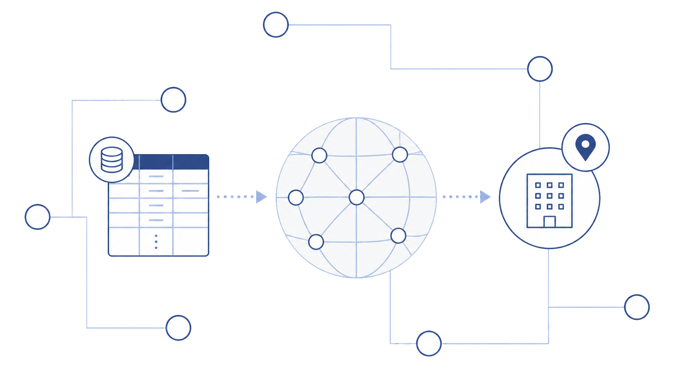
PART ONE
01
From RIB to origin AS
Reading the global routing table to attribute address space.
Notes:
Part one: origin-AS attribution and address counting (Task 1).

Slide 5
TASK 1 · FRAMING
WEEK 2 · BUILDING BLOCK 2 / 10
BGP as a system, not just a protocol
BGP is a protocol for inter-domain routing — we analyze it as a system of global reachability.
who talks to whom
who owns & reaches what
Measurement: how do we see the global routing state at one moment?
RIB (Routing Information Base): a collector’s snapshot of every route it has received.
this module shifts the question
ESCALATE Training Program · Summer 2026
Notes:
BGP basics are INTERMEDIATE for this cohort (median 3) — brief grounding, then move to address space. Emphasize the topology→address-space shift.

Slide 6
WHAT YOU’LL WORK WITH
WEEK 2 · BUILDING BLOCK 2 / 10
Datasets & tools for this lab
RouteViews / MRT
COLLECTOR · RIB
Global routing tables archived by Univ. of Oregon collectors, as MRT (Multi-Threaded Routing Toolkit) binary records.
route-views3 · 2026.05
bgpkit
TOOL
Decodes MRT so you iterate over routing records as Python objects.
pybgpkit_parser
CAIDA customer cones (PPDC)
FILE
Per-AS customer-cone membership, derived from provider→customer links.
20260501.ppdc-ases.txt.bz2
AS2Org
STORED AS
Maps ASNs to real-world organizations and country.
as2org.jsonl
ESCALATE Training Program · Summer 2026
ESCALATE Training Program · Summer 2026
Notes:
Names + identifiers in Roboto Mono. RouteViews/MRT confirmed snapshot route-views3 / 2026.03. IODA is an optional cross-check, not used here.

Slide 7
TASK 1 · THE DATA
WEEK 2 · BUILDING BLOCK 2 / 10
Anatomy of a RIB entry
Each MRT record is one prefix announcement seen from one vantage point (peer):
Field | Example | Meaning
collector | route-views3 | which collector
peer_asn / peer_ip | 10 / 12.3.2.1 | the vantage point
as_path | 10 724 8234 | ASNs the route traversed
origin_asns | 8234 | last ASN — the originator
prefix | 192.0.2.0/24 | the announced CIDR block
The origin AS — the last ASN — is what we attribute address space to.
ESCALATE Training Program · Summer 2026
Notes:
origin_asns is a set in bgpkit — usually one ASN, sometimes several. Several = MOAS (next).

Slide 8
TASK 1 · ATTRIBUTION
WEEK 2 · BUILDING BLOCK 2 / 10
The AS path: origin and MOAS
Take the last ASN in the path — the origin AS, via elem.origin_asns.
# as_path: 10 724 8234 -> origin = last hop
for elem in bgpkit.Parser(url=url):
prefix_origins[elem.prefix] \
.update(elem.origin_asns)
Attribution: each prefix is credited to its origin AS — this drives the Task 1 counts.
MOAS: the same prefix shows different origins across the table.
ESCALATE Training Program · Summer 2026
Notes:
Task 1 needs only the origin (last hop). The full path's link structure is what CAIDA uses upstream to build the cone file loaded in Task 2 — not reconstructed in this notebook.

Slide 9
TASK 1 · MOAS
WEEK 2 · BUILDING BLOCK 2 / 10
The Multi-Origin AS puzzle
A MOAS prefix is announced from more than one AS at once.
if len(origins) > 1:
moas_count += 1
else:
asn = next(iter(origins))
Benign: multi-homing, traffic engineering, mergers / acquisitions.
Security risk: can signal a BGP hijack — an unauthorized AS announcing someone else’s space.
Task rule: exclude MOAS from per-AS counting (can’t attribute cleanly). Ballpark < 1%.
ESCALATE Training Program · Summer 2026
Notes:
Q2 asks for the MOAS percentage — real value ≈ 0.4%. If a student reports 10%+, the MOAS test is wrong (e.g. counting peers, not origins).

Slide 10
TASK 1 · ADDRESS MATH
WEEK 2 · BUILDING BLOCK 2 / 10
Prefixes vs. address space
Counting prefixes is coarse — prefix size varies exponentially.
/8 block
/8 → 16,777,216 addresses /16 → 65,536 /24 → 256
/16
/24
A few coarse blocks can dwarf thousands of /24s — we need an address count.
(32−n)
addresses = 2 for a /n prefix
ESCALATE Training Program · Summer 2026
Notes:
Plants the seed for Q3 (divergence). CIDR math is INTERMEDIATE; keep it brief.

Slide 11
METHODOLOGY
WEEK 2 · BUILDING BLOCK 2 / 10
Counting addresses: longest-prefix match
Prefixes nest. Credit each address to the most-specific prefix covering it: take a prefix’s size and subtract the sizes of its direct children only.
Load
THE HARDEST CORRECTNESS POINT
ipv4_single_origin
Direct children only. If A⊃B⊃C, A subtracts B (which already contains C); B subtracts C. Subtracting C from A too undercounts A.
↓
Insert into trie
pytricia.PyTricia(32)
↓
Subtract direct kids
pyt.parent(child)==prefix
↓
Per-AS total
counts[asn]
ESCALATE Training Program · Summer 2026
Notes:
Hardest correctness point in the lab. Walk the 3-level case slowly (also in the appendix).

Slide 12
TASK 1 · IMPLEMENTATION
WEEK 2 · BUILDING BLOCK 2 / 10
Longest-prefix match with PyTricia
pyt = pytricia.PyTricia(32)
for prefix, asn in ipv4_single_origin:
pyt[prefix] = asn
for prefix, asn, plen in parsed:
total = 1 << (32 - plen)
overlap = 0
for child in pyt.children(prefix):
if child == prefix: continue # children() includes self
if pyt.parent(child) == prefix: # DIRECT children only
overlap += 1 << (32 - int(child.split('/')[1]))
counts[asn] += total - overlap
Scale check: total attributed IPv4 ≈ 3.1 billion across ≈ 77,600 origin ASes (not ≈ 4.3B — that means double-counting).
ESCALATE Training Program · Summer 2026
Notes:
Two gotchas: children() includes the prefix itself; filter to direct children. Off-by-billions means nested space double-counted.

Slide 13
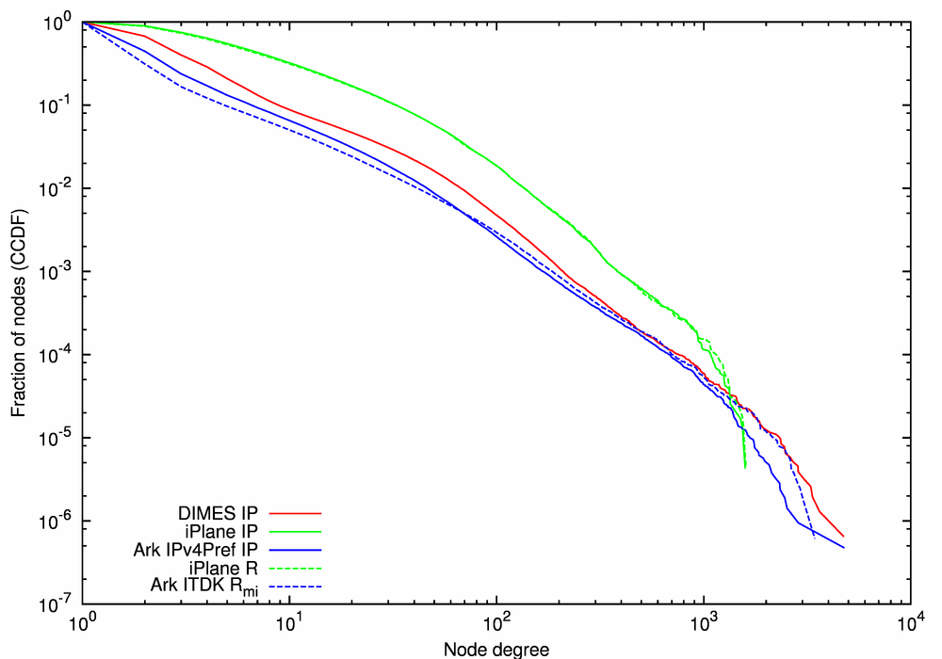
TASK 1 · READING SHAPES
WEEK 2 · BUILDING BLOCK 2 / 10
Reading a CCDF
A CCDF plots, for each value x, the number of ASes with ≥ x.
Log–log axes — counts span 8+ orders of magnitude.
Steep left + long tail = a few heavy hitters dominate; a near-straight line ≈ power law.
CCDF of Node Degree
ESCALATE Training Program · Summer 2026
Notes:
Each point means “this many ASes have at least x.” Stress at least. CCDF is lab-specific — teach it here.

Slide 14
TASK 1 · OUTPUT
WEEK 2 · BUILDING BLOCK 2 / 10
Origin metrics, and Q1 / Q3
Metric | min | max | mean | median
Origin prefix count | 1 | ~14.4k | ~14 | 2
Origin address count | 8 | ~223M | — | —
Q1 — shape: heavy-tailed; most ASes tiny (median 2), a few enormous (mean 14, dragged by the tail).
Q3 — divergence: the curves separate because prefix size varies hugely — the top-prefix AS is not the top-address AS.
ESCALATE Training Program · Summer 2026
Notes:
Mean 14 vs median 2 is the Q1 headline. Calibration figures real but rounded; exact answers withheld.

Slide 15
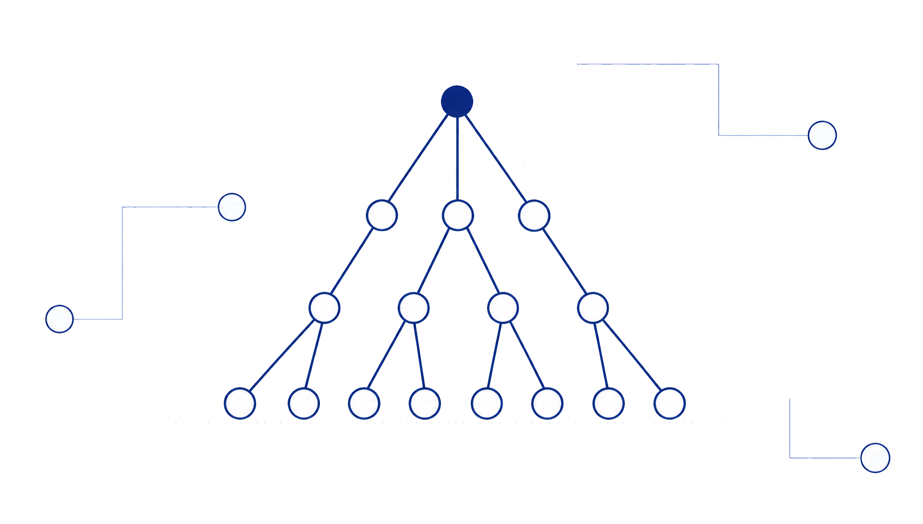
PART TWO
02
Customer cones & reach
From what an AS announces to what its cone can reach.
Notes:
Part two: customer cones (Task 2).

Slide 16
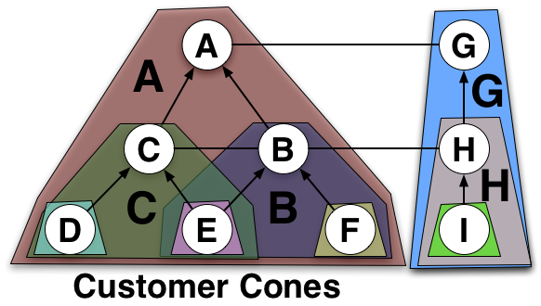
TASK 2 · CONES
WEEK 2 · BUILDING BLOCK 2 / 10
The customer cone
Customer cone = the root AS plus every AS reachable via provider→customer links.
Measures transit influence — not just what an AS announces itself.
Input: CAIDA PPDC file 20260501.ppdc-ases.txt.bz2, loaded as a black box.
You use the precomputed cone file here; how relationships & cones are inferred is Block 4.
This graph shows the respective cone sizes for each AS
ESCALATE Training Program · Summer 2026
Notes:
Root is in its own cone → a stub's cone is just itself → cone == origin for stubs. Anchors Q5.

Slide 17
TASK 2 · TWO COUNTS
WEEK 2 · BUILDING BLOCK 2 / 10
Owns vs. reaches
Task 1 — origin
Task 2 — cone
what an AS owns
what an AS reaches
Question: who owns the space?
Question: what does the cone reach?
Nested more-specifics: subtracted (LPM)
Nested more-specifics: NOT subtracted
Method: PyTricia children-subtraction
Method: sorted-interval sweep
ESCALATE Training Program · Summer 2026
Notes:
The dual-method distinction is the biggest correctness gap. Owns (subtract) vs reaches (don't subtract).

Slide 18
TASK 2 · COUNTING
WEEK 2 · BUILDING BLOCK 2 / 10
Counting the cone: prefix sum + address sweep
Cone prefix count — sum members’ prefix counts
Cone address count — merge nets into runs
cone_prefix_count[root] = sum(
asn_prefix_count.get(m, 0)
for m in members)
nets = sorted(member_nets, key=...)
total, covered_end = 0, -1
for net in nets:
start = int(net.network_address)
if start > covered_end:
total += net.num_addresses
covered_end = start + \
net.num_addresses - 1
Within a cone we ask “is this reachable through me?” — so we do not subtract more-specifics. The deliberate opposite of Task 1.
ESCALATE Training Program · Summer 2026
Notes:
Address sweep merges sorted intervals; no more-specific subtraction.

Slide 19
TASK 2 · OUTPUT
WEEK 2 · BUILDING BLOCK 2 / 10
Cone metrics, and Q4 / Q5
Metric | min | max | mean | median
Cone prefix count | 1 | ~893k | ~203 | 3
Cone address count | 8 | ~2.35B | — | ~1k
Q4 — shape: even more heavy-tailed (median cone 3; the top cone reaches hundreds of thousands).
Q5 — why cone ≥ origin: the cone is a superset of the AS itself (equal only for stubs). Providers reach customer prefixes they don’t originate — so cone count dwarfs origin count.
ESCALATE Training Program · Summer 2026
Notes:
Q5 hinges on superset → cone ≥ origin, equal only for stubs. Largest origin ≈14.4k vs largest cone ≈882k.

Slide 20
PART THREE
03
From numbers to organizations
Who are the leaders — and why they rank where they do.
Notes:
Part three: ranking and AS2Org (Task 3).

Slide 21
TASK 3 · ORGS
WEEK 2 · BUILDING BLOCK 2 / 10
Map ASNs to organizations (AS2Org)
Join the numeric leaders back to real-world orgs using CAIDA as2org.jsonl (orgName, country, members).
One organization can hold many ASNs — clustered from registry records.
Kind | Example | Ranks high via
Transit backbone | Lumen / L3 | huge cone
Cloud / content | Amazon | own prefixes / addresses
Legacy holder | US DoD | coarse address blocks
ESCALATE Training Program · Summer 2026
Notes:
Leader TYPES, not the answer key. Real ranked table and counts are [student computes].

Slide 22
TASK 3 · RANKING
WEEK 2 · BUILDING BLOCK 2 / 10
The rank-vector sort
1.
Rank each metric independently (rank 1 = highest).
def ranked(d):
return {asn: r for r, (asn, _) in
enumerate(sorted(d.items(),
key=lambda x: x[1],
reverse=True), start=1)}
2.
Union the top-3 ASNs across the four rank dicts.
3.
Sort rows by each ASN’s sorted vector of ranks — best first.
[1,1,3,4] beats [1,2,2,3] beats [2,2,3,9999] — compare best rank, then next. Being #1 in two metrics beats #1 in one.
ESCALATE Training Program · Summer 2026
Notes:
The rank-vector sort is what trips students up. #1 in two metrics outranks #1 in one.

Slide 23
TASK 3 · OUTPUT
WEEK 2 · BUILDING BLOCK 2 / 10
Q6: one sentence per top-4 organization
Transit backbone — ranks via cone (prefixes + addresses), needn’t own much itself.
Cloud / content — ranks via own address count (large hosting allocations).
Legacy holder — ranks via address count from historic coarse blocks, modest cone.
The exact four orgs and counts are [student computes] — name the mechanism, not just the org.
ESCALATE Training Program · Summer 2026
Notes:
A good Q6 names the mechanism (transit vs ownership vs legacy), not just the org name.

Slide 24
BEFORE YOU RUN IT
WEEK 2 · BUILDING BLOCK 2 / 10
Common pitfalls
Don’t double-count nested space — total ≈ 3.1B, not ≈ 4.3B.
Task 2 sweep does NOT subtract more-specifics — the opposite of Task 1.
Use .update(origin_asns) not .add(); exclude MOAS; CCDF y = ASes with ≥ x (log–log).
Ranking unions top-3 across metrics, sorted by the rank vector.
ESCALATE Training Program · Summer 2026
Notes:
Run this before students leave for JupyterHub. Orange marks the two costliest correctness traps.

Slide 25
ASSIGNMENT 2 · DUE BEGINNING OF WEEK 3
WEEK 2 · BUILDING BLOCK 2 / 10
nids-bgp-control-plane
Attribute address space from the global routing table, measure cone reach, and rank the leaders — the BGP section of your module.
MODULE MILESTONE
Becomes the BGP / control-plane section of your own training module.
Task 1 — origin map, MOAS %, LPM address counts, origin CCDF (Q1–Q3)
Task 2 — customer-cone prefix & address counts (Q4–Q5)
Task 3 — top-3-in-any-metric table joined to AS2Org (Q6)
REPOSITORY
github.com/CAIDA/ nids-bgp-control-plane
Finish all notebook tasks and questions
ESCALATE Training Program · Summer 2026
ESCALATE Training Program · Summer 2026
Notes:
Assignment structure identical every week. Slug + repo in Roboto Mono. Authoritative grading lives in the Claude Code workflow, not here.

Slide 26
BEFORE NEXT WEEK
WEEK 2 · BUILDING BLOCK 2 / 10
This week, in five steps
Open the notebook on NRP JupyterHub (jupyterhub-west.nrp-nautilus.io).
OPTIONAL BACKGROUND
Work Tasks 1–3; replace each # YOUR CODE HERE.
RouteViews & MRT background; CAIDA AS Rank notes on customer cones — context, returns in Block 4.
Finish the assignment by the beginning of Week 3.
Attend the plenary — or catch up; materials are posted.
Use the hands-on hour and mentors for infrastructure help.
Questions · Mattermost (fastest)
training-program-info@caida.org
ESCALATE Training Program · Summer 2026
ESCALATE Training Program · Summer 2026
Notes:
Predictable close. Confirm NRP access before the session, not during. Questions line kept identical.

Slide 27
APPENDIX · FOR SELF-STUDY
A
Supporting detail, not covered live
A few slides so the deck stands on its own.
Notes:
Everything after this is self-study.

Slide 28
APPENDIX · ADDRESS COUNTING
Longest-prefix match, three levels deep
Prefixes nest arbitrarily deep. Each address must be credited once, to the most-specific prefix that covers it, so a provider’s block is not counted on top of the customer more-specifics inside it.
Subtract direct children only. With A ⊃ B ⊃ C: A subtracts B (B already contains C), and B separately subtracts C. If A also subtracted C, A would be undercounted — C would be removed twice.
/8 = A
/16 = B
/24 = C
A = 10.0.0.0/8 (16,777,216)
B = 10.1.0.0/16 (65,536, in A)
A = 16,777,216 - 65,536 = 16,711,680
B = 65,536
ESCALATE Training Program · Summer 2026
ESCALATE Training Program · Summer 2026
Notes:
Self-study detail for the LPM rule; denser text is fine here.

Slide 29
APPENDIX · GLOSSARY
Advanced terms and acronyms
Program-, platform-, and research-specific terms used in this deck. (General terms like IPv4, BGP, AS, CIDR omitted.)
AS2Org
MRT
CAIDA dataset mapping ASNs to organizations (orgName, country, members).
Multi-Threaded Routing Toolkit — binary format for archived routing tables.
bgpkit
origin AS
Toolkit that parses MRT routing dumps into Python objects.
The last ASN in a BGP path — who announced the prefix.
CCDF
OSDF
Complementary CDF: for each x, the count of items with value ≥ x.
Open Science Data Federation — staging path used to fetch the RIB.
customer cone
PPDC
Root AS plus all ASes reachable via provider→customer links.
Per-AS customer-cone membership file (provider→customer derived).
LPM
RIB
Longest-prefix match: credit an address to its most-specific covering prefix.
Routing Information Base — a collector’s snapshot of received routes.
MOAS
RouteViews
Multi-Origin AS: one prefix announced by more than one origin AS.
Univ. of Oregon project archiving BGP tables from many collectors.
ESCALATE Training Program · Summer 2026
ESCALATE Training Program · Summer 2026
Notes:
Advanced terms only; alphabetized; two-column reflow.

