Slide 1
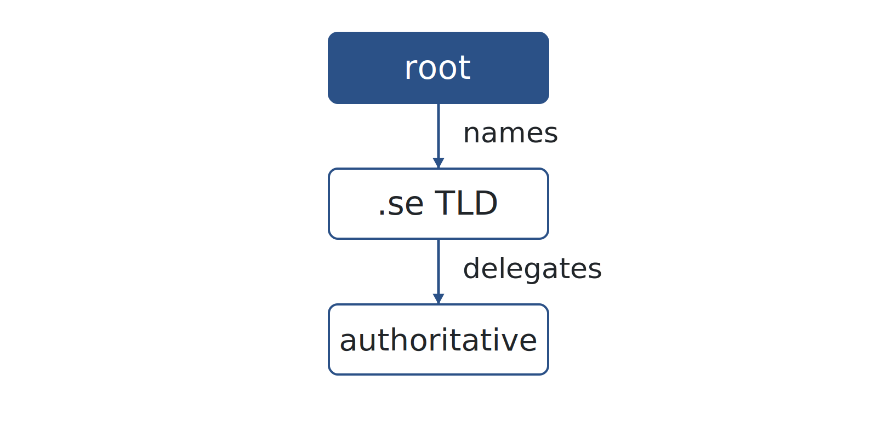
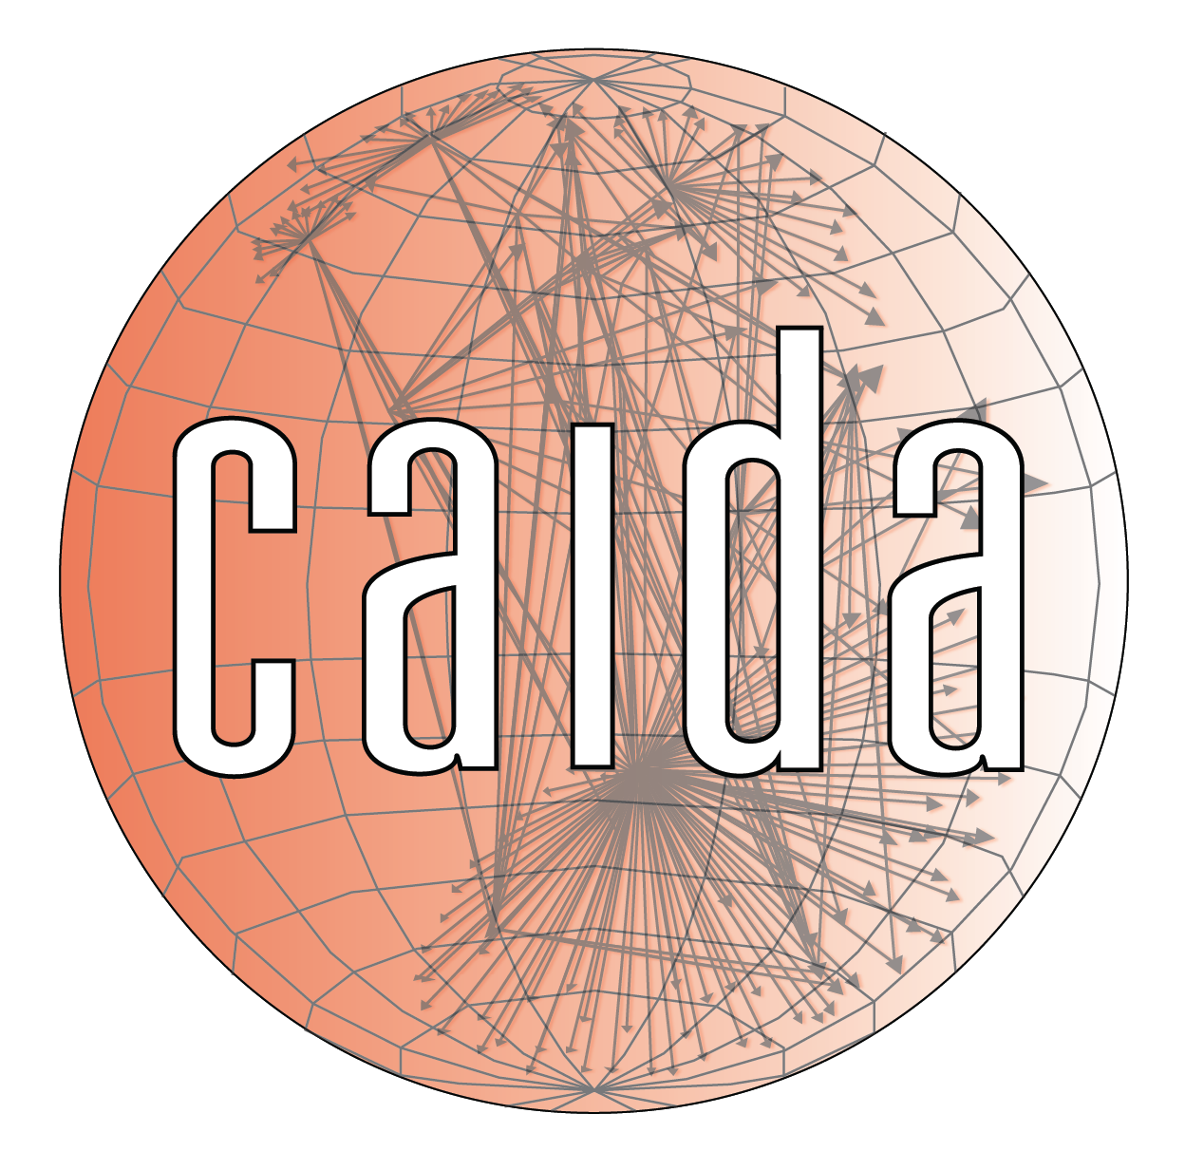

ESCALATE TRAINING PROGRAM · SUMMER 2026
The DNS Ecosystem — and How It Breaks
Every registered domain answers a fixed set of DNS questions every day — and every answer is a place where things can quietly go wrong.
PLENARY
INSTRUCTOR
SENIOR MENTORS
PROGRAM CONTACT
Plenary · Tue Jul 14, 2026 · 12:00 PT
kc claffy
Ricky Mok · Bradley Huffaker · Raffaele Sommese
training-program-info@caida.org
Supported by the NSF ESCALATE project · OAC-2519416
Notes:
Welcome to Week 5, building block 5 of 10: DNS. Two threads this week. First, the DNS ecosystem at scale — who actually answers for the world's domains, how resilient that is, and whether it is secured. Second, and new this year, how the DNS breaks: the failure modes from a simple typo up to a nation-state delegation hijack. The plenary today covers the concepts and the failure landscape; Thursday's infrastructure hour is the dataset and the tooling — OpenINTEL and PySpark on NRP. No recordings, so both decks stand on their own.

Slide 2
THE ARC
WEEK 5 · BUILDING BLOCK 5 / 10
Ten building blocks — you are here
1
2
3
4
5
Internet structure & ASNs
BGP at scale
Registries: WHOIS / IRR / RPKI
Traceroute, ITDK
DNS
6
7
8
9
10
Traffic analysis
Network telescope
Data fusion (IYP)
Your own module
SDSC hackathon
Weeks 1–8 build one block at a time; weeks 9–10 integrate them into a full forensic pipeline.
ESCALATE Training Program · Summer 2026
Notes:
You are here: block 5. Blocks 1–4 gave you Internet structure and ASNs, BGP, the registries, and traceroute plus the ITDK router graph. This week adds the naming layer. It feeds directly into block 9, degradation forensics — a hijacked or dependent namespace is one way a country's connectivity degrades.

Slide 3
LAST WEEK · RECAP
WEEK 5 · BUILDING BLOCK 5 / 10
Last week: the router-level Internet
Traceroute reveals a forwarding path one TTL hop at a time.
The ITDK collapses millions of traces into a router-level graph.
Router hostnames carry operator and location annotations.
THIS WEEK BUILDS ON IT
This week you measure the naming layer: who serves it, how resilient it is, how secure(d) it is, and how it fails.
ESCALATE Training Program · Summer 2026
Notes:
Quick orientation, not a re-teach. Last week was topology: the physical-ish graph of routers and links. This week is a different layer entirely — the naming system that sits on top. Same measurement mindset, new object of study.

Slide 4
PART ONE
01
Who runs the DNS?
From NS records to market structure.
Notes:
Part one: the ecosystem. Before we can talk about failure we need to know who is actually in the picture — and it turns out a handful of providers answer for a large share of the Internet.

Slide 5
WEEK 5 · BUILDING BLOCK 5 / 10
THE QUESTION
Someone else answers DNS for you. What if they fail?
In October 2016, one provider's bad day took major sites down.
ESCALATE Training Program · Summer 2026
Notes:
Set the hook. When you register example.com you delegate the answering to a set of nameservers — usually your provider's. That is a dependency, and dependencies fail. Hold Dyn in mind; we come back to it in a few slides.

Slide 6
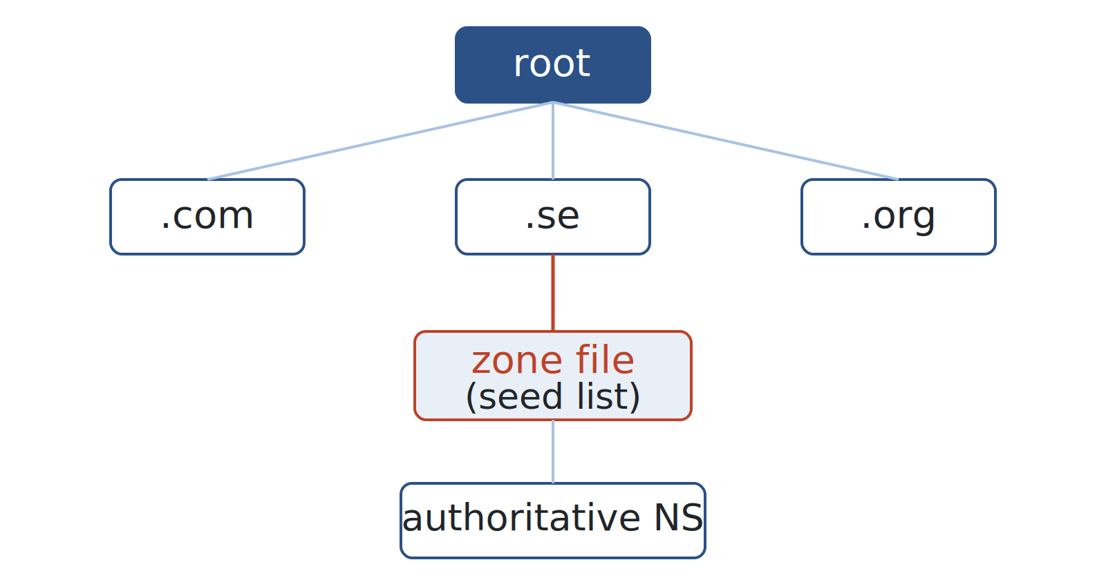
WHO RUNS IT · HIERARCHY
WEEK 5 · BUILDING BLOCK 5 / 10
The DNS hierarchy in 90 seconds
Resolution walks down: root names the TLD servers, the TLD registry names each zone.
The TLD zone file is the registry's delegation list — for OpenIntel, it seeds measurements.
Authoritative servers hold the records; everything below is caching.
Root → TLD registry → zone file → authoritative NS.
ESCALATE Training Program · Summer 2026
Notes:
Fast recap — the cohort is split on DNS, so one slide of mechanics and move on. The one thing to anchor: the TLD zone file. It is the registry's authoritative list of delegations, and it is exactly what OpenINTEL uses as its seed list and what CZDS distributes. That is the bridge from concept to data.

Slide 7
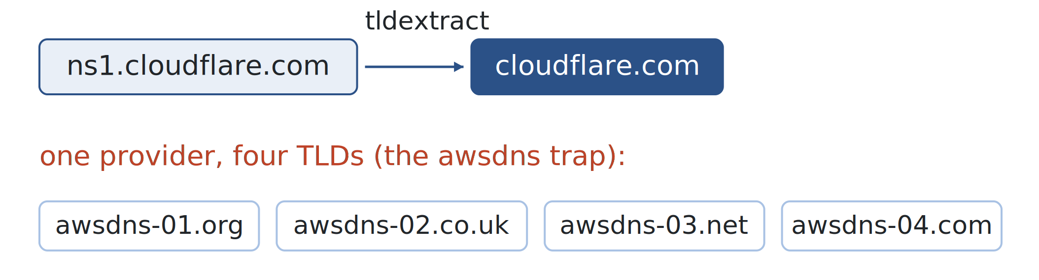
WHO RUNS IT · PROVIDERS
WEEK 5 · BUILDING BLOCK 5 / 10
An NS record names a hostname, not a company
Provider = registrable domain of NS host: ns1.cloudflare.com → cloudflare.com.
Use tldextract, not string-splitting — co.uk is a public suffix, not a registrable domain.
Watch the awsdns- trap: four NS hostnames across different TLDs, one provider.
Provider attribution = public-suffix-aware registrable-domain extraction.
ESCALATE Training Program · Summer 2026
Notes:
This is the subtle-but-crucial measurement step. Naive string manipulation gets provider counts wrong. tldextract knows the public suffix list, so it stops at the registrable boundary. The awsdns example is the classic gotcha: awsdns-01.org, awsdns-02.co.uk and so on are deliberately spread across TLDs but all belong to AWS — count them as one provider or your concentration numbers are garbage.

Slide 8
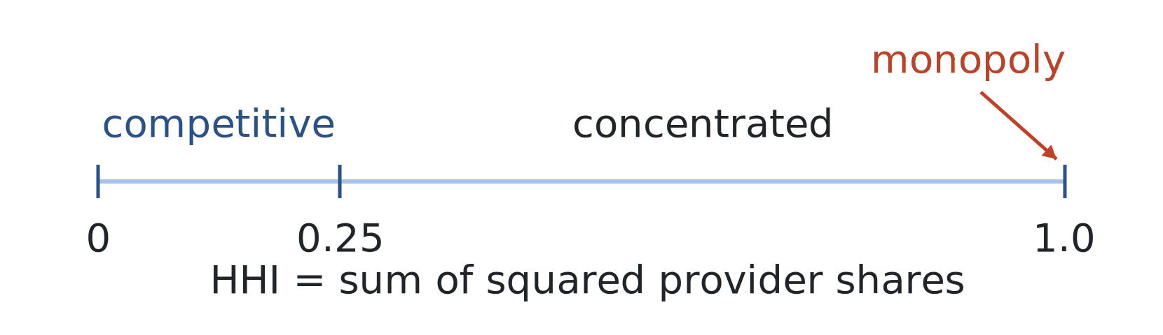
WHO RUNS IT · CONCENTRATION
WEEK 5 · BUILDING BLOCK 5 / 10
Measuring concentration: the HHI
Take each provider's market share, square it, sum across all providers — that's HHI.
Bands: near 0 competitive, above 0.25 concentrated, 1.0 a single-provider monopoly.
One number for how much the namespace leans on a few operators.
HHI = Σ(share²). A dependency metric, not just an economics one.
ESCALATE Training Program · Summer 2026
Notes:
The cohort asked for stats refreshers, so define HHI from scratch. It comes from antitrust economics but here it is a resilience metric: a highly concentrated namespace means a single provider outage has enormous blast radius. Do not put a fabricated market number on the slide — the figure is a band scale, not real data. The real numbers come out of their own analysis Thursday.

Slide 9
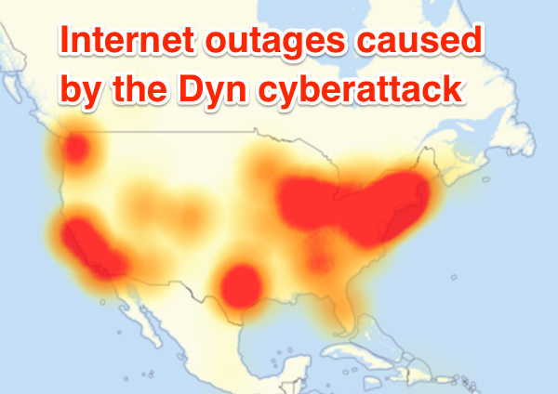
CASE STUDY
WEEK 5 · BUILDING BLOCK 5 / 10
Dyn DDoS — October 21, 2016
Many high-profile domains (Twitter, GitHub, Reddit) used Dyn as their sole DNS provider.
A Mirai-botnet DDoS flooded Dyn's authoritative servers, and resolution for its customers failed.
Single-provider domains went dark for hours.
The failure axis was provider diversity, not NS count.
ESCALATE Training Program · Summer 2026
Notes:
The canonical single-provider-dependency outage. The teaching point is the last beat: many affected domains had four, six, eight NS records and still went fully dark, because every one of those nameservers was Dyn. Redundancy that shares a fate is not redundancy. kc is supplying a real outage figure — placeholder holds until then. Do not fabricate a plot.

Slide 10
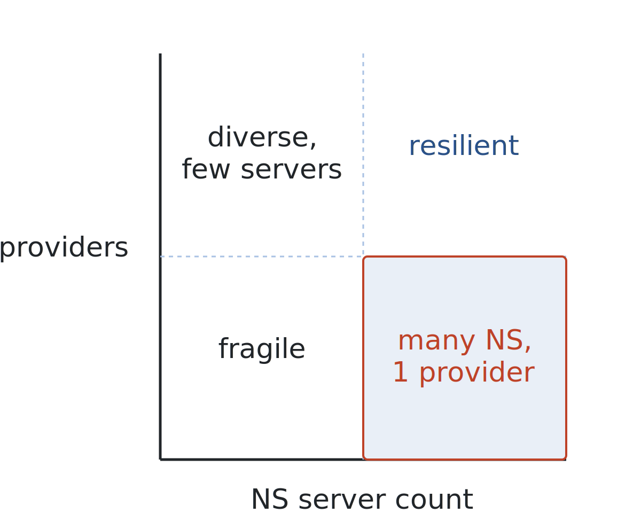
WHO RUNS IT · RESILIENCE
WEEK 5 · BUILDING BLOCK 5 / 10
Two different axes of resilience
NS server count: RFC 1034 wants every zone on ≥2 nameservers — baseline redundancy.
Provider diversity: ns1–ns4 from one provider is still one dependency.
Dyn failed on the second axis, not the first.
Server count vs provider diversity:
a domain can be strong on one and fragile on the other.
ESCALATE Training Program · Summer 2026
Notes:
Make the two axes explicit because they are easy to conflate. The 2x2 makes the point: the dangerous quadrant is many servers, one provider — it looks redundant and isn't. Task 2 of the assignment measures both axes.

Slide 11
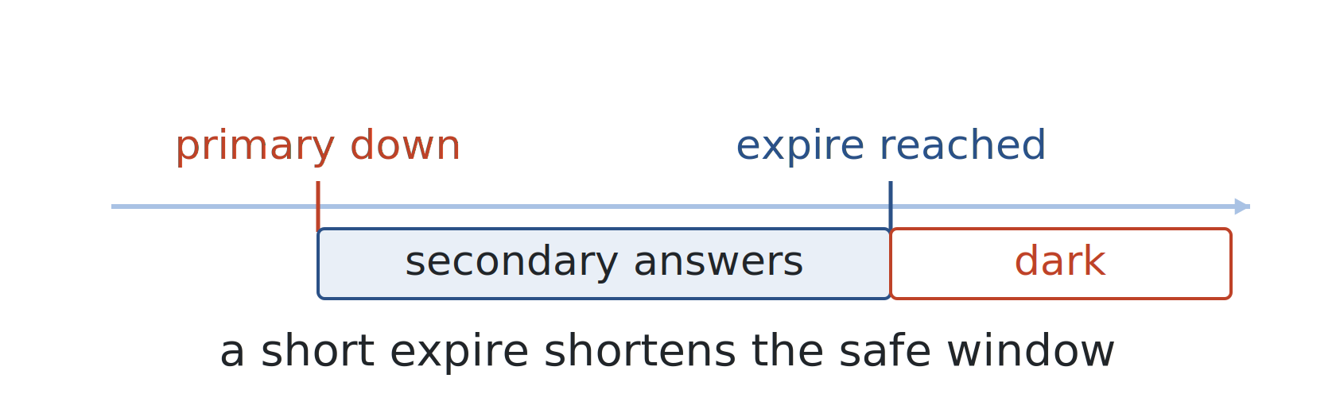
WHO RUNS IT · SOA TIMING
WEEK 5 · BUILDING BLOCK 5 / 10
SOA timing governs how long failure lasts
The SOA record sets refresh / retry / expire / minimum for the zone's secondaries.
A short expire strands a zone when the primary is down for longer than that window.
A long minimum keeps resolvers caching a negative answer well after the fix.
The same knobs that tune load can extend or shorten an outage.
ESCALATE Training Program · Summer 2026
Notes:
SOA timing is where a resilience problem becomes a duration problem. expire is the one to watch: it is how long a secondary keeps serving after it loses contact with the primary. Set it short and a long primary outage means the secondaries stop answering too. minimum governs negative caching — set it long and even after you fix a record, resolvers keep serving the old NXDOMAIN. Task 2 reads these fields.

Slide 12
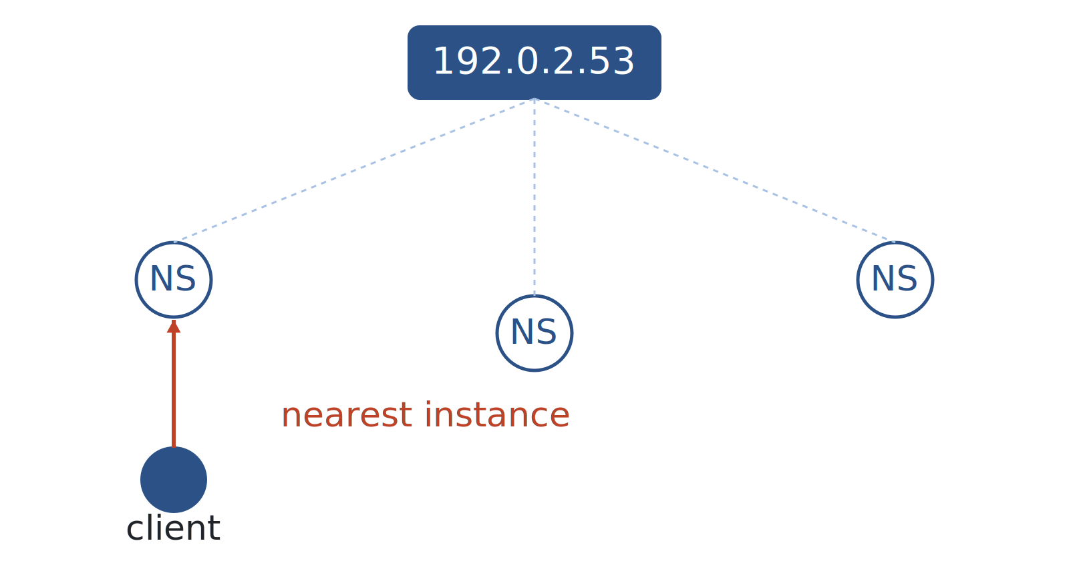
WHO RUNS IT · ANYCAST
WEEK 5 · BUILDING BLOCK 5 / 10
Anycast: one address, many locations
One IP announced into BGP from many sites; each client routes to the nearest instance.
How root servers and big DNS providers absorb global load and DDoS.
Detecting it needs active measurement — invisible in the records alone.
The same address served from everywhere — a scaling and resilience mechanism.
ESCALATE Training Program · Summer 2026
Notes:
Anycast is the main way big DNS operators scale and survive DDoS. The key measurement point: you cannot tell a domain uses anycast from its NS or A records — the address looks singular. You detect it by probing from many vantage points, which is what the LACeS census does and what Task 2's anycast piece uses. Deeper detail is in the appendix.

Slide 13
PART TWO
02
Is the DNS secured?
Three mechanisms, three very different adoption curves.
Notes:
Part two: security best practices, and how you measure their adoption at scale. Three mechanisms — DNSSEC, SPF, CAA — each solving a different threat, each adopted at a different rate.

Slide 14
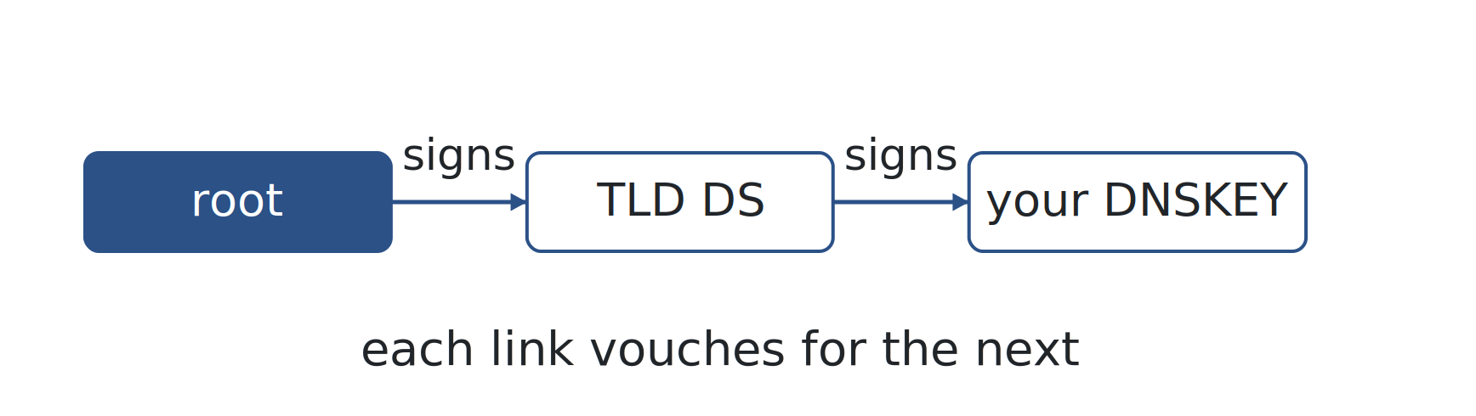
IS IT SECURED · DNSSEC
WEEK 5 · BUILDING BLOCK 5 / 10
(1) DNSSEC adds the authentication DNS never had
DNS shipped with no way to verify an answer — anyone on-path could forge answer.
DNSSEC signs records:
root → TLD DS → your DNSKEY.
Each link vouches for the next, anchored at the root.
A signature chain from the root down to your zone.
ESCALATE Training Program · Summer 2026
Notes:
DNSSEC is the authentication layer retrofitted onto DNS. The chain of trust is the concept to land: the root signs a pointer to the TLD's key, the TLD signs a pointer (the DS record) to your key, your key signs your records. A resolver can walk that chain from a root key it already trusts. Break any link and validation fails closed.

Slide 15
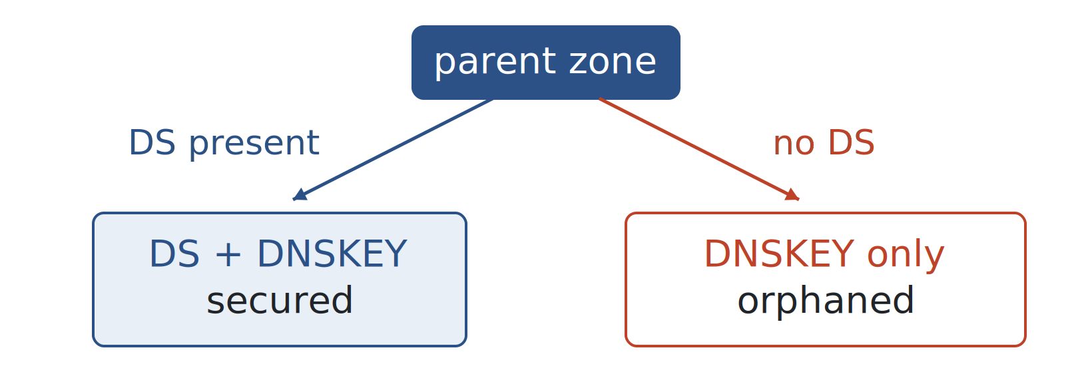
IS IT SECURED · DNSSEC
WEEK 5 · BUILDING BLOCK 5 / 10
Effectively secured needs both DS and DNSKEY
A DNSKEY in your zone with no matching DS at the parent is an orphaned key — no resolver will trust it.
So measuring adoption means checking both the child and the parent, not just one.
KSK (flags 257) is what the DS references; ZSK (flags 256) signs the ordinary records.
DS present at parent AND DNSKEY present at child =
a working chain.
ESCALATE Training Program · Summer 2026
Notes:
This is the measurement subtlety for Task 3. Plenty of zones publish a DNSKEY but never get the DS record installed at the parent — a common misconfiguration. That key is orphaned: it exists but no validating resolver will use it, so the zone is effectively unsecured. You have to join child and parent data to tell real deployment from cargo-cult deployment. KSK vs ZSK is the one-line detail: the DS points at the key-signing key.

Slide 16
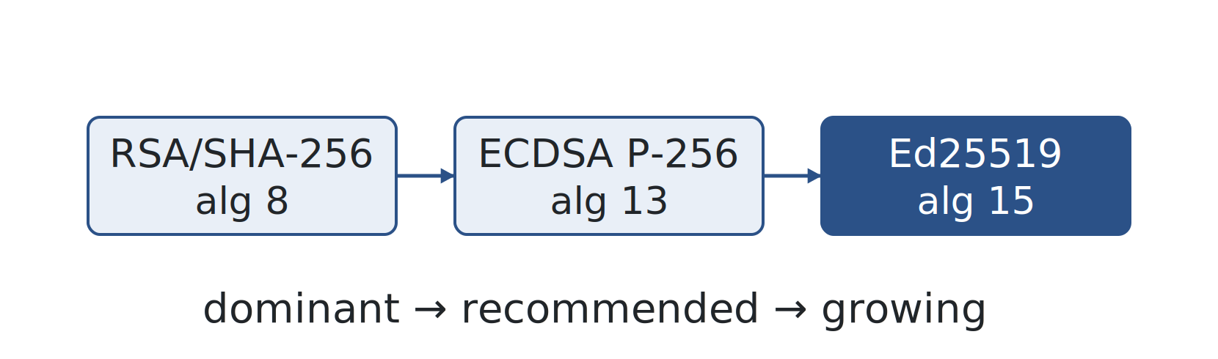
IS IT SECURED · ALGORITHMS
WEEK 5 · BUILDING BLOCK 5 / 10
Signing algorithms move over time
RSA/SHA-256 (algorithm 8) was historically dominant.
ECDSA P-256 (13) is now recommended
smaller signatures, same security.
Ed25519 (15) is growing;
SHA-1 variants deprecated.
An adoption curve you can watch over years in the data.
ESCALATE Training Program · Summer 2026
Notes:
Algorithm choice is itself a measurable adoption signal. The trend is away from RSA toward elliptic-curve — ECDSA P-256 and Ed25519 give much smaller signatures, which matters for DNS packet sizes. SHA-1 is deprecated. Task 3.5 looks at this shift longitudinally. Algorithm numbers are in mono because they are protocol identifiers.

Slide 17
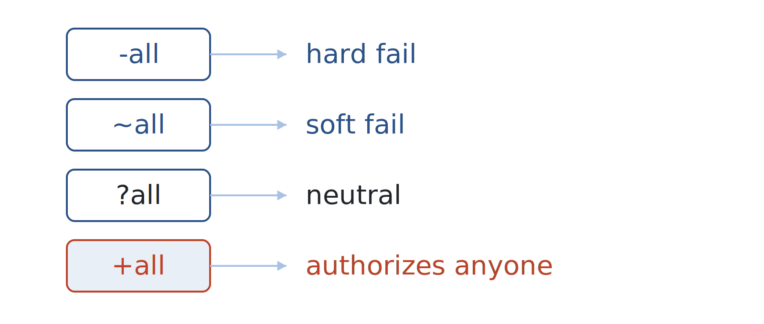
IS IT SECURED · EMAIL
WEEK 5 · BUILDING BLOCK 5 / 10
(2) Sender Policy Framework: who may send mail as this domain
A TXT record v=spf1 … lists the IPs and hosts authorized to send mail for the domain.
The trailing qualifier is the policy: -all hard-fail, ~all soft-fail, ?all neutral.
Watch for +all or a missing qualifier — it authorizes the whole Internet to spoof you.
The last token decides whether the record protects anything.
ESCALATE Training Program · Summer 2026
Notes:
SPF is email anti-spoofing published in DNS. The whole security value is in the final qualifier. -all means reject anything not listed. +all — which people do publish by mistake — means accept everything, i.e. the record does nothing. The alert coloring is reserved for that failure case. Task 3 measures the distribution of qualifiers.

Slide 18
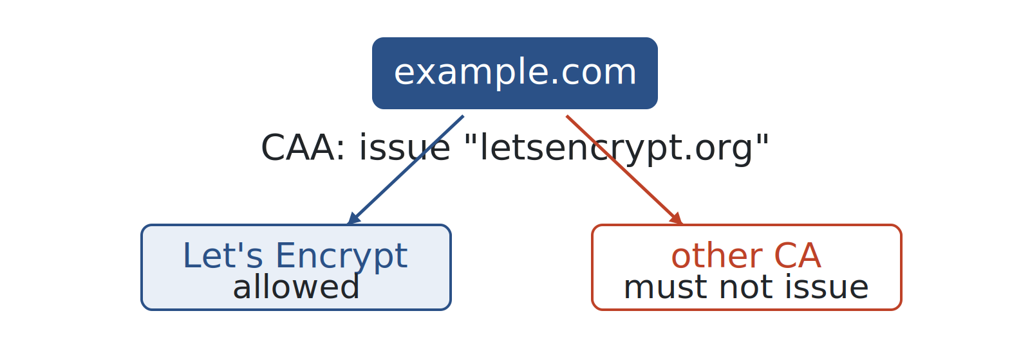
IS IT SECURED · CERTIFICATES
WEEK 5 · BUILDING BLOCK 5 / 10
(3) Certificate Authority Authorization (CAA):
which CAs may issue for this domain
A CAA record names the certificate authorities allowed to issue for the domain.
Tags are issue / issuewild / iodef; a value of ; forbids issuance entirely.
It complements DNSSEC by constraining a different threat — mis-issued certificates.
A DNS record that fences off who can mint your HTTPS certificates.
ESCALATE Training Program · Summer 2026
Notes:
CAA closes a gap DNSSEC does not touch: a CA issuing a certificate for your domain when it shouldn't. You publish which CAs are allowed; compliant CAs check CAA before issuing. This sets up the trust-dependence slide in Part 3 — because if an attacker controls your DNS, they control your CAA too. Task 3 measures CAA adoption.

Slide 19
PART THREE
03
When the DNS goes wrong
From a typo to a nation-state hijack — the same records, very different failure stories.
Notes:
Part three, new this year. Everything so far was the healthy ecosystem. Now: how it breaks. The throughline is that most failures look identical from the outside — a name that does not resolve — but the causes span accident to attack, and telling them apart is a measurement problem.

Slide 20
WEEK 5 · BUILDING BLOCK 5 / 10
THE QUESTION
Your site won't load, your mail is silent. Why?
Same symptom, at least six different causes.
ESCALATE Training Program · Summer 2026
Notes:
Run this live — it is the discussion prompt from the CSE 291 lecture and it works well as a cold open for the taxonomy. Let them call out causes: a typo in the zone, an expired registration, nameservers that stopped answering, a DDoS, someone hijacking the delegation. Collect them, then reveal the taxonomy on the next slide as the organized version of what they just brainstormed. Second and last big-question of the deck.

Slide 21
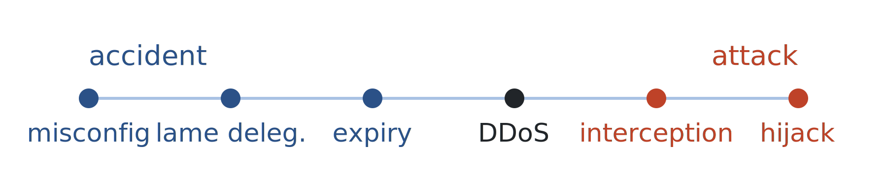
WHEN IT BREAKS · TAXONOMY
WEEK 5 · BUILDING BLOCK 5 / 10
A spectrum from accident to attack
Benign end: misconfiguration (typos, stale glue), lame delegation, expiry.
Malicious end: DDoS, on-path interception and censorship, delegation hijack.
Most look identical from outside — a name that won't resolve. So we measure.
Lame delegation = an NS listed at the parent that doesn't actually answer authoritatively.
ESCALATE Training Program · Summer 2026
Notes:
The organizing frame for the whole part. Lay it out as a spectrum because the response differs by cause. Define lame delegation explicitly since it is the least familiar and the Akiwate paper is a reading option: the parent zone delegates to a nameserver that does not actually serve the zone authoritatively — so resolution is fragile or fails, with no attacker involved. The measurement challenge is that the external symptom is often the same across the whole spectrum.

Slide 22
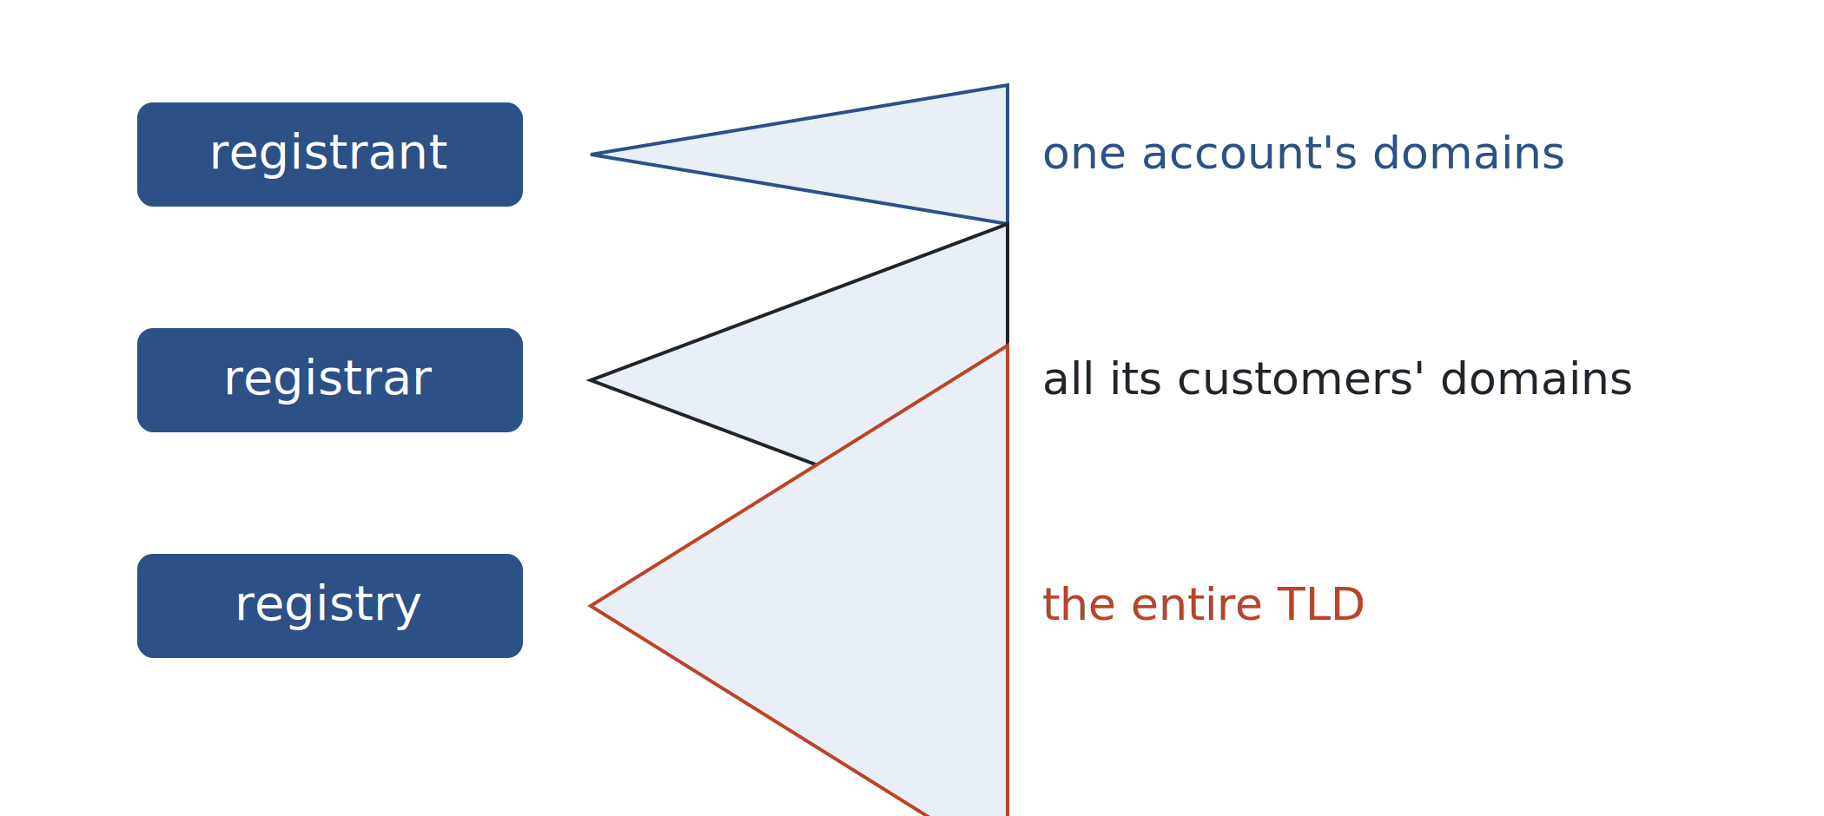
WHEN IT BREAKS · THREAT MODEL
WEEK 5 · BUILDING BLOCK 5 / 10
Three tiers, three blast radii
Registrant account compromise:
the domains in that one account.
Registrar compromise (EPP credentials):
potentially every domain that registrar manages.
Registry compromise:
every domain in the entire TLD.
Registrant → registrar → registry:
control moves up, blast radius widens.
ESCALATE Training Program · Summer 2026
Notes:
The ecosystem threat model from the CSE 291 lecture. The point is that the DNS is administered through a chain — you talk to a registrar, the registrar talks to the registry via EPP — and a compromise at each tier has a wildly different blast radius. One phished registrant loses their domains; a compromised registrar can lose all its customers' domains at once; a compromised registry endangers the whole TLD. Keep it qualitative.

Slide 23
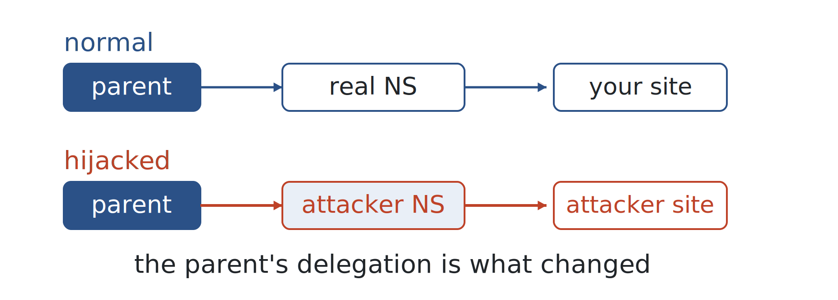
WHEN IT BREAKS · HIJACK
WEEK 5 · BUILDING BLOCK 5 / 10
Anatomy of a targeted delegation hijack
Attacker changes the NS delegation at the registrar, pointing it at their servers.
They serve forged records, redirecting logins and mail, then revert to evade notice.
Country-level victims (2014 aerospace, 2020–21 .gov.kg) — fit the degradation theme.
Normal vs hijacked delegation—parent points somewhere new.
ESCALATE Training Program · Summer 2026
Notes:
This is the sharp end. Unlike a cache-poisoning trick, a delegation hijack changes the authoritative truth at the registrar — so it is globally consistent and DNSSEC on the victim's own zone does not help if the attacker replaces the delegation wholesale. The keep-it-brief tradecraft is why these are hard to catch without continuous measurement. Country-code government domains as victims is exactly the national-degradation scenario the capstone asks about. Details stay qualitative per kc — no hard numbers on the slide.

Slide 24
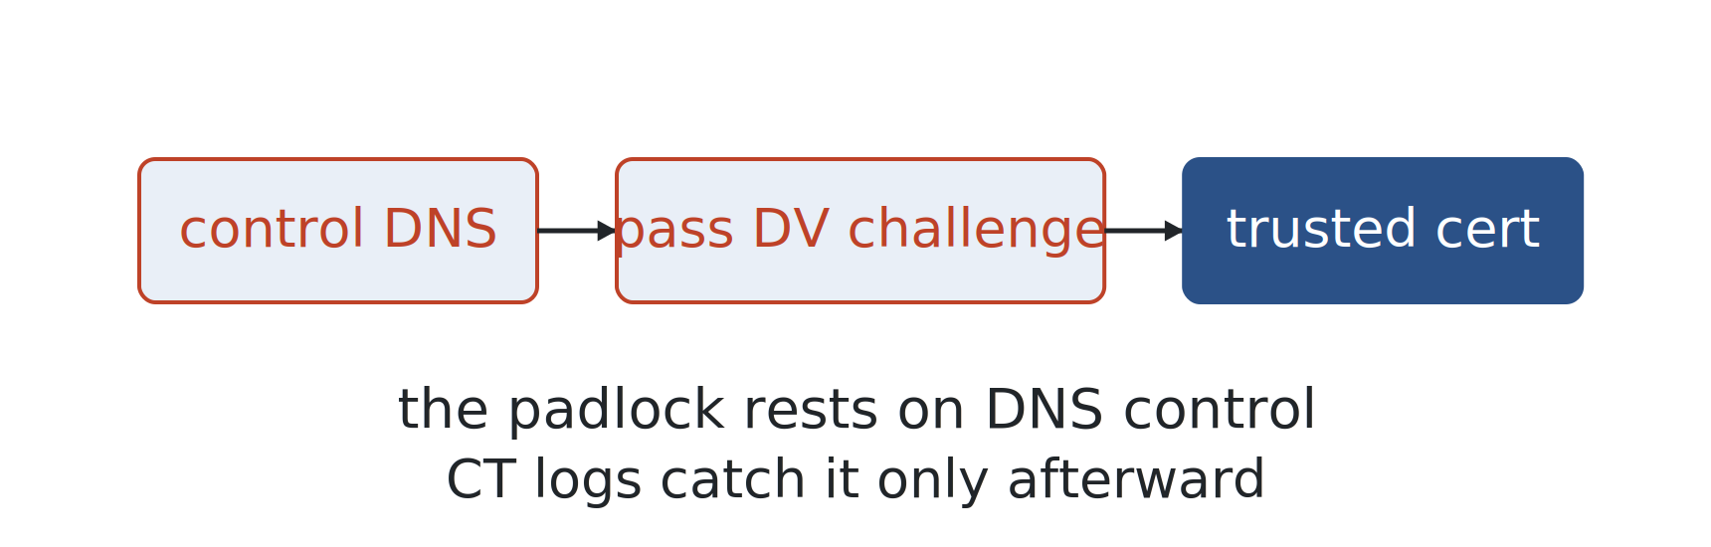
WHEN IT BREAKS · HIDDEN TRUST
WEEK 5 · BUILDING BLOCK 5 / 10
The DNS underwrites TLS
Domain-validated (DV) issuance proves control
by answering a DNS (or HTTP) challenge.
So whoever controls your DNS can get a real, browser-trusted cert: malicious but valid.
CT logs make issuance auditable — but only afterward.
ESCALATE Training Program · Summer 2026
Notes:
The week's sharpest lesson in hidden dependencies, and it ties Part 2 (CAA) to Part 3 (hijack). Students trust the padlock; the padlock ultimately rests on DNS control. If an attacker owns your DNS even briefly they can pass a domain-validation challenge and mint a legitimate certificate — the browser shows no warning. CT logs are the saving grace: every issued cert is logged publicly, so you can detect the mis-issuance afterward. This is why CAA and DNSSEC matter beyond compliance checkboxes.

Slide 25
WHEN IT BREAKS · SILENT DECAY
WEEK 5 · BUILDING BLOCK 5 / 10
Failure without an attacker: Risky BIZness
EPP host-object rules incentivize registrars to rename dangling NS hosts into other TLDs.
Live domains (courthouses, healthcare, gov/edu) then point at hijackable names.
The owner never acts; re-registering doesn't fix it. Visible in zone files.
Gautam’s slides:
https://cseweb.ucsd.edu/classes/wi23/cse291-e/slides/cse291e-lecture-09.pdf
Risky BIZness paper in Recommended Reading for this week
ESCALATE Training Program · Summer 2026
Notes:
The Akiwate Risky BIZness result, and the subtlest failure here — no attacker, just a standards artifact. When a nameserver host object becomes problematic, EPP rules lead registrars to rename it into a TLD they don't control, often .biz, with a dropthishost- style label. But live domains still delegate to that name. Anyone who registers the renamed name inherits authoritative control of those domains. It is measurable directly in CZDS zone files, which is why it belongs to this week. The lesson: well-meaning standards can silently degrade the namespace.

Slide 26
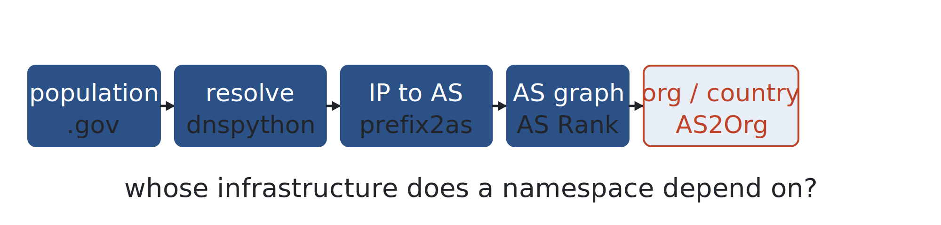
WHEN IT BREAKS · MEASURE IT
WEEK 5 · BUILDING BLOCK 5 / 10
Measuring dependency at national scale
Take a domain population (a country's gov), resolve NS/A/AAAA, map IPs to ASes.
Walk AS relationships upward; tag the org and country behind each provider.
It answers: whose infrastructure does a namespace depend on — any of it foreign?
Domains → resolve → prefix2as → AS Rank → AS2Org. (capstone method in miniature.)
ESCALATE Training Program · Summer 2026
Notes:
This scales up the idea behind the CSE 291 PA3 assignment — but as global-dataset mining, not the zdns exercise. The pipeline reuses building blocks they already have: RouteViews prefix2as for IP-to-AS, AS Rank for AS relationships and cones, AS2Org for the organization and country behind an AS. Chaining them answers a resilience question with national-security weight: how much of a government's DNS sits on foreign or single-operator infrastructure. This is a scaled-down rehearsal of the block-9 capstone. The datasets are named per project canon.

Slide 27
PART FOUR
04
Your module this week: nids-dns-ecosystem
Three tasks, one arc: who hosts it, how resilient, how secured.
Notes:
Now the assignment itself. It walks the same arc as the lecture — hosting, resilience, security — and each task answers one of the failure modes from Part 3.

Slide 28
DATASETS · THE DNS, MEASURED
WEEK 5 · BUILDING BLOCK 5 / 10
Two views of the same namespace
OpenINTEL forward DNS
PATH
Daily active-DNS snapshots per TLD — the answers side.
s3a://openintel-public/…
CZDS TLD zone files
SOURCE
ICANN zone data — the registration side (NS delegations).
czds.icann.org
ESCALATE Training Program · Summer 2026
Notes:
Two complementary views. OpenINTEL is the answers side — what the nameservers say when you ask them, captured daily. CZDS is the registration side — the delegations as the registry records them. Part 3's failures (lame delegation, Risky BIZness renames) live in the gap between what the registry delegates and what actually answers. We give you a CAIDA-staged copy of the CZDS data so you don't need your own ICANN account. Full OpenINTEL mechanics are Thursday.

Slide 29
DATASETS · SUPPORTING
WEEK 5 · BUILDING BLOCK 5 / 10
Anycast detection and the Python helpers
LACeS anycast census
SITE
Daily census of anycast /24s — how you detect anycast.
manycast.net
dnspython / tldextract
INSTALL
NS-hostname → IP resolution; registrable-domain extraction.
pip install dnspython
ESCALATE Training Program · Summer 2026
Notes:
The supporting cast. LACeS is how Task 2 knows whether a nameserver IP is anycast — you cannot see it in the records, so you join against a census. dnspython resolves NS hostnames to IPs (zone data gives you names, not addresses). tldextract is the public-suffix-aware provider attribution from Part 1. All identifiers in mono.

Slide 30
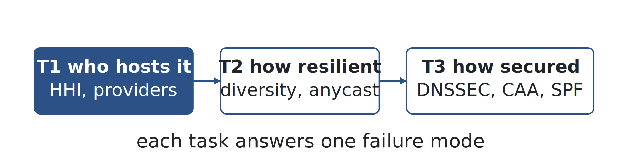
YOUR MODULE · THE ARC
WEEK 5 · BUILDING BLOCK 5 / 10
Three tasks
T1 — who hosts it: provider market share, HHI, CCDF, the 2019–2024 trend.
T2 — how resilient: NS counts, provider diversity, SOA timing, anycast.
T3 — how secured: DNSSEC deployment, algorithms, CAA, SPF, adoption curves.
ESCALATE Training Program · Summer 2026
Notes:
The map of the assignment. Notice the tasks mirror the lecture's three ecosystem questions, and each one is the measurement counterpart to a way the DNS breaks: hosting concentration is the Dyn failure mode, resilience is the redundancy question, security adoption is the hijack-and-mis-issuance defense. The arc is deliberate.

Slide 31
ASSIGNMENT 5 · DUE BEGINNING OF WEEK 6
WEEK 5 · BUILDING BLOCK 5 / 10
nids-dns-ecosystem
Complete Tasks 1–3 in the module notebook on NRP: replace every # YOUR CODE HERE and answer Q1–Q18.
MODULE MILESTONE
STRUCTURE: Intro → Datasets → Tasks → Notebook. Reuse for your module.
Prototype each task on .gov (small, fast) before scaling.
Run the full analysis on .se, the statistically meaningful TLD.
Answer all 18 questions inline in the notebook.
Remember to commit and push the completed notebook to your repo!
REPOSITORY
github.com/CAIDA/nids-dns-ecosystem
ESCALATE Training Program · Summer 2026
Notes:
One assignment per week. The .gov-then-.se pattern matters: .gov is about 25k domains so a task runs in seconds and you can debug logic; .se is about a million, statistically meaningful, and where the real answers come from. Do not scale to .se until the .gov prototype is clean. The milestone sidebar states the common assignment structure — Intro, optional Background, Datasets, Tasks, Notebook — which is also the shape their own module should take. Due beginning of Week 6.

Slide 32
BEFORE NEXT WEEK
WEEK 5 · BUILDING BLOCK 5 / 10
Before next week
Attend Thursday's infrastructure hour — OpenINTEL deep-dive + PySpark hands-on (Deck B), Thu Jul 16 · 12:00 PT.
Finish notebook Tasks 1–3 and all of Q1–Q18.
Prototype on .gov before the weekend; run .se before Week 6.
Push the completed notebook to GitHub.
Recommended reading — see sidebar; one paper is enough.
OPTIONAL BACKGROUND
RECOMMENDED: the OpenINTEL paper (van Rijswijk-Deij, JSAC 2016) — the week's dataset.
Questions Mattermost (fastest)
training-program-info@caida.org
ESCALATE Training Program · Summer 2026
Notes:
The standard close. The single most important item is attending Thursday — the assignment needs the PySpark tooling and the OpenINTEL access walk-through. Reading is recommended, not required (kc's call): the OpenINTEL JSAC paper if you read one, or the Risky BIZness paper if Part 3 grabbed you. Questions line is the usual.

Slide 33
APPENDIX · FOR SELF-STUDY
A
Appendix — self-study
Not covered live. The deck stands on its own.
Notes:
Everything past here is self-study, since sessions are not recorded and attendance is partial. Three reference slides and a glossary.

Slide 34
APPENDIX
A1 · DNSSEC algorithm numbers
Deprecated / legacy: RSA/SHA-1 (5), RSA/SHA-1-NSEC3 (7), RSA/MD5 retired. SHA-1 is no longer considered secure.
Current mainstream: RSA/SHA-256 (8), RSA/SHA-512 (10), ECDSA P-256/SHA-256 (13), ECDSA P-384 (14).
Growing: Ed25519 (15), Ed448 (16). The DS record references the KSK because the KSK is the zone's trust anchor — the parent vouches for it, and it signs the ZSK set.
ESCALATE Training Program · Summer 2026
Notes:
Reference detail for Task 3.5's algorithm analysis. The why-DS-references-KSK point: the key-signing key is the stable anchor the parent commits to via the DS record, so it can rotate the zone-signing key freely without touching the parent.

Slide 35
APPENDIX
A2 · Interception, censorship, and encrypted DNS
Where queries are exposed: on the LAN, at the ISP resolver, and anywhere on-path.
Why: national censorship, network filtering, and NXDOMAIN-hijacking for ad injection.
QNAME minimization limits exposure; DoT/DoH encrypt the query — but ECS still leaks the client subnet.
ESCALATE Training Program · Summer 2026
Notes:
This is the CSE 291 lecture-08 material on the resolution path as an attack and surveillance surface. Optional here because the assignment does not measure it, but it rounds out the failure picture: interception and censorship are the on-path malicious end of Part 3's spectrum. The encrypted-DNS point worth making is that DoH/DoT move trust rather than removing it — you are now trusting the DoH provider, and ECS can still leak your subnet.

Slide 36
APPENDIX
A3 · How LACeS detects anycast
AB (iGreedy-style): send ICMP from many vantage points;
latencies impossible (v. speed of light) for one location mean anycast (AB>3).
GCD: use speed-of-light latency geometry to place instances
a second independent signal (GCD>1).
Filter (AB>3)|(GCD>1) trades precision for recall; granularity is the /24.
ESCALATE Training Program · Summer 2026
Notes:
Backs the anycast piece of Task 2. Two independent detection methods, and the confidence filter is a tunable — high-confidence for precision, comprehensive for recall. The /24 granularity is the caveat to flag when they report per-address results.

Slide 37
APPENDIX · GLOSSARY
Advanced terms and acronyms
Advanced, program- or platform-specific terms only — alphabetical.
CAA DNS record naming which certificate authorities may issue for a domain.
CCDF Complementary CDF — the tail view used for skewed provider/count distributions.
CZDS ICANN Centralized Zone Data Service — access to TLD zone files.
DNSKEY The public key a zone publishes for DNSSEC validation.
DS record Delegation Signer — the parent's hash of the child KSK, the chain-of-trust link.
EPP Extensible Provisioning Protocol — how registrars manage domains at a registry.
HHI Herfindahl–Hirschman Index — sum of squared market shares; a concentration metric.
KSK / ZSK Key-signing key (anchored by the DS) vs zone-signing key (signs records).
LACeS Daily census of anycast /24s (manycast.net) used for anycast detection.
lame delegation An NS listed at the parent that does not answer authoritatively for the zone.
OpenINTEL Daily large-scale active DNS measurement; the week's primary dataset.
orphaned key A DNSKEY with no matching DS at the parent — published but untrusted.
public suffix A label under which registrations happen (com, co.uk); the tldextract boundary.
registrable domain The public suffix plus one label — the unit of provider attribution.
SOA expire / minimum Zone-timing knobs controlling secondary lifetime and negative-cache TTL.
SPF qualifier The trailing token (-all/~all/?all/+all) that sets the mail-authorization policy.
zone file The registry's authoritative list of a TLD's delegations; the measurement seed.
ESCALATE Training Program · Summer 2026
Notes:
Advanced and program-specific terms only — DNS, TXT, TLD are assumed. Definitions are one line each so the two-column reflow stays clean. These are the terms a master's-level reader might not already have.

