Slide 1
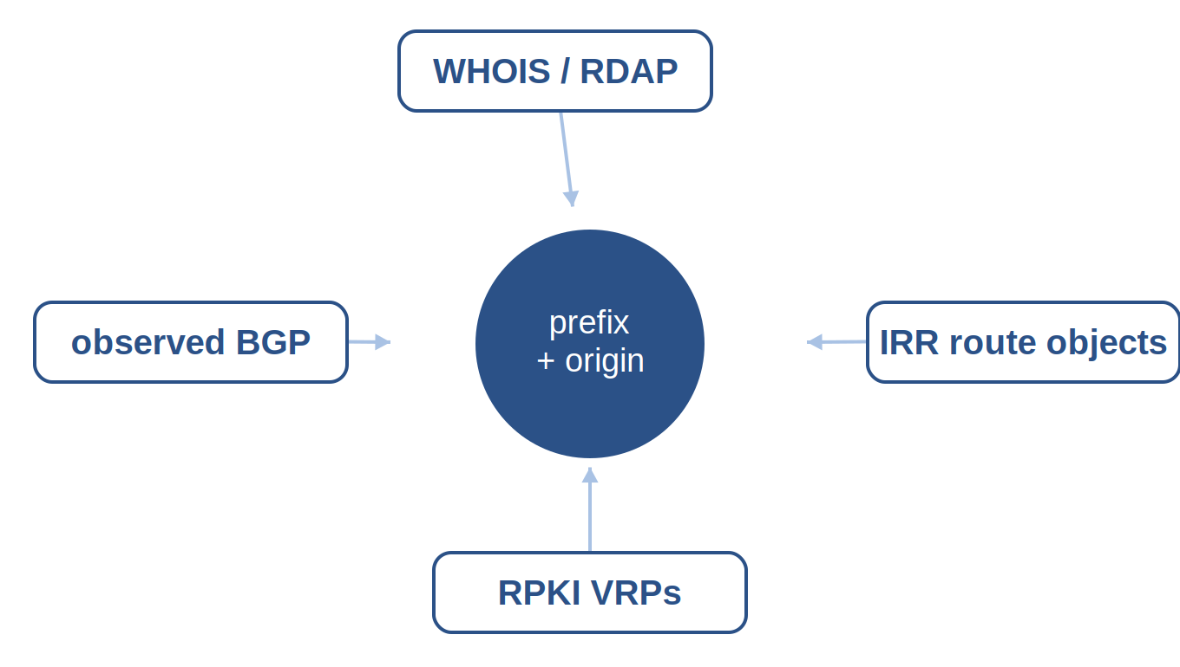


ESCALATE TRAINING PROGRAM · SUMMER 2026
Registries: WHOIS, IRR & RPKI
Week 3: who holds address space, who's authorized to route it, and how registries agree, disagree, and reveal routing risk.
PLENARY
INSTRUCTOR
SENIOR MENTORS
PROGRAM CONTACT
Tue Jun 30 · 12:00 PT
kc claffy
Ricky Mok · Bradley Huffaker · Ben Du
Alex Ma
Supported by the NSF ESCALATE project · OAC-2519416

Slide 2
THE ARC
WEEK 3 · BUILDING BLOCK 3 / 10
Ten building blocks — you are here
1
2
3
4
5
Internet structure & ASNs
BGP at scale
Registries: WHOIS / IRR / RPKI
Traceroute, ITDK
DNS
6
7
8
9
10
Geolocation
Network telescope
Data fusion (IYP)
Degradation forensics
SDSC hackathon
Weeks 1–8 build one block at a time; weeks 9–10 integrate them into a full forensic pipeline.
ESCALATE Training Program · Summer 2026

Slide 3
LAST WEEK · RECAP
WEEK 3 · BUILDING BLOCK 3 / 10
Last week: BGP at scale
You pulled prefix-origin pairs from real BGP tables
(RouteViews / RIS via BGPKit).
You saw MOAS, AS relationships, and customer cones at global scale.
Open question: a BGP origin is what's announced — but is it authorized?
THIS WEEK BUILDS ON IT
This week adds the authorization layer: who is allowed to originate a prefix, per the registries.
ESCALATE Training Program · Summer 2026

Slide 4

PART ONE
01
Who holds it, who may route it
The registries that record who owns address space and who may route it.

Slide 5
WEEK 3 · BUILDING BLOCK 3 / 10
THE QUESTION
A prefix appears in BGP — but is its origin AS authorized to announce it?
ESCALATE Training Program · Summer 2026

Slide 6
WHY THIS MATTERS · THE BIG PICTURE
WEEK 3 · BUILDING BLOCK 3 / 10
One piece of the degradation puzzle
Ultimate goal: understanding Internet dynamics
    e.g., attributing a country's connectivity degradation to a root cause.
That's hard — no single dataset shows cause; you assemble evidence.
Registries are the ownership / authorization layer
Traceroute, DNS, and geolocation are other dimensions (later in course)
ESCALATE Training Program · Summer 2026

Slide 7
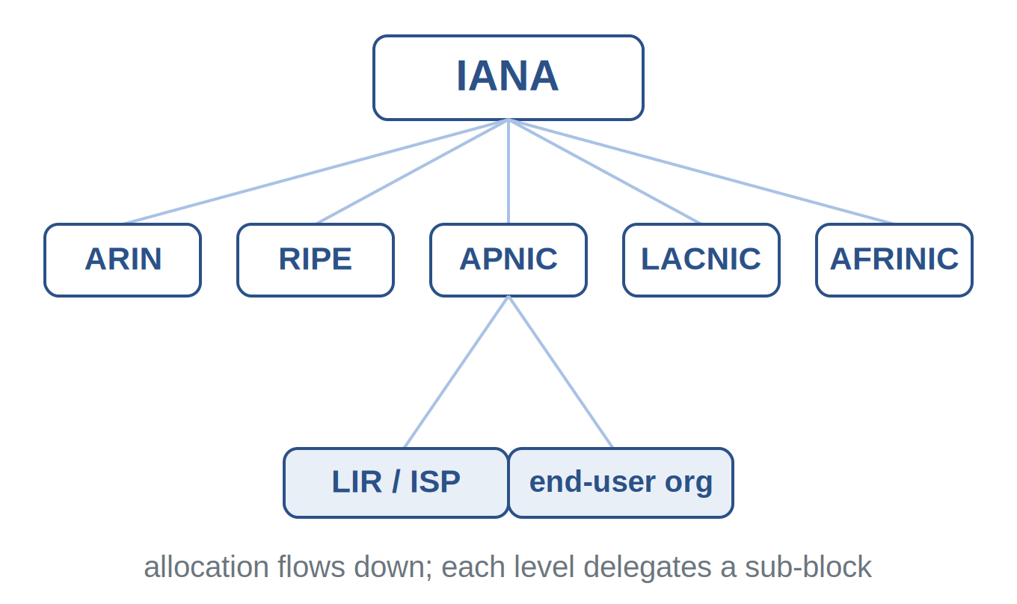
REGISTRIES · DELEGATION
WEEK 3 · BUILDING BLOCK 3 / 10
Number resources flow down a hierarchy
Number resource: block of IP addresses or an AS number.
IANA delegates to five RIRs; RIRs delegate to LIRs or orgs.
Each level records who holds what.
IANA → RIR → LIR / end-user org
ESCALATE Training Program · Summer 2026

Slide 8
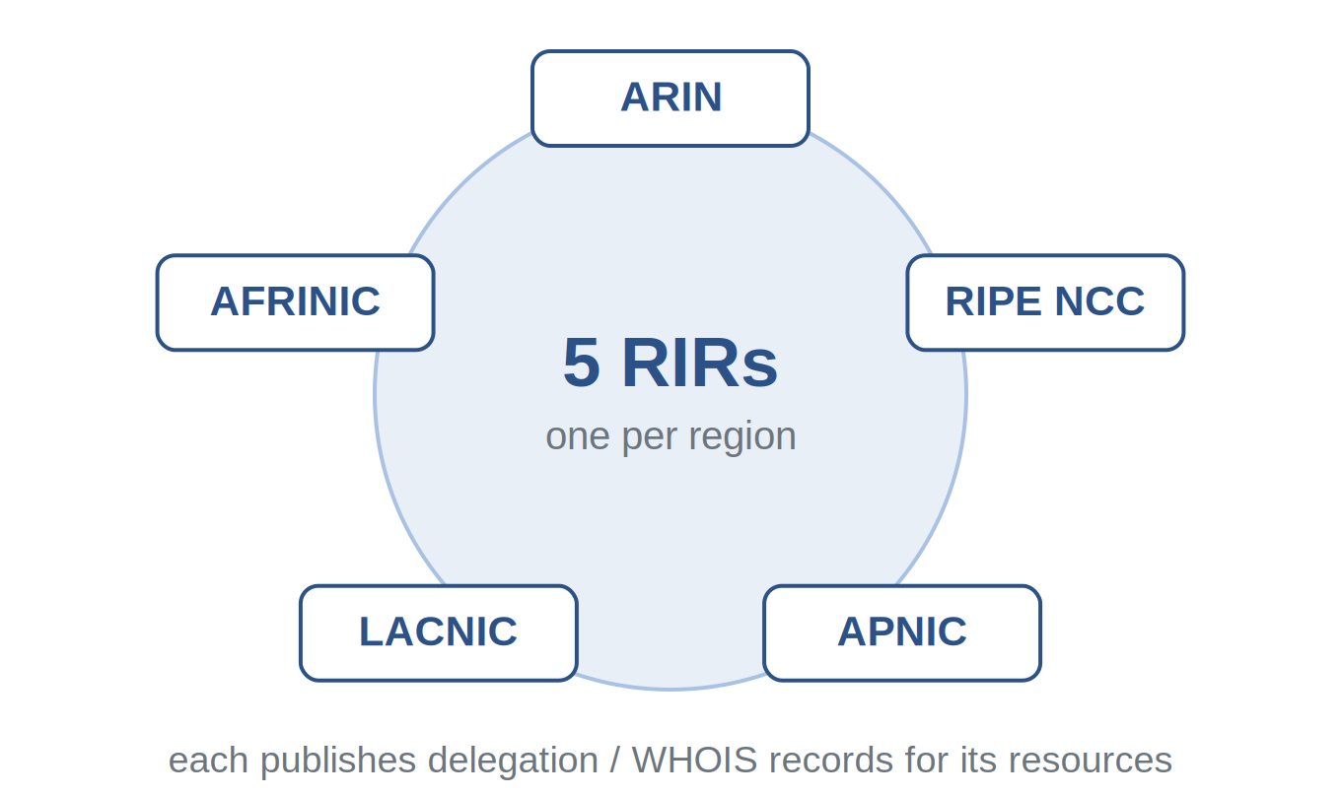
REGISTRIES · RIRs
WEEK 3 · BUILDING BLOCK 3 / 10
Five Regional Internet Registries
ARIN, RIPE NCC, APNIC, LACNIC, AFRINIC — one per region.
Each publishes WHOIS / RDAP and daily delegated-stats files..
ESCALATE Training Program · Summer 2026

Slide 9
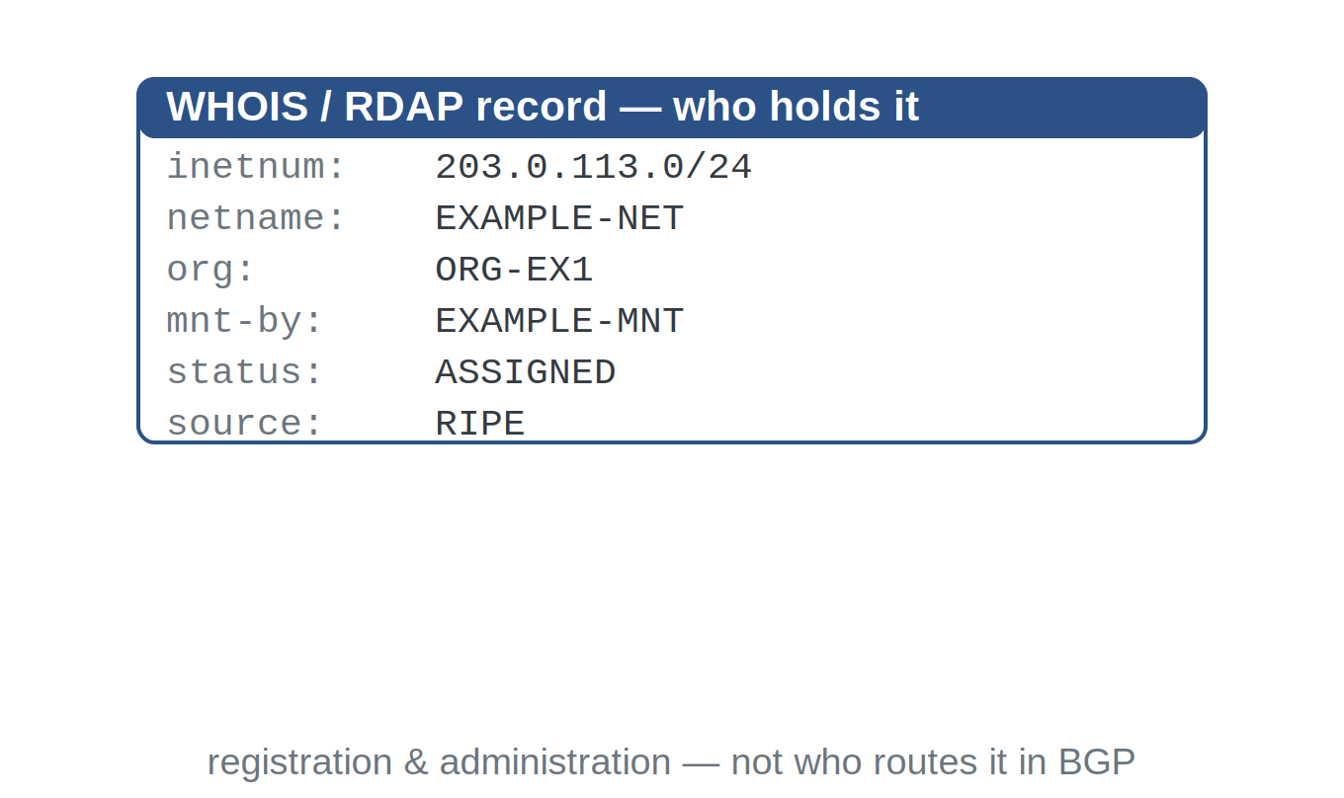
REGISTRIES · WHOIS
WEEK 3 · BUILDING BLOCK 3 / 10
WHOIS: who registered the space
Query a prefix or ASN; get the holder, org, and maintainer.
It records registration and administration — not who routes it.
Free-text format varies by RIR, which makes parsing painful.
ESCALATE Training Program · Summer 2026

Slide 10
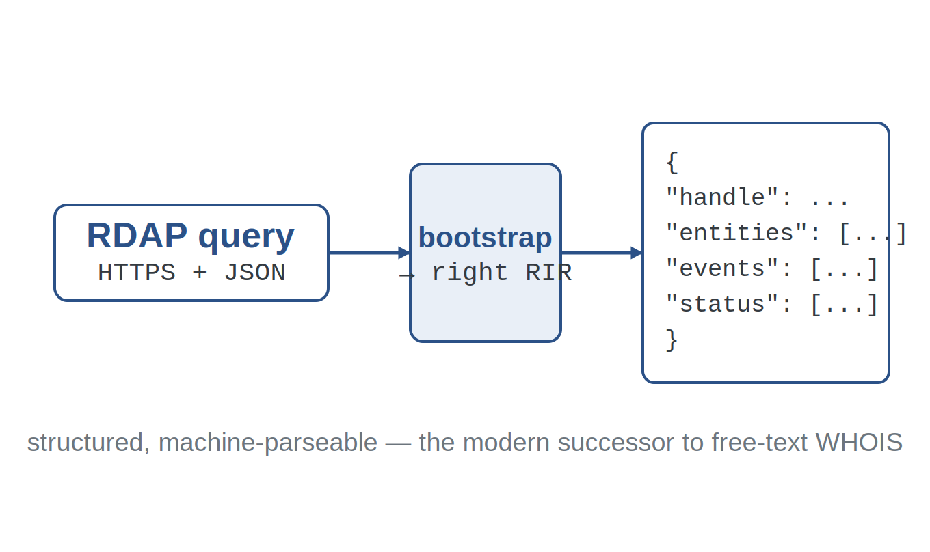
REGISTRIES · RDAP
WEEK 3 · BUILDING BLOCK 3 / 10
RDAP: the structured successor
Same data as WHOIS
But over HTTPS as machine-readable JSON.
Bootstrapping routes query to the authoritative RIR.
Structured fields mean you can script lookups reliably.
RDAP query → JSON you can parse
ESCALATE Training Program · Summer 2026

Slide 11
WHOIS VS RDAP
WEEK 3 · BUILDING BLOCK 3 / 10
Same facts, two access methods
WHOIS
RDAP
legacy · free text
HTTPS · JSON
Port-43 text; format differs per registry.
Human-readable, but brittle to parse at scale.
Bootstrapped to the right RIR automatically.
Structured fields; reliable for scripting.
ESCALATE Training Program · Summer 2026

Slide 12
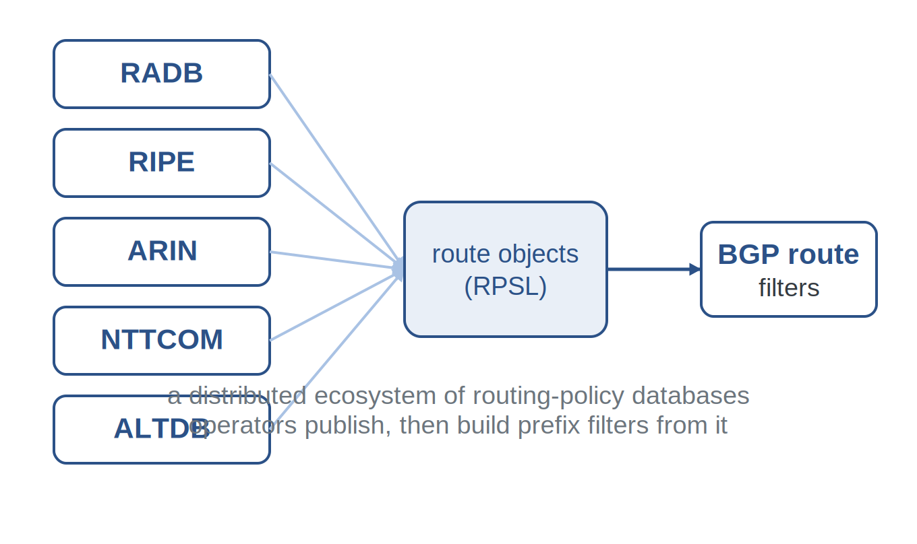
REGISTRIES · IRR
WEEK 3 · BUILDING BLOCK 3 / 10
The Internet Routing Registry
A set of databases where operators publish routing policy.
Written in RPSL; route objects say which AS originates a prefix.
Operators turn these into prefix filters that accept/reject routes.
many IRR databases → route filters
ESCALATE Training Program · Summer 2026

Slide 13
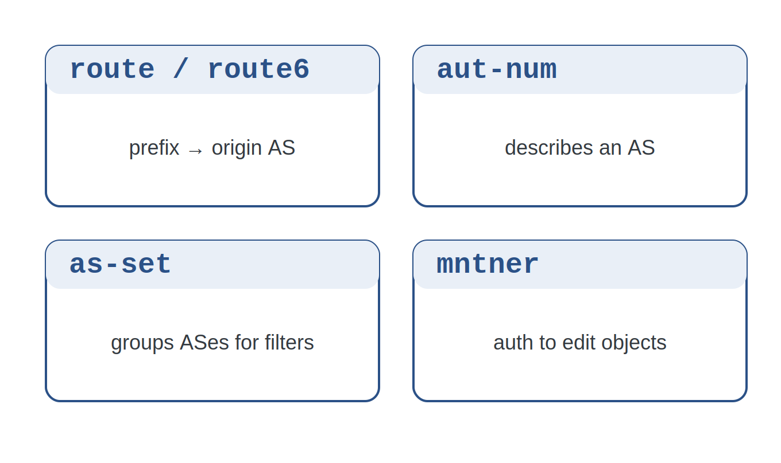
REGISTRIES · IRR OBJECTS
WEEK 3 · BUILDING BLOCK 3 / 10
The objects you'll actually parse
route / route6 — bind a prefix to an origin AS (key object).
aut-num describes an AS; as-set groups ASes for filters.
mntner holds the authorization to edit related objects.
core RPSL object types
ESCALATE Training Program · Summer 2026

Slide 14
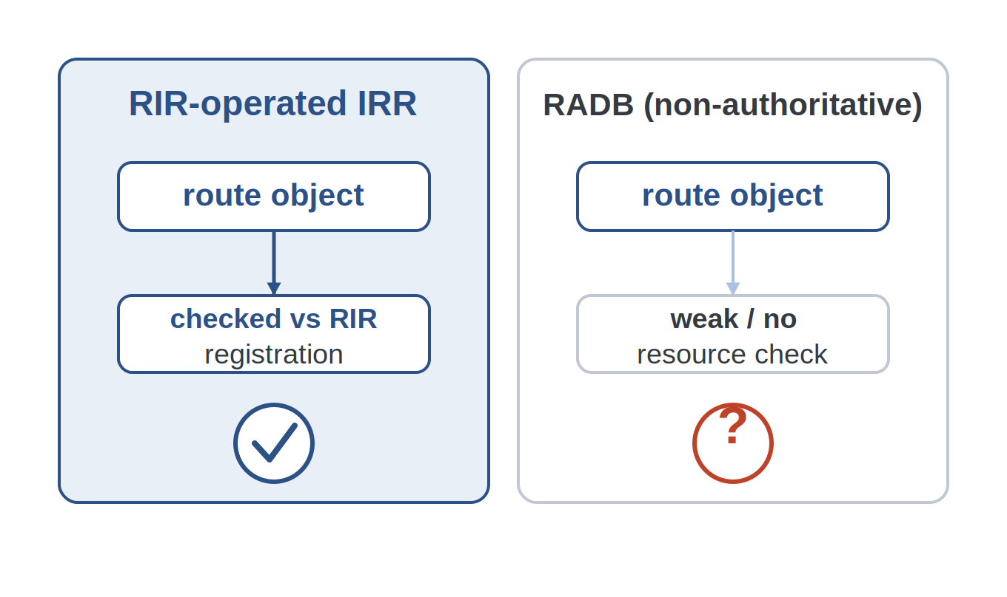
REGISTRIES · IRR TRUST
WEEK 3 · BUILDING BLOCK 3 / 10
Not all IRR data is equally trustworthy
Authoritative IRRs: run by an RIR; check registration.
Non-authoritative IRRs (e.g., RADB) accept loosely-validated objects.
So a route object's source matters when you judge it.
ESCALATE Training Program · Summer 2026

Slide 15
AUTHORITATIVE VS RADB
WEEK 3 · BUILDING BLOCK 3 / 10
Where an IRR object comes from matters
RADB et al.
RIR-operated IRR
non-authoritative
authoritative
Anyone can register; weak resource checks.
Stale objects can linger for years.
Validated against the RIR's own registration.
Higher confidence the origin is real.
ESCALATE Training Program · Summer 2026

Slide 16
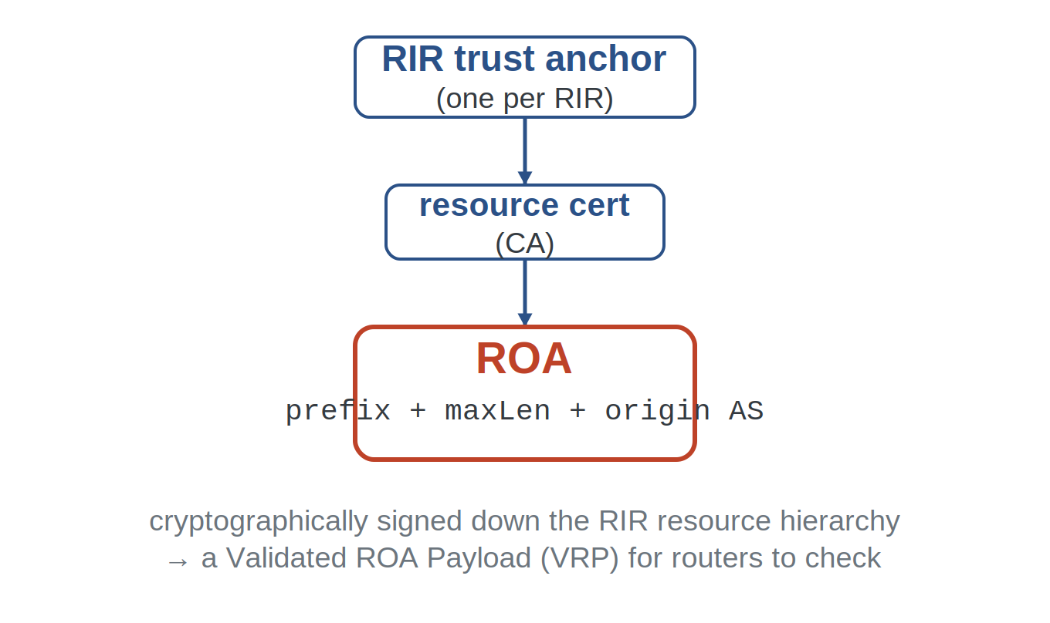
RPKI · FROM SCRATCH
WEEK 3 · BUILDING BLOCK 3 / 10
RPKI: cryptographic route authorization
RIRs act as trust anchors and sign certificates for resources.
A holder issues a ROA: 'AS X may originate this prefix.'
ROAs become VRPs that routers check — no trust in free text.
trust anchor → certificate → ROA
ESCALATE Training Program · Summer 2026

Slide 17
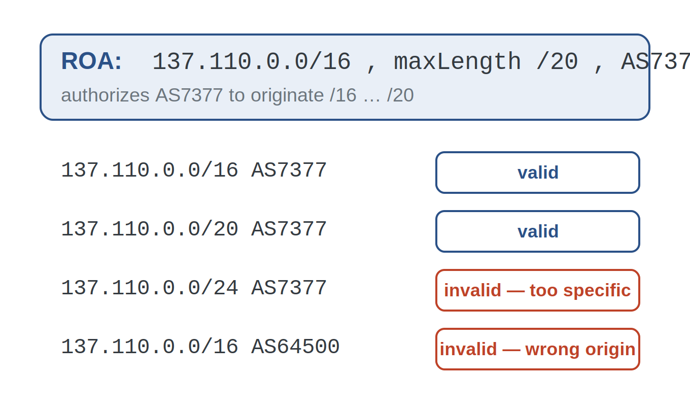
RPKI · ROA & MAXLENGTH
WEEK 3 · BUILDING BLOCK 3 / 10
A ROA authorizes an origin and a length
A ROA = (prefix, maxLength, origin AS).
maxLength caps how specific an announcement may be.
Example:
  137.110.0.0/16, maxLength /20, AS7377 — a /24 is invalid.
one ROA, four announcements judged
ESCALATE Training Program · Summer 2026

Slide 18
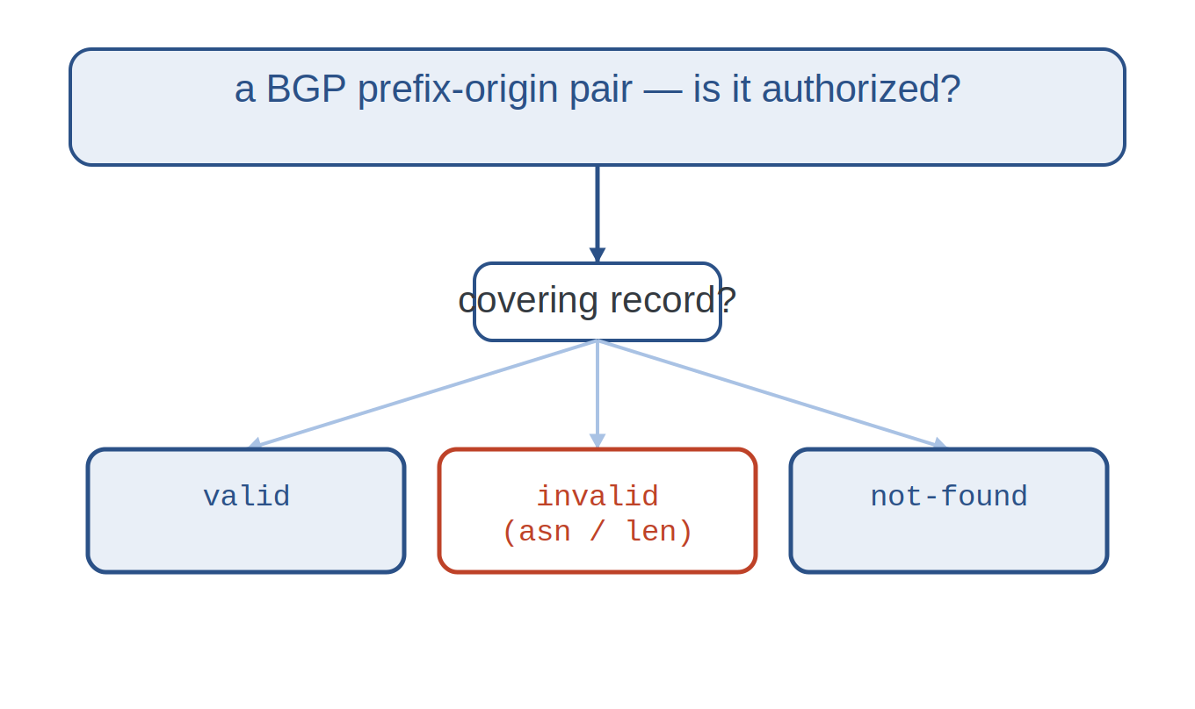
RPKI · ROV
WEEK 3 · BUILDING BLOCK 3 / 10
Validating an announcement (ROV)
Routers compare each prefix-origin to the covering VRPs.
Outcomes: valid, invalid (wrong AS or too long), or not-found.
not-found ≠ invalid — most space simply has no ROA yet.
ROV: valid / invalid / not-found
ESCALATE Training Program · Summer 2026

Slide 19
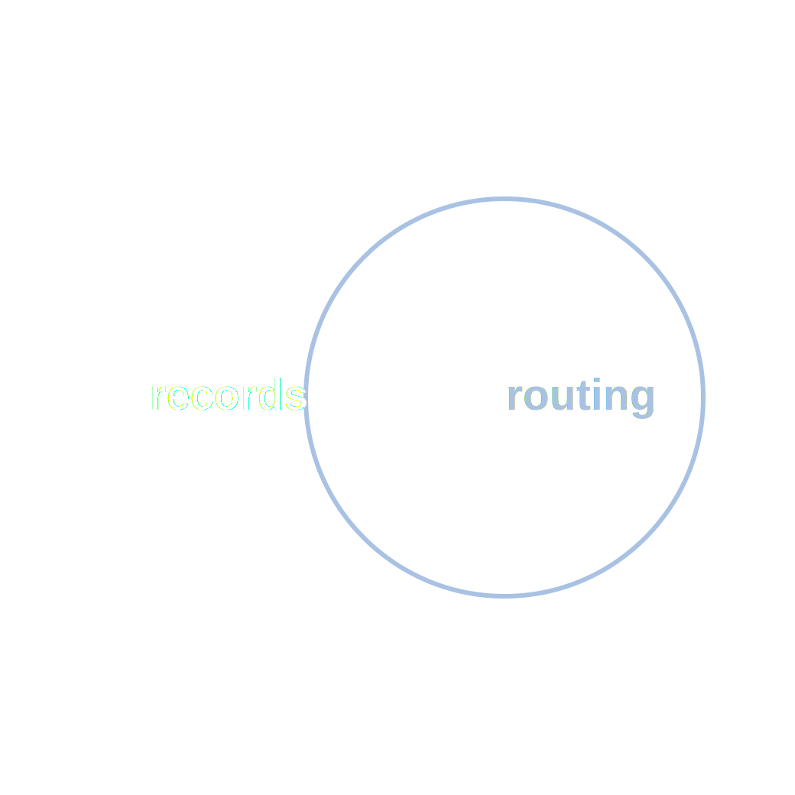
PART ONE
02
Where records meet routing
How registration, authorization, and observed BGP line up — or don't.

Slide 20
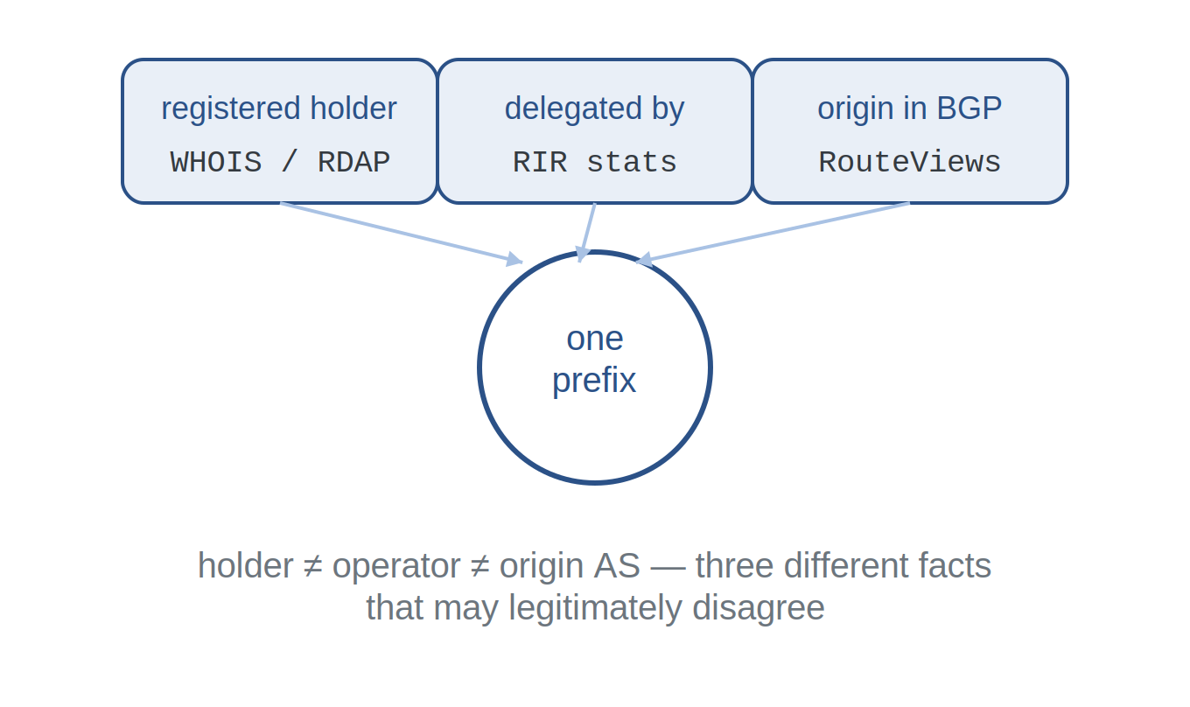
RECORDS VS ROUTING
WEEK 3 · BUILDING BLOCK 3 / 10
Three different facts about one prefix
Registered holder (WHOIS / RDAP) — who owns the space.
Authorized origin (RPKI / IRR) — who may announce it.
Observed origin (BGP) — who actually announces it.
ESCALATE Training Program · Summer 2026

Slide 21
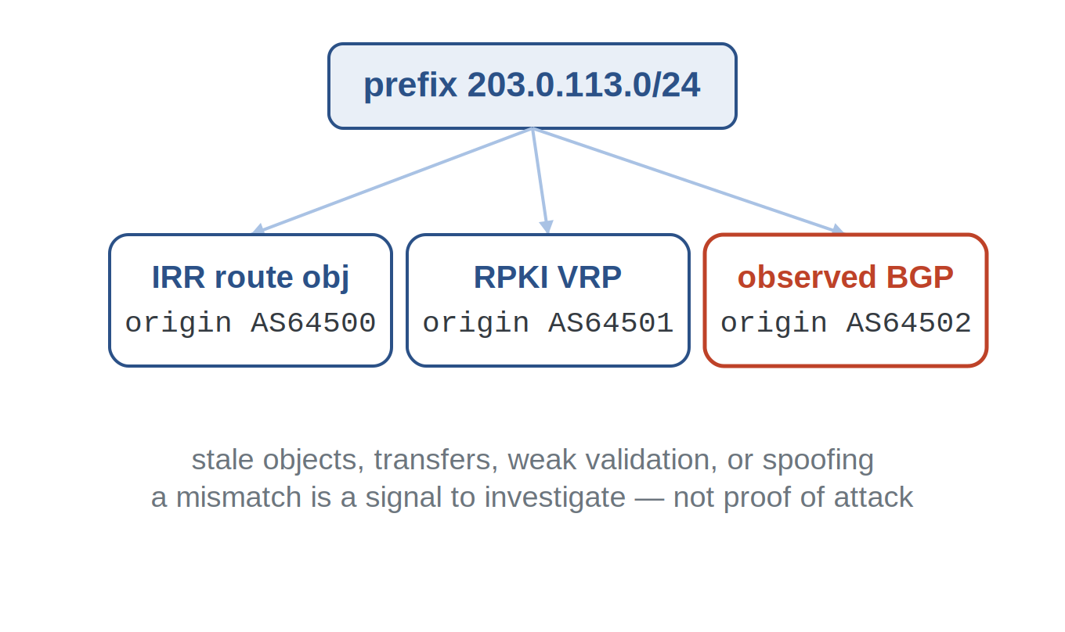
RECORDS VS ROUTING
WEEK 3 · BUILDING BLOCK 3 / 10
Why the sources disagree
Records go stale; transfers and reassignments lag.
Weak IRR validation lets wrong or old objects persist.
And deliberate hijacks announce space the AS doesn't hold.
ESCALATE Training Program · Summer 2026

Slide 22
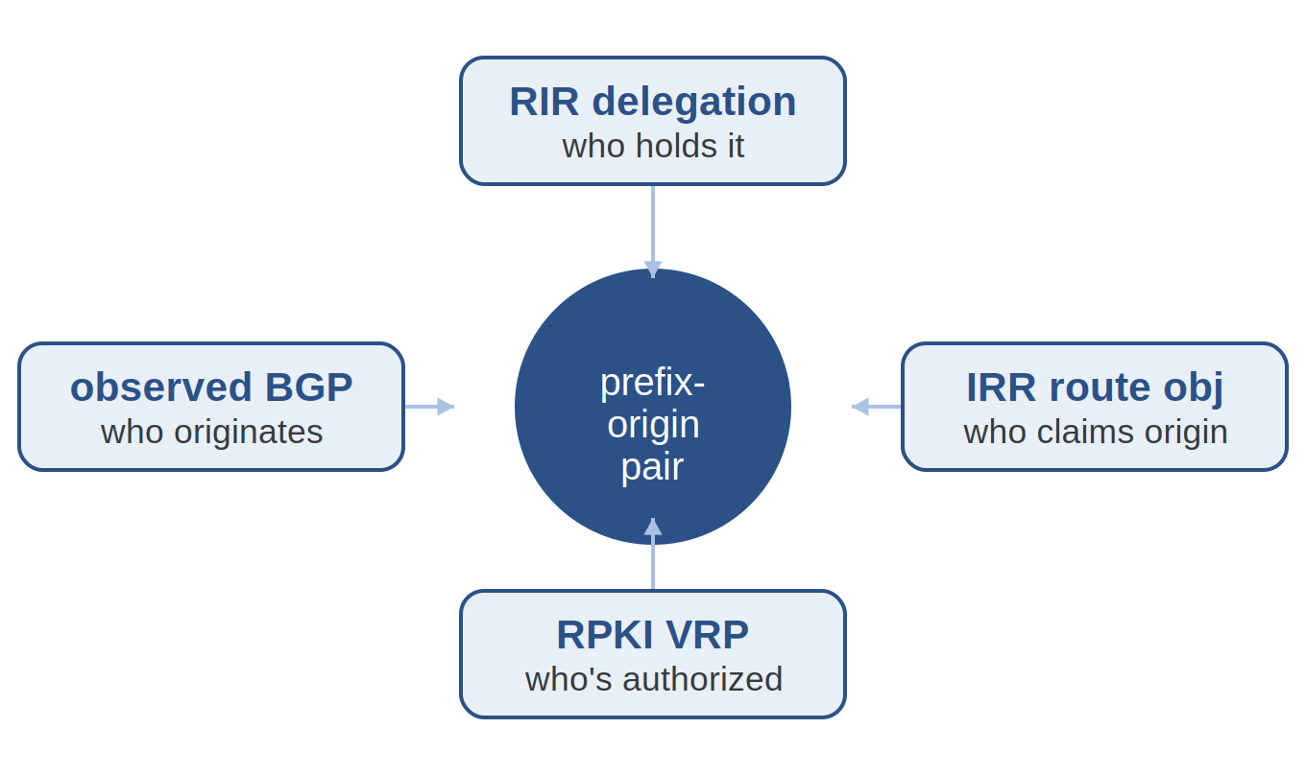
RECORDS VS ROUTING
WEEK 3 · BUILDING BLOCK 3 / 10
Four views of one prefix-origin
RIR delegation: who the space is delegated to.
IRR route object: who claims to originate it.
RPKI VRP: who is authorized; BGP: who originates it.
ESCALATE Training Program · Summer 2026

Slide 23
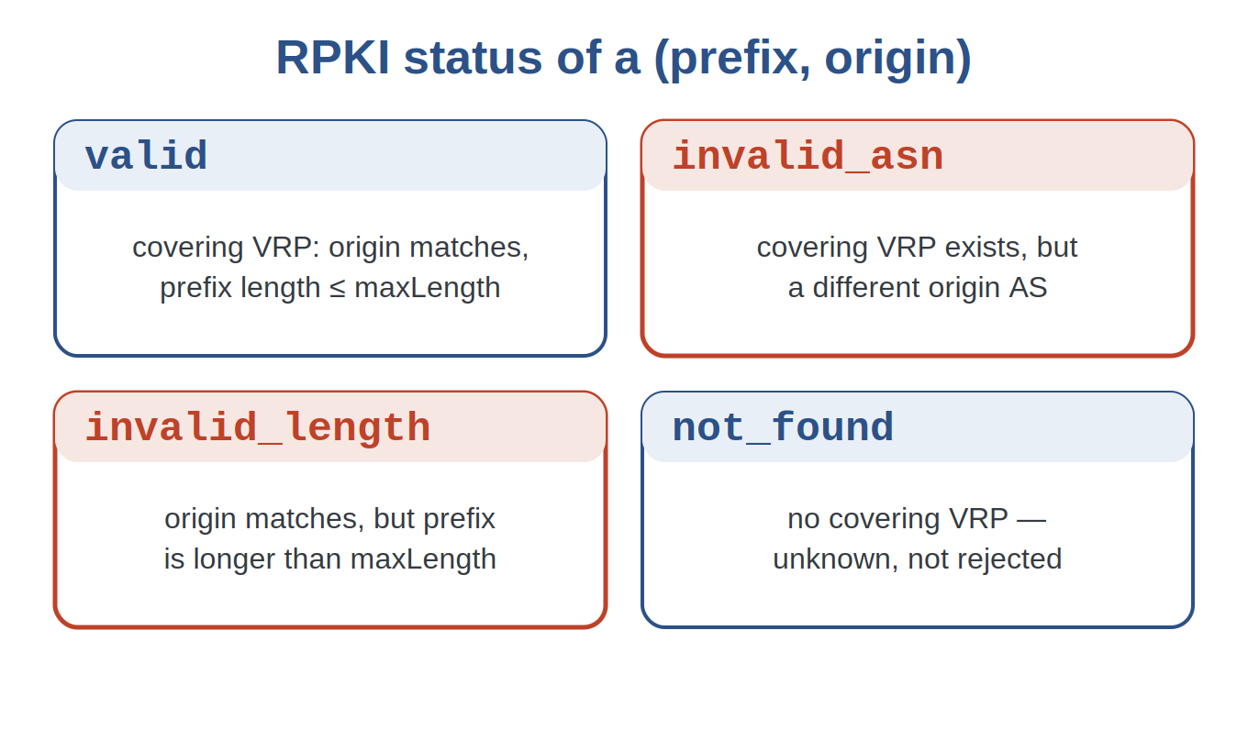
RPKI · STATUS
WEEK 3 · BUILDING BLOCK 3 / 10
The four RPKI statuses, precisely
valid: a covering VRP matches origin and length.
invalid_asn / invalid_length: covered, but wrong AS or too specific.
not_found: no covering VRP — unknown, not rejected.
ESCALATE Training Program · Summer 2026

Slide 24
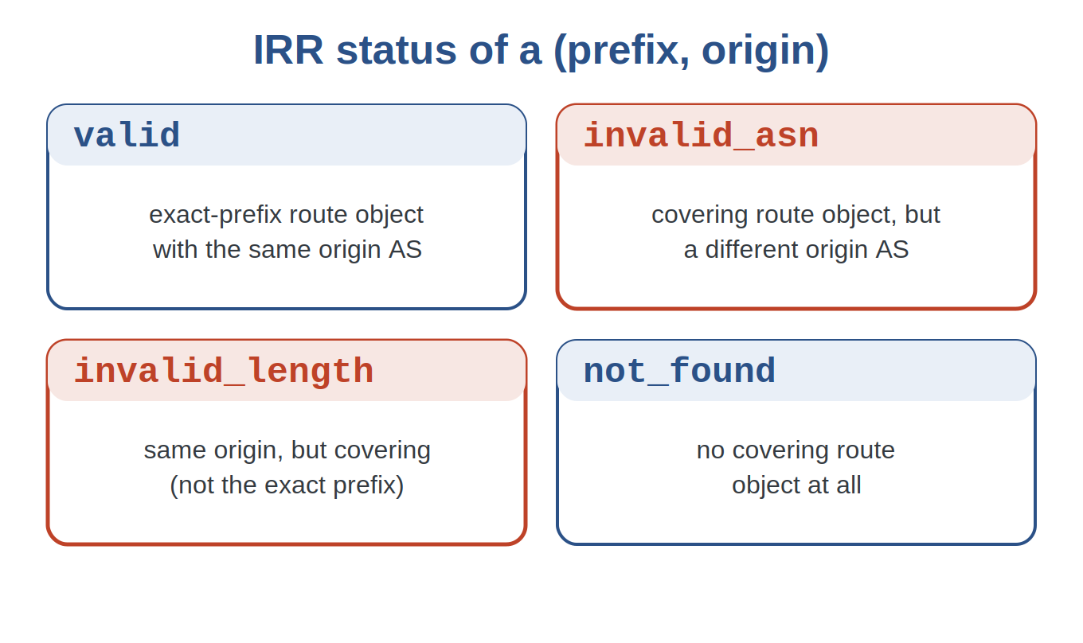
IRR · STATUS
WEEK 3 · BUILDING BLOCK 3 / 10
The four IRR statuses, precisely
valid: an exact-prefix route object with the same origin AS.
invalid_asn / invalid_length: covered, but wrong AS or only a covering prefix.
IRR has no maxLength — only the exact prefix counts as valid.
IRR status taxonomy
ESCALATE Training Program · Summer 2026

Slide 25
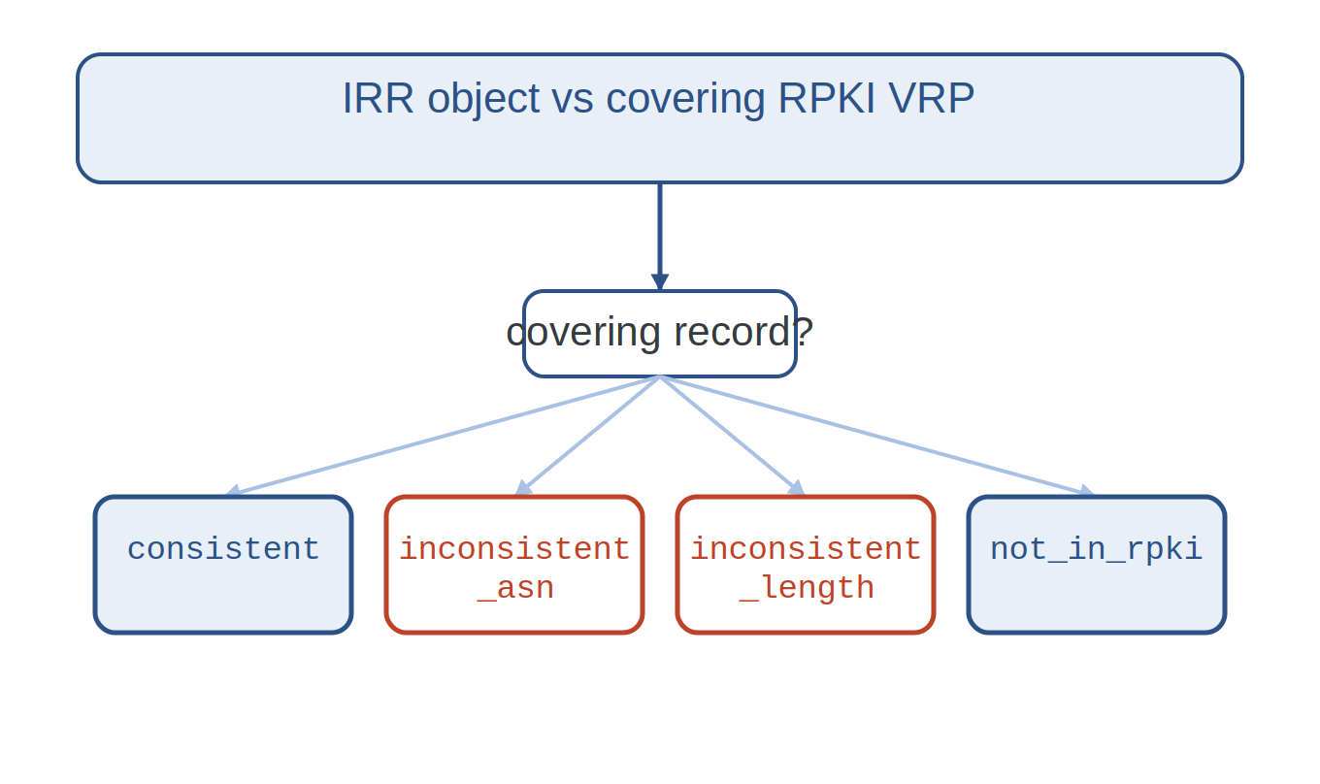
IRR ↔ RPKI
WEEK 3 · BUILDING BLOCK 3 / 10
Do IRR and RPKI agree?
For a route object, find the covering RPKI VRP.
consistent, inconsistent_asn, inconsistent_length, or not_in_rpki.
Disagreement between the two is exactly what Task 3A measures.
ESCALATE Training Program · Summer 2026

Slide 26
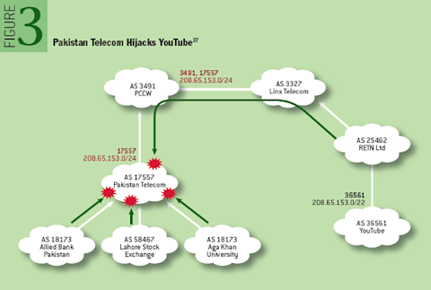
CASE STUDY
WEEK 3 · BUILDING BLOCK 3 / 10
YouTube / Pakistan Telecom hijack — Feb 24, 2008
SETUP
YouTube announced 208.65.152.0/22; the world routed to it normally.
WHAT HAPPENED
AS17557 announced a more-specific /24; the leak spread worldwide.
WHAT THE DATA SHOWED
Longest-prefix-match pulled YouTube traffic worldwide for ~2 hours — origin validation (ROV) would have flagged the bogus origin.
Kentik, 'A Brief History of the Internet's Biggest BGP Incidents' (Madory).
ESCALATE Training Program · Summer 2026

Slide 27
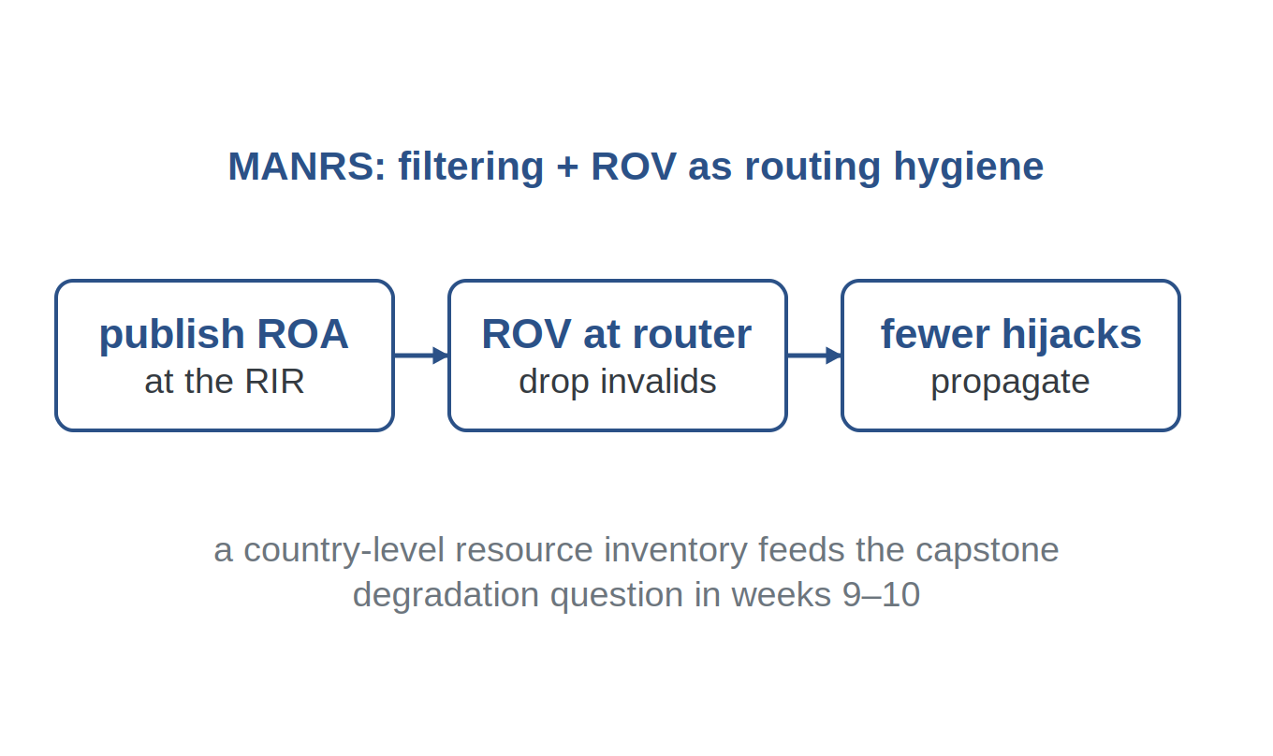
WHY IT MATTERS
WEEK 3 · BUILDING BLOCK 3 / 10
From records to routing security
Publish ROAs; enforce ROV to drop invalid announcements.
MANRS bundles this as basic routing hygiene for operators.
ROAs + ROV → fewer propagated hijacks
ESCALATE Training Program · Summer 2026

Slide 28
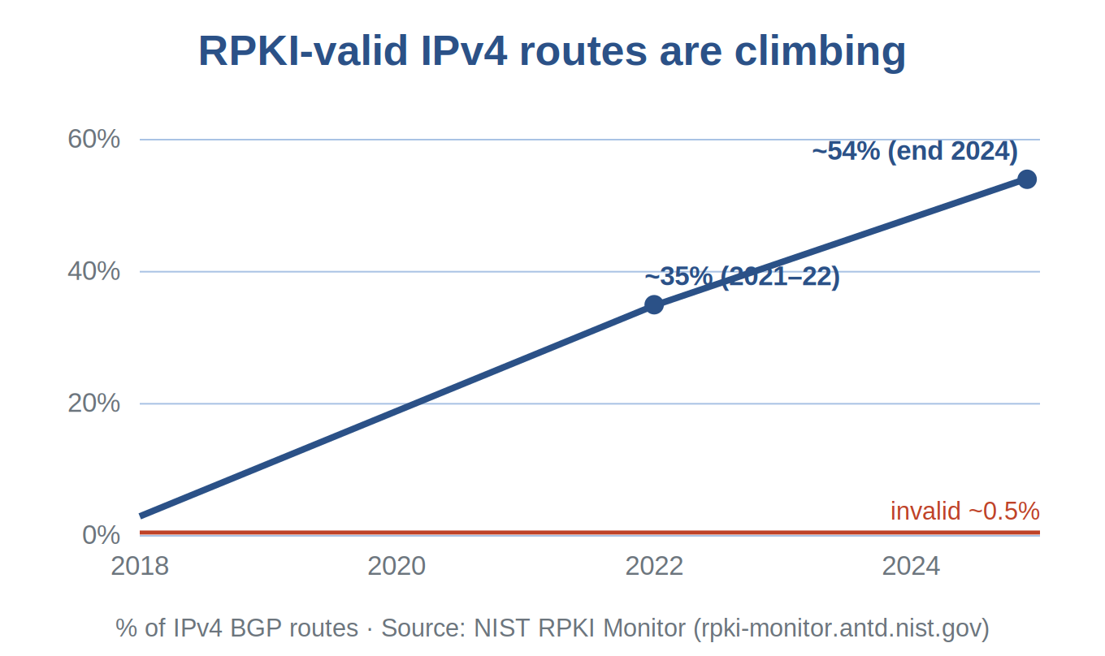
WHY IT MATTERS · ADOPTION
WEEK 3 · BUILDING BLOCK 3 / 10
RPKI coverage is climbing
RPKI-valid IPv4 routes rose from ~35% (2021–22) to ~54% (end 2024).
Persistently invalid stays tiny — about half a percent.
The rest are not-found: no ROA yet, which is not a rejection.
ESCALATE Training Program · Summer 2026

Slide 29
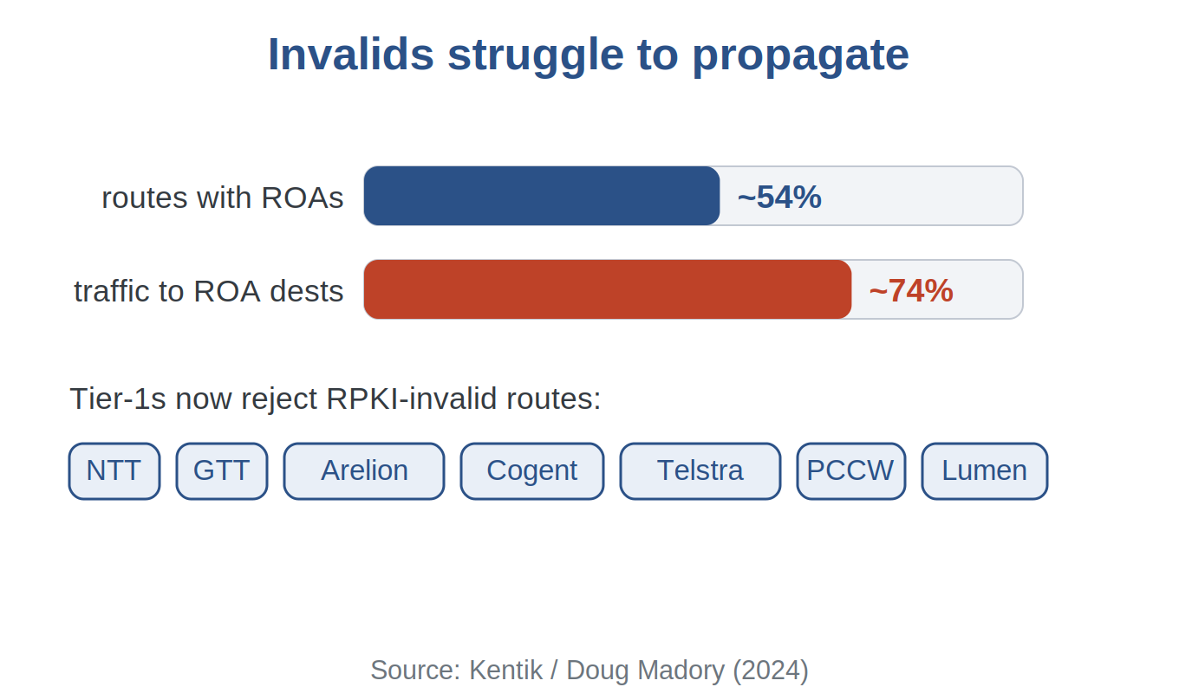
WHY IT MATTERS · IMPACT
WEEK 3 · BUILDING BLOCK 3 / 10
Invalids struggle to propagate
Kentik estimates ~74% of IP traffic goes to ROA-covered destinations.
Major transit providers now drop RPKI-invalid routes.
So a bogus origin spreads far less easily than in 2008.
ESCALATE Training Program · Summer 2026

Slide 30
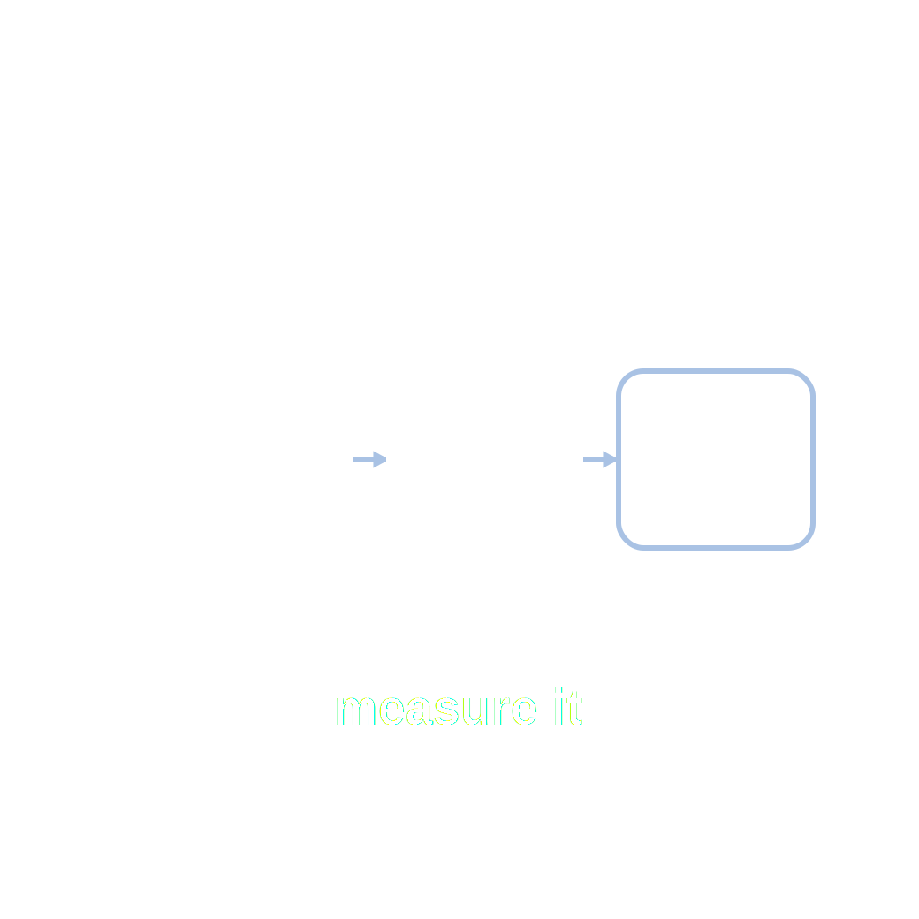
PART ONE
03
Measuring it: the assignment
Classify every prefix-origin against IRR and RPKI, and watch the disagreement over time.

Slide 31
WHAT YOU'LL WORK WITH
WEEK 3 · BUILDING BLOCK 3 / 10
Three inputs, fetched at run time
IRR route objects
FILES
RPSL dumps from 16 IRR databases, one file per source per day — 15 return data for the sample day.
<source>.db.gz
RPKI VRPs
FILE
Validated ROA payloads from all five RIR trust anchors (RIPE archive).
roas.csv.xz
ESCALATE Training Program · Summer 2026

Slide 32
WHAT YOU'LL WORK WITH
WEEK 3 · BUILDING BLOCK 3 / 10
BGP ground truth, and the sample day
RouteViews pfx2as
FILE
Observed BGP prefix-origin; multi-origin rows split into separate pairs.
*.pfx2as.gz
Sample day 2023-03-01
CACHE
~2M IRR objects, ~400K VRPs, ~1M BGP pairs. Parsed files cached locally.
cache_nids/
ESCALATE Training Program · Summer 2026

Slide 33
ACTION REQUIRED · WEEK 3 SETUP
WEEK 3 · BUILDING BLOCK 3 / 10
Get onto NRP before the hands-on hour
1
Sign in. Log in at nrp.ai with your institutional identity.
2
Request access. Email training-program-info@caida.org to be added.
3
Join the namespace. You'll be added to caida-nids on NRP.
4
Launch & open. Start a JupyterHub server (2 cores, 32 GB, SciPy) and open the notebook — ask on Mattermost if stuck.
ESCALATE Training Program · Summer 2026

Slide 34
METHODOLOGY
WEEK 3 · BUILDING BLOCK 3 / 10
How the comparison is built
Source
IRR · RPKI · BGP
↓
Each day: load IRR, RPKI, and BGP; normalize to (prefix, origin) pairs; look up covering records in a radix tree; classify each pair.
Build
radix trees
↓
Classify
per pair
KNOW THE LIMITS
↓
Coverage is partial — many prefixes have no ROA or route object, so not_found / not_in_rpki is common and is not the same as 'wrong'.
Result
fractions / trend
ESCALATE Training Program · Summer 2026

Slide 35
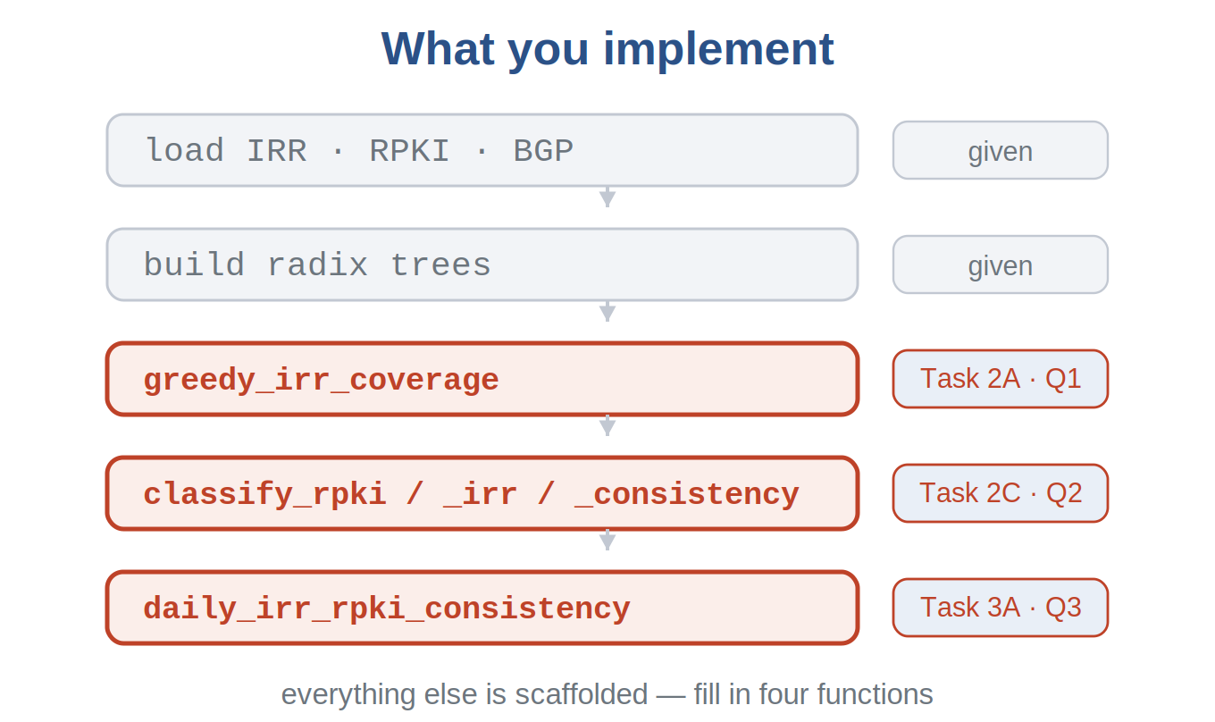
HANDS-ON · WHAT YOU IMPLEMENT
WEEK 3 · BUILDING BLOCK 3 / 10
You fill in four functions
greedy_irr_coverage for the one-day coverage table (Task 2A).
classify_rpki, classify_irr, and the consistency check (Task 2C).
daily_irr_rpki_consistency for the monthly trend (Task 3).
everything else — loading, parsing, trees — is scaffolded
ESCALATE Training Program · Summer 2026

Slide 36
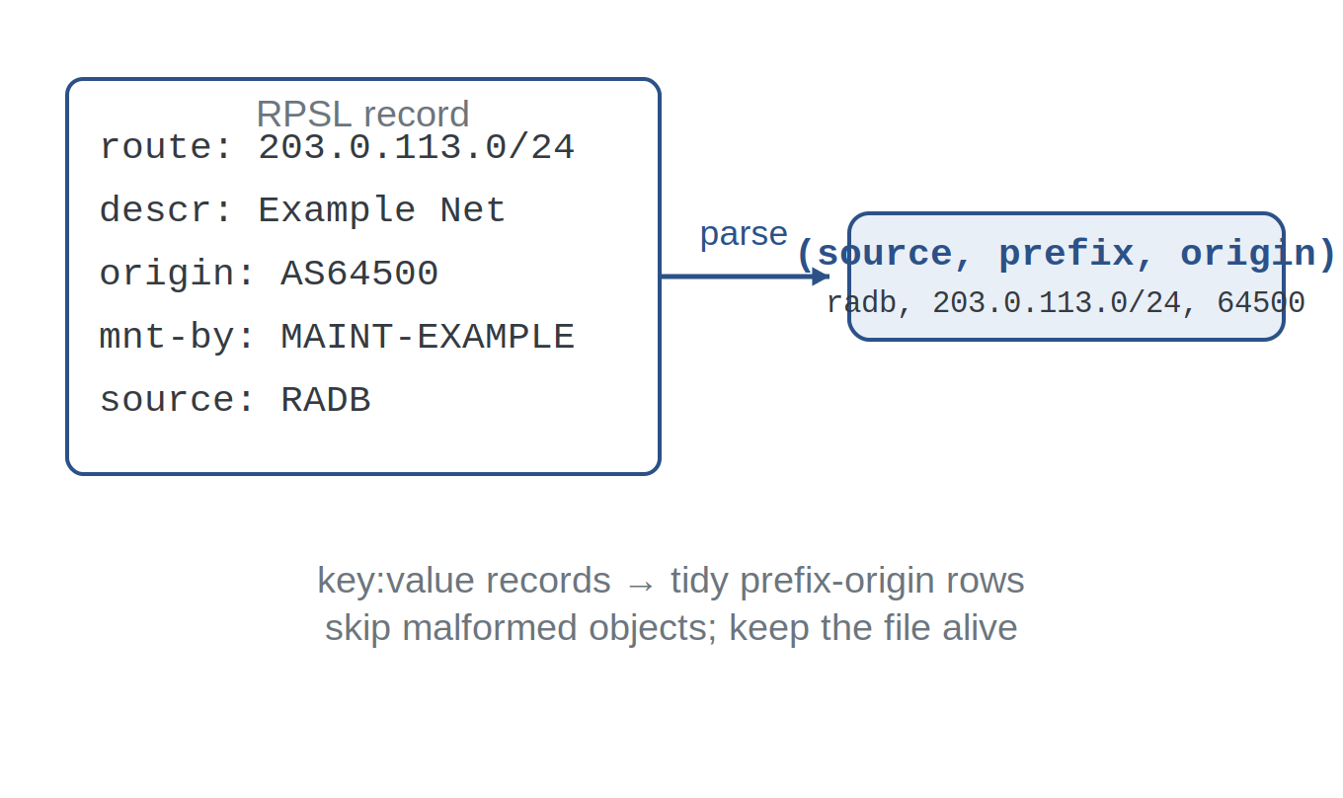
HANDS-ON · PARSE IRR
WEEK 3 · BUILDING BLOCK 3 / 10
From RPSL records to tidy rows
IRR dumps are whois-style key:value records (parser provided).
It pulls route / route6 + origin into (source, prefix, origin) rows.
Malformed objects are skipped so one bad record can't stop the run.
RPSL record → prefix-origin row
ESCALATE Training Program · Summer 2026

Slide 37
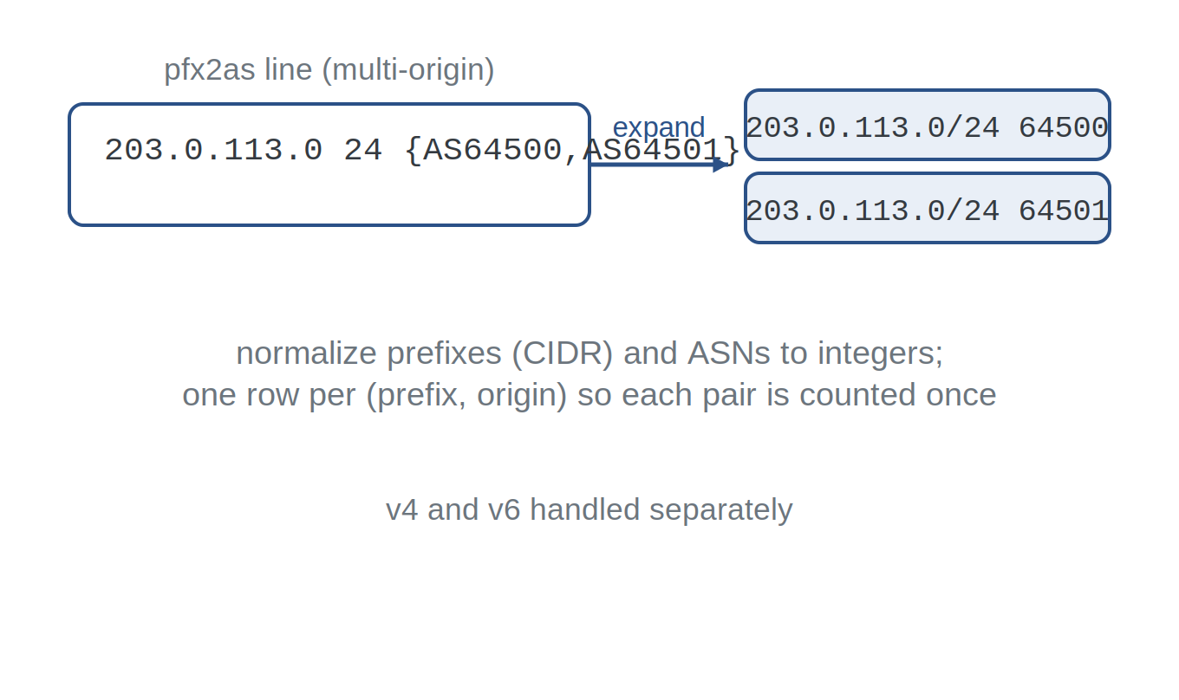
HANDS-ON · NORMALIZE
WEEK 3 · BUILDING BLOCK 3 / 10
Make everything comparable
Prefixes normalized to CIDR; ASNs to integers.
pfx2as multi-origin rows expand to one row per origin.
IPv4 and IPv6 are handled separately throughout.
one row per (prefix, origin)
ESCALATE Training Program · Summer 2026

Slide 38
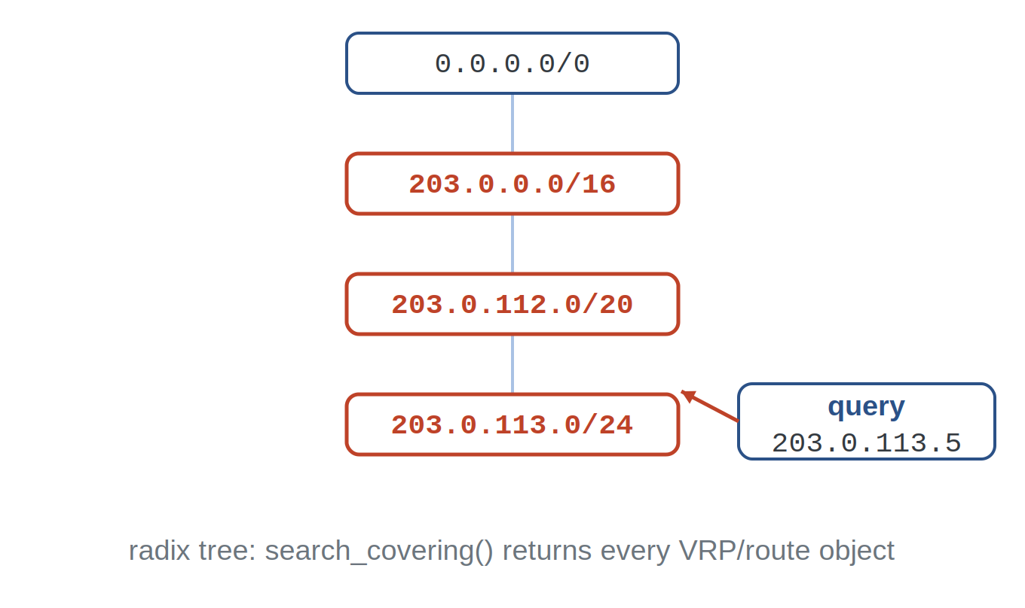
HANDS-ON · RADIX TREES
WEEK 3 · BUILDING BLOCK 3 / 10
Covering-prefix lookups, fast
Validation needs the covering prefix, not an exact match.
build_vrp_trees / build_irr_trees make one tree per family.
search_covering() returns every covering VRP or route object.
radix tree → covering records
ESCALATE Training Program · Summer 2026

Slide 39
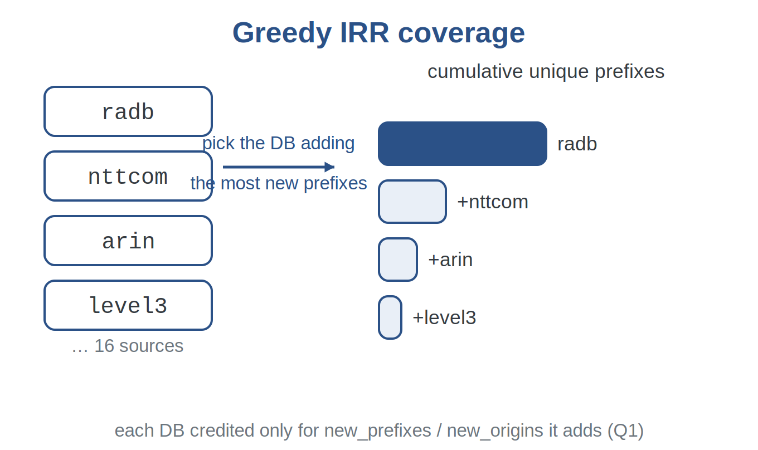
HANDS-ON · TASK 2A
WEEK 3 · BUILDING BLOCK 3 / 10
Which IRR databases cover the most?
Greedily order IRR databases by the new prefixes each one adds.
Credit each database only for prefixes / origins not already covered.
Shows how far RADB outpaces every other source — even NTT, the next-largest non-RIR database, adds only ~7.5% more prefixes (Q1).
greedy IRR coverage
ESCALATE Training Program · Summer 2026

Slide 40
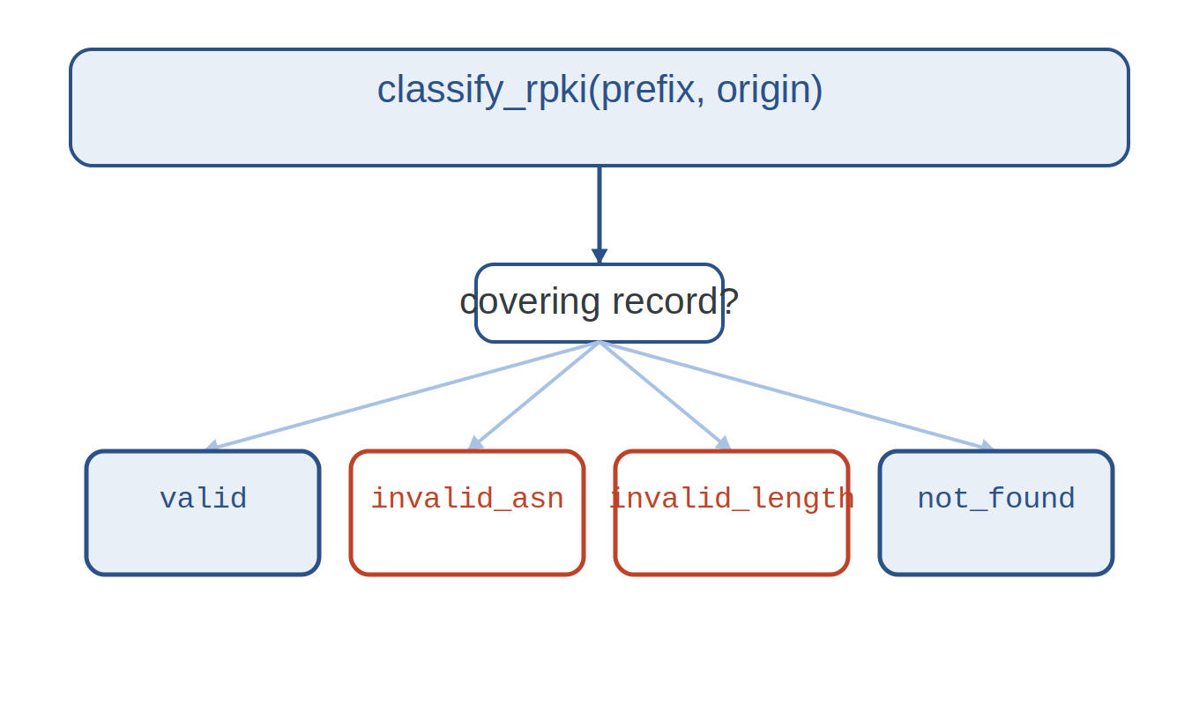
HANDS-ON · classify_rpki
WEEK 3 · BUILDING BLOCK 3 / 10
Implementing RPKI validation (Q2)
Find the covering VRPs for the (prefix, origin).
Same origin and length ≤ maxLength → valid (short-circuit).
Wrong AS → invalid_asn; too long → invalid_length; none → not_found.
classify_rpki: the decision
ESCALATE Training Program · Summer 2026

Slide 41
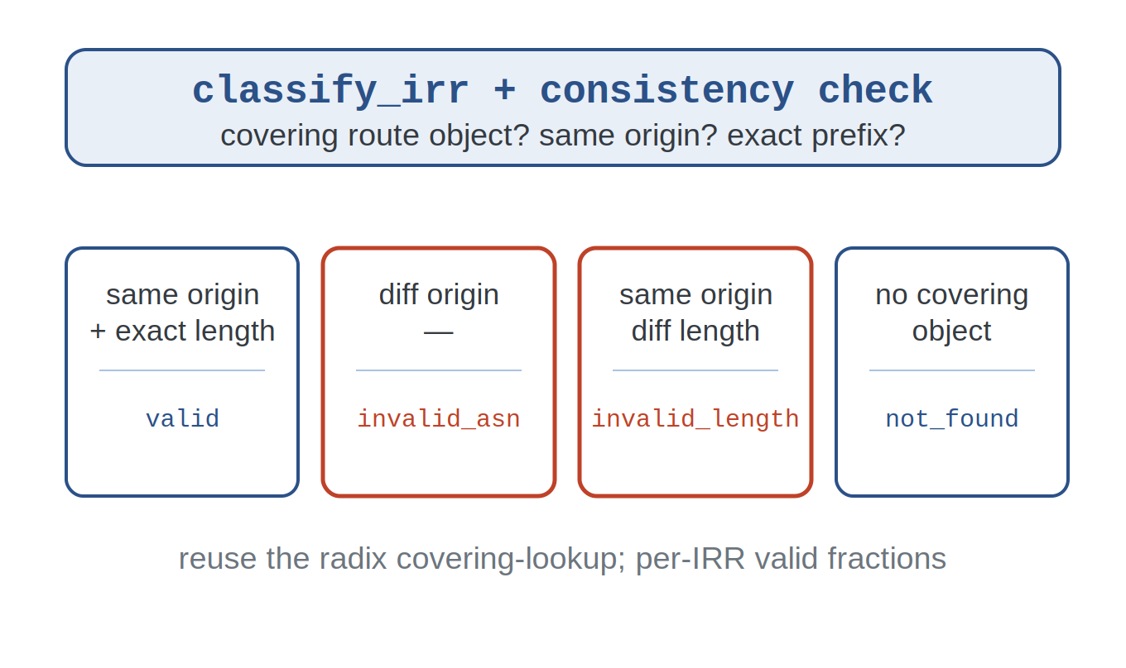
HANDS-ON · classify_irr
WEEK 3 · BUILDING BLOCK 3 / 10
IRR validity + RPKI consistency (Q2)
Reuse the covering lookup against IRR route objects.
Exact prefix + same origin → valid; else invalid_asn / invalid_length.
classify_irr_rpki_consistency compares each IRR pair to its covering VRP.
classify_irr + consistency
ESCALATE Training Program · Summer 2026

Slide 42
ASSIGNMENT · TASK 2B
WEEK 3 · BUILDING BLOCK 3 / 10
Classify one day against each IRR
For 2023-03-01, classify every BGP pair vs each IRR database and vs RPKI.
Report per-source irr_valid_fraction and rpki_valid_fraction.
Compare invalid_asn vs invalid_length, and IRR vs RPKI (Q2).
ESCALATE Training Program · Summer 2026

Slide 43
ASSIGNMENT · TASK 3
WEEK 3 · BUILDING BLOCK 3 / 10
Monthly disagreement, Jan–Jun 2023
Six monthly snapshots; classify each IRR pair against same-day VRPs.
consistent / inconsistent_asn / inconsistent_length / not_in_rpki.
Track the disagreement_fraction across the six months (Q3).
ESCALATE Training Program · Summer 2026

Slide 44
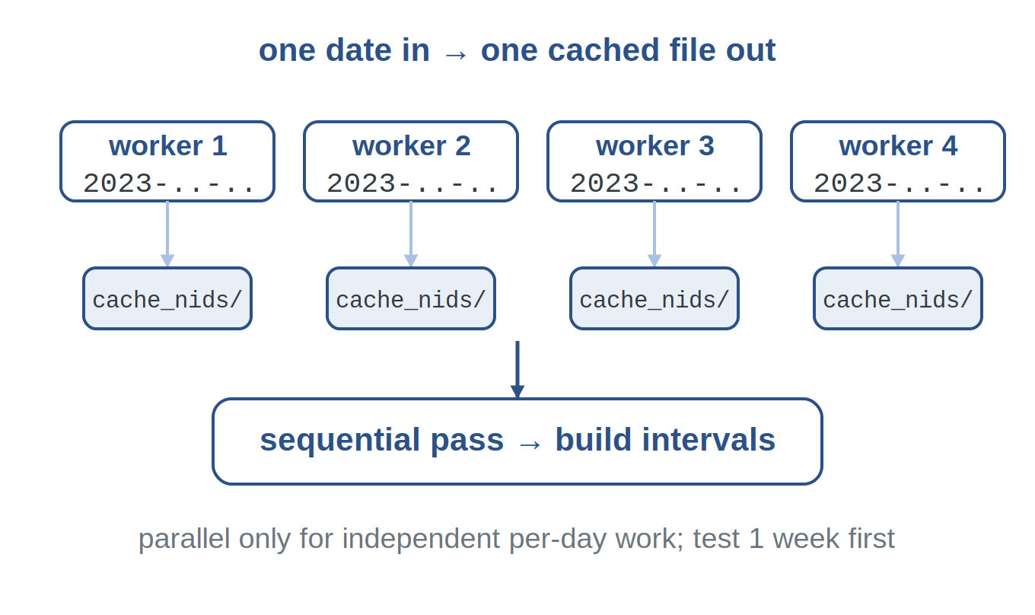
ENGINEERING TIPS
WEEK 3 · BUILDING BLOCK 3 / 10
Make the six-month run survivable
Start on one day or one month before running all six.
Cache parsed daily files; reruns skip what's already done.
Use multiprocessing only for independent per-day fetch and parse.
cache → parallel days → monthly trend
ESCALATE Training Program · Summer 2026

Slide 45
ASSIGNMENT 3 · DUE BEGINNING OF WEEK 4
WEEK 3 · BUILDING BLOCK 3 / 10
nids-irr-rpki-whois
Compare IRR, RPKI, and BGP, then track how IRR–RPKI agreement changes over six months.
MODULE MILESTONE
The registries / routing-authorization section of your own training module.
Task 1: get NRP access and run the notebook end to end.
Task 2: one-day greedy coverage (Q1) and per-source classification (Q2).
Task 3: monthly IRR–RPKI disagreement, Jan–Jun 2023 (Q3).
Finish all notebook tasks and questions
REPOSITORY
github.com/CAIDA/nids-irr-rpki-whois
ESCALATE Training Program · Summer 2026

Slide 46
BEFORE NEXT WEEK
WEEK 3 · BUILDING BLOCK 3 / 10
This week, in five steps
Get NRP access and run the setup cells.
OPTIONAL BACKGROUND
Do Task 2 on 2023-03-01, then Task 3 across Jan–Jun 2023.
Background (not graded): Du et al. (PAM 2022; IMC 2023), ICANN SSAC SAC-121, and Testart & Clark (2017) — why records drift and hijacks happen.
Finish the assignment by the beginning of next week.
Attend the plenary — or catch up; materials are posted.
Use the hands-on hour and mentors for infrastructure help.
Questions Mattermost (fastest)
training-program-info@caida.org
ESCALATE Training Program · Summer 2026

Slide 47
APPENDIX · FOR SELF-STUDY
A
Supporting detail, not covered live
A few deeper slides so the deck stands on its own — reference, not required.

Slide 48
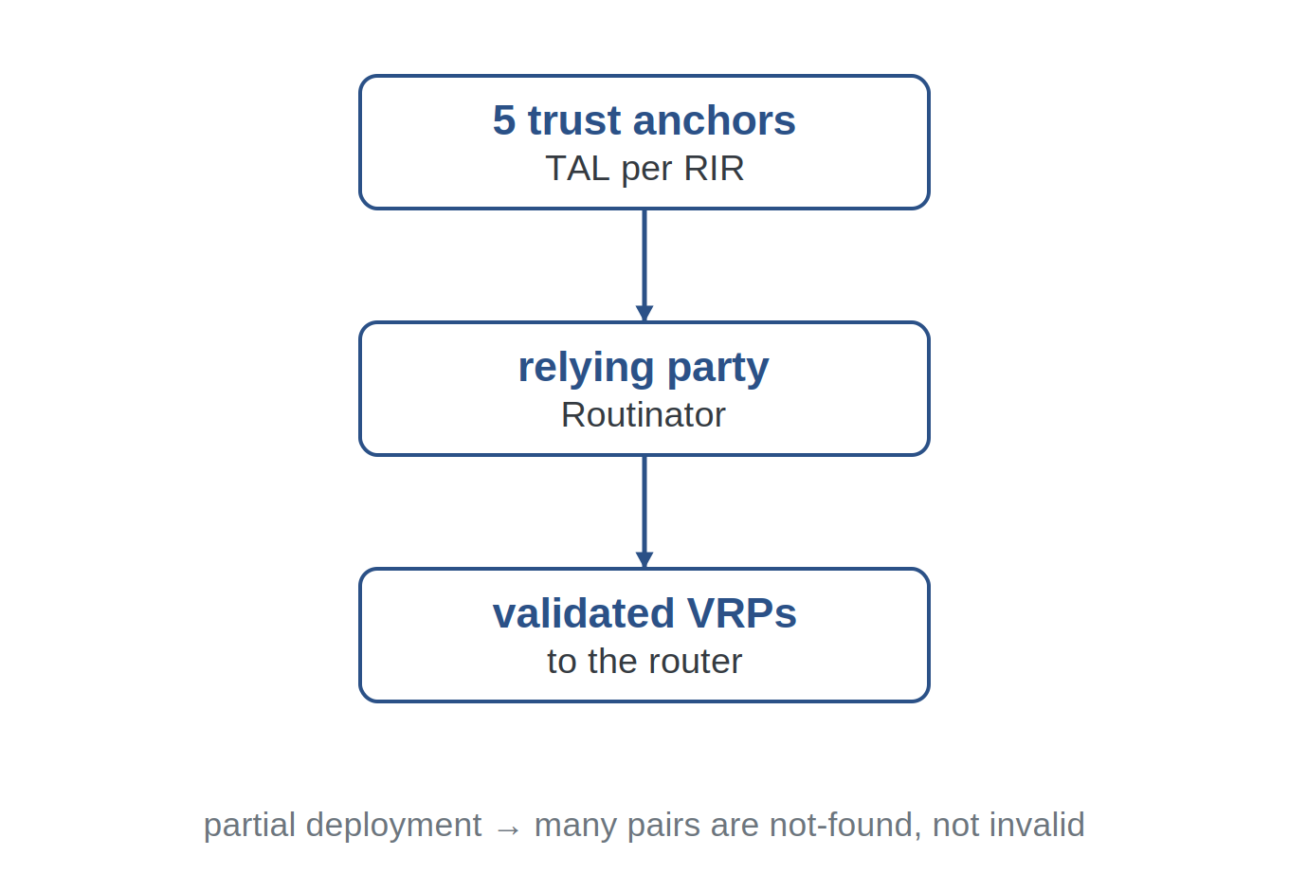
APPENDIX · RPKI
RPKI validation, a little deeper
The five RIRs act as trust anchors, each published as a TAL; relying-party software (e.g., Routinator) fetches and validates the certificate tree into VRPs.
Because deployment is partial, many prefix-origins are not-found rather than invalid — absence of a ROA is not a rejection.
ESCALATE Training Program · Summer 2026

Slide 49
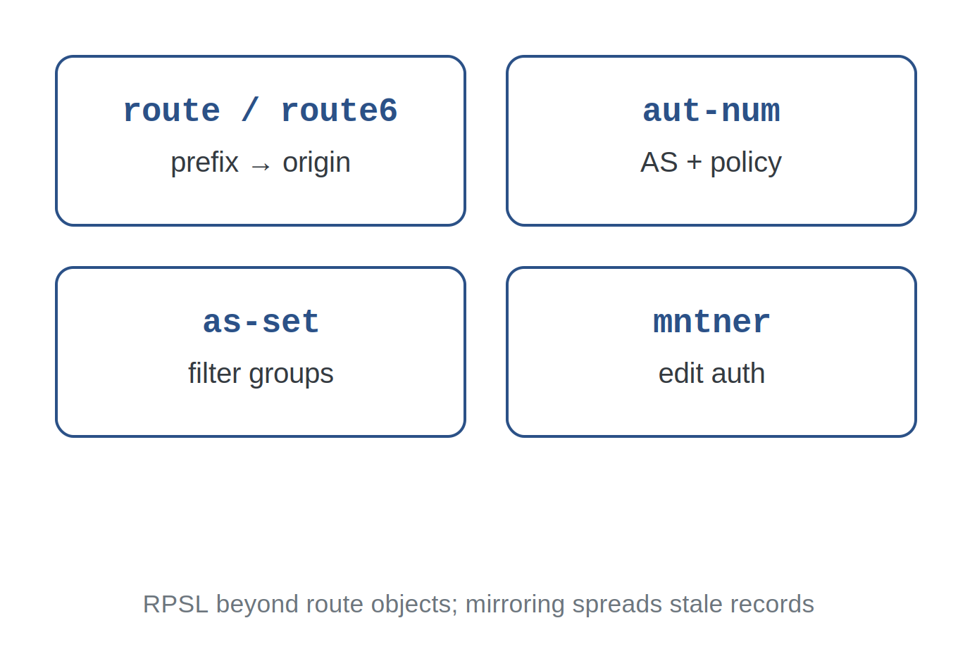
APPENDIX · IRR
The IRR ecosystem, a little deeper
RPSL covers more than route objects: aut-num policy, as-sets for filters, and mntner objects for authorization. Many IRRs mirror each other, which spreads stale objects widely.
This is why a route object's source and freshness matter — and why IRR-valid requires an exact-prefix match, not just a covering object.
ESCALATE Training Program · Summer 2026

Slide 50
APPENDIX · GLOSSARY
Advanced terms and acronyms
Advanced, program- or platform-specific terms only — alphabetical.
authoritative IRR RIR-run routing registry that validates route objects against the RIR's own registration.
IRR Internet Routing Registry — distributed databases of routing policy used to build filters.
maxLength ROA field capping how specific (long) an authorized prefix announcement may be.
RADB Large non-authoritative IRR database operated by Merit; widely mirrored.
RDAP Registration Data Access Protocol — structured JSON / HTTPS successor to WHOIS.
RIR Regional Internet Registry — allocates and records number resources for a region.
ROA Route Origin Authorization — signed (prefix, maxLength, origin AS) statement in RPKI.
route / route6 RPSL object binding an IPv4 / IPv6 prefix to an origin AS (exact-prefix match).
ROV Route Origin Validation — checking a BGP announcement against RPKI VRPs.
RPKI Resource Public Key Infrastructure — cryptographically binds prefixes to authorized origins.
trust anchor Top RPKI certificate (one per RIR), distributed as a TAL, that roots validation.
VRP Validated ROA Payload — the (prefix, maxLength, origin) tuple routers use for ROV.
ESCALATE Training Program · Summer 2026

