Slide 1
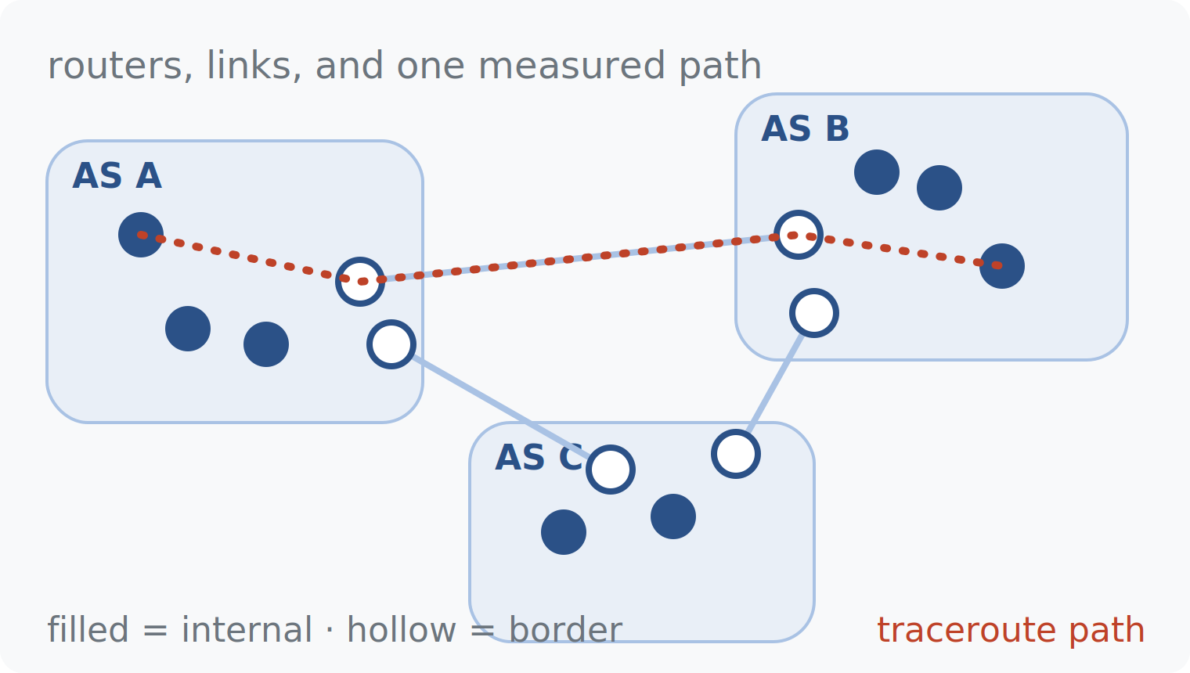
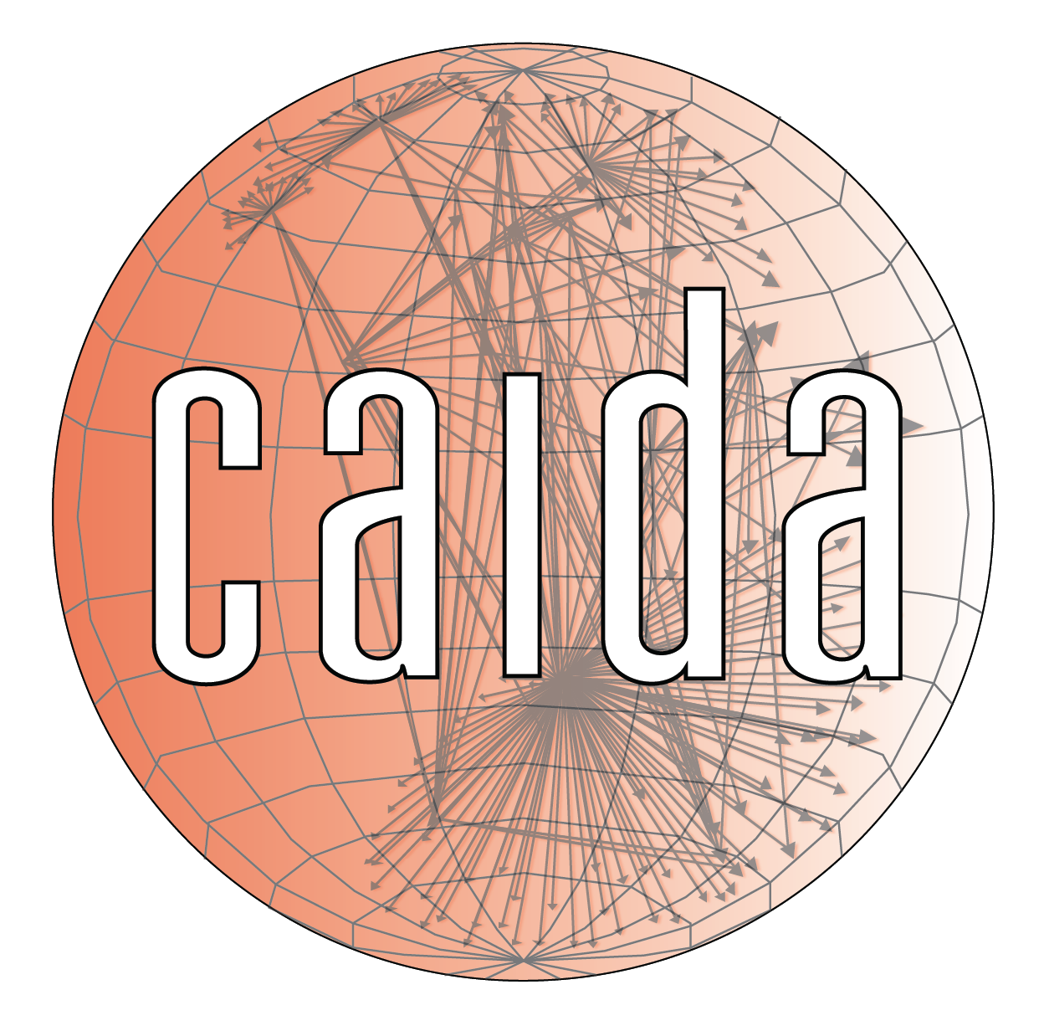

ESCALATE TRAINING PROGRAM · SUMMER 2026
Router-level Internet topology
Week 4: traceroute reveals routers one TTL at a time — and the ITDK turns millions of traces into a queryable map of the Internet.
PLENARY
INSTRUCTOR
SENIOR MENTORS
PROGRAM CONTACT
Tue 7 Jul 2026 · 12:00 PT
kc claffy
Ricky Mok · Bradley Huffaker · Matthew Luckie
Alex Ma
Supported by the NSF ESCALATE project · OAC-2519416
Notes:
Week 4 plenary. Frame for the hour: last week was the control plane (who announces routes); today is the data plane (which routers carry packets, and how we map them). Two arcs: traceroute mechanics, then how CAIDA industrializes traceroute into the ITDK. Thursday's infrastructure hour covers the database and query mechanics for the nids-itdk module.

Slide 2
THE ARC
WEEK 4 · BUILDING BLOCK 5 / 10
Ten building blocks — you are here
1
2
3
4
5
Internet structure & ASNs
BGP at scale
Registries: WHOIS / IRR / RPKI
AS relationships & cones
Traceroute, topology, cables
6
7
8
9
10
Geolocation
Network telescope
Data fusion (IYP)
Degradation forensics
SDSC hackathon
Weeks 1–8 build one block at a time; weeks 9–10 integrate them into a full forensic pipeline.
ESCALATE Training Program · Summer 2026
Notes:
Re-orient on the ten blocks. We are at block 5: traceroute, topology, cables. Blocks 1-4 gave the AS-level view; today we go to the router level. Block 6 (geolocation) gets a preview at the end of this deck and returns in full in Week 6.

Slide 3
LAST WEEK · RECAP
WEEK 4 · BUILDING BLOCK 5 / 10
Where we left off
THIS WEEK BUILDS ON IT
This week we drop one level: from which ASes announce prefixes to which routers move the packets.
BGP is the control plane: ASes announce prefixes and pick routes by policy, not by distance.
RouteViews and RIPE RIS collectors let us watch those announcements at global scale.
Open question: the AS view says who routes traffic — but where is the hardware that carries it?
ESCALATE Training Program · Summer 2026
Notes:
Bridge from Week 3. Keep it to two minutes: control plane established, measurement infrastructure established, and the deliberately open question — announcements are promises, not hardware. Today we measure the hardware.

Slide 4
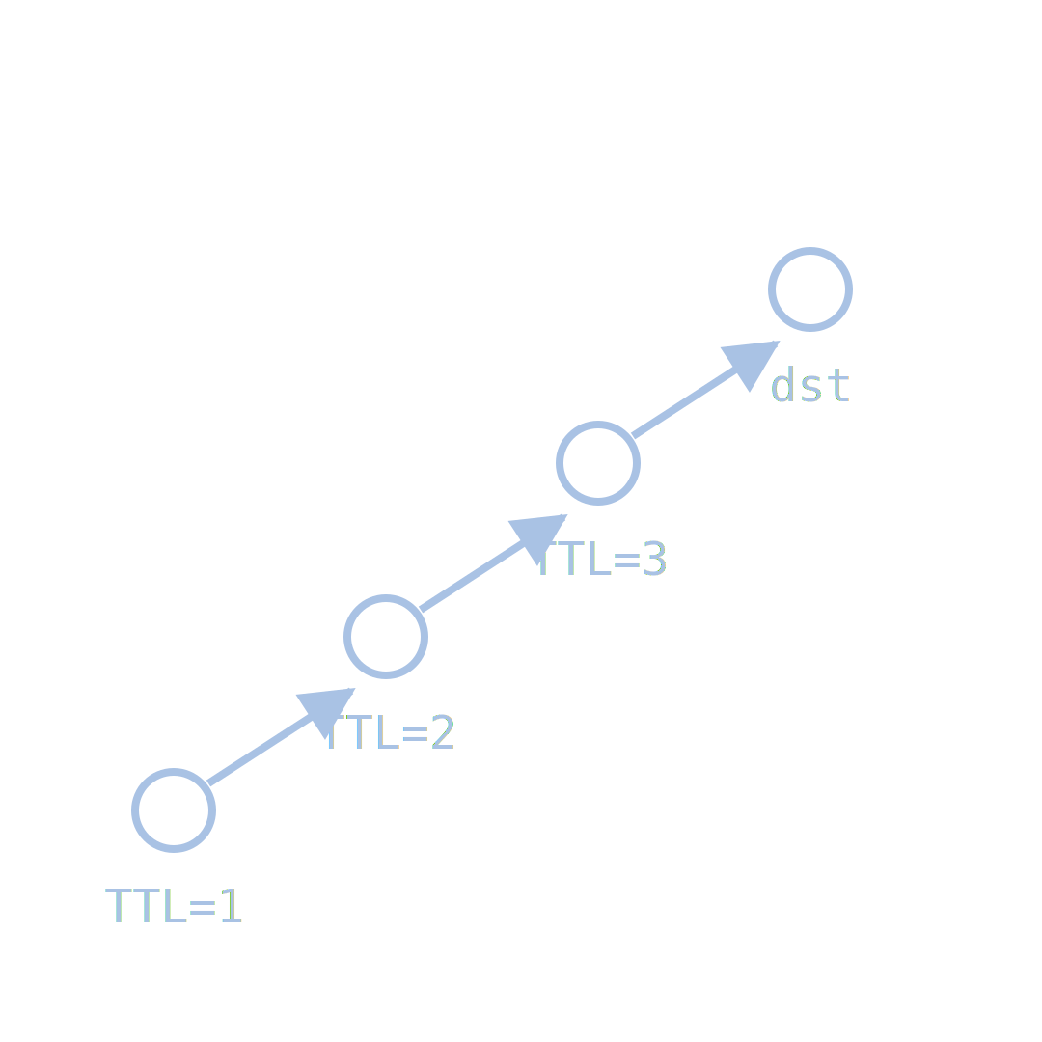
PART ONE
01
From packets to paths: traceroute
the one hack that lets any host discover the routers on its forward path
Notes:
Part one: the measurement primitive. Everything in the ITDK is built out of the mechanism in the next six slides.

Slide 5
WEEK 4 · BUILDING BLOCK 5 / 10
THE QUESTION
The Internet has no map and no owner. How do you draw one anyway?
No registry lists the routers or the links between them — every map must be measured into existence.
ESCALATE Training Program · Summer 2026
Notes:
Let this sit for a beat. The point: unlike a road network, there is no authoritative blueprint. The rest of the hour is one long answer to this question.

Slide 6
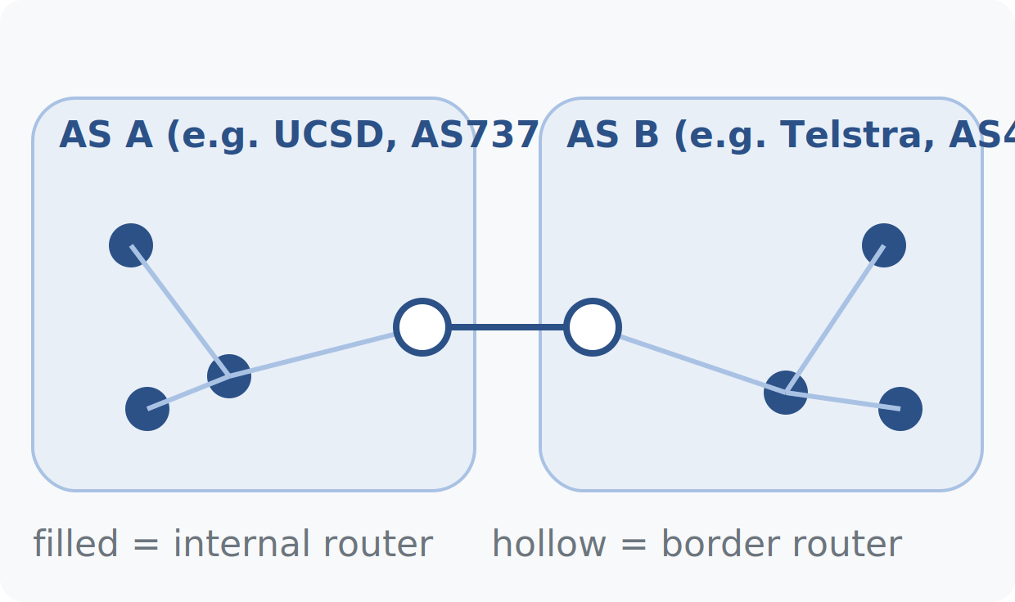
TRACEROUTE · NETWORK ANATOMY
WEEK 4 · BUILDING BLOCK 5 / 10
An AS is a network of routers
An autonomous system is one operator's network — UCSD is AS7377, Telstra is AS4637 — built from many routers forwarding packets.
Internal routers connect only to routers of the same AS; border routers have a neighbor in another AS.
BGP told us how ASes exchange routes; it says nothing about the routers that implement the exchange.
This week's unit of analysis is the node (a router) and the link (an observed adjacency between two).
two ASes, their internal routers, and the border routers that join them
ESCALATE Training Program · Summer 2026
Notes:
Recap AS definition briefly (Week 1 material; AS Rank at asrank.caida.org is the refresher pointer). The new move: zooming inside the AS cloud. Define node and link here — the whole week uses these two words.

Slide 7
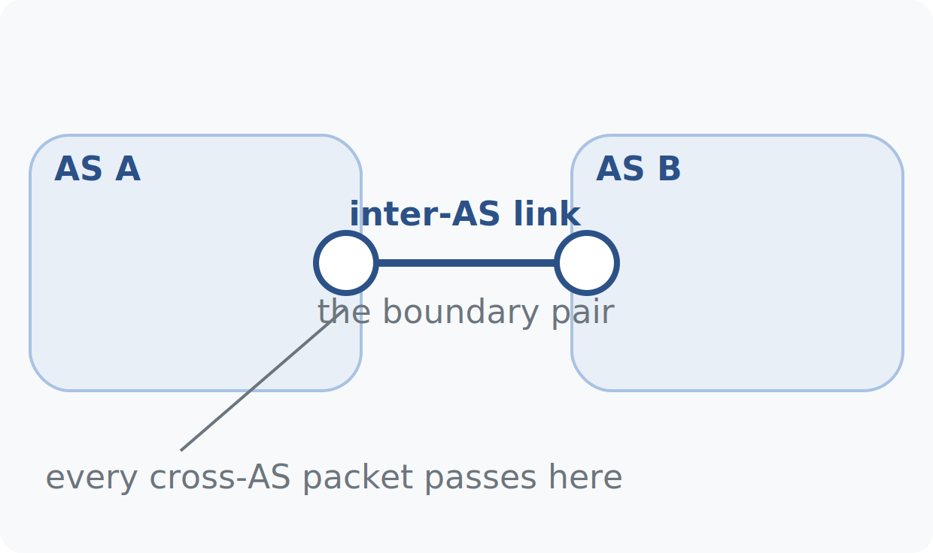
TRACEROUTE · NETWORK ANATOMY
WEEK 4 · BUILDING BLOCK 5 / 10
Border routers are where networks touch
A border router belongs to one AS while at least one of its link neighbors belongs to a different AS.
Every packet that crosses an AS boundary passes through a pair of border routers — the physical interconnection.
Finding these pairs, and working out where they sit, is exactly what this week's module does at Internet scale.
the boundary pair: one router in each AS, one link between them
ESCALATE Training Program · Summer 2026

Slide 8
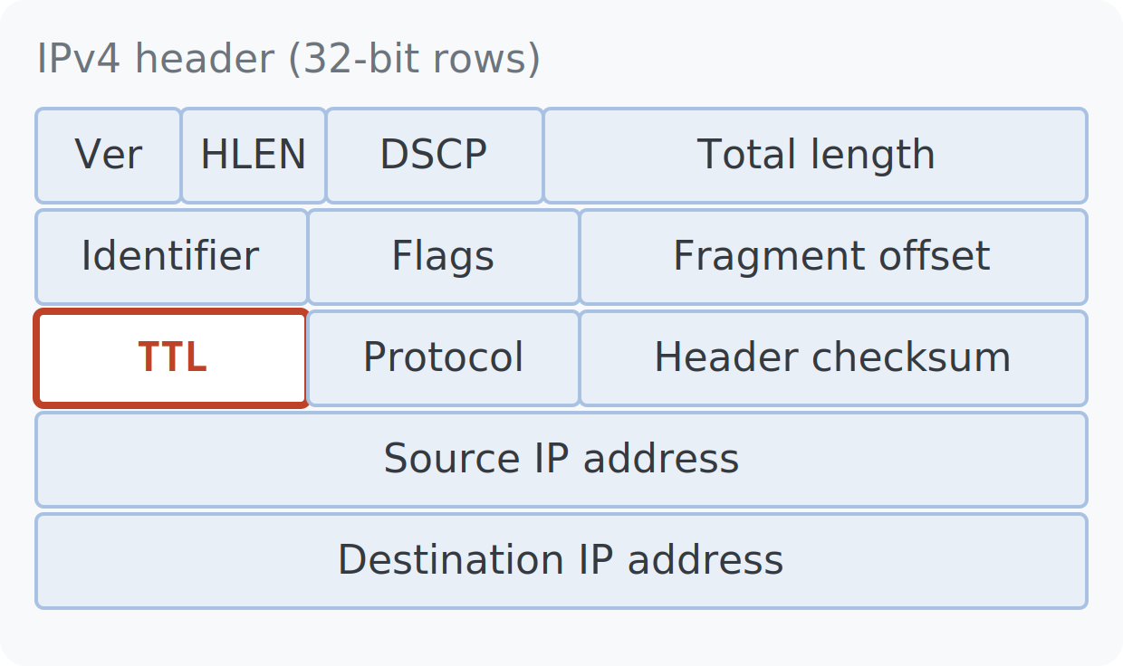
TRACEROUTE · THE MECHANISM
WEEK 4 · BUILDING BLOCK 5 / 10
The Internet cannot trace its own paths
IP has no built-in way to report the path a packet takes — traceroute is a hack, not a protocol feature.
Every IPv4 header carries a TTL (time to live); each router decrements it to stop packets looping forever.
At TTL = 0 the router discards the packet and sends an ICMP “time exceeded” error back to the source.
That error names its sender — a router reveals one of its interface addresses by complaining.
the TTL field of the IPv4 header — decremented at every hop
ESCALATE Training Program · Summer 2026

Slide 9
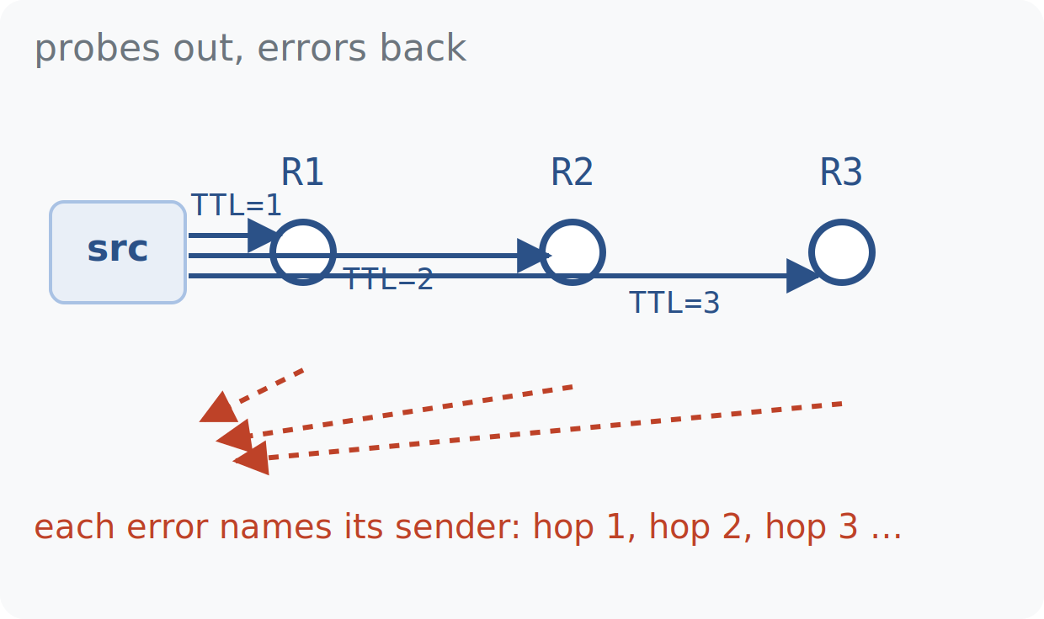
TRACEROUTE · THE MECHANISM
WEEK 4 · BUILDING BLOCK 5 / 10
Raise the TTL, collect the errors
Send a probe with TTL = 1: the first router's error reveals hop 1. TTL = 2 reveals hop 2, and so on.
Repeat until the destination answers — the sequence of error senders is the forward path, one IP per hop.
scamper, the probing engine behind CAIDA's Ark, automates this toward millions of destinations.
three probes, three errors, three hops recovered in order
ESCALATE Training Program · Summer 2026

Slide 10
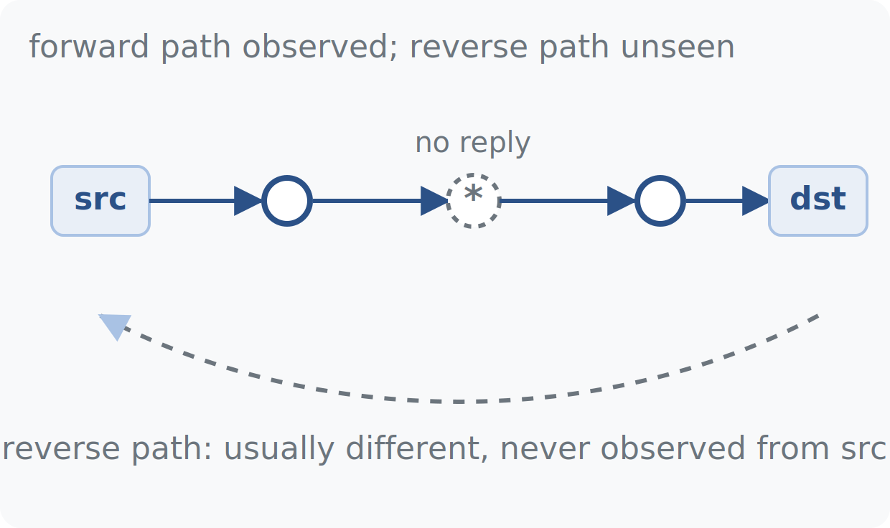
TRACEROUTE · THE MECHANISM
WEEK 4 · BUILDING BLOCK 5 / 10
What a traceroute cannot see
Forward path only: the reverse path is usually different and stays invisible from this vantage point.
Routers are not obliged to reply — a silent hop shows up as * and leaves a gap in the path.
Each interface has its own IP: two traces through one router can report two different addresses.
These three gaps drive the ITDK's design — placeholder nodes, alias resolution, and many vantage points.
gaps in a single trace — the problems the ITDK must repair
ESCALATE Training Program · Summer 2026

Slide 11
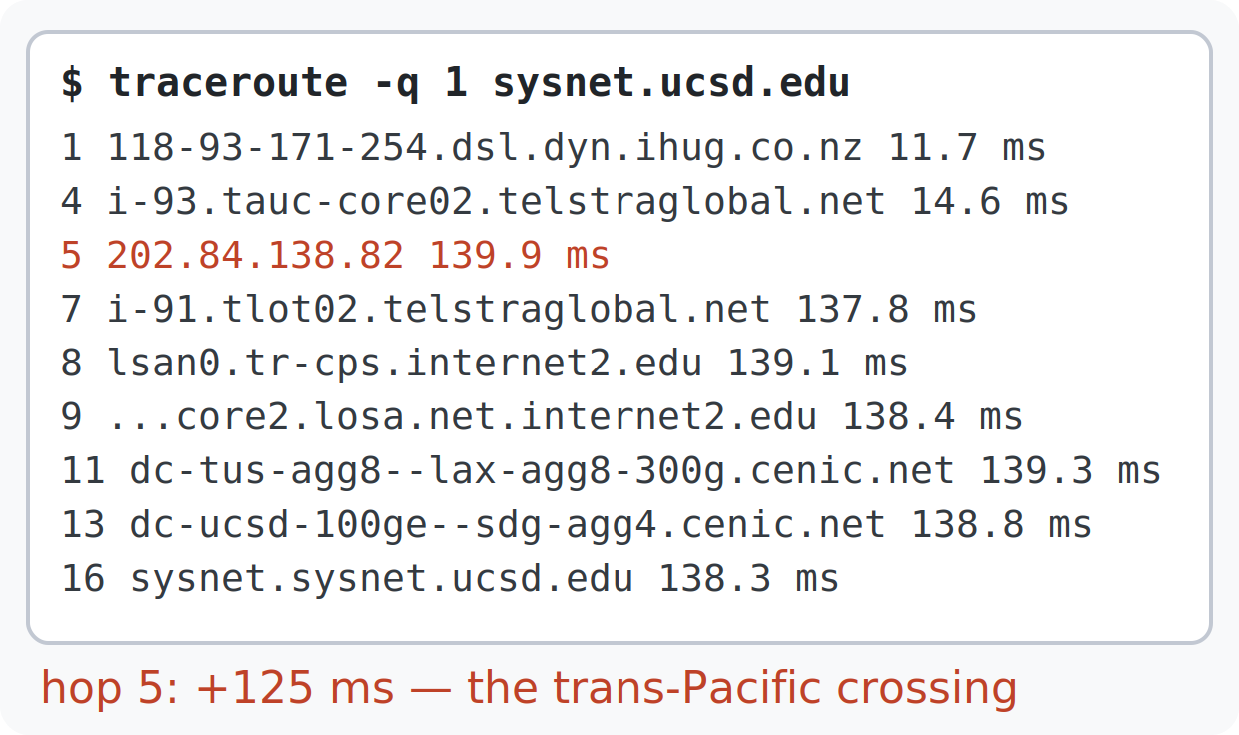
TRACEROUTE · READING OUTPUT
WEEK 4 · BUILDING BLOCK 5 / 10
A real trace: New Zealand to UCSD
Sixteen hops from a home DSL line in Auckland to sysnet.ucsd.edu — each line is one router interface.
The latency jump from 14 ms to 139 ms at hop 5 is the trans-Pacific submarine cable crossing.
The hostnames, not the IPs, carry most of the human-readable signal — decoded on the next slide.
traceroute -q 1 sysnet.ucsd.edu — sixteen hops, abridged
ESCALATE Training Program · Summer 2026

Slide 12
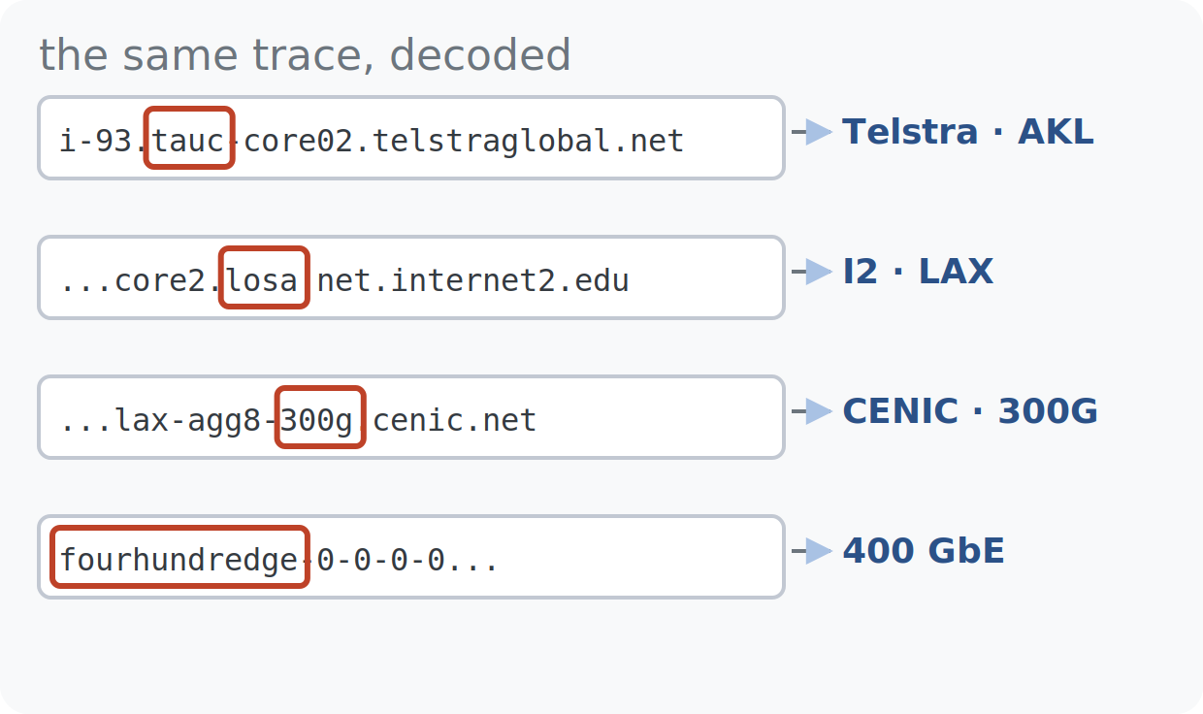
TRACEROUTE · READING OUTPUT
WEEK 4 · BUILDING BLOCK 5 / 10
Hostnames are operator annotations
Operators name interfaces with structure: tauc = Telstra Auckland, losa = Los Angeles.
Link capacities leak too: 300g = 300 Gb/s, fourhundredge = a 400 GbE interface.
These are PTR (reverse-DNS) records, set by hand — informative when fresh, misleading when stale (part two).
the same trace: city codes and link speeds embedded in PTR names
ESCALATE Training Program · Summer 2026

Slide 13
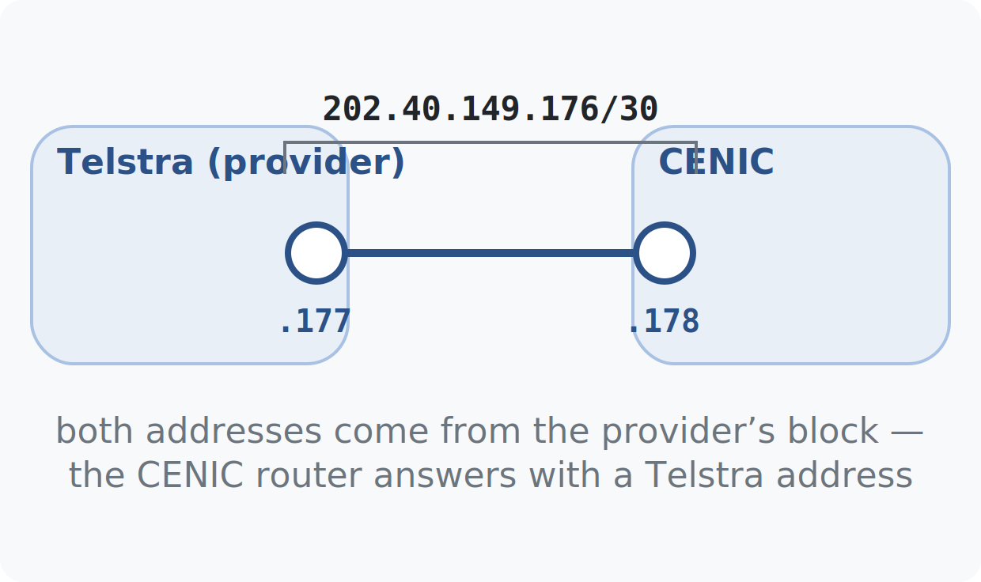
TRACEROUTE · READING OUTPUT
WEEK 4 · BUILDING BLOCK 5 / 10
Whose address do you see at the border?
The two ends of an inter-AS link share one small subnet, typically a /30 — IP/CIDR refresher: Week 1 notes.
One side supplies the block (often the provider), so a border router can answer with an address from its neighbor's space.
Consequence: mapping IP → AS by BGP origin can misattribute border routers — bdrmapIT exists to fix exactly this.
a /30 shared across the boundary: the neighbor's block on your router
ESCALATE Training Program · Summer 2026

Slide 14
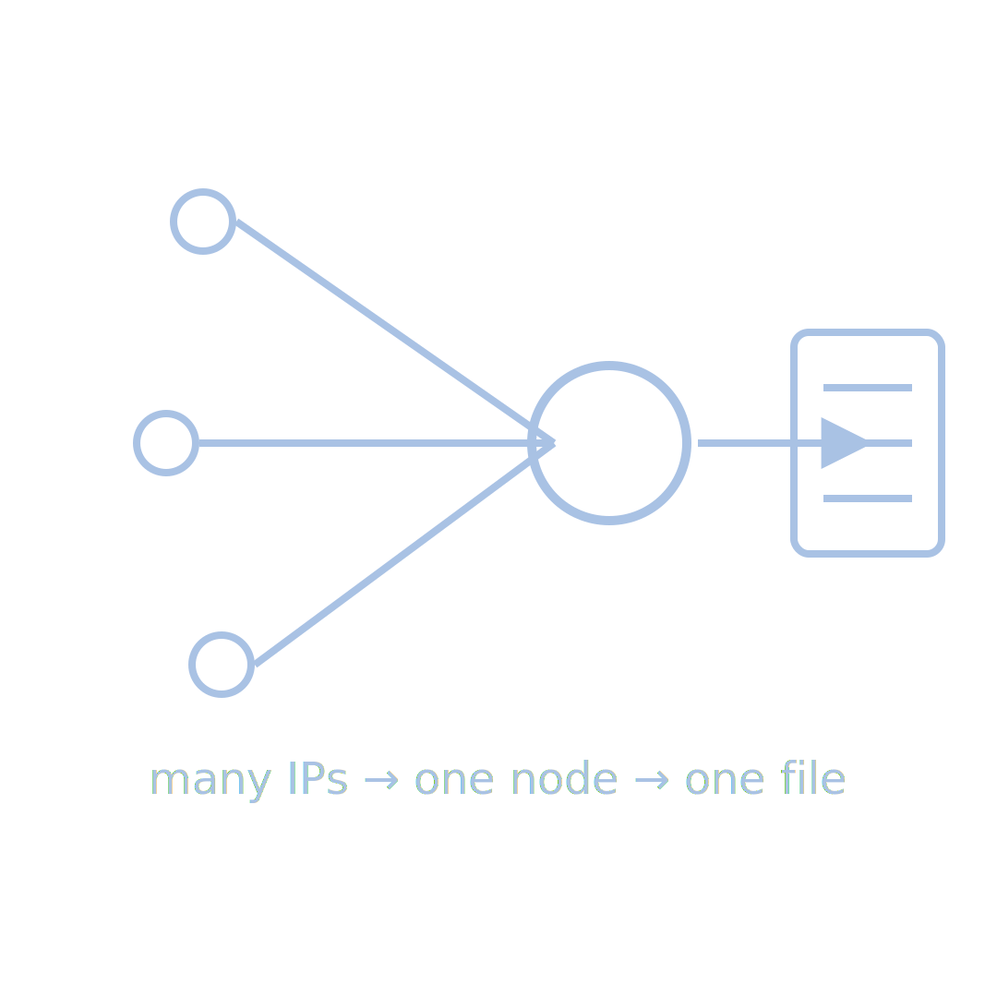
PART TWO
02
From a million traceroutes to the ITDK
alias resolution, operator inference, and geolocation turn raw paths into an annotated router graph

Slide 15
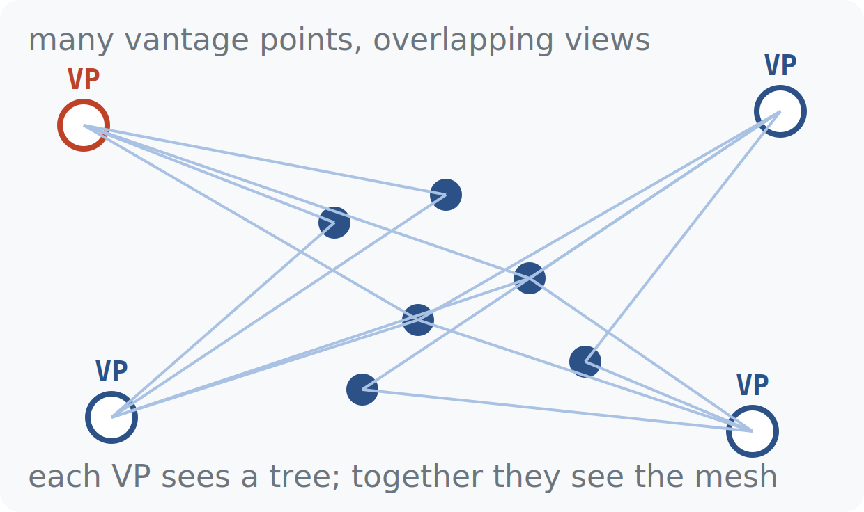
ITDK · DATA COLLECTION
WEEK 4 · BUILDING BLOCK 5 / 10
Macroscopic discovery: probe from everywhere
CAIDA's Ark platform runs traceroute campaigns from vantage points worldwide toward every routed /24.
One vantage point sees one tree of forward paths; many vantage points see the mesh between them.
The raw output (warts files) is post-processed into the Internet Topology Data Kit — the ITDK — released 1–2 times a year.
many vantage points, millions of destinations, overlapping trees
ESCALATE Training Program · Summer 2026

Slide 16
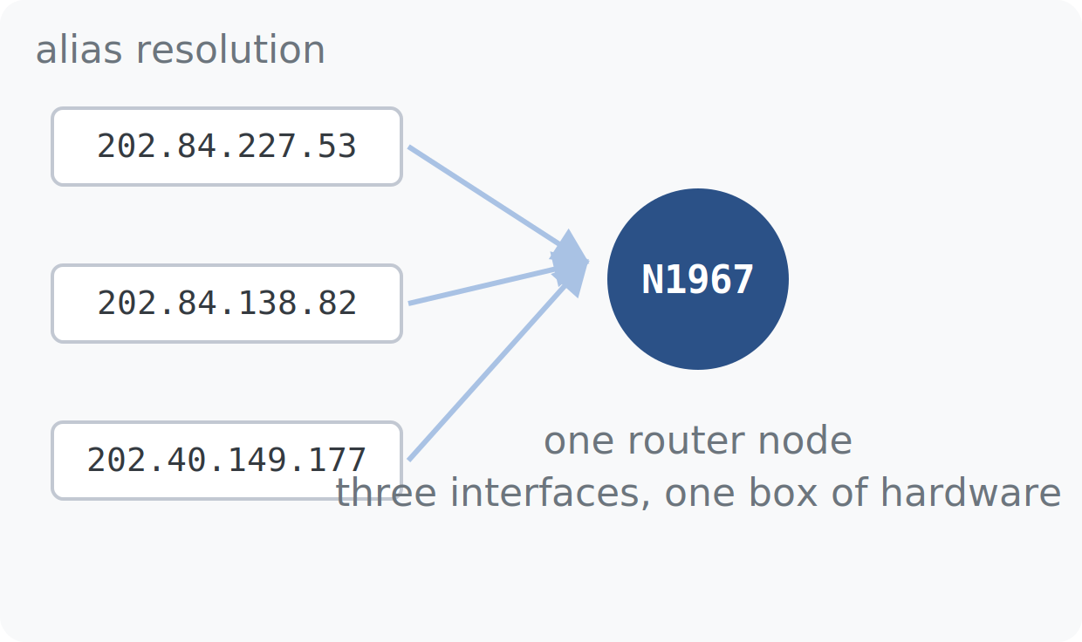
ITDK · ALIAS RESOLUTION
WEEK 4 · BUILDING BLOCK 5 / 10
Many addresses, one router
A physical router has one IP per interface — traces entering different sides report different addresses.
Alias resolution groups the interface IPs that belong to one chassis into a single node, e.g. N1967.
Skip this step and you double-count routers and invent links — every ITDK node is the product of this grouping.
three observed IPs collapse into one node after alias resolution
ESCALATE Training Program · Summer 2026

Slide 17
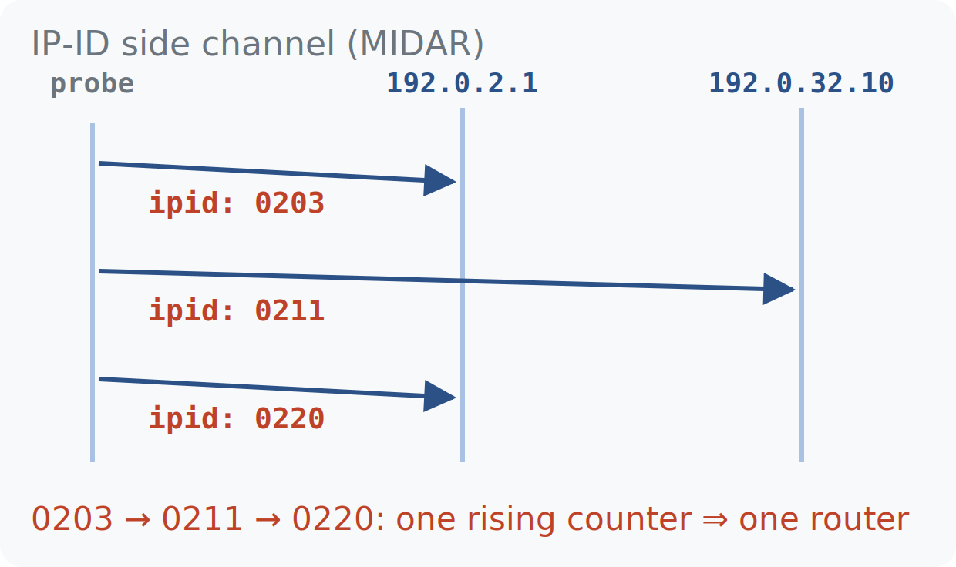
ITDK · ALIAS RESOLUTION
WEEK 4 · BUILDING BLOCK 5 / 10
MIDAR's trick: the IP-ID side channel
Many routers stamp every packet's IP-ID field from one central counter, whichever interface replies.
Probe two candidate addresses in alternation: if the IP-IDs interleave in one rising sequence, one router.
MIDAR runs this test at Internet scale — more than 2 million interfaces resolved per release.
Going deeper: the MIDAR paper and Hoiho alias work are linked from the module's optional reading.
interleaved IP-IDs betray a shared counter — one router, two names
ESCALATE Training Program · Summer 2026

Slide 18
METHODOLOGY
WEEK 4 · BUILDING BLOCK 5 / 10
How an ITDK release is built
Source
ark (scamper)
↓
Ark vantage points traceroute toward every routed /24. MIDAR and iffinder collapse interface addresses into routers; bdrmapIT assigns each router an operator AS; Hoiho and Maxmind attach locations. The annotated graph ships as the ITDK.
Collect
traceroutes.warts
KNOW THE LIMITS
Traceroute-observed only — unseen links stay unseen.
↓
Process
midar+bdrmapit+hoiho
↓
Result
ITDK 2026 release
ESCALATE Training Program · Summer 2026
Notes:
The one-slide summary of part two. Limits alert matters: the ITDK is a lower bound on the real topology — backup links, unprobed regions, and MPLS tunnels are all invisible. Say 'lower bound' out loud.

Slide 19
THE NUMBERS
WEEK 4 · BUILDING BLOCK 5 / 10
The ITDK, in figures
>2M
5
18
2026
router interfaces resolved by MIDAR per release
relational tables carry the graph in this module
major ASes cross-analyzed in Task 3's heatmap
the ITDK release year behind this module's database
One hour of querying can touch the whole measured Internet — these figures set the scale of what you will work with.
ESCALATE Training Program · Summer 2026
Notes:
All four numbers are real: >2M interfaces from MIDAR's published scale, five tables in the module's Postgres schema, 19 ASes in Task 4, and the 2026 release loaded in the class database. Never inflate these.

Slide 20
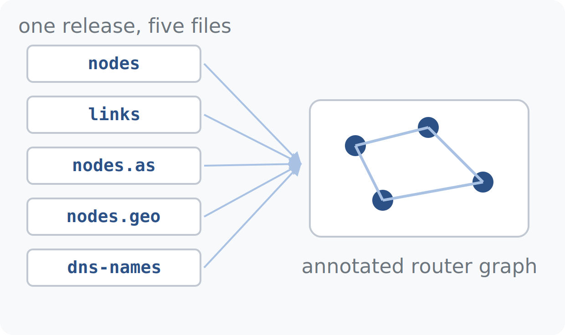
ITDK · THE RELEASE
WEEK 4 · BUILDING BLOCK 5 / 10
What's inside a raw ITDK release
nodes — every router, listed as the set of interface addresses inferred to belong to it.
links — inferred adjacencies between nodes, from consecutive traceroute hops.
nodes.as and nodes.geo — the operator AS and the location annotation for each node.
dns-names — PTR hostnames per interface; Thursday's database serves all five relationally.
five flat files, one annotated graph
ESCALATE Training Program · Summer 2026

Slide 21
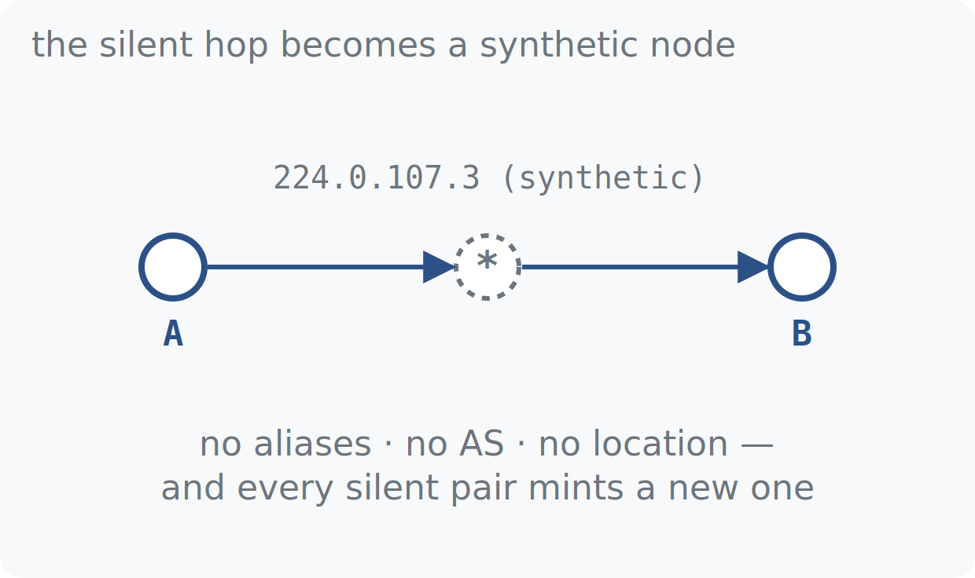
ITDK · THE RELEASE
WEEK 4 · BUILDING BLOCK 5 / 10
Placeholder nodes: mapping the silent routers
A hop that never answers still exists — the ITDK inserts a placeholder node so the path stays connected.
Placeholders get synthetic addresses in reserved space (e.g. 224.0.x.x) — no aliases, no AS, no location.
Aliases cannot be resolved between silent routers, so one real router may appear as many placeholder nodes.
Counting them naively corrupts degree and distance analysis — handling strategies: Thursday's session.
A — * — B: the silent hop becomes a synthetic node
ESCALATE Training Program · Summer 2026

Slide 22
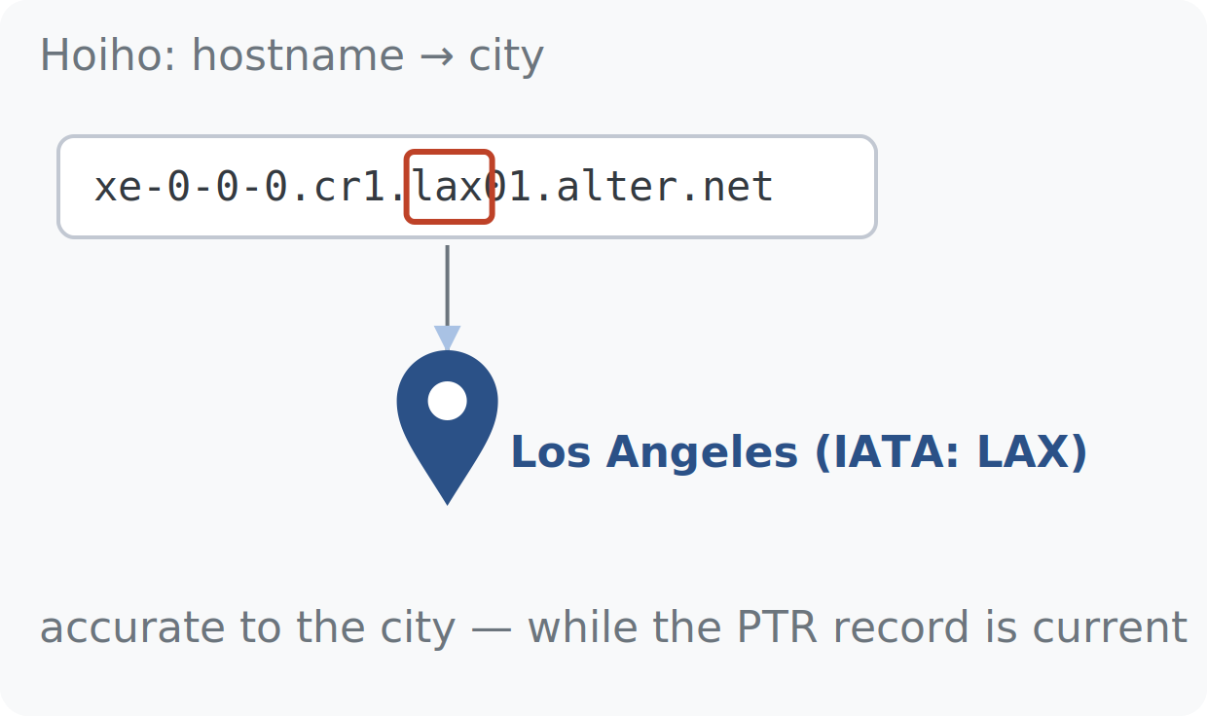
ITDK · GEOLOCATION
WEEK 4 · BUILDING BLOCK 5 / 10
Signal 1 — Hoiho reads the hostname
Operators embed location hints in PTR names: IATA codes (lax, ams, ord) and city abbreviations.
Hoiho learns each operator's naming convention and converts a hostname into a city-level location.
While the PTR record is current, hostname geolocation is typically accurate to the city.
The catch: PTR records are maintained by hand — they can outlive the router's move to another city.
xe-0-0-0.cr1.lax01.alter.net → Los Angeles
ESCALATE Training Program · Summer 2026

Slide 23
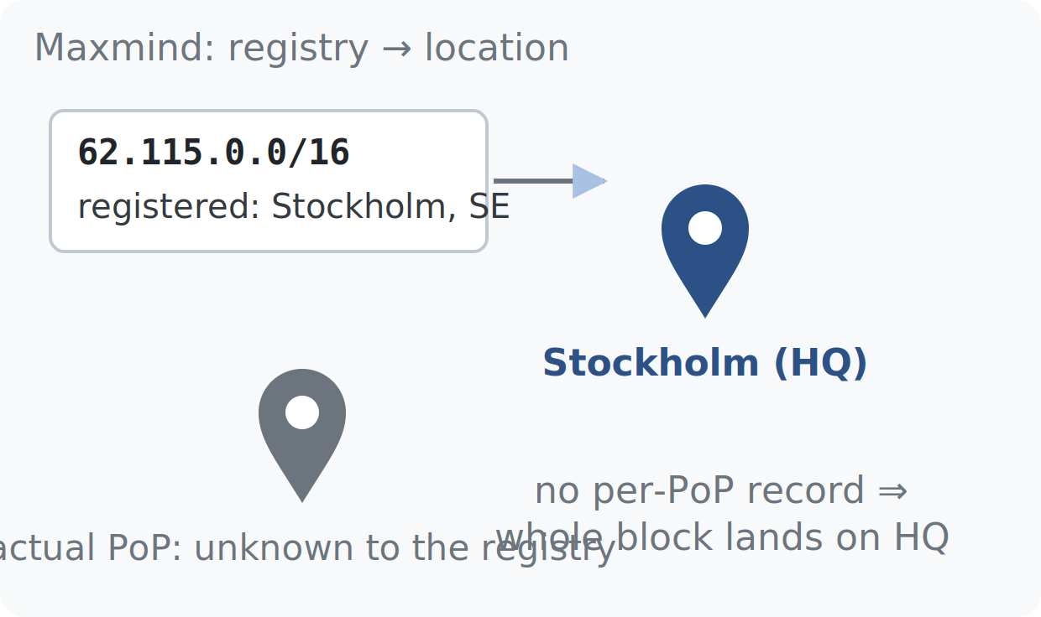
ITDK · GEOLOCATION
WEEK 4 · BUILDING BLOCK 5 / 10
Signal 2 — Maxmind reads the registry
Maxmind maps an IP to the location its address block is registered to (ARIN, RIPE, APNIC records).
Global carriers register huge blocks centrally — so a router's IP often resolves to corporate headquarters.
With no per-PoP record, an entire /16 can land on one HQ city, thousands of km from the hardware.
the registry says headquarters; the router may sit elsewhere
ESCALATE Training Program · Summer 2026

Slide 24
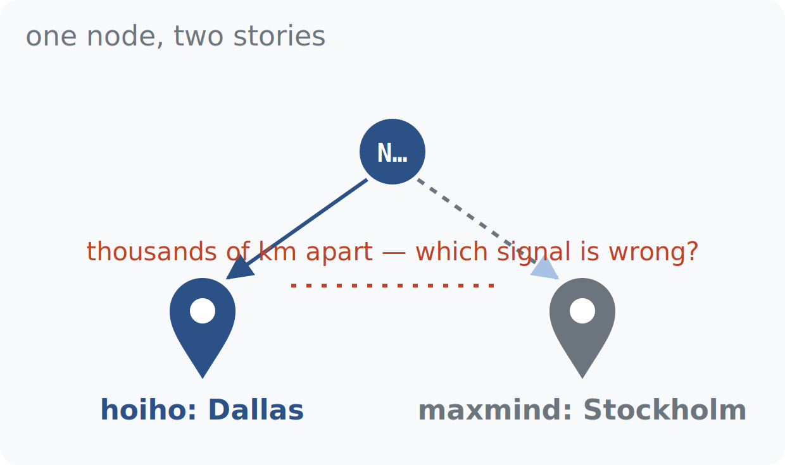
ITDK · GEOLOCATION
WEEK 4 · BUILDING BLOCK 5 / 10
When the two signals disagree, investigate
Agreement → confidence. Disagreement by hundreds of km → one signal is wrong, and which one is the finding.
Stale hostname: the PTR encodes where the router used to be; the registry reflects the current assignment.
HQ fallback: the registry parks the block at headquarters; the hostname correctly names the PoP.
In this module the disagreement shows up as distance — a large Level3–Netflix link distance in Task 1 usually means a geolocation error, not a long cable.
same node, two cities — the disagreement is the finding
ESCALATE Training Program · Summer 2026

Slide 25
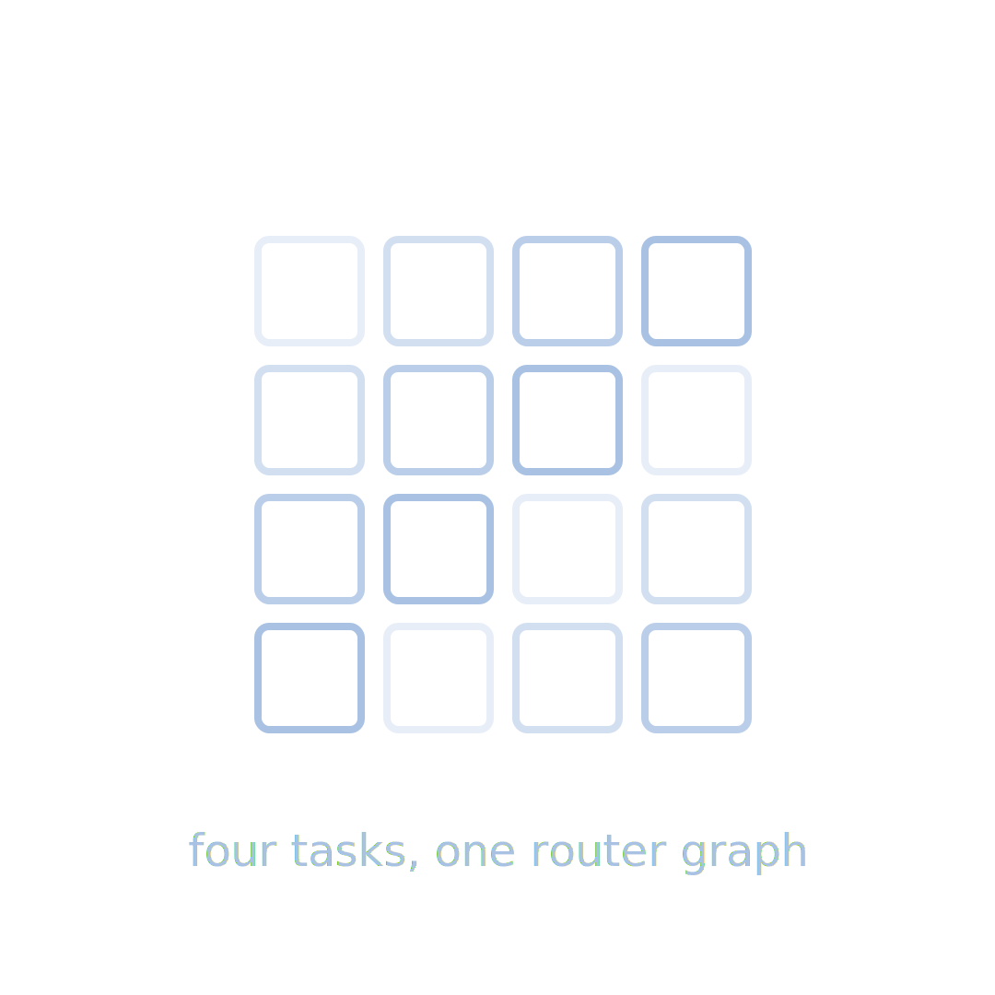
PART THREE
03
Your module this week: nids-itdk
three tasks against a live ITDK database — query mechanics on Thursday

Slide 26
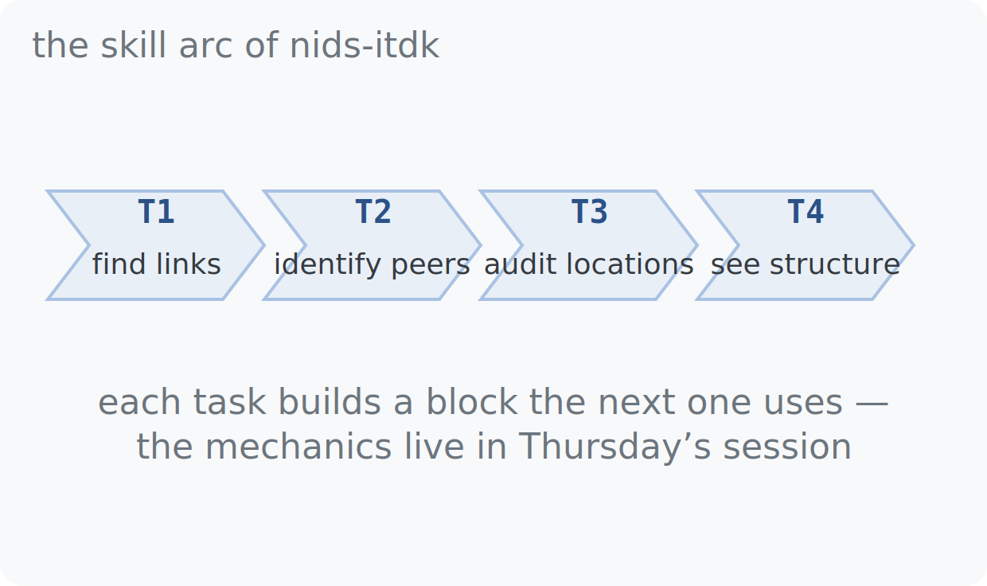
THIS WEEK · NIDS-ITDK
WEEK 4 · BUILDING BLOCK 5 / 10
Three tasks, one skill arc
Task 1 — find every router link between Level3 and Netflix, and map where the two networks peer.
Task 2 — identify who China Unicom connects to on the US West Coast, using AS data and hostnames.
Task 3 — cross 18 major ASes in one heatmap and read the economics of interconnection from it.
find links → identify peers → see structure
ESCALATE Training Program · Summer 2026

Slide 27
ASSIGNMENT 4 · DUE BEGINNING OF WEEK 5
WEEK 4 · BUILDING BLOCK 5 / 10
nids-itdk
Query the 2026 ITDK in PostgreSQL: find cross-AS router links, geolocate their endpoints, and interpret the interconnection patterns you uncover.
MODULE MILESTONE
Completing the nids-itdk module end to end is this week’s milestone.
Read the Introduction and Datasets pages of the module
Tasks 1–2: cross-AS links, distances, peer identification
Task 3: the 18-AS interconnection heatmap
Finish all notebook tasks and questions
REPOSITORY
github.com/CAIDA/nids-itdk
ESCALATE Training Program · Summer 2026
Notes:
Due at the start of Week 5. Interpretation questions (Q1.c, Q2.b, Q4) carry the weight — paragraphs tied to their own query output, not link dumps. Thursday's session is effectively assignment office hours.

Slide 28
BEFORE NEXT WEEK
WEEK 4 · BUILDING BLOCK 5 / 10
This week, in five steps
Run the nids-itdk notebook locally and start Tasks 1–2
Come to Thursday's infrastructure hour (9 Jul): database + query walkthrough
Finish the assignment by the beginning of next week
Attend the plenary — or catch up; materials are posted
Use the hands-on hour and mentors for infrastructure help
OPTIONAL BACKGROUND
Hoiho — extracting router geolocation from hostnames (Luckie et al.); returns in Week 6.
Questions Mattermost (fastest)
training-program-info@caida.org
ESCALATE Training Program · Summer 2026
Notes:
The standard close. Emphasize step 2: Thursday is not optional filler — the schema walkthrough is where the assignment gets tractable. Mattermost for anything blocking before then.

Slide 29
APPENDIX · FOR SELF-STUDY
A
Supporting detail, not covered live
a few slides included so the deck stands on its own — reference, depth, derivations
Notes:
Appendix: raw ITDK file formats and the glossary. Not covered live; the deck stands alone for catch-up viewers.

Slide 30
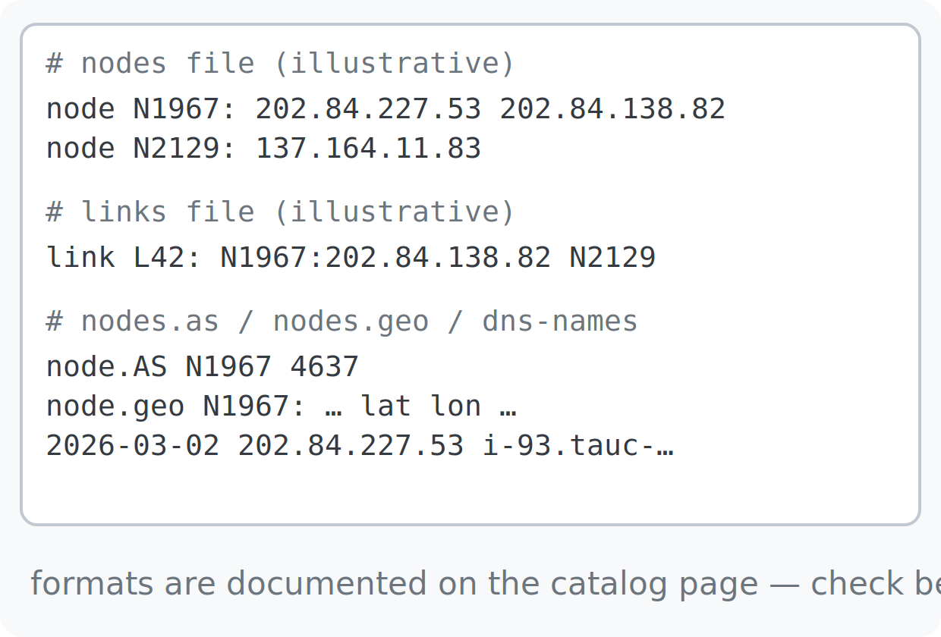
APPENDIX · ITDK FILE FORMATS
The raw release, file by file
A raw ITDK release is flat text. The nodes file lists each router as its set of interface addresses; the links file records each adjacency with the interfaces observed; nodes.as maps node to operator ASN; nodes.geo carries city, country and coordinates; dns-names holds timestamped PTR lookups per interface address.
This module serves the same content from PostgreSQL so you can join instead of parse. If you later work with a raw release — they run to tens of GB uncompressed — stream line by line, filter early, and check the exact formats on the ITDK catalog page at caida.org before writing a parser.
ESCALATE Training Program · Summer 2026
Notes:
Self-study reference for anyone touching raw releases; the class database makes it optional this week.

Slide 31
APPENDIX · GLOSSARY
Advanced terms and acronyms
Advanced, program- or platform-specific terms only — alphabetical.
alias resolution Grouping the interface IPs that belong to one physical router into one node.
Ark CAIDA's distributed platform of traceroute vantage points.
bdrmapIT Algorithm assigning each ITDK router to the AS that operates it.
border router A router with at least one link neighbor in a different AS.
haversine Great-circle distance between two lat/lon points — kilometers, here.
Hoiho CAIDA tool inferring router locations from hostname naming conventions.
iffinder Alias-resolution tool exploiting replies sent from a different interface.
IP-ID IPv4 header counter; a shared counter across interfaces reveals aliases.
ITDK Internet Topology Data Kit — CAIDA's annotated router-level graph.
MIDAR Monotonic-ID alias resolution; scales the IP-ID test past 2M interfaces.
placeholder node Synthetic node standing in for a router that never replied.
PTR record Reverse-DNS record mapping an IP address back to a hostname.
stale hostname A PTR name that outlived a move — it encodes the router's old city.
ESCALATE Training Program · Summer 2026
Notes:
Thirteen advanced terms for this week's tooling and pipeline; general networking terms intentionally excluded.

