Slide 1
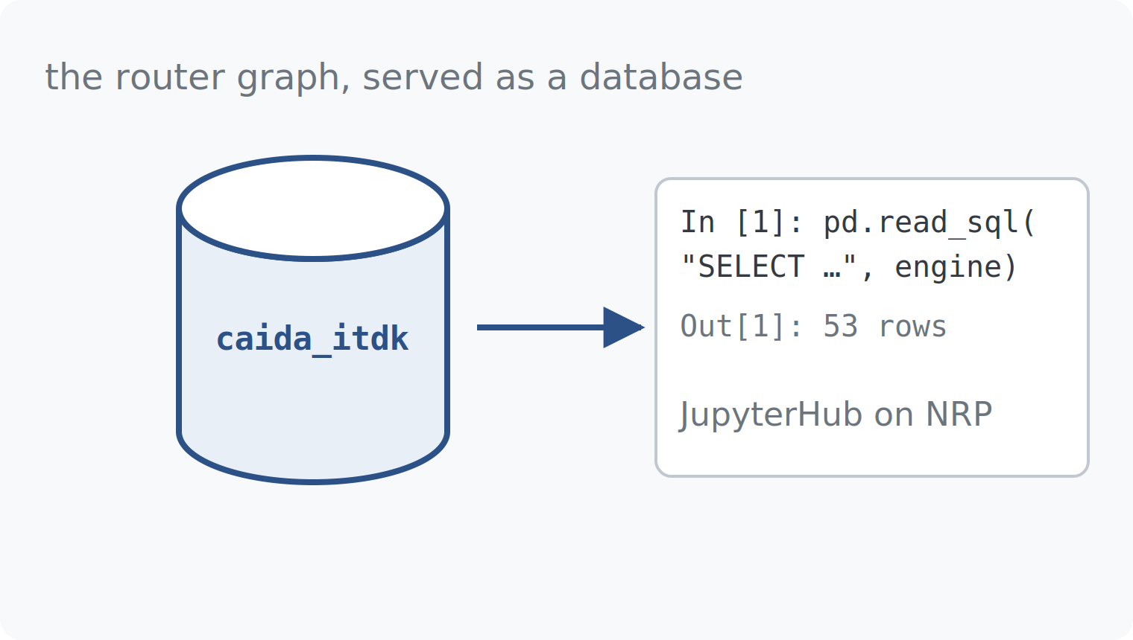


ESCALATE TRAINING PROGRAM · SUMMER 2026
Analyzing the CAIDA ITDK
Week 4, hands-on: from a PostgreSQL schema to three answered questions about Internet interconnection.
INFRA HOUR
INSTRUCTOR
SENIOR MENTORS
PROGRAM CONTACT
Thu 9 Jul 2026 · 12:00 PT
kc claffy
Ricky Mok · Bradley Huffaker · Matthew Luckie
Alex Ma
Supported by the NSF ESCALATE project · OAC-2519416
Notes:
Week 4 infrastructure hour — the hands-on companion to Tuesday's plenary. Goal: everyone leaves with the notebook connected, the schema understood, and Task 1's query pattern working. Keep it interactive; run queries live.

Slide 2
THE ARC
WEEK 4 · BUILDING BLOCK 4 / 10
Ten building blocks — you are here
1
2
3
4
5
Internet structure & ASNs
BGP at scale
Registries: WHOIS / IRR / RPKI
AS relationships & cones
Traceroute, topology, cables
6
7
8
9
10
Geolocation
Network telescope
Data fusion (IYP)
Degradation forensics
SDSC hackathon
Weeks 1–8 build one block at a time; weeks 9–10 integrate them into a full forensic pipeline.
ESCALATE Training Program · Summer 2026
Notes:
Ten seconds: same block as Tuesday, different register — mechanics instead of concepts.

Slide 3
TUESDAY · RECAP
WEEK 4 · BUILDING BLOCK 4 / 10
Where we left off
THIS WEEK BUILDS ON IT
Today is mechanics: the module's PostgreSQL schema, the join patterns, and what each task expects.
Traceroute reveals one interface per hop; alias resolution collapses interfaces into router nodes.
The ITDK annotates each node with an operator AS and two geolocation signals (Hoiho, Maxmind).
Open question: how do we actually query millions of nodes and links without drowning?
ESCALATE Training Program · Summer 2026
Notes:
Two-minute bridge from Tuesday. If someone missed the plenary, the three left-hand points are the minimum context; the deck is posted.

Slide 4
ACTION REQUIRED · BEFORE WE START
WEEK 4 · BUILDING BLOCK 4 / 10
Get connected — first ten minutes
1
Get the module. Clone or download github.com/CAIDA/nids-itdk and open nids-itdk.ipynb locally.
2
Install dependencies. Run pip install -r requirements.txt (or uv sync) in the project folder.
3
Set up local credentials. Create a local copy of db_credentials.env and populate db_read_user / db_read_password (host db.nids.caida.org).
4
Run the connection cell. A row count prints on success. Stuck? Mattermost, now — mentors are online.
ESCALATE Training Program · Summer 2026
Notes:
Do this live and wait — nothing after this slide works for a student who isn't connected. The password is distributed through course materials, never on slides or in the repo.

Slide 5
WHAT YOU’LL WORK WITH
WEEK 4 · BUILDING BLOCK 4 / 10
What you will work with today
ITDK 2026, relational
SCHEMA
The routers-file ITDK graph served as five PostgreSQL tables.
caida_itdk
nids-itdk module
REPO
Notebook, task pages, and background for this week’s assignment.
github.com/CAIDA/nids-itdk
ESCALATE Training Program · Summer 2026
Notes:
Two artifacts only: the database and the module. SQLAlchemy + pandas do the querying from Jupyter; students met both in earlier weeks.

Slide 6
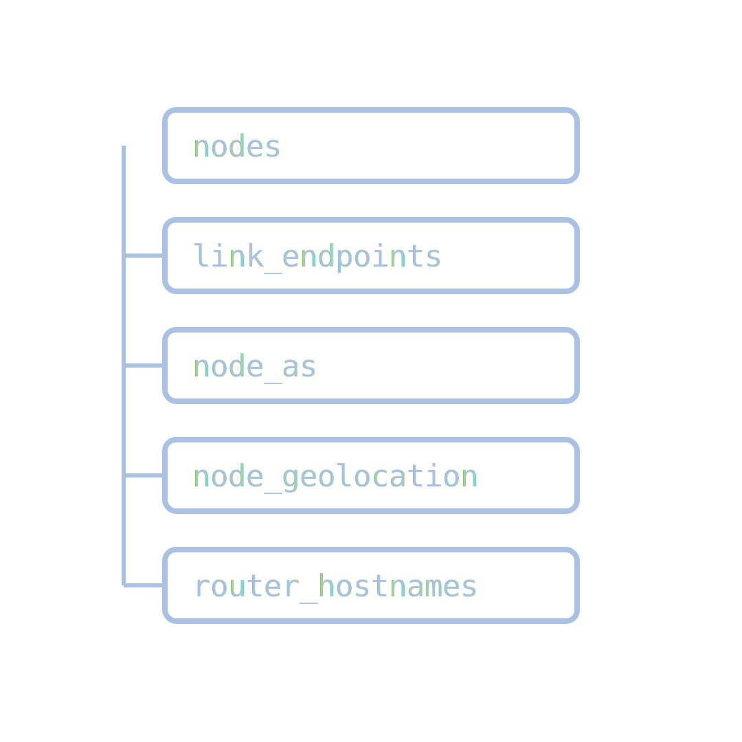
PART ONE
01
The database
five tables that carry the whole router graph — and the caveats baked into them
Notes:
Part one: the schema, table by table, then the two caveats (NULL peers, placeholder handling) that separate correct answers from plausible-looking wrong ones.

Slide 7
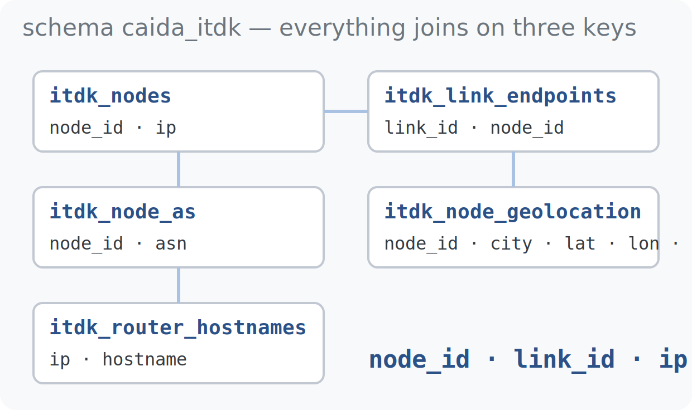
DATABASE · SCHEMA
WEEK 4 · BUILDING BLOCK 4 / 10
The ITDK, relational: five tables
v_itdk_ifaces_transit — interface IPs for transit-observed nodes (a view).
itdk_link_endpoints — two rows per link, one per endpoint node.
itdk_node_as and itdk_node_geolocation — operator ASN; city, coordinates and method.
itdk_router_hostnames — the PTR hostname per interface IP, where one exists.
everything joins on node_id, link_id, or ip
ESCALATE Training Program · Summer 2026
Notes:
The five tables mirror Tuesday's five raw files one-for-one. Put the schema diagram up and leave it up — students will screenshot this slide. All tables live in schema caida_itdk.

Slide 8
DATABASE · SCHEMA
WEEK 4 · BUILDING BLOCK 4 / 10
Database schema overview
Table Name | Rows / Size | Technical Description
itdk_link_endpoints | 14,222,743 rows 1,537.84 MB | Maps each inferred link to its endpoint router nodes (~2 rows per link)
itdk_node_geolocation | 3,735,246 rows 518.91 MB | City/country/lat-lon per node, tagged by method (hoiho or maxmind)
v_itdk_ifaces_transit | 3,231,689 rows 452.48 MB | Interface IPs for transit-observed nodes (a view), linked via link_id
itdk_router_hostnames | 2,240,516 rows 414.45 MB | DNS PTR hostname per interface IP, where one exists
itdk_node_as | 3,737,018 rows 391.16 MB | Maps each router node to its operating ASN (bdrmapIT)
schema caida_itdk (PostgreSQL) · join keys: node_id, link_id, ip
ESCALATE Training Program · Summer 2026

Slide 9
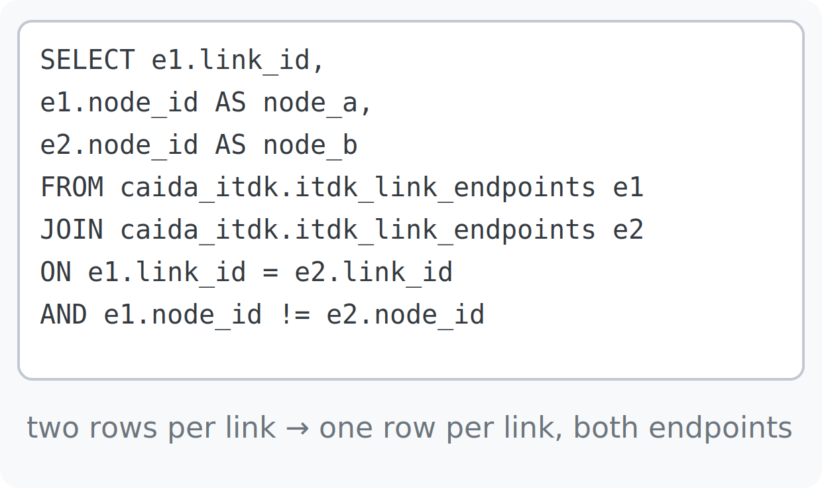
DATABASE · QUERY PATTERNS
WEEK 4 · BUILDING BLOCK 4 / 10
A link is two rows: the self-join
Each link_id normally appears twice in itdk_link_endpoints — once per endpoint node.
Join the table to itself on link_id with node_id != node_id to lay a link flat: one row, both ends.
Every task this week starts from this pattern — get it right once and reuse it everywhere.
two rows per link become one row with both endpoints
ESCALATE Training Program · Summer 2026

Slide 10
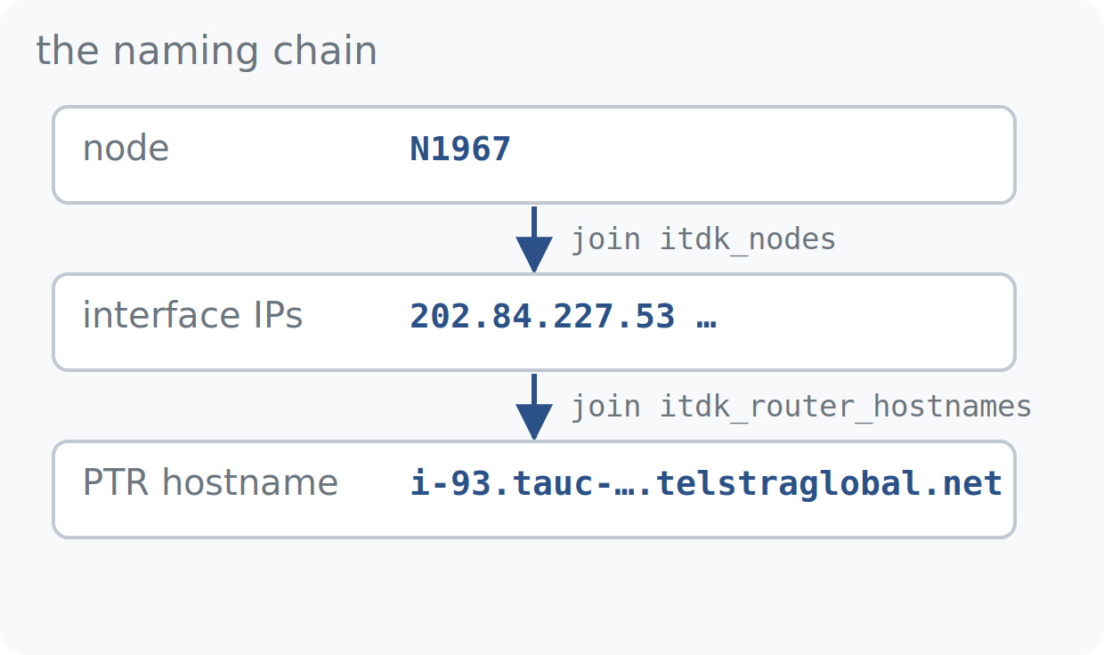
DATABASE · SCHEMA
WEEK 4 · BUILDING BLOCK 4 / 10
Who operates it, what it's called
itdk_node_as maps node → ASN, as assigned by the ITDK build (bdrmapIT, not naive BGP origin).
v_itdk_ifaces_transit expands a node into its interface IPs — the bridge from topology to addresses.
itdk_router_hostnames turns an IP into its PTR name; join through v_itdk_ifaces_transit to name a router.
node → interface IPs → hostnames: the naming chain
ESCALATE Training Program · Summer 2026

Slide 11
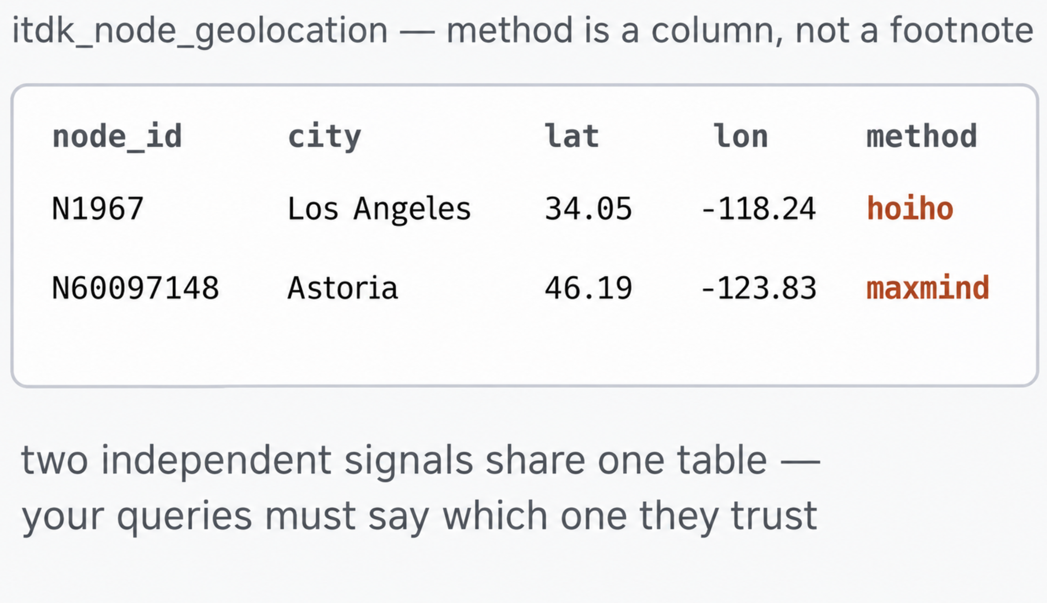
DATABASE · SCHEMA
WEEK 4 · BUILDING BLOCK 4 / 10
Where it sits: one location, one method
itdk_node_geolocation: city, country, latitude, longitude — one row per located node.
The method column names the signal that produced the row: hoiho or maxmind.
Carry method through your joins — Task 3's entire analysis is a comparison of the two.
the method column is data, not metadata
ESCALATE Training Program · Summer 2026

Slide 12
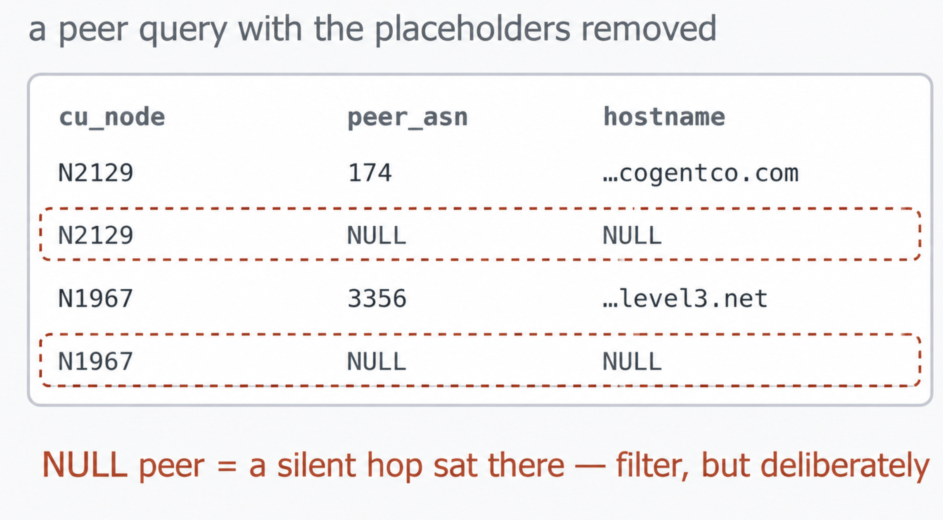
DATABASE · CAVEATS
WEEK 4 · BUILDING BLOCK 4 / 10
This database is routers-file only
Placeholder nodes were dropped at build time — every node_id here is a real, observed router.
Their absence surfaces as NULLs: peer queries return rows with peer_asn IS NULL where a silent hop sat.
Filter with peer_asn IS NOT NULL for tables like Task 2's — and say that you did in your write-up.
dropped placeholders leave NULL-shaped holes — filter deliberately
ESCALATE Training Program · Summer 2026

Slide 13
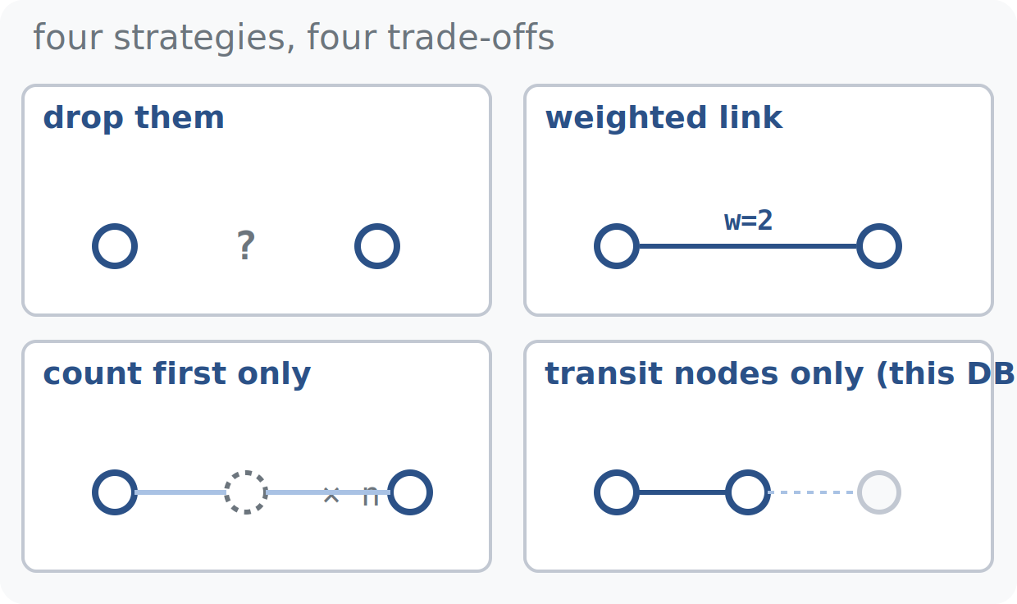
DATABASE · CAVEATS
WEEK 4 · BUILDING BLOCK 4 / 10
Four ways to handle silent hops
Drop them — simplest; breaks distance and connectivity math across the gap.
Weighted links — replace A–*–B with one link of weight 2; preserves reach, distorts degree counts.
Count the first only — at least one silent router exists there; a defensible lower bound.
Transit nodes only — keep routers observed forwarding traffic; smaller graph, every node real. This database's choice.
no free lunch — each strategy trades a different error
ESCALATE Training Program · Summer 2026

Slide 14
PART TWO
02
SQL Tips
01
Build outward from a small seed set
02
Composite indexes help left-to-right only
03
Never start from a full scan
04
Attach cheap enrichment before you fan out
05
Prototype small, then scale up
06
Select only the columns you need
Notes:
This section expands the single 'writing efficient queries' slide. Six habits, each paired with the query from the answer key that puts it into practice. The through-line: every task starts from a small, indexed seed and grows outward, so a 14-million-row graph stays responsive.

Slide 15
DATABASE · QUERY PATTERNS
Reference
WEEK 4 · BUILDING BLOCK 4 / 10
Know which columns are indexed
A blank cell means a scan. Every query that follows seeks one of these indexed columns first.
No Index BAD! Has Index GOOD!
Table
Rows
node_id
link_id
endpoint_ordinal
asn
(country, longitude)
ip
hostname
itdk_link_endpoints
14M
IX
PK
PK
itdk_node_as
4M
PK
PK·IX
itdk_node_geolocation
4M
PK
IX
v_itdk_ifaces_transit
3M
IX
IX
itdk_router_hostnames
2M
PK
PK·IX
PK
primary key
IX
secondary index
PK·IX
indexed primary key
blank = not indexed (forces a scan)
ESCALATE Training Program · Summer 2026
Notes:
The map for everything that follows. PK = primary key, IX = secondary index, PK·IX = an indexed primary key. A blank cell means that column is not indexed, so filtering or joining on it forces a scan. Every efficient query in this section seeks one of these indexed columns first: asn on itdk_node_as, (country, longitude) on itdk_node_geolocation, link_id / node_id on the endpoint table, hostname on itdk_router_hostnames.

Slide 16
DATABASE · QUERY PATTERNS
01 / 06
WEEK 4 · BUILDING BLOCK 4 / 10
Never start from a full scan
itdk_link_endpoints alone is 14.2M rows / 1.5 GB. Filter or join on an indexed column first: node_id, asn, hostname, or link_id.
WITH level3_nodes AS (
SELECT le.link_id, le.node_id, g.latitude, g.longitude
FROM itdk_link_endpoints le
JOIN itdk_node_as na ON le.node_id = na.node_id
JOIN itdk_node_geolocation g ON le.node_id = g.node_id
WHERE na.asn = 3356 -- indexed column, never a full scan
)
TASK 1
Level3 (AS3356) × Netflix border routers. The asn filter seeks an index instead of reading all 14.2M endpoint rows.
ESCALATE Training Program · Summer 2026
Notes:
The single most important habit. itdk_link_endpoints is 14.2M rows / 1.5 GB. The Task 1 query never touches it unfiltered: asn on itdk_node_as is indexed, so WHERE na.asn = 3356 seeks straight to Level3's nodes and the link join follows only those.

Slide 17
DATABASE · QUERY PATTERNS
02 / 06
WEEK 4 · BUILDING BLOCK 4 / 10
Composite indexes help left-to-right only
itdk_node_geolocation is indexed on (country, longitude). Filtering by country uses it; filtering by longitude alone does not.
WITH cu AS ( -- West Coast China Unicom routers (slide 15)
SELECT a.node_id, g.city
FROM itdk_node_as a
JOIN itdk_node_geolocation g ON g.node_id = a.node_id
WHERE a.asn = 4837
AND g.country = 'US' -- leading column: uses the index
AND g.longitude < -115 -- alone, this would not
)
TASK 2
China Unicom (AS4837) on the US West Coast. country leads the composite index, so it does the work; a longitude-only filter would fall back to a scan.
ESCALATE Training Program · Summer 2026
Notes:
itdk_node_geolocation is indexed on (country, longitude). A B-tree composite index can only be used left-to-right: filtering on country (the leading column) uses it; filtering on longitude alone cannot. Task 2 filters country first, so the index applies.

Slide 18
DATABASE · QUERY PATTERNS
03 / 06
WEEK 4 · BUILDING BLOCK 4 / 10
Build outward from a small seed set
Start from a few node_ids or a single ASN, then join outward. Never begin unfiltered.
SELECT DISTINCT cu.node_id, e2.node_id AS peer_node,
a2.asn AS peer_asn
FROM cu -- a few dozen seed routers
JOIN itdk_link_endpoints e1 ON e1.node_id = cu.node_id
JOIN itdk_link_endpoints e2 ON e2.link_id = e1.link_id
AND e2.node_id <> cu.node_id
JOIN itdk_node_as a2 ON a2.node_id = e2.node_id
AND a2.asn <> 4837
TASK 2
The cu seed drives everything. Links are walked outward from it, never enumerated across the whole table first.
ESCALATE Training Program · Summer 2026
Notes:
Start from a few node_ids or a single ASN, then join outward. Task 2 builds a small seed of West Coast China Unicom routers in the cu CTE, then walks each router's links to the far endpoint. The seed is tiny; the links are followed from it, never enumerated first.

Slide 19
DATABASE · QUERY PATTERNS
04 / 06
WEEK 4 · BUILDING BLOCK 4 / 10
Attach cheap enrichment before you fan out
Join the one-row-per-node tables onto the seed first; save the row-multiplying joins (links, interfaces) for last.
WITH le_as AS ( -- collapse to the grain first
SELECT DISTINCT le.link_id, na.asn
FROM itdk_link_endpoints le
JOIN itdk_node_as na ON na.node_id = le.node_id
WHERE na.asn IN (174, 701, 1299, ...) -- the 18 ASes
)
SELECT a.asn, b.asn, COUNT(*) AS link_count
FROM le_as a
JOIN le_as b ON b.link_id = a.link_id AND a.asn < b.asn
TASK 3
18-AS interconnection heatmap. Collapsing to distinct (link_id, asn) first keeps the row-multiplying self-join small.
ESCALATE Training Program · Summer 2026
Notes:
A direct self-join of itdk_link_endpoints x itdk_node_as fans out badly: multiple endpoints per link, multiple ASNs per node. Task 3 first collapses to the grain it needs with a DISTINCT (link_id, asn) CTE, then does the row-multiplying self-join last, on the small collapsed set.

Slide 20
DATABASE · QUERY PATTERNS
05 / 06
WEEK 4 · BUILDING BLOCK 4 / 10
Prototype small, then scale up
Use LIMIT while developing, and confirm with EXPLAIN / EXPLAIN ANALYZE that the query uses an index scan, not a sequential scan.
-- while drafting: cap the output and read the plan
EXPLAIN ANALYZE
SELECT a.asn, b.asn, COUNT(*) AS link_count
FROM le_as a
JOIN le_as b ON b.link_id = a.link_id AND a.asn < b.asn
GROUP BY a.asn, b.asn
LIMIT 20 ; -- want "Index Scan", not "Seq Scan"
ANY TASK
Wrap a draft in EXPLAIN ANALYZE and add LIMIT while iterating on the Task 3 query; remove both once the plan shows index scans.
ESCALATE Training Program · Summer 2026
Notes:
While developing, wrap the draft query in EXPLAIN ANALYZE and add LIMIT so it returns fast. Read the plan: you want an Index Scan, not a Seq Scan. Once the plan is clean and the result shape looks right, drop both and run the full query.

Slide 21
DATABASE · QUERY PATTERNS
06 / 06
WEEK 4 · BUILDING BLOCK 4 / 10
Select only the columns you need
Avoid SELECT *. The endpoint and hostname tables carry rows you rarely need in full.
SELECT DISTINCT
cu.node_id AS cu_node,
cu.city AS cu_city,
e2.node_id AS peer_node,
a2.asn AS peer_asn,
h.hostname AS peer_hostname -- five columns, not SELECT *
FROM cu
JOIN itdk_link_endpoints e1 ON e1.node_id = cu.node_id
LEFT JOIN itdk_router_hostnames h ON h.ip = ... -- wide table
TASK 2
The endpoint and hostname tables are wide. Naming the five columns you use keeps result rows small and the LEFT JOIN cheap.
ESCALATE Training Program · Summer 2026
Notes:
Avoid SELECT *. The endpoint and hostname tables are wide and carry rows you rarely need in full. Task 2's peer query names exactly five columns across itdk_link_endpoints and itdk_router_hostnames, keeping result rows small and the LEFT JOIN cheap.

Slide 22
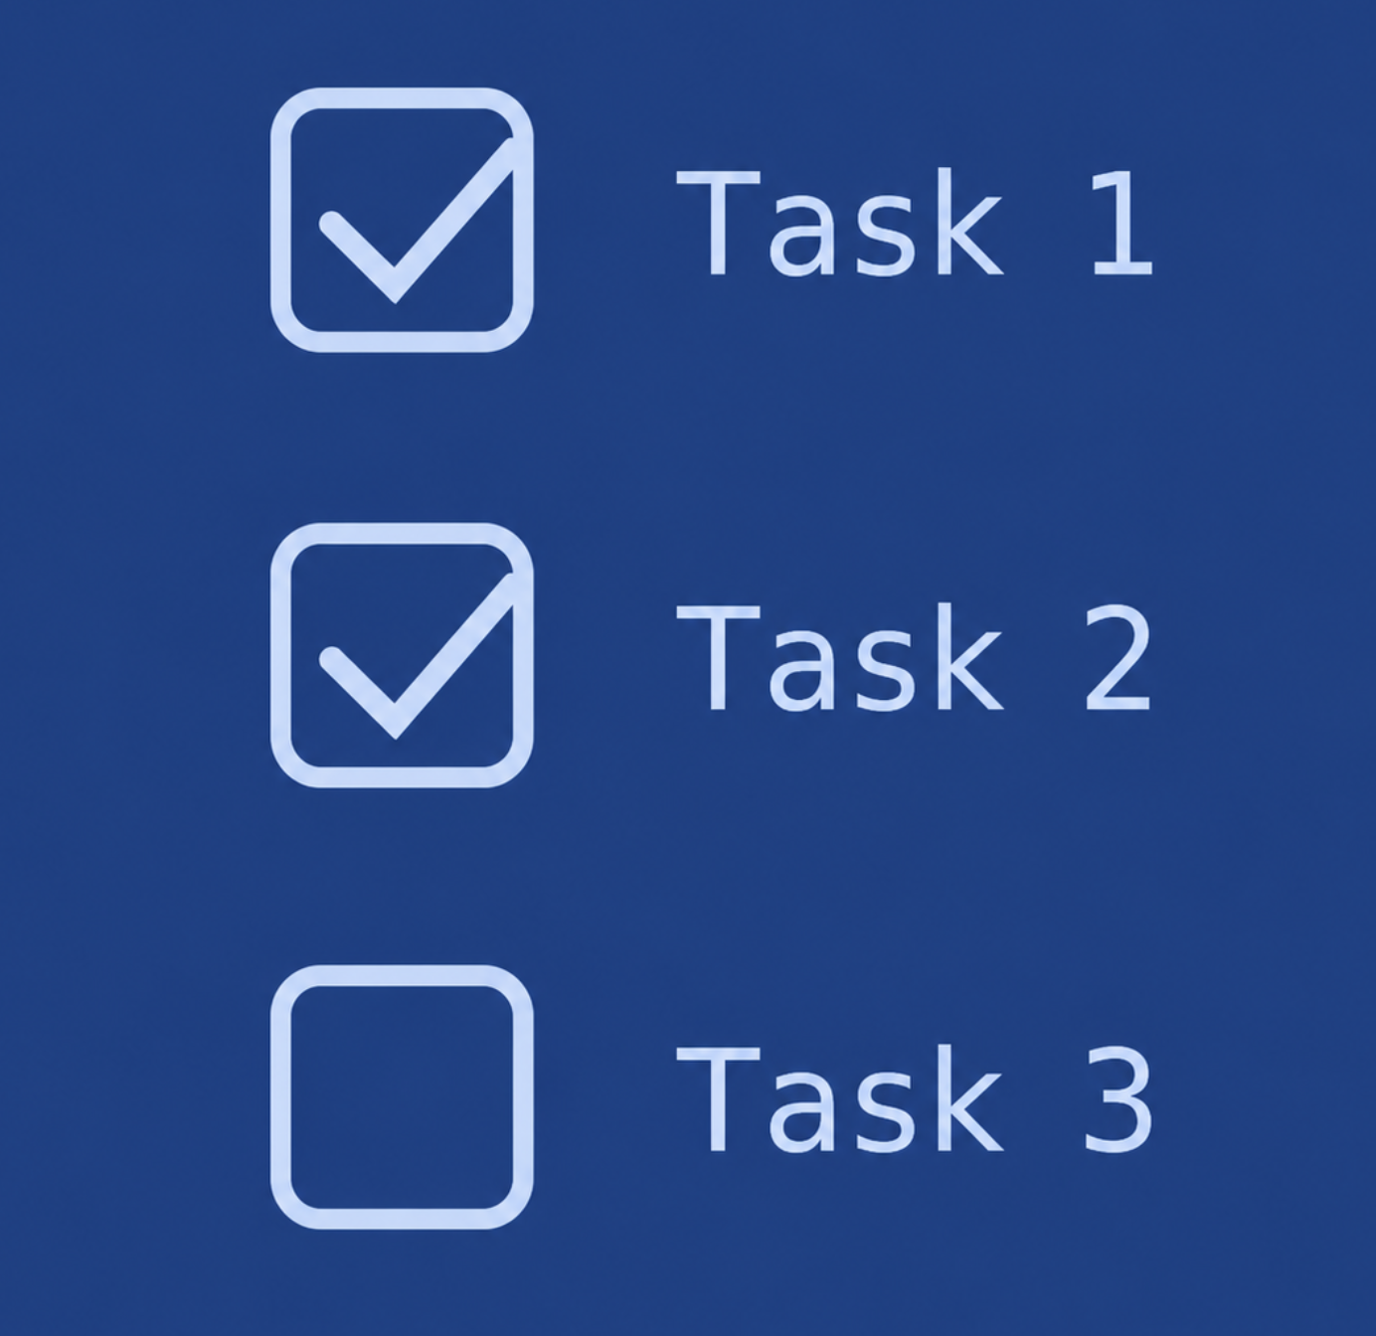
PART TWO
03
The three tasks
what each task asks, and the query pattern that answers it

Slide 23
TASKS · TASK 1
WEEK 4 · BUILDING BLOCK 4 / 10
Border routers: Level3 × Netflix
Find locations where Level3 and Netflix interconnect at the same location.
This should revealing how major networks optimize their topology to minimize video streaming latency and manage high-traffic internet economics.
ESCALATE Training Program · Summer 2026

Slide 24
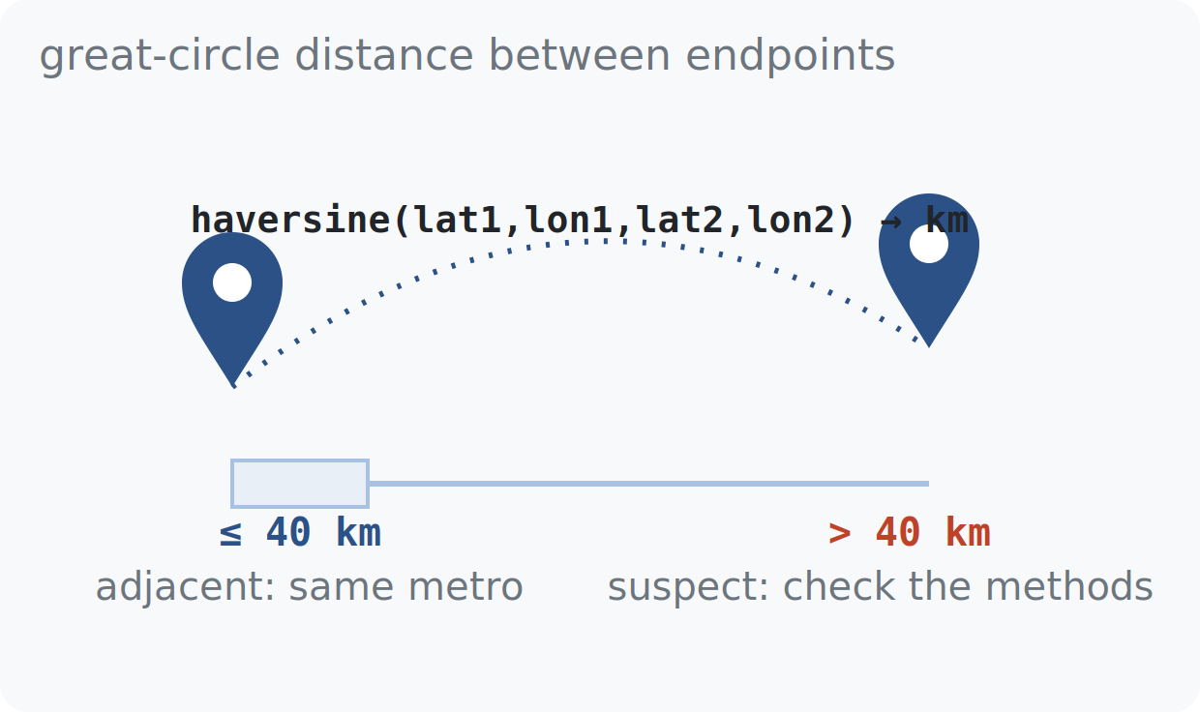
TASKS · DISTANCE
WEEK 4 · BUILDING BLOCK 4 / 10
From coordinates to kilometers
haversine(lat1, lon1, lat2, lon2) — the notebook provides it — returns great-circle km.
Task 1 calls a link geographically adjacent when its endpoints fall within 40 km: same metro area.
A large distance usually means a geolocation error, not a long cable — check the two methods first.
the 40 km threshold separates same-metro links from suspect ones
ESCALATE Training Program · Summer 2026

Slide 25
TASKS · TASK 1
WEEK 4 · BUILDING BLOCK 4 / 10
Comparing China Unicom (AS837) with Level 3 (AS3356)
Find countries where Level 3 and China Unicom have routers.
This highlights how differing market mandates and national boundaries shape regional infrastructure density versus a globally distributed Tier-1 architecture
ESCALATE Training Program · Summer 2026

Slide 26
TASKS · TASK 1
WEEK 4 · BUILDING BLOCK 4 / 10
Comparing China Unicom (AS837) with Level 3 (AS3356)
Where and with whom does China Unicom peer?
To analyze and compare the density and distribution of China Unicom's network infrastructure and peering relationships across major West Coast connectivity hubs.
ESCALATE Training Program · Summer 2026

Slide 27
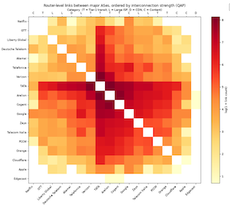
TASKS · TASK 1
WEEK 4 · BUILDING BLOCK 4 / 10
Cross-AS Link Heat Map
Create a heat map of the interconnections between 18 ASNs
To analyze global Internet peering behavior, revealing how core backbone networks directly interconnect with massive content distributors to efficiently route internet traffic.
ESCALATE Training Program · Summer 2026

Slide 28
APPENDIX · FOR SELF-STUDY
A
Supporting detail, not covered live
a few slides included so the deck stands on its own — reference, depth, derivations
Notes:
Appendix: a short SQL/tooling glossary. Not covered live.

Slide 29
APPENDIX · GLOSSARY
Advanced terms and acronyms
Advanced, program- or platform-specific terms only — alphabetical.
crosstab Pivoting rows into a two-way table — here, method × method counts.
DISTINCT SQL keyword deduplicating result rows; collapses multi-interface links.
log1p log(1 + x) — keeps zero and small counts visible on a log color scale.
NULL SQL's missing value; joins produce it where a dropped placeholder sat.
schema A named collection of tables in PostgreSQL — ours is caida_itdk.
self-join Joining a table to itself; pairs the two endpoint rows of one link.
sslmode Connection flag telling the Postgres driver to encrypt the session.
SQLAlchemy Python database toolkit; pandas uses its engine to run our queries.
ESCALATE Training Program · Summer 2026
Notes:
Eight SQL/tooling terms sized up for the short list; networking terms live in Tuesday's glossary.

