Slide 1
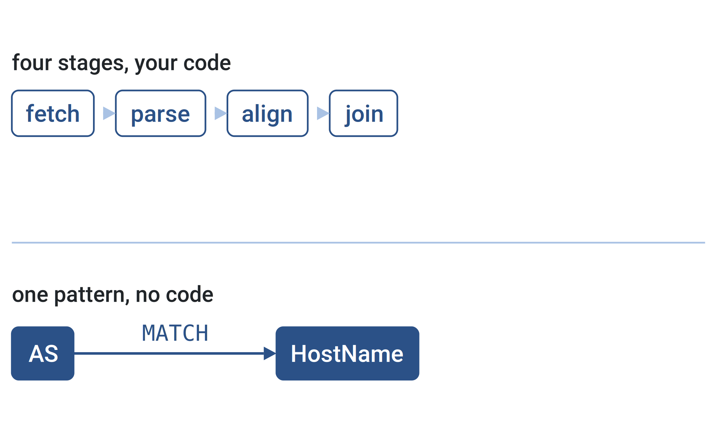


ESCALATE TRAINING PROGRAM · SUMMER 2026
Data fusion: the Internet Yellow Pages
Eighty datasets, one graph, one query
PLENARY
INSTRUCTOR
SENIOR MENTORS
PROGRAM CONTACT
Tue Aug 4 · 12:00 PT
kc claffy
Ricky Mok · Bradley Huffaker · Rocky Chang
Alex Ma
Supported by the NSF ESCALATE project · OAC-2519416

Slide 2
THE ARC
WEEK 8 · BUILDING BLOCK 8 / 10
Ten building blocks — you are here
1
2
3
4
5
Internet structure & ASNs
BGP at scale
Registries: WHOIS / IRR / RPKI
Traceroute, ITDK
DNS
6
7
8
9
10
Network telescope Part 1
Network telescope Part 2
Data fusion (IYP)
Stories of the Internet
SDSC hackathon
Weeks 1-7 built one block at a time. This week fuses them, and the hackathon puts them to work.
ESCALATE Training Program · Summer 2026

Slide 3
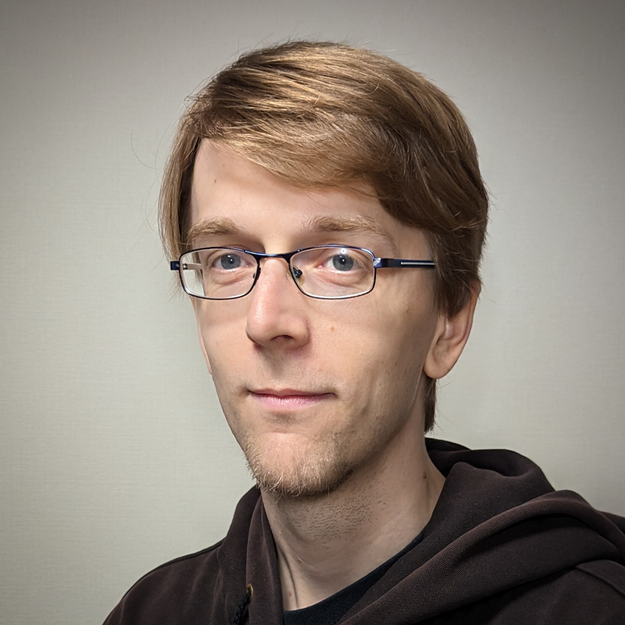
GUEST SPEAKER
WEEK 8 · BUILDING BLOCK 8 / 10
Today’s guest
Malte Tashiro
IIJ Research Laboratory / SOKENDAI
Co-author of the IYP paper and maintainer of the IYP codebase. Member of the ETP program committee.
ON TODAY’S AGENDA
What IYP is, how to query it, and what to ask it at the hackathon.
ESCALATE Training Program · Summer 2026

Slide 4
LAST WEEK · RECAP
WEEK 8 · BUILDING BLOCK 8 / 10
Last week: one sensor, one format, your own aggregation
THIS WEEK BUILDS ON IT
This week the joins arrive already done, and the questions get much shorter.
The telescope gave you raw flow records and nothing else.
You wrote the geolocation join, the ASN attribution, the daily rollup.
Every answer cost a pipeline before it cost an insight.
ESCALATE Training Program · Summer 2026

Slide 5
WEEK 8 · BUILDING BLOCK 8 / 10
THE QUESTION
What would you ask if the datasets were already joined?
Every module so far handed you exactly one.
ESCALATE Training Program · Summer 2026

Slide 6
PART ONE
01
Why a graph
The cost of merging datasets, and who pays it

Slide 7
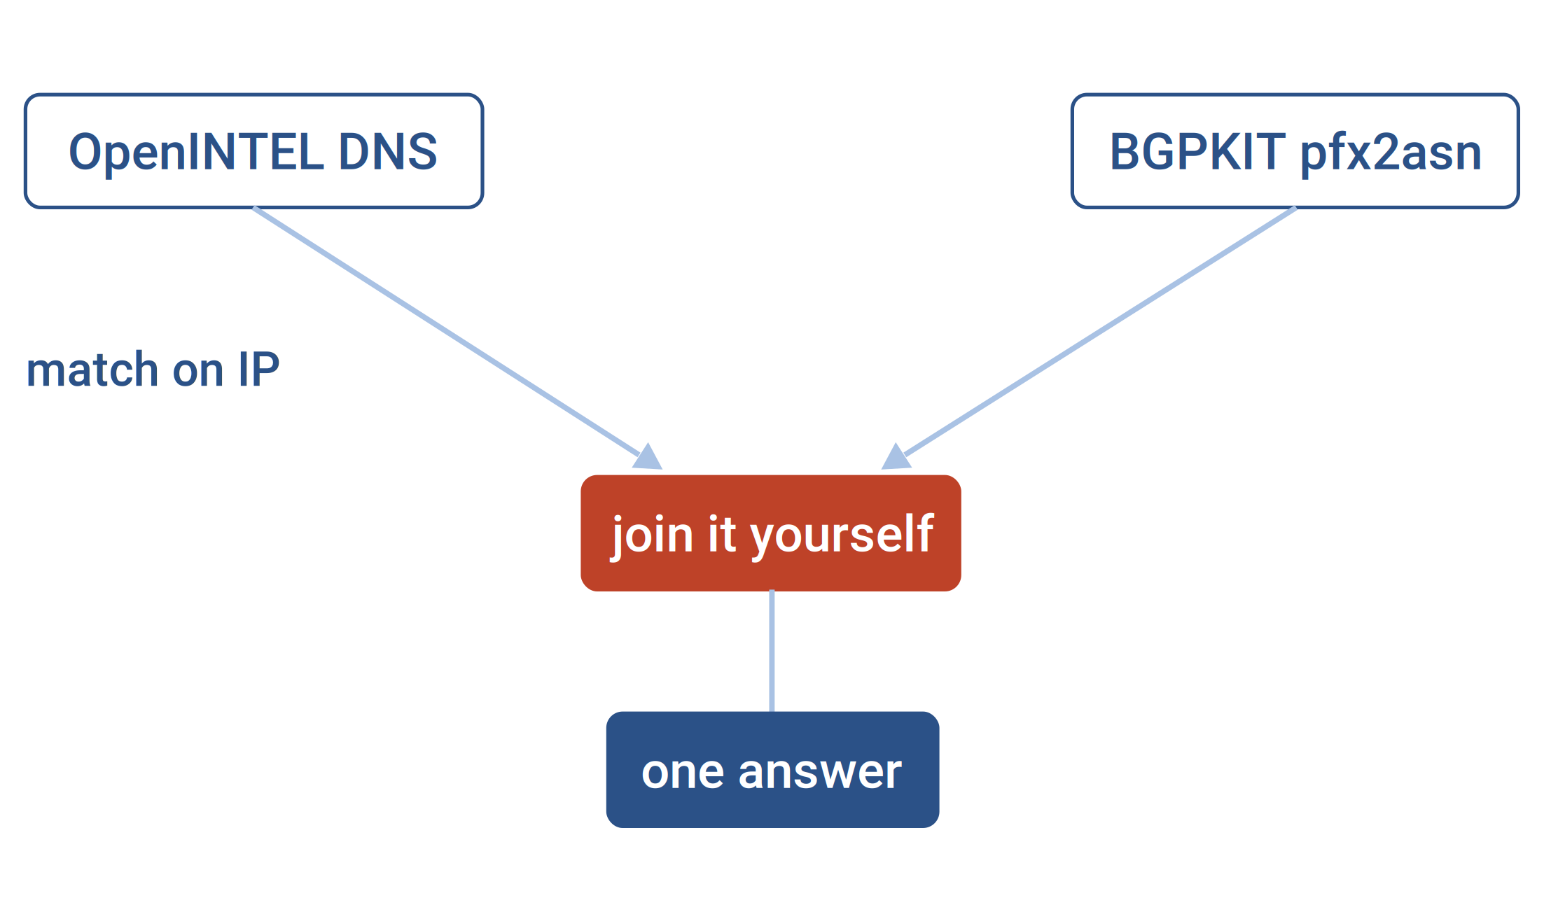
WHY A GRAPH · THE JOIN TAX
WEEK 8 · BUILDING BLOCK 8 / 10
Merging datasets costs enough that questions go unasked
Different formats, different terminology, different areas of expertise.
So people merge two datasets only when the payoff is obvious upfront.
The questions that die are the cheap, curious, exploratory ones.
Two datasets, and the bridge you have to build yourself
ESCALATE Training Program · Summer 2026

Slide 8
WHERE THIS SCALES
WEEK 8 · BUILDING BLOCK 8 / 10
The same question, asked two ways
Write the join
Walk the graph
what the DNS module made you do
what Task 2 asks today
Fetch OpenINTEL resolution data.
Fetch a prefix-to-AS mapping separately.
Match on IP, then join in Spark.
Start at the AS node.
Chain three relationship types.
One MATCH, one result.
ESCALATE Training Program · Summer 2026

Slide 9
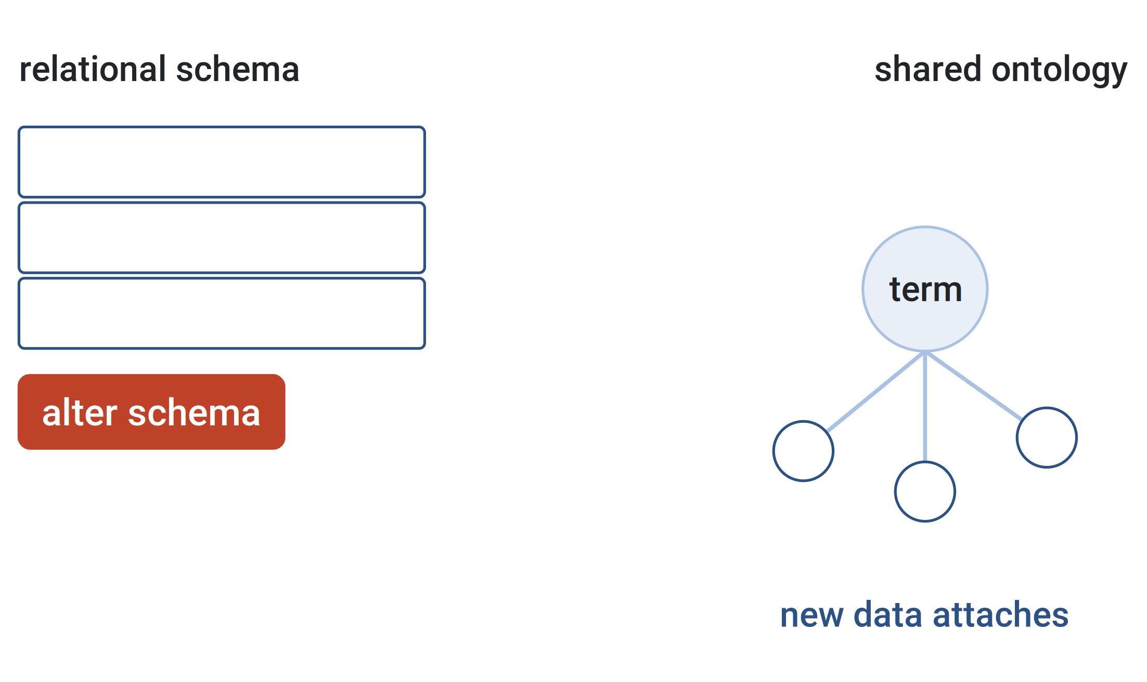
WHY A GRAPH · ONTOLOGY
WEEK 8 · BUILDING BLOCK 8 / 10
An ontology describes meaning, a schema describes structure
Adding a dataset to a relational schema means changing the schema.
Mimicking a graph in tables works, until the joins pile up.
The ontology fixes what a term means, so new data just attaches.
Rewriting a schema, versus attaching to a shared vocabulary
ESCALATE Training Program · Summer 2026

Slide 10
WHAT IS ACTUALLY IN THERE
WEEK 8 · BUILDING BLOCK 8 / 10
Some of what IYP already holds
BGPKIT prefix-to-AS
REFERENCE
Origin AS per prefix, from all RIS and RouteViews collectors
bgpkit.pfx2asn
CAIDA AS Rank
REFERENCE
AS ranking derived from customer cone size
caida.asrank
ESCALATE Training Program · Summer 2026

Slide 11
WHAT IS ACTUALLY IN THERE
WEEK 8 · BUILDING BLOCK 8 / 10
And some of what makes Task 2 possible
OpenINTEL Top Lists
REFERENCE
Daily DNS resolution for top-list domains (e.g., Cisco Umbrella Top 1M)
openintel.toplist
PeeringDB
REFERENCE
IXPs and their members, as the operators report them
peeringdb.ix
ESCALATE Training Program · Summer 2026

Slide 12
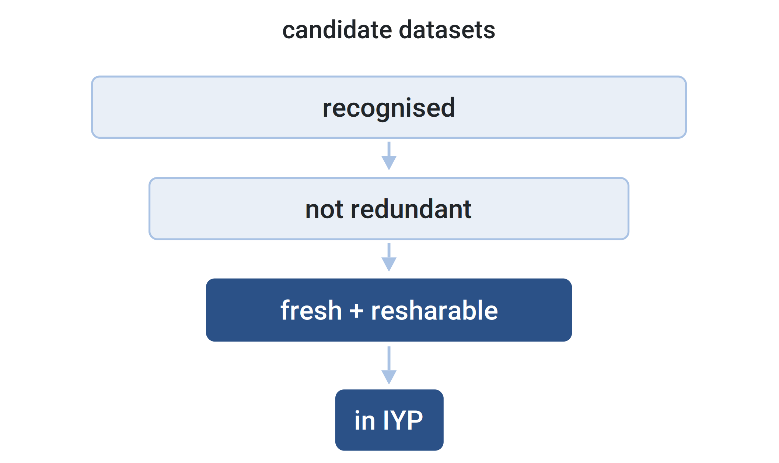
WHY A GRAPH · SELECTION
WEEK 8 · BUILDING BLOCK 8 / 10
Why these datasets and not others
Recognised: peer reviewed, or independently used, or authoritative.
Not redundant: no two datasets derived from the same source.
Fresh, and licensed so the merged snapshots can be shared at all.
Four filters between a public dataset and a place in the graph
ESCALATE Training Program · Summer 2026

Slide 13
THE NUMBERS
WEEK 8 · BUILDING BLOCK 8 / 10
IYP at publication
46
23
24
4x
datasets integrated
organisations providing them
node types in the ontology
rebuilds every month
Figures as published in May 2024. The graph has grown since.
ESCALATE Training Program · Summer 2026

Slide 14
PART TWO
02
Nodes, relationships, provenance
The one modelling choice you have to understand first

Slide 15
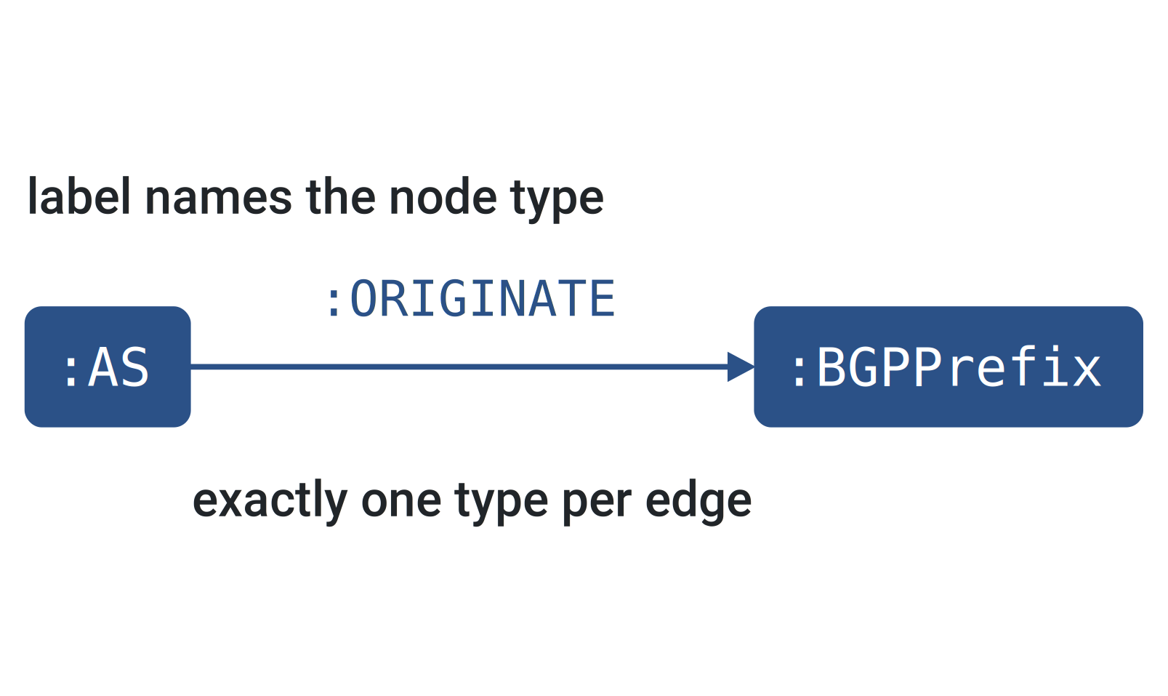
DATA MODEL · LABELS AND TYPES
WEEK 8 · BUILDING BLOCK 8 / 10
Nodes carry labels, relationships carry exactly one type
A node has one or more labels naming what it is.
A relationship has exactly one type, and its own properties.
Node labels are camel case, relationship types upper snake case.
A labelled node, a typed edge, and the naming convention
ESCALATE Training Program · Summer 2026

Slide 16
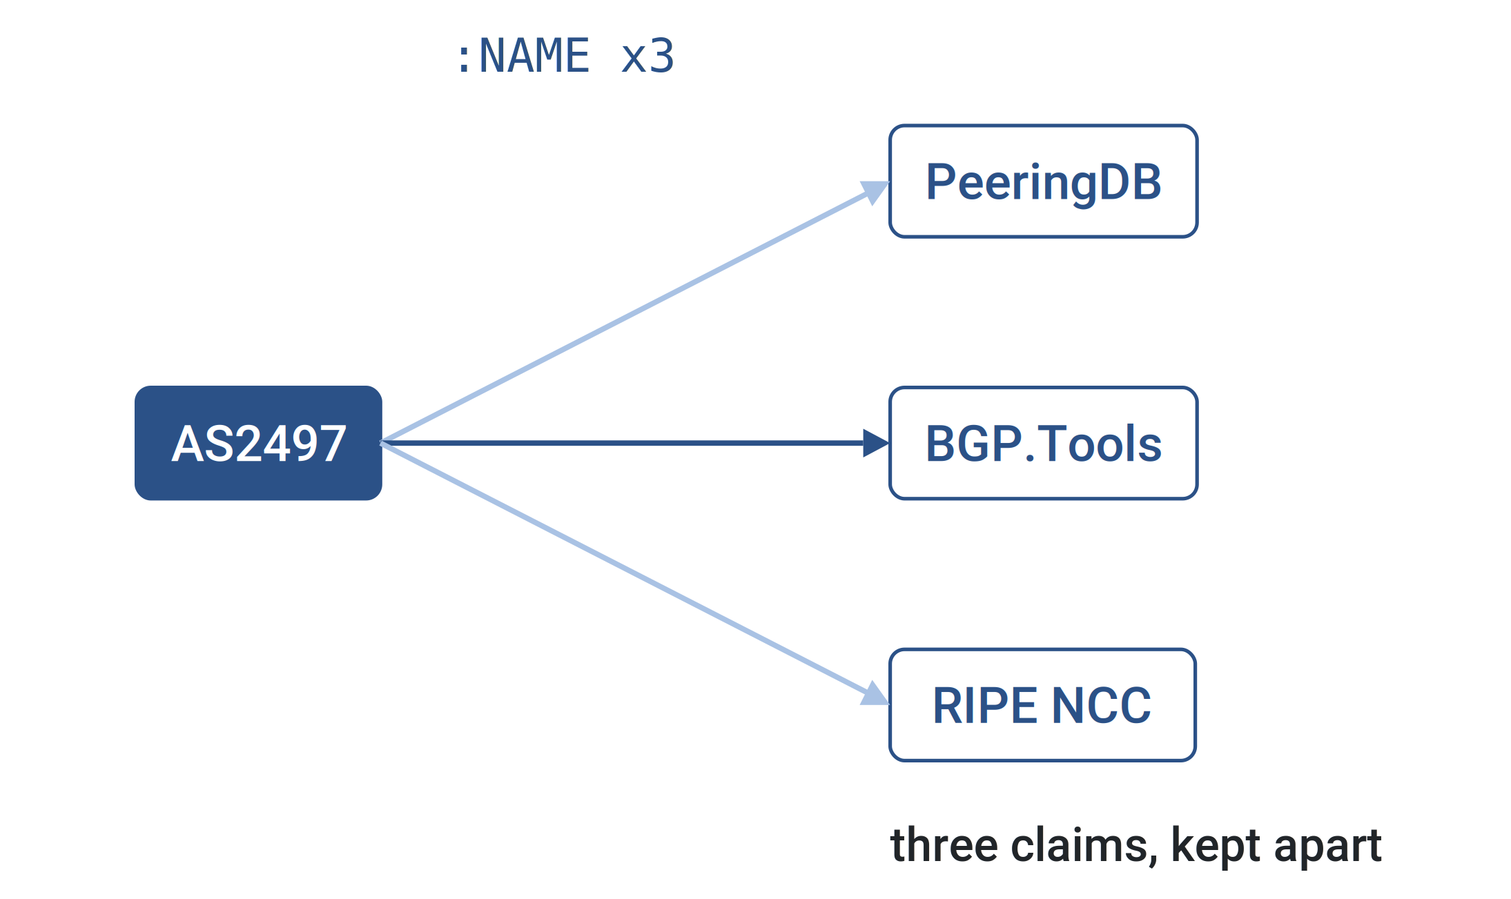
DATA MODEL · THE KEY CHOICE
WEEK 8 · BUILDING BLOCK 8 / 10
IYP stores every source's claim, not one truth
An AS name is not a property. It is a Name node reached by NAME.
PeeringDB, BGP.Tools and RIPE NCC each get their own NAME edge.
Sources genuinely disagree, and flattening them would hide it.
One AS, three sources, three separate claims
ESCALATE Training Program · Summer 2026

Slide 17
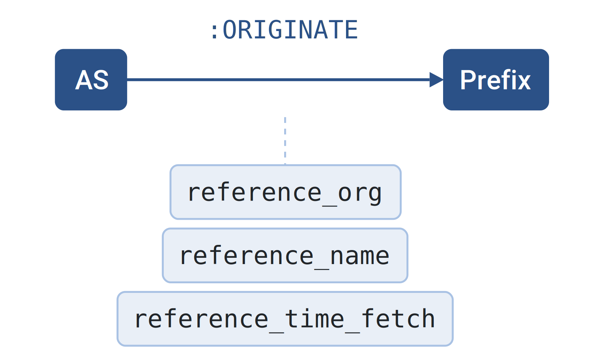
DATA MODEL · PROVENANCE
WEEK 8 · BUILDING BLOCK 8 / 10
Every relationship records where the fact came from
reference_org, reference_name, the fetch time, the source URL.
Filter on those before you aggregate, or you average rivals together.
It is also how you check a result after the fact.
Provenance properties hanging off a single relationship
ESCALATE Training Program · Summer 2026

Slide 18
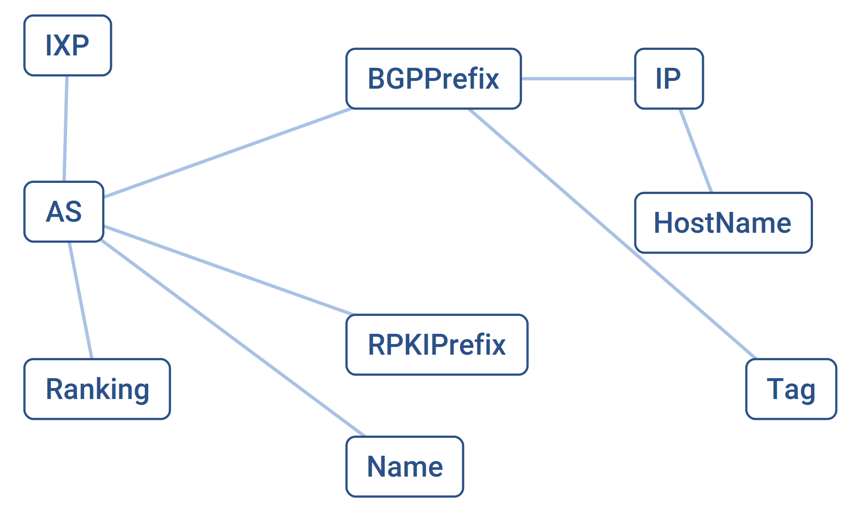
DATA MODEL · YOUR CORNER OF IT
WEEK 8 · BUILDING BLOCK 8 / 10
Nine labels and ten relationship types carry the whole assignment
AS, BGPPrefix, RPKIPrefix, IP, HostName, IXP, Ranking, Name, Tag.
ORIGINATE, PART_OF, RESOLVES_TO, MANAGED_BY, PEERS_WITH, MEMBER_OF.
Plus NAME, RANK, CATEGORIZED and ROUTE_ORIGIN_AUTHORIZATION.
The subgraph the three tasks actually traverse
ESCALATE Training Program · Summer 2026

Slide 19
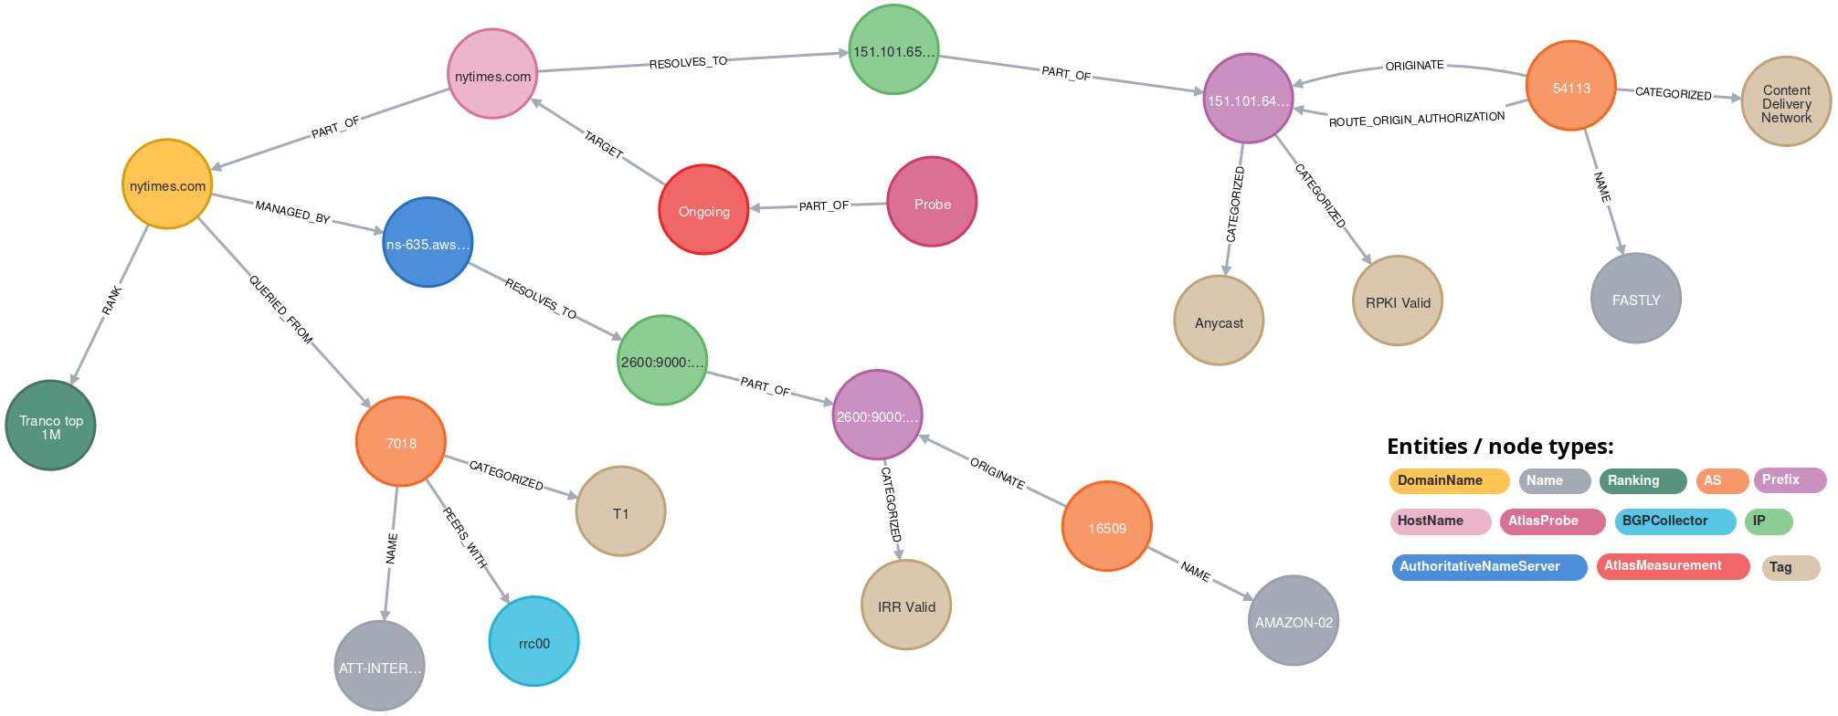
CASE STUDY
WEEK 8 · BUILDING BLOCK 8 / 10
One domain name, thirteen datasets
SETUP
TRAVERSE THE GRAPH
WHAT THE DATA SHOWED
Start at a single DomainName node, nytimes.com, and follow relationships outward.
Domain to hostname to IP to prefix to origin AS, then out to rankings, tags and nameservers.
Thirteen independent datasets in one readable picture, with no join written by hand and no format conversion.
ESCALATE Training Program · Summer 2026

Slide 20
PART THREE
03
Cypher
Draw the pattern you want, and that is the query

Slide 21
CYPHER · THE IDEA
WEEK 8 · BUILDING BLOCK 8 / 10
A query is a drawing of the pattern you want
AS
2497
ORIGINATE
Prefix
Parentheses are nodes. Square brackets in the dashes are edges.
MATCH gives the pattern, WHERE constrains it, RETURN picks fields.
Edges are undirected unless you add an arrowhead on purpose.
MATCH (x:AS)-[:ORIGINATE]-(p:Prefix)
WHERE x.asn = 2497
RETURN p
The same relationship, drawn and then written
ESCALATE Training Program · Summer 2026

Slide 22
CYPHER · A REAL QUERY
WEEK 8 · BUILDING BLOCK 8 / 10
Multiple origin AS prefixes, in three lines
Match a prefix connected by ORIGINATE to two different AS nodes.
Constrain the two ASNs to differ, and return the prefix.
Shape reflects intent.
x
y
AS
ORIGINATE
Prefix
ORIGINATE
AS
MATCH (x:AS)-[:ORIGINATE]-(p:Prefix)↵
-[:ORIGINATE]-(y:AS)
WHERE x.asn <> y.asn
RETURN p
Two ASes originating the same prefix
ESCALATE Training Program · Summer 2026

Slide 23
CYPHER · MULTI-HOP
WEEK 8 · BUILDING BLOCK 8 / 10
Chain relationship types and cross datasets in one pattern
AS to announced prefix, prefix to IP, IP to hostname. One MATCH.
From left to right: Each hop is a different underlying dataset.
This is the technique that makes IYP different from a pile of files.
ORIGINATE
PART_OF
RESOLVES_TO
AS
BGPPrefix
IP
HostName
announced space
what it hosts
MATCH q = (:AS)-[:ORIGINATE]->(:BGPPrefix)↵
<-[:PART_OF]-(:IP)↵
<-[:RESOLVES_TO]-(:HostName)
RETURN q
Four node types, three hops, three source datasets
ESCALATE Training Program · Summer 2026

Slide 24
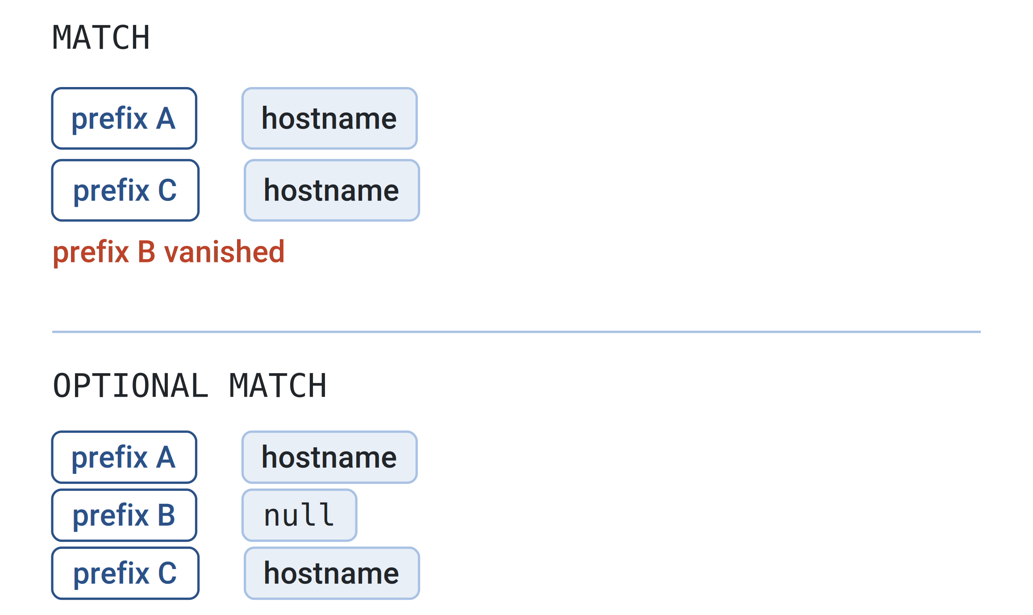
CYPHER · OPTIONAL MATCH
WEEK 8 · BUILDING BLOCK 8 / 10
A plain MATCH drops the row, which looks like a zero
If any part of the pattern misses, the whole row disappears.
That reads as 'none' when it means 'this source has no entry'.
OPTIONAL MATCH keeps the row and gives you a null instead.
The same three prefixes, with and without OPTIONAL MATCH
ESCALATE Training Program · Summer 2026

Slide 25
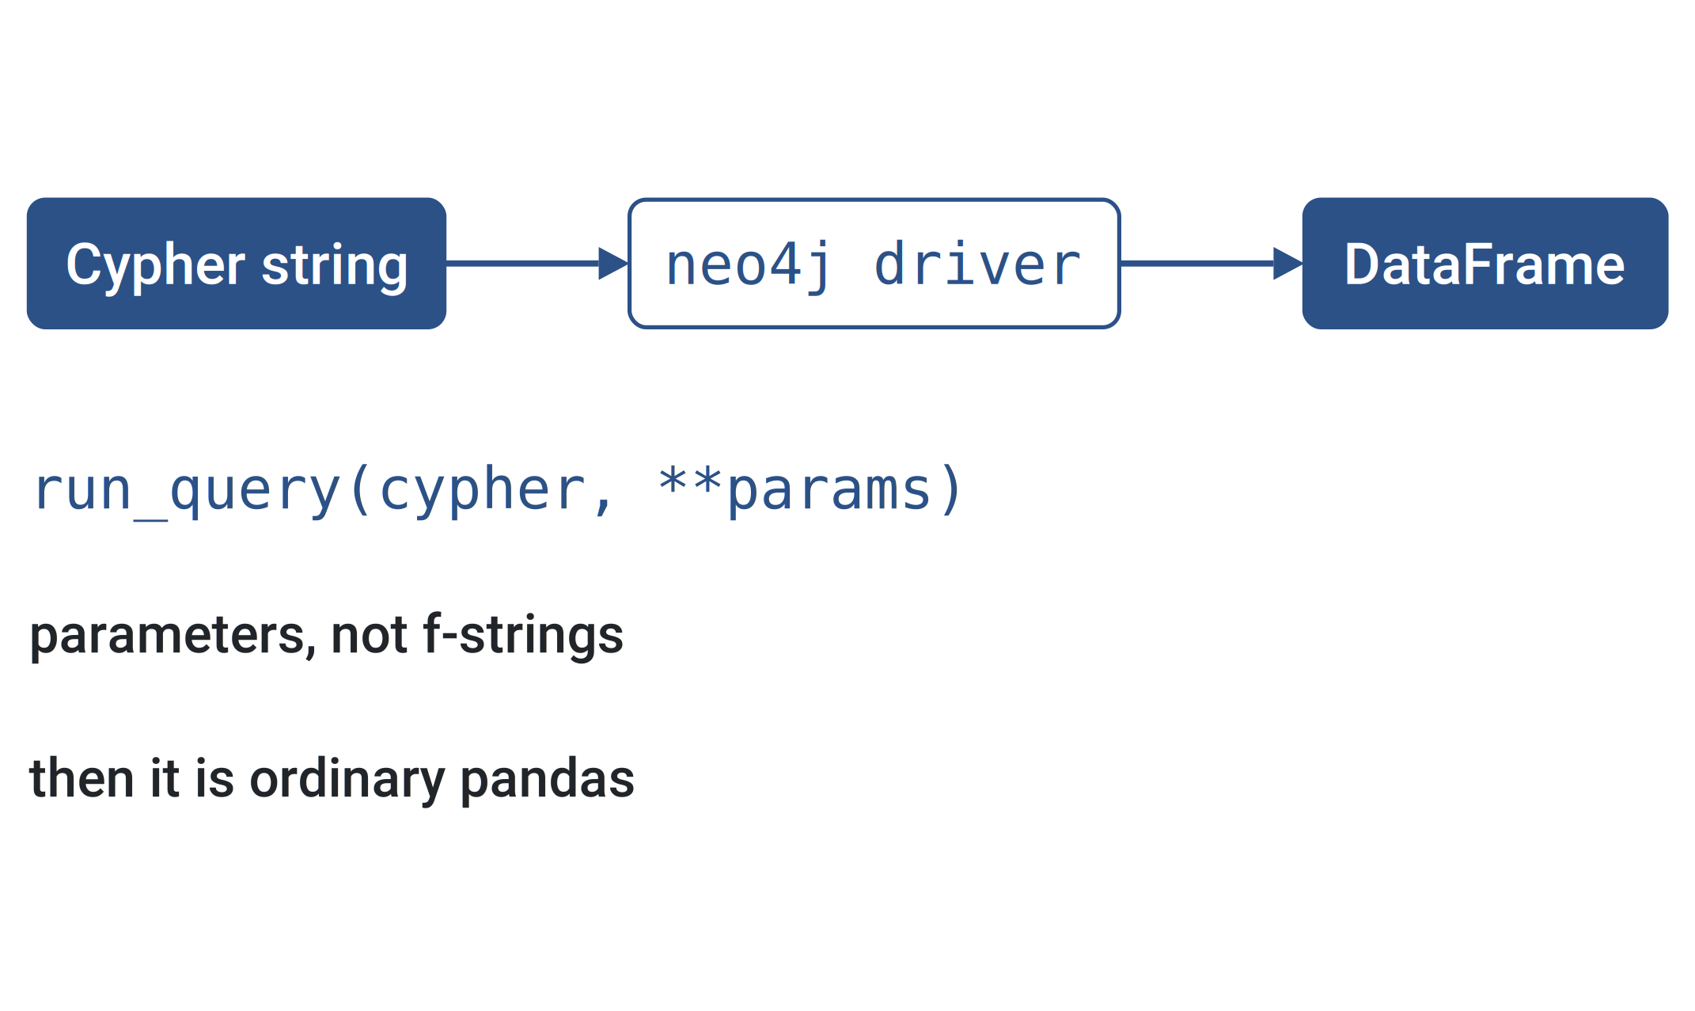
CYPHER · FROM PYTHON
WEEK 8 · BUILDING BLOCK 8 / 10
One driver, one helper, and then it is ordinary pandas
Open a driver once, hand it a Cypher string, get records back.
The notebook wraps that in run_query(), which returns a DataFrame.
Pass values as parameters, not as f-strings.
Cypher string to driver to DataFrame
ESCALATE Training Program · Summer 2026

Slide 26
METHODOLOGY
WEEK 8 · BUILDING BLOCK 8 / 10
Writing a query that comes back
Start
AS {asn: ...}
↓
Tens of millions of nodes, so query shape matters as much as it would against a large SQL table.
Filter
reference_name
↓
Traverse
explicit hops
KNOW THE LIMITS
A shared read-only service on 4 vCPU and 8 GB of RAM. Run your own copy if you need to query at a high rate.
↓
Prototype
LIMIT 10
ESCALATE Training Program · Summer 2026

Slide 27
PART FOUR
04
What it is for
And what it will not do for your hackathon project

Slide 28
WEEK 8 · BUILDING BLOCK 8 / 10
THE QUESTION
IYP is a snapshot. Your question is about change over time.
So what is it actually the right tool for?
ESCALATE Training Program · Summer 2026

Slide 29
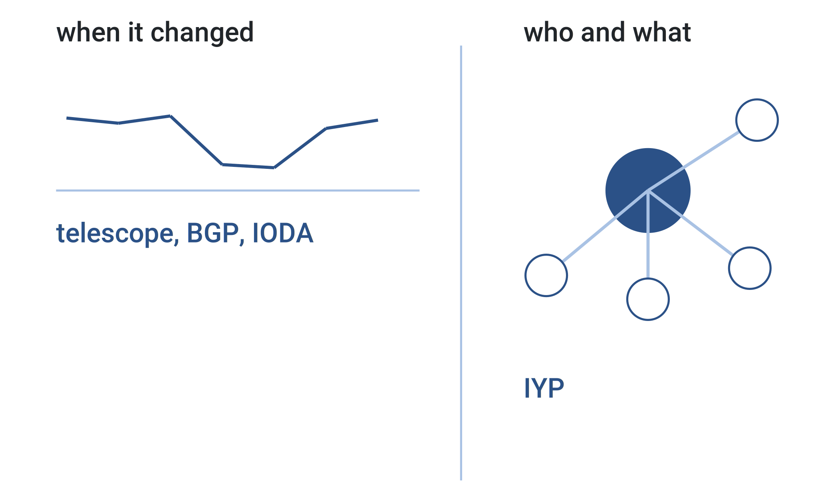
AT THE HACKATHON · DIVISION OF LABOUR
WEEK 8 · BUILDING BLOCK 8 / 10
Time series tell you when. IYP tells you who and what
Telescope, BGP feeds and IODA answer when something changed.
IYP answers whose address space it was and what depended on it.
A forensic story needs both halves, from different tools.
Two different questions, two different shapes of data
ESCALATE Training Program · Summer 2026

Slide 30
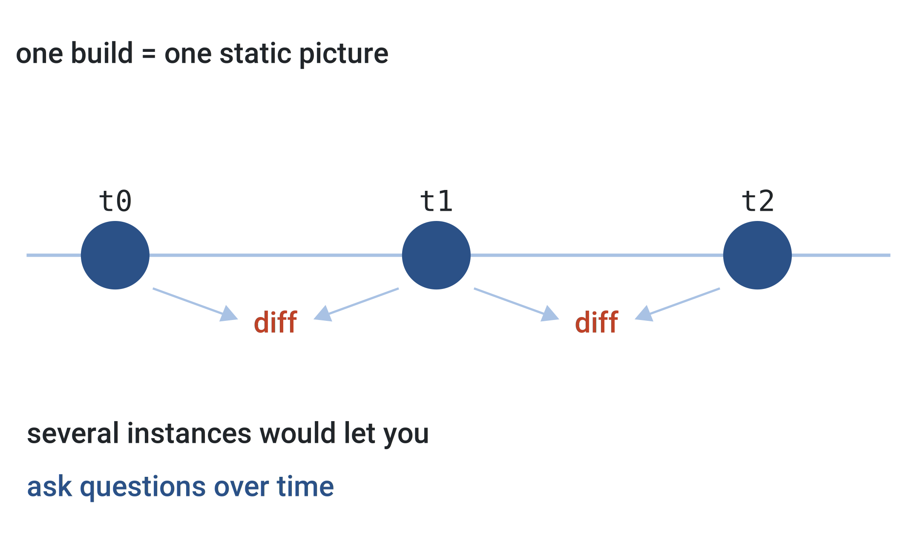
AT THE HACKATHON · A PROJECT IDEA
WEEK 8 · BUILDING BLOCK 8 / 10
One build is one static picture of the Internet
Each snapshot is topology at a moment, which is why change is hard.
Several instances at different dates could be diffed against each other.
Standing that up is non-trivial, and it is on the table as a project.
Three snapshots, and the diffs nobody has taken yet
ESCALATE Training Program · Summer 2026

Slide 31
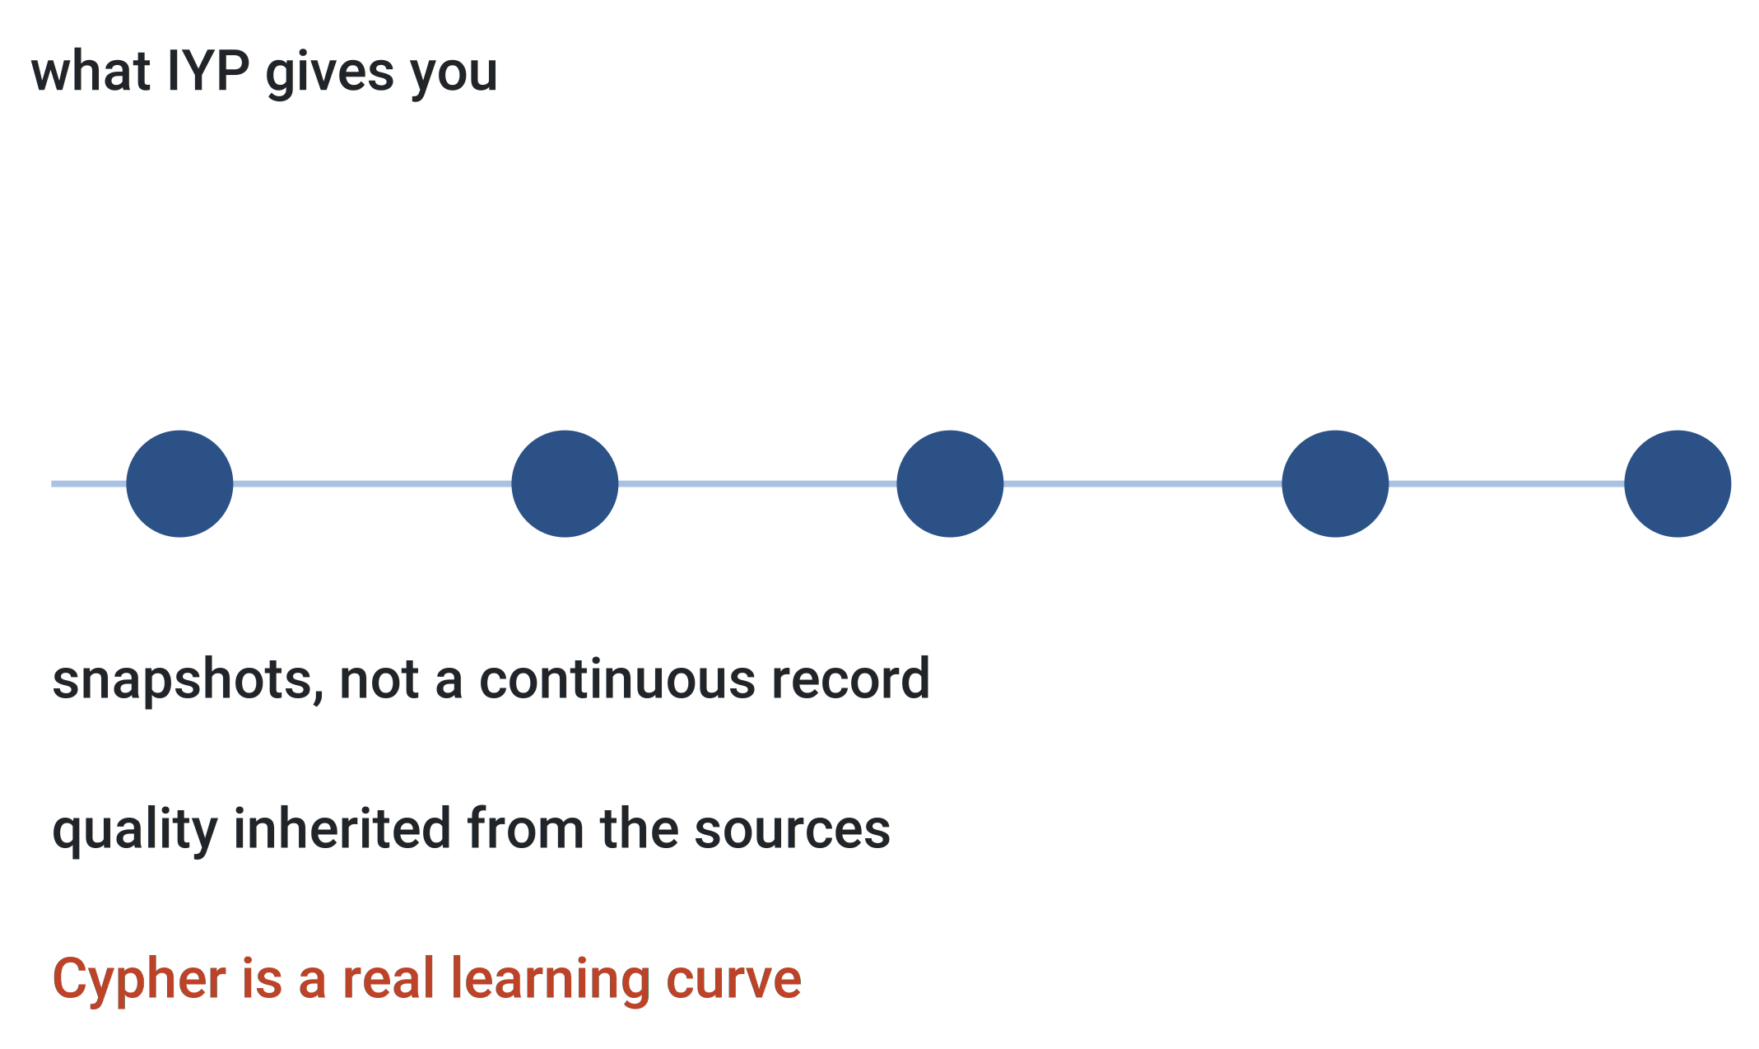
AT THE HACKATHON · LIMITS
WEEK 8 · BUILDING BLOCK 8 / 10
Three limits the paper states about itself
Not built for longitudinal analysis. Snapshots, not a time series.
Data quality is inherited from the sources and deliberately not cleaned.
Cypher and the dataset landscape are both a real learning curve.
What you are getting, and what you are not
ESCALATE Training Program · Summer 2026

Slide 32
ACTION REQUIRED · WEEK 8 SETUP
WEEK 8 · BUILDING BLOCK 8 / 10
Getting to the database
1
Open iyp.iijlab.net/iyp/browser/ in a browser.
2
Connect to iyp-bolt.iijlab.net:443. No username, no password.
3
Uncheck Connect result nodes in the settings cogwheel.
From Python: neo4j://iyp-bolt.ihr.live:7687, auth=None.
ESCALATE Training Program · Summer 2026

Slide 33
ASSIGNMENT 8 · DUE BEGINNING OF WEEK 9
WEEK 8 · BUILDING BLOCK 8 / 10
nids-iyp
Three tasks, nine questions, all inside the notebook. Each task re-asks a question you already answered the hard way.
MODULE MILESTONE
Your first worked example of querying a fused dataset.
Task 1: AS names, ASRank, IXP membership and peering degree.
Task 2: walk from an AS's address space to the domains hosted in it.
Task 3: compare RPKI authorisations against what BGP actually shows.
Answer all nine questions in the notebook markdown cells, then push.
REPOSITORY
github.com/CAIDA/nids-iyp
ESCALATE Training Program · Summer 2026

Slide 34
BEFORE NEXT WEEK
WEEK 8 · BUILDING BLOCK 8 / 10
Before next week
Finish the three tasks and push the completed notebook.
Skim the IYP tutorial pages on data and on querying.
Draft one IYP query aimed at your own hackathon idea.
Bring that query to Thursday's session.
Next week's guest lecture is a good place to sharpen the idea.
OPTIONAL BACKGROUND
Fontugne et al., The Wisdom of the Measurement Crowd, ACM IMC 2024.
Questions Mattermost (fastest)
training-program-info@caida.org
ESCALATE Training Program · Summer 2026

Slide 35
APPENDIX · FOR SELF-STUDY
A
Appendix

Slide 36
APPENDIX · FINDING YOUR WAY
A relationship type you have not met yet
The nine labels here are a small corner of the ontology. The full reference is the documentation folder of the IYP repository on GitHub, one page per node type and relationship type.
Faster in practice: the console's database icon lists every type in the loaded snapshot, with a real example on click. That is the live schema, so it cannot drift from the data.
ESCALATE Training Program · Summer 2026

Slide 37
APPENDIX · WHAT TASKS 1 AND 2 ASK
Disagreement, then the join you did not write
Task 1 is about disagreement. Resolve one name across three sources, then relate peering degree, IXP membership and ASRank. What does ASRank measure, and do the three signals move together?
Task 2 is about the join you did not have to write. Walk from announced prefixes to the hostnames inside them, then ask what you gave up by not fetching the two datasets yourself.
ESCALATE Training Program · Summer 2026

Slide 38
APPENDIX · WHAT TASK 3 ASKS
An RPKI Invalid tag is not proof of a hijack
Non-adoption by a legitimate deaggregating announcer, a stale or missing ROA, a wrong maximum prefix length, or a routing leak all produce the same tag. Saying so is most of the credit.
A ROA with no matching BGPPrefix is usually not an anomaly either. The prefix may not be announced right now, or announced at a length the ROA does not list. Read the actual prefixes first.
ESCALATE Training Program · Summer 2026

Slide 39
APPENDIX · GOTCHAS
Two labels that will mislead you
PEERS_WITH also connects an AS to a BGPCollector, which is a monitoring session and not a peering relationship. Put an explicit AS label on both ends before you count anything.
PART_OF means an IP inside a prefix, or a hostname inside a domain. The node labels tell you which, not the type. COUNTRY is the same: geolocation from one source, registration from another.
ESCALATE Training Program · Summer 2026

