Slide 1
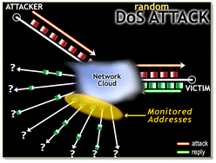
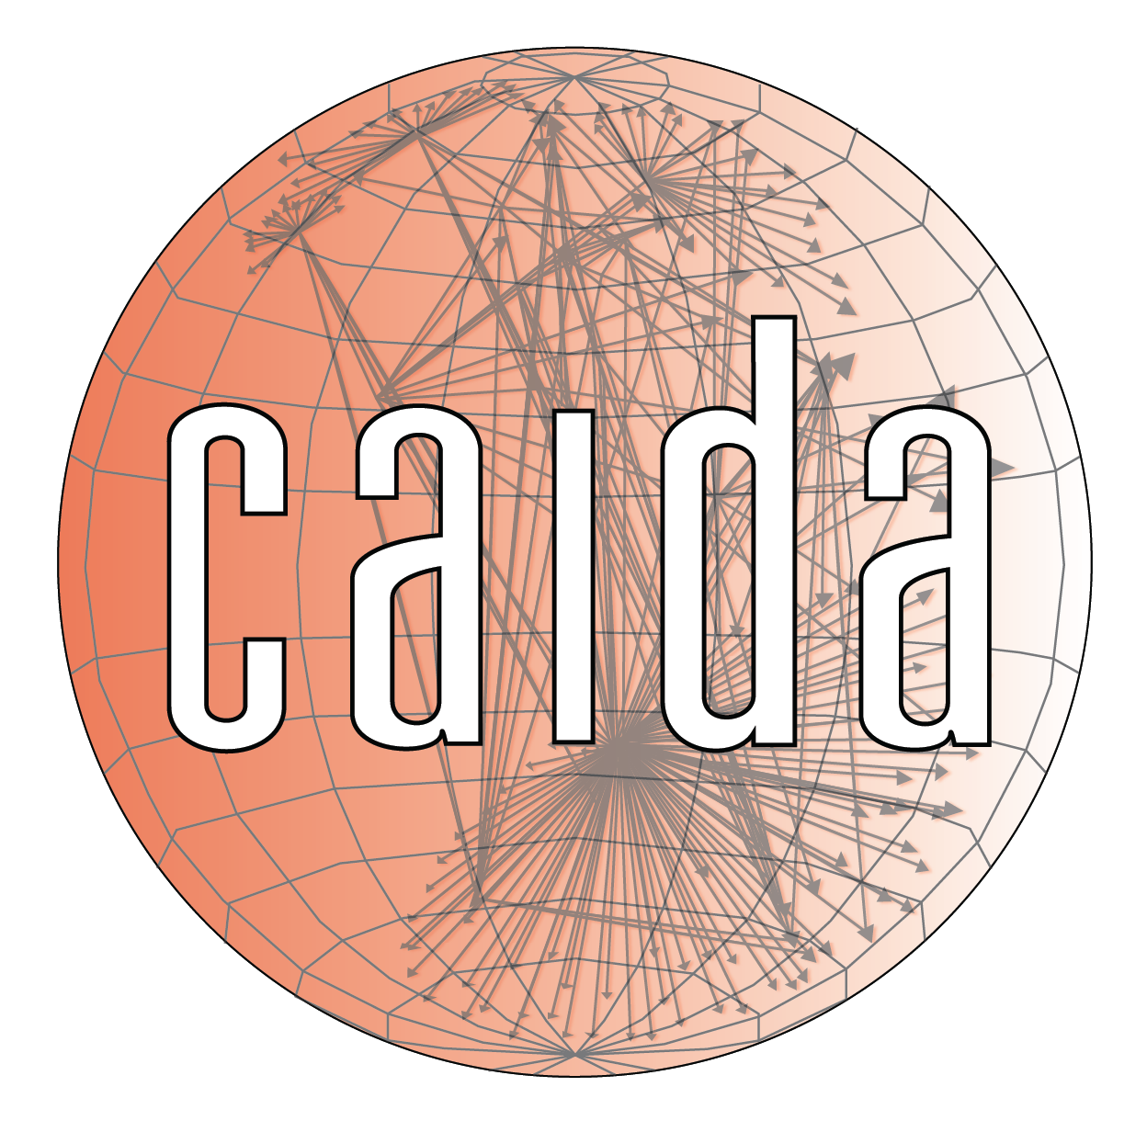

ESCALATE TRAINING PROGRAM · SUMMER 2026
Traffic Data: The UCSD Network Telescope
What 25 years of unsolicited traffic taught us about Internet security
PLENARY
INSTRUCTOR
SENIOR MENTORS
PROGRAM CONTACT
Tue Jul 21, 2026 · Plenary
kc claffy
Ricky Mok, Bradley Huffaker, Rocky Chang
training-program-info@caida.org
Supported by the NSF ESCALATE project · OAC-2519416
Notes:
Welcome to Week 6. This week is about traffic data: what a network telescope is, what it has taught us, and what it costs to keep one running. Today's plenary is the story and the science; Thursday is the hands-on investigation of a real traffic surge. Drop-in figure: a telescope / dark-address-space hero image (CAIDA project page has Worm_Frame.jpg).

Slide 2
THE ARC
WEEK 6 · BUILDING BLOCK 6 / 10
Ten building blocks — you are here
1
2
3
4
5
Internet structure & ASNs
BGP at scale
Registries: WHOIS / IRR / RPKI
Traceroute, ITDK
DNS
6
7
8
9
10
Network Telescope
Network telescope
Data fusion (IYP)
Module planning/building
SDSC hackathon
Week 6 of 10 — from routing tables to raw traffic.
ESCALATE Training Program · Summer 2026
Notes:
We are at building block 6. The last few weeks built control-plane tools; this week we point them at the data plane — actual packets arriving from across the Internet.

Slide 3
LAST WEEK · RECAP
WEEK 6 · BUILDING BLOCK 6 / 10
Where we left off: DNS ecosystem
You measured who runs the DNS: provider market share and concentration (HHI)
You assessed resilience (NS counts, anycast) and security (DNSSEC, SPF, CAA)
You queried OpenINTEL’s daily DNS snapshots at scale with PySpark
THIS WEEK BUILDS ON IT
This week we start looking at Internet traffic!
ESCALATE Training Program · Summer 2026
Notes:
Recap assumes Week 5 was the BGP control-plane module (nids-bgp-control-plane), which the traffic module lists as its prerequisite. [Confirm the exact prior-week topic.] Keep this to orientation, not re-teaching — the LPM trie and MOAS return on Thursday applied to telescope traffic.

Slide 4
WEEK 6 · BUILDING BLOCK 6 / 10
THE QUESTION
What can you learn from traffic that nobody asked for?
A block of unused address space sees a slice of everything sprayed blindly at the Internet.
ESCALATE Training Program · Summer 2026
Notes:
Motivating provocation. The whole field of network telescopes rests on one insight: unused address space should receive nothing, so whatever arrives is a free, unbiased sample of the Internet's unsolicited traffic.

Slide 5
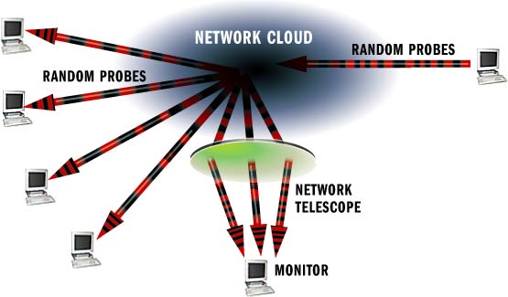
PART ONE
01
What a telescope is
Dark address space as a scientific instrument
Notes:
Part one: the instrument itself — what it observes and how.

Slide 6
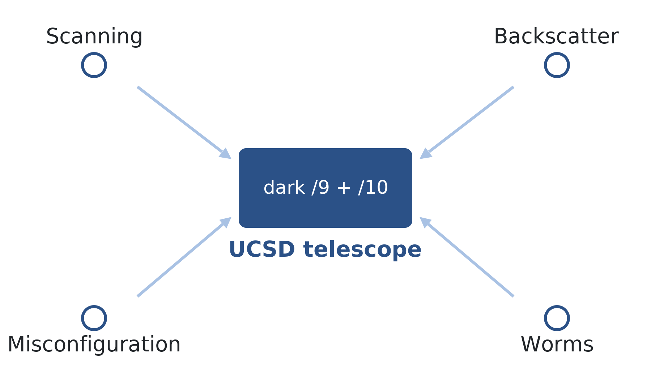
WHAT A TELESCOPE IS · IBR
WEEK 6 · BUILDING BLOCK 6 / 10
Internet Background Radiation
A darknet is routed but unused space, so nothing legitimate should arrive
Everything it receives is unsolicited: scanning, backscatter, misconfiguration, worms
That noise is a continuous, global signal about Internet-wide events
Unsolicited traffic classes converging on unused address space.
ESCALATE Training Program · Summer 2026
Notes:
Define IBR on first use. The key move is conceptual: what looks like pollution is actually signal, because the address space is dark by construction. Teach this from scratch — the cohort snapshot rates Telescope/IBR as TEACH (60% novice).

Slide 7
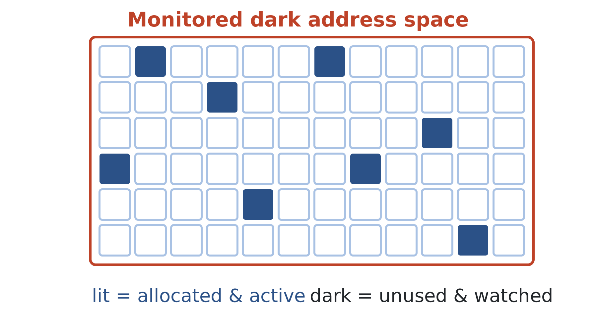
WHAT A TELESCOPE IS · DARKNET
WEEK 6 · BUILDING BLOCK 6 / 10
Why unused address space is the trick
Pick a random IPv4 address and you land in the telescope about 1 in (was 256) 390 times
No hosts means no legitimate traffic to filter out of your signal
You see a representative slice of anything sprayed blindly across IPv4
Lit (allocated, active) vs dark (unused, monitored) address space.
ESCALATE Training Program · Summer 2026
Notes:
The 1/256 figure is the classic framing for the UCSD /9 + /10 (roughly 1/256 of IPv4). Savage's Wi25 lecture uses the same framing. Emphasize why 'unused' matters: it removes the hardest part of passive measurement — separating your signal from real traffic.

Slide 8
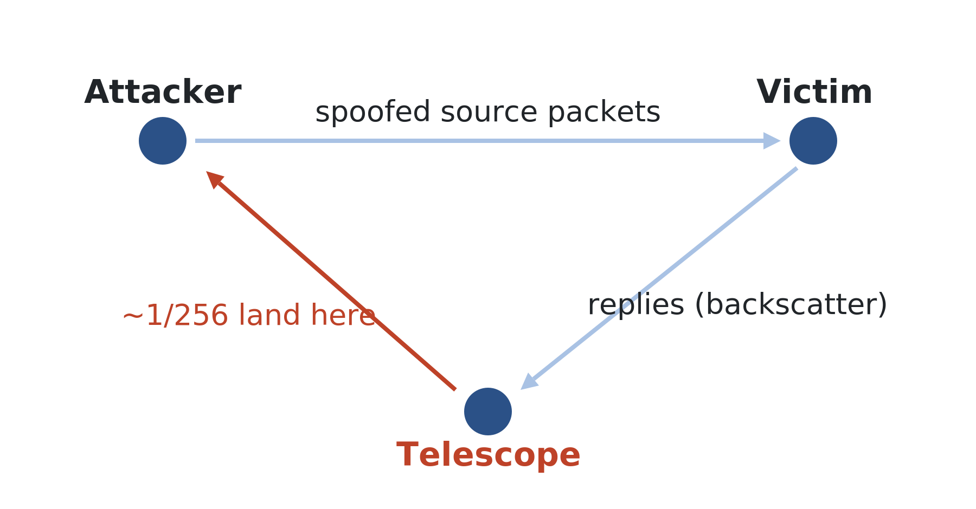
WHAT A TELESCOPE IS · BACKSCATTER
WEEK 6 · BUILDING BLOCK 6 / 10
Backscatter: seeing DDoS attacks you were never part of
A DoS attacker spoofs random source addresses so the victim cannot filter
The victim replies to those spoofed addresses — some land in the telescope
Those stray replies let us infer the victim, the volume, and the target
Attacker spoofs into the telescope; victim's replies arrive as backscatter.
ESCALATE Training Program · Summer 2026
Notes:
This is the mechanism behind the founding study. Walk the triangle: attacker -> victim (spoofed source in net-44) -> reply arrives at the telescope. Because the telescope is ~1/256 of IPv4, it catches ~1/256 of the victim's replies. Video: youtu.be/Yj_SdiG0RuY.

Slide 9
METHODOLOGY
WEEK 6 · BUILDING BLOCK 6 / 10
How the UCSD telescope collects traffic
An optical splitter copies the /9 + /10 traffic; a filter drops ARDC-allocated subnets; nDAG streams feed FlowTuple and PCAP products.
Tap
optical splitter
↓
Filter
ARDC list 2x/day
↓
Transport
nDAG multicast
KNOW THE LIMITS
Filter-list sync errors have silently added or dropped address space, corrupting the data (see Part 3).
↓
Products
FlowTuple / PCAP
ESCALATE Training Program · Summer 2026
Notes:
Different register from a concept slide — this explains provenance. FlowTuple is CAIDA's aggregated flow record (Corsaro/corsaro3 produces it); raw PCAP is unanonymized, ~100 GB/hour. The limits line foreshadows Part 3. Source: SIGCOMM 2025 lessons-learned paper and the 2023 CSE 291-E lecture.

Slide 10
WHAT A TELESCOPE IS · SCALE
WEEK 6 · BUILDING BLOCK 6 / 10
The scale of the instrument
~0.2%
3-6 TB
~8 PB
~300
of all IPv4 address space observed
compressed packets stored per day
pcap archive going back to 2003
publications using telescope data
Figures from the CAIDA network telescope project page and Männel et al., SIGCOMM 2025.
ESCALATE Training Program · Summer 2026
Notes:
All four are real. Publication count: the CAIDA project page states 319 (current); the SIGCOMM 2025 paper counted 294 as of Jan 2025 — I used the project-page figure as the canonical public number. The 3 TB/day is the paper's 'over 3 TB of compressed packets stored each day.'

Slide 11
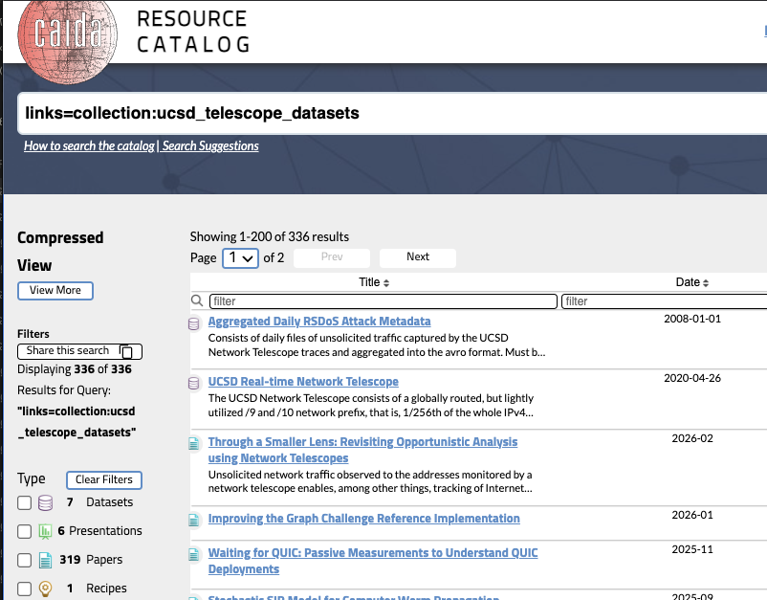
PART TWO
02
History and achievements
From a strange traffic burst to two decades of discovery
Notes:
Part two: how the instrument came to be and the science it enabled.

Slide 12
TIMELINE
WEEK 6 · BUILDING BLOCK 6 / 10
How we got here
1981
2000-04
2011-16
2019
Today
AMPRNet /8
Discovery & worms
Outage detection
The sale
~85% dark
Amateur radio gets the net-44 /8; private address space did not yet exist
DOS Backscatter discovered, then Code Red, Slammer, and Witty captured globally
Telescope data exposes natural and government-induced outages, seeding CAIDA's IODA
ARDC sells the last /10; the telescope shrinks to a /9 plus a /10
A /9 + /10, about 85% dark, still enabling novel security research
ESCALATE Training Program · Summer 2026
Notes:
Dates in mono per house style. The outage-detection node covers Dainotti et al.'s country-wide outage and censorship analysis (Egypt/Libya 2011) through CAIDA's IODA platform. The 2000 discovery is now folded into the worm-era node to keep the 5-node cap while adding IODA.

Slide 13
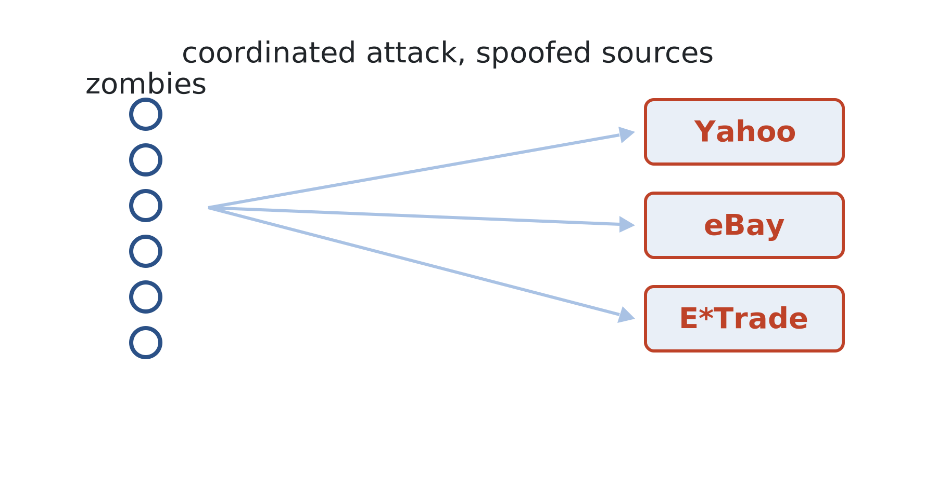
HISTORY · CONTEXT
WEEK 6 · BUILDING BLOCK 6 / 10
The year DoS became a national problem
In 2000, coordinated attacks knocked Yahoo, eBay, and E*Trade offline for hours
The culprit: a 15-year-old ('mafiaboy') driving compromised machines then called 'zombies'
Spoofed sources meant victims could not filter — or even be counted
The threat landscape that motivated the founding backscatter study.
ESCALATE Training Program · Summer 2026
Notes:
Cite: S. Savage, 'Taking apart Inferring Internet Denial-of-Service Activity,' CSE 291-C Wi25 lecture. The words 'bot' and 'botnet' did not exist yet. The counting problem — you cannot see spoofed attacks directly — is exactly what backscatter solved. Drop-in figure: none needed, or a period news headline.

Slide 14
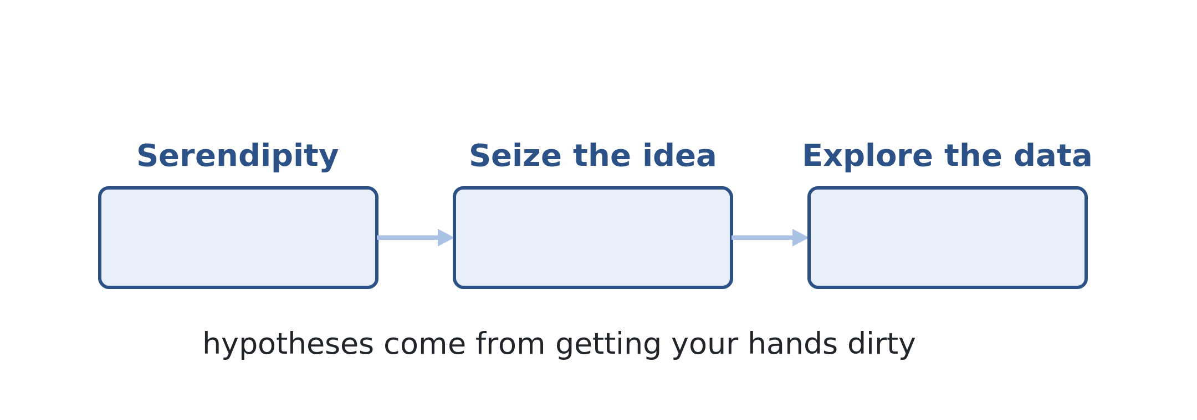
HISTORY · HOW SCIENCE HAPPENS
WEEK 6 · BUILDING BLOCK 6 / 10
How the first paper actually happened
Serendipity: CAIDA researchers/graduate student David Moore flagged inexplicable packets arriving at large prefix announced by UCSD
Seizing it: a quirk became a method for a global measurement of attacks
Then exploratory data analysis — poke the data before you have a hypothesis
"There is no substitute for getting your hands dirty looking at the data."
ESCALATE Training Program · Summer 2026
Notes:
Cite: Savage, CSE 291-C Wi25 lecture. This is a methodological lesson for the cohort's own module work: hypotheses come from somewhere, and that somewhere is usually messing around with real data. Prepared minds exploit lucky data.

Slide 15
METHODOLOGY
WEEK 6 · BUILDING BLOCK 6 / 10
Counting attacks you cannot see directly
Each victim's replies became one 'attack' flow, then the observed backscatter rate was scaled by 256 (now 341..) under a uniform-randomness assumption.
Observe
SYN/ACK backscatter
↓
Group
flow = attack proxy
↓
Extrapolate
rate x 256
KNOW THE LIMITS
A four-year sensitivity analysis on the flow thresholds concluded there were no 'best' parameter values.
↓
Estimate
count, size, rate
ESCALATE Training Program · Summer 2026
Notes:
Cite: Savage, CSE 291-C Wi25 lecture. The 'flow as a proxy for attack' idea directly previews Thursday's flow records. The four-year sensitivity-analysis anecdote (a student's 'intro project' that ballooned) is a great, honest teaching moment about magic numbers in measurement.

Slide 16
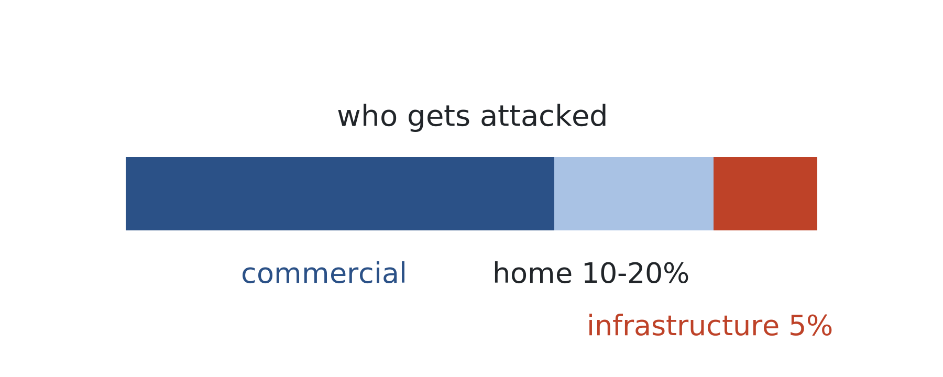
HISTORY · WHAT IT REVEALED
WEEK 6 · BUILDING BLOCK 6 / 10
What backscatter revealed about attacks (2001, Moore et al.)
The full spectrum: Yahoo and CNN, but also thousands of small targets
10-20% of attacks hit home machines — personal vendettas, not just commerce
5% hit infrastructure: routers and name servers
The 2001 study won a test-of-time award in 2017.
ESCALATE Training Program · Summer 2026
Notes:
Cite: Savage, CSE 291-C Wi25 lecture and Moore et al., TOCS 2006. The lineage runs forward to 'Millions of Targets Under Attack' (IMC 2017) and CAIDA's daily RSDoS metadata today. Reverse-DNS names of targets revealed a cultural / personal-grudge dimension nobody expected.

Slide 17
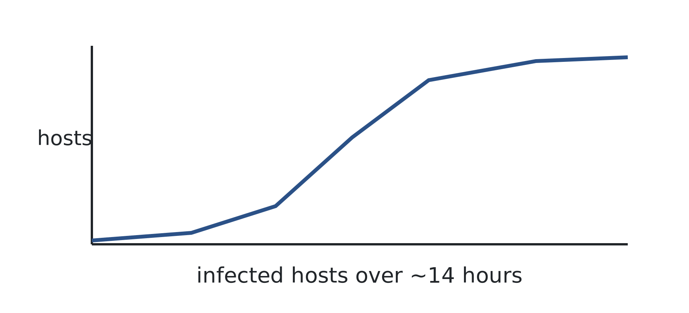
CASE STUDY
WEEK 6 · BUILDING BLOCK 6 / 10
Code Red · July 2001
SETUP
A worm hits a Microsoft IIS bug and probes random addresses; the telescope saw ~1 in 256 of the probes.
WHAT HAPPENED
More than 359,000 hosts were infected in under 14 hours; together they could DDoS the Internet.
WHAT THE DATA SHOWED
The first global, empirical picture of a worm spreading — an animation that made its severity vivid.
ESCALATE Training Program · Summer 2026
Notes:
Cite: G. Voelker, 'Methods of Code-Red,' CSE 291-C Wi25 lecture, and Moore, Shannon & Brown, IMW 2002. The telescope was the study's 'secret weapon.' 359,000 is the paper's headline number for the 14-hour window. Drop-in figure: the Code Red infection map/animation still.

Slide 18
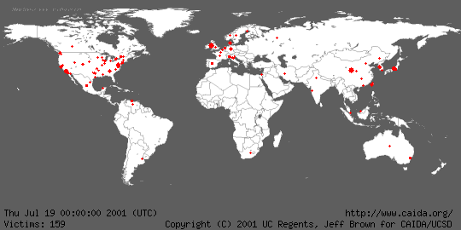

Slide 19
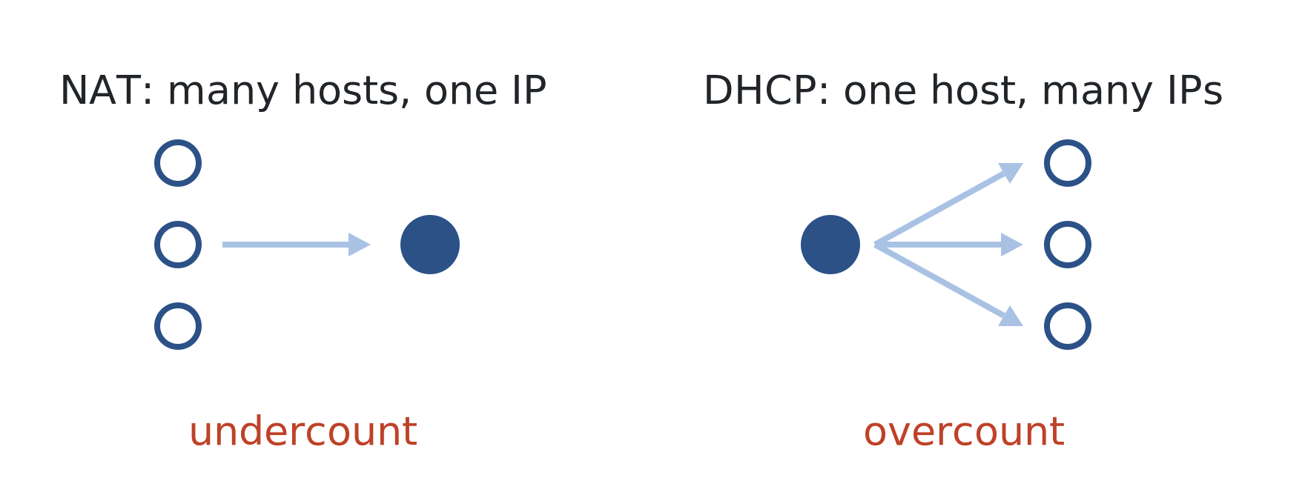
HISTORY · MEASUREMENT HONESTY
WEEK 6 · BUILDING BLOCK 6 / 10
The number depends on the question
359,000 hosts is a 14-hour count; two million is the two-week count
The measurement window changes the claim — state it plainly
NAT undercounts hosts; DHCP overcounts them — know which bias you can live with
Aliasing: one IP can hide many hosts, and one host can wear many IPs.
ESCALATE Training Program · Summer 2026
Notes:
Cite: Voelker, CSE 291-C Wi25 lecture. Why the paper headlines 359k not 2M: honesty about the window. This is a transferable lesson for the cohort's own analysis — a big number is meaningless without its measurement window and its aliasing caveats.

Slide 20
HISTORY · TWO WORMS
WEEK 6 · BUILDING BLOCK 6 / 10
Code Red vs Slammer: why speed changed everything
Code Red (2001)
Slammer (2003)
Latency-limited
Bandwidth-limited
TCP: 100 threads waiting on SYN/ACKs
Spread over ~14 hours
Humans could still react in time
Exploit fit in a single UDP packet
All susceptible hosts in under 10 minutes
Faster than any human response
ESCALATE Training Program · Summer 2026
Notes:
Cite: Voelker, CSE 291-C Wi25 lecture. Both worms fit classic SI (susceptible-infected) epidemic models — the characterize -> model -> predict arc that led to the 'Internet Quarantine' containment work. Slammer being bandwidth-limited is why it saturated so fast.

Slide 21
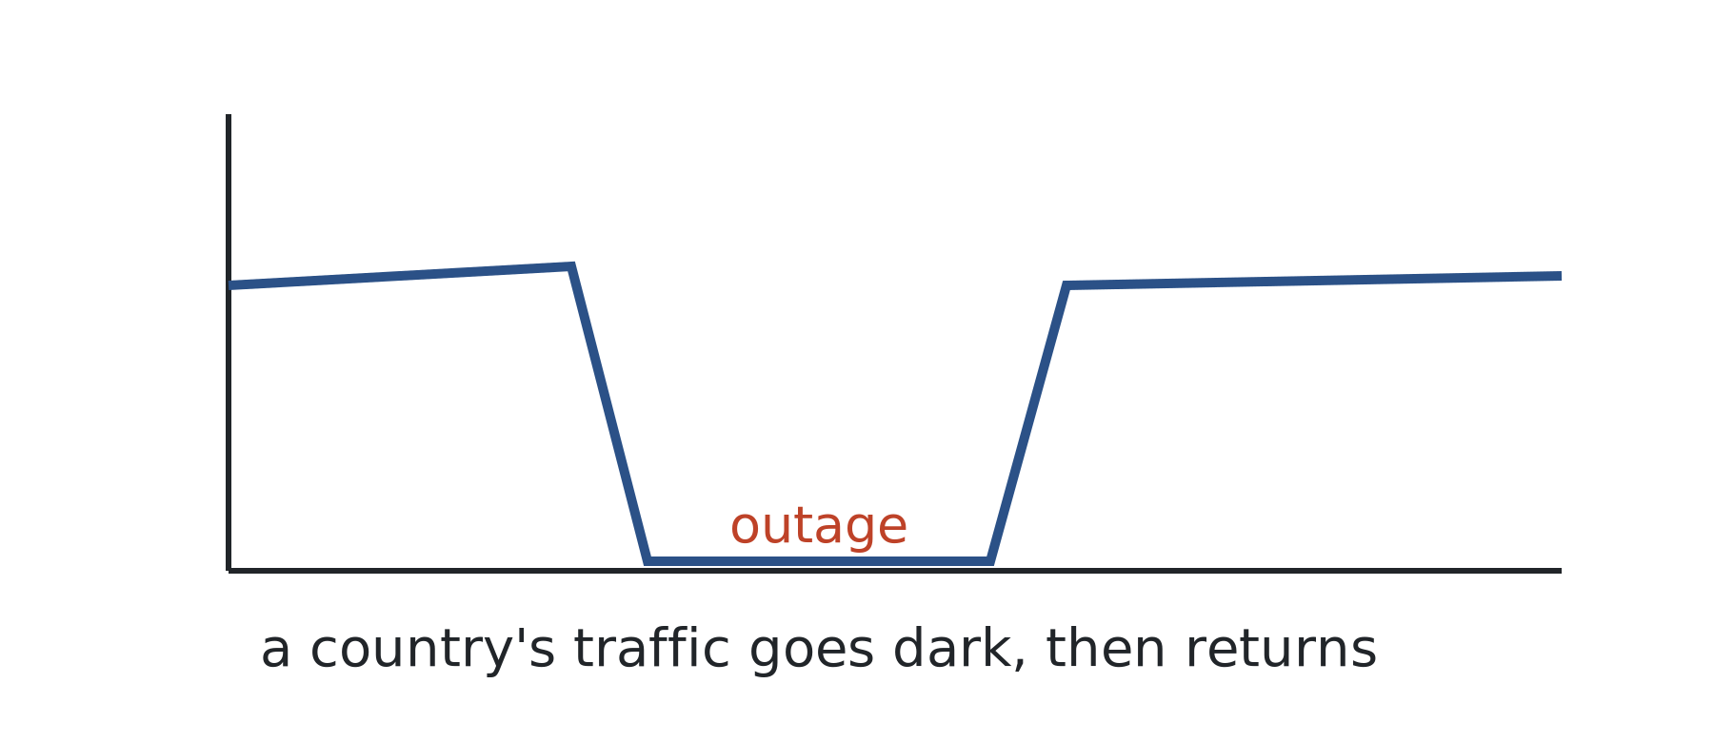
HISTORY · BEYOND ATTACKS
WEEK 6 · BUILDING BLOCK 6 / 10
Beyond attacks: outages and censorship
Country-wide outages and censorship leave fingerprints in telescope traffic
This lineage led to CAIDA's IODA outage-detection platform
The framing: extracting benefit from harm
Malware pollution as a lens on political and geophysical events.
ESCALATE Training Program · Summer 2026
Notes:
Dainotti et al. analyzed country-wide outages (Egypt, Libya) and censorship using telescope data. 'Extracting benefit from harm' is the title framing of the CCR 2012 paper. IODA is the operational descendant.

Slide 22
HISTORY · TODAY
WEEK 6 · BUILDING BLOCK 6 / 10
The telescope in security research today
IoT and ZMap-era mass scanning keep IBR volume climbing
Uses now include botnet tracking and ML analytics (DarkVec, DarkSim)
Vetted researchers bring code to the data via VMs — sensitive traffic never leaves
ESCALATE Training Program · Summer 2026
Notes:
The composition of IBR has shifted from high-intensity scanning and worms toward longer-duration, low-intensity botnet activity (project page and SIGCOMM 2025 paper). The bring-code-to-data VM model is how the cohort's own data access works conceptually — relevant to Thursday.

Slide 23
PART THREE
03
Operational challenges
Lessons learned from operating a large network telescope
Notes:
Part three source: Männel, Mücke, claffy, Gao, Mok, Nawrocki, Schmidt, Wählisch, 'Lessons Learned from Operating a Large Network Telescope,' ACM SIGCOMM 2025.

Slide 24
WEEK 6 · BUILDING BLOCK 6 / 10
THE QUESTION
Physics gets CERN, SLAC, FermiLab, Hubble, etc. Who operates the Internet's telescopes?
The two largest network telescopes run on short-term grants and a few volunteers.
ESCALATE Training Program · Summer 2026
Notes:
The flagship framing of the SIGCOMM 2025 paper: unlike mature sciences with multi-country consortia, network telescopes stand on the shoulders of a few volunteers on short-term grants. Sets up the sustainability argument.

Slide 25
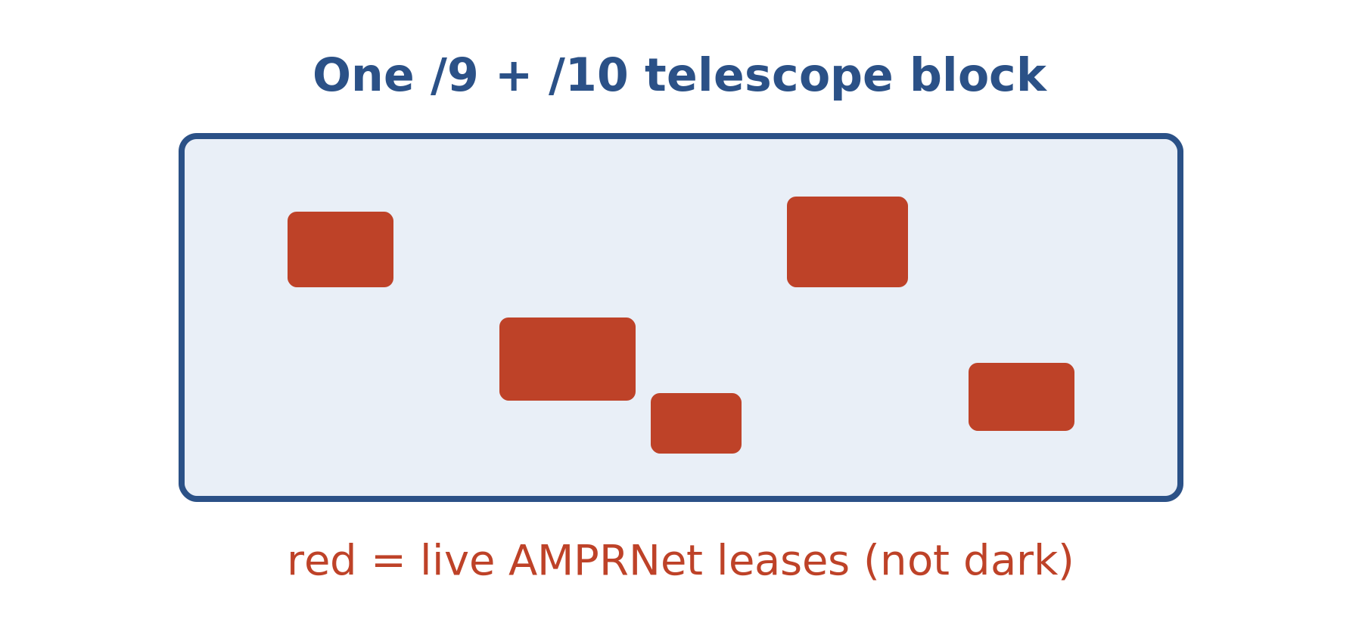
CHALLENGES · NOT DARK
WEEK 6 · BUILDING BLOCK 6 / 10
The telescope is not truly dark
It shares the AMPRNet block with amateur-radio operators
Leases come and go → dark space is constantly changing
A filter list must track ARDC's allocations to stay accurate
A /9 + /10 with live, allocated holes punched through it.
https://www.caida.org/catalog/papers/2025_lessons_learned_from_operating_network/lessons_learned_from_operating_network.pdf
ESCALATE Training Program · Summer 2026
Notes:
Cite: SIGCOMM 2025 paper. The central myth-busting claim: 'The UCSD-NT is not the stable block of dark IP addresses as often assumed.' This matters because researchers assume a fixed, fully-dark block — and that assumption is wrong.

Slide 26
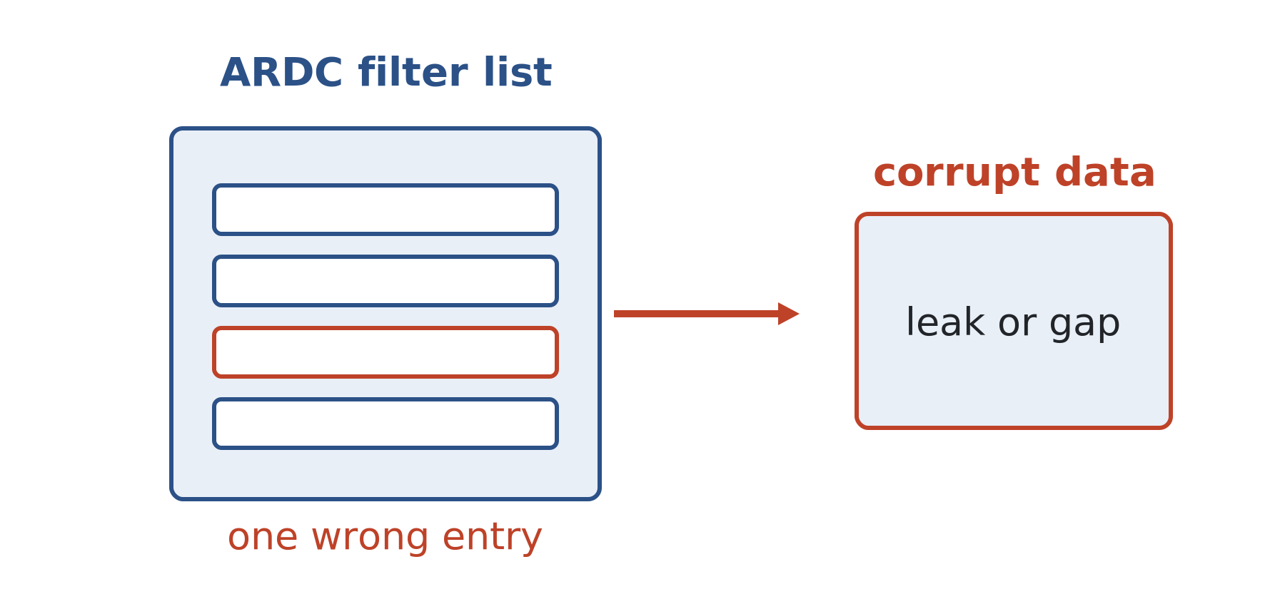
CHALLENGES · FILTERING
WEEK 6 · BUILDING BLOCK 6 / 10
When filtering fails, science fails
A Sept 2024 API change silently dropped 5,945 dark /24s — down 14.3%
A 2-hour BGP withdrawal leaked .gov DNS backscatter into the data
"Even a slight change in allocation can yield a different research conclusion"
Both missing and excess filter entries corrupt the data set.
ESCALATE Training Program · Summer 2026
Notes:
Cite: SIGCOMM 2025 paper. Two concrete failures: the 2024 relabeling that erased 14.3% of coverage, and the Sept 2023 event where a withdrawn /24's real traffic (mostly .gov DNS responses) leaked in and could be mistaken for a DDoS victim. The quote is verbatim from the paper.

Slide 27
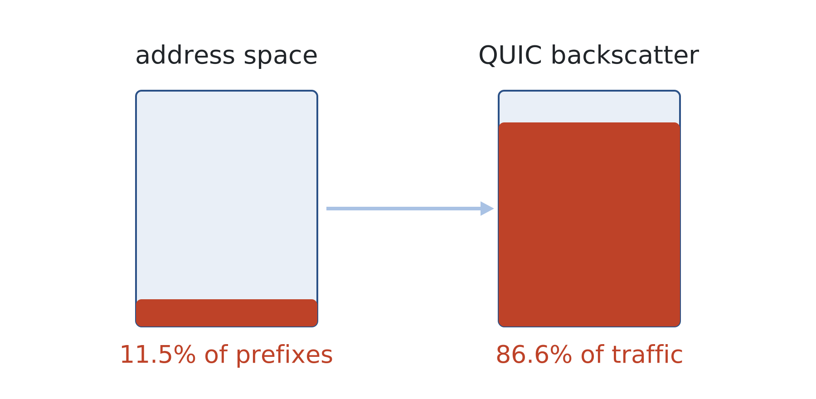
CHALLENGES · NON-UNIFORM
WEEK 6 · BUILDING BLOCK 6 / 10
Traffic is not spread evenly across dark space
Prefixes with repeating bytes (a.a.a.y) attract disproportionate traffic
11.5% of the address space carried 86.6% of the QUIC backscatter
Lose the wrong prefixes and your results skew
Which prefixes you hold matters as much as how many.
ESCALATE Training Program · Summer 2026
Notes:
Cite: SIGCOMM 2025 paper, the Jan 2025 QUIC-backscatter events. The lesson: coverage is not fungible. Losing 5% of addresses is not a uniform 5% loss of signal if those addresses were traffic-heavy.

Slide 28
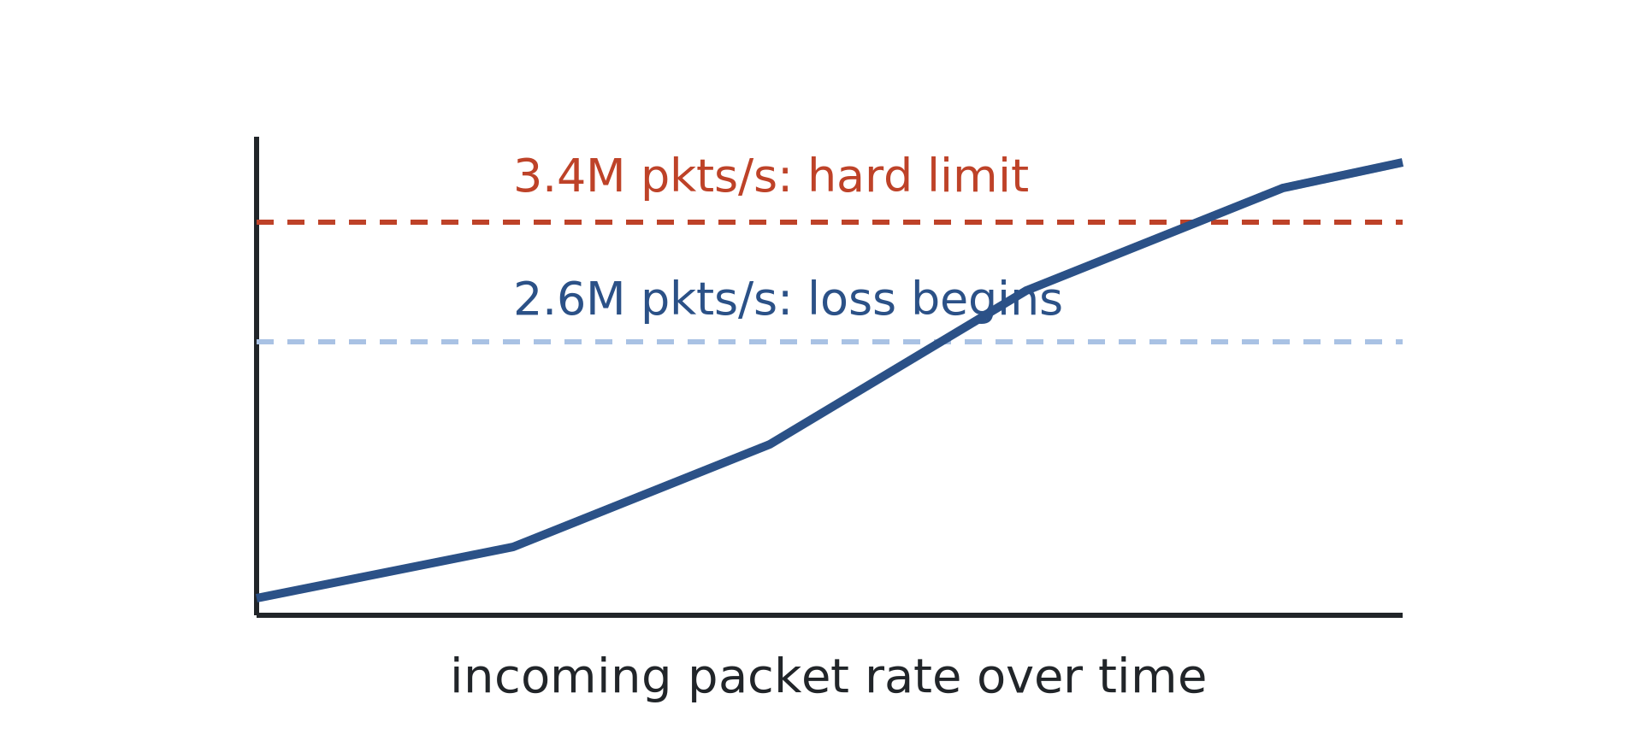
CHALLENGES · OVERLOAD
WEEK 6 · BUILDING BLOCK 6 / 10
Drinking from the firehose
Packet loss begins near 2.6M pkts/s;
    the hard limit is 3.4M pkts/s
At least 116 overload episodes since 2022
A Dec 2024 overload made US traffic appear to jump an order of magnitude
Instrument overload manufactures signals that were never real.
ESCALATE Training Program · Summer 2026
Notes:
Cite: SIGCOMM 2025 paper. Thresholds: 2.6M soft / 3.4M hard pkts/s (3 / 5 Gbps). The Dec 2024 case is the scary one: loss was not uniform, so US traffic appeared to spike an order of magnitude — a pure artifact. Verified via kernel and NIC drop counters.

Slide 29
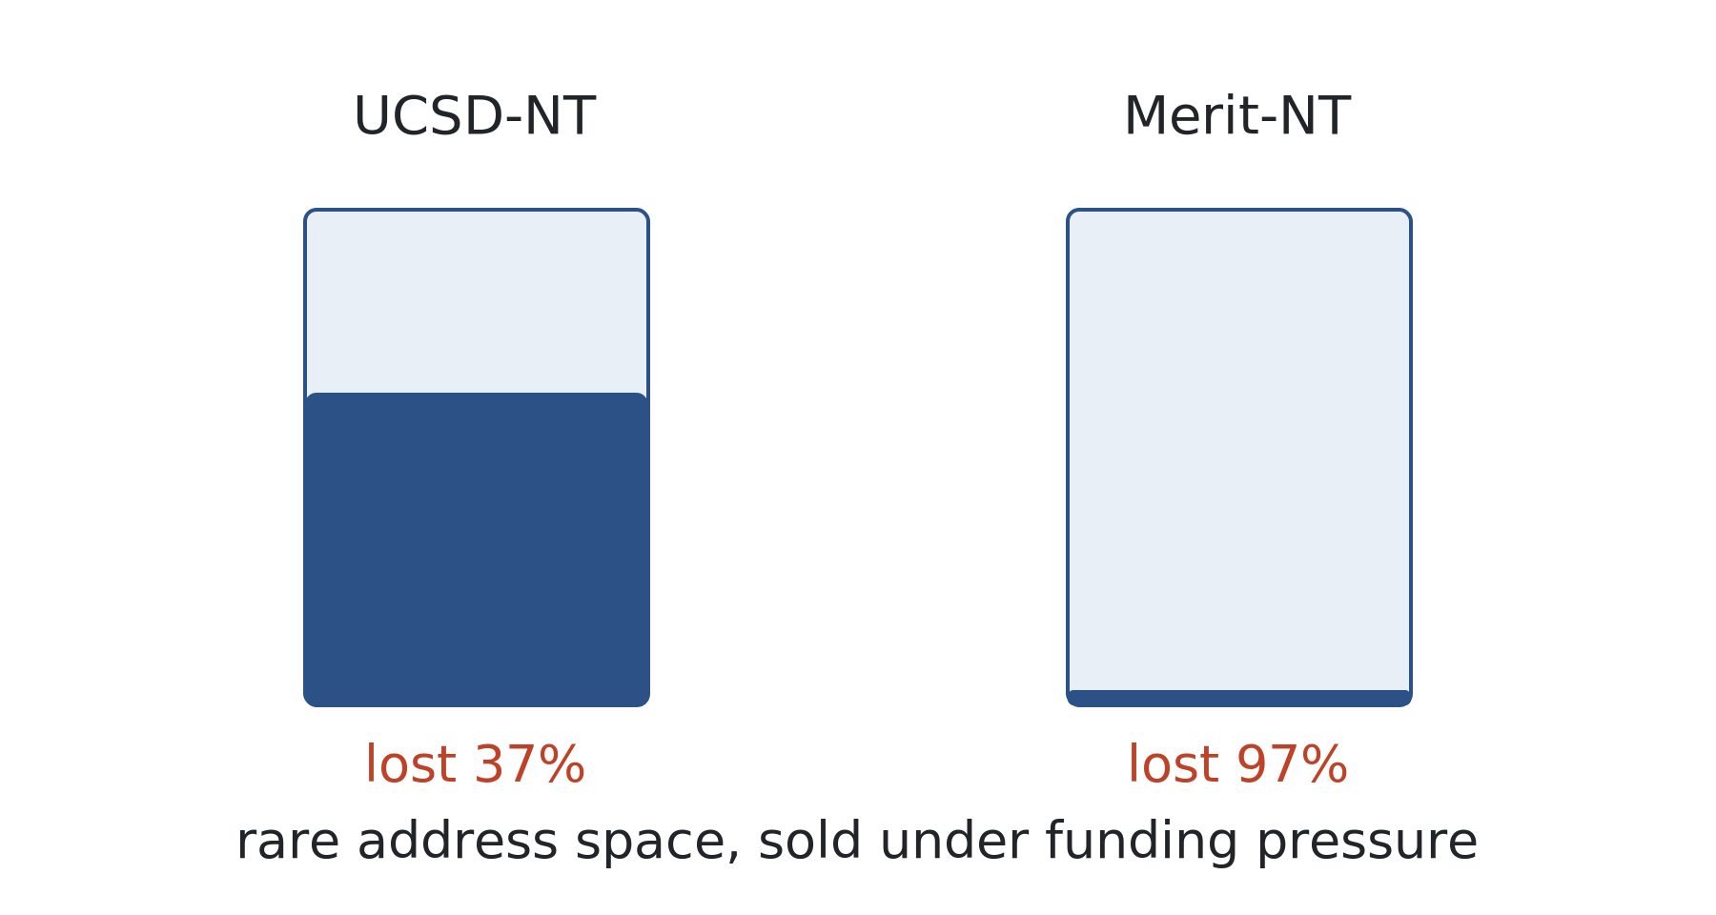
CHALLENGES · SUSTAINABILITY
WEEK 6 · BUILDING BLOCK 6 / 10
A fragile, irreplaceable instrument
Rising IPv4 prices pressure operators to sell dark space (the 2019 sale)
Grant-to-grant funding leaves no staff for continuous integrity monitoring
UCSD-NT has lost 37% of its addresses; Merit-NT has lost 97%
"A fragile state of operations... not a sustainable model for the future."
ESCALATE Training Program · Summer 2026
Notes:
Cite: SIGCOMM 2025 paper. The sustainability argument: these instruments are rare, irreplaceable, and underfunded relative to their scientific value. The 37% / 97% address-loss figures make the fragility concrete.

Slide 30
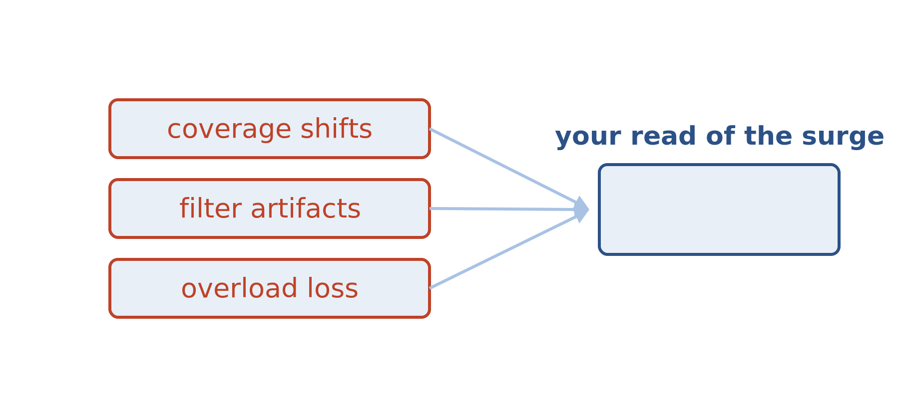
CHALLENGES · FOR THURSDAY
WEEK 6 · BUILDING BLOCK 6 / 10
Why this matters for your analysis
Coverage changes, filter artifacts, and overload loss are confounders
Know your instrument before you trust a surge or a ranking
This week you investigate a real surge — with these caveats in mind
A good scientist interrogates the instrument first.
ESCALATE Training Program · Summer 2026
Notes:
Bridge to Thursday. The point is not to distrust the data but to reason about it. When they see a traffic surge on Thursday, the operational lessons here are the alternative hypotheses they should rule out.

Slide 31
BEFORE NEXT WEEK
WEEK 6 · BUILDING BLOCK 6 / 10
Before Thursday
Read the module Introduction and Datasets pages
Confirm your NRP JupyterHub login works (16 GB+ instance)
Optional: skim Männel et al., SIGCOMM 2025
Bring questions on backscatter, scanning, or flows
OPTIONAL BACKGROUND
Optional background: the 2023 CSE 291-E lecture 14 and the CAIDA telescope project page both give a gentler on-ramp.
Questions Mattermost (fastest)
training-program-info@caida.org
ESCALATE Training Program · Summer 2026
Notes:
Thursday is hands-on and assumes the reading is done. The NRP login check is the single most common day-of blocker — flag it hard. Questions -> Mattermost.

Slide 32
APPENDIX · FOR SELF-STUDY
A
Appendix
Self-study — not covered live
Notes:
Everything after this is for self-study so the deck stands alone (no recordings).

Slide 33
APPENDIX
A · Reading and sources
Founding studies: Moore, Voelker & Savage, DoS backscatter (USENIX Security 2001; TOCS 2006); Moore, Shannon & Brown, Code-Red (IMW 2002); Shannon & Moore, Witty (IEEE S&P 2004).
Operations: Männel et al., SIGCOMM 2025. Lectures: Savage & Voelker, CSE 291-C Wi25; claffy, CSE 291-E lecture 14 (Wi23).
ESCALATE Training Program · Summer 2026
Notes:
Full citations for everything referenced live. The two CSE 291-C lecture PDFs are the Savage backscatter and Voelker worms decks.

Slide 34
APPENDIX · GLOSSARY
Advanced terms and acronyms
Advanced, program- or platform-specific terms only — alphabetical.
AMPRNet The amateur-radio net-44 /8 address space allocated in 1981; the telescope lives in it.
ARDC Amateur Radio Digital Communications, the non-profit that manages net-44 allocations.
Backscatter Reply packets from a DoS victim to spoofed source addresses, some of which land in the telescope.
Corsaro CAIDA's plugin-based packet-processing toolchain that produces FlowTuple and RSDoS data.
Darknet Routed but unused address space instrumented to capture all incoming traffic; a network telescope.
FlowTuple CAIDA's aggregated per-interval flow record summarizing telescope packets by key.
IBR Internet Background Radiation: the unsolicited scanning, backscatter, and misconfiguration a darknet sees.
nDAG CAIDA's in-house protocol for encapsulating captured packets into multicast streams for distribution.
RSDoS Randomly-Spoofed Denial-of-Service; the attack class backscatter analysis detects.
SI model Susceptible-Infected epidemic model used to describe and predict worm spread.
STARDUST The NSF project providing sustainable tools and access for darknet traffic analysis.
Telescope coverage The fraction of a telescope's nominal address space that is actually dark and monitored.
Zombie Early term for a compromised host used in an attack, before 'bot' and 'botnet' were coined.
ESCALATE Training Program · Summer 2026
Notes:
Program- and research-specific terms only; general terms (IPv4, DNS, TCP) excluded per house rules. Alphabetized.

