Slide 1



ESCALATE TRAINING PROGRAM · SUMMER 2026
Telescope data analysis on Expanse
Week 7: run UCSD-NT FlowTuple analysis on an HPC cluster, interactively and then as a batch job.
PLENARY
INSTRUCTOR
SENIOR MENTORS
PROGRAM CONTACT
Tue Jul 28, 2026 · 12:00 PT
Ricky Mok
kc claffy · Bradley Huffaker · Rocky Chang
training-program-info@caida.org
Supported by the NSF ESCALATE project · OAC-2519416
Notes:
Infrastructure session for the Network-telescope block. Goal: everyone can log in to Expanse, run the FlowTuple demo interactively, and submit it as a batch job.
Hands-on guide authored by Ricky Mok and Max Gao.
Pilot mentors: Alex Marder, Ricky Mok, kc claffy, Bradley Huffaker, Rocky Chang, Max Gao, Ben Du.
Technical questions: Ricky Mok (cskpmok@caida.org).
TODO confirm: session time (12:00 PT assumed from the standard plenary slot).

Slide 2
THE ARC
WEEK 7 · BUILDING BLOCK 7 / 10
Ten building blocks — you are here
1
2
3
4
5
Internet structure & ASNs
BGP at scale
Registries: WHOIS / IRR / RPKI
Traceroute, ITDK
DNS
6
7
8
9
10
Network telescope
Traffic analysis on HPC
Data fusion (IYP)
Degradation forensics
SDSC hackathon
Block 7, the network telescope. This session is the platform hour, where the analysis runs at scale.
ESCALATE Training Program · Summer 2026
Notes:
Re-orient: still block 7. The plenary covers what the telescope analysis means; here we run it on Expanse.

Slide 3
LAST WEEK · RECAP
WEEK 7 · BUILDING BLOCK 7 / 10
Where we are
THIS WEEK BUILDS ON IT
This week adds the platform, not new analysis: Expanse is where telescope work scales.
You have run Pcap analysis using a small subset of UCSD-NT data on NRP, and learn the concept of flows.
Today: You are going to learn how to analyze FlowTuple data published by UCSD-NT on SDSC Expanse, interactive first, then batch.
ESCALATE Training Program · Summer 2026
Notes:
Keep it to orientation. No new concepts here; we are moving the existing workload onto HPC.

Slide 4
PART ONE
01
Why Expanse?
The HPC model: login nodes, compute nodes, and a scheduler.
Notes:
Frame the three ideas the rest of Part 1 unpacks: nodes, Slurm, storage.

Slide 5
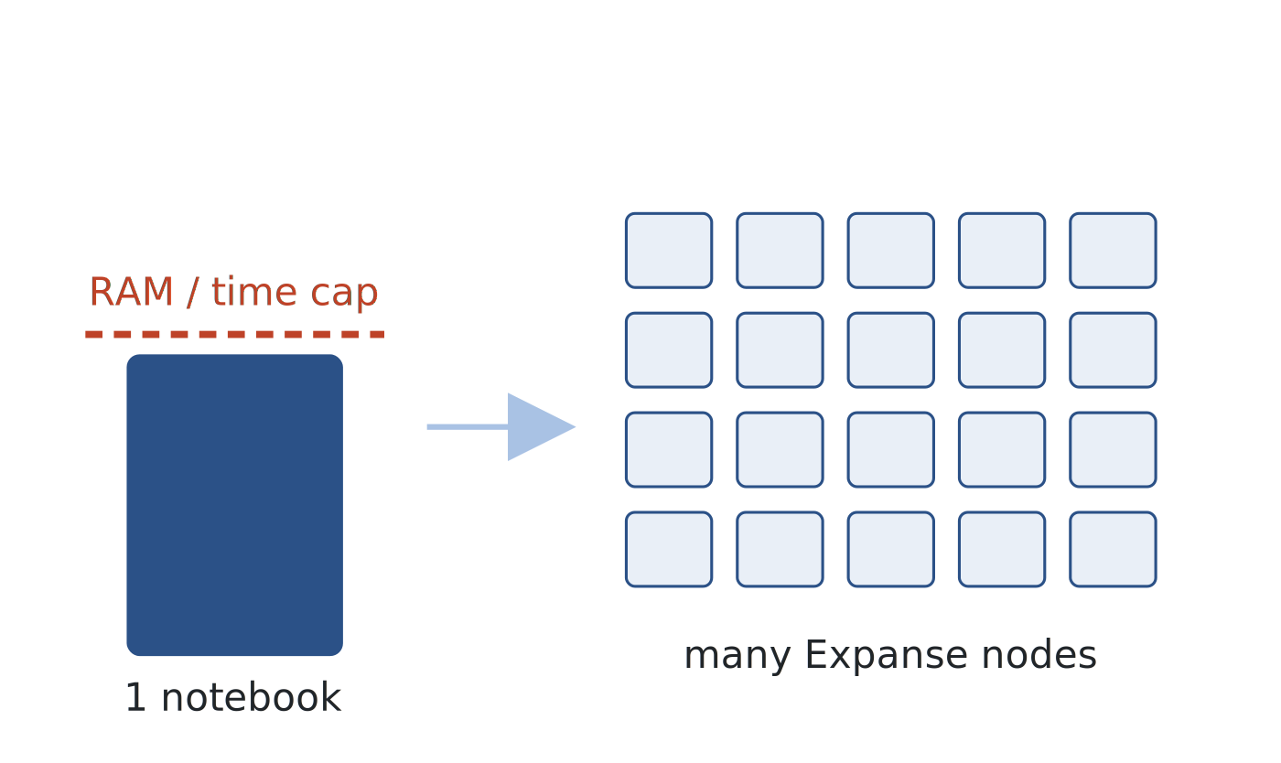
WHY EXPANSE · SCALE
WEEK 7 · BUILDING BLOCK 7 / 10
Interactive notebooks have its limitation
A notebook has overhead, reducing the resource you could use for analysis.
Notebooks typically support python and R. Both are inefficient to handle traffic data.
Expanse can schedule batch jobs across multiple compute nodes (not cover today).
One notebook on one node, versus many scheduled nodes.
ESCALATE Training Program · Summer 2026
Notes:
Motivate HPC from the workload: memory and wall-clock limits, plus the need to queue many runs.

Slide 6
WHY EXPANSE · SCALE
WEEK 7 · BUILDING BLOCK 7 / 10
SDSC Expanse at a glance
728
93,184
52
5.16 PF
compute nodes
CPU cores
GPU nodes
peak performance
A shared cluster; each job uses a small slice of it.
ESCALATE Training Program · Summer 2026
Notes:
Scale-setting only; you never use most of this.
stat: 728 compute nodes src: https://www.sdsc.edu/systems/expanse/user_guide.html
stat: 93,184 CPU cores src: https://www.sdsc.edu/systems/expanse/user_guide.html
stat: 52 GPU nodes (208 V100 GPUs) src: https://www.sdsc.edu/systems/expanse/user_guide.html
stat: 5.16 PFlop/s peak src: https://www.sdsc.edu/systems/expanse/user_guide.html
note: the user guide's prose says 54 GPU nodes; its full-system table says 52 / 208 GPUs — used 52.

Slide 7
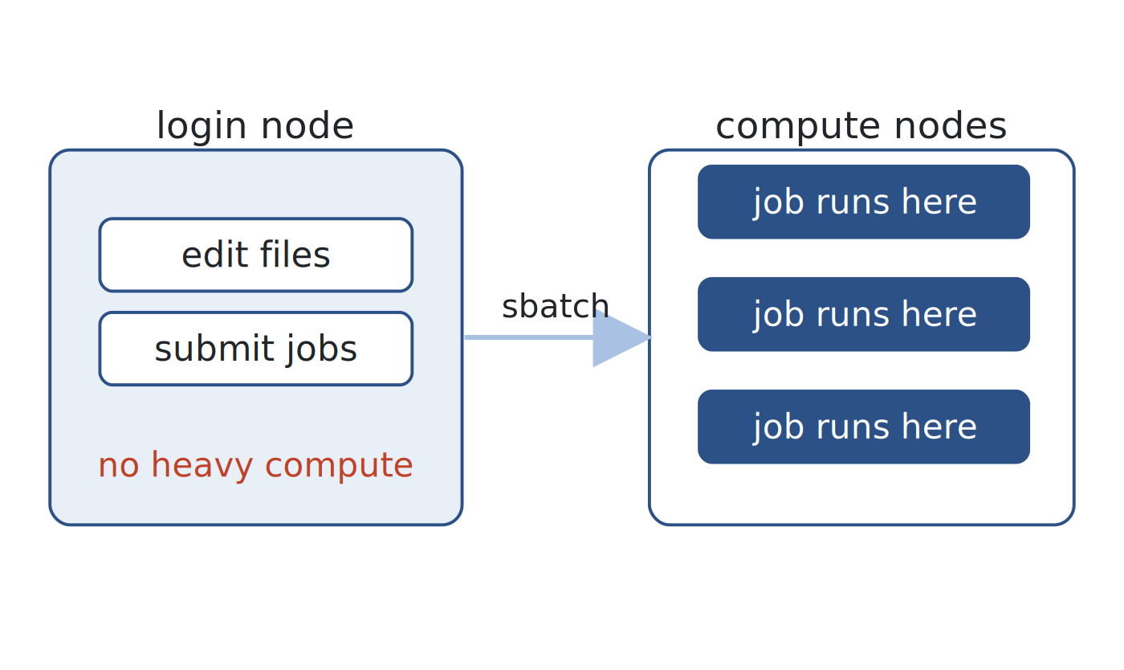
WHY EXPANSE · THE NODES
WEEK 7 · BUILDING BLOCK 7 / 10
Login nodes vs. compute nodes
You land on a login node: edit files, submit jobs, move small data.
Never run heavy compute on the login node. It is shared by everyone.
Real work runs on compute nodes, reached with srun or sbatch.
Submit from the login node; compute happens on the nodes.
ESCALATE Training Program · Summer 2026
Notes:
The single most common new-user mistake is running work on the login node. Say it plainly.

Slide 8
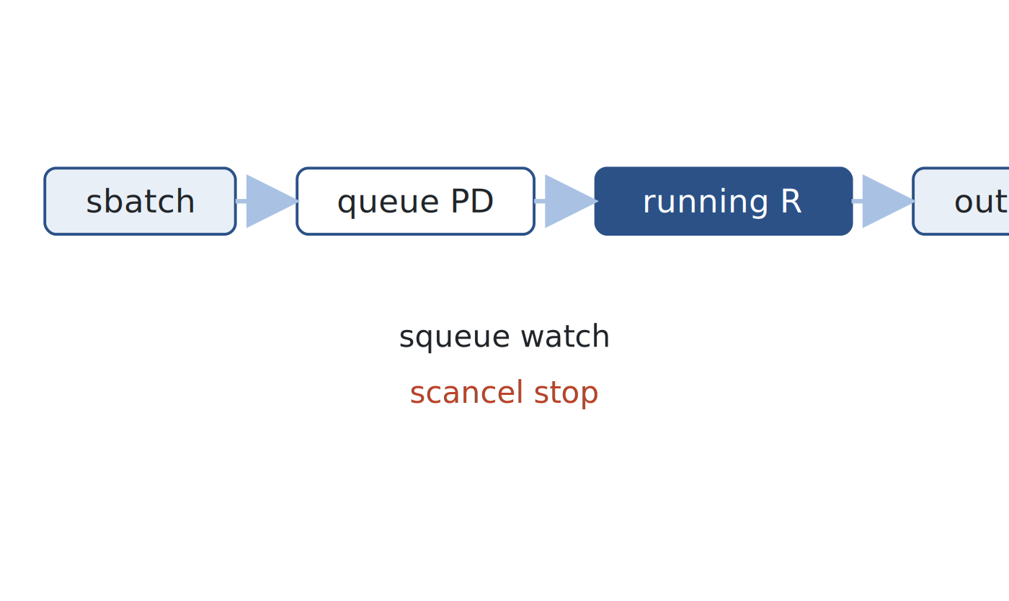
WHY EXPANSE · SLURM
WEEK 7 · BUILDING BLOCK 7 / 10
Slurm, the job scheduler
Compose .slurm scripts to configure jobs.
sbatch submits a job; squeue watches it; scancel stops it.
Partitions run time limits:
    debug (30 min),
    Shared (48 hrs, 1 node),
    Compute (48 hrs, exclusive access to 1 or more nodes).
A job waits (PD) until resources free, then runs (R) on a compute node.
sbatch to queue to run to output; squeue watches, scancel stops.
ESCALATE Training Program · Summer 2026
Notes:
These three commands cover almost everything students do this session. Partitions: they will use shared.

Slide 9
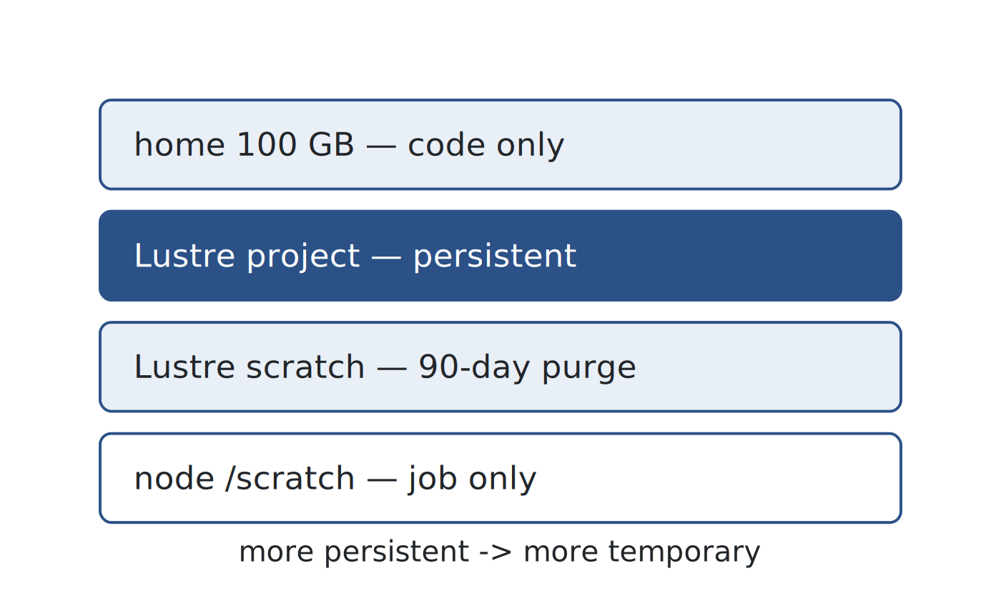
WHY EXPANSE · STORAGE
WEEK 7 · BUILDING BLOCK 7 / 10
Storage on Expanse
/home (100 GB) is for code only; never store data there
Lustre projects persists
    /expanse/lustre/projects/<proj_id>
scratch is purged after 90 days
    /expanse/lustre/scratch/<username>
Node-local /scratch (1TB) is fast but erased when the job ends.
Put results in project space; scratch and node-local are temporary.
ESCALATE Training Program · Summer 2026
Notes:
Project space is where results go; scratch and node-local are temporary.
note: user guide — project purged 90 days after allocation expires; scratch 90 days from creation.

Slide 10
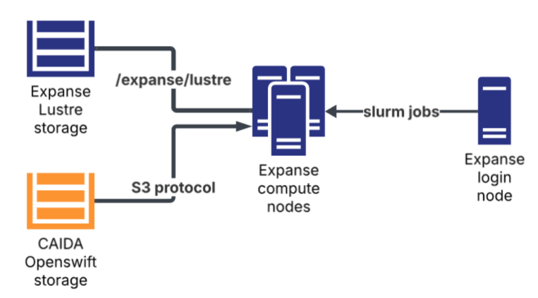
WHY EXPANSE · STORAGE
WEEK 7 · BUILDING BLOCK 7 / 10
UCSD-NT Data pipeline
Expanse can directly access CAIDA’s object storage via S3 protocol
telescope-ucsdnt-pcap-live
    One file every hour
    datasource=ucsd-nt/year=<YYYY>/month=<MM>/day=<DD>/hour=<HH>/ucsd-nt.<unixts>.pcap.gz
telescope-ucsdnt-avro-flowtuple-v4-<YYYY>
    FlowTuple files. One every 5 mins
    datasource=ucsd-nt/year=<YYYY>/month=<MM>/day=<DD>/hour=<HH>/ucsd-nt.<unixts>.flowtuple-v4.avro
UCSD-NT data is stored in an OpenSwift object storage at CAIDA accessible via S3 protocol.
ESCALATE Training Program · Summer 2026
Notes:
Project space is where results go; scratch and node-local are temporary.
note: user guide — project purged 90 days after allocation expires; scratch 90 days from creation.

Slide 11
WHY EXPANSE · STORAGE
WEEK 7 · BUILDING BLOCK 7 / 10
Reference materials
Code and documentation for this class: https://github.com/CAIDA/nids-expanse-2026
Expanse user guide: https://www.sdsc.edu/systems/expanse/user_guide.html
CIML summer institute resources: https://github.com/ciml-org/ciml-summer-institute-2026/tree/main
ESCALATE Training Program · Summer 2026
Notes:
Project space is where results go; scratch and node-local are temporary.
note: user guide — project purged 90 days after allocation expires; scratch 90 days from creation.

Slide 12
PART TWO
02
Get onto Expanse
Account, two-factor login: https://github.com/CAIDA/nids-expanse-2026/tree/main/0_hello_world_to_expanse
Setup your environment:
https://github.com/CAIDA/nids-expanse-2026/tree/main/1_setting_up_env
Notes:
Keep this part brisk; it is one-time setup. Students who did it already can help neighbors.

Slide 13
ACTION REQUIRED · WEEK 7 SETUP
WEEK 7 · BUILDING BLOCK 7 / 10
Get an account and log in
Register at access-ci.org with your institution email; send your ACCESS ID to the instructor.
1
Reset your ACCESS password if you have not set one.
2
Enroll 2FA at passive.sdsc.edu (Globus, choose ACCESS CI) using Google Authenticator; allow up to 15 min after enrolling.
3
4
SSH to login.expanse.sdsc.edu and enter the TOTP code.
ESCALATE Training Program · Summer 2026
Notes:
Do this before the session if possible. The 15-minute propagation delay catches people off guard.

Slide 14
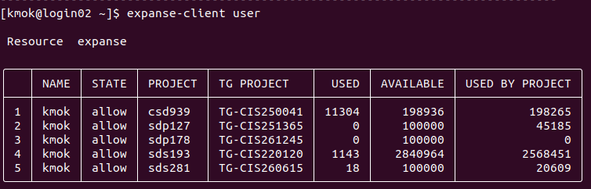
GET ON · YOUR PROJECT
WEEK 7 · BUILDING BLOCK 7 / 10
Confirm you're in
Run expanse-client user to list your projects.
The ETP 2026 project is sdp178; you charge jobs to it.
The browser Expanse Portal (https://portal.expanse.sdsc.edu) works too, but SSH is recommended.
expanse-client user lists your projects; ETP 2026 is sdp178.
ESCALATE Training Program · Summer 2026
Notes:
Screenshot is the real expanse-client output. Point out the PROJECT column showing sdp178.

Slide 15
ACTION REQUIRED · WEEK 7 SETUP
WEEK 7 · BUILDING BLOCK 7 / 10
Set up your shell environment
Clone git@github.com:CAIDA/nids-expanse-2026.git into your home dir (SSH agent forwarding).
1
Back up your .bashrc, then copy the repo's .bashrc over it.
2
Log out and back in to load the new environment.
3
Check it: echo $ETP26_ACCOUNT prints sdp178.
4
ESCALATE Training Program · Summer 2026
Notes:
The repo .bashrc defines the srun/jupyter aliases used for the rest of the session.

Slide 16
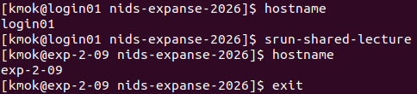
ACTION REQUIRED · WEEK 7 SETUP
WEEK 7 · BUILDING BLOCK 7 / 10
Run your first job
Run hostname
Run srun-shared-lecture
Run hostname again
Exit the node
ESCALATE Training Program · Summer 2026
Notes:
The repo .bashrc defines the srun/jupyter aliases used for the rest of the session.

Slide 17
PART THREE
03
Run the analysis
Hands-on guide:
Interactive https://github.com/CAIDA/nids-expanse-2026/tree/main/2_running_juypter_notebook
Batch https://github.com/CAIDA/nids-expanse-2026/tree/main/3_running_batch_job
Notes:
Credit the guide authors here. Two beats follow: the interactive notebook, then the batch job.

Slide 18
RUN · THE DEMO
WEEK 7 · BUILDING BLOCK 7 / 10
The demo code: ft-demo.ipynb/.py
ft-demo loads 30 minutes of UCSD-NT FlowTuple data (i.e., 6 files) with PySpark.
The notebook version (ft-demo.ipynb) and the batch version (ft-demo.py) perform the same analysis
It filters and aggregates metrics of flows based on the different features.
ESCALATE Training Program · Summer 2026
Notes:
Same analysis in the notebook and the batch script. Screenshot is the galyleo Jupyter launch screen.

Slide 19
RUN · THE DEMO
WEEK 7 · BUILDING BLOCK 7 / 10
What is FlowTuple?
FlowTuple is a flow-like format designed for aggregating UCSD-NT data
Each FlowTuple file is stored as Apache Avro format (row-based) for high compression ratio
Details about the format and schema:
https://www.caida.org/projects/network_telescope/docs/data/flowtuple/
ESCALATE Training Program · Summer 2026
Notes:
Same analysis in the notebook and the batch script. Screenshot is the galyleo Jupyter launch screen.

Slide 20
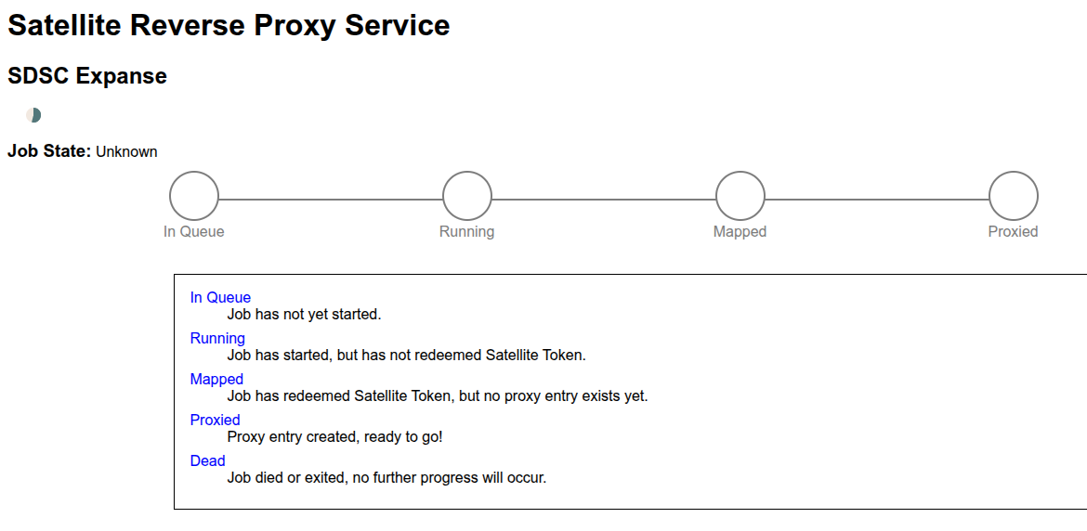
ACTION REQUIRED · WEEK 7 SETUP
WEEK 7 · BUILDING BLOCK 7 / 10
Run the juypter notebook version
Load credentials: source /expanse/lustre/projects/sdp178/kmok/.ucsdnts3.key
1
Run jupyter-shared-spark-lecture
(shared: 4 CPU, 16 GB, 1 hr).
2
Open the printed URL and token in your browser.
3
Run ft-demo.ipynb top to bottom.
4
Waiting page after you executed jupyter-shared-spark
ESCALATE Training Program · Summer 2026
Notes:
jupyter-shared-spark launches a galyleo Jupyter session as its own Slurm job.
note: srun-shared's mem/time differ between the README (16 GB / 4 hr) and the shipped .bashrc (4 GB / 30 min); the galyleo Jupyter alias here is unambiguous at 16 GB / 1 hr.

Slide 21
RUN ·IT ·NOW
WEEK 7 · BUILDING BLOCK 7 / 10
Try it now
It takes a couple minutes to complete
Don’t hesitate to ask questions!
ESCALATE Training Program · Summer 2026
Notes:
Cost discipline. A forgotten interactive job can burn credits for hours.

Slide 22
RUN · CLEAN UP
WEEK 7 · BUILDING BLOCK 7 / 10
Stop your job when you're done
Closing the browser tab does not stop the Slurm job.alert
Find it with squeue -u <username>, then scancel <JOBID>.
Idle jobs waste shared nodes, block other students from using Expanse, and burn project credits.
Always release the node when you finish.
ESCALATE Training Program · Summer 2026
Notes:
Cost discipline. A forgotten interactive job can burn credits for hours.

Slide 23
BEHIND THE SCENE
WEEK 7 · BUILDING BLOCK 7 / 10
Behind the scene
Run alias jupyter-shared-spark-lecture
    galyleo launch --account sdp178 --partition shared –reservation caida --cpus 4 --memory 16 --time-limit 01:00:00 --sif /expanse/lustre/projects/sdp178/kmok/etp26.sif --bind /expanse,/scratch,/cm –quiet
etp26.sif is a singularity image that I pre-built for you, including the libraries that you may need in the notebook.
    Building details: https://github.com/CAIDA/nids-expanse-2026/tree/main/2_running_juypter_notebook/code/etpimage
ESCALATE Training Program · Summer 2026
Notes:
Cost discipline. A forgotten interactive job can burn credits for hours.

Slide 24
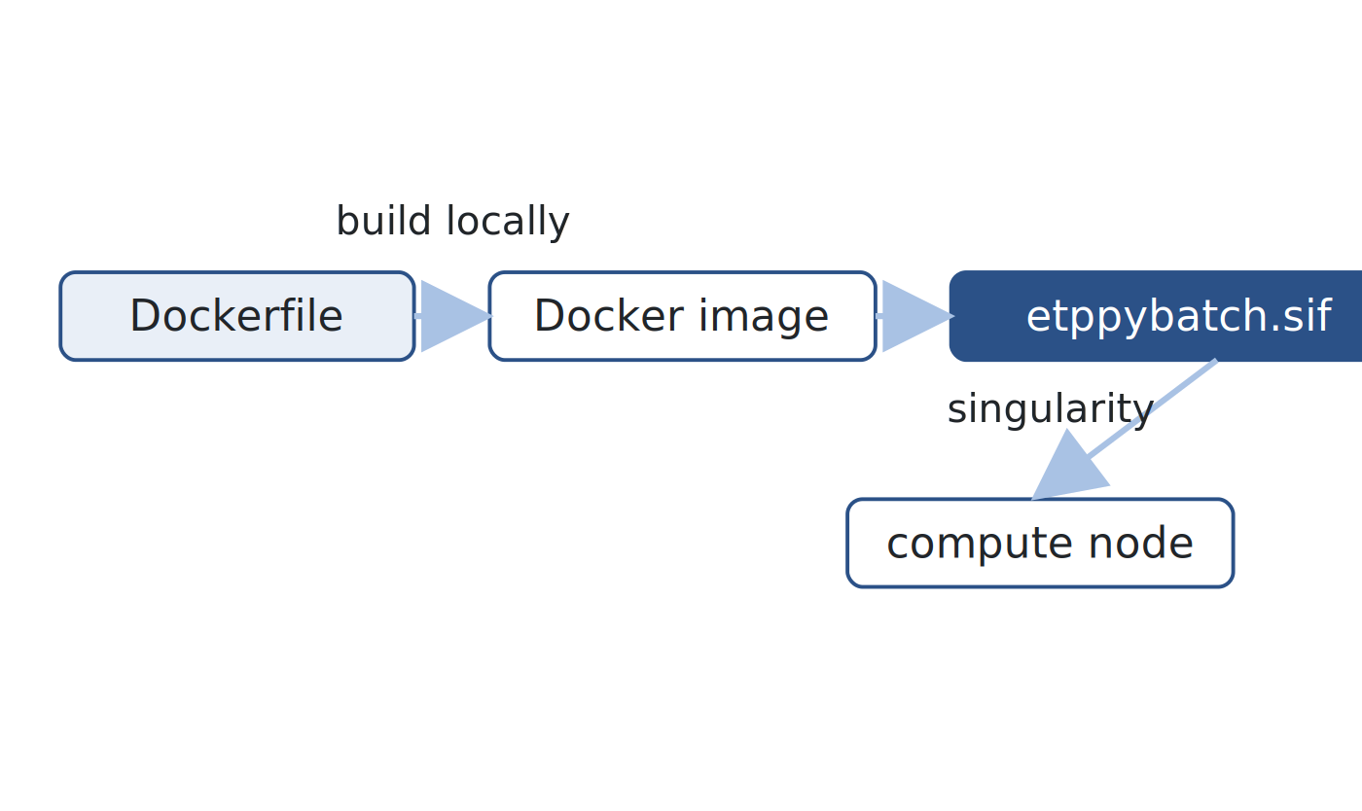
RUN · CONTAINER
WEEK 7 · BUILDING BLOCK 7 / 10
Package the software environment as a container
The batch job runs inside a python:3.12-slim image.
It adds build-essential (to build pytricia) and a JDK (PySpark needs a JVM).
On Expanse it runs as a Singularity .sif; a shared one is prebuilt.
Further details: https://github.com/CAIDA/nids-expanse-2026/tree/main/3_running_batch_job
A Docker image, converted to a Singularity .sif on Expanse.
ESCALATE Training Program · Summer 2026
Notes:
Most students never rebuild the image; a shared .sif is referenced by the Slurm script. Login nodes cannot build images.

Slide 25
ACTION REQUIRED · WEEK 7 SETUP
WEEK 7 · BUILDING BLOCK 7 / 10
Submit the batch job
Find the location of the S3 keys: .ucsdnts3.env (passed via --env-file).
1
cd 3_running_batch_job/code, then sbatch shared_4x16G-batch-lecture.slurm.
2
Watch squeue -u <username> and joblogs/slurm-<jobid>.out.
3
Results land in output/<jobid>/result.csv and resultcountry.csv.
4
ESCALATE Training Program · Summer 2026
Notes:
shared_4x16G-batch.slurm: 4 CPU, 16 GB total (mem-per-cpu 4000 x 4), 30 min, shared partition.

Slide 26
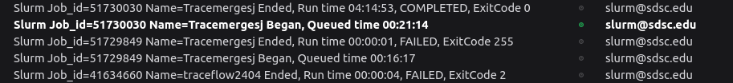
RUN · CONFIGURE
WEEK 7 · BUILDING BLOCK 7 / 10
Configure a Slurm job
#SBATCH --job-name=etp-ft-batch-demo
#SBATCH --partition=shared
#SBATCH --account=sdp178
#SBATCH --nodes=1
#SBATCH --ntasks=1
#SBATCH --ntasks-per-node=1
#SBATCH --cpus-per-task=4
#SBATCH --mem-per-cpu=4000
#SBATCH --time=00:30:00
#SBATCH –output="joblogs/slurm-%j.out"
...
singularity exec --env-file ${PROJ_DIR}/kmok/.ucsdnts3.env \
--bind ${OUTPUT_DIR}:/output,${REPO_DIR}:/etp,/tmp,/scratch \
${PROJ_DIR}/kmok/etppybatch.sif \
python /etp/3_running_batch_job/code/ft-demo.py --output-dir /output
#SBATCH header configures the job: cores, memory, time, and partition.
Add --mail-type=BEGIN/END with --mail-user to be emailed when it finishes.
This line is the actual job.
--env-file reads the S3 credentials
--bind maps directory from outside to insider the container
etppybatch.sif is the pre-build image for this class
python …. is the command to be ran inside the container
ESCALATE Training Program · Summer 2026
Notes:
From the old Expanse tutorial's Slurm slide, including its email-notification exercise. shared caps at one node.

Slide 27
RUN · LOGS & OUTPUT
WEEK 7 · BUILDING BLOCK 7 / 10
Find your logs and output
Slurm writes stdout and stderr to joblogs/slurm-<jobid>.out, beside where you ran sbatch.
Results land in your project space under output/<jobid>/.
That folder holds result.csv and resultcountry.csv.
Logs sit at the joblogs directory at the location you execute the slurm script; results go to project output.
ESCALATE Training Program · Summer 2026
Notes:
Full output path: /expanse/lustre/projects/sdp178/<user>/output/<jobid>/ (from shared_4x16G-batch.slurm).

Slide 28
ASSIGNMENT 7 · DUE BEGINNING OF WEEK 8
WEEK 7 · BUILDING BLOCK 7 / 10
Recap
Run the telescope FlowTuple analysis on Expanse, both ways.
MODULE MILESTONE
Your module now runs on Expanse, interactively and as a batch job.
Set up your ACCESS-CI account, 2FA login, and shell environment.
Basic commands on Expanse
Launch a Jupyter notebook using gelyleo
Submit a batch job using slurm script
Customize slurm scripts
REPOSITORY
https://github.com/CAIDA/nids-expanse-2026/
ESCALATE Training Program · Summer 2026
Notes:
Deliverable is proof both paths ran: the two CSVs from the batch output directory.

Slide 29
ASSIGNMENT 7 · DUE BEGINNING OF WEEK 8
WEEK 7 · BUILDING BLOCK 7 / 10
Assignment
Release by this Thursday. Some tips
MODULE MILESTONE
Your module now runs on Expanse, interactively and as a batch job.
Use jupyter-shared-spark-large for generating the parquet results
Start early (your code code takes hours to run, and you may not get a slot from Expanse last minute)
Use AI tools to translate your notebook to pure python
You may occasionally encounter S3 authentication errors. You can just rerun it.
REPOSITORY
https://github.com/CAIDA/nids-expanse-2026/
ESCALATE Training Program · Summer 2026
Notes:
Deliverable is proof both paths ran: the two CSVs from the batch output directory.

