Slide 1



Slide 2


Emergence of Biases in AI
Abhash Shrestha
02, 01, 2025

Slide 3





MSc Computer Science
Research
Co-founder
1

Slide 4
Outline
Introduction - Bias in AI: Why We Should Care
Symbolic AI
Sub-Symbolic AI
Understanding AI Biases
Standard Approaches to Mitigate AI Bias
Combining Symbolic & Sub symbolic AI
1

Slide 5
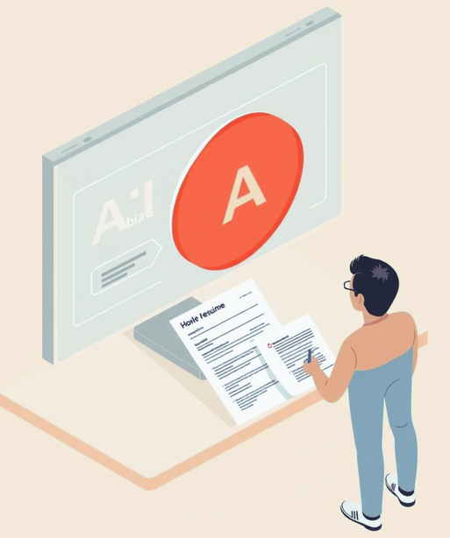
Why Deal with AI biases?
Is it even a problem worth solving?
Imagine applying to your dream job and never getting an interview because the AI screening résumés learned to favor certain demographics. Real incidents like Amazon’s hiring tool highlight the human impact of AI bias and why addressing it is so urgent.
2

Slide 6
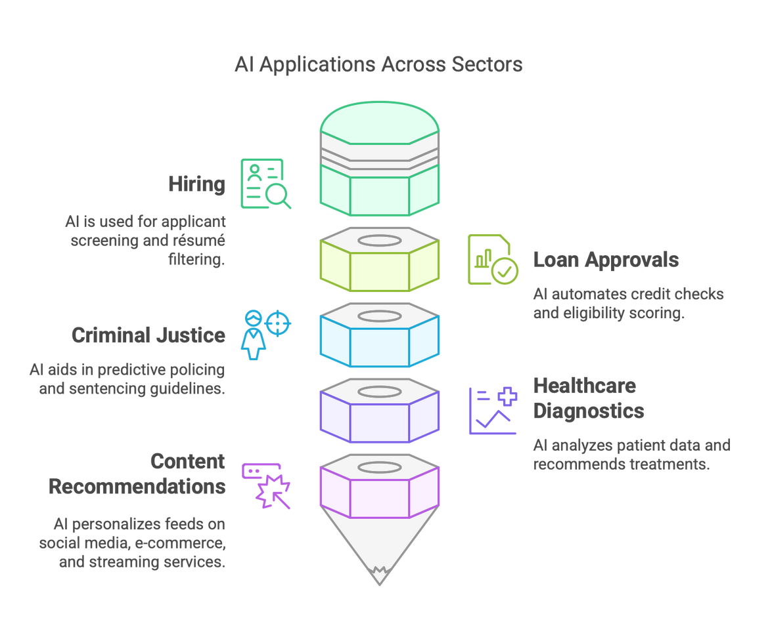
1. Introduction - Bias in AI: Why We Should Care
Prevalence of AI
increasing integration into decision-making processes
hiring
loan approvals
criminal justice
healthcare diagnostics
content recommendations etc.
3

Slide 7
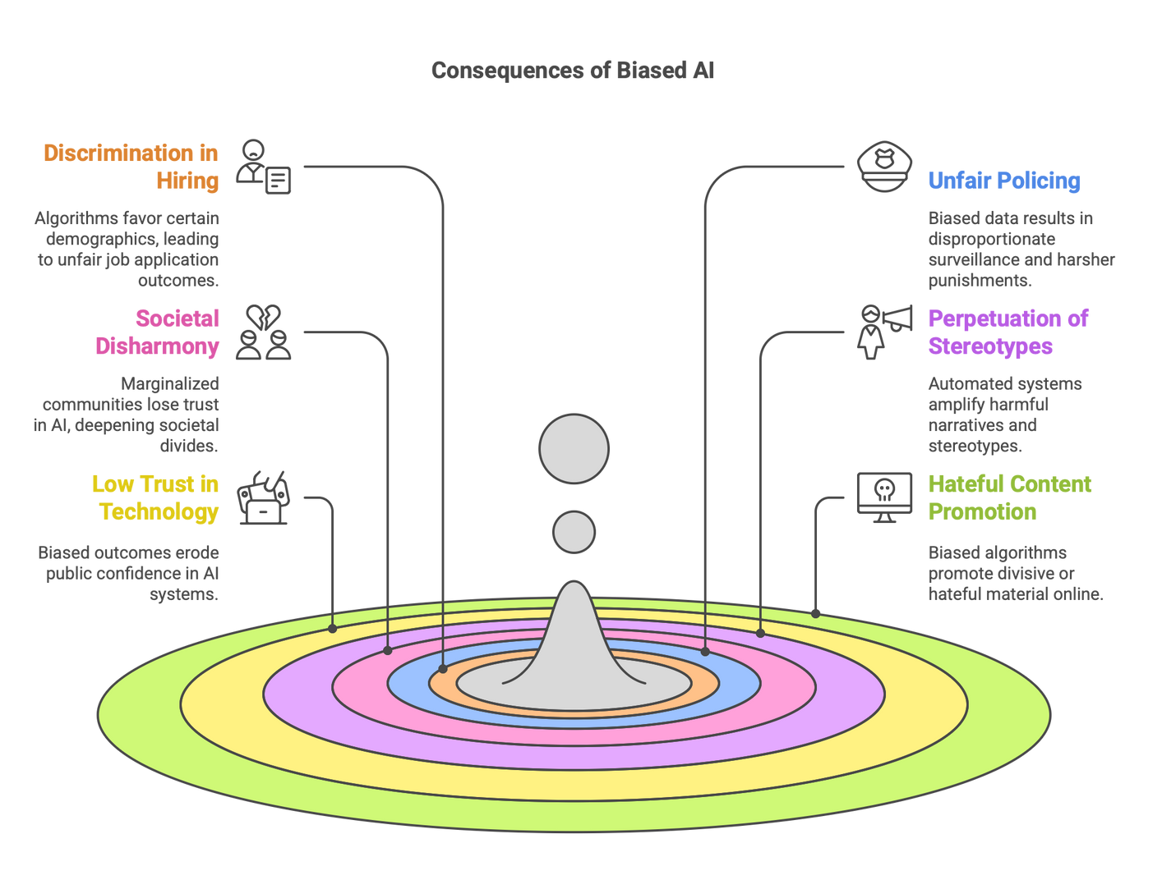
Consequences
4

Slide 8
Real-World Consequences
Biased AI can lead to unfair treatment
gender or racial discrimination in job applications
unfair policing and sentencing
Societal Impact:
Societal Disharmony
Perpetuation of Stereotypes
Low trust in Technology
Hateful Content in AI and internet
Real-World Example:
Amazon’s Hiring Tool
Internal AI recruitment system - penalized résumés containing the word “women’s.”
Shows how historical data (dominated by men in tech roles) can inadvertently encode discrimination
5

Slide 9
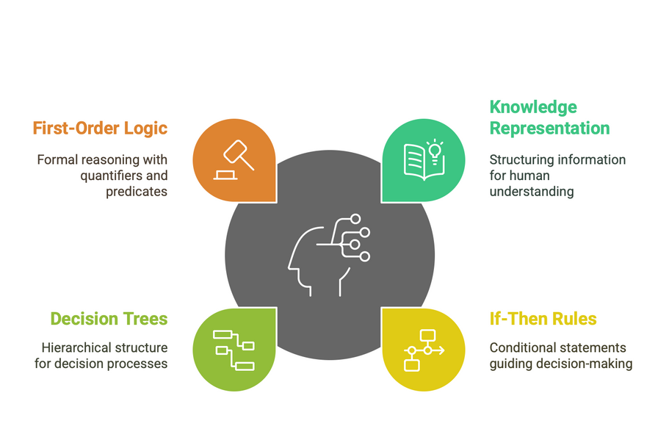
2. Symbolic AI - Good Old Fashioned AI
Symbolic AI represents knowledge through symbols - words, logical rules, and explicit ontologies.
Historically dominated early AI research (1950s–1980s).
Key Characteristics
Knowledge Representation
Information is encoded in a structured, human-readable way
if-then rules
decision trees
first-order logic
Reasoning
Symbolic systems use logical inference engines to draw conclusions from known facts.
Example
IBM’s chess-playing system that used symbolic search trees and rule-based evaluation functions to defeat Garry Kasparov.
6

Slide 10
Examples & Applications
Expert Systems (e.g., MYCIN for medical diagnosis): If symptom X and symptom Y, then consider disease Z.
Knowledge Graphs in semantic web and enterprise settings (e.g., storing relationships: “Product X is made by Company Y”).
Why use them?
Easy interpretation : You can trace how the system arrived at a conclusion via logical steps.
Easy Update: Easy to identify and modify rules if a certain rule is found to be biased or incorrect.
Domain Knowledge: Allows easy incorporation of formal domain knowledge (e.g., legal constraints, medical guidelines).
7

Slide 11
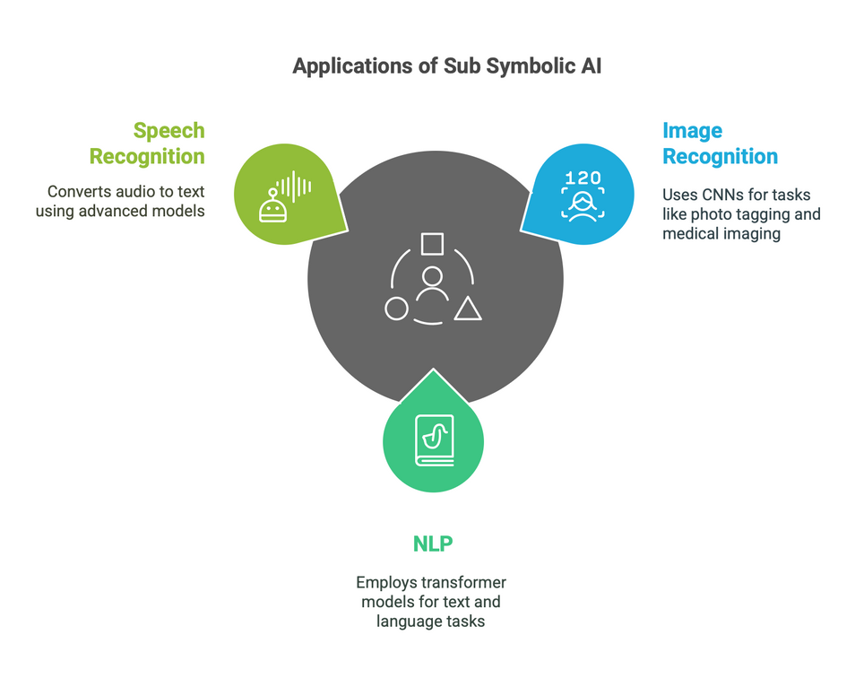
3. Subsymbolic AI
Most popular these days
Machine Learningn, Deep Learning
focuses on learning patterns from data instead of explicitly programmed rules.
Examples & Applications
Image Recognition: Convolutional Neural Networks (CNNs) used in photo tagging, medical imaging diagnostics.
Natural Language Processing (NLP): Transformer-based models (e.g., GPT, BERT) for text generation, language translation, chatbots.
Speech Recognition: Recurrent or transformer-based models that convert audio waveforms to text.
8

Slide 12
Weaknesses
Black-Box Nature
Difficult to interpret or explain decisions
e.g: why did the model classify this person as high risk?
Data Dependency: The model’s accuracy and fairness heavily depend on the training data’s quality and representativeness.
Emergence of Bias - herein lies it’s susceptibility to biases
9

Slide 13
4. Understanding AI Bias
Deviation from a “true” or “fair” outcome, leading to disproportionate negative impacts on specific groups or individuals.
Why Does Bias Occur in AI?
Historical & Societal Patterns: AI learns from data reflecting past and present inequalities (e.g., fewer women in tech leads to biased hiring models).
Data Collection & Curation: Datasets might overrepresent certain demographics and underrepresent others, reinforcing stereotypes.
Some Consequences
Reinforcement of Stereotypes: Language models generating text that stereotypically portrays women in caretaker roles and men in leadership roles.
Discrimination: Banks offering unfair loan terms to minority applicants.
10

Slide 14
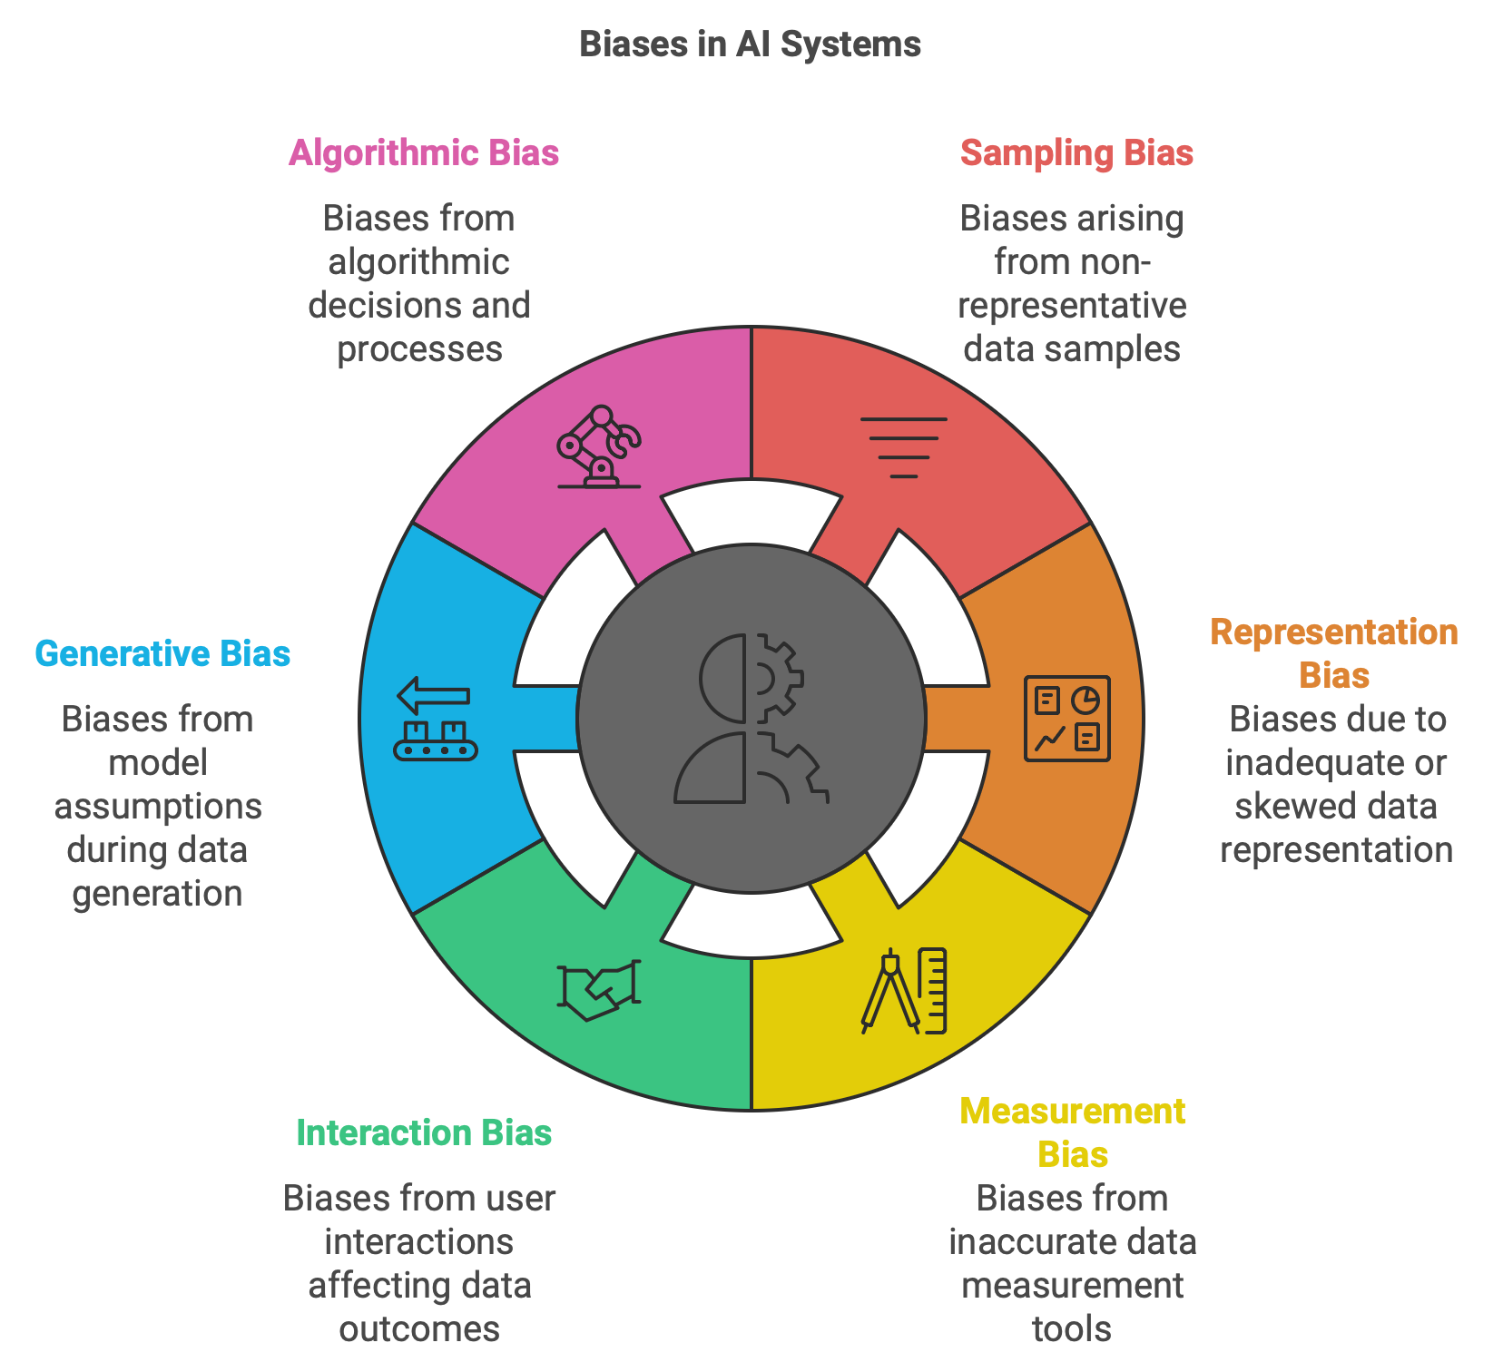
Some common types of Biases
10

Slide 15
5. Standard Approaches to Mitigate AI Bias
Data-Centric Approaches
Data Collection (Preprocessing):
Use balanced datasets or oversampling techniques for underrepresented groups.
Perform de-biasing transformations (eg: removing or anonymizing sensitive attributes).
Algorithmic Approach (In-processing)
Fairness-Constrained Learning:
Incorporate fairness metrics (e.g., demographic parity, equalized odds) into the training objective.
Example: Adjust predictions to ensure false positive rates are equitable across demographic groups.
Auditing & Explainability (Post-processing )
Interpretability Tools: LIME, SHAP, or integrated gradients to highlight which features are most influential in a decision.
Fairness Dashboards & Toolkits: IBM AI Fairness 360, Microsoft Fairlearn, and Google’s Responsible AI toolkit offer metrics and visualizations to diagnose biases.
11

Slide 16
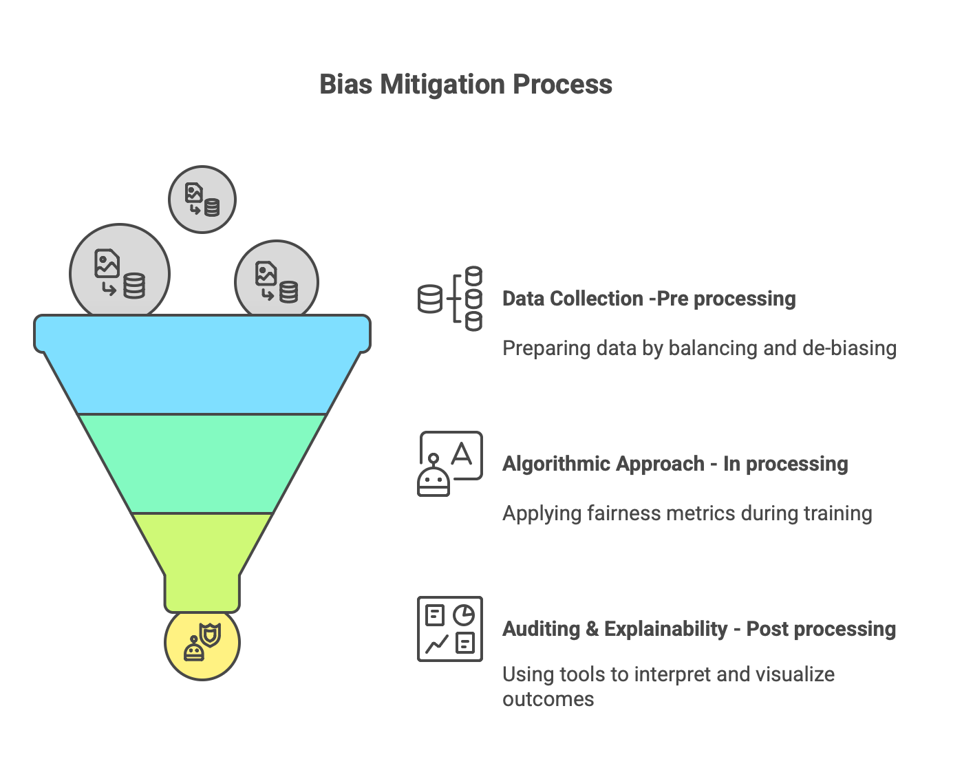
12

Slide 17
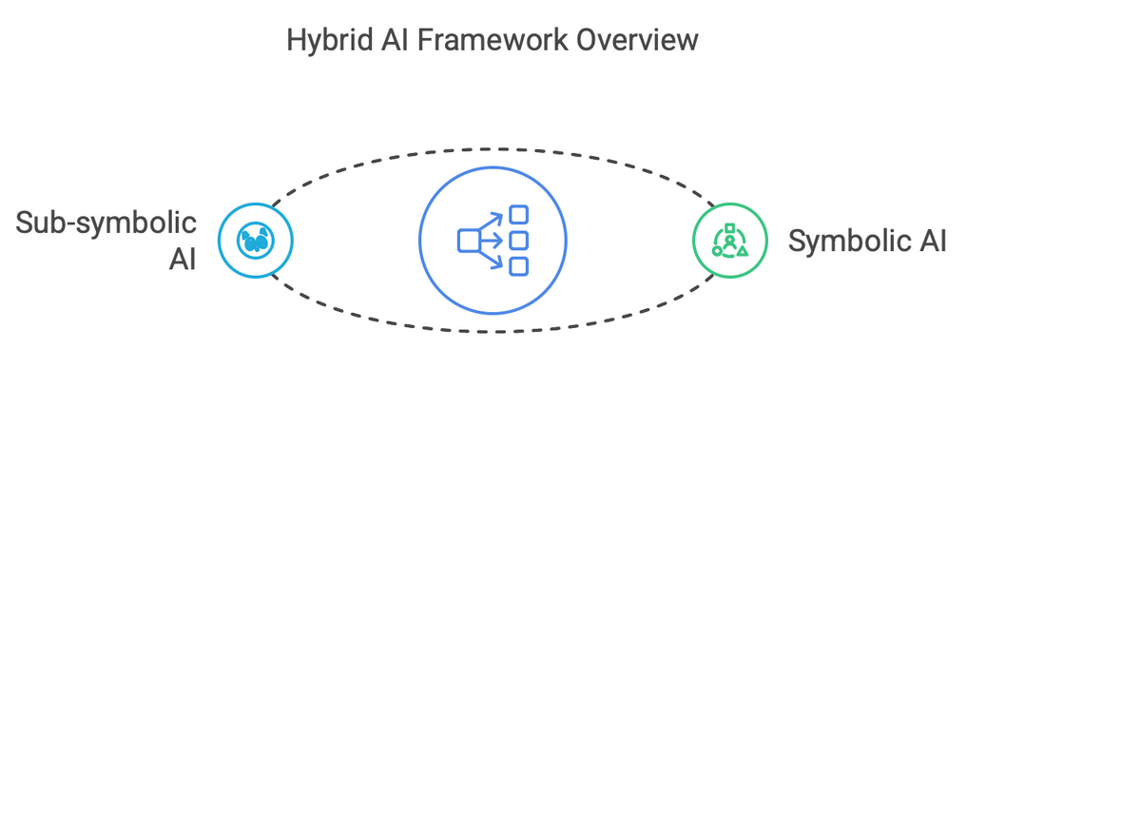
6. Combining Symbolic & Subsymbolic AI
A Hybrid Approach
Complimentary Strengths
Symbolic AI => explicit, logical constraints about fairness, ethical principles, or legal compliance.
Sub-symbolic AI => excels at pattern discovery and handling high-dimensional data.
Mitigating Bias
Rule-Based Fairness Constraints
Use Symbolic logic
define rules
eg: “candidates with equivalent qualifications must have comparable scores regardless of demographic group”
Data-Driven Insight
Neural networks can detect complex, non-obvious relationships
Guided by symbolic logic to avoid discrimination
Symbolic AI
Sub Symbolic AI
13

Slide 18
]
A Hybrid Approach
Interpretability & Accountability
Output Explanations:
Symbolic layer - store relations
decisions can be traced back to them
Error Checking and Preventing Discrimination:
symbolic rules can act as a safety net
If sub-symbolic AI (neural model) - output violates a fairness constraints
system can adjust or override the decision
Symbolic AI
Sub Symbolic AI
14

Slide 19
A Hybrid Approach
Challenges & Limitations of the Hybrid Approach
Increased System Complexity
Merging symbolic and subsymbolic components can lead to more intricate architectures that are harder to maintain and debug.
Ongoing Rule Management
Symbolic rules must be frequently updated as definitions of fairness or regulations change (e.g., new protected categories).
Performance vs. Fairness Trade-Off
Imposing fairness constraints can sometimes reduce raw accuracy, creating tension between performance and social responsibility.
Symbolic AI
Sub Symbolic AI
15

Slide 21
Thank you!
16

