Slide 2
Using AI Tools For Academic Writing
Dr. Semih Yumusak
Research Fellow, University of Southampton
1 February 2025
Research Writing (Online) Hosted by IEEE Pulchowk Campus & CAIR-Nepal

Slide 3
Outline
Introduction
AI for Academic Writing
AI for Code Writing

Slide 4
1.
Introduction

Slide 5
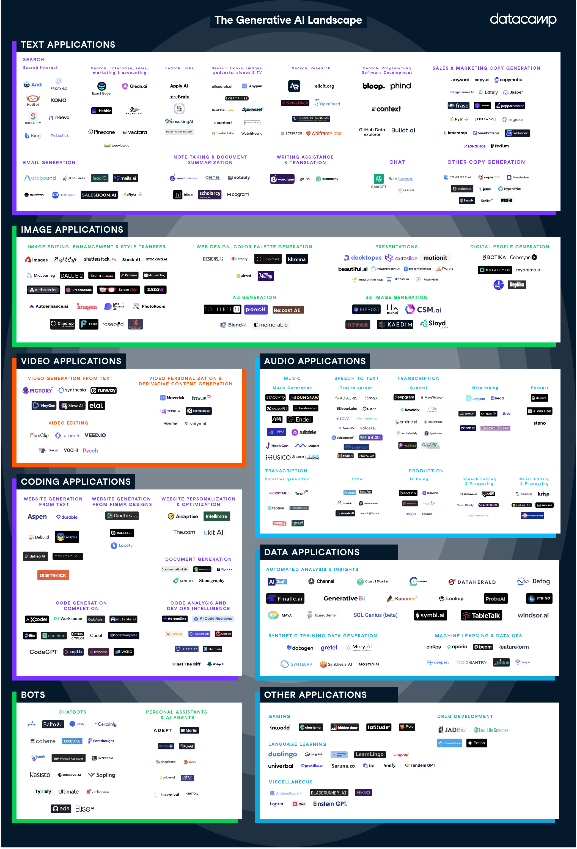
1. Introduction

Slide 6
2.
AI for Academic Writing

Slide 7
2. AI for Academic Writing
Ethics: Do not ask an LLM to write your paper—it is plagiarism.
Good to know! LLM-generated text: - Is detectable. - Can be incorrect. - Is based on a generic summary of prior knowledge.

Slide 8
2. AI for Academic Writing
Rule of thumb: The better you understand, the better you ask. The more you know, the better you verify the output.

Slide 9
3.
AI for Code Writing

Slide 10
3. AI for Code Writing
Do not: - Copy & paste if you don’t understand the meaning. - Let AI generate the main idea.
Do not: - Use it as an assistant robot.
- Utilise it for editing & proofreading.
- Leverage it for code writing.

Slide 11
3. AI for Code Writing
Know what you want.
Understand the architecture.
Develop your own high-level understanding.
Let AI generate syntactic code lines.

Slide 12
Thank you!

