Slide 1

YOUR HELPER
AT WORK
A safer day.
A little more independence.
♥
Tap the logo to visit the website

Slide 2
Meet your workplace helper
Two simple ways to get support.
1 SAFETY CHECK
2 WORKSHOP MAP
The camera checks for
safety gear.
Need something?
You get a friendly reminder.
Tap the map to see more.
Tap a symbol to learn
what it means.
2

Slide 3
Ready for work?
A quick check can help you remember your safety gear.
CAMERA
REMINDER
→
→
Please put
on your
safety gear.
Looks for gear
YOU
The AI can make mistakes. A person can always help.
3

Slide 4
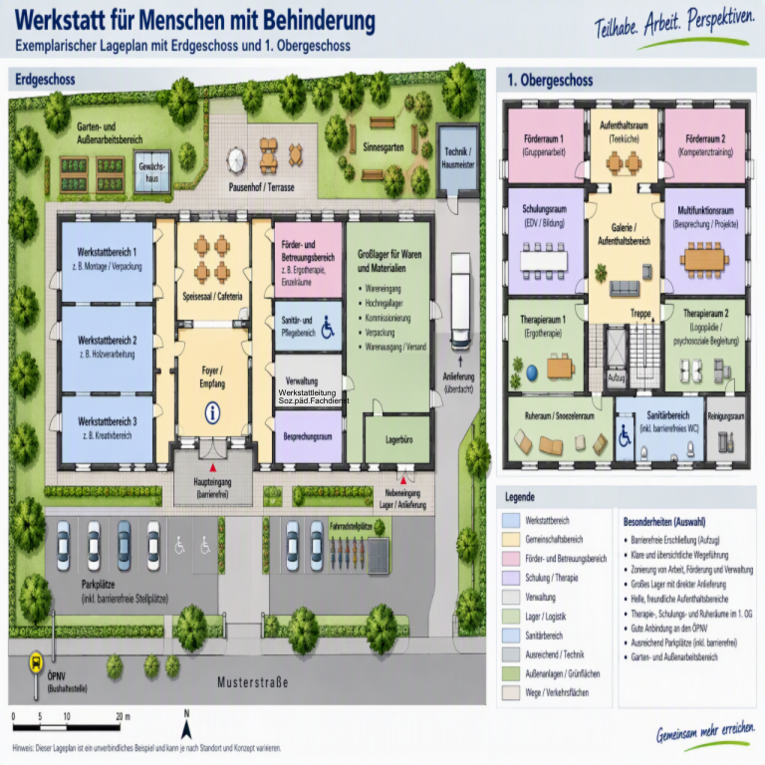
Find your way
Tap the map. It gets bigger.
1
Tap the workshop map.
2
Zoom in to see more.
3
Tap a symbol.
Example plan supplied for the challenge.
4

Slide 5
Tap a symbol. Learn what it means.
See it. Read it. Hear it.
+
First aid
→
You can get help here
if you are hurt.
FIRST AID
▶ Listen again
Example symbol. Real locations must be checked on site.
5

Slide 6
Colours help you choose
Each colour has a meaning. Tap a colour to explore.
!
−
+
!
BLUE
RED
GREEN
YELLOW
You must do this.
Do not do this.
Help and safe exits.
Be careful.
6

Slide 7
A little help. A big difference.
Our idea for a friendlier, safer workplace.
✓ Remember your safety gear
✓ Explore the workshop map
♥
✓ Learn with pictures and sound
Thank you!
7

