Slide 1
CSS Cont.
Web Full Stack

Slide 2
Brief Summary of Today
“Cascading” in Cascading Style Sheet
The position property.
The float property.
Basic animation so your website wouldn’t look like newspaper.

Slide 3
“Cascading” in CSS
CSS ensures that if 2 or more conflicting rules affect the same element:
Only 1 of them will take effect.
The rule chosen is consistent every time.
To do that, CSS “cascade” through a list of defined priorities and always choose the rule with highest priority.
Cascading comes in 2 parts:

Slide 4
1.1 Specificity
<div style=”background: blue;”>
Inline styles will always overwrite external styles.
div {
background: red;
}
?

Slide 5
1.1 Specificity
<div class=”block”>
div {
background: green;
}
div.block {
background: gray;
}
Inline styles will always overwrite external styles.
Rules with higher selector specificity will overwrite less specific rules.
?

Slide 6
Specificity Cheatsheet
Value | Type | Examples
0 | * , relationship selectors | * > ~
1 | Tagname selectors, pseudo-element | h2 footer :before
10 | Class selectors, Attribute Selectors, pseudo-state | .nav_main [type=text] :hover
100 | ID selectors | #banner #video_player

Slide 7
1
p{...}
h2 small {...}
.nav_main a:hover{...}
#categories_list.fixed li a:active{...}
1
1
0
1
1+0+1 = 2
10
1
10
10+1+10 = 21
100
10
1
1
10
100+10+1+1+10 = 122
The specificity of each rule is the sum of all its parts’

Slide 8
1.2 What if 2 rules have equal specificity?
In those cases, whichever rule declared later in the rendered style will take control.
div {
background: orange;
}
…
div {
background: red;
}
?

Slide 9

1.3 In practice
<nav class=”menu menu_vertical”>
<span>Item 1</span>
<span>Item 2</span>
<span>Item 3</span>
<span>Item 4</span>
</nav>
.menu span{
display: inline-block;
}
.menu.menu_vertical span{
display: block;
}

Slide 10
Positioning
It’s a big deal

Slide 11
Positioning
Positioning is usually the hardest part in CSS. Actual position of an element is affected by:
margin
position
float
transform
Positioning is usually the hardest part in CSS. Actual position of an element is affected by:
margin - push the element away from other contents.
position - put the element somewhere.
float - warp the lines of current html document around the element.
transform - transform the element based on its current state.
Each of them is easy enough to understand, but the only way to understand how they work together is through practice. Reading won’t get you far.

Slide 12
Rule of thumb for CSS positioning
Never combine more than 2 positioning methods in the same element!

Slide 13
2. The position property
The position property affect the meaning of its 4 related positioning properties: top, right, bottom and left.
There are 4 different values:
position: static - default value of all elements. The browser decides where to place the element.
position: relative - top, right, bottom and left determine how the element is placed relative to its static position.
position: fixed - top, right, bottom and left determine how the element is placed relative to the browser’s window.
position: absolute - top, right, bottom and left determine how the element is placed relative to its first non-static parent.

Slide 14
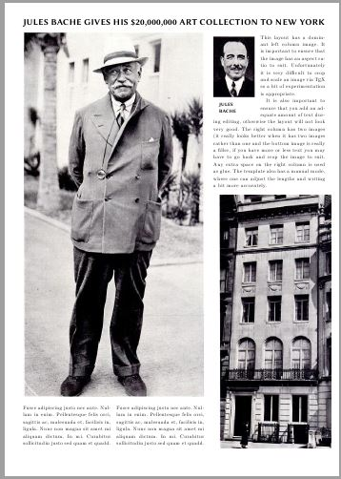
3. The float property
Floating was originally created to allow elements to break out of the HTML document’s lines.
When float-ed, the element is removed from the HTML lines, and all subsequent lines get warped around its box model.
Accepted values are none(default), left and right.

Slide 15

3.2 The float property (Cont.)
Sometimes the float-ed element might be bigger than its container, causing undesired results. In such case, overflow: auto; would come in handy.
Totally SFW
Totally SFW

Slide 16

4 The transform property
The transform property applies a 2D or 3D transformation to an element. This property allows you to rotate, scale, move, skew, etc., elements.
element {
transform: rotate(45deg);
}
More cool stuff: https://www.w3schools.com/cssref/css3_pr_transform.asp

Slide 17
Basic animation
transition: <property> <duration> <easing> <delay>;
transition: width 1s linear;
transition: all 0.3s ease-in-out 0.2s;
transition: width .3s linear,
height .4s ease-in .1s;

