Slide 1
hdl_graph_slam & lidarslam_ros2
Ankang Chu
cakgod9621@gmail.com

Slide 2
Introduction
system: ubuntu 18.04 (Bionic Beaver)
software: ROS Melodic Morenia + ROS2 Eloquent Elusor
hardware: cloud server Xeon 6266C-16U 32G && notebook (i7-1065G7 8G)
dataset: Stevens dataset && KITTI dataset
test: cpu/memory usage && trajectory offset

Slide 3

Introduction
system: ubuntu 18.04 (Bionic Beaver)
software: ROS Melodic Morenia + ROS2 Eloquent Elusor
hardware: cloud server Xeon 6266C-16U 32G && notebook (i5 3337U-12G, i7-1065G7 8G)
dataset: Stevens dataset && KITTI dataset
test: cpu/memory usage && trajectory offset

Slide 4
hdl_graph_slam
Github: https://github.com/koide3/hdl_graph_slam.git
hdl_graph_slam is an open source ROS package for real-time 6DOF SLAM using a 3D LIDAR. It is based on 3D Graph SLAM with NDT scan matching-based odometry estimation and loop detection. It also supports several graph constraints, such as GPS, IMU acceleration (gravity vector), IMU orientation (magnetic sensor), and floor plane (detected in a point cloud).
/velodyne
prefiltering
/filtered_point
scan_matching_odometry
/odom
hdl_graph_slam
/map_points
floor_detection
/floor_coeffs

Slide 5
lidarslam_ros2
Github: https://github.com/rsasaki0109/lidarslam_ros2.git
lidarslam_ros2 is a ROS2 package of the frontend using OpenMP-boosted gicp/ndt scan matching and the backend using graph-based slam.
/velodyne
scan_matcher
graph_based_slam
/map_points

Slide 6
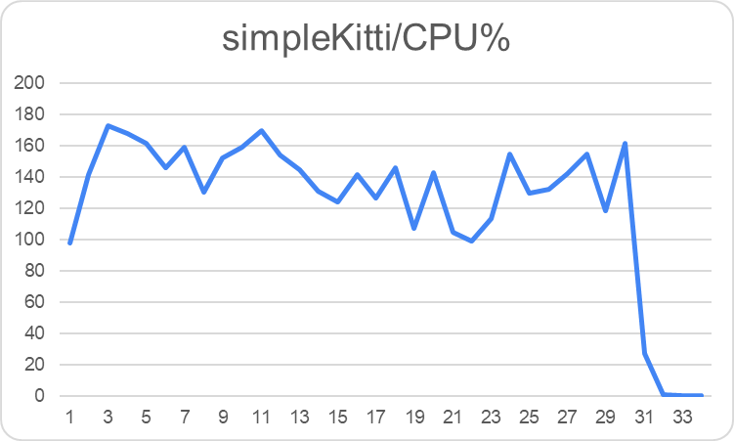
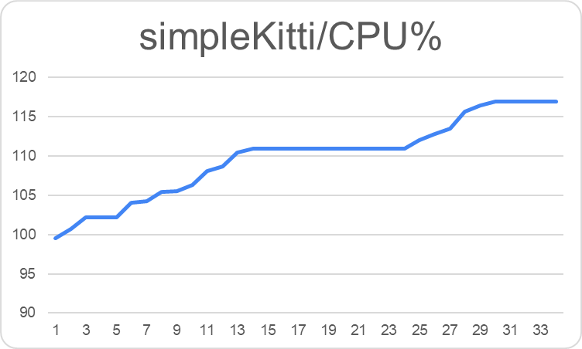
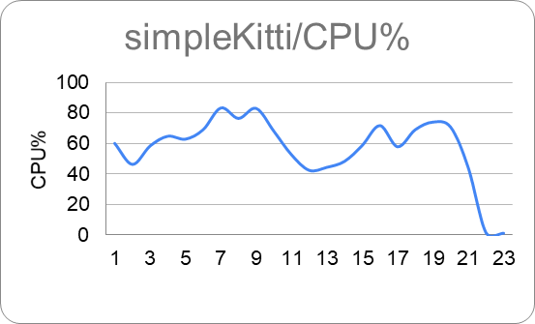
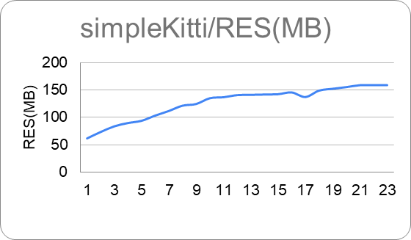
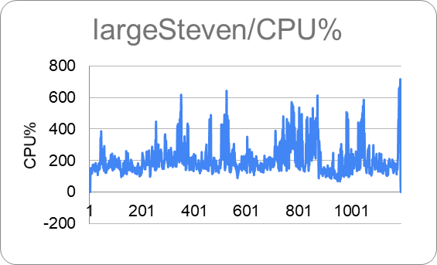
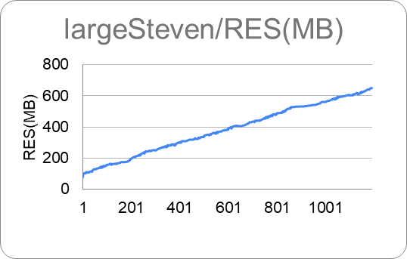
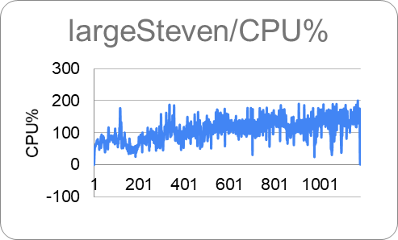
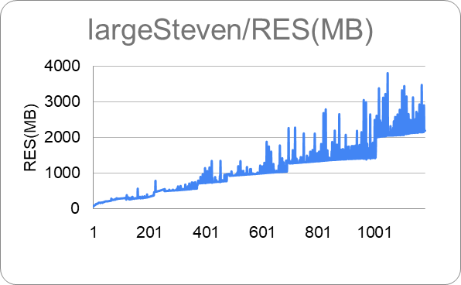
TEST
cpu && memory
hdl_graph_slam
lidarslam_ros2

Slide 7
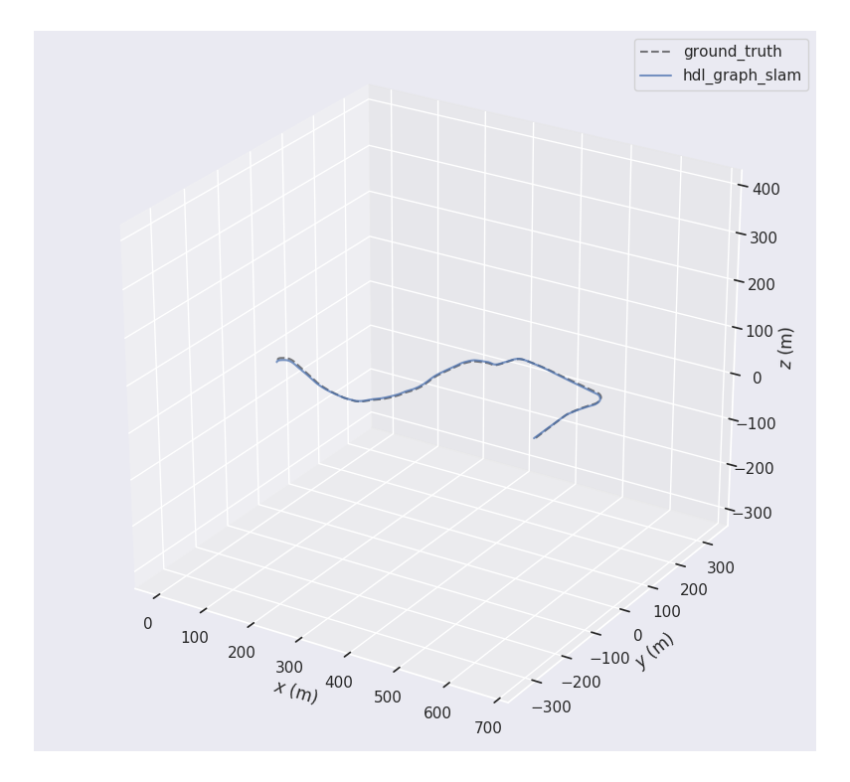
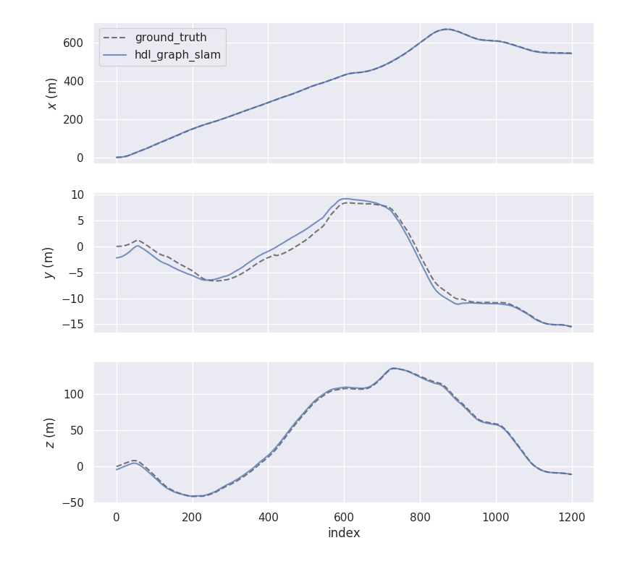
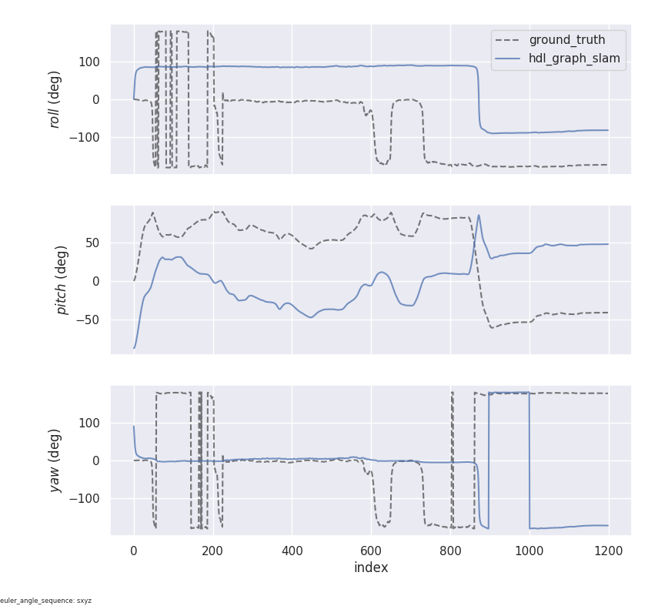
TEST
trajectory comparison
hdl_graph_slam
APE: max 872.414809 mean 521.429256 median 551.063871 min 0.000000
rmse 583.516519 sse 408589833.235609 std 261.921856
RPE: max 2.198713 mean 1.077650 median 1.139164 min 0.017491
rmse 1.176116 sse 1658.515779 std 0.471084

Slide 8
TEST
trajectory comparison
lidarslam_ros2

