Slide 1
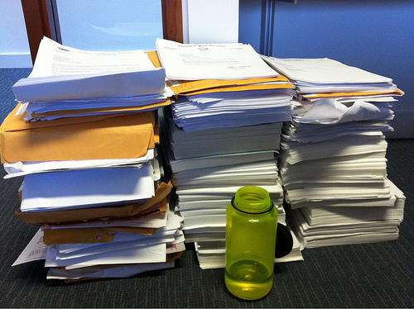
Tutorials on Data Management
Lesson 3: Data Management Planning
CC image by Joe Hall on Flickr
Notes:
Updated 21 Dec 2016

Slide 2

Lesson Topics
What is a data management plan (DMP)?
Why prepare a DMP?
Components of a DMP
Recommendations for DMP content
Example of NSF DMP
CC image by Darla Hueske on Flickr
Notes:
The topics covered in this module will answer the questions:
What is a data management plan, or DMP?
Why would you want to prepare a DMP?
What are the components of a DMP? And
What are the requirements for DMPs prepared for National Science Foundation (or NSF) proposals?
We will also go over an example of a data management plan prepared for NSF.

Slide 3

Learning Objectives
After completing this lesson, the participant will be able to:
Define a DMP
Understand the importance of preparing a DMP
Identify the key components of a DMP
Recognize the DMP elements required for an NSF proposal
CC image by cybrarian77 on Flickr
Notes:
After completing this lesson, the participant will be able to:
Understand what a data management plan, or DMP, is, and describe the components of a DMP; and
understand the importance of preparing a DMP, identify the key components of a DMP, and recognize the elements of a DMP that are required for NSF proposals

Slide 4
The Data Life Cycle
Assure
Preserve
Discover
Integrate
Analyze
Plan
Describe
Collect
Notes:
Data management planning is the starting point in the data life cycle. However the plan should be revisited often throughout the project to ensure proper data documentation and management.

Slide 5
What is a Data Management Plan?
Formal document
Outlines what you will do with your data during and after you complete your research
Ensures your data is safe for the present and the future
From University of Virginia Library
Notes:
A DMP is a formal document that outlines what you will do with your data both during and after your research project.
Data management plans are meant to ensure that your data will be preserved and useful both now and in the future, by both you and other researchers.

Slide 6
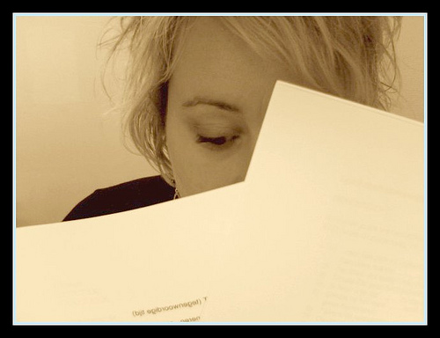
Why Prepare a DMP? (1)
Save time
Less reorganization later
Increase research efficiency
Ensures you and others will be able to
understand and use data in future
CC image by Cathdew on Flickr
Notes:
Why would you want to prepare a data management plan? First and foremost, they save you time. If your data organization scheme is decided on early in the project, or even before data collection begins, you are less likely to spend time organizing your data later.
Second, preparing a plan for data organization and storage allows you to focus on your research, increasing your efficiency. You are better able to locate and use your data, and share it with collaborators.
If data are documented well both before and during data collection, it prevents problems in understanding data and metadata in the future.

Slide 7
Why Prepare a DMP? (2)
Easier to preserve your data
Prevents duplication of effort
Can lead to new, unanticipated discoveries
Increases visibility of research
Makes research and data more relevant
Funding agency requirement
Notes:
Another reason to prepare a DMP is that it makes your data easier to preserve and archive. Some data centers and repositories have specific requirements for data documentation, and knowing these requirements in advance saves time and effort that might be spent trying to append data after it’s collected.
By preserving and archiving your data, you are benefiting both yourself and others in your field. If others can easily find and use your data, it might prevent duplication of scientific efforts to re-collect your data.
Data that you preserve can lead to new, unanticipated discoveries you might not predict.
It also increases your research visibility and makes your work more relevant.
Finally, data management plans are now required by many funding agencies. In 2011, the National Science Foundation began requiring a 2-page DMP be submitted with all proposals. Other funders have followed suit.

Slide 8
Components of a General DMP
Information about data & data format
Metadata content and format
Policies for access, sharing and re-use
Long-term storage and data management
Roles and responsibilities
Budget
Notes:
For a general DMP, there are five main categories of information that should be included. Some funders or institutions may require specific elements in a data management plan; you should check with the agency or group for which you are preparing your DMP before beginning.
The slides that follow will go into more detail for each of the general categories on this slide. They are 1) Information about the data and its format, 2) information about the metadata content and format that will be used, 3) policies for access, sharing, and reuse of data, 4) long-term storage and data management, 5) roles and responsibilities, and 6) budget considerations for data management.

Slide 9

1. Information About Data & Data Format
1.1 Description of data to be produced
Experimental
Observational
Raw or derived
Physical collections
Models and their outputs
Simulation outputs
Curriculum materials
Software
Images
Etc…
CC image by Jeffery Beall on Flickr
Notes:
There are many different types of data that may be produced by a research study. Consider this list when describing data that will be produced by the project. These include experimental and observational data, raw or derived data, physical collections, models and their outputs, outputs from simulations, curriculum materials for courses, software, images, etcetera.
More information can be found at https://library.uoregon.edu/datamanagement/datadefined.html

Slide 10

1. Information About Data & Data Format
1.2 How data will be acquired
When?
Where?
1.3 How data will be processed
Software used
Algorithms
Workflows
CC image by Ryan Sandridge on
Flickr
Notes:
In addition to a description of the data that will be generated, the methods of data acquisition should be specified. Include the who, what, when, where of your collection.
How will the data be processed once it is acquired? This step is important to consider before the project since it may affect how data are organized, what formats are used, and how much should be budgeted for hardware and software. Things to consider are what software may be used, what algorithms will be employed, how these fit into the overall workflow of the project.

Slide 11

1. Information About Data & Data Format
1.4 File formats
Justification
Naming conventions
1.5 Quality assurance & control during
sample collection, analysis, and
processing
CC image by Artform Canada on Flickr
Notes:
You should also describe the file formats you plan to use for your data. When saving files for the long term, it’s best to use standard formats such as dot csv or dot txt. These are nonproprietary and likely to be readable in the future, regardless of software availability.
Whatever format you choose, you should justify your choice. Consider what standards are commonly used in your scientific discipline when deciding.
Also describe the naming conventions that will be used for your data sets, files, and folders. By determining these conventions ahead of time, you are less likely to need to change or reorganize files during the project.
You should also identify what quality assurance and control measures you plan to take. Include what will be done during data collection, after data collection, and in the course of data analysis.

Slide 12
1. Information About Data & Data Format
1.6 Existing data
If existing data are used, what are their origins?
Will your data be combined with existing data?
What is the relationship between your data and existing data?
1.7 How data will be managed in short-term
Version control
Backing up
Security & protection
Who will be responsible
Notes:
It is also important to identify any existing data you may use, including their origins, and how the data you collect will relate to those data.
If your dataset will be combined in the future with existing data, how you will ensure that formats are compatible? What is the relationship between the data you are collecting and what already exists?
You should describe how data will be managed in the short term. How will you keep track of different versions of your data and analyses? How will you back up your data? Are servers available at your institution? Consider both on-site and off-site backup options. Describe how you will ensure the security of your data, especially if your data are sensitive. Who will have access to the data?
Be sure to identify who will be responsible for short-term data management. Assign roles and responsibilities for data management, archiving, version control, and backing up.

Slide 13

2. Metadata Content & Format
Metadata defined:
Documentation and reporting of data
Contextual details: Critical information about the dataset
Information important for using the data
Descriptions of temporal and spatial details, instruments, parameters, units, files, etc.
CC 0 image from The Noun Project
Notes:
The second major category for a DMP is metadata content and format. First, we should define metadata. Metadata is data documentation. It includes contextual details about data collection and any information that is important for using and understanding the data. Examples of some of the many components of metadata are temporal and spatial details, instruments used, parameters, units, etcetera.

Slide 14

2. Metadata Content & Format
2.1 What metadata are needed
Any details that make data meaningful
2.2 How metadata will be created
and/or captured
Lab notebooks? GPS units?
Auto-saved on instrument?
2.3 What format will be used for the metadata
Standards for community
Justification for format chosen
CC 0 image from The Noun Project
Notes:
This section of the DMP should first describe how the metadata will be created or captured. For instance, will field or lab notebooks be used to record critical information? Will instruments such as GPS units be implemented for data collection? Will metadata be saved automatically by the instrument you are using?
Indicate what format, or metadata standard, will be used. There are many different metadata standards available. Ask colleagues about what is commonly used in your discipline. Also, check with the repository or data center with which you plan to archive your data - many have metadata format requirements. Justify the format you choose for your metadata, considering your research community, the data center you will use, and the nature of the project.

Slide 15
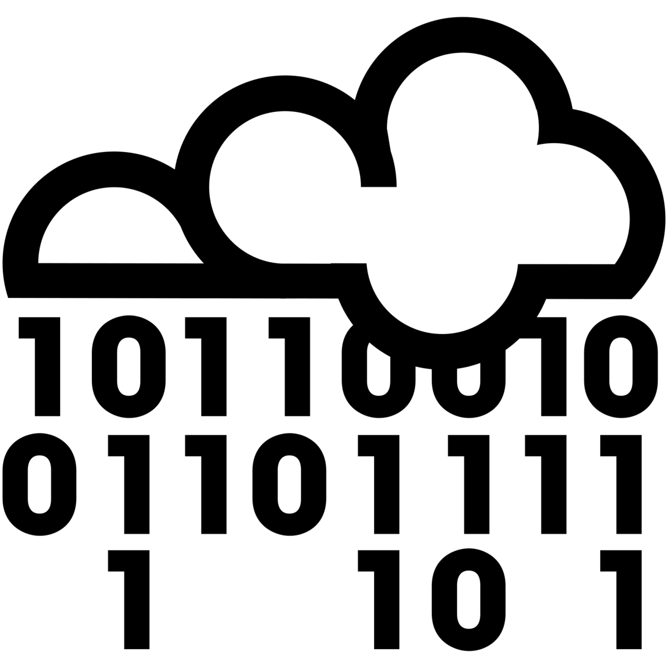
3. Policies for Access, Sharing, Reuse
3.1 Obligations for sharing
Funding agency
Institution
Other organization
Legal
3.2 Details of data sharing
How long?
When?
How access can be gained?
Data collector rights
3.2 Ethical/privacy issues with data sharing
CC 0 image from The Noun Project
Notes:
The third section of a data management plan should describe policies for access, sharing, and reuse of your data.
What obligations do you have to share your data? Sharing requirements may come from your institution, your funder, or your professional society. There may also be legal obligations for sharing your data.
You should also describe the details of how you will share your data. How long after collection will data be available? When will access be granted to interested users? Who will have access to those data? How will they gain access? Will the data collector, creator, or PI have exclusive rights to data for a certain period of time?
Be sure to address any ethical or and privacy issues associated with your data. For example, If your data involves human subjects, endangered species, or locations of sensitive habitats, you may have special considerations for data sharing.

Slide 16

3. Policies for Access, Sharing, Reuse
3.4 Intellectual property & copyright issues
Who owns the copyright?
Institutional policies
Funding agency policies
Embargos for political/commercial reasons
3.5 Intended future uses/users for data
3.6 Citation
How should data be cited when used?
Persistent citation?
CC 0 image from The Noun Project
Notes:
Describe any intellectual property or copyright issues associated with your data. Who owns the copyright to your data? Institutions and/or funding agencies often have a policy for intellectual property and copyright. There may be other considerations such as embargos on data due to patents, politics, or journal requirements.
Be prepared to describe the intended future uses and users of your data. This helps determine the most appropriate data center to archive your data.
You should also describe how your data should be cited when used. It is best to establish a persistent identifier or citation, such as a DOI, or digital object identifier. Consult policies and options with the data archive you choose.

Slide 17




4. Long-term Storage & Data Management
4.1 What data will be preserved
4.2 Where will it be archived
Most appropriate archive for data
Community standards
3.6 Data transformations/formats needed
Consider archive policies
4.4 Who will be responsible
Contact person for archive
Notes:
The fourth major section of a data management plan describes plans for long term storage and data management.
First, you should describe what data will be preserved. Not all data should necessarily be preserved. In general, any raw data should be kept. Also, any data products that were particularly expensive or time consuming to obtain should be preserved. Any data that is not easily replaceable should be kept.
Second, identify where you will archive your data. Find out what archives or data centers are commonly used in your discipline. Data centers usually last longer than lab or personal websites. Check to see if your institution has a repository available to researchers. Also, ask colleagues in your field where data are commonly archived.
Third, your data management plan should describe what data transformations and formats need to be preserved to ensure future usability of your data. Contact the data repository you will use early in the project to be sure you have data in the correct format. This will save time later.
Fourth, identify the person who will be responsible for maintaining contact information with the data center. This is especially important if there are restrictions on data use, for instance a requirement that potential users contact the data collector before reusing data.

Slide 18

5. Roles and responsibilities
5.1 Outline the roles and responsibilities for implementing this data management plan.
For example:
Who will be responsible for data management and for monitoring the data management plan?
How will adherence to this data management plan be checked or demonstrated?
What process is in place for transferring responsibility for the data?
Who will have responsibility over time for decisions about the data once the original personnel are no longer available?
CC 0 image from The Noun Project
Notes:
Explain how the responsibilities regarding the management of your data will be delegated. This should include time allocations, project management of technical aspects, training requirements, and contributions of non-project staff - individuals should be named where possible. Remember that those responsible for long-term decisions about your data will likely be the custodians of the repository/archive you choose to store your data. While the costs associated with your research (and the results of your research) must be specified in the Budget Justification portion of the proposal, you may want to reiterate who will be responsible for funding the management of your data. [from DMPTool, NSF-ENG template]

Slide 19
6. Budget
6.1 Anticipated costs
Time for data preparation & documentation
Hardware/software for data preparation & documentation
Personnel
Archive costs
6.2 How costs will be paid
Notes:
The fifth and final component of a general DMP is budget. Although most proposals have separate budget requirements, it is important to consider costs that might be incurred in the process of managing and preserving your data.
Consider costs such as salary time needed for data preparation and documentation, hardware and software requirements, personnel needed to prepare data, and costs associated with archiving your data.
You should identify how the costs associated with your DMP will be paid.

Slide 20
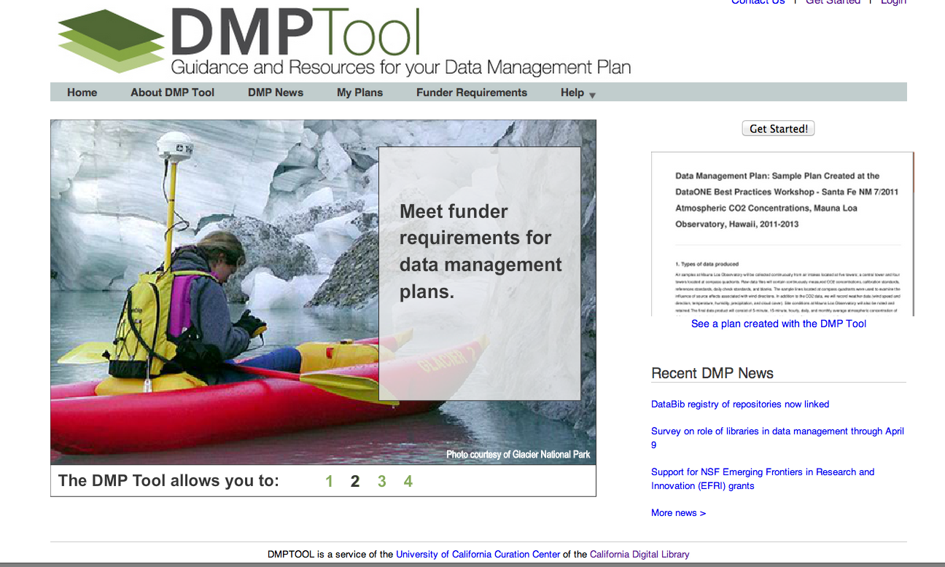
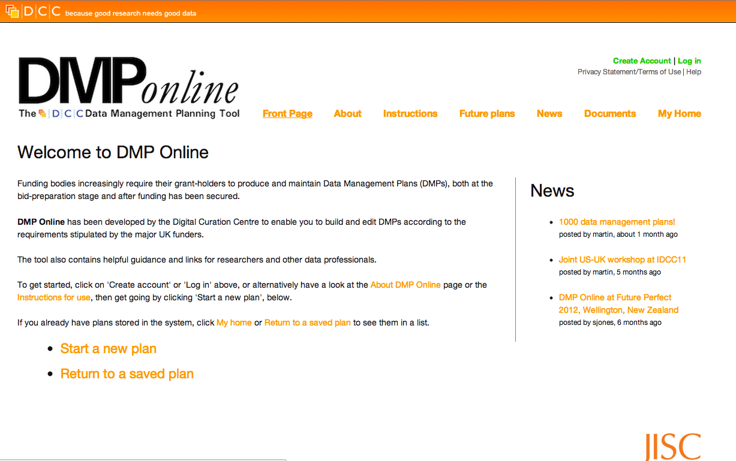
Tools for Creating Data Management Plans
dmptool.org
dmponline.dcc.ac.uk
Notes:
There are several tools available for creating data management plans. Two of the most commonly used are the DMPTool (US) and DMP Online (UK funders only).
Both operate as “wizards” and provide prompts for the user to fill out in order to create their data management plan. You can save your plan, print it, or export it to your computer.

Slide 21

NSF DMP Requirements
From Grant Proposal Guidelines:
Plans for data management and sharing of the products of research. Proposals
must include a supplementary document of no more than two pages labeled “Data
Management Plan”. This supplement should describe how the proposal will
conform to NSF policy on the dissemination and sharing of research results (in
AAG), and may include:
the types of data, samples, physical collections, software, curriculum materials, and other materials to be produced in the course of the project
the standards to be used for data and metadata format and content (where existing standards are absent or deemed inadequate, this should be documented along with any proposed solutions or remedies)
policies for access and sharing including provisions for appropriate protection of privacy, confidentiality, security, intellectual property, or other rights or requirements
policies and provisions for re-use, re-distribution, and the production of derivatives
plans for archiving data, samples, and other research products, and for preservation of access to them
Notes:
We will now focus on NSF’s data management plans. As of January 2011 NSF requires that a two page data management plan be included with submitted proposals. This is in addition to the 15 pages for the proposal.
The text on this slide is taken from NSF’s grant proposal guidelines. It states that the DMP may include
-types of data
-standards used for data and metadata
-policies describing data access and sharing, and
-plans for archiving data

Slide 22
NSF DMP Requirements
Summarized from Award & Administration Guide:
4. Dissemination and Sharing of Research Results
Promptly publish with appropriate authorship
Share data, samples, physical collections, and supporting materials with others, within a reasonable timeframe
Share software and inventions
Investigators can keep their legal rights over their intellectual property, but they still have to make their results, data, and collections available to others
Policies will be implemented via
Proposal review
Award negotiations and conditions
Support/incentives
Notes:
There is more information from NSF about requirements in section 4 of the Award and Administration guide. It states that research results should be promptly published, data should be shared, software and inventions should be shared, and describes some intellectual property and policy issues.
In addition to these general requirements, there are directorate- and division-specific requirements that will likely be updated in the near future. Not all directorates and divisions have DMP requirements available yet.

Slide 23
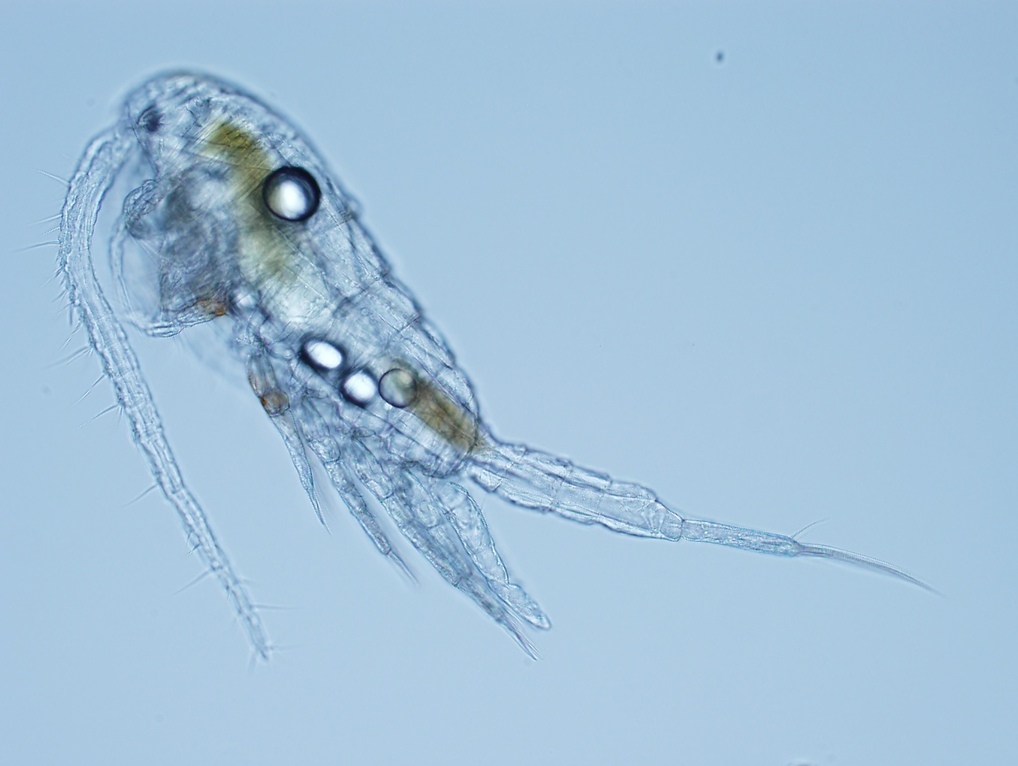
Data in Real Life: A DMP Example
Project name: Effects of temperature and salinity on population growth of the estuarine copepod, Eurytemora affinis
Project participants and affiliations:
Carly Strasser (University of Alberta and Dalhousie University)
Mark Lewis (University of Alberta)
Claudio DiBacco (Dalhousie University and Bedford Institute of
Oceanography)
Funding agency: CAISN (Canadian Aquatic Invasive Species Network)
Description of project aims and purpose:
We will rear populations of E. affinis in the laboratory at three temperatures and three salinities (9 treatments total). We will document the population from hatching to death, noting the proportion of individuals in each stage over time. The data collected will be used to parameterize population models of E. affinis. We will build a model of population growth as a function of temperature and salinity. This will be useful for studies of invasive copepod populations in the Northeast Pacific.
Video Source: Plankton Copepods. Video. Encyclopædia Britannica Online. Web. 13 Jun. 2011
Photo by C. Strasser; all rights reserved
Notes:
The next four slides provide an example of a two-page NSF-mandated Data Management Plan. This slide describes the project, and the following slides address each of the five sections described above for a general data management plan.

Slide 24
Data in Real Life: A DMP Example
1. Information about data
Every two days, we will subsample E. affinis populations growing at our treatment conditions. We will use a microscope to identify the stage and sex of the subsampled individuals. We will document the information first in a laboratory notebook, then copy the data into an Excel spreadsheet. For quality control, values will be entered separately by two different people to ensure accuracy. The Excel spreadsheet will be saved as a comma-separated value (.csv) file daily and backed up to a server. After all data are collected, the Excel spreadsheet will be saved as a .csv file and imported into the program R for statistical analysis. Strasser will be responsible for all data management during and after data collection.
Our short-term data storage plan, which will be used during the experiment, will be to save copies of 1) the .txt metadata file and 2) the Excel spreadsheet as .csv files to an external drive, and to take the external drive off site nightly. We will use the Subversion version control system to update our data and metadata files daily on the University of Alberta Mathematics Department server. We will also have the laboratory notebook as a hard copy backup.

Slide 25
Data in Real Life: A DMP Example
2. Metadata format & content
We will first document our metadata by taking careful notes in the laboratory notebook that refer to specific data files and describe all columns, units, abbreviations, and missing value identifiers. These notes will be transcribed into a .txt document that will be stored with the data file. After all of the data are collected, we will then use EML (Ecological Metadata Language) to digitize our metadata. EML is on of the accepted formats used in Ecology, and works well for the type of data we will be producing. We will create these metadata using Morpho software, available through the Knowledge Network for Biocomplexity (KNB). The documentation and metadata will describe the data files and the context of the measurements.

Slide 26
Data in Real Life: A DMP Example
3. Policies for access, sharing & reuse
We are required to share our data with the CAISN network after all data have been collected and metadata have been generated. This should be no more than 6 months after the experiments are completed. In order to gain access to CAISN data, interested parties must contact the CAISN data manager (data@caisn.ca) or the authors and explain their intended use. Data requests will be approved by the authors after review of the proposed use.
The authors will retain rights to the data until the resulting publication is produced, within two years of data production. After publication (or after two years, whichever is first), the authors will open data to public use. After publication, we will submit our data to the KNB, allowing discovery and use by the wider scientific community. Interested parties will be able to download the data directly from KNB without contacting the authors, but will still be required to give credit to the authors for the data used by citing a KNB accession number either in the publication text or in the references list.

Slide 27
Data in Real Life: A DMP Example
4. Long-term storage and data management
The data set will be submitted to KNB for long-term preservation and storage. The authors will submit metadata in EML format along with the data to facilitate its reuse. Strasser will be responsible for updating metadata and data author contact information in the KNB.
5. Budget
A tablet computer will be used for data collection in the field, which will cost approximately $500. Data documentation and preparation for reuse and storage will require approximately one month of salary for one technician. The technician will be responsible for data entry, quality control and assurance, and metadata generation. These costs are included in the budget in lines 12-16.

Slide 28
Summary
DMPs are an important part of the data life cycle. They save time and effort in the long run, and ensure that data are relevant and useful for others.
Funding agencies are beginning to require DMPs
Major components of a DMP:
Information about data & data format
Metadata content and format
Policies for access, sharing and re-use
Long-term storage and data management
Budget
Notes:
In summary, DMPs are an important part of the data life cycle. They save time and effort in the long run and ensure that data are relevant and useful for others. Funders, journals and institutions are beginning to mandate data management plans, so it is important for scientists to understand what a DMP entails.
The major components of a DMP include information about the data its format; metadata content and format; policies for access, sharing, and re-use, budget; and plans for long term storage and management.

Slide 29
Resources
University of Virginia Library http://www2.lib.virginia.edu/brown/data/plan.html
Digital Curation Centre http://www.dcc.ac.uk/resources/data-management-plans
Oregon State University Library http://guides.library.oregonstate.edu/dmp/policies
NSF Grant Proposal Guidelines http://www.nsf.gov/pubs/policydocs/pappguide/nsf11001/gpg_2.jsp#dmp
Inter-University Consortium for Political and Social Research http://www.icpsr.umich.edu/icpsrweb/ICPSR/dmp/index.jsp
DataONE https://www.dataone.org/data-management-planning

Slide 30

The full slide deck may be downloaded from:
http://www.dataone.org/education-modules
Suggested citation:
DataONE Education Module: Data Management Planning. DataONE. Retrieved Nov12, 2012. From http://www.dataone.org/sites/all/documents/L03_DataManagementPlanning.pptx
Copyright license information:
No rights reserved; you may enhance and reuse for your own purposes. We do ask that you provide appropriate citation and attribution to DataONE.

