Slide 1
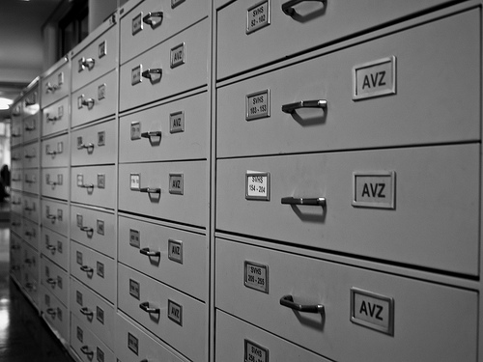
Tutorials on Data Management
Lesson 8: Data Citation
CC image by adesigna on Flickr,

Slide 2

Lesson Topics
Data Citation in the Data Life Cycle
Definitions: What is Data Citation?
Benefits of Data Citation
Collaborating to Support Data Citation
How to Cite Data
How to Obtain a Persistent Identifier for
a Data Set
Best Practices to Support Data Citation
CC image by cybrarian77 on Flickr,

Slide 3
Learning Objectives
After completing this lesson, the participant will be able to:
Define data citation
Describe benefits of data citation
Identify roles of data authors/managers, data publishers, and journal publishers in supporting data citation
Recognize metadata elements useful for data citation
Recognize common persistent data locators and describe the process for obtaining one
Summarize best practices for supporting data citation

Slide 4
The Data Life Cycle
Assure
Preserve
Discover
Integrate
Analyze
Plan
Describe
Collect
Notes:
The Data Life Cycle is a continuum of data development, manipulation, management, and storage stages. Data citation is part of the “Describe” phase of the Life Cycle, though it is also related to Preservation and Discovery.

Slide 5
Definitions
Data citation
“The practice of providing a reference to data in the same way as researchers routinely provide a bibliographic reference to printed resources”¹
“A key practice underpinning the recognition of data as a primary research output rather than as a by-product of research”¹
Data author
“Individual involved in research, education, or other activities that generate digital data that are subsequently deposited in a data collection”²
Persistent identifier
A unique web-compatible alphanumeric code that points to a resource (e.g., data set) that will be preserved for the long term (i.e., over several hardware and software generations)
Should direct to latest available version of resource or to metadata which enables acquisition of desired version or format
Notes:
Australian National Data Service (ANDS), Data Citation Awareness Guide. Accessed May 10, 2012 at http://ands.org.au/guides/data-citation-awareness.html.
2. National Science Board, Long-Lived Digital Data Collections: Enabling Research and Education in the 21st Century, September, 2005. p. 17. http://www.nsf.gov/pubs/2005/nsb0540/ Accessed May 10, 2012.
3. Hakala, J. Persistent identifiers – an overview. Accessed May 10, 2012 at http://metadaten-twr.org/2010/10/13/persistent-identifiers-an-overview/.

Slide 6
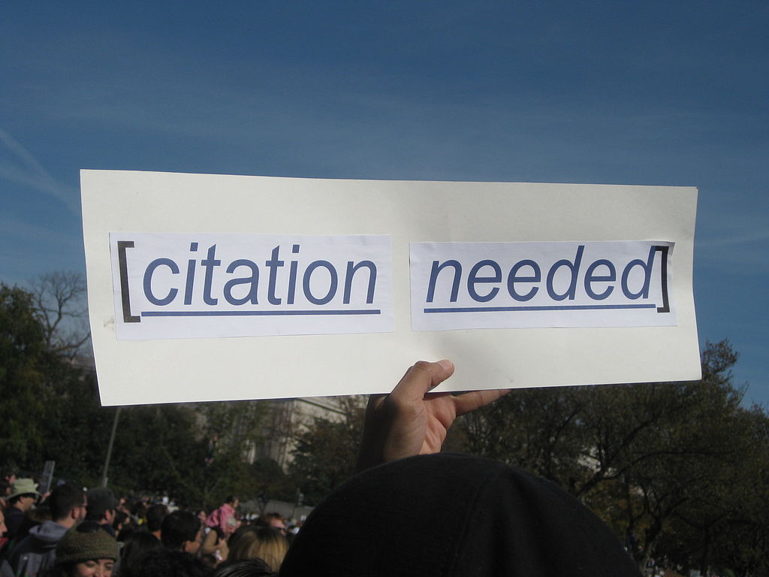
Benefits of Data Citation
Short term
Facilitates discovery of relationships between data and publications, making it easier to validate and build upon previous work
Ensures that proper credit can be given when others use your work
Facilitates impact assessments of datasets based on number of publications that cite them
Helps researchers re-using data to find other ways the data has been used.
CC image by futureatlas.com on Flickr,as “Citation Needed”

Slide 7
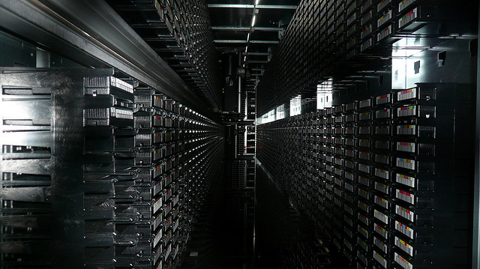
Benefits of Data Citation
Long term
Promotes the availability of data into the future
Facilitates discovery of existing data relevant to a particular question
Enables recognition of scholarly effort within disciplines and organizations
Increases transparency of scientific research
CC image by gruntzooki on Flickr
Notes:
Adoption of practices that rely on publishing infrastructure help to ensure data will be available in the future --- is this really true? I reworded it, but just thinking about it…nothing is guaranteed…?
Prevents ‘data stealing’ because rules of publication apply to citable data in that it must be cited or treated as plagiarism….
Easier to discover existing data relevant to a particular question

Slide 8

Principles of Data Citation
Importance - Data should be considered legitimate, citable products of research
Credit and Attribution - Data citations should facilitate giving scholarly credit and normative and legal attribution to all contributors to the data
Evidence - In scholarly literature, whenever and wherever a claim relies upon data, the corresponding data should be cited.
Unique Identification - A data citation should include a persistent method for identification that is machine actionable, globally unique, and widely used by a community.
https://www.force11.org/datacitation

Slide 9
Principles of Data Citation
Access - Data citations should facilitate access to the data, metadata, code, and other materials, as necessary for both humans and machines.
Persistence - Unique identifiers, data, and metadata should persist beyond the lifespan of the data they describe.
Specificity and Verifiability - Data citations should facilitate identification of, access to, and verification of the specific data that support a claim.
Interoperability and Flexibility - Data citation methods should be flexible, but enable interoperability across communities.
https://www.force11.org/datacitation

Slide 10
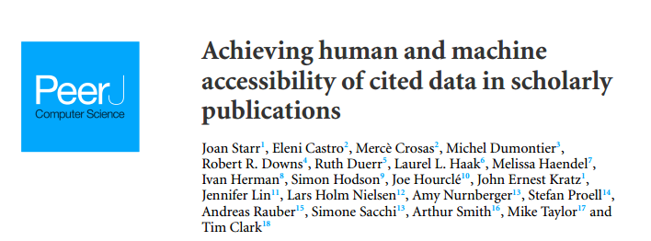
How to Cite Data
Similar to citing a published article or book
Provide information necessary to identify and locate the work cited
Broadly-applicable data citation standards have not yet been established; use standards adopted by relevant academic journal, data repository, or professional organization
In “Achieving human and machine accessibility of cited data in scholarly publications” Starr et al. (2015) begin to lay out implementation guidelines across disciplines¹
doi: 10.7717/peerj-cs.1
Notes:
Starr J, Castro E, Crosas M, Dumontier M, Downs RR, Duerr R, Haak LL, Haendel M, Herman I, Hodson S, Hourclé J, Kratz JE, Lin J, Nielsen LH, Nurnberger A, Proell S, Rauber A, Sacchi S, Smith A, Taylor M, Clark T. (2015) Achieving human and machine accessibility of cited data in scholarly publications. PeerJ Computer Science 1:e1 https://doi.org/10.7717/peerj-cs.1

Slide 11
Examples of information needed in a citation
Author/Principal Investigator/Data Creator
Release Date/Year of Publication – year of release, for a completed dataset
Title of Data Source – formal title of the dataset
Version/Edition Number – the version of the dataset used in the study
Format of the Data – physical format of the data
3rd Party Data Producer – refers to data accessed from a 3rd party repository
Archive and/or Distributor – the location that holds the dataset

Slide 12
Examples of information needed in a citation, continued
Locator or Identifier – includes Digital Object Identifiers (DOI), Handles, Archival Resource Key (ARK), etc.
Access Date and Time – when data is accessed online
Subset of Data Used – description based on organization of the larger dataset
Editor or Contributor – reference to a person who compiled data, or performed value-added functions
Publication Place – city and state and country of the distributor of the data
Data within a Larger Work – refers to the use of data in a compilation or a data supplement (such as published in a peer-reviewed paper)

Slide 13
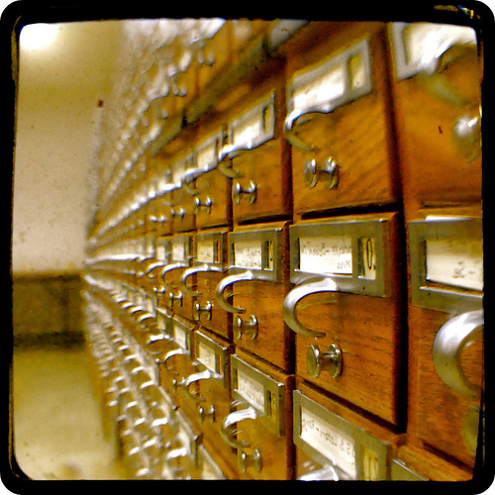
Examples of Data Citation Formats
DataCite: Creator (Publication Year): Title. Publisher. Identifier
Dryad: Author (Date of Article Publication) Data from: Article name. Dryad Digital Repository. doi: DOI number
CC image by Paxsimius on Flickr

Slide 14
Examples of Data Citation Formats, continued
Earth Science Information Partners (ESIP)¹:
Required citation elements: Author. Release date. Title. Version. Archive/Distributor. Locator/Identifier. Access date and time.
Optional citation elements: Subset Used; Editor, Compiler, or other important role; Distributor, Associate Archive, or other Institutional Role; Data Within a Larger Work
Example citation:
Zwally, H. J., R. Schutz, C. Bentley, J. Bufton, T. Herring, J. Minster, J. Spinhirne, and R. Thomas. 2011. GLAS/ICESat L1A Global Altimetry Data, Version 33. [Indicate subset used]. Boulder, Colorado USA. NASA National Snow and Ice Data Center Distributed Active Archive Center. doi: http://dx.doi.org/10.5067/ICESAT/GLAS/DATA121. [Date Accessed].
Notes:
More guidelines/suggestions from ESIP: http://wiki.esipfed.org/index.php/Interagency_Data_Stewardship/Citations/provider_guidelines

Slide 15
Examples of Data Citation Formats, continued
Research Data Alliance (RDA):
The RDA Working Group on Data Citation (WG-DC)¹ aims to bring together a group of experts to discuss the issues, requirements, advantages and shortcomings of existing approaches for efficiently citing subsets of data.
Final recommendations of the WG-DC were published in “Data Citation of Evolving Data” in 2015².
Recommended citation elements: persistent query identification and storage on versioned data; based on timestamping, a specific subset can be retrieved by re-executing the query.
Example citation:
Stefan Proell (2015) “Austria Facts” created at 2015-10-07 10:51:55:0, PID[ark:12345/qmZi2wO2vv]. Subset of CIA: “The CIA World Factbook”, PID[ark:12345/cLfH9FjxnA].
Notes:
https://www.rd-alliance.org/groups/data-citation-wg.html
https://www.rd-alliance.org/system/files/documents/RDA-DC-Recommendations_150609.pdf

Slide 16
What are examples of Persistent Identifiers?
A persistent identifier should be included in the citation:
DOI (Digital Object Identifier)
Globally unique, alphanumeric string assigned by a registration agency to identify content and provide a persistent link to its location.
May be assigned to any item of intellectual property that is defined by structured metadata
Examples:10.1234/NP5678, 10.5678/ISBN-0-7645-4889-4; 10.2224/2004-10-ISO-DOI
ARK (Archival Resource Key)
URL designed to support long-term access to information objects
Can refer to digital, physical, or intangible objects or living beings and groups
Example: http://ark.cdlib.org/ark:/13030/tf5p30086k
Notes:
DOIs always start with 10.
*************************************************
http://www.doi.org
https://wiki.ucop.edu/display/Curation/ARK

Slide 17
What are examples of Persistent Identifiers?
More persistent identifiers:
UUID (Universally Unique Identifier)
‘practically unique’ identifiers that can be generated by distributed systems but later combined into a single database without needing to resolve identifier (ID) conflicts
32 hexadecimal digits, displayed in five groups separated by hyphens, in the form 8-4-4-4-12 for a total of 36 characters
Example: 550e8400-e29b-41d4-a716-446655440000
Researcher identifier: ORCID (Open Researcher & Contributor ID)
Central registry of unique identifiers for individual researchers to address author name ambiguity
Transparent linking mechanism between ORCID and other author ID schemes
Notes:
*************************************************
http://www.doi.org
https://wiki.ucop.edu/display/Curation/ARK

Slide 18



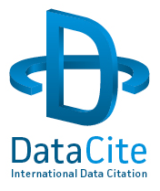

How to obtain a DOI for a dataset
Contact organization/institution that can create DOIs
Organization hierarchy
20+ services registered through DataCite include
California Digital Library’s EZID
ANDS Cite My Data Service
DataCite Canada
DOI Foundation
DataCite
x
x
California Digital Library (EZID)
UCSB Libraries
x
x
NCEAS
x
X
X
x
Notes:
http://n2t.net/ezid
Note: DOI's imply a long term commitment to making the data accessible and that the data should go to/be in a place willing to make that commitment.

Slide 19
How to obtain a DOI for a dataset, continued
Provide data and necessary citation profile (metadata)
DataCite: creator, title, publisher, publication year
Dublin Core: creator, title, publisher, date
ERC: who, what, when
Additional information: owner, owner group, co-owners
Receive DOI to be used for citation purposes
Notes:
http://n2t.net/ezid
Note: DOI's imply a long term commitment to making the data accessible and that the data should go to/be in a place willing to make that commitment.

Slide 20

Collaborative effort
Requires participation of a variety of individuals and institutions
Journal publishers
Data publishers/repositories
Data authors
Data managers
Data users
Professional organizations
CC image via Wikimedia Commons (Masur, derivative of Al Maghi)

Slide 21






Collaborating with publishers
Data authors and managers should
Choose appropriate repository for data publication
Use common standards for data and metadata
Work data up to publication standard
Obtain citation information from data publisher and include it in associated paper in accordance with journal’s citation standards
Include citations for any prior datasets used in research
Notify data publisher (e.g., data center or repository) about associated paper(s)
Notes:
Work data up to publication standard – what does this mean?
******************
Dryad
Knowledge Network for Biocomplexity (KNB)
Oak Ridge National Laboratory Distributed Active Archive Center (ORNL DAAC)
South Africa National Parks
United States Geological Survey
UC Curation Center Merritt

Slide 22
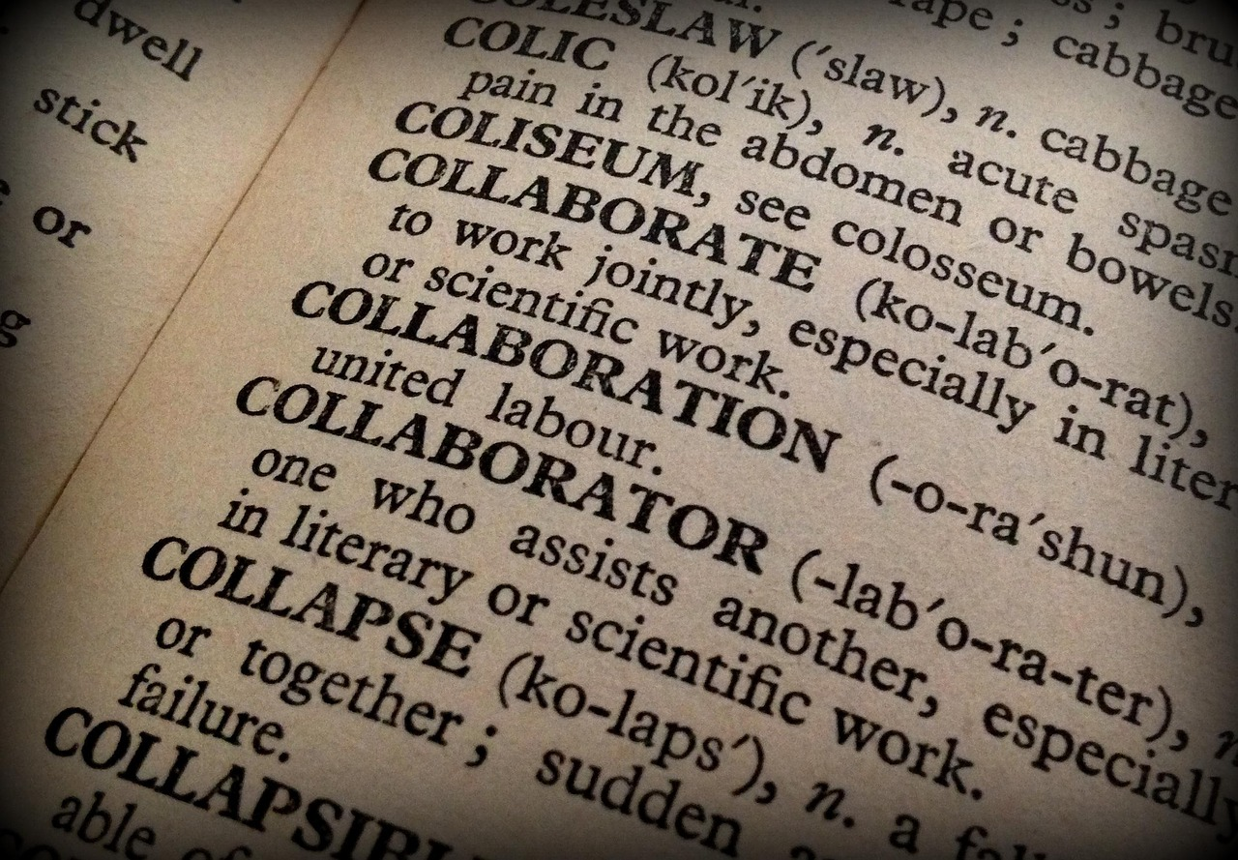
Collaborating with publishers
Data centers or distributors should
Ensure that data and metadata remain accessible, robust, and usable over time
Assign persistent and unique identifiers so that data are discoverable
Make data citation information easily findable by data users
Image courtesy of https://pixabay.com/en/collaboration-collaborator-book-1106196/
Journal publishers should
Provide clear guidance on how and where data sets should be cited
Be responsive to needs of authors, funding agencies, and data repositories
Alert data publisher when publishing a paper that cites a data set

Slide 23
Best Practices to Support Data Citation
To support access to your data:
Use application that supports metadata creation for environmental data sets
Morpho
Metavist (USDA Forest Service)
Mermaid (NOAA)
Use standardized keywords to describe your data
Biocomplexity Thesaurus (USGS)
Global Change Master Directory (NASA)
Use a persistent identifier such as DOI or ARK

Slide 24
Best Practices to Support Data Citation, continued
Work with journal publishers and data repositories to archive data during the publication process
Allows information about how to access your data set to be published with your article
Note: Data repositories typically offer to embargo archived data for a pre-determined time period after publication
Allows article citation/DOI to be included with archived data set
Encourage other data authors to cite data and to make their own data available for reuse:
Provide full citation information for data whenever you publish work that makes use of another author’s data
Archive your own data in a repository that supports data discovery and reuse
Update your archived data sets when newer versions are available

Slide 25

Citation of Scientific Software
Image courtesy of https://pixabay.com/en/code-programming-hacking-html-web-820275/
“Software citation is an evolving area. A web search for ‘how to cite software’ and its variants shows that this is a popular question. The answers can broadly be classed into citation formats recommended by journals, citation formats recommended/mandated by software providers and, most contentious, the view that software is not a citable output.”
- Mike Jackson, Software Sustainability Institute
Notes:
http://www.software.ac.uk/how-cite-and-describe-software?mpw

Slide 26
Citation of Scientific Software
Why cite software?
Software itself may be considered to be data or a research product.
Findings of a study are not only based on data, but on the software used to support the analysis of the data.
Software citation is essential for enabling reproducibility of results.
Give proper attribution to the developers/authors of software.
When to cite software?
“Standard” office software (e.g. Word, Excel) and programming languages do not need formal citations.
DO provide citations for specialized/custom software or programs when their use directly impacts the results.

Slide 27
Examples of information needed in software citations
Similar to data citation, software citations should include:
Title/Name of the Software
Author/Developer – if known
Release Date/Year
Version Number – the version of the software/program used
Descriptor – the text“[computer program]” (including brackets) is often included in the citation
Publisher name and location – if applicable
URL – if the software is available online, provide the URL
DOI – if one exists for the software, cite it

Slide 28
Examples of Software Citation
Software purchased off-the-shelf¹: Product Name. Version. Release Date. Publisher. Location.
SuperScience. 1.2. December 2012. Research Software. Edinburgh, UK.
Software downloaded from the web¹: Product Name. Version. Release Date. Publisher. Location. DOI or URL. Download Date.
OGSA-DAI REST. 4.2.1. December 2012. OGSA-DAI Project. http://sourceforge.net/projects/ogsa-dai. 27/04/2012.
Software provided by a researcher¹: Product Name. Author. Location. Contact Details. Received Date.
BestFFTroutine ever file. Fred Bloggs, EPCC, The University of Edinburgh, UK. Fred.bloggs@epcc.ed.ac.uk. 27/04/2012.
AMA Format²:
Epi Info [computer program]. Version 3.2. Atlanta, GA: Centers for Disease Control and Prevention; 2004.
APA Format³:
Hayes, B. et al. (2003). OTSoft: Optimality Theory Software (Version 2.1) [Software]. Available from http://www.linguistics.ucla.edu/people/hayes/otsoft/
Notes:
Format & examples from: http://software.ac.uk/so-exactly-what-software-did-you-use
See: http://www.amamanualofstyle.com/view/10.1093/jama/9780195176339.001.0001/med-9780195176339-div2-86 and http://blogs.library.ucla.edu/biomedical/2011/11/02/cite-it-right-citing-software-or-software-manuals-databases-and-legal-references/
https://owl.english.purdue.edu/owl/resource/560/10/

Slide 29
Software Citation Resources
The Software Sustainability Institute: http://www.software.ac.uk/
Working towards Sustainable Software for Science Practice and Experiences (WSSSPE): http://wssspe.researchcomputing.org.uk/
NSF Workshop on Supporting Scientific Discovery through Norms and Practices for Software and Data Citation and Attribution: https://softwaredatacitation.org/Pages/home.aspx
Software Carpentry and Data Carpentry: http://software-carpentry.org/ and http://www.datacarpentry.org/

Slide 30
Resources
Australian National Data Service (ANDS), Data Citation Awareness Guide. Accessed April 9, 2015 at http://ands.org.au/guides/data-citation-awareness.html.
Ball, A. & Duke, M. (2011). How to Cite Datasets and Link to Publications. DCC How-to Guides. Edinburgh: Digital Curation Centre. Accessed April 9, 2015 at http://www.dcc.ac.uk/resources/how-guides.
CODATA-ICSTI Task Group on Data Citation Standards and Practices. (2013). Out of Cite, Out of Mind: The Current State of Practice, Policy, and Technology for the Citation of Data. Data Science Journal, 12: CIDCR1 - CIDCR75. Accessed April 9, 2015 at http://dx.doi.org/10.2481/dsj.OSOM13-043.
Costello, M. J. (2009). Motivating Online Publication of Data. BioScience, 59(5): 418-427. Accessed April 9, 2015 at http://www.bioone.org/doi/full/10.1525/bio.2009.59.5.9.
CrossCite DOI Citation Formatter. Accessed April 9, 2015 at http://crosscite.org/citeproc/.
Data Citation Principles Glossary. FORCE11. Accessed April 9, 2015 at Accessed April 9, 2015 at https://www.force11.org/node/4770.

Slide 31
Resources, continued
Data Citation Synthesis Group. (2014). Joint Declaration of Data Citation Principles. Martone, M. (ed.). San Diego, CA: FORCE11. Accessed April 9, 2015 at https://www.force11.org/datacitation.
Duke, C. S. & Porter, J. H. (2013). The Ethics of Data Sharing and Reuse in Biology. BioScience 63: 483-489. Accessed April 9, 2015 at http://dx.doi.org/10.1525/bio.2013.63.6.10.
ESIP Federation Interagency Data Stewardship/Citations/Provider Guidelines. Accessed April 9, 2015 at http://bit.ly/data_citation.
Hakala, J. Persistent identifiers – an overview. Accessed April 9, 2015 at http://metadaten-twr.org/2010/10/13/persistent-identifiers-an-overview/.
Starr J, Castro E, Crosas M, Dumontier M, Downs RR, Duerr R, Haak LL, Haendel M, Herman I, Hodson S, Hourclé J, Kratz JE, Lin J, Nielsen LH, Nurnberger A, Proell S, Rauber A, Sacchi S, Smith A, Taylor M, Clark T. (2015) Achieving human and machine accessibility of cited data in scholarly publications. PeerJ Computer Science 1:e1 https://doi.org/10.7717/peerj-cs.1
Jackson, Mike. 2012. How to cite and describe software. Software Sustainability Institute. http://www.software.ac.uk/how-cite-and-describe-software?mpw. Accessed May 12, 2016.

Slide 32

The full slide deck may be downloaded from:
http://www.dataone.org/education-modules
Suggested citation:
DataONE Education Module: Data Citation. DataONE. Retrieved Nov12, 2012. From http://www.dataone.org/sites/all/documents/L09_DataCitation.pptx
Copyright license information:
No rights reserved; you may enhance and reuse for your own purposes. We do ask that you provide appropriate citation and attribution to DataONE.

