Slide 1
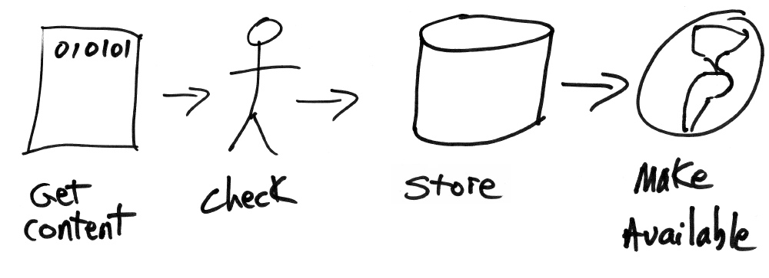
Tutorials on Data Management
Lesson 9: Analysis and Workflows
CC image by wlef70 on Flickr
Notes:
This dataONE data management education tutorial will cover data analysis, including workflows and other tools.

Slide 2
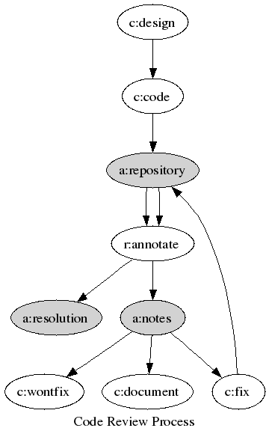
Lesson Topics
Overview of typical data analyses
Reproducibility & provenance
Workflows in general
Informal workflows
Formal workflows
Version Control
CC image by jwalsh on Flickr
Notes:
The topics covered in this tutorial will include a review of typical data analyses, reproducibility, provenance,
workflows in general, and both informal and formal workflows

Slide 3

Learning Objectives
After completing this lesson, the participant will be able to:
Enumerate various analysis types
Be familiar with symbols on flowcharts for sketching workflows
Know when to use a formal or informal workflow
Know about several workflow tools
Know about version control tools
CC image by cybrarian77 on Flickr
Notes:
After completing this lesson you will be able to understand a subset of typical analyses used by ecologists and environmental scientists. You will be able to define a workflow and understand the basic concepts of both formal and informal workflows. Lastly you will able to discuss the benefits of using a workflow.

Slide 4
The Data Life Cycle
Assure
Preserve
Discover
Integrate
Analyze
Plan
Describe
Collect
Notes:
In this tutorial we will be focusing on data analysis which appears here in the data life cycle. Analysis can be performed on original data collected by a researcher, or on data ‘discovered’ in data repositories and integrated.

Slide 5
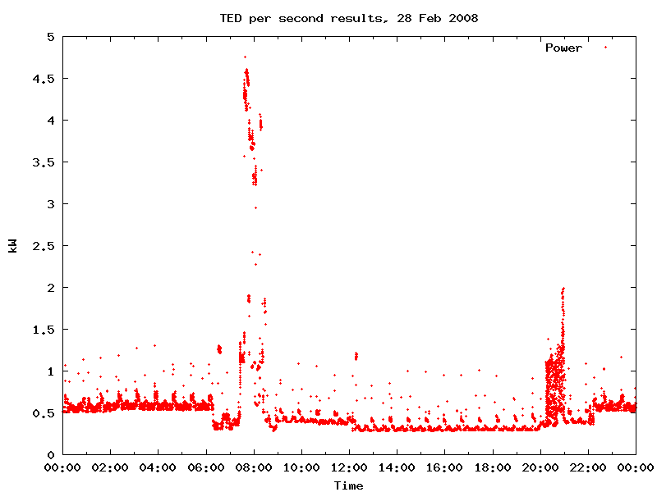

Data Analyses
Conducted via personal computer, grid, cloud computing
Statistics, model runs, parameter estimations, graphs/plots etc.
CC image by hegemonx on Flickr
CC image by tai viinikka on Flickr
Notes:
The types of analyses, software, and hardware used by ecologists and environmental scientists vary widely. Personal computers are commonly used to perform these analyses. Other computational tools are grid and cloud computing.
Grid computing integrates large-scale resources such as computational devices, data applications, and scientific instruments to understand and explore research questions efficiently. It is also commonly used to share, manage, and process large datasets in physics, geophysics, astronomy, and bioinformatics.
Cloud computing is location-independent computing, whereby shared servers provide resources, software, and data to a various number of external computers located elsewhere.
Examples of data analyses that might be used with any of these computational tools are statistics, model runs and simulations, parameter estimations, plotting of spatial data, or visualizations such as graphs. The types of analyses vary widely both among and within scientific areas of study.

Slide 6
Types of Analyses
Processing: subsetting, merging, manipulating
Reduction: important for high-resolution datasets
Transformation: unit conversions, linear and nonlinear algorithms
Date time air temp precip
C mm
11-Jul-07 5:00 27.6 000
11-Jul-07 6:00 27.6 000
11-Jul-07 7:00 27.7 003
11-Jul-07 8:00 28.2 017
11-Jul-07 9:00 28.5 000
11-Jul-07 10:00 29.3 000
11-Jul-07 11:00 30.1 000
11-Jul-07 12:00 30.4 000
0711070500276000 0711070600276000 0711070700277003 0711070800282017 0711070900285000 0711071000293000 0711071100301000 0711071200304000
Recreated from Michener & Brunt (2000)
Notes:
Typically the first step in any data analysis is processing the data. Processing can include selecting a subset of the data for analysis, merging multiple datasets, or manipulating the data so it is more useable by a researcher or a computer program.
A common requirement for large datasets is to reduce the amount of data in the working data file. This makes computing and handling of the dataset easier. For example, a sensor might take a temperature measurement every 5 seconds for one year. For the study, only monthly patterns are important. We might therefore only use one data point for every 5 minutes.
Data will also need to be transformed before use. This might involve the conversion of data to common units, normalization of data collected by multiple people and instruments, or developing algorithms for converting raw data into meaningful values.
An example of data transformation is shown here, the relatively meaningless string of numbers on the left, which were raw output from a sensor, can be transformed into the table on the right, which is more understandable for humans.

Slide 7
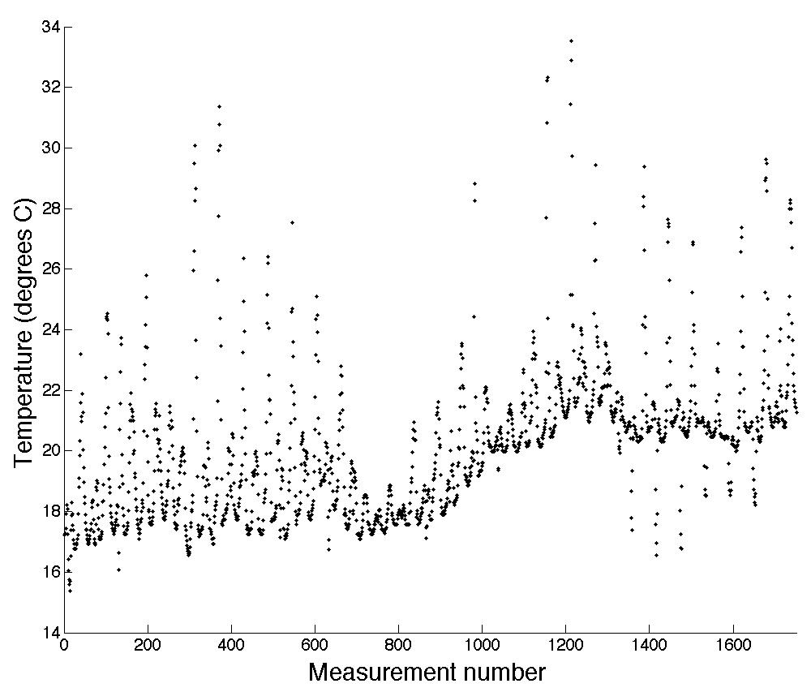
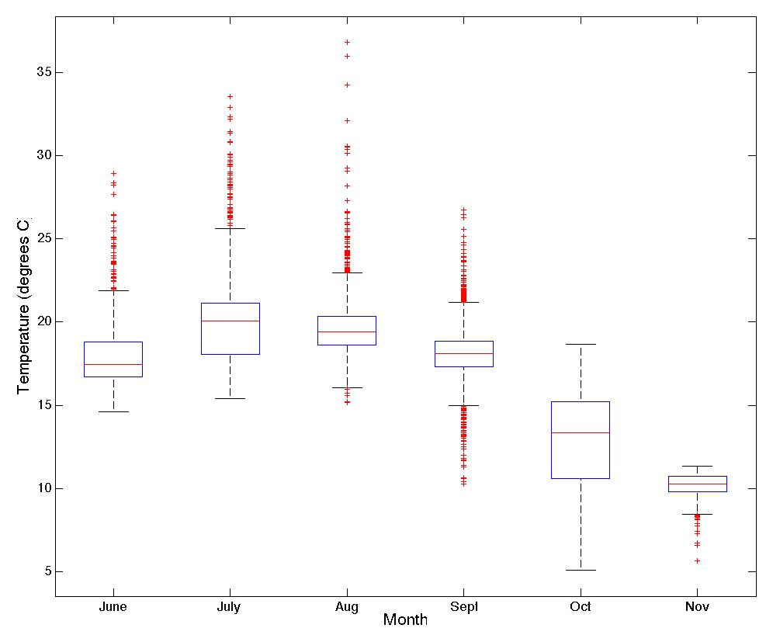
Types of Analyses
Graphical analyses
Visual exploration of data: search for patterns
Quality assurance: outlier detection
Scatter plot of August Temperatures
Box and whisker plot of temperature by month
Strasser, unpub. data
Strasser, unpub. data
Notes:
Another way to analyze data is by visually representing it. Numbers in charts can be difficult to interpret but patterns can be readily apparent in a few well-chosen graphs or other visual representations.
Examples of different types of plots are scatter plots and Box-and-whisker plots, which show the statistical distribution of data.
On the left is a scatter plot of temperatures for the month of August. The general pattern is easily discernable, and particularly warm measurements are readily apparent.
On the right is a box-and whisker plot of monthly temperatures. The boxes indicate averages, and measurements far from the averages are visible as red dots outside of the error bars.
Plots can be used to assure the quality of data as well. They can quickly show you potential data errors such as impossible values.

Slide 8
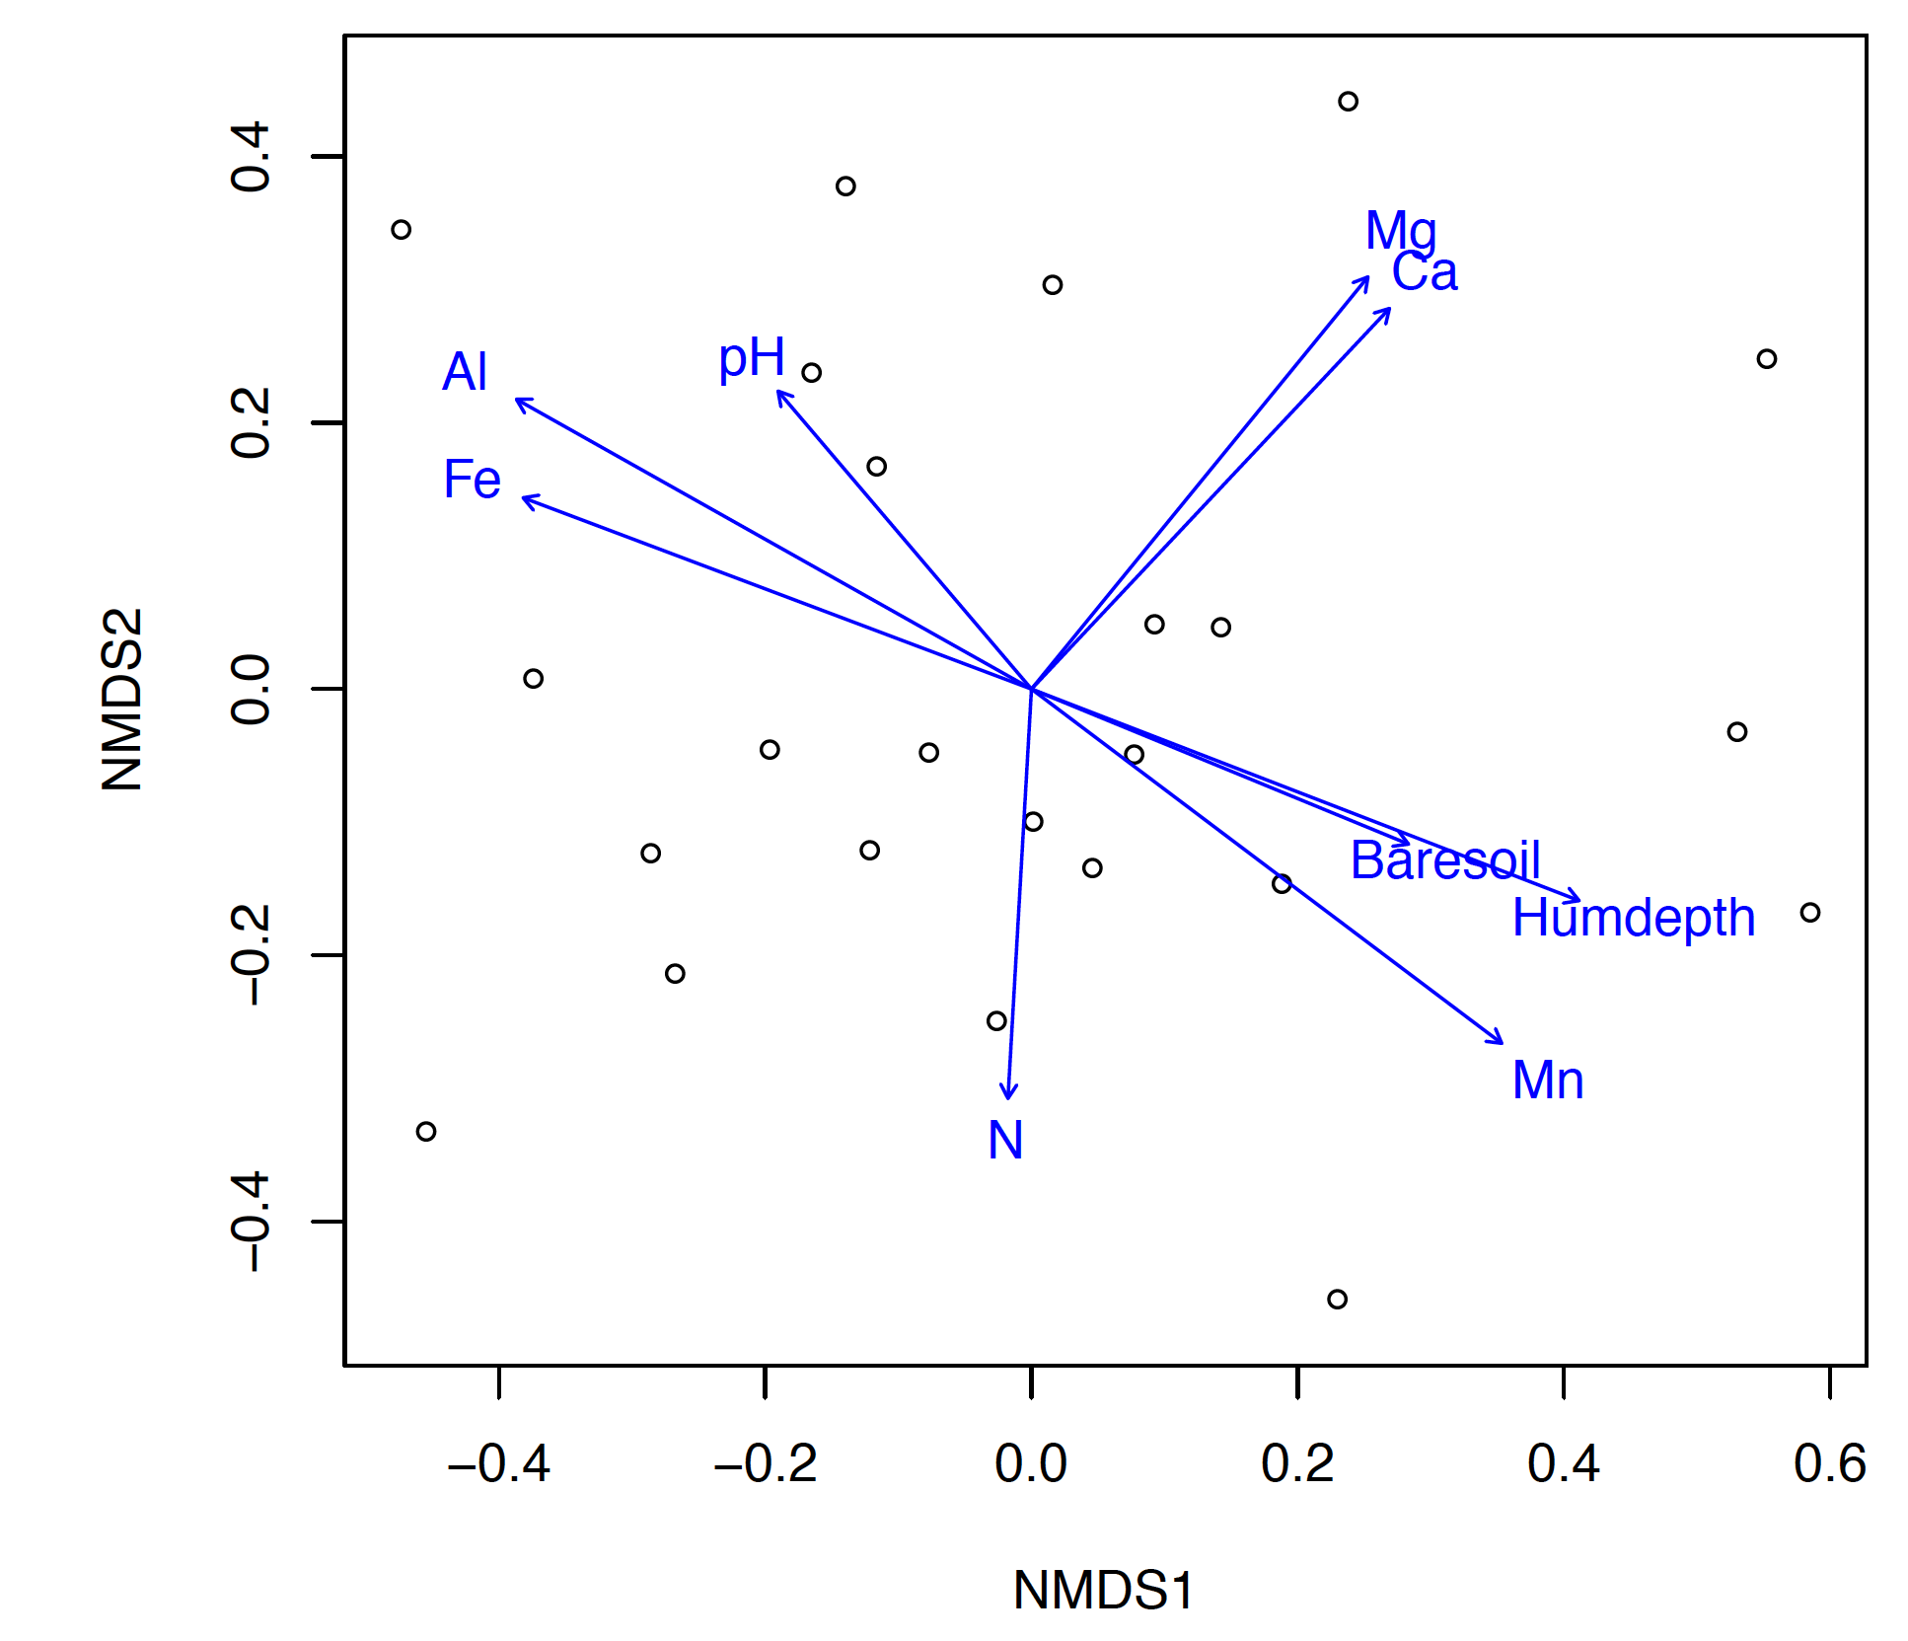
Types of Analyses
Statistical analyses
Conventional statistics
Experimental data
Examples: ANOVA, MANOVA, linear and
nonlinear regression
Rely on assumptions: random
sampling, random & normally
distributed error, independent error
terms, homogeneous variance
Descriptive statistics
Observational or descriptive data
Examples: diversity indices, cluster
analysis, quadrant variance, distance methods,
principal component analysis, correspondence analysis
Example of Principle Component Analysis
From Oksanen (2011) Multivariate Analysis of Ecological Communities in R: vegan tutorial
Notes:
Statistics are among the most common types of analyses performed on data.
There are many different types of statistical analyses, only a few of which we show here. Conventional statistics are often used to understand experimental data. The most common types are analysis of variance (ANOVA), multivariate analysis of variance (MANOVA), and regressions. Conventional statistics tend to rely on assumptions such as random error and homogeneous variance.
Descriptive statistics are traditionally applied to observational or descriptive data. Descriptive data might include the distribution of organisms in space, species-abundance relationships, inter-specific associations, community structure, similarity or dissimilarity, and community-habitat relationships. Statistics used to understand these types of data include diversity indices, cluster analysis, and principle components analysis, among many others.

Slide 9
Types of Analyses
Statistical analyses (continued)
Temporal analyses: time series
Spatial analyses: for spatial autocorrelation
Nonparametric approaches useful when conventional assumptions violated or underlying distribution unknown
Other misc. analyses: risk assessment, generalized linear models, mixed models, etc.
Analyses of very large datasets
Data mining & discovery
Online data processing
Notes:
Statistical analyses might also include temporal or spatial analyses, and nonparametric approaches which do not rely on specific assumptions about the data’s distribution, and many other types of analysis, including risk assessment and GLM’s.
Analyzing very large datasets requires special considerations. The process can often be broken into two steps.
The first involves discovering and mining for the data of interest. This is typically done via computers and involves pattern searching and the use of decision trees.
The second step involves online data processing. Large datasets can be analyzed using high-performance computing systems such as cloud computing.

Slide 10
After Data Analysis
Re-analysis of outputs
Final visualizations: charts, graphs, simulations etc.
Science is iterative:
The process that results in the final product can be complex
Notes:
The process is often modified based on analyses and re-run with small (or large) changes.
Science is inherently an iterative process. We run analyses, modify hypotheses, and re-run analyses. This can result in a complex process that results in the final product.
Based on results from preliminary analysis, a researcher will often re-run or re-analyze the data or outputs.
Visualizations created to display results might include charts, graphs, simulations, or other outputs.
Remember that science is an inherently iterative process. We run analyses, modify hypotheses, and re-run analyses. This can result in a complex process that results in the final product.

Slide 11

Reproducibility
Reproducibility at core of scientific method
Complex process = more difficult to reproduce
Good documentation required for reproducibility
Metadata: data about data
Process metadata: data about process used to create, manipulate, and analyze data
CC image by Richard Carter on Flickr
Notes:
Reproducibility is at the core of scientific method. If results are not reproducible, the study loses credibility. The complex processes used to create final outputs can be quite difficult to reproduce. In order to maintain scientific integrity, good documentation of the data and the analytical process is essential.
Documentation includes metadata, which is data about data, and process metadata, which is data about the process.

Slide 12
Ensuring Reproducibility: Documenting the Process
Process metadata: Information about process (analysis, data organization, graphing) used to get to data outputs
Related concept: data provenance
Origins of data
Good provenance = able to follow data throughout entire life cycle
Allows for
Replication & reproducibility
Analysis for potential defects, errors in logic, statistical errors
Evaluation of hypotheses
Notes:
Process metadata is information about the process used to create any data outputs. This includes any data cleaning, transformation, reduction, and any analyses performed.
A related concept to process metadata is “data provenance”. Provenance means “origin”, so data provenance is a description of the origins of the data.
A mark of good provenance is that a person not directly involved with the project is able to follow the data through its life cycle and understand any steps used to create outputs.
Good provenance allows for the ability to replicate analyses and reproduce results. Others can identify potential problems, logical, or statistical errors that might affect the study’s outcome. Others are also able to evaluate a study’s hypotheses for themselves. All of these possibilities mean greater accountability and more trustworthy science.

Slide 13
Workflows: The Basics
Formalization of process metadata
Precise description of scientific procedure
Conceptualized series of data ingestion, transformation, and analytical steps
Three components
Inputs: information or material required
Outputs: information or material produced & potentially used as input in other steps
Transformation rules/algorithms (e.g. analyses)
Two types:
Informal
Formal/Executable
Notes:
A workflow is a formalization of the process metadata. Workflows are commonly used in other fields, including business.
In general, a “workflow” is a precise description of the procedures used in a project.
It is a conceptualized series of data ingestion, transformation, and analytical steps.
A workflow consists of three components. First, there are inputs that contain the information required for the process, for example the raw data. Second the output is information or materials produced, such as final plots of the data. Third, there are transformation rules, algorithms, or analyses that are required to create the outputs from the inputs.

Slide 14
Informal Workflows
Workflow diagrams: Some basic building blocks
Data (input or output)
Inputs or outputs include data, metadata, or visualizations
Analytical processes include operations that change or manipulate data in some way
Decisions specify conditions that determine the next step in the process
Predefined processes or subroutines specify a fixed multi-step process
Analytical process
Decision
Predefined process
(subroutine)
Notes:
Mention that example workflow diagrams shown here were drawn freehand in PowerPoint using default flowchart symbology – no specialized software necessary!

Slide 15
Informal Workflows
Workflow diagrams: Simple linear flow chart
Conceptualizing analysis as a sequence of steps
arrows indicate flow
Raw data and associated metadata
Data ingestion
Data cleaning
Analysis Step 1
Analysis Step 2
Output generation
Output data, visualizations, associated metadata

Slide 16
Informal Workflows
Flow charts: simplest form of workflow
Data import into R
Quality control & data cleaning
Analysis: mean, SD
Graph production
Notes:
This is an example of a simple conceptual workflow.
Here we focus first on the analytical steps used to create outputs from the data. In the first step the data are imported into a scripted program, R, for cleaning and analysis.
The data then go through a quality control and cleaning process to identify outliers, remove erroneous data, and identify any missing data.
The data are then analyzed to generate mean temperature and salinity for the location, as well as error envelopes for the data.
Finally, graphs are produced to display the resulting mean temperatures.

Slide 17
Informal Workflows
Flow charts: simplest form of workflow
Transformation Rules
Data import into R
Quality control & data cleaning
Analysis: mean, SD
Graph production
Notes:
These steps are known in workflows as “transformation rules”. Transformation rules describe what is done to/with the data to obtain the relevant outputs for publication.

Slide 18
Informal Workflows
Flow charts: simplest form of workflow
Inputs & Outputs
Temperature data
Data import into R
Salinity data
Data in R format
Quality control & data cleaning
“Clean” T & S data
Analysis: mean, SD
Summary statistics
Graph production
Notes:
Now we focus on the actual data. The Inputs & outputs of this workflow are shown here in red.
The first inputs are the raw temperature & salinity data. These are imported into R.
The output of this process is the data in R format.
That data in R format then become the input for the quality control and data cleaning step.
The output of this step is “clean” temperature and salinity data, which is then the input for the analysis step.
The output of the analysis step is the summary statistics, such as mean and standard deviation by month. These are subsequently the inputs for the visualization step.

Slide 19
Informal Workflows
Workflow diagrams: Adding decision points
CONDITIONAL LOOP
CONDITION
Analysis 1
IF
false
Analysis 2
true

Slide 20
Informal Workflows
Workflow diagrams: a simple example
Compile list of unique taxa
Calculate taxa frequencies
species name
QA/QC (e.g., check for appropriate data types, outliers)
FOR
Generate output data and visualizations for taxa frequencies in stated range
Data and metadata
Data ingestion
counts
lat/long
Data, visualizations, and metadata
Determine range (calculate convex hull of points)

Slide 21
Informal Workflows
Workflow diagrams: a complex example
Data and metadata
Analysis 1A
Data ingestion
Data cleaning
A
Data integration
FOR
Data integration
Analysis 2
Output generation
Data and metadata
B
Data ingestion
Data cleaning
Analysis 1B
Data, visualizations, and metadata
false
Data and metadata
Predefined process
(subroutine)
Data ingestion
Data cleaning
IF
true

Slide 22
Informal Workflows
Commented scripts: best practices
Well-documented code is easier to review, share, enables repeated analysis
Add high-level information at the top
Project description, author, date
Script dependencies, inputs, and outputs
Describes parameters and their origins
Notice and organize sections
What happens in the section and why
Describe dependencies, inputs, and outputs
Construct “end-to-end” script if possible
A complete narrative
Runs without intervention from start to finish
%
#
$
&

Slide 23
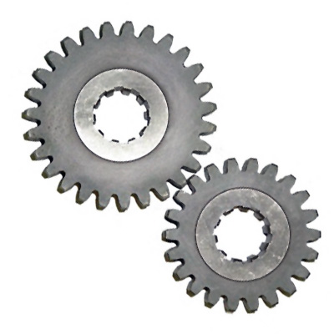
Formal/Executable Workflows
Analytical pipeline
Each step can be implemented in different software systems
Each step & its parameters/requirements formally recorded
Allows reuse of both individual steps and overall workflow
CC image by AJ Cann on Flickr
Notes:
Formal Scientific workflow systems are now in development to help scientists document their workflows. These analytical pipelines will make it possible for lay scientists to use workflows effectively for documenting their process metadata.
Each step within the scientific workflow system can be implemented using different software systems. In the process of performing analyses, each step and its parameters and requirements are formally recorded. This allows both the individual steps and the overall workflow to be reused, either by the original scientist or someone else.

Slide 24
Formal/Executable Workflows
Benefits:
Single access point for multiple analyses across software packages
Keeps track of analysis and provenance: enables reproducibility
Each step & its parameters/requirements formally recorded
Workflow can be stored
Allows sharing and reuse of individual steps or overall workflow
Automate repetitive tasks
Use across different disciplines and groups
Can run analyses more quickly since not starting from scratch
Notes:
There are many benefits of using scientific workflows.
First, they can provide a single access point for multiple analyses across software packages.
Second they allow a researcher to keep track of analyses conducted, which enables reproducibility.
Third, workflows can be stored as documentation of the research project. A stored workflow is essentially higher-level metadata which offers tremendous potential for scientific advancement.
Finally, workflows allow researchers to share and reuse the workflow or its components. This means less time doing repetitive tasks, allows for collaboration across disciplines, and rapid analysis since time is not spent “reinventing the wheel”.

Slide 25
Formal/Executable Workflows
Example: Kepler Software
Open-source, free, cross-platform
Drag-and-drop interface for workflow construction
Steps (analyses, manipulations etc) in workflow represented by “actor”
Actors connect from a workflow
Possible applications
Theoretical models or observational analyses
Hierarchical modeling
Can have nested workflows
Can access data from web-based sources (e.g. databases)
Downloads and more information at kepler-project.org
Notes:
One example of a scientific workflow software program is Kepler. Kepler is an open-source and free cross-platform program. Cross-platform means it can work with any operating system.
Kepler uses a drag-and-drop interface for scientists to construct their workflow. Steps in the analytical process are represented by an “actor”. These actors then connected to form a workflow. Possible applications of Kepler are listed here.

Slide 26
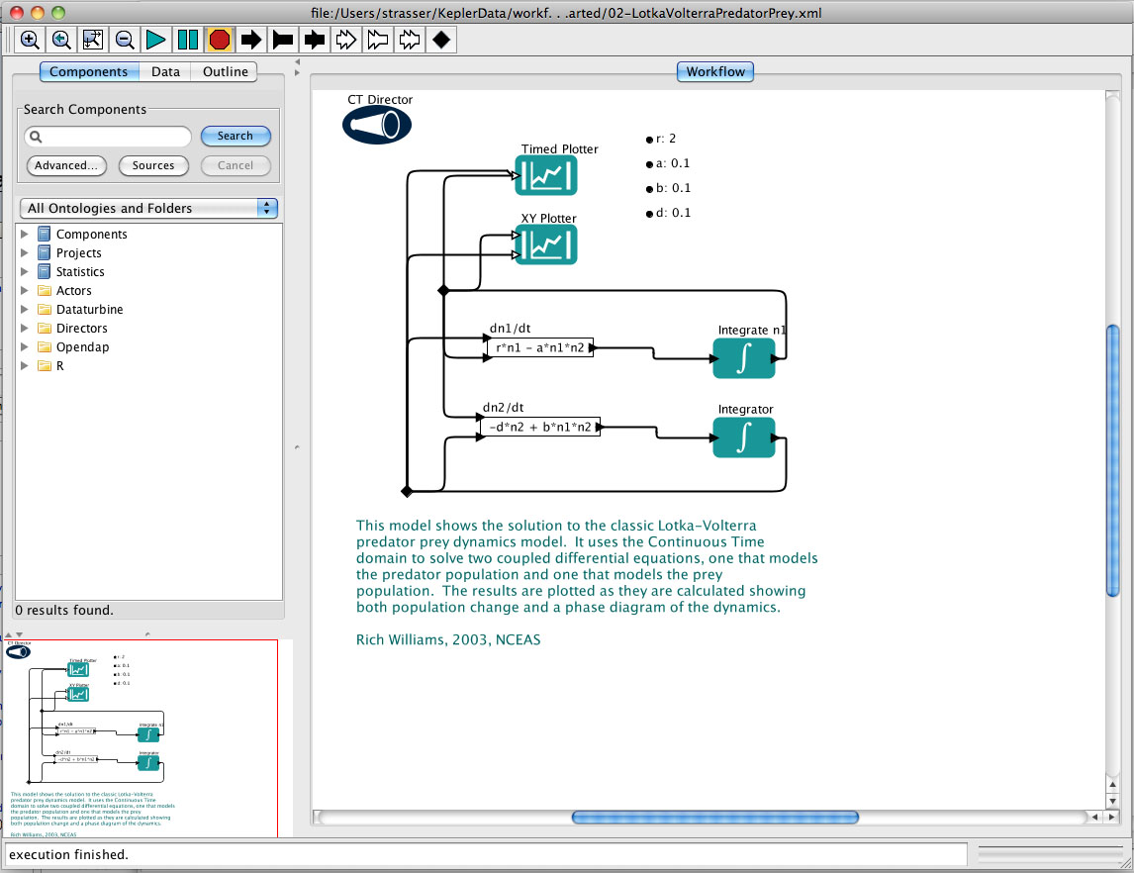
Formal/Executable Workflows
Example: Kepler Software
Actors in workflow
Drag & drop components from this list
Notes:
Here is a screenshot of the Kepler interface. It has a user-friendly GUI (pronounced gooey) or graphical user interface.
The list of possible actors is searchable, and you can drag and drop the actors into the workflow creation space to the right.
Actors are connected via inputs and outputs represented by black lines.

Slide 27
Formal/Executable Workflows
Example: Kepler Software
This model shows the solution to the classic Lotka-Volterra predator prey dynamics model. It uses the Continuous Time domain to solve two coupled differential equations, one that models the predator population and one that models the prey population. The results are plotted as they are calculated showing both population change and a phase diagram of the dynamics.
Notes:
This example workflow solves two coupled equations, one for the predator population, and one for the prey population. The solutions to the equations are then routed to the “Timed plotter” and “XY plotter” in the top of the panel. The text describes what this workflow is calculating.

Slide 28
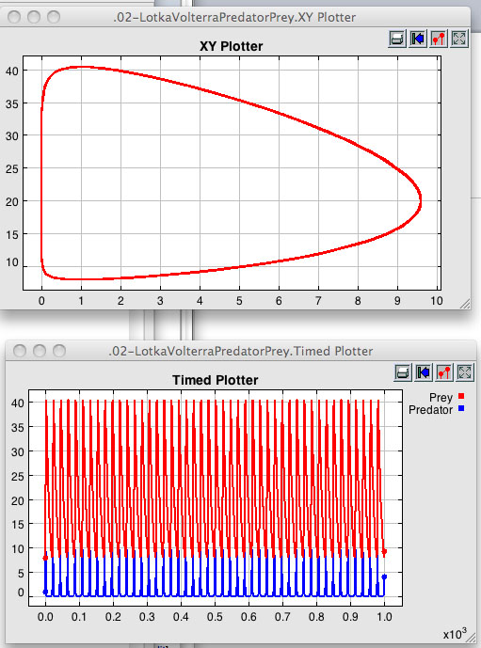
Formal/Executable Workflows
Example: Kepler Software
Output
Notes:
The resulting outputs from this workflow are plots of the predator and prey populations.
Kepler and other scientific workflow tools are being developed for use by ecologists and environmental scientists who may not be comfortable creating scripted workflows using the command line.
Along with scientific workflows, tools are being developed to facilitate their use, such as VisTrails.

Slide 29
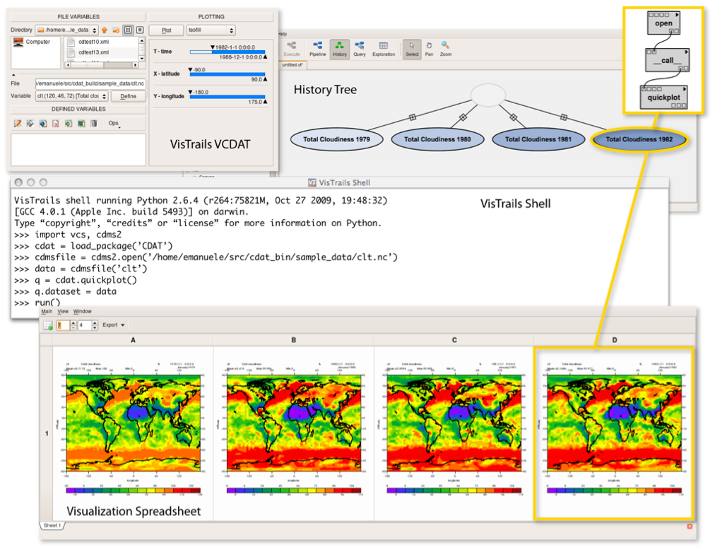
Formal/Executable Workflows
Example: VisTrails
Open-source
Workflow & provenance
management support
Geared toward
exploratory
computational tasks
Can manage evolving SWF
Maintains detailed history
about steps & data
www.vistrails.org
Screenshot example
Notes:
VisTrails is another example of an open source workflow tool that provides provenance and management support. It is geared toward VisTrails is an open source workflow tool that provides provenance and management support. It is geared toward exploratory and computational tasks.
Using Vistrails, scientists can manage evolving scientific workflows and maintain detailed history about the steps taken and the data consumed and produced.

Slide 30
Workflows in General
Science is becoming more computationally intensive
Sharing workflows benefits science
Scientific workflow systems make documenting workflows easier
Minimally: document your analysis via informal workflows
Emerging workflow applications (formal/executable workflows) will
Link software for executable end-to-end analysis
Provide detailed info about data & analysis
Facilitate re-use & refinement of complex, multi-step analyses
Enable efficient swapping of alternative models & algorithms
Help automate tedious tasks
Notes:
Workflows are beneficial because they document the exact process used to create data outputs. This is especially true with the advent of more computationally intensive processes due to sensor networks, complex statistical programs, and integration of many types of data in a single study.
One of the major advantages of workflows is they allow the analytical process to be shared with other scientists. This would be easier to accomplish if there was a formal way of creating and saving workflows.
There are now scientific workflow systems in development that will make documenting workflows easier. This will also increase the ability to share workflows with others.
The simplest form of a scientific workflow is using scripts to document the process of analysis. This is done often using scripted programs such as R or Matlab, or if multiple software packages are used, via the command line using programming languages such as Java, Python, or Perl. However executing codes and analyses via the command line is beyond the expertise of many ecological and environmental scientists.

Slide 31
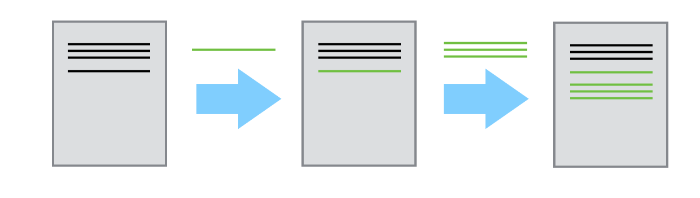
Version Control
Software to manage changes to files, particularly script & source code
Essential to managing evolving workflows
Is useful for managing changes to code and scripts
Enables collaboration at scale
Allows you to track exact revision of code/script used for a workflow

Slide 32



Version Control Tools
Git – distributed model, widely used, simple to branch and merge
SVN – many legacy projects still use, requires a master server to collaborate
Mercurial – distributed model with niche userbase

Slide 33

Best Practices for Data Analysis
Scientists should document workflows used to create results
Data provenance
Analyses and parameters used
Connections between analyses via inputs and outputs
Documentation can be informal (e.g. flowcharts, commented scripts) or formal (e.g. Kepler, VisTrails)
CC image geek calendar on Flickr
Notes:
Best practices for data analysis should involve the documentation of workflows, either conceptual or formal, to show how results were obtained. This includes data provenance, analyses used, parameters used, and connections between analyses via inputs and outputs.
This documentation can be informal, like in a flowchart, or more formal, such as Kepler or vistrails.

Slide 34
Summary
Modern science is computer-intensive
Heterogeneous data, analyses, software
Reproducibility is important
Workflows = process metadata
Use of informal or formal workflows for documenting process metadata ensures reproducibility, repeatability, validation
Notes:
In summary, modern science is becoming more and more computationally-intensive, and scientists are working with heterogeneous data, analyses, and software. Reproducibility is more important than ever given this environment.
Workflows are equivalent to process metadata, also known as provenance.
Using both informal and formal workflows and are necessary for reproducibility, repeatability, and validation of your research.

Slide 35
Resources for Data Analysis & Workflows
W. Michener and J. Brunt, Eds. Ecological Data: Design, Management and Processing. (Blackwell, New York, 2000).

Slide 36

The full slide deck may be downloaded from:
http://www.dataone.org/education-modules
Suggested citation:
DataONE Education Module: Analysis and Workflows. DataONE. Retrieved Nov12, 2012. From http://www.dataone.org/sites/all/documents/L10_Analysis Workflows.pptx
Copyright license information:
No rights reserved; you may enhance and reuse for your own purposes. We do ask that you provide appropriate citation and attribution to DataONE.

