Slide 1
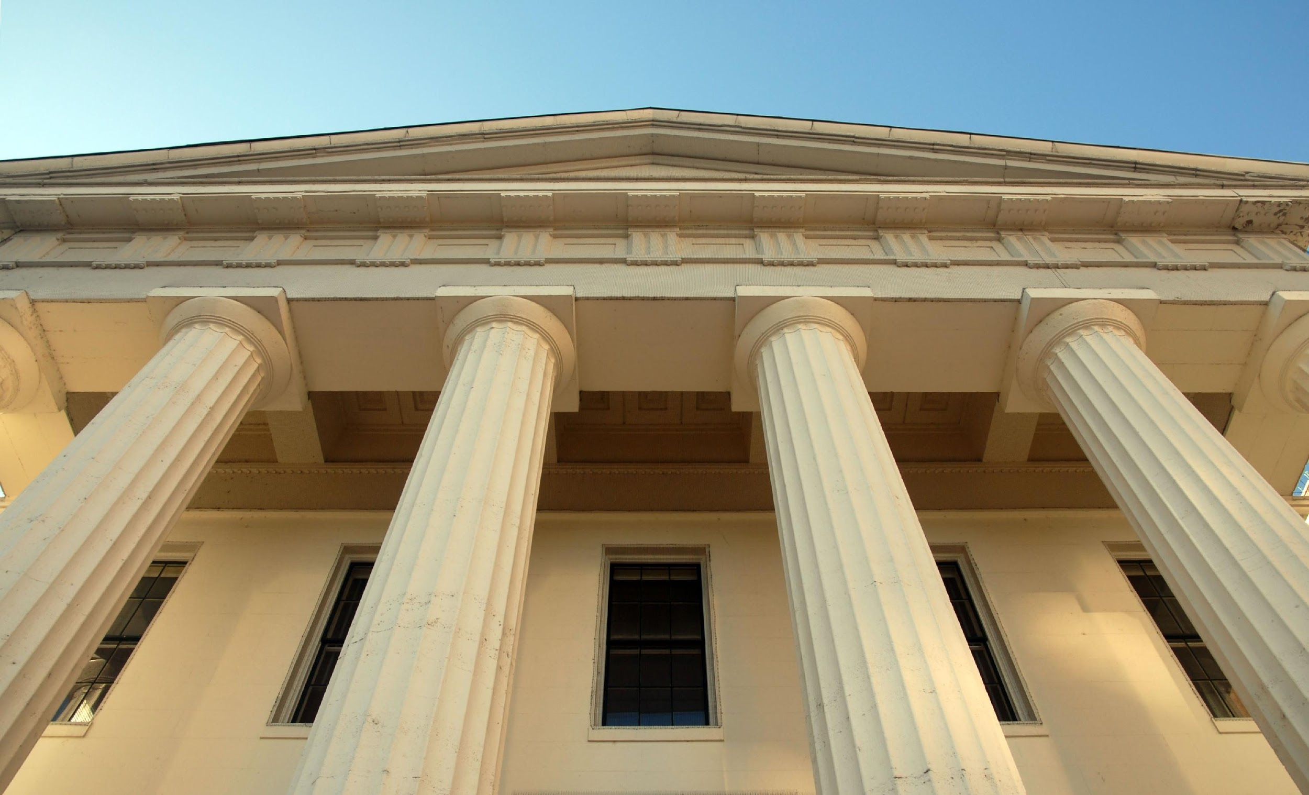

Legal & Policy Issues
Photo Attribution:http://www.therealestatemedia.com/wp-content/uploads/2012/05/real-estate-investment-scam.jpg

Slide 2
Learning Outcomes
After completing this lesson, participants will be able to:
Identify ethical, legal, and policy issues for managing research data
Define copyrights, licenses and waivers
Understand reasons behind data restrictions and how to observe them
Discuss ethical considerations surrounding the use of research data

Slide 3
Setting the Stage
Legal – a law is “any written or positive rule or collection of rules prescribed under the authority of the state or nation.”
e.g., U.S. Copyright Act
Ethical – “being in accordance with the rules or standards for right conduct or practice, especially the standards of a profession.”
e.g., IRB & IACUC
Policy - a specified “course of action adopted for the sake of expediency, facility, etc.”
e.g., Paperwork Reduction Act
- Definitions from Dictionary.com
Notes:
IRB stands for Institutional Review Board and IACUC stands for Institutional Animal Care and Use Committee. Both are institutional structures, which exist to ensure that research meets the ethical standards of that institution and the scientific community.
The purpose of the Paperwork Reduction Act remains to ensure that federal agencies do not overburden the public with federally sponsored data collections.
Resource for PRA: http://www.hhs.gov/ocio/policy/collection/infocollectfaq.html

Slide 4
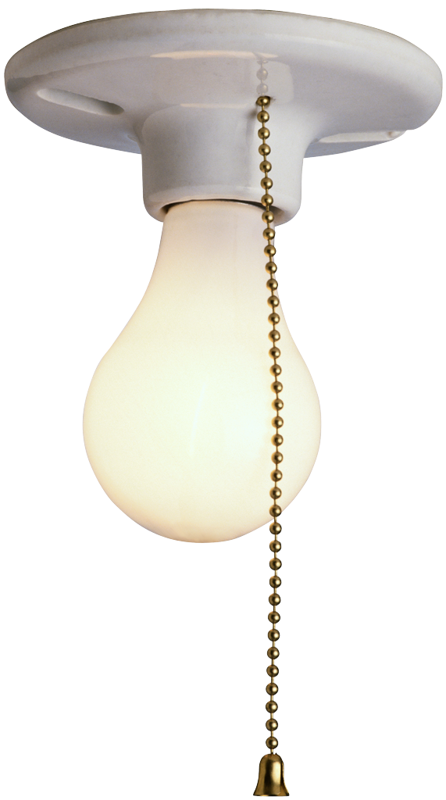
Intellectual Property (IP)
“Intellectual property refers to creations of the mind, such as inventions; literary and artistic works; designs; and symbols, names and images used in commerce.”
-World Intellectual Property Organization
Photo Attribution: https://theforevergreenstateofmind.files.wordpress.com/2012/07/lightbulb3.png

Slide 5
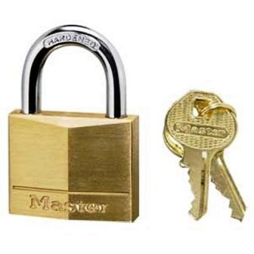
What does IP include?
Copyright
Patents
Trademarks
Industrial Designs
Photo Attribution:
http://ecx.images-amazon.com/images/I/41DS66B06KL.jpg
Notes:
Resource: http://www.wipo.int/edocs/pubdocs/en/intproperty/450/wipo_pub_450.pdf

Slide 6
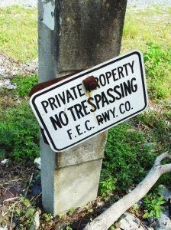
Who might claim control over data?
You
A funder
Student, scientist, researcher, PI
An institution
A private company
Nobody
Photo Attribution: http://www.ihomepm.com/wp-content/uploads/2015/05/727453_10231848.jpg
Notes:
Who controls intellectual property? Think about where your data come from. Who might have a claim on the data?
Remember, stewardship doesn’t equal ownership.
Similarly, control over data does not lead to ownership. Rights of control over data or access to data can be given without shifting ownership.
Example: A data set, produced under a federal grant, contained within an institutional data repository may be owned by that institution. The PI of the project that generated that data, while not the owner, maybe grants the authority to restrict or release access to that data, or limit the use of the data by others. In this circumstance, the PI can claim control of the data without the ability to claim ownership.

Slide 7

Identifying Ownership and Control
Funder agreement
Institutional intellectual property policy
Private company data use agreement
Attached license
Photo Attribution: http://cdn.gobankingrates.com/wp-content/uploads/nashville-housing-market-overview-300x238.jpg
Notes:
Does the funder who paid for the research own the data? Check the funder agreement to see who maintains ownership of the data.
The Bayh-Dole Act of 1980 made it possible for universities to maintain ownership of outputs from federally funded research projects.
Does the graduate student who collected the data have ownership? What about the Principle Investigator? Check the IP policy of your institution. Some institutions have clear policies on what students may take with them when they move on. IP policies should also indicate when research outputs belong to the institution and when they belong to the researcher.
If access to the data for your research is provided through a private company, you will need to check the data use agreement to identify if they are maintaining ownership of that data.
Is there a license already attached to the data? If there is a CC0 license attached, the data owner has waived all claims and it is in the public domain. This applies if you are using someone else’s data for your research.
Most universities and government agencies have written policies that state that they retain ownership over all products produced by employees and contractors. Faculty, staff, and students (usually graduate students) might retain copyright over their “traditional scholarly products”, but that term may refer to a narrow range of products and may not pertain to data or data products. Rights may vary by discipline.

Slide 8

Why Does Ownership & Control Matter?
For Creators
to derive benefit as a result of their work
For others
To avoid potential legal trouble
To know where to get permission for use.
Photo Attribution: Attention By Viktor Vorobyev at the Noun Project

Slide 9
Copyright versus License
Copyright: “ [T]he body of exclusive rights granted by law to copyright owners for protection of their work.” (U.S. Copyright Office)
Facts and data* cannot be protected by copyright
Metadata and data arrangement can be protected (sometimes)
License: States what can be done with the data and how that data can be redistributed (e.g., GPL and CC)
Waiver: (e.g., CC0) relinquishes all rights of ownership or control and usually commits the “work” to the public domain
Intellectual property laws will vary depending upon country or region
Notes:
You need to have copyright before you can have the power to assign licenses or waivers.
*The line between data that is “purely factual” vs descriptive is blurry and can be subjective at times. In some cases, such as a biodiversity data set, much of the data may be considered to be purely factual (e.g., a place name, a species name) while other data within the same data set may contain descriptions of a place that, while being factual in nature, are actually the creative content of the individual(s) making the observations. See Slide: Fact and Copyright for examples of current case law.
The arrangement or organization of data can be protected when the structure can be proven to be original. Some arrangements, such as lists (e.g., the telephone book) cannot be protected by copyright.
Source: http://www.copyright.gov/help/faq/definitions.html
Reference: http://fairuse.stanford.edu/overview/faqs/copyright-basics/

Slide 10

Fact and Copyright
Facts cannot be protected by copyright, but what is a fact?
Current case law determines the limits.
Feist Publications, Inc. vs. Rural Telephone Service Co.
Baker v. Seldon
Miller v. Universal Studios
Photo Attribution:
http://www.romakerlaw.com/blog/wp-content/uploads/2015/07/doctelportal.jpg
Notes:
Feist vs. Rural:
From https://en.wikipedia.org/wiki/Feist_Publications,_Inc.,_v._Rural_Telephone_Service_Co.
Feist Publications, Inc., v. Rural Telephone Service Co., 499 U.S. 340 (1991), was a decision by the Supreme Court of the United Statesestablishing that information alone without a minimum of original creativity cannot be protected by copyright.^{[1]} In the case appealed, Feist had copied information from Rural's telephone listings to include in its own, after Rural had refused to license the information. Rural sued for copyright infringement. The Court ruled that information contained in Rural's phone directory was not copyrightable and that therefore no infringement existed.
Baker vs. Seldon
From https://en.wikipedia.org/wiki/Baker_v._Selden
Baker v. Selden, 101 U.S. 99 (1879), was a leading Supreme Court of the United States copyright case cited to explain the idea-expression dichotomy. The court held that a book did not give an author the right to exclude others from practicing what was described in the book, only right to exclude reproduction of the material in the book. Exclusive rights to an "useful art" described in a book was only available by patent.
Miller v. Universal Studios
From https://en.wikipedia.org/wiki/Miller_v._Universal_City_Studios,_Inc.
Miller v. Universal City Studios, Inc., is a case where an appeals court found that although the plaintiff apparently deserved to prevail, it reversed the jury verdict and remanded the case for retrial because it found reversible error in the trial judges’ instructions to the jury. The appellate court found that the judge’s jury instructions, which included the statement that the labor of research by an author is protected by copyright, had been given in error. The court noted that plaintiff, over the objection of the defense, had urged the district court judge to include this instruction.

Slide 11

Choosing an open license
Why use an open license?
Facilitate data sharing and discovery
Increase visibility of your data
Advance knowledge
Creative Commons
CC0 (not a license, but a waiver)
CC BY (Attribution)
CC BY-ND (Attribution-NoDerivs)
CC BY-NC (Attribution-NonCommercial)
CC BY-SA (Attribution-ShareAlike)
Notes:
BY, NC, SA, and ND are not licenses. They are restrictions that, when used individually or together create to create a license. Thus CC-NC is the license, while NC is a restriction.
If you choose to make your data open, you have many options:
CC0 is a waiver and waives all your rights to the data;
CC BY allows anyone to use, change or distribute your work for any purpose as long as attribution is given;
CC BY-ND allows anyone to use or distribute your work in its unchanged form, with attribution;
CC BY-NC allows anyone to share or modify your work for non-commercial purposes, with attribution;
CC BY-SA allows anyone to edit your work for commercial purposes, with attribution, but any redistribution must be under the same license as the original.
CC licenses BY, ND, NC, and SA may be combined to create aggregated licenses, such as CC BY-NC-SA.
Resource: https://creativecommons.org/
Attribution Stacking: http://wir.okfn.org/2012/01/27/attribution-stacking-as-a-barrier-to-reuse/http://wir.okfn.org/2012/01/27/attribution-stacking-as-a-barrier-to-reuse/

Slide 12

Other Considerations
Copyright vs. Copyleft
“a strategy of utilizing copyright law to pursue the policy goal of fostering and encouraging the equal and inalienable right to copy, share, modify and improve creative works of authorship.” (copyleft.org)
Attribution Stacking
CC BY requires all derivative works to acknowledge all contributors to all works from which they are derived.
Redistribution
CC BY-SA requires all works that derive from a work designated BY-SA must be distributed under the same license.
Notes:
CC BY allows anyone to use, change or distribute your work for any purpose as long as attribution is given;
CC BY-SA allows anyone to edit your work for commercial purposes, with attribution, but any redistribution must be under the same license as the original.
Resource: https://creativecommons.org/
Attribution stacking can be a serious impediment to reuse. It occurs when multiple data sets with attribution (or other) licensing requirements are combined. For example, the share-alike requirement can be applied to licenses that allow OR prohibit commercial uses of the content, and a prospective user can't possibly share a derivative data set with a license that satisfies both sets of requirements. A simpler but still potentially cumbersome example of attribution stacking occurs when many data sets are combined and require individual attribution in derivatives.
http://wir.okfn.org/2012/01/27/attribution-stacking-as-a-barrier-to-reuse/
http://www.dcc.ac.uk/resources/how-guides/license-research-data
http://discovery.ac.uk/files/pdf/Licensing_Open_Data_A_Practical_Guide.pdf
Copyleft:
https://copyleft.org/
https://www.gnu.org/copyleft/gpl.html

Slide 13
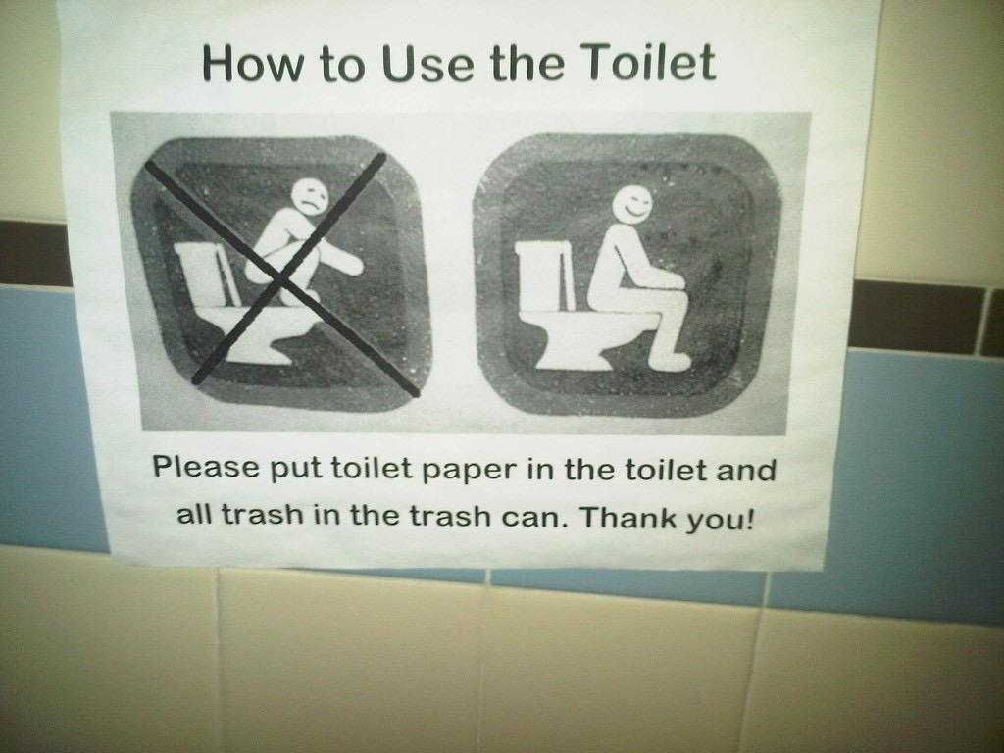
Norms for Data Use
When using data
Give credit to the data authors
Be responsible with the data
Share what you learned
Respect the Data License or Waiver
Understand and follow any restrictions or regulations
Photo Attribution: http://soctheory.iheartsociology.com/wp-content/uploads/2011/10/IMG02369-20111028-1602.jpg
Notes:
Norms are standards agreed upon by the community to guide behaviors and conduct.
Resource: http://www.vertnet.org/resources/norms.html

Slide 14
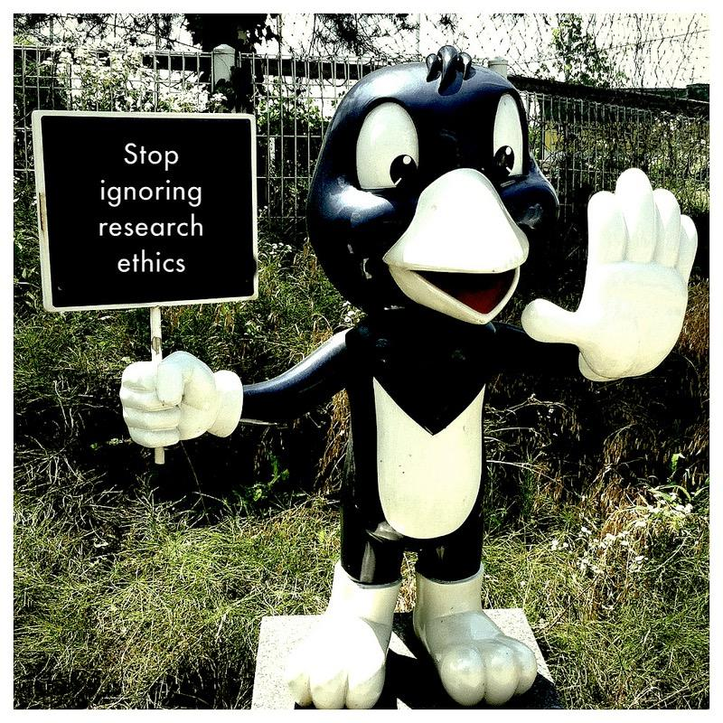
Ethical Use of Data
Before you share your data
Understand your funder/institution policies on data sharing
Review your IRB protocols and approvals
Remove personal data
Using someone else’s data
Give credit
Respect the license
Protect the data appropriately
Photo Attribution: https://www.flickr.com/photos/michaelgallagher/14592386702/

Slide 15

Why might data use or sharing be restricted?
Threatened and endangered species
National security and classified research
Export controls
Can apply to technologies and data
Use of Human Subjects
Personally identifiable information of any kind
E.g., HIPAA as governing law for personal health information
Photo Attribution: https://www.iconfinder.com/icons/40968/folder_red_restricted_icon
Notes:
Threatened and endangered species
Usually, when applying to work with endangered species, you will need to apply for permits from US Fish and Wildlife Service, which will determine what data you can or cannot release
National Security
The restrictions surrounding this data should be explicitly understood from the beginning of your research
Export controls
These regulations are crafted in such a manner that publicly available, fundamental research results are excluded from the regulatory requirements for approvals or licenses.
Reference: http://vcresearch.berkeley.edu/export-controls
Human subjects
A researcher must follow specific procedures which ensure that the rights of the individuals from protected groups, including children and prisoners, involved will be protected. This is typically part of an institution's IRB process.
Reference: http://www.hhs.gov/ohrp/policy/index/index.html
There are guidelines related to the type of research which can be performed according to the benefits a child might receive from the experiment and any possibility of danger to the child. Guidelines protect the rights of the prisoner and to ensure that a prisoner has not been coerced into participation and is volunteering to participate in the experiment. Reference: http://www.uidaho.edu/ora/committees/irb/protectedgroups.
Personal Health Information
Check IRB recommendations and http://www.hhs.gov/ocr/privacy/
HIPAA requires the removal of 18 personal identifiers.

Slide 16
Be Aware of Regulations
Range of regulations mediating how researchers interact with data or objects of data collection (e.g., humans, animals; consult IRB or IACUC)
Constraints around data management (e.g., cloud services, software agreements, etc.)
Institutional policy review processes (e.g. Paperwork Reduction Act)
Open vs. proprietary – some institutions (e.g., universities) may need to waive rights to permit open access.
Notes:
Paperwork Reduction Act (PRA) clearance is the term used for the process of obtaining approval from the Office of Management and Budget (OMB) for federally sponsored data collections as required by the PRA.
Software agreements --- SaaS like Google Docs, DropBox, Box.net, etc.
Re: Open vs. Proprietary. Universities and other umbrella entities may retain ownership rights over products and other content created while the creator is employed by the institution. Creators may not have the right to distribute products and other content without the permission of the institution or their office of technology transfer.

Slide 17

Privacy and Security
What we can collect and how
How we share data, results and outcomes
Reuse of human subject data
Data storage and destruction
IRB interpretations and review across institutions are not always consistent
Photo Attribution: http://www.charlottecriminallawyer-blog.com/files/2013/12/Surveillance-Camera.jpg
Notes:
IRB committees are responsible for reviewing and approving data handling and use in research studies.
There are likely to be separate policies and procedures related to animal research at your institution.
IRB approvals must be re-reviewed if the study changes in a meaningful way.

Slide 18
Privacy vs. Confidentiality
Privacy
Protects access to individuals (or entities)
Confidentiality
Protects access to information about individuals
Can be thought of as information privacy
Notes:
A lot of people don’t know the difference between privacy and confidentiality in a research context, and in many fields, these terms are used interchangeably. However, it’s useful to keep in mind that access to individuals, or entities like plants and animals, is a complicated matter.
Locking doors and drawing curtains are actions to control others’ access to ourselves physically – part of what we consider privacy. Anonymizing data and reporting in aggregate are moves to keep information about individuals confidential. Maintaining data confidentiality helps maintain personal privacy because sometimes data can be traced back to the individual, so if data are not confidential, personal privacy can be compromised. Be mindful of the possible limitations of anonymization when data sets are combined with other data sets.

Slide 19
Summary
Know who can claim ownership or control over data products
Assign licenses or waivers appropriately
Behave ethically and in accordance with established community norms
Respect the licenses or waivers assigned
Protect privacy and confidentiality
Know what restrictions and liabilities apply to products and processes

Slide 20
Resources
Frequently asked questions about PRA / Information Collection. Accessed June 26, 2015 at http://www.hhs.gov/ocio/policy/collection/infocollectfaq.html.
Creative Commons. Accessed June 26, 2015 at https://creativecommons.org.
Norms for data use and publication. Accessed June 26, 2015 at http://www.Vertnet.org/resources/norms.html.
Export controls. Accessed June 26, 2015 at http://vcresearch.berkeley.edu/export-controls.
Protected groups. Accessed June 26, 2015 at http://www.uidaho.edu/ora/committees/irb/protectedgroups.
Health information privacy. Accessed June 26, 2015 at http://www.hhs.gov/ocr/privacy.
Protecting personal health information in research: understanding the HIPAA privacy rule. Accessed June 26, 2015 athttp://privacyruleandresearch.nih.gov/pr_02.asp.
Information Liability. Accessed June 26, 2015 at http://www.law.fsu.edu/journals/lawreview/downloads/263/phil.pdf.
Guidelines for Responsible Data Management in Scientific Research. Accessed June 26, 2015 at http://ori.hhs.gov/education/products/clinicaltools/data.pdf
Who Owns Research Data? Accessed June 26, 2015 at http://ori.dhhs.gov/education/products/columbia_wbt/rcr_data/case/index.html#2
Constructing Access Permissions. Accessed June 26, 2015 at http://libweb.uoregon.edu/datamanagement/sharingdata.html#three

