Slide 1
An introduction to blockmodeling
Carl Nordlund
Carl.nordlund@liu.se
www.carlnordlund.net
Institute for Analytical Sociology

Slide 2
Roadmap to lecture
Role-analysis: theoretical considerations and sociological origins
Conceptual examples
Learn about positions, roles, blocks
Equivalences: core concept
Focus on structural equivalence
Blockmodeling heuristics
Focus on indirect approaches
Run through examples
Followed by a short interactive session
Python notebook on blockmodeling

Slide 3
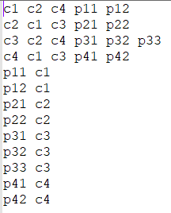
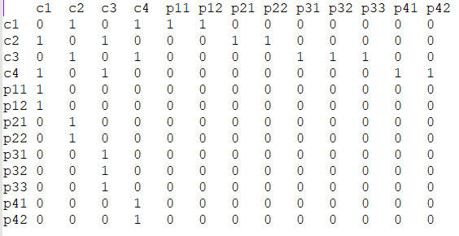
Terminology and network formats
Nodes: “actors” (classical SNA notion) – here, interchangeably
Data formats:
Blockmodeling: exclusively in sociomatrix format
Edgelist
Sociomatrix

Slide 4
Limitations in this introduction
Single-layer (no multilayer/plex)
1-mode/unipartite (no 2-mode/bipartite)
Binary (not valued, not signed)
Aim: provide fundamentals, opening up for future studies!

Slide 5
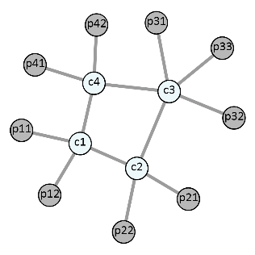
Reading a sociomatrix
“to”
“from”

Slide 6
Role-analysis?
See what I did there? I used the word “actor” instead of “node”!
“3rd pillar” of Social Network Analysis
1st: Node-centric properties and metrics (micro-level)
Measures and metrics that say something about individual actors, e.g. centrality measures
2nd: Cohesive subgroups, triadic analysis etc (meso-level)
Measures and metrics relating to sets of actors (or more often: the sets themselves)
3rd: Macro-level: measures and metrics that say something about the whole network
Density! Average betweenness centrality! Etc
But more overarching and relevant: role analysis and blockmodeling
Indeed dealing with individual actors and subsets of actors, but the analysis and approach is about the network as a whole

Slide 7
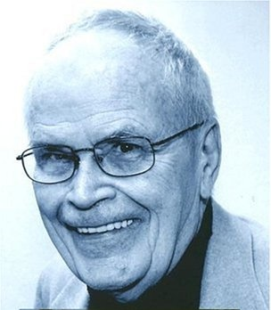
Historical roots
Harrison White
With colleagues, asked whether sociologists can define the “role concept” in a purely relational form?
Society IS social structure: a multiplex network of inter-personal relations (friendships, kinships, dialogue, interaction, exchange, affiliation networks etc)
Roles and identities in society are “reciprocally defined”: only emerges in the interactions. How we relate to each other.
Robinson Crusoe didn’t have a role!

Slide 8

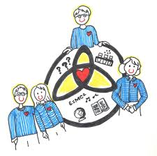
Notions of role and position
At a hospital!
We have patients, nurses, doctors, and admin personnel
Different attributes: work descriptions, salaries, tasks, educations
But also different roles: different types of relations with each other:
Doctors relate to each other, and to patients
Nurses relate to doctors, patients and to admin personnel
Admin personnel relate to patients
Patients relate to all, except other patients
Parents, kids, school teachers
The parents in a family relate with each other, some of other parents
Parents relate to their kids, not other kids
Teachers relate to all kids, some parents, some teachers

Slide 9
Notions of role and position
Identifying and operationalizing positions
Somehow we want to partition the actors (nodes) in a network into subsets (positions/clusters) based on some notion of equivalence
Having similar patterns of relations somehow…
Mapping role-structure
Mapping overall relationships of actors within and between such positions
Quintessential technique for doing the above:
BLOCKMODELING

Slide 10
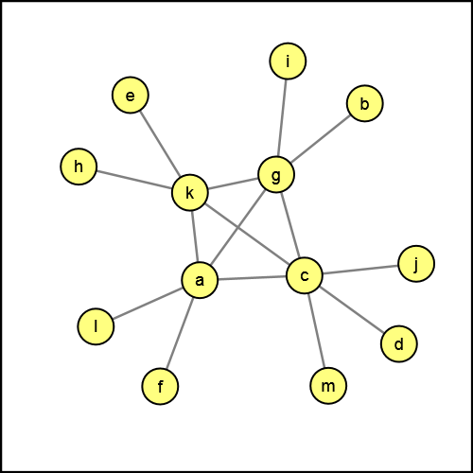
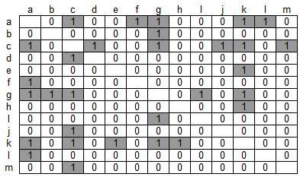
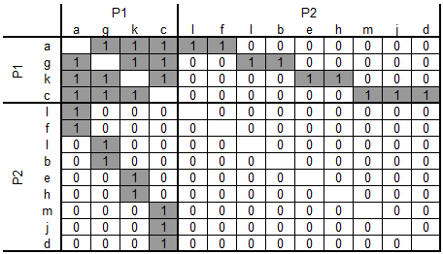
Quick’n’dirty example: Galtung’s feudal interaction structure
Intuitive understanding of this network
A set of 4 “central” and connected actors in the middle. Remaining actors hanging on to these, otherwise poorly connected.
Sociomatrix representation
(Galtung 1971)
So let’s hypothesize that these two represent two different positions:
P1={a,c,g,k}
P2={b,d,e,f,h,i,j,l,m}
We sort the original matrix according to these positions

Slide 11
Galtung’s feudal interaction structure
A hypothetical blockmodel of the Galtung network
Two (2) positions, four (2x2) blocks
Having sorted the original sociomatrix according to our 2 positions (P1 and P2), a total of four (2x2) blocks can be delineated, capturing the ties within and between actors of the positions.
Blocks: P1-P1, P1-P2, P2-P1, P2-P2
In this state, we observe certain patterns in these blocks!
P1-P1: completely filled with ties (except for the diagonal)
P2-P2: totally missing ties
P1-P2, P2-p1: not empty, not filled, something in-between (with ties on each row and each column of the blocks)
I.e. a specific partition of the actors (with the sociomatrix ordered according this this partition)

Slide 12
Galtung’s feudal interaction structure
A hypothetical blockmodel of the Galtung network
Interpreting the blocks
Turns out that the blocks we identify in this hypothetical blockmodel represent three ideal blocks in blockmodeling:
The complete block (com)
Structural equivalence blockmodeling
The null block (nul)
Regular equivalence blockmodeling
The regular block (reg)

Slide 13
Galtung’s feudal interaction structure
A hypothetical blockmodel of the Galtung network
Collapsing the blockmodel
Having modeled each empirical block in terms of an ideal block, we can now “collapse” the blockmodel into a block image, or an image graph.
Here, nodes represent positions (subsets of equivalent actors)
From this: roles
Role of P1 is to be connected other in P1, and having sporadic ties to and from P2
Role of P2 is to have sporadic ties with P1, but lack ties to other in P2
Block image
Image graph
P2
P1

Slide 14
Galtung’s feudal interaction structure
But why do we do blockmodeling?
Reduction of complexity
A blockmodel reduces a complex network into its fundamental structure. We tease out the “functional anatomy”.
In the Galtung network, we find a blockimage that corresponds to a classical core-periphery structure.
For a network twice (or 100 times) the size, the same block image could appear, with different relative sizes of P1 and P2. Still the same underlying functional anatomy.
Allows for comparing complex networks: finding similarities in what could appear as dissimilar
P2
P1

Slide 15
Galtung’s feudal interaction structure
But why do we do blockmodeling?
Comparisons with structural types
The Galtung network turned out to be a core-periphery structure
…but there are a multitude of other possibilities: hierarchies, transitive structures, cohesive subgroups.
Community structures: a special case (one possible outcome) of blockmodeling!
P2
P1

Slide 16
Types of equivalences
What is meant by equivalence in a network? Different notions and usages exist.
Structural equivalence
Two actors are structurally equivalent if they have identical sets of ties to the other actors.
Under this notion of equivalence, blockmodels would ideally consist of complete and null blocks
Regular equivalence
Two actors are regular equivalent if they have ties to actors that in turn are also regular equivalent (!?)
Under this notion of equivalence, blockmodels would ideally consist of null blocks and regular blocks (at least one tie in each row, and at least one tie in each column)

Slide 17
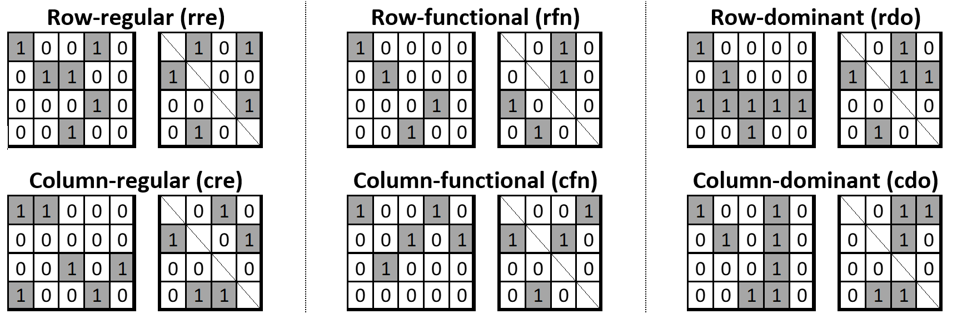
Types of equivalences
What is meant by equivalence in a network? Different notions and usages exist.
Generalized equivalence
Anything goes! In generalized blockmodeling, ideal blocks consists of null, complete and regular blocks – and a host of other block types:

Slide 18
Types of equivalences
What is meant by equivalence in a network? Different notions and usages exist.
Structural, regular, generalized equivalence
Depending on the notion of equivalence that is used, different outcomes will likely emerge. Most common: structural equivalence, then regular equivalence. Sometimes special blockimages need specific ideal blocks (e.g. power-relational core-periphery structures have complete, null and regular blocks)
Different notions of equivalence => Different outcomes and interpretations
Ideal vs. Real world
In the Galtung network, we managed to perfectly fit the network to ideal blocks (and on first attempt as well!). This is typically rare! Real-world networks are more messy!
Thus: ambition is to find the best possible fit (but we are likely to find inconsistencies)

Slide 19
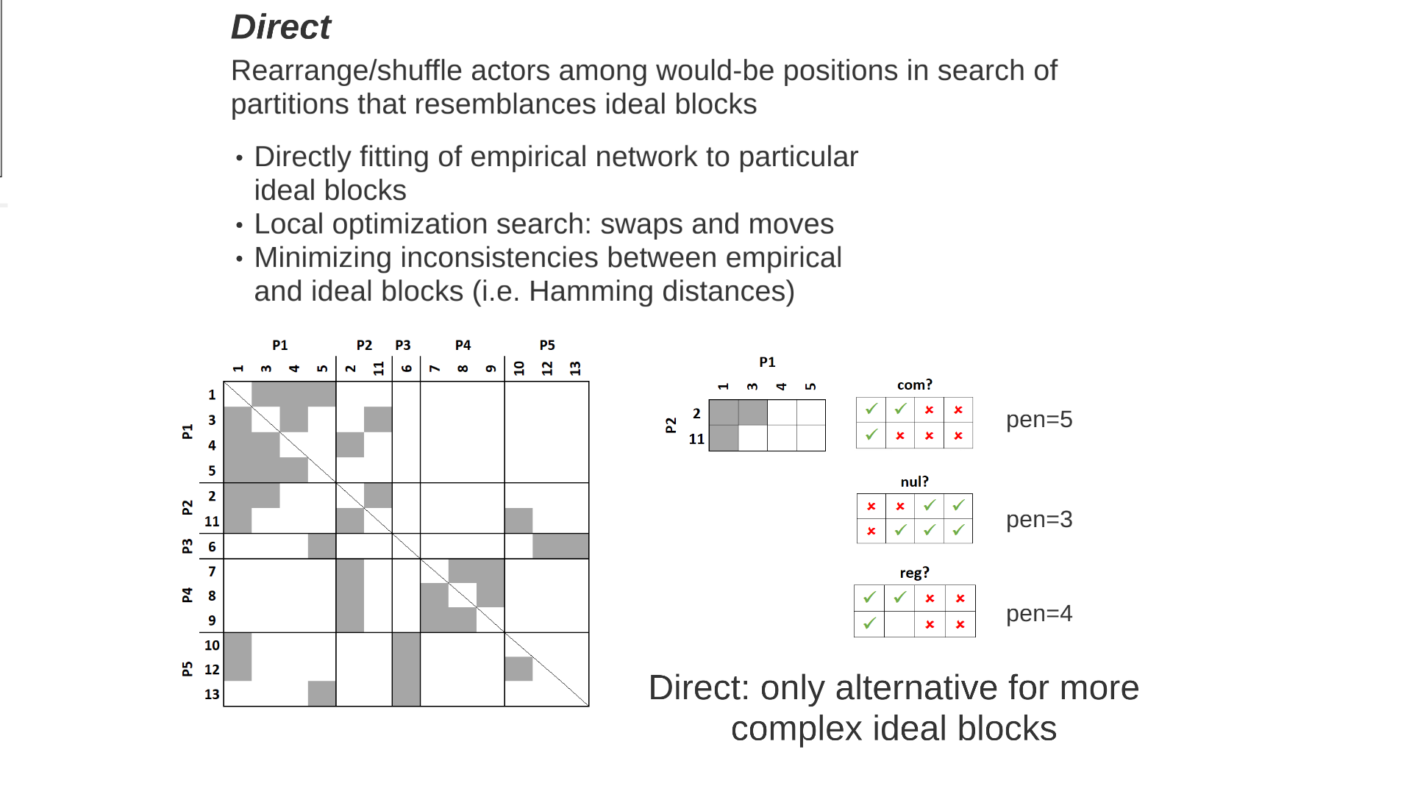
Finding positions
There are two broad approaches for finding equivalent partitions in a network: direct and indirect methods.
Actually three ways: hypothesis testing as well
Direct blockmodeling (semi-supervised)
Given a random starting partition, given number of positions, and a set of ideal blocks, the direct approach uses genetic algorithms (local optimization) to move/swap actors between positions. A criteria function is used (e.g. number of inconsistencies), testing among the various types of ideal blocks.
Advantage:
Deemed better
Allows for capturing complicated ideal blocks (generalized blockmodeling)
Disadvantage:
Computationally heavy
Potentially finding local minima
Swap or move

Slide 20
Finding positions
There are two broad approaches for finding equivalent partitions in a network: direct and indirect methods.
Indirect blockmodeling
First, calculate/determine a suitable indirect measure of equivalence. How these are calculated depend on the notion of equivalence we are interested in.
This yields a new matrix (distances or correlations)
Apply hierarchical clustering to this matrix,
Choose suitable number of positions
Create blockmodel
Advantage:
Works for large networks
Analytical, not computational
Disadvantage:
Restricted to certain notions of equivalence
Generalized blockmodeling: nope!
Lots of choices in the analysis
In what follows:
Indirect structural equivalence!

Slide 21
Indirect structural equivalence
Little League Baseball (Transatlantic Industries team)
Reported friendships between kids playing baseball (Fine 1987)
What does structural equivalence mean?
That two actors have the same patterns of ties to the other actors!
Let’s pick two actors (e.g. Tom_2 and Frank_3) and look at their respective rows (outbound ties):
Inconsistencies: 7 (+2)
Similarities: 14
…and columns (inbound ties):
Self-ties: non-existent: instead, check for reciprocity
Repeat for all pairs of actors!

Slide 22
Indirect structural equivalence
Indirect measures of structural equivalence
Different ways to compare these vectors
Hamming: number of inconsistencies
Euclidean distances
Correlations
(etc.)
Additional choices
Just rows, just columns or both
What to do with reciprocal ties (exclude, include once, include twice)?
Valued networks: correlations or Euclidean distances? (Dichotomization?)
The provided Python code checks both rows and columns, including the recipcrocal once, and either using the Hamming distance or the correlation.

Slide 23
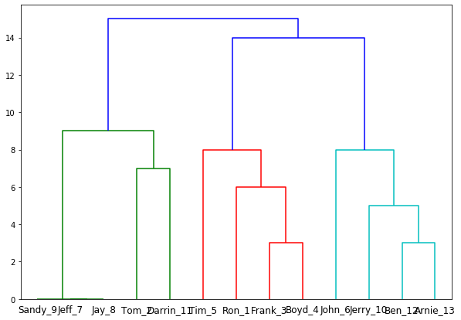
Indirect structural equivalence
Little League Baseball (Transatlantic Industries team)
Indirect structural equivalence (Hamming distances)
Original sociomatrix
Distance matrix (Hamming)
Hierarchical clustering (complete-link)
Note how Jeff_7, Jay_8 and Sandy_9 are all perfectly structurally equivalent!
bm.indirectSE(mat,method='hamming')

Slide 24
Indirect structural equivalence
Little League Baseball (Transatlantic Industries team)
Indirect structural equivalence (Hamming distances); cutting dendrogram
Cutting the dendrogram: deciding on the number of positions!
Further down (strict criteria for equivalence): many positions
Further up (loose criteria for equivalence): few positions
Ways to decide
Theoretically : Perhaps you know how many to expect (e.g. professions at a hospital)
Test metrics (similar to modularity in Newman-Girvan)
Or just try several, evaluate resulting blockmodel
Cutting at 7: 6 positions
Cutting at 10: 3 positions (We try this here)

Slide 25
Indirect structural equivalence
Little League Baseball (Transatlantic Industries team)
Indirect structural equivalence (Hamming distances)
P1={Tom_2, Darrin_11, Jeff_7, Jay_8, Sandy_9}
P2={Ron_1, Frank_3, Boyd_4, Tim_5}
P3={John_6, Ben_12, Arnie_13, Jerry_10}

Slide 26
Indirect structural equivalence
Little League Baseball (Transatlantic Industries team)
bm.calcDensityBlockimage(mat,blockdict)
Indirect structural equivalence (Hamming distances)
To assist in interpreting the blockmodel, we can calculate block densities:
Although not very “crisp”, we could interpret it like:
Which is a cohesive subgroup!

Slide 27
Indirect structural equivalence
What to do with these results?
Interpret block image What is the functional anatomy of the network at large? Does it follow a given structural template (e.g. cohesive groups, core-periphery etc) or is it best explained with a “custom” solution?
Compare position/role with other nodal attributes In the early blockmodeling studies of international trade networks, identified roles of countries were connected to country developmental attributes (GDP/cap, gini coefficients etc)
Test goodness-of-fit measures for solution Test with different number of positions (k=2,3,4…) Test with other notions of equivalence (but ok, in this course only structural equivalence) Make different choices along the way (clustering approach, indirect measures etc) …all to examine the “stability” of your finding

Slide 28
Python exercises
Python resources for blockmodeling and structural equivalence
Virtually non-existent (there is some functions for collapsing blockmodels)
R is the go-to environment for role-analysis (sna, blockmodeling etc)
For this course, I have however coded together functionality for doing indirect structural equivalence (although I’m not an active Python user)
Notebook:
Lab_Blockmodeling.ipynb
Module:
blockmodeling.py
/bm_examples : folder with data

Slide 29

Other software resources for Blockmodeling
Pajek
Developed by Ljubljana scholars: fast, complicated to use, direct blockmodeling
http://mrvar.fdv.uni-lj.si/pajek/
R
Also Ljubljana: Ziberna’s valued blockmodeling approach but also other related direct/indirect approaches:
https://cran.r-project.org/web/packages/blockmodeling/index.html
Ucinet
Borgatti/Everett/Freeman – classic piece of software (Fortran…). Contains many indirect approaches:
https://sites.google.com/site/ucinetsoftware/home

Slide 30


Other software resources for Blockmodeling
KrishKrosh, BEblocker, Ceunet
Developed by myself (C#) – fast, not very stable, direct and indirect methods. Ceunet has indirect methods, hierarchical clustering functionality; KrishKrosh/BEblocker has direct methods.
http://cnslabs.ceu.edu/software.php
https://demesta.com/page1.php?page=academia#software
Direct blockmodeling needs more computational power, thus preferably more low-level languages (C/C#)

Slide 31
Thank you!
And for future blockmodeling questions (software, projects, ideas, questions etc):
carl.nordlund@liu.se
or
carl.nordlund71@gmail.com

Slide 32
Linköping University
Institute for Analytical Sociology
analytical.sociology@liu.se
www.liu.se/ias

