Slide 1
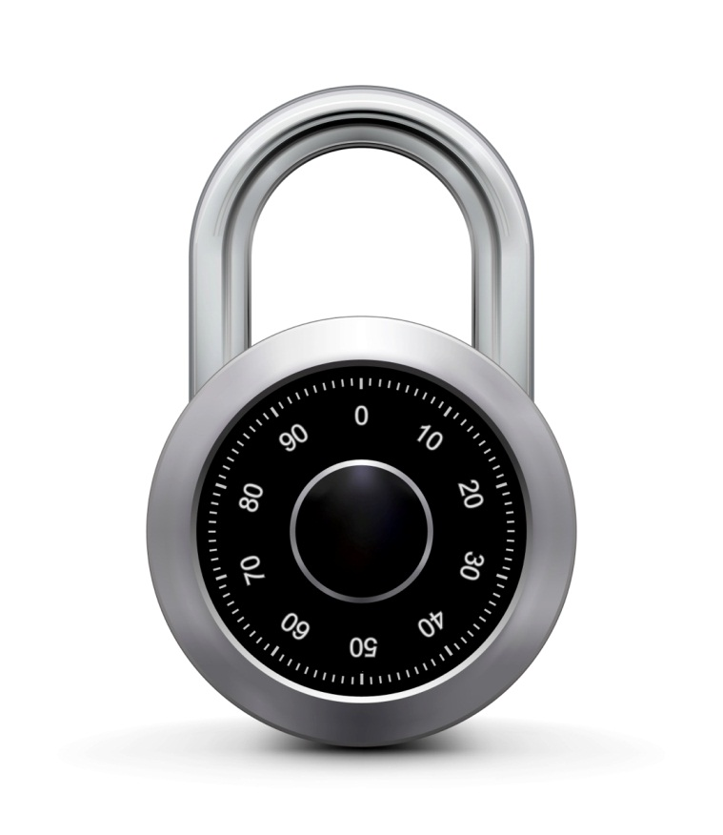
MACs based on PRFs
Online Cryptography Course Dan Boneh
Message Integrity

Slide 2
Review: Secure MACs
MAC: signing alg. S(k,m)⟶t and verification alg. V(k,m,t) ⟶0,1
Attacker’s power: chosen message attack
for m₁,m₂,…,m_{q} attacker is given t_{i} ← S(k,m_{i})
Attacker’s goal: existential forgery
produce some new valid message/tag pair (m,t).
(m,t) ∉ { (m₁,t₁) , … , (m_{q},t_{q}) }
⇒ attacker cannot produce a valid tag for a new message

Slide 3
Secure PRF ⇒ Secure MAC
For a PRF F: K × X ⟶ Y define a MAC I_{F} = (S,V) as:
S(k,m) := F(k,m)
V(k,m,t): output `yes’ if t = F(k,m) and `no’ otherwise.
message m
tag
Alice
Bob
tag ← F(k,m)
accept msg if
tag = F(k,m)

Slide 4
A bad example
Suppose F: K × X ⟶ Y is a secure PRF with Y = {0,1}¹⁰
Is the derived MAC I_{F} a secure MAC system?
Yes, the MAC is secure because the PRF is secure
No tags are too short: anyone can guess the tag for any msg
It depends on the function F

Slide 5
Security
Thm: If F: K×X⟶Y is a secure PRF and 1/|Y| is negligible (i.e. |Y| is large) then I_{F} is a secure MAC.
In particular, for every eff. MAC adversary A attacking I_{F} there exists an eff. PRF adversary B attacking F s.t.:
Adv_{MAC}[A, I_{F}] ≤ Adv_{PRF}[B, F] + 1/|Y|
⇒ I_{F} is secure as long as |Y| is large, say |Y| = 2⁸⁰ .

Slide 6
Proof Sketch
Suppose f: X ⟶ Y is a truly random function
Then MAC adversary A must win the following game:
A wins if t = f(m) and m ∉ { m₁ , … , m_{q} }
⇒ Pr[A wins] = 1/|Y|
m₁ ∈ X
m₂
, …, m_{q}
Chal.
Adv.
t₁ ← f(m₁)
f(m₂₎
, …, f(m_{q})
f in
Funs[X,Y]
(m,t)
same must hold for F(k,x)

Slide 7
Examples
AES: a MAC for 16-byte messages.
Main question: how to convert Small-MAC into a Big-MAC ?
Two main constructions used in practice:
CBC-MAC (banking – ANSI X9.9, X9.19, FIPS 186-3)
HMAC (Internet protocols: SSL, IPsec, SSH, …)
Both convert a small-PRF into a big-PRF.

Slide 8
Truncating MACs based on PRFs
Easy lemma: suppose F: K × X ⟶ {0,1}^{n} is a secure PRF.
Then so is F_{t}(k,m) = F(k,m)[1…t] for all 1 ≤ t ≤ n
⇒ if (S,V) is a MAC is based on a secure PRF outputting n-bit tags
the truncated MAC outputting w bits is secure
… as long as 1/2^{w} is still negligible (say w≥64)

Slide 9
End of Segment

