Slide 1
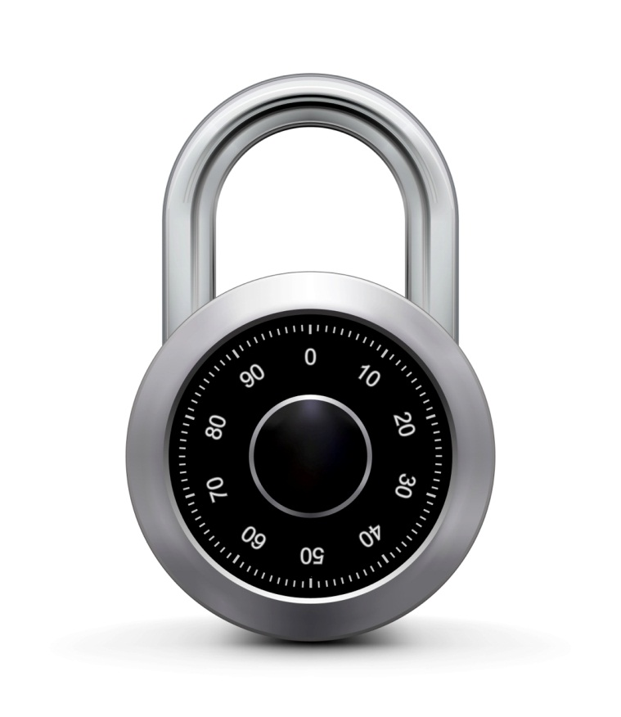
A Parallel MAC
Online Cryptography Course Dan Boneh
Message Integrity

Slide 2
Construction 3: PMAC – parallel MAC
P(k, i): an easy to compute function
m[0]
m[1]
m[2]
m[3]
key = (k, k₁)
⊕
无法抵御攻击:交换分组的位置,(异或是可交换的
所以要把分组的位置信息加进去
P(k,0)
P(k,1)
⊕
P(k,2)
⊕
P(k,3)
⊕
最后一个分组不用
F(k₁,⋅)
F(k₁,⋅)
F(k₁,⋅)
⊕
Let F: K × X ⟶ X be a PRF
Define new PRF F_{PMAC} : K² × X^{≤L} ⟶ X
F(k₁,⋅)
tag

Slide 3
Construction 3: PMAC – parallel MAC
P(k, i): an easy to compute function
m[0]
m[1]
m[2]
m[3]
key = (k, k₁)
⊕
⊕
⊕
⊕
P(k,0)
P(k,1)
P(k,2)
P(k,3)
最后一个分组不用
F(k₁,⋅)
F(k₁,⋅)
F(k₁,⋅)
⊕
Let F: K × X ⟶ X be a PRF
Define new PRF F_{PMAC} : K² × X^{≤L} ⟶ X
F(k₁,⋅)
tag

Slide 4
Construction 3: PMAC – parallel MAC
P(k, i): an easy to compute function
m[0]
m[1]
m[2]
m[3]
key = (k, k₁)
⊕
⊕
⊕
⊕
P(k,0)
P(k,1)
P(k,2)
P(k,3)
最后一个分组不用
F(k₁,⋅)
F(k₁,⋅)
F(k₁,⋅)
Padding 方法:类似 CMAC
⊕
Let F: K × X ⟶ X be a PRF
Define new PRF F_{PMAC} : K² × X^{≤L} ⟶ X
F(k₁,⋅)
tag

Slide 5
PMAC: Analysis
PMAC Theorem: For any L>0, If F is a secure PRF over (K,X,X) then F_{PMAC} is a secure PRF over (K, X^{≤L}, X).
For every eff. q-query PRF adv. A attacking F_{PMAC} there exists an eff. PRF adversary B s.t.:
Adv_{PRF}[A, F_{PMAC}] ≤ Adv_{PRF}[B, F] + 2 q² L² / |X|
PMAC is secure as long as qL << |X|^{1/2}
必有可忽略
要使可忽略
已知可忽略

Slide 6
qL << |X|^{1/2}
q: 一个密钥应被用于加密的消息的数量
L: 所有消息中的长度的最大值
对于 AES 有 X = 2^128
每次 q * L 接近 2^64 时 应当更换密钥

Slide 7
已经由 m 计算得到 tag,如何由m’得到tag’
(m 和 m’只有一个分组不同

Slide 8
PMAC is incremental
Suppose F is a PRP.
When m[1] ⟶ m’[1] can we quickly update tag?
m[0]
m[1]
m[2]
m[3]
P(k,0)
⊕
P(k,1)
⊕
P(k,2)
⊕
P(k,3)
⊕
F(k₁,⋅)
F(k₁,⋅)
F(k₁,⋅)
⊕
F(k₁,⋅)
tag
no, it can’t be done
do F⁻¹(k₁,tag) ⨁ F(k₁, m’[1] ⨁ P(k,1))
do F⁻¹(k₁,tag) ⨁ F(k₁, m[1] ⨁ P(k,1)) ⨁ F(k₁, m’[1] ⨁ P(k,1))
do tag ⨁ F(k₁, m[1] ⨁ P(k,1)) ⨁ F(k₁, m’[1] ⨁ P(k,1))
Then apply F(k₁, ⋅)

Slide 9

F⁻¹(k₁,tag) ⨁ F(k₁, m[1] ⨁ P(k,1)) ⨁ F(k₁, m’[1] ⨁ P(k,1))
抵消 m[1]的影响
引入 m’[1]的影响
m[0]
m[1]
m[2]
m[3]
⊕
⊕
⊕
⊕
P(k,0)
P(k,1)
P(k,2)
P(k,3)
最后一个分组不用
F(k₁,⋅)
F(k₁,⋅)
F(k₁,⋅)
⊕
m[1] ⨁ P(k,1)
F(k₁,⋅)
tag
F(k₁, m[1] ⨁ P(k,1))

Slide 10
One time MAC (analog of one time pad)
类似一次性密码本的完整性版
For a MAC I=(S,V) and adv. A define a MAC game as:
Def: I=(S,V) is a secure MAC if for all “efficient” A: Adv_{MAC}[A,I] = Pr[Chal. outputs 1] is “negligible.”
m₁ ∈ M
Chal.
Adv.
k←K
t₁ ← S(k,m₁)
(m,t)
b
b=1 if V(k,m,t) = `yes’ and (m,t) ≠ (m₁,t₁)
b=0 otherwise

Slide 11
One-time MAC: an example
Can be secure against all adversaries and faster than PRF-based MACs
Let q be a large prime (e.g. q = 2¹²⁸+51 )
key = (k, a) ∈ {1,…,q}² (two random ints. in [1,q] )
msg = ( m[1], …, m[L] ) where each block is 128 bit int.
P_{msg}(x) = m[L]⋅x^{L} + … + m[1]⋅x L 次 多项式.
S( key, msg ) = P_{msg}(k) + a (mod q)

Slide 12
这种 MAC 方法是一次安全的
这种 MAC 方法不是二次安全的
二次使用会完全暴露key
given S( key, msg₁ ) adv. has no info about S( key, msg₂ )
given S( key, msg₁ ) S( key, msg₂ ) adv. has info about S( key, msg₃ ) S( key, msg₄ ) S( key, msg₅ )...

Slide 13
One-time MAC ⇒ Many-time MAC
Let (S,V) (签名算法,验证算法) be a secure one-time MAC over (K_{I},M, {0,1}^{n} ) .
Let F: K_{F} × {0,1}^{n} ⟶ {0,1}^{n} be a secure PRF.
Carter-Wegman MAC: CW( (k₁,k₂), m) = (r, F(k₁,r) ⨁ S(k₂,m) )
for random r ⟵ {0,1}^{n} .
Thm: If (S,V) is a secure one-time MAC and F a secure PRF then CW is a secure MAC outputting tags in {0,1}^{2n} .
slow but short inp
fast long inp
PRF
一次性
Notes:
Note: the PRF is only used for short messages and yet we get a MAC for long messages.

Slide 14
CW( (k₁,k₂), m) = (r, F(k₁,r) ⨁ S(k₂,m) )
对于一个消息,每次计算 ,都会取到不同的 r
导致最后输出的tag 不同
单个消息可以被映射到不同的标签

Slide 15
t
CW( (k₁,k₂), m) = (r, F(k₁,r) ⨁ S(k₂,m) )
How would you verify a CW tag (r, t) on message m ?
Recall that V(k₂,m,.) is the verification alg. for the one time MAC.
Run V( k₂, m, F(k₁, r) ⨁ t) )
F(k₁, r) ⨁ t = s(k₂,m)

Slide 16
Construction 4: HMAC (Hash-MAC)
Most widely used MAC on the Internet.
… but, we first we need to discuss hash function.

Slide 17
Further reading
J. Black, P. Rogaway: CBC MACs for Arbitrary-Length Messages: The Three-Key Constructions. J. Cryptology 18(2): 111-131 (2005)
K. Pietrzak: A Tight Bound for EMAC. ICALP (2) 2006: 168-179
J. Black, P. Rogaway: A Block-Cipher Mode of Operation for Parallelizable Message Authentication. EUROCRYPT 2002: 384-397
M. Bellare: New Proofs for NMAC and HMAC: Security Without Collision-Resistance. CRYPTO 2006: 602-619
Y. Dodis, K. Pietrzak, P. Puniya: A New Mode of Operation for Block Ciphers and Length-Preserving MACs. EUROCRYPT 2008: 198-219

Slide 18
End of Segment

