Slide 1

Collision resistance
抗碰撞

Slide 2

Collision resistance
Let H: M →T be a hash function ( |M| >> |T| )
A collision for H is a pair m₀ , m₁ ∈ M :
H(m₀) = H(m₁) and m₀ ≠ m₁
若所有算法A都不能输出函数H的碰撞，那函数H是抗碰撞的:
Adv_{CR}[A,H] = Pr[ A outputs collision for H]
Example: SHA-256 (outputs 256 bits)

Slide 3
Collision resistance
Let I = (S,V) be a MAC for short messages over (K,M,T)
Let H: M^{big} → M
Def: I^{big} = (S^{big} , V^{big} ) over (K, M^{big}, T) as:
S^{big}(k,m) = S(k,H(m)) ; V^{big}(k,m,t) = V(k,H(m),t)
定理: If I is a secure MAC and H is collision resistant
then I^{big} is a secure MAC.
Example: S(k,m) = AES_{2-block-cbc}(k, SHA-256(m)) is a secure MAC.
SHA-256(m))输出32字节，可以应用16字节的AES；把AES带到一个两个分组的CBC中，将AES从16字节的PRF扩展成32字节的PRF

Slide 4
Collision resistance
如果哈希函数H不是抗碰撞的
Then: S^{big} is insecure under a 1-chosen msg attack
step 1: adversary asks for t ⟵S(k, m₀)
step 2: output (m₁ , t) as forgery

Slide 5
Collision resistance
某个应用：用户在下载软件包想确保软件包未被攻击者篡改，用户可以参考公共空间(保存软件包哈希值，空间很小，只读，不允许被修改)，公共空间可以使得任何人不需要密钥就可以通过核对哈希值判断软件包有没有被篡改(这区别于MAC)。

Slide 6
Generic birthday attack

Slide 7
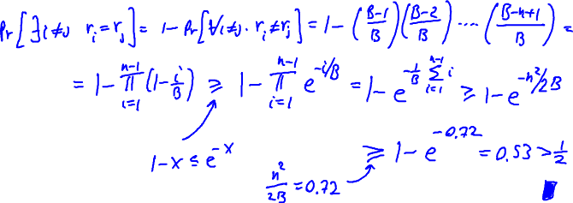
Collision resistance
Let r₁, …, r_{n}∈{1,…,B}相互独立，且同分布
定理: when n= 1.2 × B^{1/2} then Pr[ ∃i≠j:r_{i} = r_{j}] ≥ ½
(各随机变量均匀分布时)

Slide 8
Collision resistance
H: M → {0,1}^{n} . Collision finding algorithm:
Choose 2^{n/2} random elements in M: m₁, …, m₂n/2
For i = 1, …, 2^{n/2} compute t_{i} = H(m_{i}) ∈{0,1}^{n}
Look for a collision (t_{i} = t_{j}).
  If not found, got back to step 1.
Expected number of iteration ≈ 2
Running time: O(2^{n/2}) (space O(2^{n/2}) )
Let H: M → {0,1}^{n} be a hash function ( |M| >> 2^{n} )
to find a collision in time O(2^{n/2}) hashes

Slide 9
Collision resistance
digest generic
function size (bits) Speed (MB/sec) attack time
SHA-1 160 153 2⁸⁰
SHA-256 256 111 2¹²⁸
SHA-512 512 99 2²⁵⁶
Whirlpool 512 57 2²⁵⁶

