Slide 1



Access to
Care Solution
+

Slide 2


Thinkers Mission
Provide Preventive Healthcare Platform Solution to Medlink

Slide 3
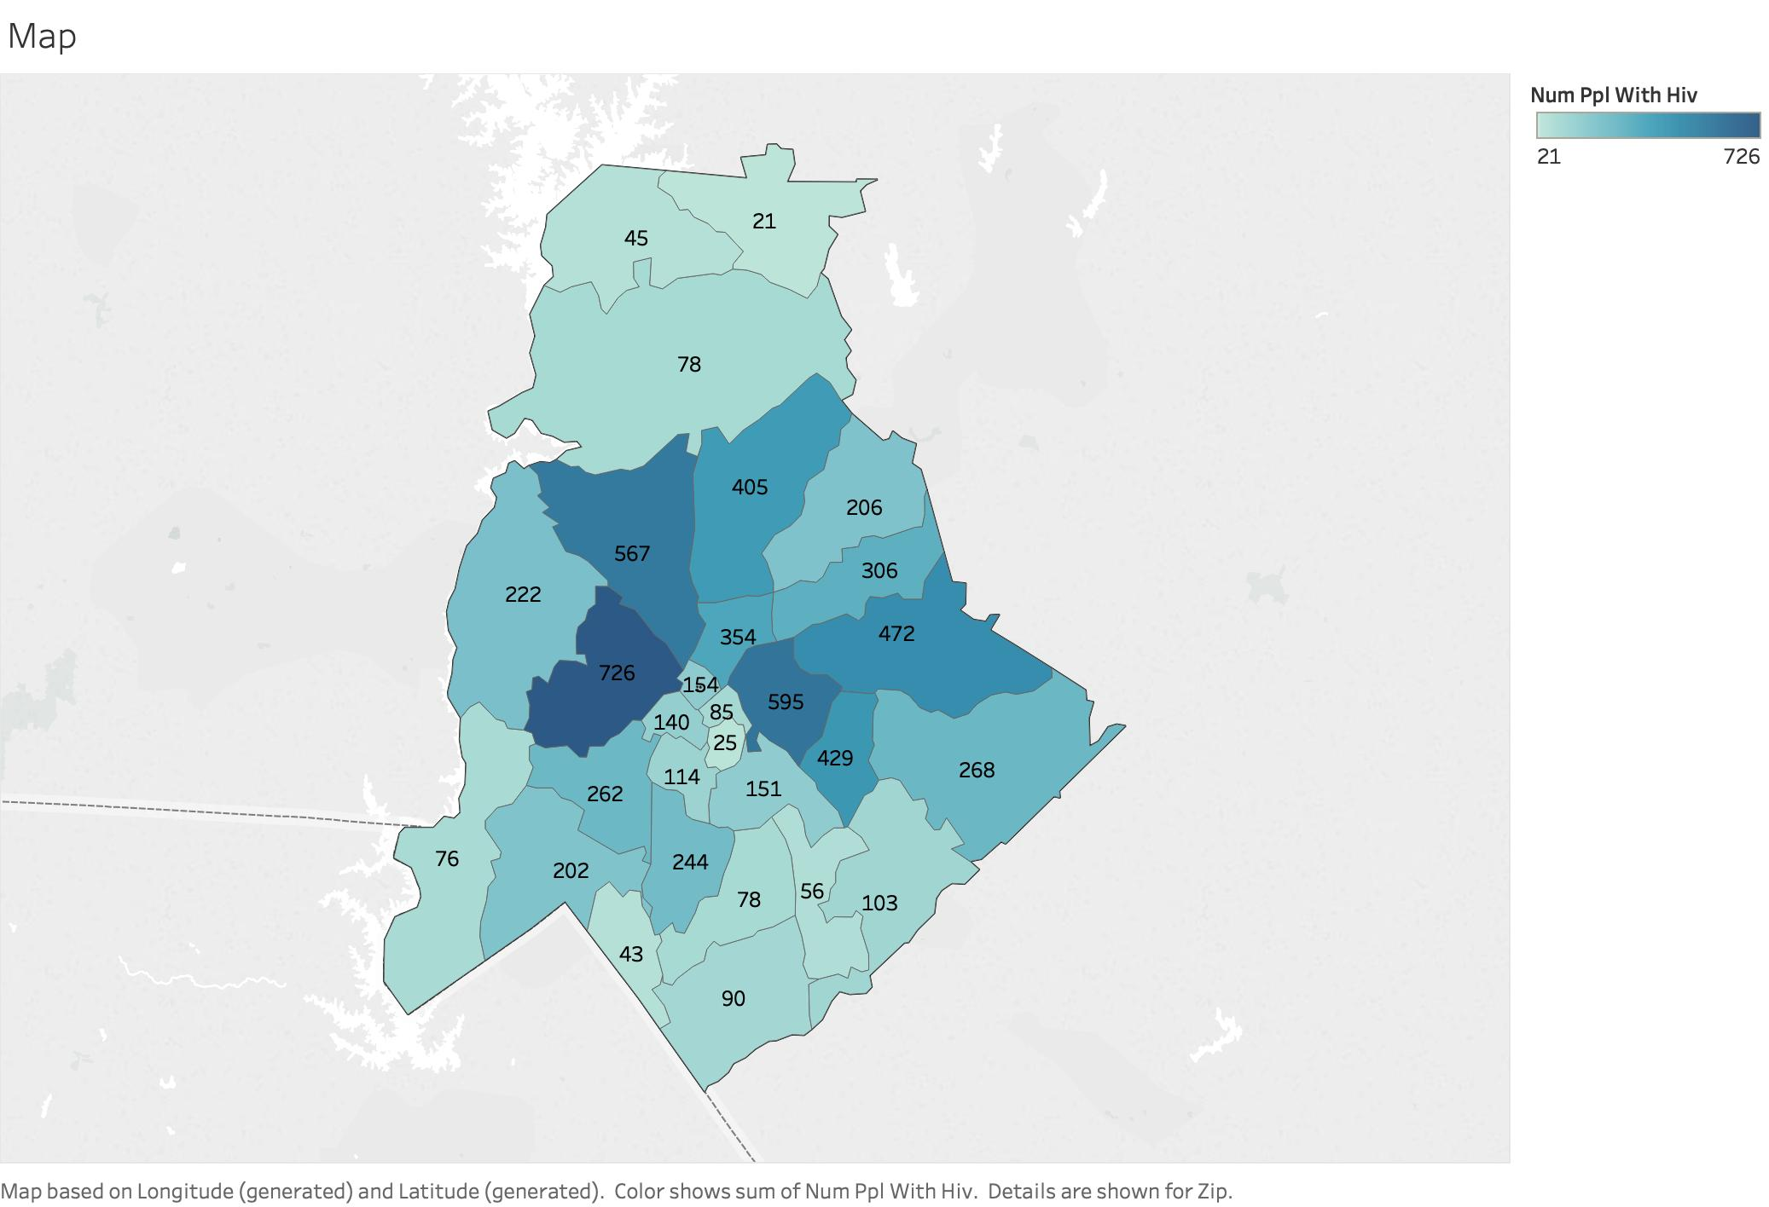

Geographic Background Area Focus 28205 28208 28216

Slide 4
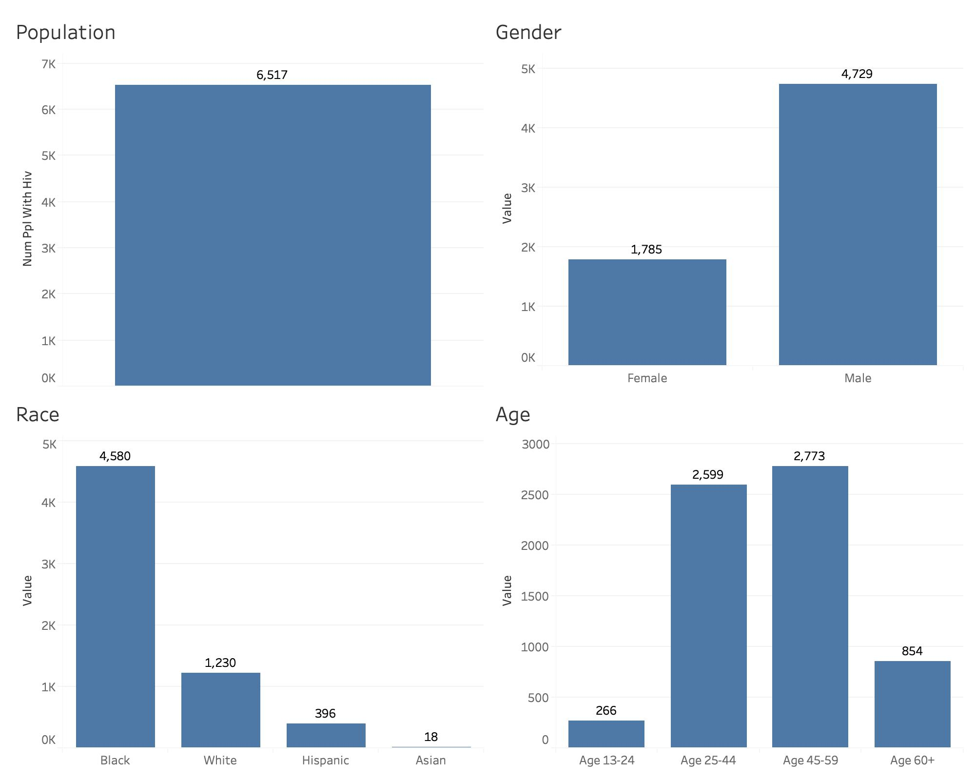

Charlotte HIV Insight

Slide 5


Slide 6
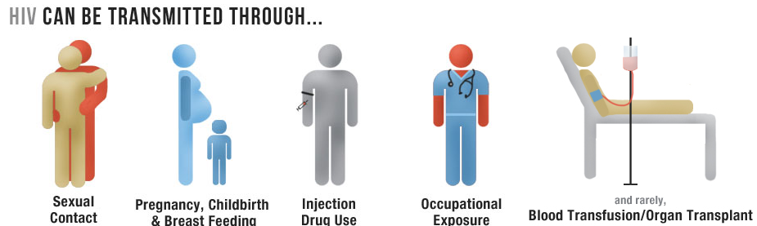
Preventive Education Tips ?
Sex Education at an early age
Abstinance
Condom use
Limited partners
Reduce Substance abuse: Ganja, cocaine, alcohol
Gender inequity and gender roles

Slide 7
Question ?

