Slide 1
Super Portal Concept Review
Notes:
Align internally on the scope of the Super Portal
Present the concept and timeline that Basil and I have been working on based on our understanding of the SuperPortal

Slide 2
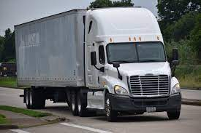
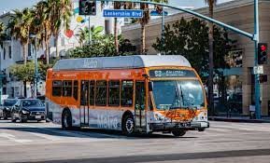
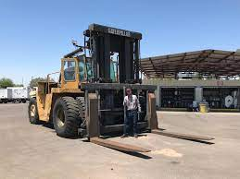
Project Scope: What data we want to capture?
Medium- and Heavy-Duty On- and Off-Road Vehicles:
Counts
Makes/Model/MY
Location (legislative district)
Specs (fuel type, battery, range, etc. from ZETI)
Funding Amount ($)
Fleet/Application (aggregated/anonymized)
Possible inclusions?
Light Duty Vehicles
Infrastructure
Funding Programs?
Performance Data?

Slide 3
Data Resources
Data Hierarchy
ICT
Carl Moyer
ACF
ACT
DMV/IHS
HVIP
Data Source | Information Category
Data Source | Vehicle | Funding | Location
Carl Moyer
ACF (Future)
ACT
ICT
VW Settlement
DMV/IHS registration
HVIP
CORE
AB 617 | ? | ? | ?
Notes:
IHS wouldn’t cover off-road or retrofits
Did I miss any?
AB 617?
Interact Analysis

Slide 4
Integrating/Uploading Data Sources
DMV
Super Portal DB
SuperPortal Web Dashboard
VW
ACT
Automated Integration
Publish
ICT

Slide 5
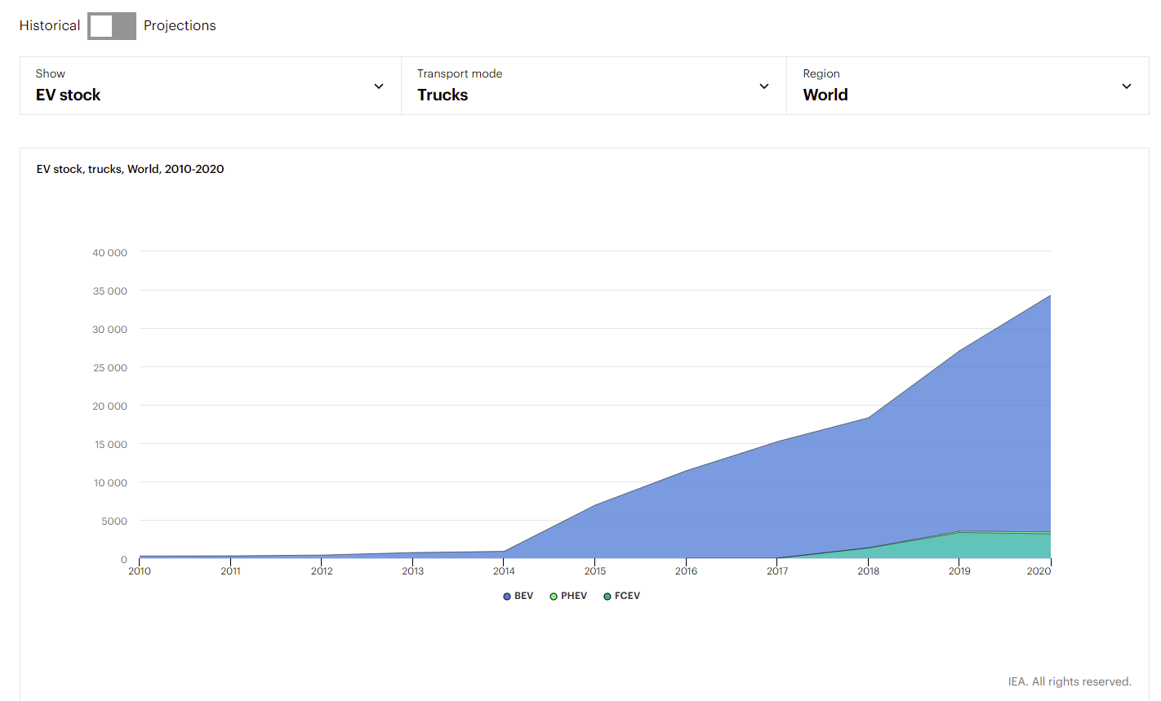
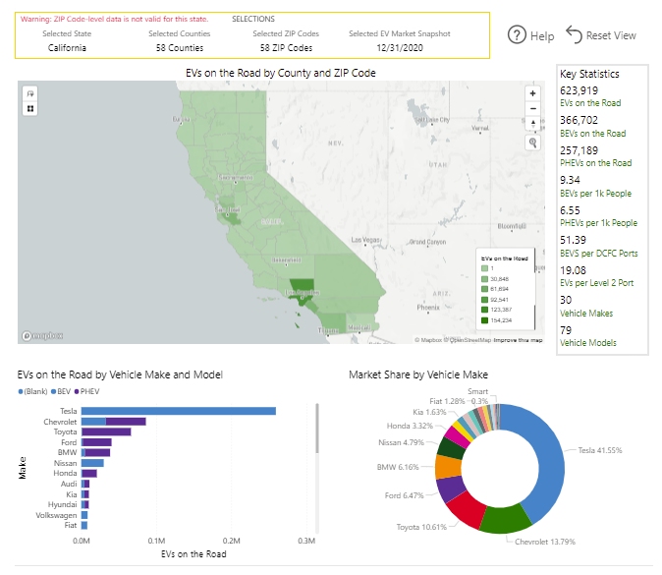
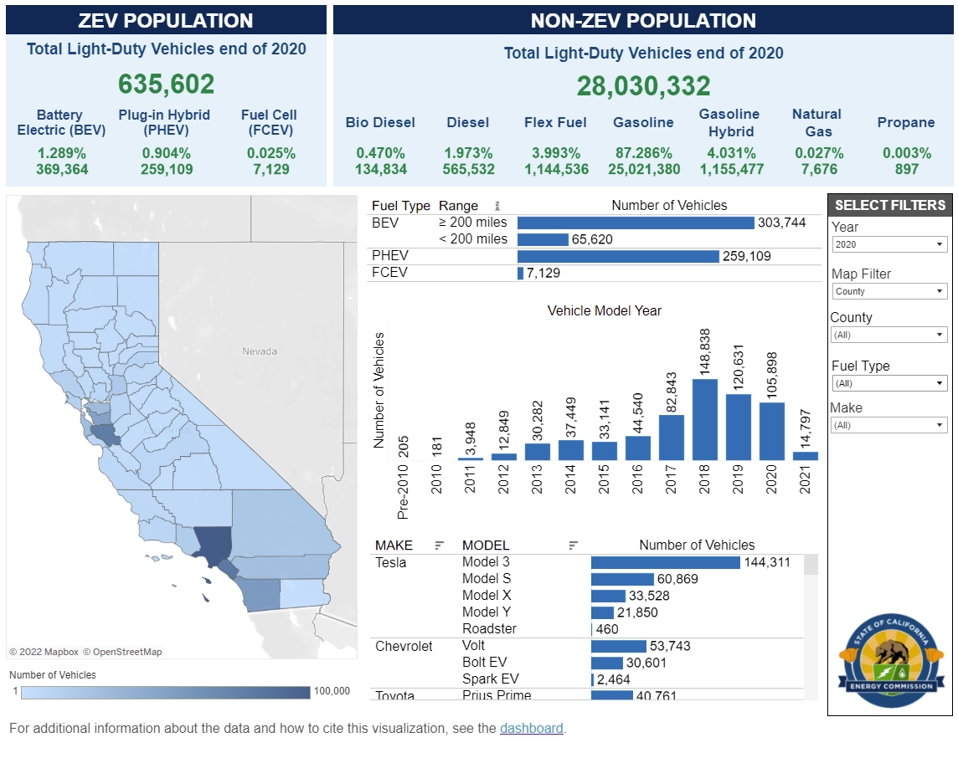
Example Dashboards
Key Statistics
IEA Global EV Data Explorer
Atlas EV Hub: State Registration Data
CEC Light Duty Dashboard
Drop Down Filters
Dynamic Map
Dynamic Graphs

Slide 6
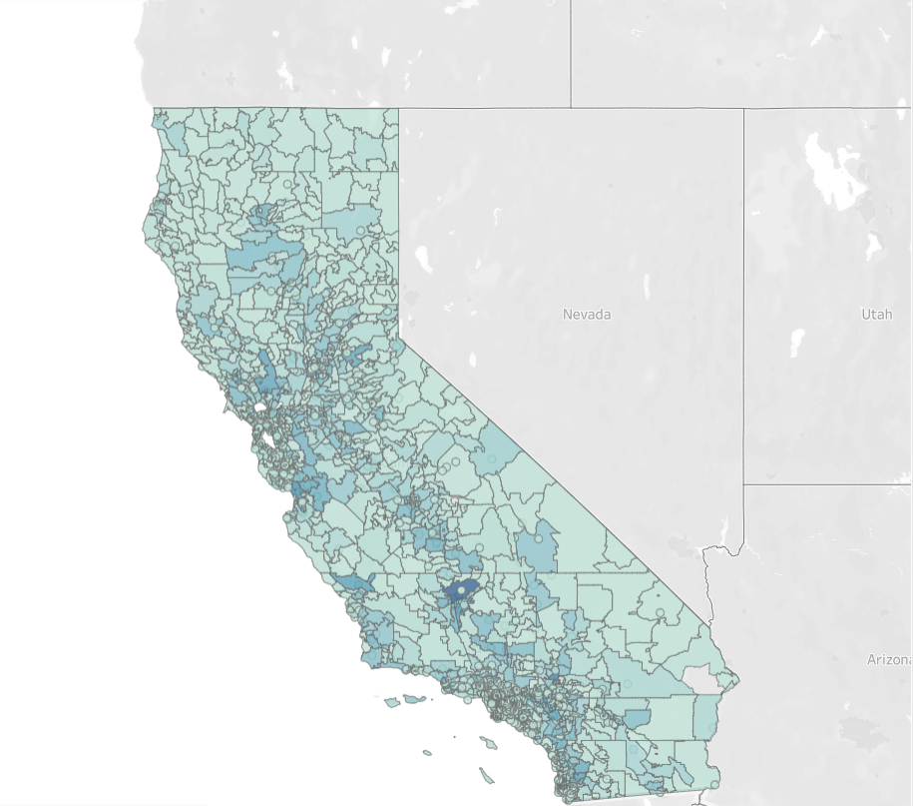
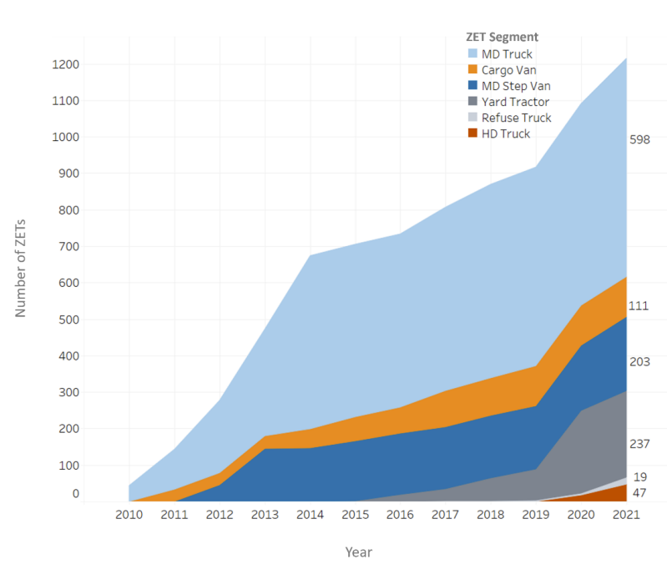
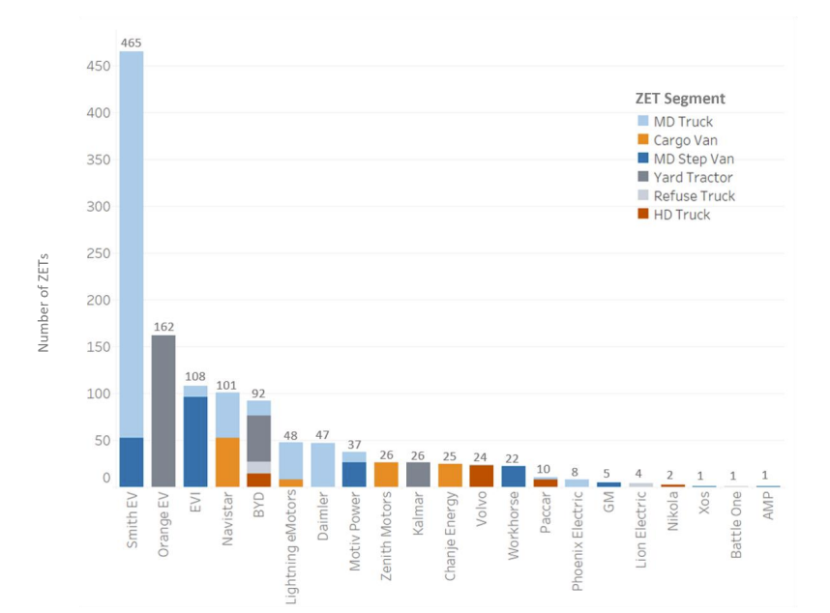
Dashboard Mockup
Dropdown Filters
Vehicle Type
GVWR
Fuel Type
County/Legislative District
Application
Key Stats
1500 vehicles
20 brands
95% battery electric
5% fuel cell
$400M in funding
Cumulative Deployments by Year
Dynamic
Map
Dynamic Graphs
Deployments by OEM and Vehicle Type
Download
Notes:
Because we know not all dataset has complete information that we want (except maybe HVIP), we will need someway to indicate/communicate to users what might be missing

Slide 7
Timeline
Identify data sources (1 week)
Collect data sources (1 month)
Integrate data (1 month)
Dashboard draft (1 month)
Notes:
Aligns with CARB’s timeline (Before end of year) phase 1 functional

Slide 8
Data Sources
Carl Moyer - Have June 2021 Bus
HVIP – as of March 30th
IHS (DMV) - Updated to December 2021; updated biannually
ACT - First batch received (10/30 OEMs), updated every year end of March
Innovative Clean Transit
VW Settlement - We have school bus data from CARB
CORE – Jacob/Niki
ACF – not passed yet therefore no tracking
Supplementing with interviews – ZEI ZEBs/ZETs

Slide 9
Data Sources Headers
Carl Moyer
CAP Identifier
Equipment ID
GVWR
Recipient School District
Address
Zip Code
Manufacturer
Model
Model Year
Vendor
Bus Status
Moyer/CAP Grant
HVIP Funding
Total Equipment Cost
HVIP
CAP Identifier
Equipment ID
GVWR
Recipient School District
Address
Zip Code
Manufacturer
Model
Model Year
Vendor
Bus Status
Moyer/CAP Grant
HVIP Funding
Total Equipment Cost
DMV/IHS
CAP Identifier
Equipment ID
GVWR
Recipient School District
Address
Zip Code
Manufacturer
Model
Model Year
Vendor
Bus Status
Moyer/CAP Grant
HVIP Funding
Total Equipment Cost

Slide 10
Data Sources Headers

Slide 11
Vehicle Level Data
Characteristics: manufacturer, battery size, weight class…
Truck 1
Truck 2
Truck 3
…
Characteristics: manufacturer, battery size, weight class…
Bus 1
Bus 2
Bus 3
…
Characteristics: manufacturer, battery size, weight class…
Truck 1
Truck 2
Truck 3
…

Slide 12
Performance: daily avg speed, total distance per day, efficiency…
Truck 1
Truck 1
Truck 3
Truck 4
…
Day 1
Day 2
Day 2
Day 4
…
Performance: daily avg speed, total distance per day, efficiency…
Bus 1
Bus 3
Bus 3
Bus 4
…
Day 1
Day 3
Day 1
Day 1
…
Performance: daily avg speed, total distance per day, efficiency…
Vehicle 1
Vehicle 2
Vehicle 2
Vehicle 2
…
Day 1
Day 1
Day 2
Day 3
…

Slide 13
Performance: trip avg speed, trip distance, efficiency…
Truck 1
Truck 1
Truck 2
…
Trip 1
Trip 2
Trip 1
…
Day 1
Day 2
Day 3
…
Performance: trip avg speed, trip distance, efficiency…
Bus 1
Bus 1
Bus 1
…
Trip 1
Trip 2
Trip 3
…
Day 1
Day 2
Day 3
…
Performance: trip avg speed, trip distance, efficiency…
Vehicle 1
Vehicle 2
Vehicle 2
…
Trip 1
Trip 3
Trip 6
…
Day 1
Day 2
Day 3
…

Slide 14
Characteristics: manufacturer, battery size, weight class…
Truck 1
Truck 2
Truck 3
…
Performance: daily avg speed, total distance per day, efficiency…
Performance: trip avg speed, trip distance, efficiency…
Truck 1
Truck 1
Truck 3
Truck 4
…
Day 1
Day 2
Day 2
Day 4
…
Truck 1
Truck 1
Truck 2
…
Trip 1
Trip 2
Trip 1
…
Day 1
Day 2
Day 3
…
Characteristics: manufacturer, battery size, weight class…
Bus 1
Bus 2
Bus 3
…
Performance: daily avg speed, total distance per day, efficiency…
Performance: trip avg speed, trip distance, efficiency…
Bus 1
Bus 3
Bus 3
Bus 4
…
Day 1
Day 3
Day 1
Day 1
…
Bus 1
Bus 1
Bus 1
…
Trip 1
Trip 2
Trip 3
…
Day 1
Day 2
Day 3
…

