Slide 1
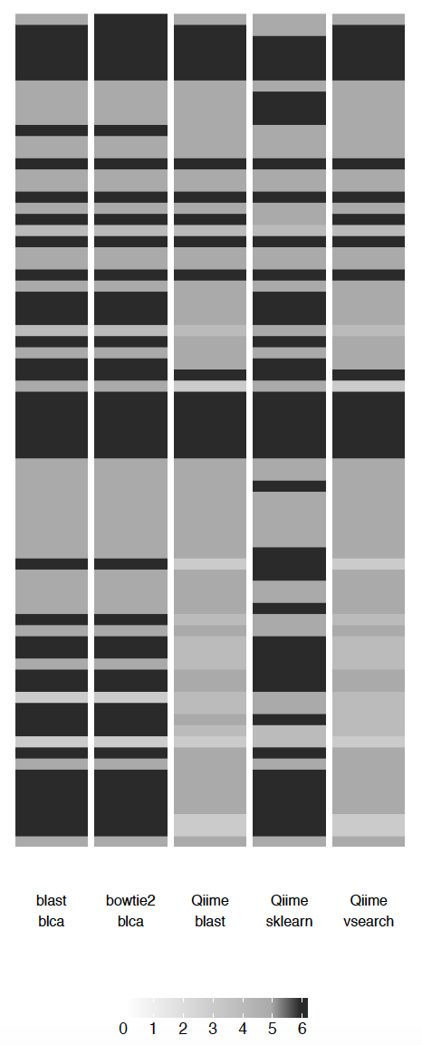
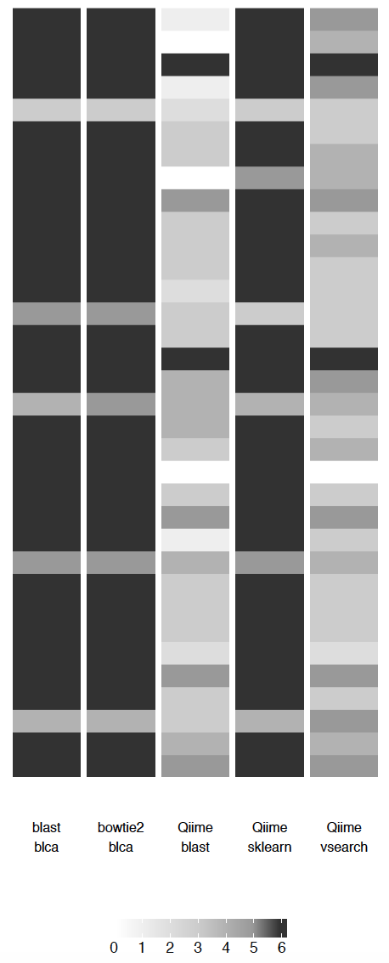

Empty
Incorrect
Correct
16S
CO1
Proportion of taxonomic
calls done correctly
Sanger Sequenced Isolates
BLAST BLCA
BLAST BLCA
Qiime sklearn
Qiime sklearn
Qiime BLAST+
Qiime BLAST+
Qiime vsearch
Bowtie 2 BLCA
Qiime vsearch
Bowtie 2 BLCA
O
S
G
C
F
P
N

