Slide 1
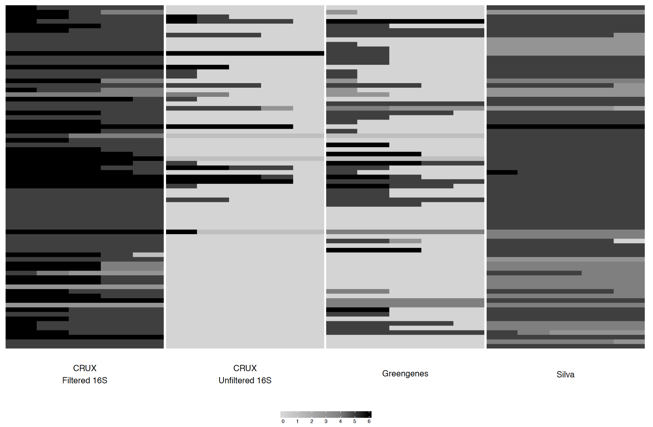
Empty
Incorrect
Correct
A.
Proportion of taxonomic calls done correctly
B.
Sanger Sequenced Isolates
70
80
90
70
80
90
BLCA cut off
60
95
60
95
60
70
80
90
95
60
70
80
90
95
CRUX Filtered 16S
CRUX Unfiltered 16S
Greengenes 16S
Silva 99 16S
Unassigned
O
S
G
C
F
P

Slide 2
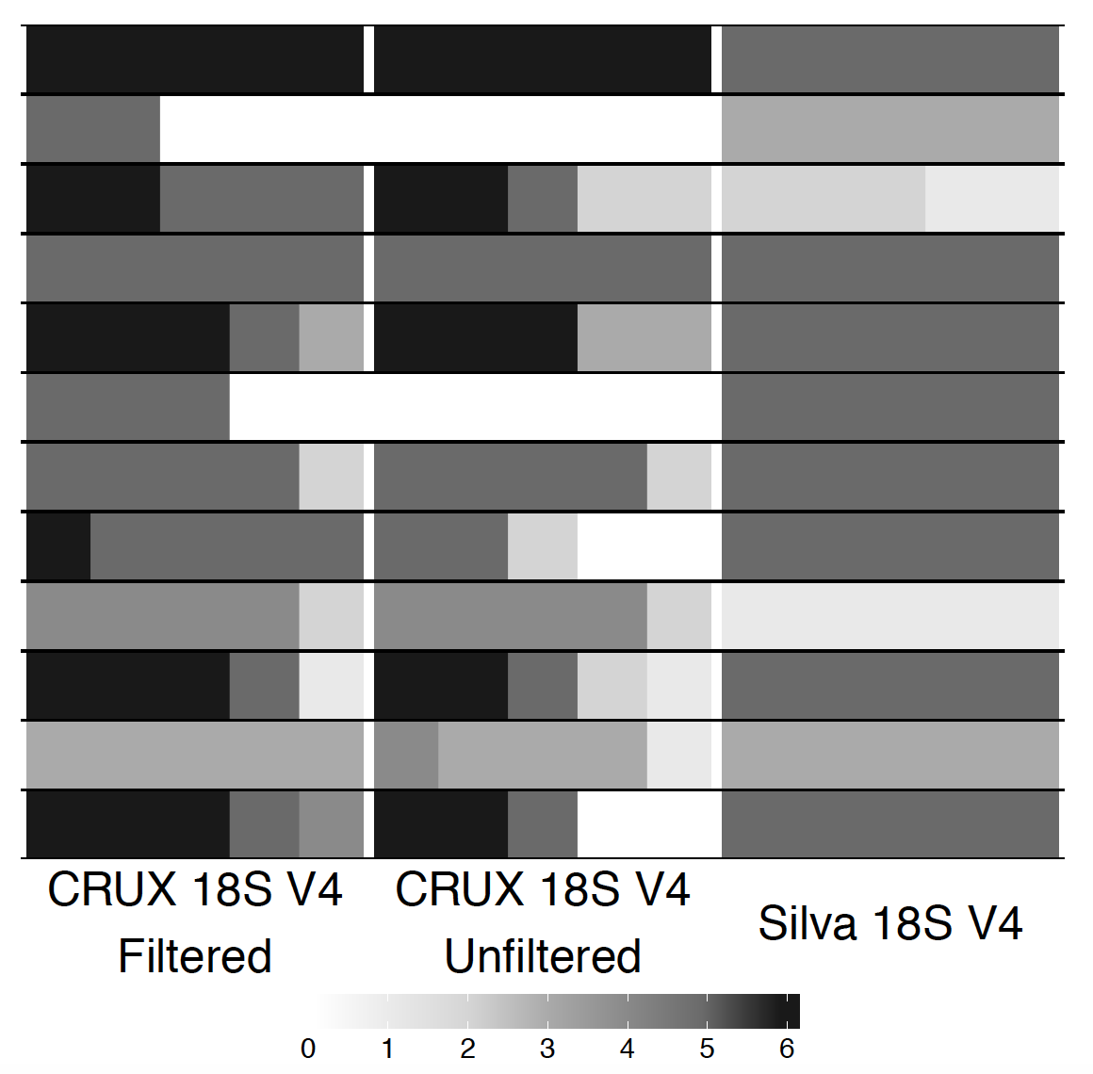
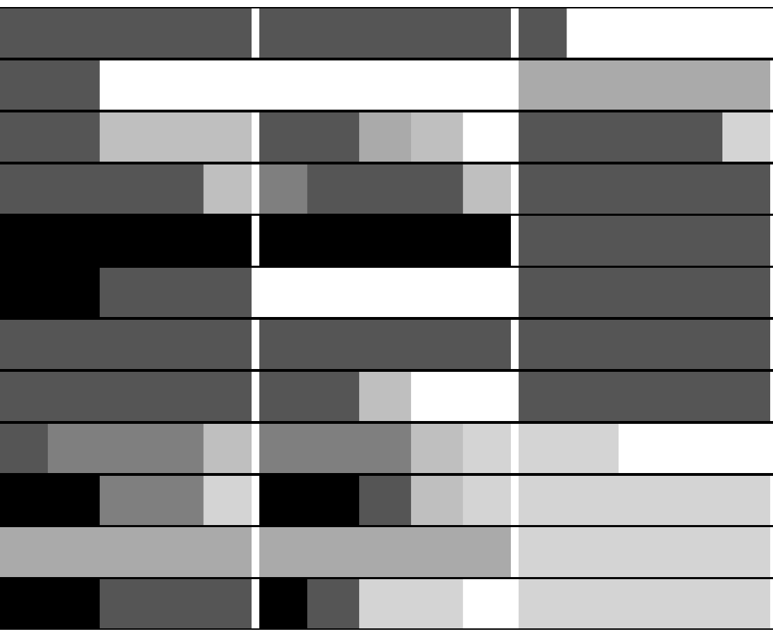
Empty
Incorrect
Correct
A.
C.
Proportion of taxonomic
calls done correctly
B.
D.
Sanger Sequenced Isolates
70
80
90
70
80
90
BLCA cut off
60
95
60
95
60
70
80
90
95
60
70
80
90
95
60
70
80
90
95
60
70
80
90
95
CRUX Filtered
18S V4
CRUX Unfiltered
18S V4
Silva 99 18S
CRUX Filtered
18S V8-9
CRUX Unfiltered
18S V8-9
Silva 99 18S
Unassigned
O
S
G
C
F
P

Slide 3
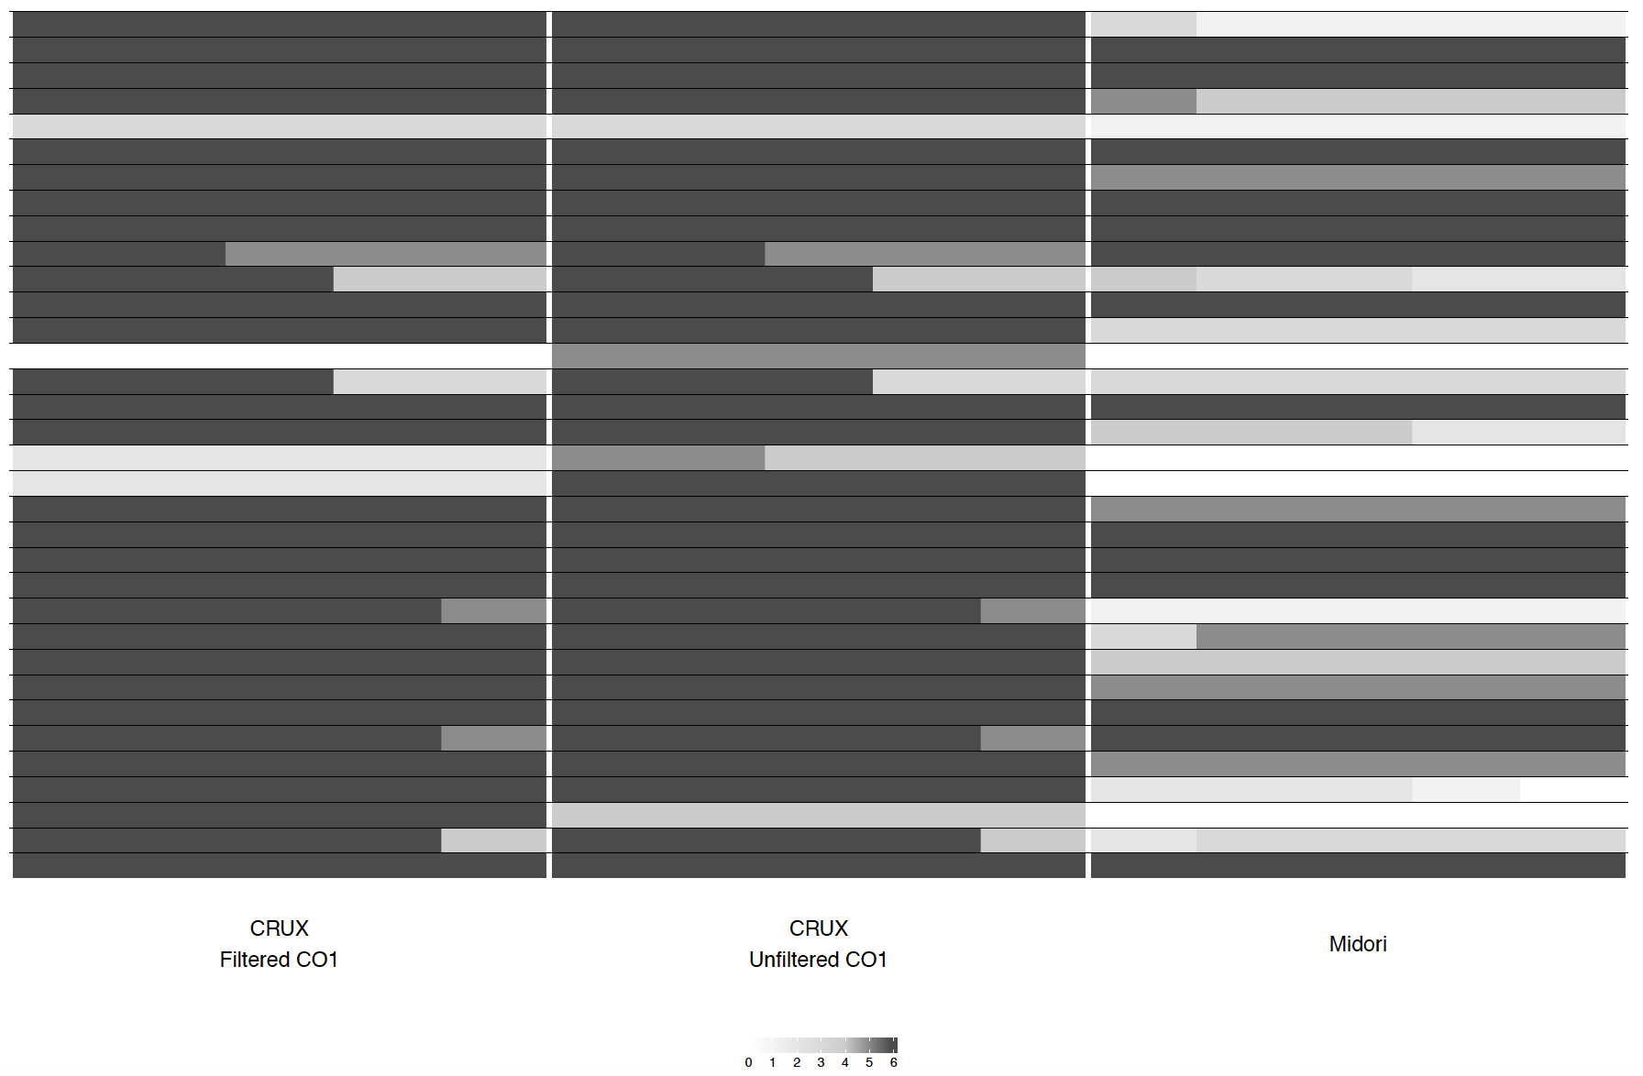

Empty
Incorrect
Correct
A.
Proportion of taxonomic
calls done correctly
B.
Sanger Sequenced Isolates
70
80
90
70
80
90
BLCA cut off
60
95
60
95
60
70
80
90
95
CRUX Filtered CO1
CRUX Unfiltered CO1
Midori CO1
Unassigned
O
S
G
C
F
P

