Slide 1
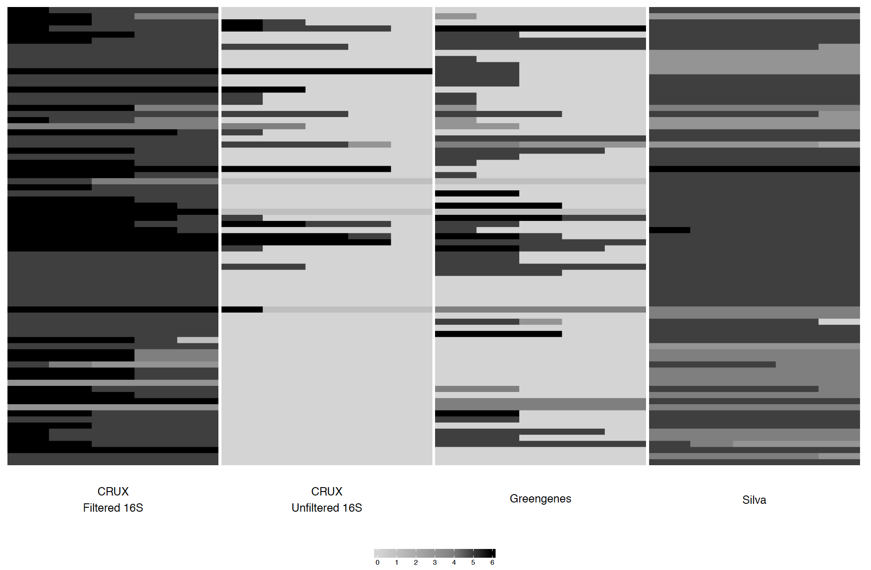
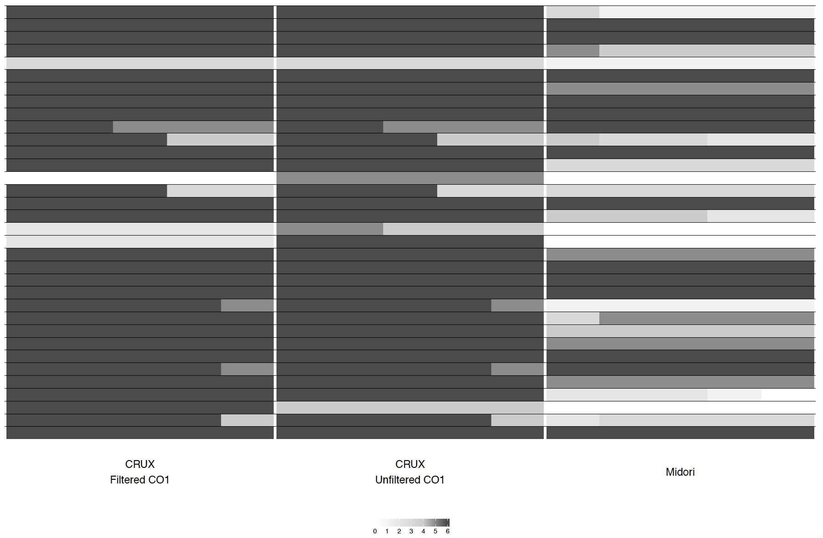
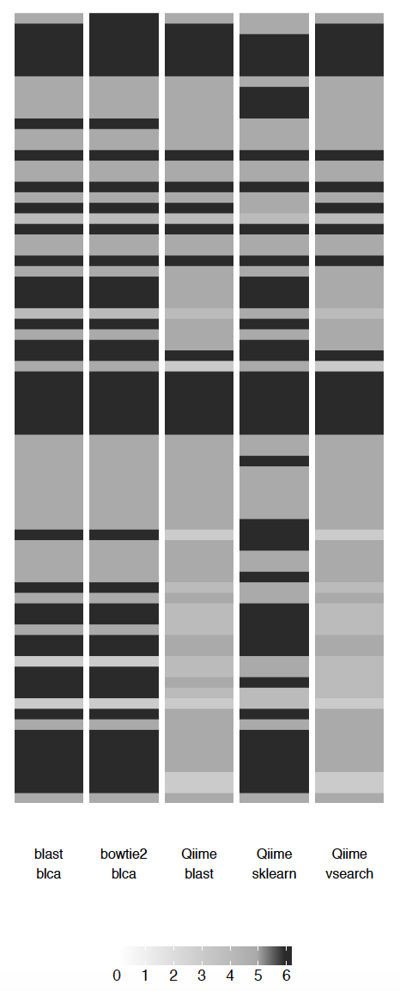
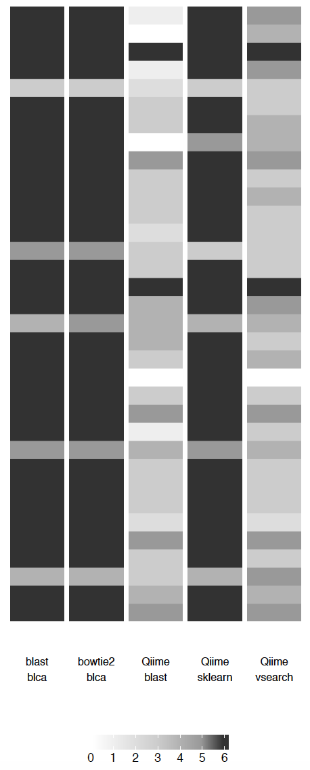

a.
b.
16S
CO1
Empty
Incorrect
Correct
16S
CO1
Proportion of taxonomic calls
Sanger sequenced isolates
Sanger sequenced isolates
cut-off
90
90
60
70
80
95
60
70
80
95
60
70
80
90
95
60
70
80
90
95
60
70
80
90
95
60
70
80
90
95
60
70
80
90
95
CRUX
Filtered 16S
CRUX
Unfiltered 16S
Greengenes 16S
Silva 99 16S
CRUX
Filtered CO1
CRUX
Unfiltered CO1
Midori CO1
BLAST BLCA
BLAST BLCA
Qiime sklearn
Qiime sklearn
Qiime BLAST+
Qiime vsearch
Qiime BLAST+
Qiime vsearch
Anacapa classifier
Anacapa classifier
N
P
C
O
F
G
S

