Slide 1
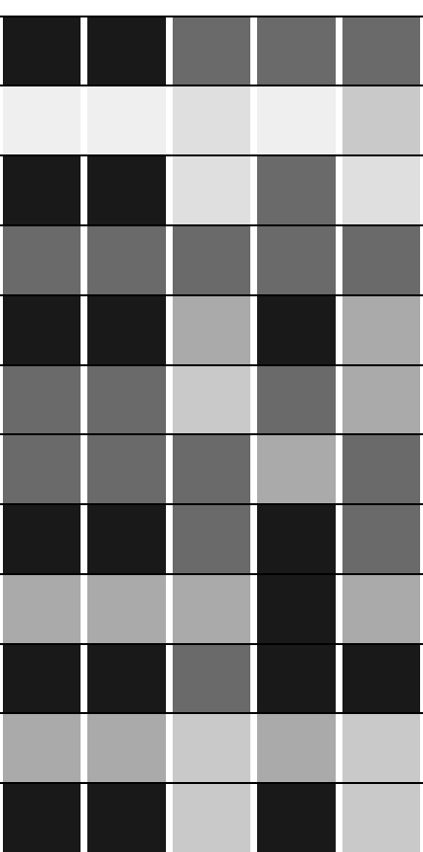
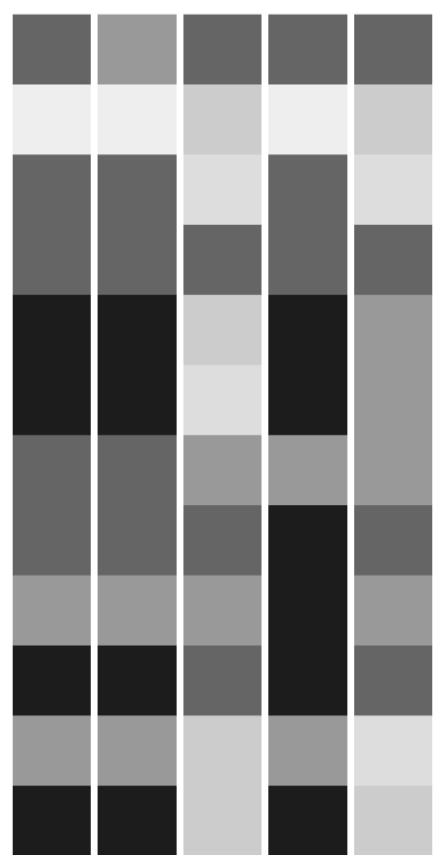

18S V4
18S V8-9
ns
ns
Empty
ns
ns
ns
ns
Incorrect
*
*
Correct
Proportion of taxonomic
Sanger Sequenced Isolates
BLAST BLCA
Qiime2 BLAST+
BLAST BLCA
Qiime2 sklearn
Qiime2 BLAST+
Qiime2 VSEARCH
Qiime2 sklearn
Anacapa Classifier
Anacapa Classifier
Qiime2 VSEARCH
O
S
G
C
F
P
N

