Slide 1
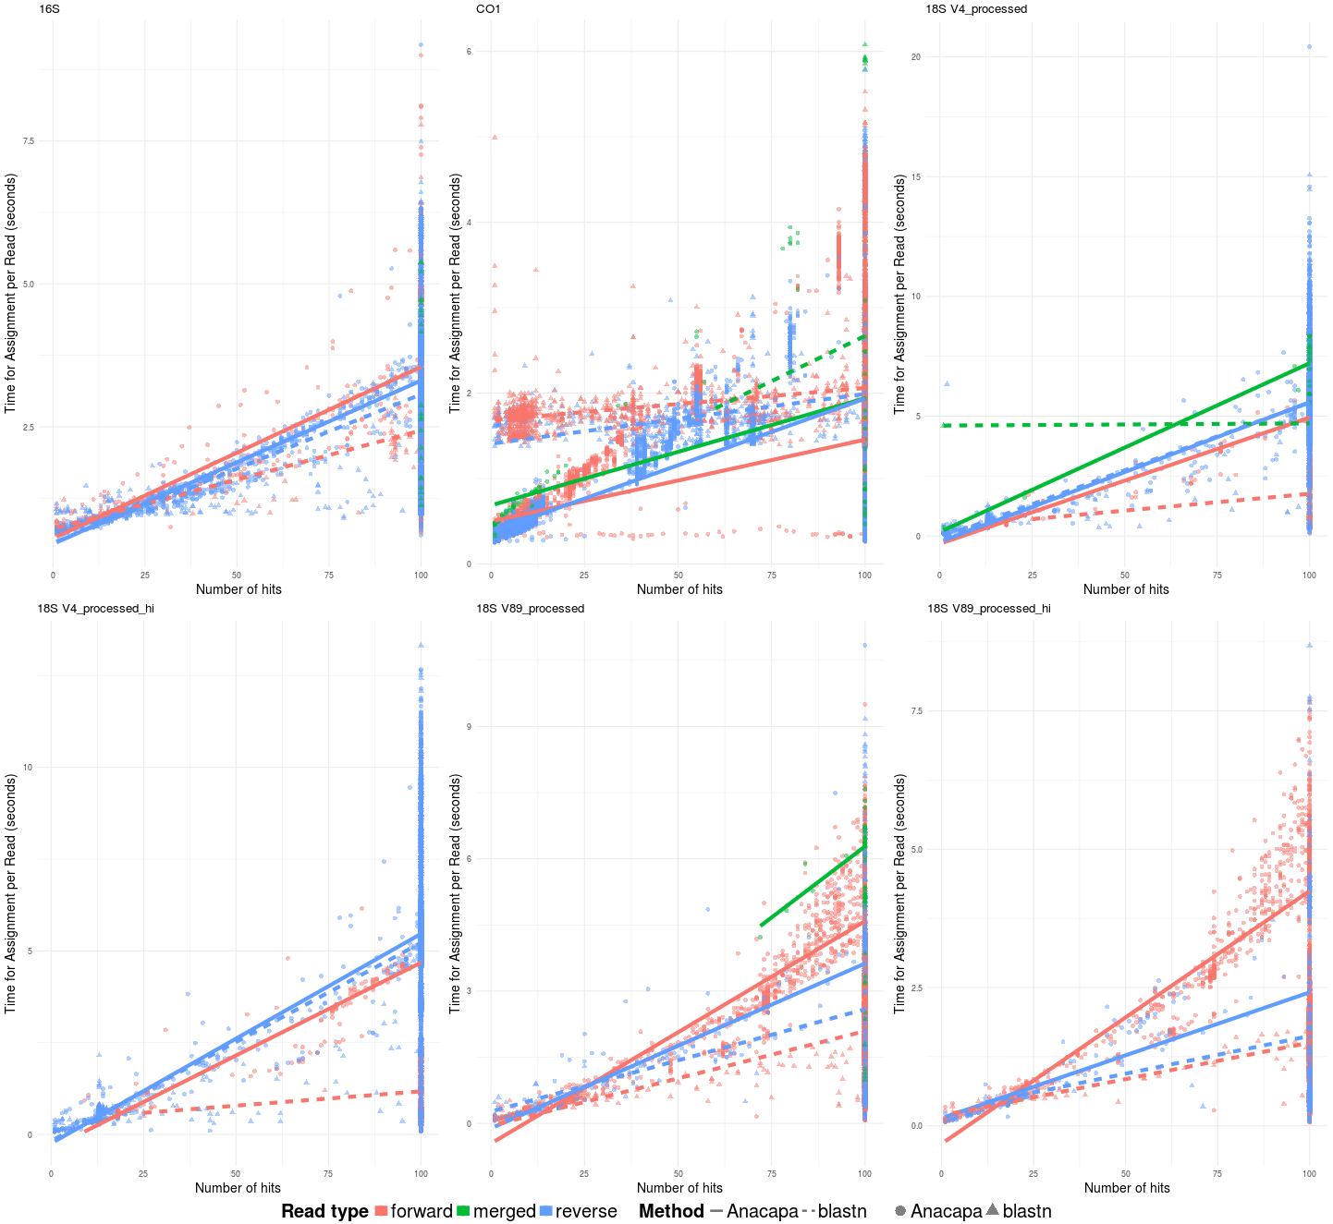
16S
6
CO1
18S V4
20
7.5
15
4
Time for assignment per read (seconds)
5.0
10
2
5
2.5
0
0
0
0
25
50
75
100
Number of hits
18S V4 HiSeq
18S V8-9
18S V8-9 HiSeq
9
7.5
10
Time for assignment per read (seconds)
6
5.0
5
3
2.5
0
0
0
0
25
50
75
100

