Slide 1
gRPC C++
Google RPC
Introduction

Slide 2
gRPC
gRPC which is short for Google RPC is an application based communication based on protocol buffers.
These buffers can communicate language-anonymous (so ruby to python or C++ to Java for example).

Slide 3
gRPC vs REST
The advantage of gRPC over REST is several. First and foremost gRPC is much quicker than REST because encoding / decoding happens over the users local CPU.
Secondly the amount of code one needs to write is less than that of most REST implementations and general type conversion is easier.

Slide 4
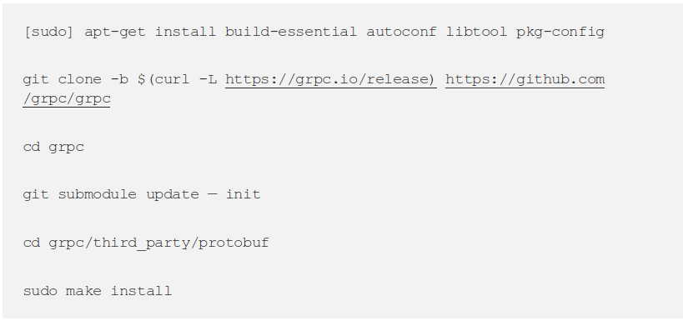
C++ Installation (Linux)

