Slide 1


VIETNAM NATIONAL UNIVERSITY – HO CHI MINH CITY
UNIVERSITY OF INFORMATION TECHNOLOGY
FACULTY OF INFORMATION SYSTEM
Study on exam invigilator assignment algorithms
Advisor: Dr. Do Trong Hop
Student: Nguyen Hoang Long
Nguyen Son Lam

Slide 2
Presentation outline
Overview of the thesis
Problem introduction
Describe the exam invigilator assignment problem
Methods:
Genetic algorithm
Linear programing
Application analysis and implementation
Conclusion and future work

Slide 3
Overview of the thesis
Focus on researching and applying genetic algorithm and linear programing to exam invigilator assignment problem
Apply genetic algorithm to the problem of assigning exam invigilators in universities with constraints and basic requirement and then build an application to display the acceptable results.

Slide 4
Overview of the thesis
Fully aware about the exam invigilator assignment problem.
Fully aware of the strengths of genetic algorithms and linear programming in solving optimization problems.
Represent the problem in the form of integer programming
Successfully implement the genetic algorithm to a working application.

Slide 5
Problems introduction
Assignment or scheduling problems can be defined as a search for the optimal solution to perform various types of works or tasks bounded to a set of constraints
Properties of the constraints
Resources
Tasks
Constraints
Objective

Slide 6
Problems introduction
Exam invigilator scheduling problem is a type of assignment problem.
This problem take a lot of time and resources to accomplish if it done by human.
The need of algorithms or computer programs to support and make the progress faster is necessary.

Slide 7
Describe the exam invigilator assignment problem
There are about 20000 candidates taking the exam and about 120 invigilators in 12-15 days at each exam of University of Information Technology.
Each exam day will have 4 shifts.
Shift | Time span
1 | 07:30 AM – 09:00 AM
2 | 09:30 AM – 11:00 PM
3 | 13:30 PM – 15:00 PM
4 | 15:30 PM – 17:00 PM

Slide 8
Describe the exam invigilator assignment problem
The schedule assigned to the invigilators can take several days during the exam, so they must be present at school only to supervise one or two subjects per day, which is time consuming, especially for those who far from school.
Our objective is focus on study and apply algorithms to minimize the number of days that invigilators must come to school.

Slide 9
Describe the exam invigilator assignment problem
An acceptable solution of the problem must satisfy the following constraints:
Hard constraints:
In a certain shift, invigilator is not allowed to view multiple exams.
Each exam must meet the required number of invigilators.

Slide 10
Describe the exam invigilator assignment problem
An acceptable solution of the problem must satisfy the following constraints:
Soft constraints:
The distance between two consecutive shifts of invigilator is as close as possible.
Each invigilator must meet the required number of shifts.

Slide 11
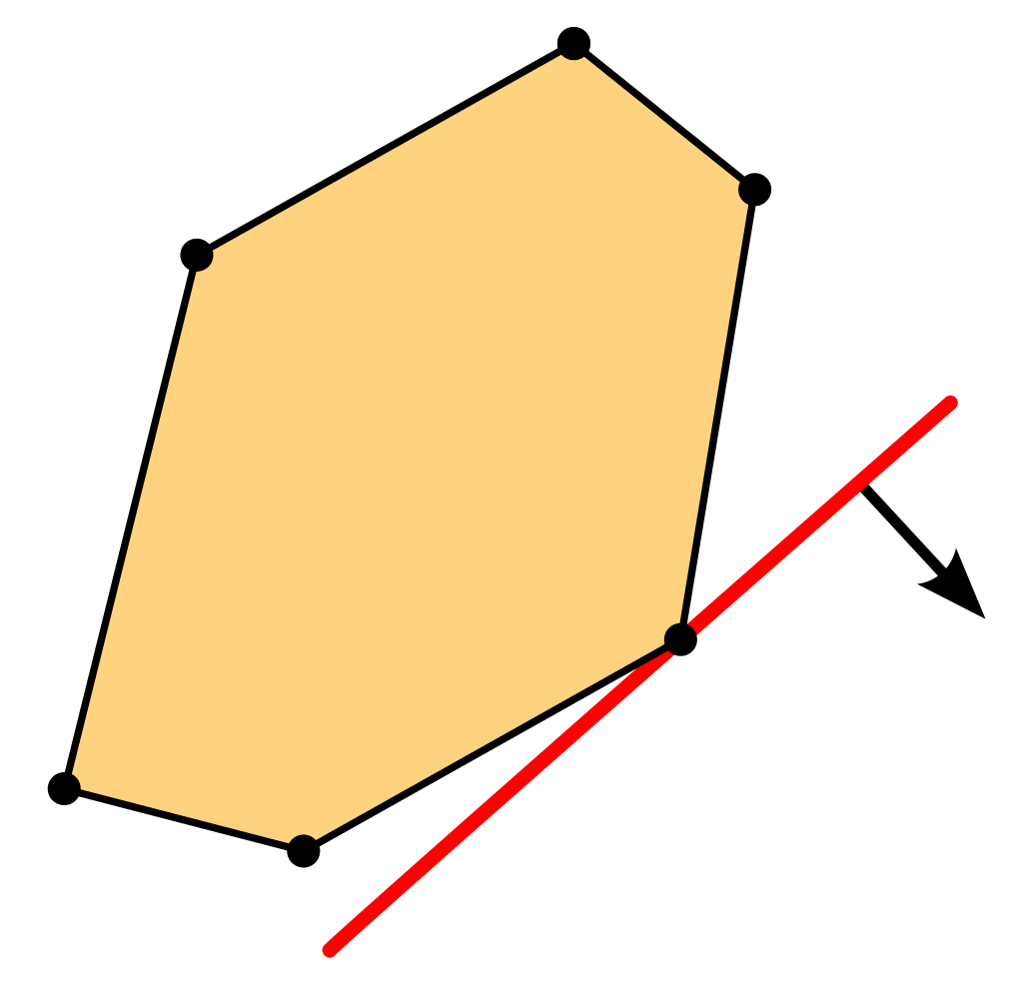

Methods
Linear Programming
Genetic Algorithm

Slide 12
Genetic algorithm
Genetic algorithms describe a set of techniques inspired by natural selection such as inheritance (selection), mutation, and crossover.
GA require both a genetic representation of the solution domain and a fitness function to evaluate the solution domain.
The technique generates a population of candidate solutions and uses the fitness function to select the optimal solution by iterating with each generation.
The algorithm terminates when the satisfactory fitness level has been reached for the population or the maximum generations have been reached.

Slide 13
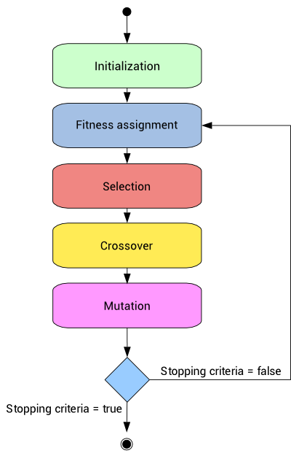
Genetic algorithm

Slide 14
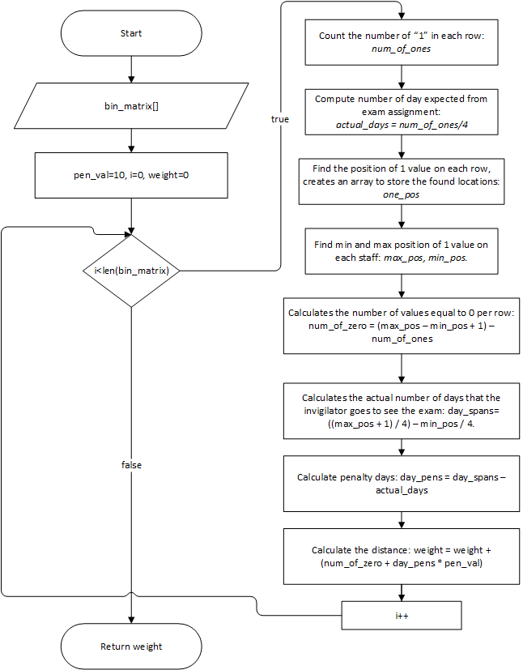
Genetic algorithm
Weight function:

Slide 15
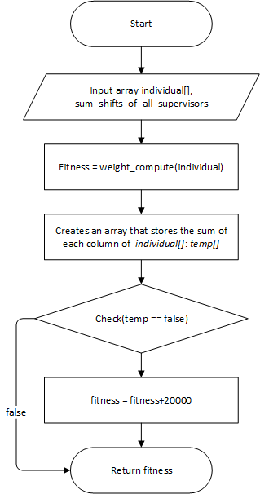
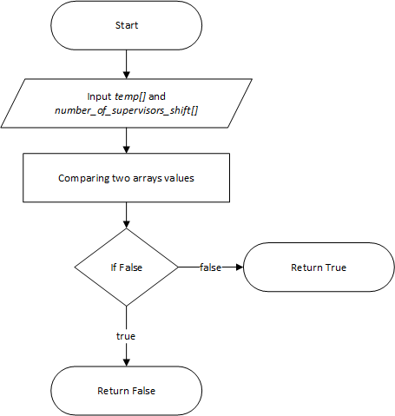
Genetic algorithm
Fitness function:
check function:

Slide 16
Genetic algorithm
Genetic operator:
Selection
Crossover
Mutation
Brute-force search

Slide 17
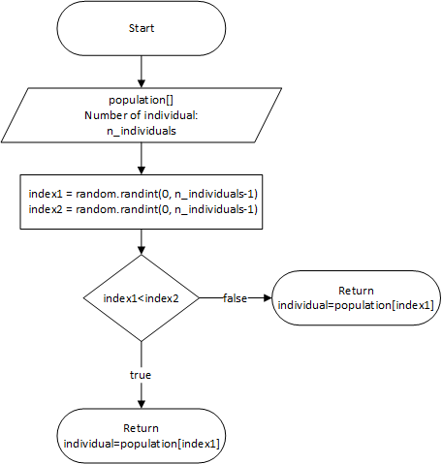
Genetic algorithm
1. Selection operator:
Selection is the process of choosing the fittest individuals and pass them to the next generations based on a fitness function.
Selection can be described as follows:
Organize the population in ascending or descending order of adaptability.
Remove the least fit individual, leaving only the best instances.

Slide 18
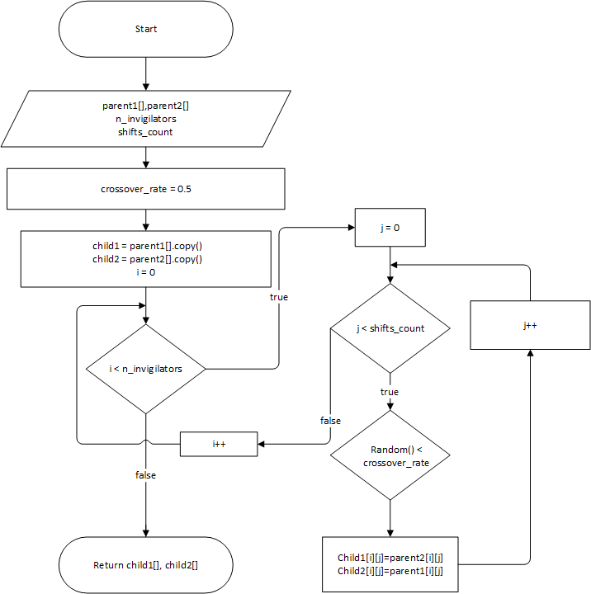
Genetic algorithm
2. Crossover operator:
Selecting a random crossover point in the parent chromosomes to form offspring that have both parent’s characteristics

Slide 19
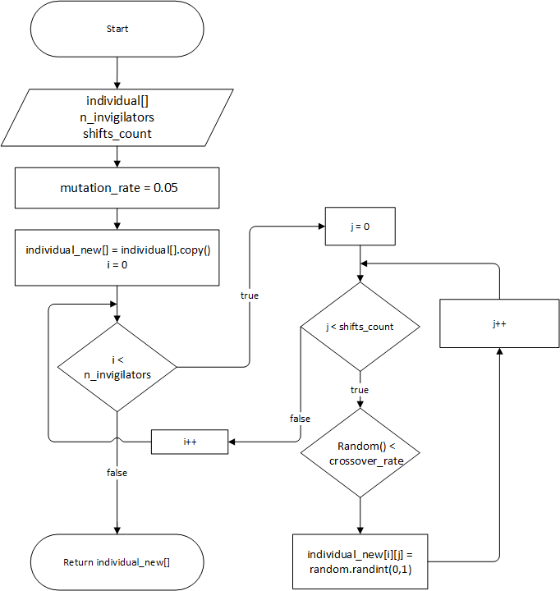
Genetic algorithm
3. Mutation operator:
Mutation is a random alteration of one or more genetic components of an individual in a previous generation, creating a completely new individual in the next generation.
Mutation can only be allowed to occur with very low frequency, as this can disturb the result and make the algorithm no longer effective.

Slide 20
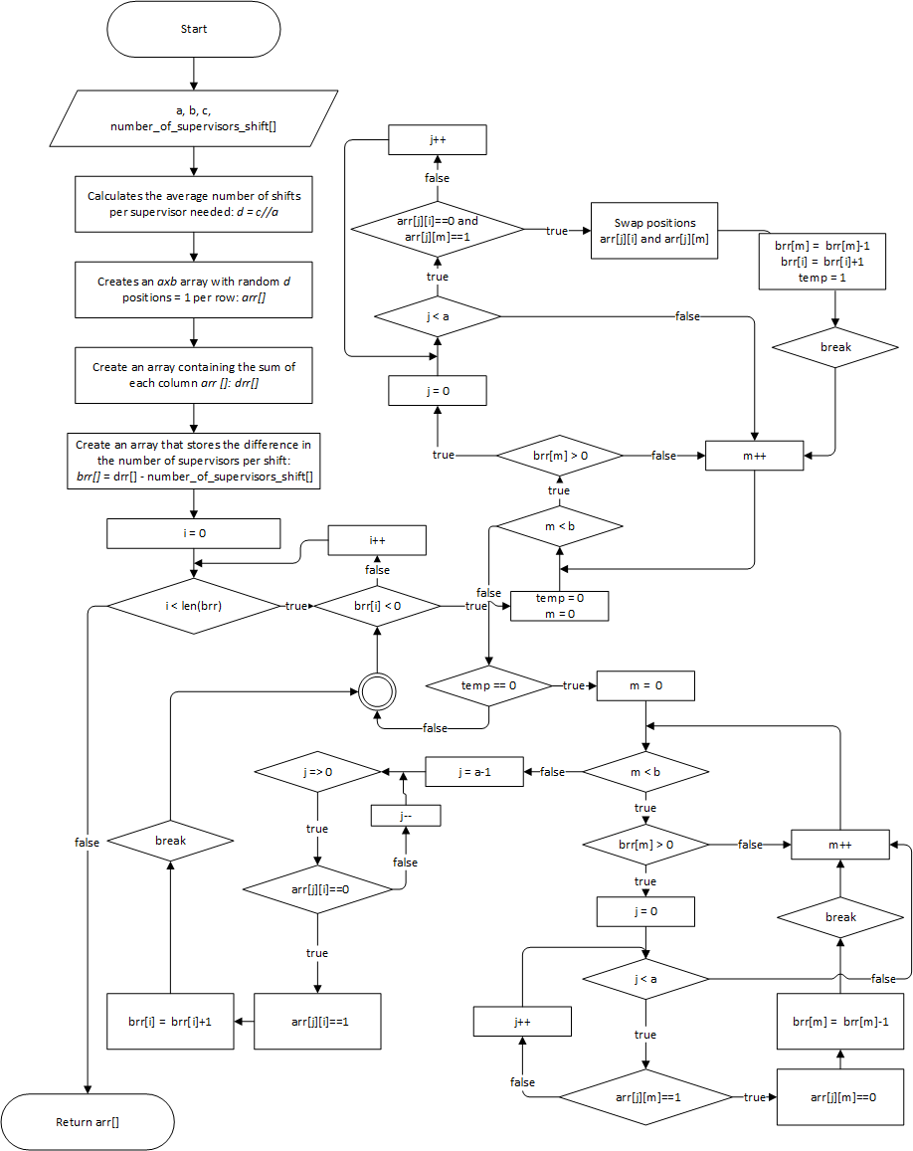
Genetic algorithm
3. Brute-force search:

Slide 21
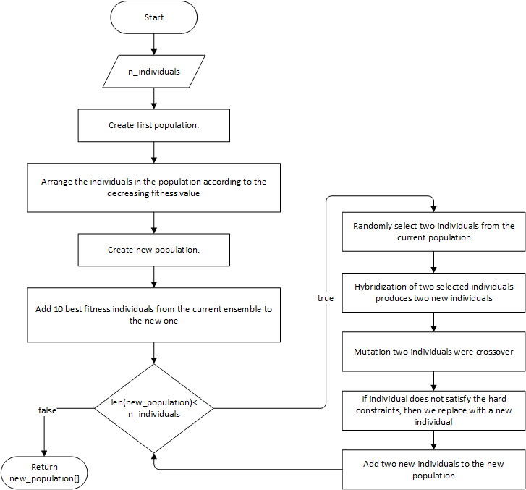
Genetic algorithm
Execution:

Slide 22
Linear Programming
Library used:
PuLP is a library for the Python scripting language that enables users to describe mathematical programs.
PuLP has many solvers like: 'GLPK_CMD', 'CPLEX_CMD', 'CPLEX_PY', 'GUROBI', 'PULP_CBC_CMD', ...
We use the solver 'PULP_CBC_CMD' because this solver can find a solution in a short time while the input data is very large.

Slide 23
Linear Programming
Model initialization
We can initialize the model by calling the LpProblem() function. The first argument in the function represents the name we want to give our model. The second argument tells our model whether we want to minimize or maximize our objective function.

Slide 24
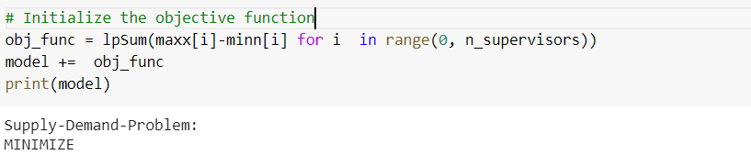
Linear Programming
Objective function initialization
lpSum is used alternatively with sum function in Python because it is much faster while performing operations with PuLP variables and also summarizes the variables well.
We further add the objective function to the model using the += shorthand operator.

Slide 25

Application analysis and implementation

Slide 26



Functional requirement
Import invigilator dataset.
Import exam schedule dataset.
View imported data (invigilator, Courses) and final output Schedule.
Run algorithm (GA execution)

Slide 27
Non-functional requirement
Friendly UI, easy to use.
Can be easily maintain or add more features.
Application work perfectly, with an acceptable output.

Slide 28



Storage requirement
Invigilators information
Courses information
Invigilators roster

Slide 29
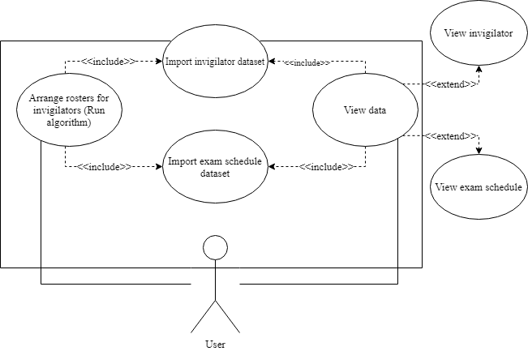
Use case diagram

Slide 30
Use case diagram
No. | Use case name | Meaning
1 | Import invigilator dataset | Users import invigilator dataset to database.
2 | Import exam schedule dataset | Users import exam schedule dataset to database.
3 | Arrange rosters for invigilator | Run genetic algorithm to schedule rosters for invigilator.
4 | View data | Users can view all of the imported data.
5 | View invigilator | Users can view invigilator information and they can select specific invigilator to inspect.
6 | View exam schedule | Users can view exam schedule that has been imported.
List of use case:

Slide 31
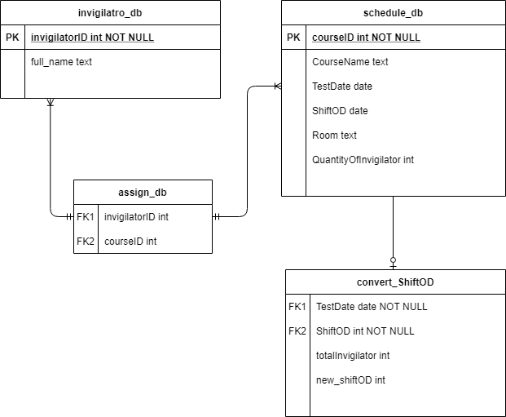
Entity relational diagram

Slide 32
Results
Conclusion and future work
Through the process of complete the thesis, we have achieved enough knowledge about optimization algorithms in general, we know how to apply algorithms to solve some optimal problem such as the exam invigilator assignment problem.
Ability to implement and apply genetic algorithm to make an application for exam invigilator assignment

Slide 33
Strong points
Conclusion and future work
Our application responds smoothly to the stated constraints in the thesis, include hard and soft constraints.
Stable application, friendly user interface, easy to use.
Scheduled results are stored locally and easily retrieved.

Slide 34
Drawbacks
Conclusion and future work
Due to the random nature of the genetic algorithm, the outcome sometimes does not fully fulfill the problem.
In practical, the requirements of scheduling problem are quite rich while our current application only meets the basic requirement.
Application execution on large datasets is quite slow. To solve this we must reduce the number of generations to make it run faster.
Application function is still limited.

Slide 35
Future work
Conclusion and future work
Refactor GUI to improve user experience.
Improve some function to make it more user friendly.
Continue improve fitness function.
Combining genetic algorithms with other techniques such as Neural network, fuzzy logic, ... to improve efficiency for the application.

Slide 36
DEMO

