Slide 1


Study on exam invigilator assignment algorithms
VIETNAM NATIONAL UNIVERSITY – HO CHI MINH CITY
UNIVERSITY OF INFORMATION TECHNOLOGY
FACULTY OF INFORMATION SYSTEM
Advisor: Dr. Do Trong Hop
Student:
Nguyen Hoang Long
Nguyen Son Lam

Slide 2
Presentation outline
Problem statement
Exam invigilator assignment problem
Methods - Algorithms
Application analysis and implementation
Conclusion and future work
Overview of the thesis

Slide 3
1. Overview of the thesis
Learn about scheduling problems, especially assignment scheduling.
Applying genetic and linear programming algorithms to the problem and compare the findings.
Building a practical application.

Slide 4
Expected results
Fully aware about the exam invigilator assignment problem.​
Fully aware of the strengths of genetic algorithms and linear programming in solving optimization problems.​
Represent the problem in the form of integer programming​
Successfully implement the genetic algorithm to a working application.​

Slide 5
2. Problem statement
Assignment or scheduling problems can be defined as a search for the optimal solution to perform various types of works or tasks bounded to a set of constraints.​
This problem takes a lot of time and resources to accomplish if it done by human.​
The need of algorithms or computer programs to support and make the progress faster is necessary.​

Slide 6
3. Exam invigilator assignment problem
The schedule assigned to the invigilators can often span the entire exam, so they must be present at school only to oversee one or two shifts per day, which is time-consuming, especially for those who far from the school.
It is crucial to study and apply algorithms in order to minimize the number of days that invigilators must come to school.

Slide 7
Describe the exam invigilator assignment problem
At University of Information Technology (UIT), the exam takes place about 15 days and there are about 120 invigilators to be assigned to oversee.
Each exam day will have 4 shifts.
Shift​ | Time span​
1​ | 07:30 AM – 09:00 AM​
2​ | 09:30 AM – 11:00 AM​
3​ | 13:30 PM – 15:00 PM​
4​ | 15:30 PM – 17:00 PM​

Slide 8
Describe the exam invigilator assignment problem
An acceptable solution for the problem must satisfy the following constraints:
Hard constraints:
In a certain shift, invigilator is not allowed to view multiple exams. ​
Each exam must meet the required number of invigilators.
Soft constraints:
The distance between two consecutive shifts of invigilators is as close as possible.
Each invigilator must meet the required number of shifts.

Slide 9

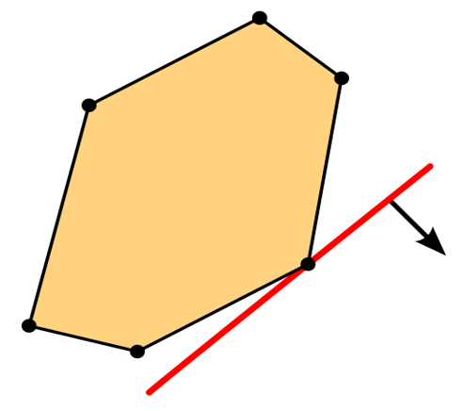
4. Methods - Algorithms
Genetic algorithm (GA)
Linear Programming​ (LP)

Slide 10
Genetic algorithm (GA)
GA describes a set of techniques inspired by natural selection such as inheritance (selection), crossover, and mutation. ​
GA requires both a genetic representation of the solution domain and a fitness function to evaluate the solution domain.

Slide 11
Genetic algorithm (GA)
Genetic operators:​
Selection​
Crossover​
Mutation​
k-point crossover
Tournament selection

Slide 12
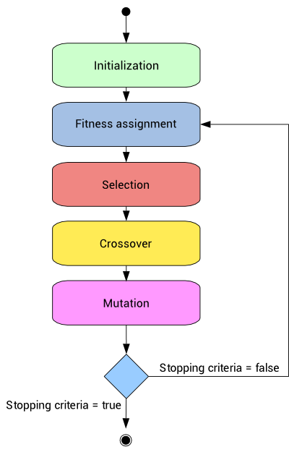
Genetic algorithm (GA)
The technique generates a population of candidate solutions and uses the fitness function to select the optimal solution by iterating with each generation.
The algorithm terminates when the satisfactory fitness level has been reached for the population or the maximum generations have been reached.

Slide 13
Individual representation
Individual representation plays a vital role in solving the scheduling problem.
In this problem, we will use a binary representation method to describe the individual in the population.
Each chromosome can be thought of as a two-dimensional array: The first dimension represents the invigilators; the second dimension represents the shifts.

Slide 14
Individual representation
The elements in the array will have a value of 1 or 0.
Where:
1 – invigilator is assigned to that shift.
0 – opposite.
 | Shift 1 | Shift 2 | Shift 3 | … | Shift n
Invigilator 1 | 0 | 1 | 0 | … | 0
Invigilator 2 | 0 | 0 | 1 | … | 1
Invigilator 3 | 1 | 1 | 0 | … | 0
… | … | … | … | … | …
Invigilator n | 0 | 1 | 1 | … | 1

Slide 15

Linear programming (LP)
Mathematically, the problem can be converted as follow:
Each element in the X array represents whether the “i” invigilator has worked in the “j” shifts or not.
(1)
$$X_{i,j}∈\left(0, 1\right)$$
The objective funtion: We minimize the sum of all distances from the first element has value ”1” to the last one on each row of the decision variable
(2)

Slide 16


Linear programming (LP)
Finding maximum position:
Finding minimum position:
$${Max}_{0}≥YI_{0}+A$$
$$⋮i$$
$${Max}_{i}≥YI_{i}+A$$
$${Min}_{0}≥ZI_{0}+A$$
$$⋮i$$
$${Min}_{i}≥ZI_{i}+A$$
(3)
(4)

Slide 17


Linear programming (LP)
Each invigilator must meet the required number of exams
$$\sum_{j=1}^{n}{X_{i,j}≥ l_{j}}$$
(5)
Each exam has a certain number of Invigilators.
$$\sum_{j=1}^{m}{X_{i,j}= r_{i}}$$
(6)
From all of the above functions, we have the target functions and the necessary constraints for optimization.

Slide 18
Result comparison
We used the fitness score to evaluate the quality of the 2 methods (Genetic algorithm and Linear programming). The result is presented in the table below.
Method | Fitness score
Genetic algorithm (GA) | 11311
Linear programming (LP) | 11458
With GA, we run on 50 generations. While on LP, we limited the running time to 235s.

Slide 19
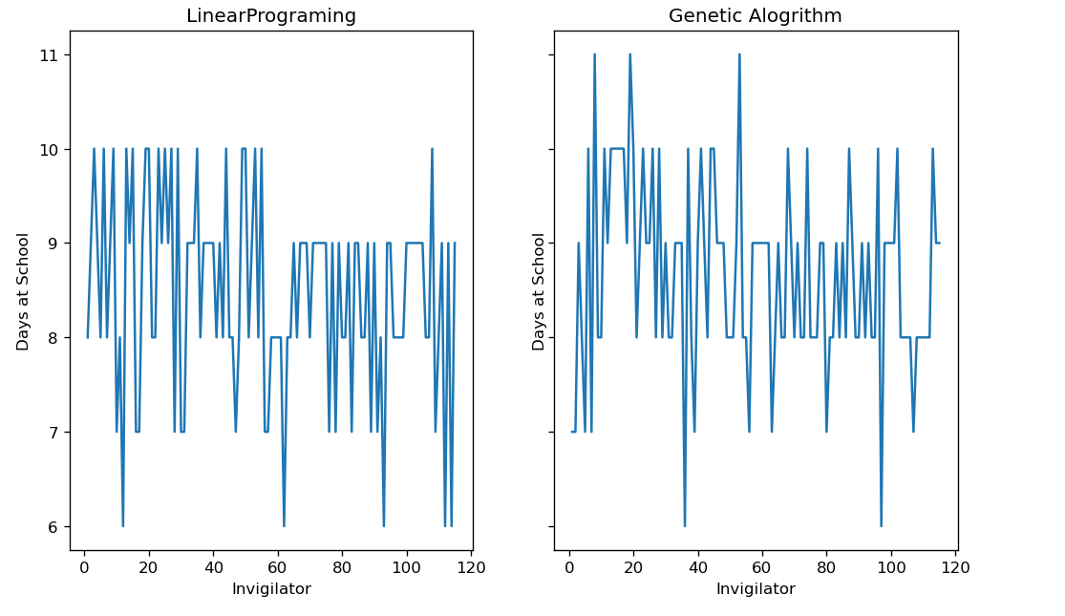
Result comparison

Slide 20
5. Application analysis and design
Requirement analysis
Functional requirement
Storage requirement
Non-functional requirement

Slide 21




Functional requirement:
Import invigilator dataset. ​
Import exam schedule dataset. ​
View imported data (invigilator, Courses) and final output Schedule. ​
Run algorithm (GA execution) ​

Slide 22



Non-functional requirement:
Friendly UI, easy to use.​
Can be easily maintain or add more features.
Application work perfectly, with an acceptable output.

Slide 23



Storage requirement:
Invigilator information
Course (exam schedule)
Invigilator schedule

Slide 24
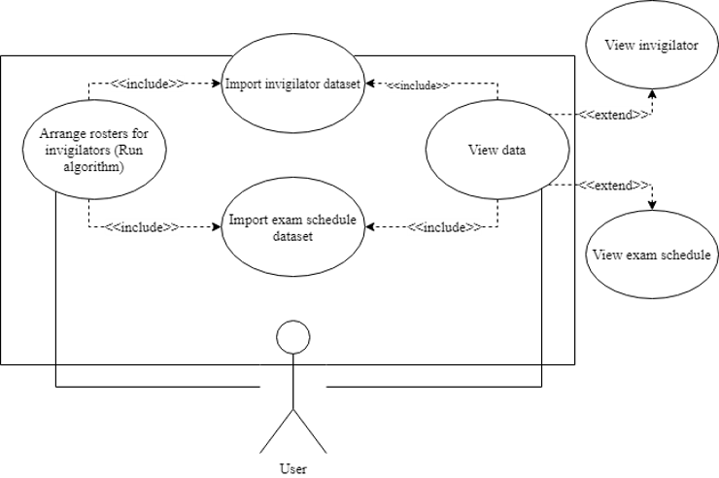
Use case diagram

Slide 25
Use case diagram
No. ​ | Use case name ​ | Meaning ​
1 ​ | Import invigilator dataset ​ | Users import invigilator dataset to database.​
2 ​ | Import exam schedule dataset ​ | Users import exam schedule dataset to database.​
3 ​ | Arrange rosters for invigilator ​ | Run genetic algorithm to schedule rosters for invigilator.​
4 ​ | View data ​ | Users can view all of the imported data. ​
5 ​ | View invigilator ​ | Users can view invigilator information and they can select specific invigilator to inspect.​
6 ​ | View exam schedule ​ | Users can view exam schedule that has been imported.​

Slide 26
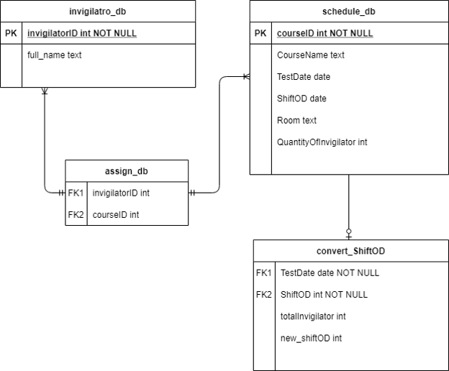
Entity relational diagram

Slide 27
6. Conclusion and future work
Results:
Through the process of complete the thesis, we have achieved enough knowledge about optimization problem in general, we know how to apply algorithms to solve some optimal problem such as the exam invigilator assignment problem.​
Ability to implement and apply genetic algorithm to make an application for exam invigilator assignment​

Slide 28
6. Conclusion and future work
Strengths:
Our application responds smoothly to the stated constraints in the thesis, include hard and soft constraints. ​
Stable application, friendly user interface, easy to use. ​
Scheduled results are stored locally and easily retrieved.

Slide 29
6. Conclusion and future work
Drawbacks:
Due to the random nature of the genetic algorithm, the outcome sometimes does not fully fulfill the problem.​
In practical, the requirements of scheduling problem are quite rich while our current application only meets the basic requirement. ​
Application execution on large datasets is quite slow. To solve this, we must reduce the number of generations to make it run faster. ​
Application function is still limited.

Slide 30
6. Conclusion and future work
Future works:
Refactor GUI to improve user experience. ​
Improve some function to make it more user friendly. ​
Continue improve fitness function.
Consider some additional constraints.​
Combining genetic algorithms with other techniques such as Neural network, fuzzy logic, ... to improve efficiency for the application.​

Slide 31

Demo!

Slide 32

Thanks!

Slide 33
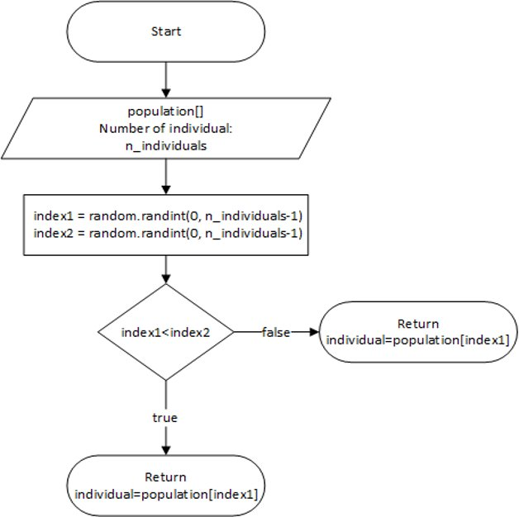
Selection
Selection is the process of choosing the fittest individuals and pass them to the next generations based on a fitness function.
We use tournament selection. This is a method of choosing the individual from the set of individuals. The winner of each tournament is selected to perform crossover.

Slide 34
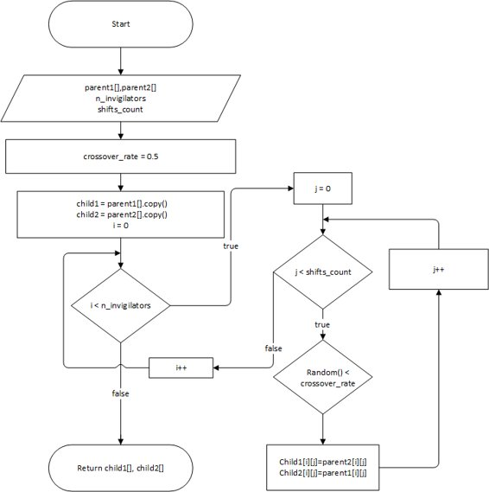
Crossover
Crossover is the process of selecting a random crossover point in the parent chromosomes to form offspring that have both parent’s characteristics​.
We use k-point crossover for any positive integer k, k crossover points are picked randomly from the parent chromosomes. The bits in between the k points are swapped between the parent organisms.

Slide 35
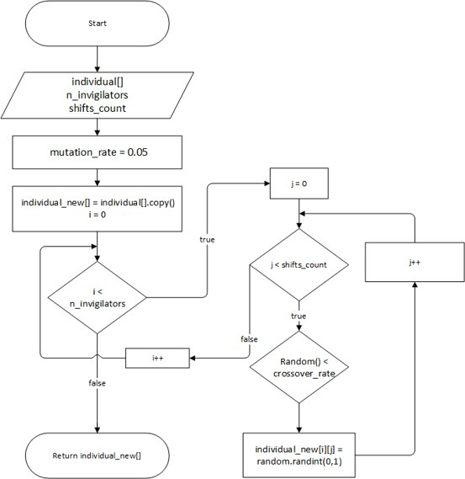
Mutation
Mutation is a random alteration of one or more genetic components of an individual in a previous generation, creating a completely new individual in the next generation. ​
Mutation can only be allowed to occur with very low frequency, as this can disturb the result and make the algorithm no longer effective.

