Slide 1
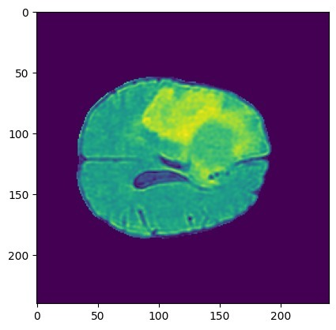
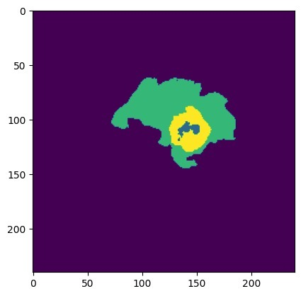
Flair, T1, T1c and T2
SAM Multi-output Segmentation
Flair, T1, T1c and T2
YOLO V8
Localizer
3D Mask
Flair only
Bounding Box

Slide 2
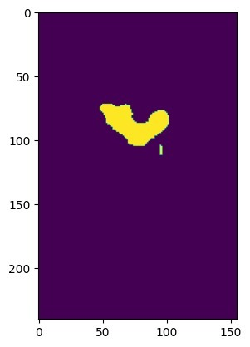
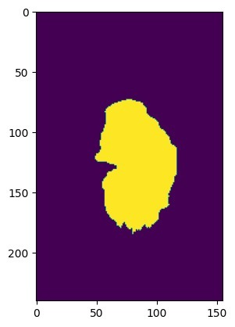
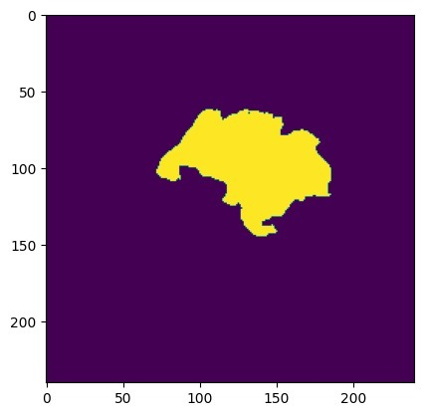
Flair, T1, T1c and T2
SAM Multi-output Segmentation
3D
Mask
Flair, T1, T1c and T2
YOLO V8
Localizer
Flair only
Bounding Box
U-Net Voting
4x3D Mask for Modalities
Flair, T1, T1c and T2

Slide 3
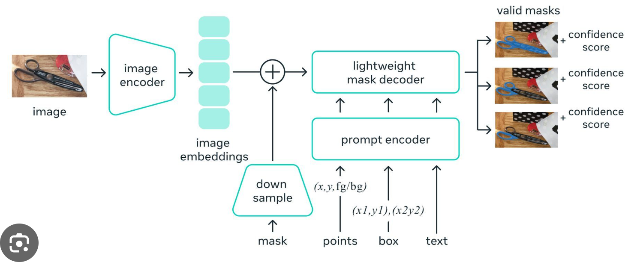
, Score
Image
Encoder
Mask Decoder
, Score
Image
Conv
Prompt Encoder
, Score
Image
Embedding
Mask
Points
Box
Text
Valid Mask

