Slide 1
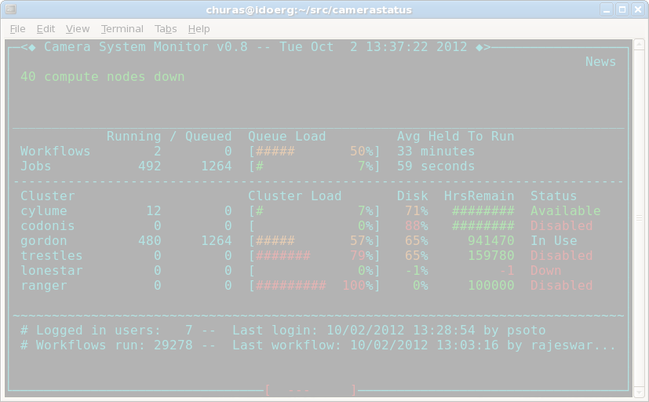
Camera Status

Slide 2

Camera Status

Slide 3
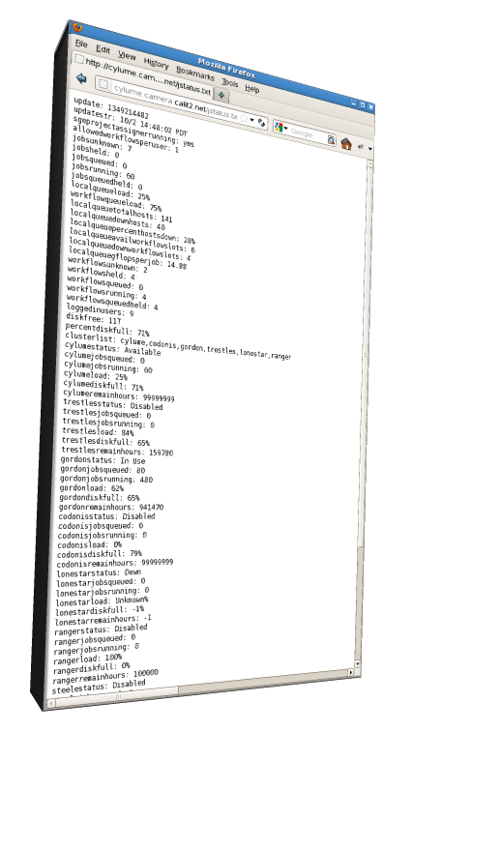
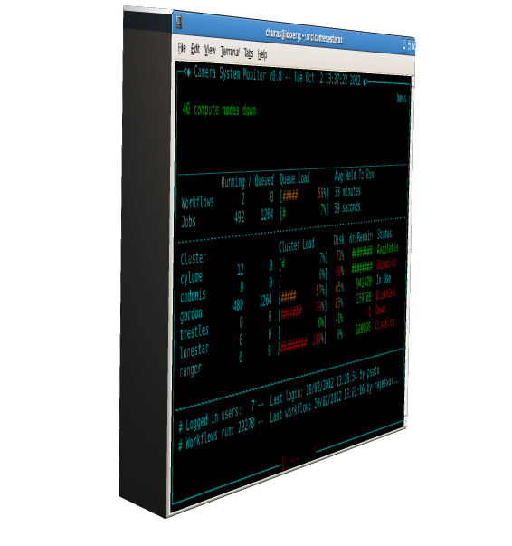
Jstatus

Slide 4
Why do this?
Provides system status to CAMERA team
Looks cool
Dual purpose, data utilized by Camera Status is necessary for Multi-cluster Blast

Slide 5
Details
C/C++ application
  14 classes 2,400 lines of code
Ncurses for user interface
Libcurl used to pull data from Jstatus
  http://cylume.camera.calit2.net/jstatus.txt

Slide 6
What the heck is Jstatus?
Perl script
Utilizes ssh and Unix commands to obtain information about CAMERA systems
Output is a text file served by webserver on Cylume

Slide 7
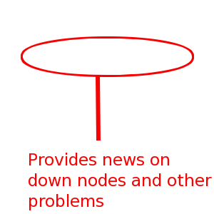
News

Slide 8
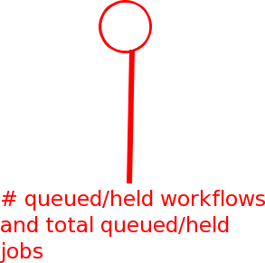
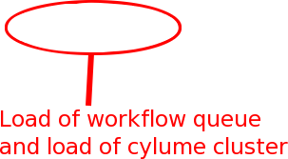
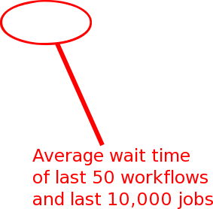

Workflows

Slide 9
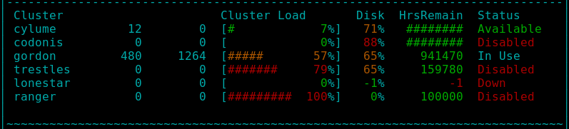




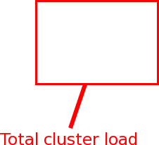

Clusters

Slide 10

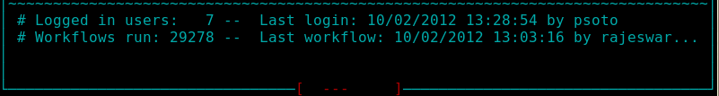
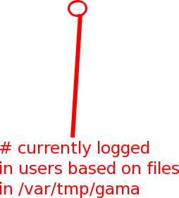
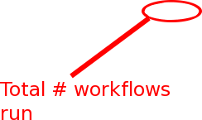
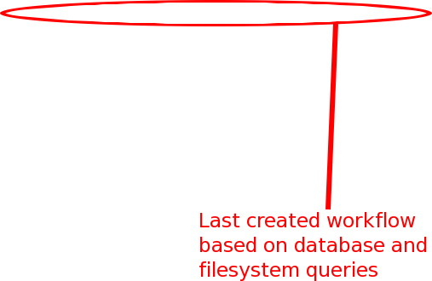

User Info

Slide 11
Usage
$ ./camerastatus -help
Usage: camerastatus [ -h,-help,--help ] [ -url http URL ] [ -v,-version ]
Display current status of CAMERA system
-h,--help Displays this help
-url [http URL] Sets alternate URL to obtain CAMERA status from
-simulate Displays fake data to test UI
-rawdata Hits URL, dumping data received to stdout and exits
-geometry [width height] Sets alternate width and height for display
-v,--version Display version

Slide 12
The Code
Github:
https://github.com/CAMERA/camerastatus
Compile and run (Requires Centos 5/6)
$ ./configure
$ make
$ ./camerastatus

Slide 13
Todo
Fix periodic crashes
Modify to inform viewers of CAMERA build and or deploy failure

