Slide 1
MS Access
Scientific Computing Fundamentals for CAMH Researchers
October 4th - 13th, 2016

Slide 2

Database or Spreadsheet
Database | Spreadsheet
Data management | Data analysis
Multiple users | Single (few) users
Defined formatting | Flexible formatting
Multiple tables – complex relationships | Complex relationships between data can be hard (VLOOKUP)
Easy to enforce data quality | Checking quality can be complex

Slide 3
Macros
Tables
Fields
Index
Relationships
Data
Views
Rows
Validation
Forms
Queries
SQL

Slide 4
Sheet 1
Subject_ID | REB | First_name | Last_name | Sex | Age | Ethnicity | Dx | Site | Smoke
SUB_1 | 025-2016 | Barbara | Shigeta | F | 43 | Asian | 0 | 2 | 0
Sub_2 | 073_2016 | Tim | Proo | M | 47 | White | 1 | 1 | 0
Sheet 2
 | Visit 1 |  |  |  |  |  | Visit 2
Subject_ID | Date | Cog1 | Cog2 | Cog3 | CGI | Comments | Date | Cog1 | Cog2 | COG3 | CGI
Sub_1 | 15-09-11 | 10.89 | 28.8 | 9,95 | 5 |  | 16-09-11 | 11.23 | 25.5 | 9.90 | 5
Sub_2 | 15-09-14 | 17.24 | 37.47 | 2.98 | 7 |  | 15-10-15 | 12 | 32.15 | 3.30 | 4
Sheet 3
Subject_Id | Genotype
Sub_1 | AG
Sub_2 | GG

Slide 5
Demographics
Subject_ID
REB
First_name
Last_name
Sex
Age
Ethnicity
Diagnosis
Site
Smoker
Cognitive_data
Subject_ID
Date
Cog1
Cog2
Cog3
CGI
Comments
Genotype
Subject_ID
genotype

Slide 6
Table design
Subject_ID
Text e.g (Sub_1)
Must be unique
REB
Must exist
Must have format XXX_XXXX
First Name
Last Name
Gender
Must be “M” or “F”
Can be blank
Age
Ethnicity
Case / Control
Site data collected
Smoker
Yes / No

Slide 7
Field properties
Validation Patterns:
<>0 Non-zero value
>=0 Zero or greater
<#01/01/2007# Date before 2007
=Date() Date not in the future
Can specify if values are required or not.
Validation rules check if values fulfill requirements
limit to a list of values “M” or “F”
match a template LIKE “SUB_*”
[tablename]![fieldname] to reference another field
Formats specify how values are displayed
(+@)@@-@@@-@@@@
Indexes make searching faster
Formatting Patterns:
@ or & - Any character
! Fill left to right
< Force lowercase
> Force uppercase
[colour] Display as named colour

Slide 8
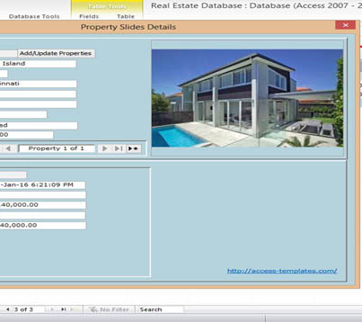
Forms
Display data from tables or queries
Can update or add data
Use layout mode for easy formatting
Navigation buttons can be added for simplicity

Slide 9

Task
Collect data from your neighbours and enter it using the datasheet view
Enter some more data using the form

Slide 10
Queries
Type | Action
Select | Select (Display) data from one or more tables
Update | Change data in a table
Append | Add data to a table
Delete | Remove data from a table
Aggregate | Summarise data

Slide 11
Importing data
Import to a staging table
Modify data
Use an append query to insert data into the main table

Slide 12
Task
Write a query to select all data about ‘Control’ subjects
What type of query should you use?
How do you limit to just controls?
Can you sort by age?
Modify the query to select ‘Control’ subjects older than 50

Slide 13
Parameters
Provide user input to queries
Put prompt in square braces [Enter minimum age]
N.B. Use the ‘Parameters’ dialog to change the parameter name

Slide 14
Task
Create a new query so select all subjects older then a user identified age.
Tip: You can copy an paste existing queries to make copies

Slide 15
Relationships
Define links between tables
Need primary key in parent table to link to foreign key in the child table
Primary Key
Demographics
Subject_ID
REB
First_name
Last_name
Sex
Age
Ethnicity
Diagnosis
Site
Smoker
Foreign Key
Cognitive_data
Subject_ID
Date
Cog1
Cog2
Cog3
CGI
Comments
Genotype
Subject_ID
genotype

Slide 16
Type of relationships
One to One
Subject has one spouse
One to many
Subject has many children
Many to Many
Subject has many friends

Slide 17
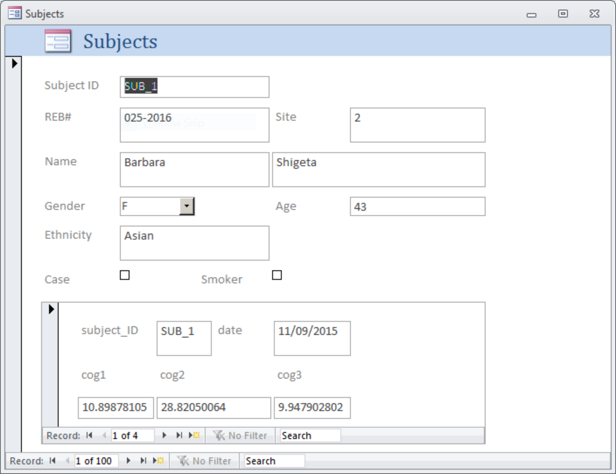
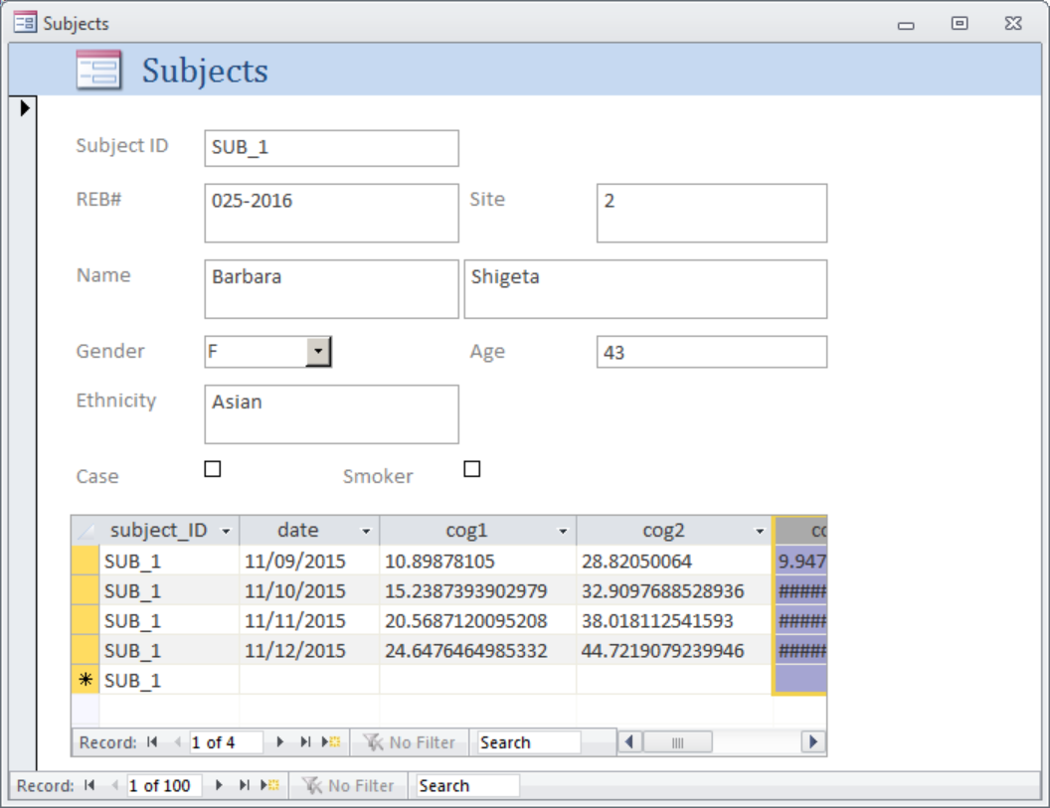
Sub-forms
Sub-forms can display related data from child tables
Data can be displayed in datasheet or form view

