Slide 1

Crashes In Queensland 2011-2020
By Group - Canadata

Slide 2
Team Introduction:
Tanveer Ahmed Ilkal
Anil Kakkar
Manpreet Kaur
Prayas Baliyan
Simaranjeet Singh
Sukan Sharma
Tanmay Alpesh Daulatwal

Slide 3
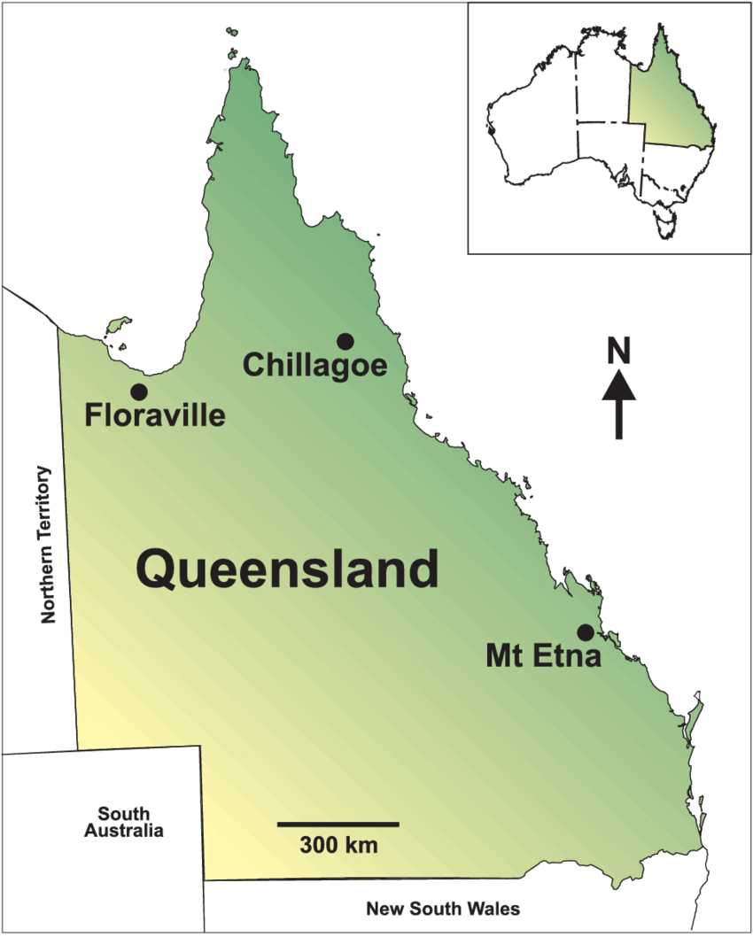
Motivation:
One of the most popular, easiest and oldest way to connect two places are Roads!
Most of the people prefer to go to work via road routes because they are easily accessible and save their time.
Huge part of freight Industry depends upon the transportation via road.
Queensland is a state situated in northeastern Australia and is the second largest and third-most populous Australian state.
Vehicle crash contributes to a significant number of deaths and injuries in this area.
The objective of this project is to analyze the number of road crashes that occur in the state of Queensland every year in order to identify major reasons of accident and try to prevent them from happening.

Slide 4
Target Audience
Queensland government: This data can facilitate the government to provide a standard transport infrastructure that can ease people in moving and travelling safely.
Safety Engineers: This project can help the construction firms and safety engineers by providing them deeper insights into the various factors that cause crashes and help them build better roads and traffic infrastructures that will increase the safety of the public.
General Public of Queensland: With the help of this information the public of Queensland can be aware of the various factors that cause accidents and crashes across the state and can take better precautions to prevent the accidents.

Slide 5

Problem Statement
THIS STUDY AIMS TO PROMOTE AND ELABORATE MORE ON DATA VISUALIZATION TECHNIQUES USING THE INTERACTIVE GRAPHS AND DATA DASHBOARD TO DISPLAY VEHICLE CRASH DATA. INTERACTIVE MAP AND DATA DASHBOARD CAN HELP THE GOVERNMENT AND TRANSPORTATION EXPERTS TO DESCRIBE VEHICLE CRASH DATA BY ANSWERING THE BELOW RESEARCH QUESTIONS:
1. What’s the count of crashes in every region?
2. What’s the Crash type over different speed limit?
3. Which month has the maximum number of crashes
4. Which age group has the maximum number of crashes?
5. Crash year has the most casualties?

Slide 6
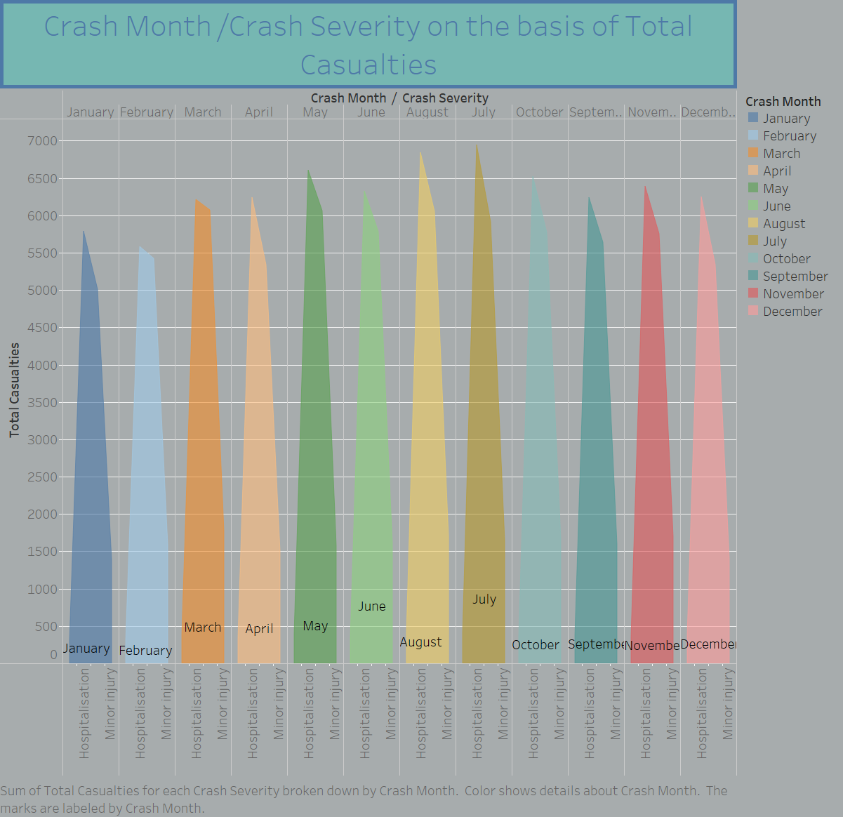
Which month has the maximum number of crashes?

Slide 7
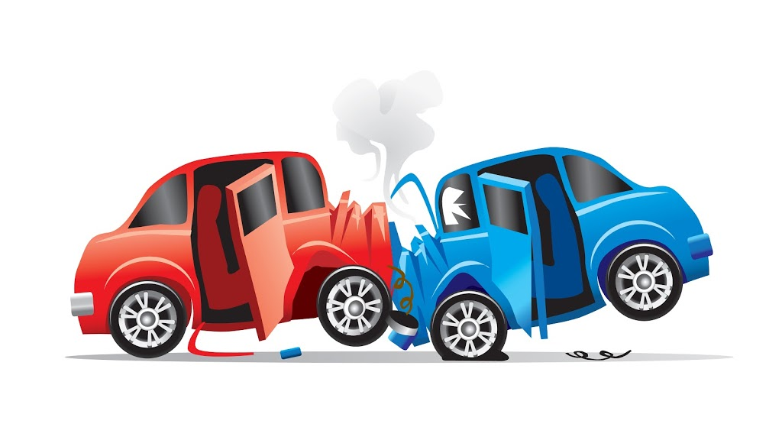
The highest number of Hospitalizations are in the month of august with 6843, 6058 were medically treated and 1072 have suffered minor injury around this time of the year. The authorities have to be more careful with the accidents around the month of August.
the month of February has the least number of accidents.

Slide 8
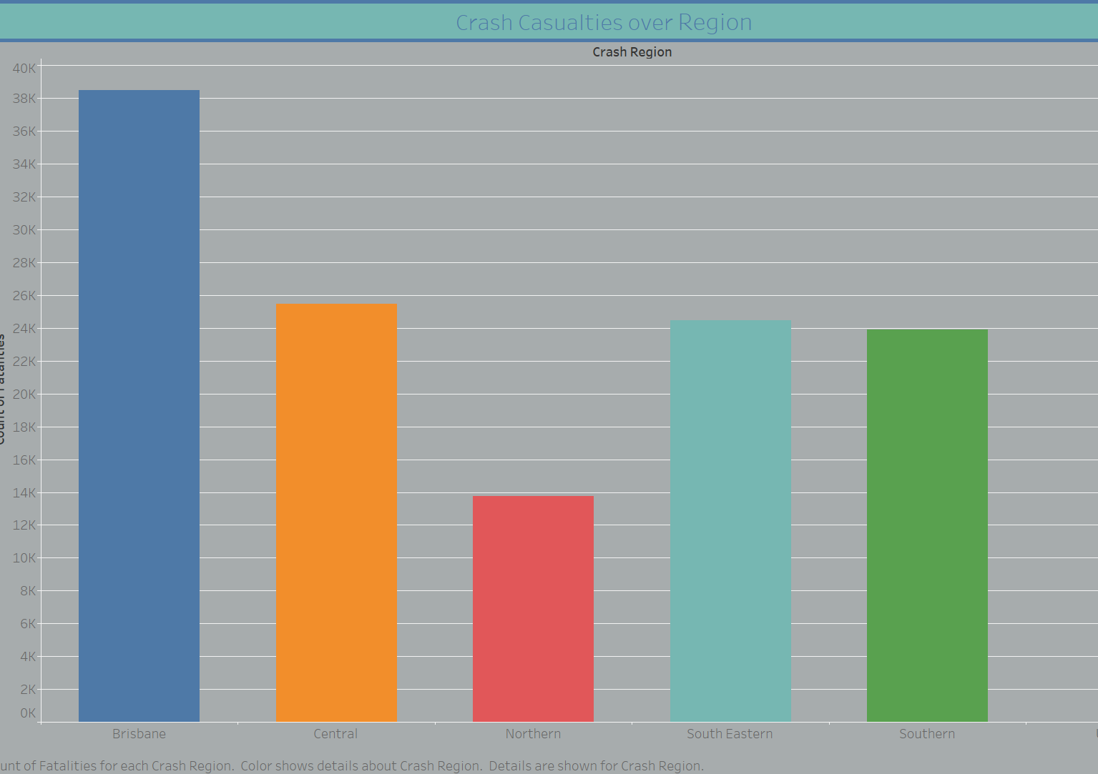
What’s the count of crashes in every region?
Brisbane has recorded the highest number of accidents compared to all the other regions.
This is because it is the capital of Queensland, and the population of the region is highest.
Buses are part of the least number of accidents in all the regions.
Frequency of crashes in descending order:
Cars > two-wheelers > trucks, pedestrians> buses

Slide 9
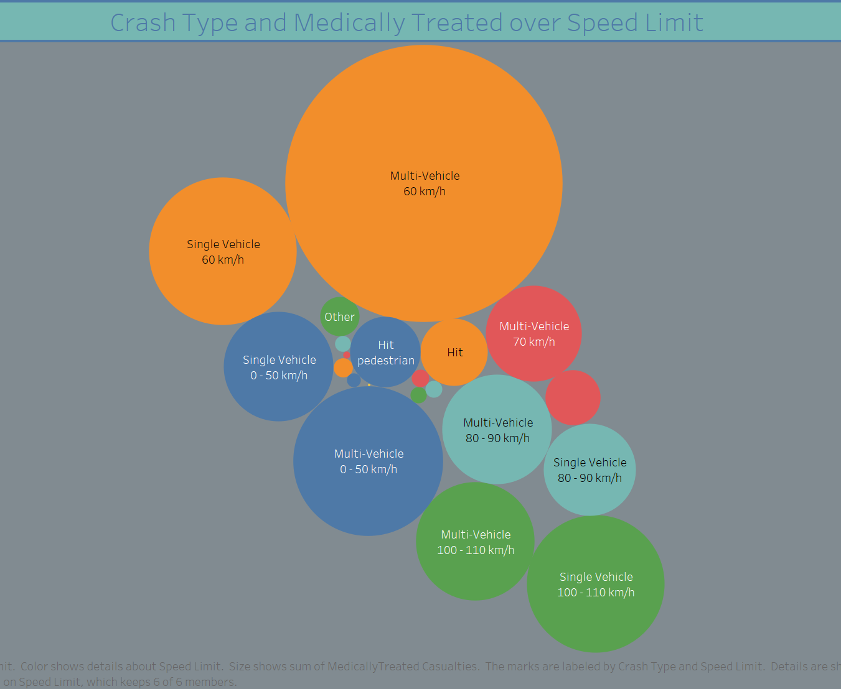
Crash type over speed limit
Overall, majority of accident fall in no traffic control area with 60km/h speed.
Count of crashes under operating traffic lights and give way sign is almost similar, speed between 0 to 50km/h and 80-90km/h with no traffic and traffic control cause countable number of crashes.
Speed of vehicle is high lies between 100-110 km/h, but count of crashes is slight low from 60km/h speed condition of vehicle

Slide 10
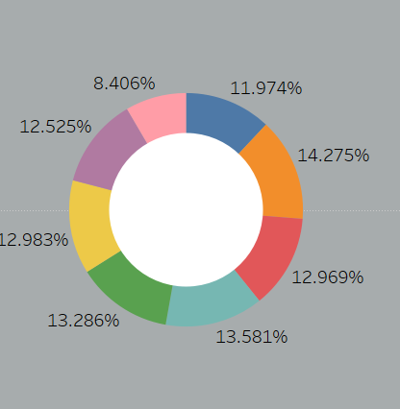
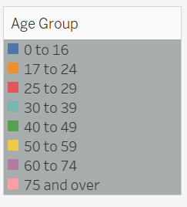
Which age group has the maximum number of crashes?
Overall, the maximum number of accidents occurred between the age group of 17 to 24.
People aged between 75 and above were marked under the lowest category.
It is evident from the graph that under the category of fatal accidents youngster age between 17 to 24 were accounted for 7,816.
Whereas people in age group 60 to 74 and above marked the lowest. I.E., 4230 and 5585 respectively.

Slide 11
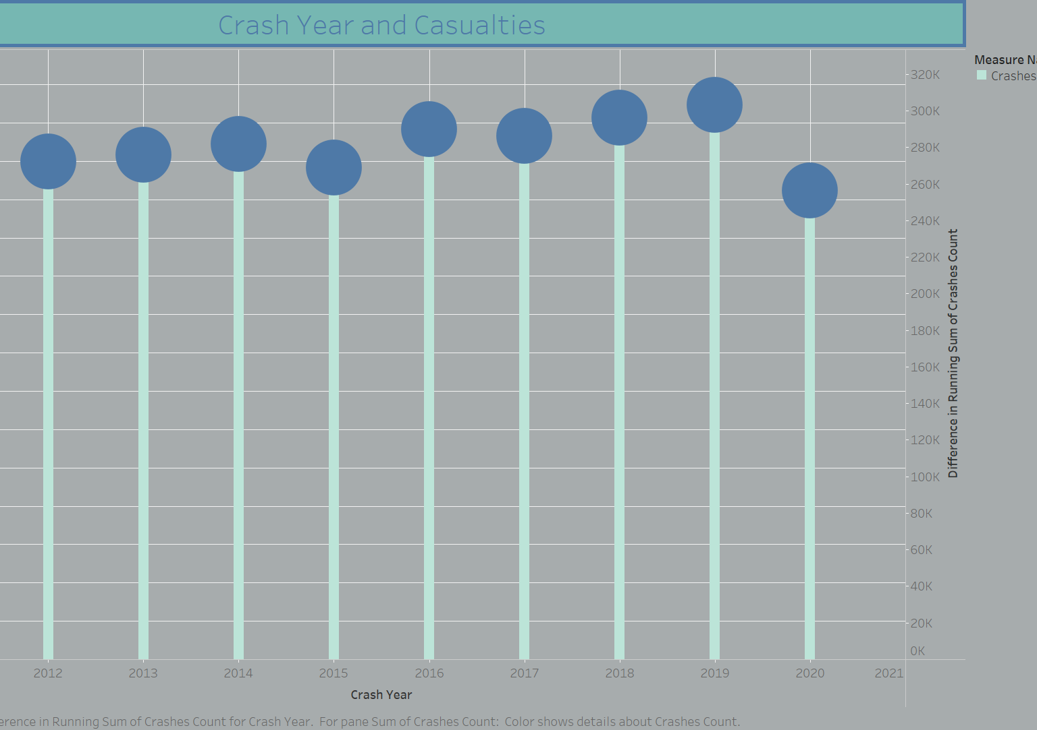
Crash year and casualties?
The number road accidents have increased each year starting from the 2011 which has the least number of casualties recorded in the past decade.
2020 has least number of accidents since 2011 and that can be because of the pandemic on people’s daily life.
The number of casualties is directly proportional to the number of accidents.
Highest number of accidents can be seen in the year 2019.
The interesting thing to note here is even though the number of accidents is lesser in the year 2011 compared to the year 2019, the number of causalities remains similar for both the years. This could be due the fact that the cars are much safer today compared to cars decade earlier.
The years 2016 and 2019 have witnessed the highest number of crashes in the state of Queensland.

Slide 12
Conclusion
The team has successfully completed the visualization of all the research questions that were intended to be analyzed for the crashes that have occurred in Queensland. Various visualization tools such as MS excel, power BI, jupyter, tableau have been used to work on the project to derive successful results.
The below conclusions can be derived after the successful plotting of the graphs in tableau.
Brisbane city faces the highest number of crashes in the state of Queensland.
The month of august has the greatest number of crashes
The age group 17 to 24 are accountable for the highest number of crashes.
The maximum number of crashes have occurred when the vehicles are driven at 60 km/hr.
The number of crashes have declined in the past decade.

Slide 13
Thank You

