Slide 1


CANOE-transportation backend v2.0
Refactored MVP status update
F. Rashid Zetter-Salcedo
September 24, 2026
Background image by wirestock on freepik.com

Slide 2
Agenda (tentative)
Legacy transport backend
CANOE-transport v2.0 backend
Key improvements/distinctions
Next steps

Slide 3

Transportation
Overview of sector detail:
160 technologies
+5,000 parameters
14 annual demands (NRCan)
(Old simplified diagram)
2-wheel
(3 technologies)
Fuel supply (13 carriers)
Import
Direct import
Moto
GSL
ETH
GHGs
Light-duty (54 technologies)
DSL
RDSL
Car
Truck
(Class 1-2)
Passenger-km
JFL
S-JFL
- Motorcycle
- Car
- Light truck
- Transit bus
- School bus
- Intercity bus
- Jet aircraft
- Rail
Fuel-cycle EFs [g CO₂/MJ]
HFO
MDO
Hourly charging
Medium-duty (10 techs)
NG
Truck
(Class 2b-7)
Demand
ELC
Parameter indexing:
Tonne-km
- Existing capacity
- Efficiency
- Lifetime
- Investment costs
- Maintenance costs
- EFs (vehicle-cycle)
H₂ SMR
H₂ H₂O
Heavy-duty (57 technologies)
- Light truck
- Medium truck
- Heavy truck
- Jet aircraft
- Rail
- Marine vessel
Tech
Truck
(Class 8)
Jet aircraft
(passenger, freight)
By
scenario
period
vintage
powertrain
H₂
Bus
(Transit, school, coach)
Rail
(passenger, freight)
Marine
(freight)
Fuel
- Fuel prices
- Blend ratio
- EFs (fuel-cycle)
Endogenous production
By
scenario
period
Notes:
Note Thiago’s work on fuel import

Slide 4
Transportation
Overview of sector detail:
160 technologies
+5,000 parameters
14 annual demands (NRCan)
(Old simplified diagram)
2-wheel
(3 technologies)
Fuel supply (13 carriers)
Import
Direct import
Moto
GSL
ETH
GHGs
Light-duty (54 technologies)
DSL
RDSL
Car
Truck
(Class 1-2)
Passenger-km
JFL
S-JFL
- Motorcycle
- Car
- Light truck
- Transit bus
- School bus
- Intercity bus
- Jet aircraft
- Rail
Fuel-cycle EFs [g CO₂/MJ]
HFO
MDO
Hourly charging
Medium-duty (10 techs)
NG
Truck
(Class 2b-7)
Demand
ELC
Parameter indexing:
Tonne-km
- Existing capacity
- Efficiency
- Lifetime
- Investment costs
- Maintenance costs
- EFs (vehicle-cycle)
H₂ SMR
H₂ H₂O
Heavy-duty (57 technologies)
- Light truck
- Medium truck
- Heavy truck
- Jet aircraft
- Rail
- Marine vessel
Tech
Truck
(Class 8)
Jet aircraft
(passenger, freight)
By
scenario
period
vintage
powertrain
H₂
Bus
(Transit, school, coach)
Rail
(passenger, freight)
Marine
(freight)
Fuel
- Fuel prices
- Blend ratio
- EFs (fuel-cycle)
Endogenous production
By
scenario
period
Notes:
Note Thiago’s work on fuel import

Slide 5
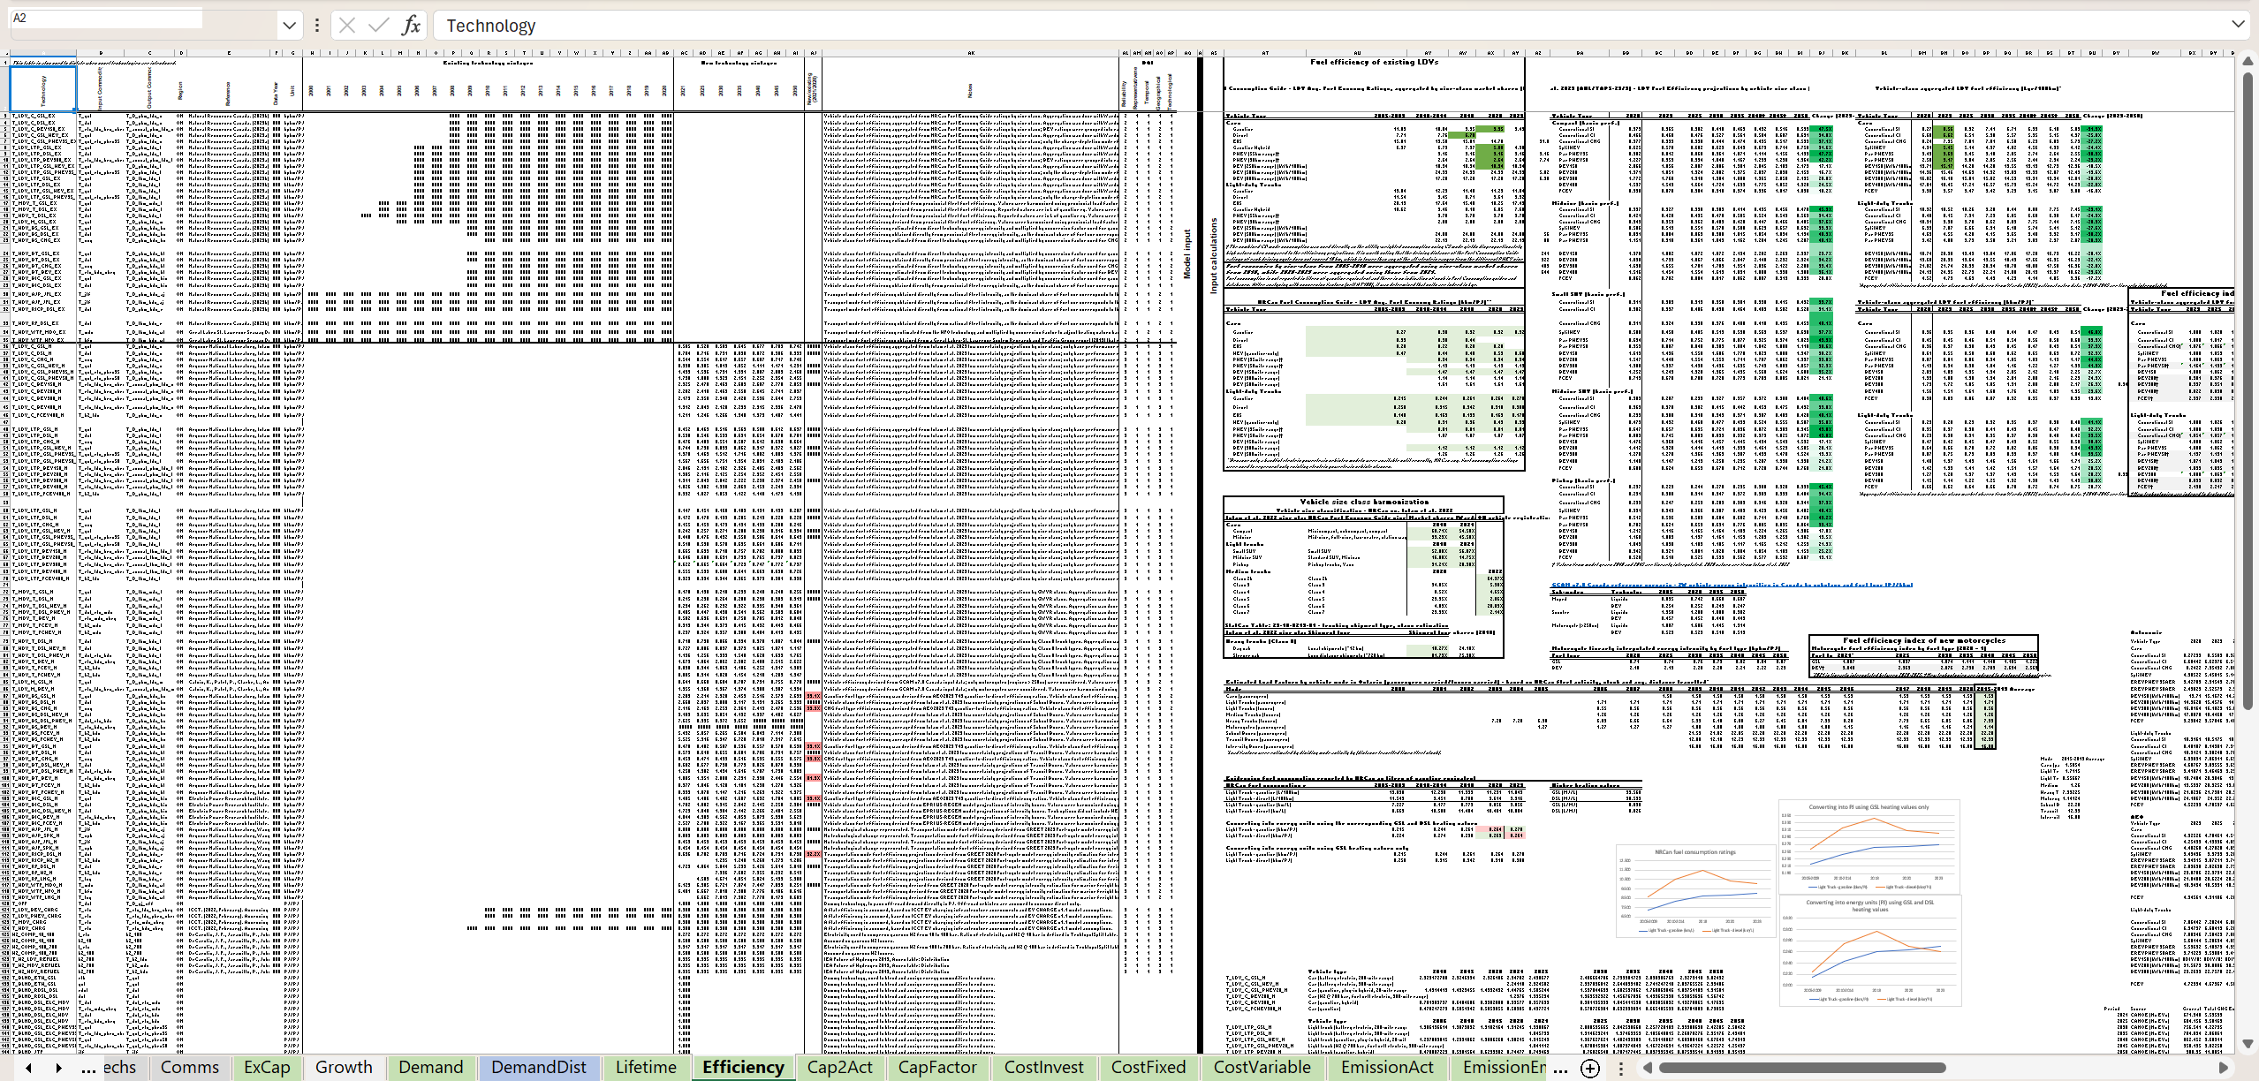
Legacy transport backend (hard to update)

Slide 6
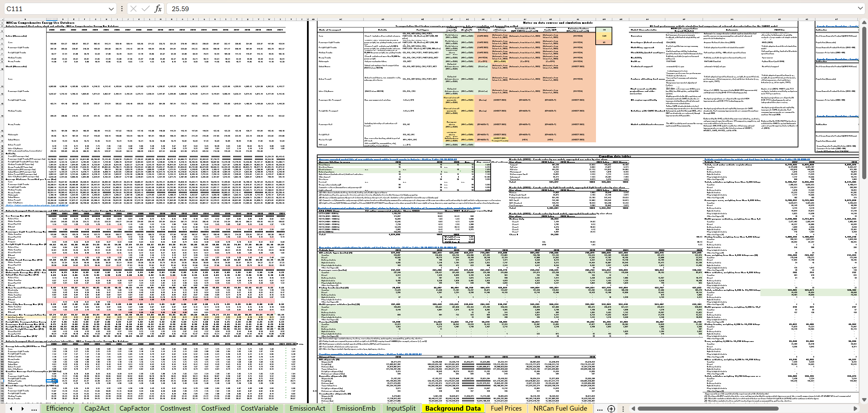
Legacy backend (hard to produce vast scenario evidence)

Slide 7
CANOE-transport v2.0 backend at a glance
Scenario config
Regions to compile
Source trajectory
Discount rate
Parameter switches
Aggregation source
Sources config
Currency and year
Citation
Region dependence
DQ scores
Notes
Parameter rules
Vehicle class mappings
Aggregation buckets
Input data filters
Table layouts
Parameter boundaries

Slide 8
CANOE-transport v2.0 backend at a glance
Scenario config
Regions to compile
Source trajectory
Discount rate
Parameter switches
Aggregation source
Sources config
Currency and year
Citation
Region dependence
DQ scores
Notes
Parameter rules
Vehicle class mappings
Aggregation buckets
Input data filters
Table layouts
Parameter boundaries

Slide 9
CANOE-transport v2.0 backend at a glance
Scenario config
Regions to compile
Source trajectory
Discount rate
Parameter switches
Aggregation source
Sources config
Currency and year
Citation
Region dependence
DQ scores
Notes
Parameter rules
Vehicle class mappings
Aggregation buckets
Input data filters
Table layouts
Parameter boundaries

Slide 10
CANOE-transport v2.0 backend at a glance
Scenario config
Regions to compile
Source trajectory
Discount rate
Parameter switches
Aggregation source
Sources config
Currency and year
Citation
Region dependence
DQ scores
Notes
Parameter rules
Vehicle class mappings
Aggregation buckets
Input data filters
Table layouts
Parameter boundaries

Slide 11
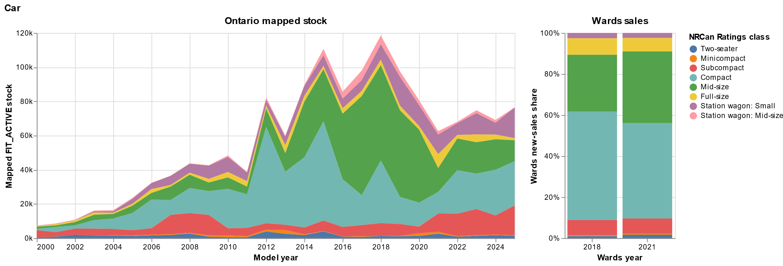
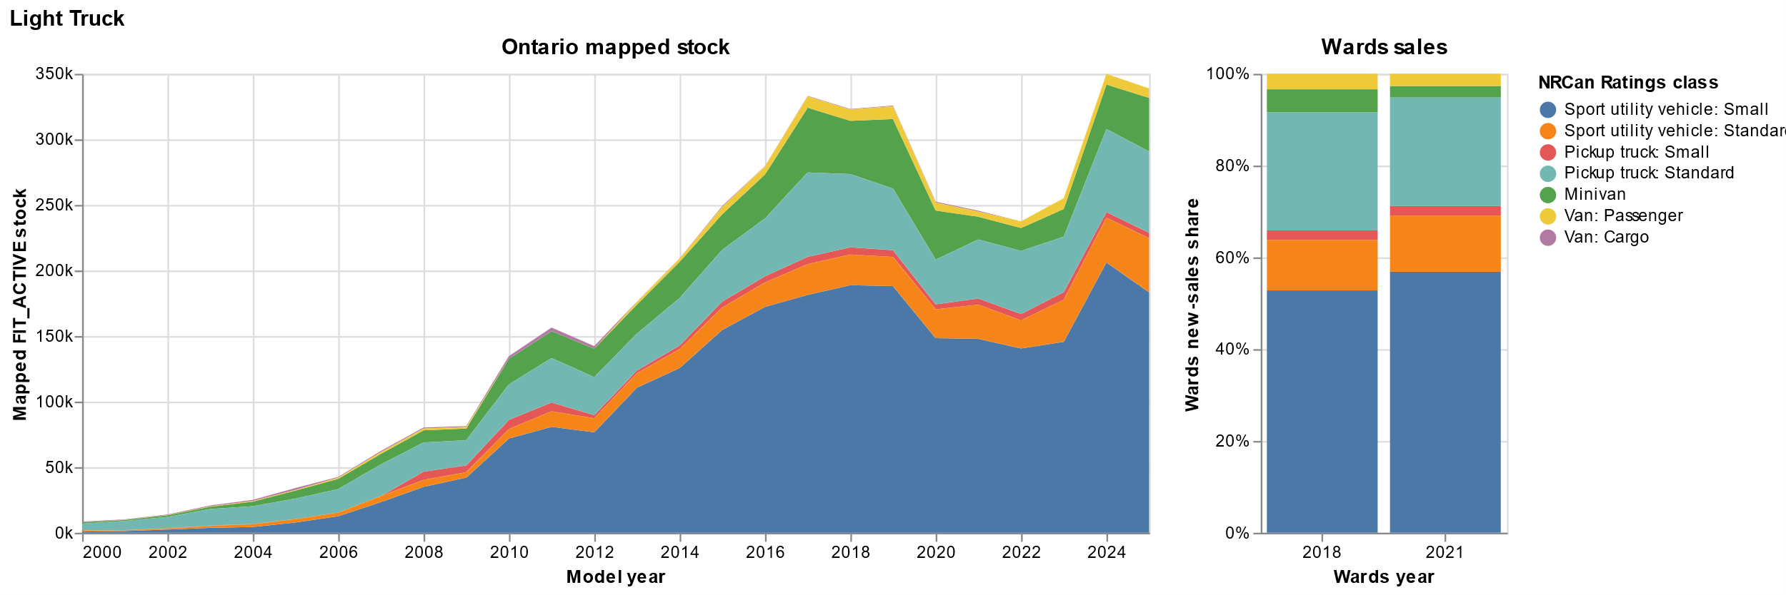
Existing capacity – vehicle cohorts represented in detail

Slide 12
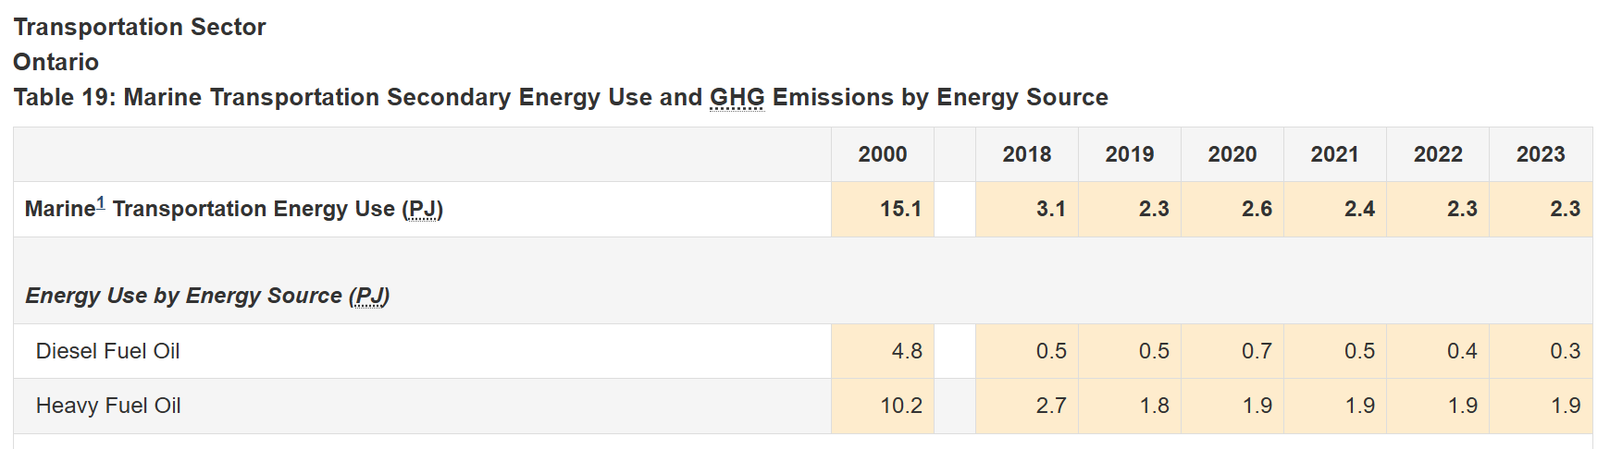
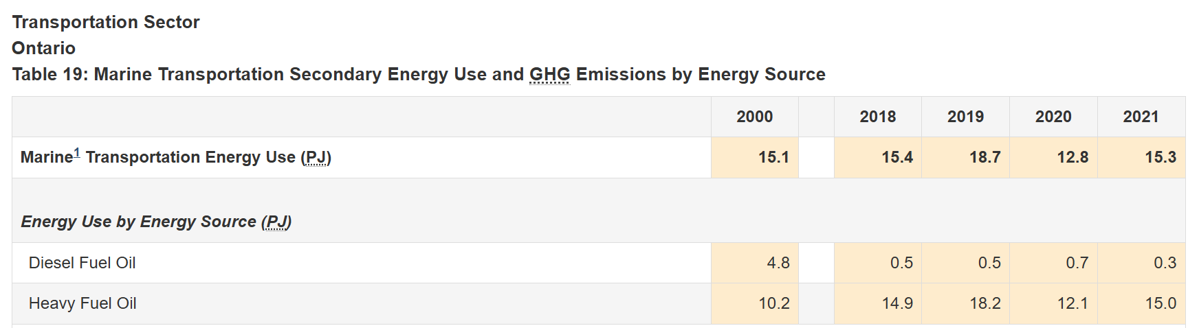
Existing capacity – Marine freight energy use changed dramatically

Slide 13
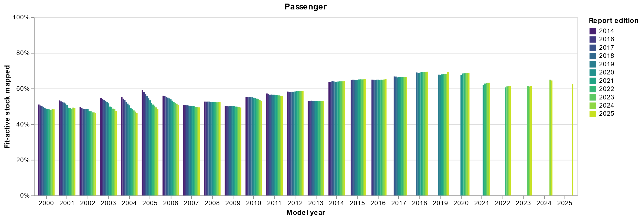
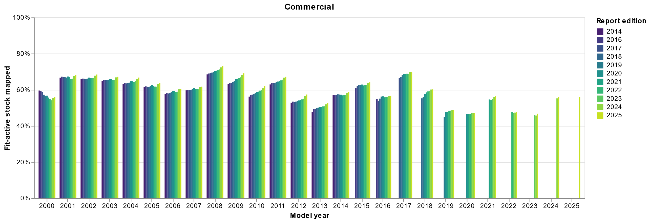
Survival curves derived from ON Ministry of Transport vehicle registrations

Slide 14
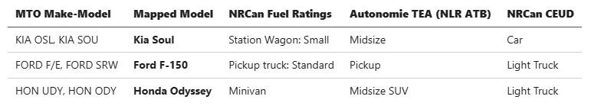
Survival curves derived from ON Ministry of Transport vehicle registrations

Slide 15
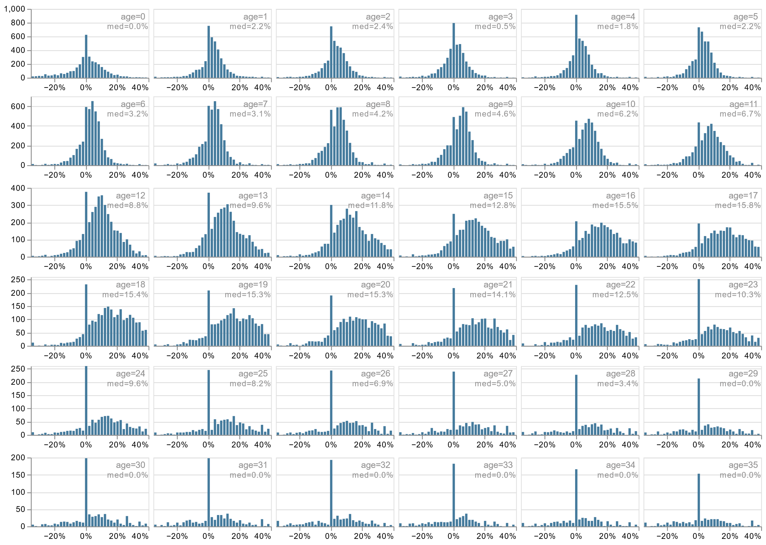
Survival curves derived from ON Ministry of Transport vehicle registrations
Frequency
Retirement rates between cohort transitions by age bucket

Slide 16
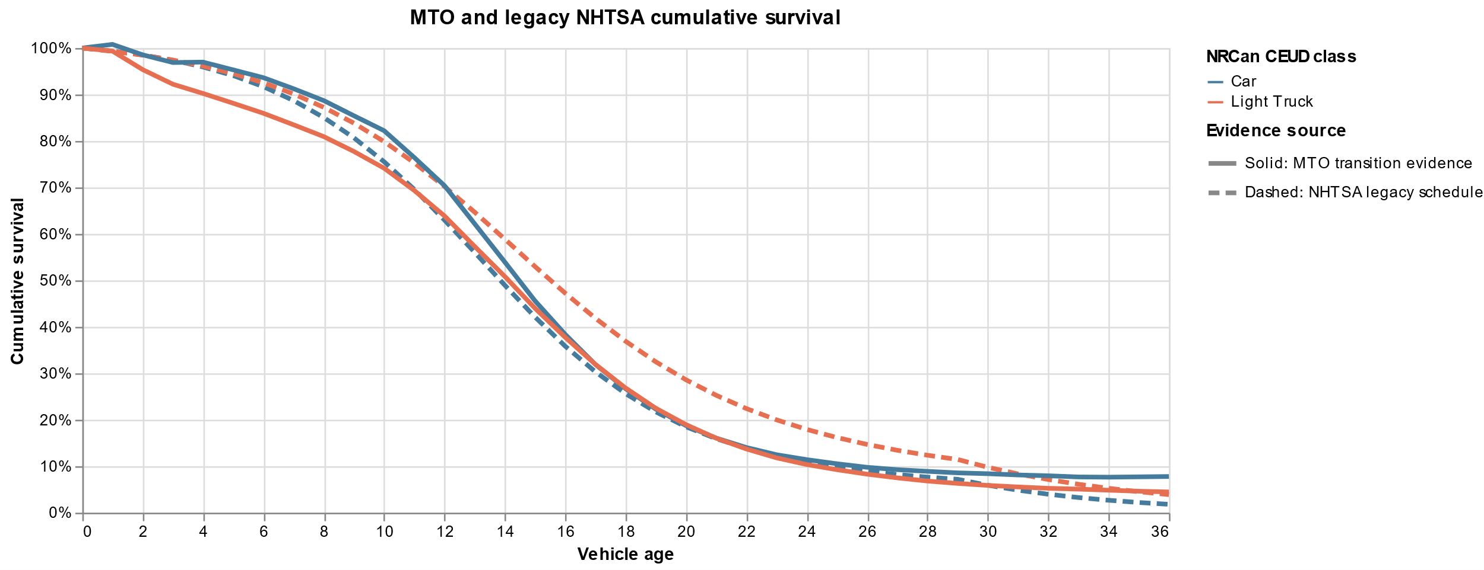
Survival curves derived from ON Ministry of Transport vehicle registrations
Legacy NHTSA CAFE survival curves
MTO population data derived survival curves

Slide 17
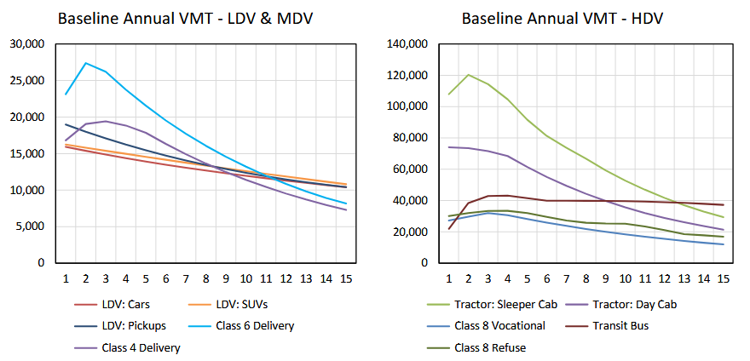
Age-based annual utilization trajectories for road vehicles
Annual miles travelled
Vehicle age

Slide 18
Improved EV charger infrastructure representation
Sources include:
NRCan/Dunsky charging infrastructure assessment
Pollution Probe charging experience survey
Transport Canada EV dashboard
NLR 2024 Assessment of alternative fueling infrastructure

Slide 19
Next steps
Parameterize adoption rates and BEV market share constraints (to-determine)
Finalize Temoa-ready sanity checks
Curate database metadata and notes
Finish MVP by end of next week (return to Toronto on Tuesday)
  MVP uses legacy charging profiles
Finish CANOE-main adapter for integrating with CANOE orchestrator (Yamil)

