Slide 1
Curvalyser
Kurvenanalyse

Slide 2
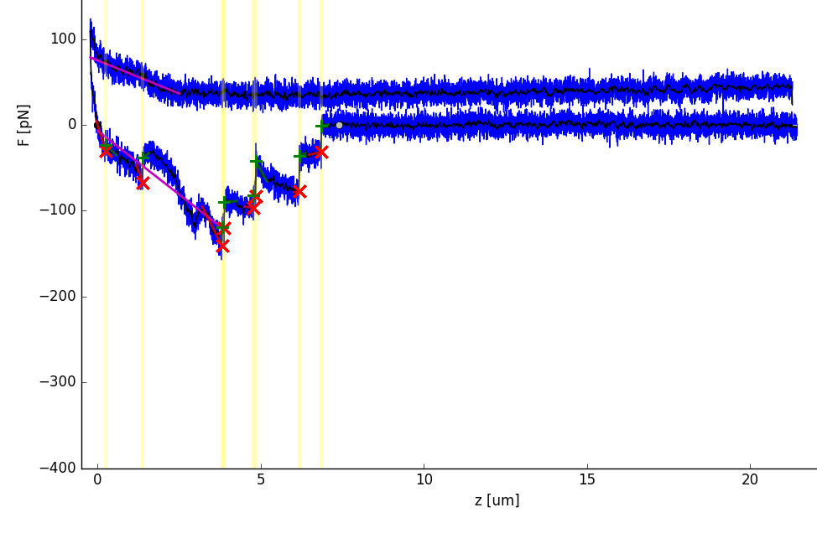
Baseline correction
Force curves can be baseline-corrected to compensate instrumental drift and to allow for correct calibration of the contact point as well as of the zero-force level.
A baseline fit is calculated iteratively every baseline_step_len data points, starting from the end of the curve.
It stops automatically if the residual sum of squares (RSS) locally exceeds the expected value by the factor baseline_max_rel_local_RSS=Threshold
The end point of the fit interval is reverted to the last local minimum of the RSS if baseline_return_to_local_min is set to 1. In case the length of the fit falls below baseline_fit_min_width, the curve is excluded from further analysis.

Slide 3
Noise reduction
Noise reduction is crucial for reliable calculation of step heights, contact point calibration, and for accurate determination of some characteristics of the force curves, such as the peak force.
Different noise reduction methods can be selected:
ReNoiR (a wavelet-based noise filter) → the force spectra contain sharp features (such as spikes or steep, narrow steps)
Gaussian smoothing → curves with more or less constant plateaus separated by smooth transitions
Savitzky-Golay filter
black line

Slide 4
Contact Point
The extension where the indentation force becomes zero for the first time during retraction is referred to as “contact point”.
Although most subsequent calculations are influenced by the calibration, it is only performed if find_contact_pos is 1
Otherwise, the extension at the reversal point between trace and retrace curve defines the zero point.

Slide 5
Step detection
Detected steps can be filtered out by defining the minimum step height (step_min_height), the minimum and maximum step width (step_min_width and step_max_width)
Linear fits of the flanks left and right of the detected steps are performed if the distance to the next step (or to the beginning/end of the force curve) is at least step_fit_min_len data points. Then, the slope and interception are recorded
The lengths of the fit intervals are optimized automatically.
In any case, the intervals are terminated at the nearest neighbouring step (or at the beginning/end of the force curve)
As most steps are not perfectly sharp, the intervals usually should not start right at the detected position, but at the beginning/end of the transition. These points can be located by finding the next local minimum in the denoised retrace curve to the left and the next local maximum to the right of the step position (these will be referred to as “lower/upper edge”)
Step heights can be determined by two different methods: If step_measuring_lt/rt = 0, the difference in force at the edges is calculated from the denoised retrace curve. If step_measuring_lt/rt = 1 or 2, the linear fits of the step flanks are extrapolated and the difference of their ordinates at the detected step positions is calculated
If the fit cannot be performed (because the interval would be smaller than step_fit_min_len data points) and step_measuring_lt/rt = 1, the first height calculation method is deployed as a fallback method. If the height cannot be calculated, a detected step is not completely ignored, but its height is not recorded.
step hight
step hight
step position

Slide 6
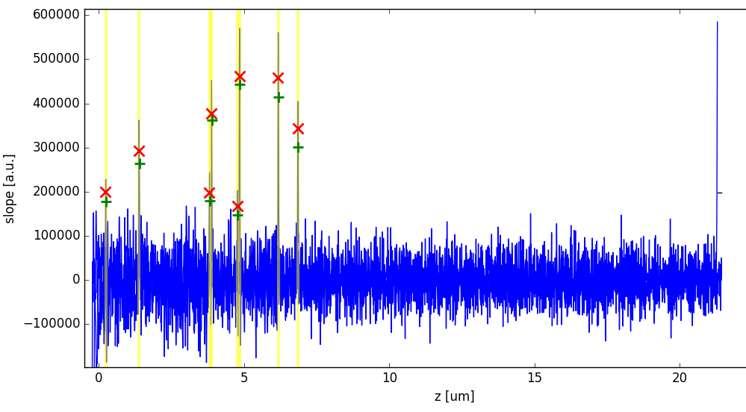
Plotted diagrams
Force curves and indicator curves.
The indicator curves are useful to adjust and check the step detection algorithm

