Slide 1





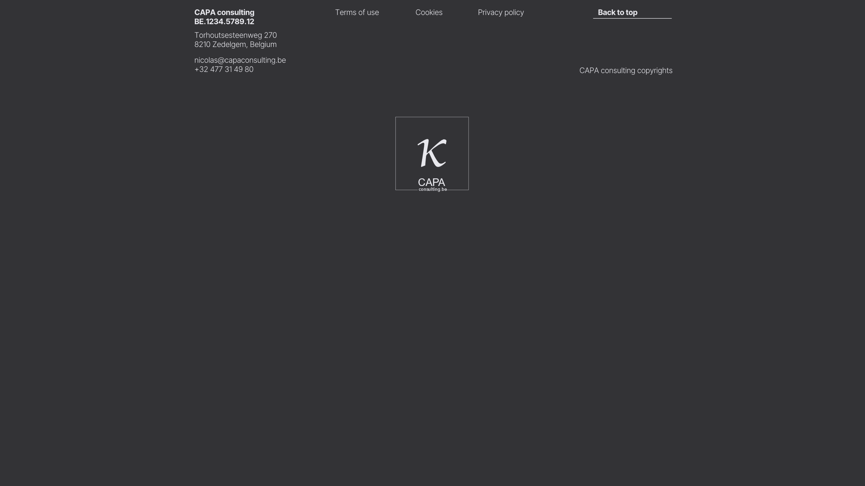
579
Content
454
🚨 Compliance Management: What It Really Means (and Why You Want to Avoid It at all cost)
Client Challenge
Enkel de titel is zichtbaar, als je klikt expand het
Impact in Action
The client approached us at a very early stage — with little more than a facility previously used as an indoor playground. Their ambition was bold: to transform this space into a fully GMP-compliant and certified manufacturing area and warehouse. Starting from scratch meant navigating everything from layout and product flows planning to creation of the Quality Management System.
Our Approach
We supported the client from the ground up — quite literally.
We began with the layout and flow design, ensuring that material, personnel, and waste flows aligned with GMP principles.
From there, we developed the most economically efficient technical infrastructure, balancing regulatory requirements with cost-effective execution.
A Quality Management System (QMS) was built from the ground up, tailored specifically to the client's operations and future plans.
We conducted the implementation process, trained the team, and prepared the organization for its first regulatory inspection.
The Result
The outcome was a success: the facility passed its GMP inspection on the first attempt, earning its certification.
What began as an unconventional starting point — an old indoor playground— was transformed into a fully operational, GMP-certified site, complete with a robust and functioning QMS. The project is a testament to what can be achieved with clear vision, planning, and hands-on regulatory expertise.
More than Compliance Management
Client Challenge
A pharmaceutical company found itself stuck in the process of Compliance Management, where their Quality Management System existed primarily to pass audits — not to support daily operations or long-term growth. Regulatory pressure was high, and the system lacked integration with on-the-ground reality.
Our Approach
We partnered closely with the client during a highly challenging period, guiding them through a full transformation of their QMS. The goal was not just to achieve compliance, but to embed Good Manufacturing Practice (GMP) principles into the organization’s day-to-day operations in a meaningful and sustainable way.
This involved:
Mapping the existing QMS and identifying critical gaps
Reframing quality as a strategic asset rather than a plain cost
Rebuilding processes and documentation to reflect both regulatory standards and operational reality
Aligning stakeholders across departments
The Result
What started as a system focused solely on surviving inspections evolved into a mature, fully integrated QMS that met all GMP requirements — in both detail and spirit.
More than just compliance, this transformation became a source of pride for CAPA — "a star on the uniform" — symbolizing ownership, resilience, and drive. The organization emerged with a system that supported not just the company, but also the patient.
Building a Fully GDP-Compliant QMS from the ground up
Client Challenge
A distributor of nuclear medicine wanted to establish a new site in Belgium and needed a fully compliant Quality Management System (QMS) aligned with Good Distribution Practice (GDP) standards and local best practices.
Our Approach
Starting from a clean slate, we worked closely with the client to design and implement a QMS tailored to the specific demands of distributing nuclear medicine. Given the complexity and risk profile of these products, the system had to go beyond standard compliance.
Key steps included:
Performing a detailed regulatory and process assessment
Structuring the QMS around GDP principles, with clear roles, responsibilities, and documentation
Introducing risk-based quality controls, training programs, and procedures
Aligning internal workflows with regulatory expectations and operational efficiency
The Result
The client now operates with a robust, fully GDP-compliant QMS that supports both regulatory inspections and daily operational efficiency. The system enables confident handling and distribution of nuclear products while minimizing compliance risk.
Automating monthly Customer Qualification Verification
Client Challenge
A pharmaceutical distributor faced a compliance issue within its customer qualification process. Due to system limitations, unauthorized sales could not be effectively prevented. Although mitigating actions like staff training were implemented, the low detectability of the issue meant that critical errors could still slip through unnoticed — posing significant risks under Good Distribution Practice (GDP) regulations.
Our Approach
Since the existing ERP systems lacked the flexibility to solve the problem, we developed a custom software solution tailored to the client’s compliance needs.
The tool:
Automatically scanned every invoice on a monthly basis
Cross-referenced customer data against up-to-date official databases
Generated a data integer PDF report with timestamp and a clear list of required actions (if any)
If no issues were detected, the user simply had to sign and archive the report — dramatically reducing manual overhead
We also advised the client that while a risk-based sampling method could theoretically guide the monthly control process, the complexity and margin for error made a fully automated approach much more suitable.
The Result
The solution delivered certainty, without relying on sampling or manual review and with zero risk of human error. This project is a strong example of how custom software can close critical compliance gaps where standard tools fall short.
From Chaos to Clarity in In-Process Control (IPC)
Client Challenge
The client’s system (Contract Manufacturer) for In-Process Controls (IPC) was disorganized and outdated. IPCs were logged using a patchwork of copied forms, multiple generations removed from the original. In batch documentation, it was often unclear which forms needed to be filled out, and no standardized instructions were available for operators. The result: confusion on the floor and time-consuming corrections during batch record reviews.
Our Approach
We began with a thorough analysis of each production process, identifying similarities and differences in documentation and execution.
From there, we implemented:
A standardized system of IPC forms tailored to each product group and process
Clear, uniform instructions integrated directly into the documentation
Targeted training to ensure all operators understood and followed the new procedures
The Result
The new system dramatically reduced post-production issues during batch record reviews, saving time and minimizing compliance risks.
By bringing structure, clarity, and training into the QA process, the client moved from reactive corrections to proactive quality control — less stress, fewer errors, and a far more efficient documentation flow.

