Slide 1
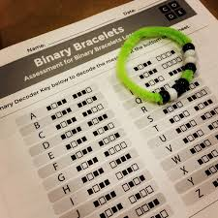
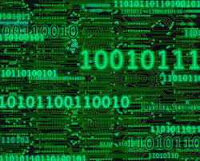
Binary Bracelets

Slide 2
What is Binary ?
https://www.youtube.com/watch?v=lsCKJ6se_1w

Slide 3
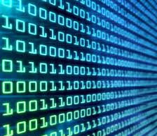
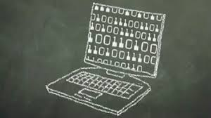
Binary is like a secret code that makes it easier for computers to understand a variety of information

Slide 4
How do we spell things in Binary
-With ASCII (American Standard Code for Information Interchange)
-ASCII allows computers and us to use binary code to form letters and create words

Slide 5
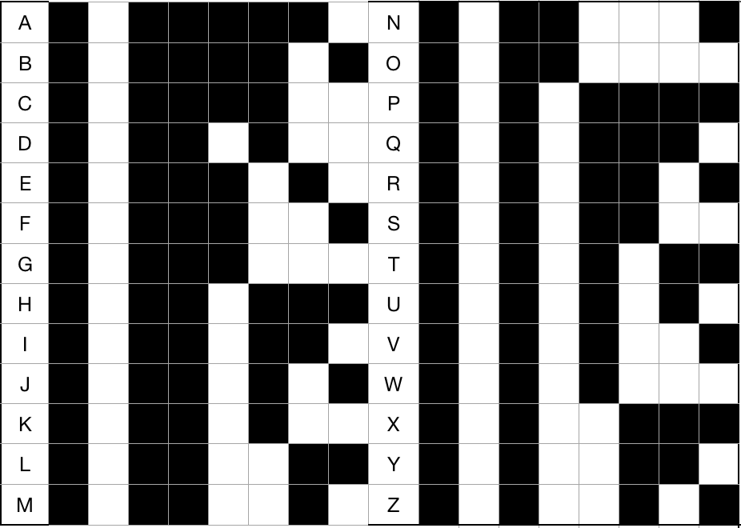
Binary Chart
Black=0
White=1

Slide 6
Example of Word Template
1. ( P ) _0_ __1__ __0__ __1__ __0__ __0__ _0___ __0__
2. ( I ) _0___ __1__ __0__ __0__ __1__ __0__ _0___ __1__
3. ( Z ) __0__ __1__ __0__ __1__ _1___ __0__ __1__ __0__
4. ( Z ) __0__ __1__ __0__ __1__ _1___ __0__ __1__ __0__
5. ( A ) __0__ __1__ __0__ __0__ _0___ __0__ __0__ __1__

Slide 7
Pick a word that is 5 or fewer letters
Pizza
Family
Taco
Dance
Read
Happy
Puppy
Kitty
Human
Robot
Dream
Hello
Peace
Shine
Spark
Think
Love
Snack
Silly
Super
Ninja
Swirl
Fizzy
Glow
Llama
Panda
Mango
Squid
Mouse
Write
Learn
Sing
Bacon
Hope
Smart
Water
Sweet
Cake
Sassy
Funny
Grand
Lava
Piano
Music
Santa
Today
Glory
Magic
Brain
Fruit
Royal
Earth
Bread
Crazy
Ocean
Socks
…Or Chose your Own

