Slide 1

Introduction to Databases & SQL
CAPS

Slide 2
SQL – Structured Query Language
Basic CRUD Commands:
Create
Read
Update*
Delete*
*You should have where clauses with these statements
INSERT INTO Vehicles(vin, make, model, year) VALUES ( ‘12345ABC’, ‘Ford’, ‘Mustang’,1988)
INSERT INTO Vehicles(vin, make, model, year) VALUES ( ‘12345ABC’, ‘Ford’, ‘Mustang’,1988)
SELECT Vin, Make, Model FROM Vehicles
SELECT Vin, Make, Model FROM Vehicles
UPDATE Vehicles SET Make = “Chevrolet”
UPDATE Vehicles SET Make = “Chevrolet”
Delete From Models
DELETE FROM Models

Slide 3
Where Clause
In order to restrict the records that a query affects we use a WHERE clause
This will only delete the record with the Id of 5.
This will update any records that currently have a Make of “Chevy”
DELETE FROM Model WHERE Id = 5
UPDATE Vehicles SET Make = ‘Chevrolet’ WHERE Make = ‘Chevy’

Slide 4
Creating Tables
Creating tables:
CREATE TABLE [TableName]
(
[FieldName] [DataType] [Specifications]
CONSTRAINT [ConstraintName] [Constraint Type] ([FieldName])
)
CREATE TABLE Vehicles
(
VehicleId int Identity(1,1) not null,
VehicleVIN varchar(30) not null,
VehicleMake varchar(50) not null,
VehicleModel varchar(50) not null,
VehicleYear int not null
CONSTRAINT PK_TVehicles Primary Key(VehicleId)
)

Slide 5
Where Clause
In order to restrict the records that a query affects we use a WHERE clause
This will only delete the record with the Id of 5.
This will update any records that currently have a Make of “Chevy”
DELETE FROM Model WHERE Id = 5
UPDATE Vehicles SET Make = ‘Chevrolet’ WHERE Make = ‘Chevy’

Slide 6
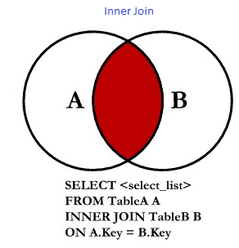
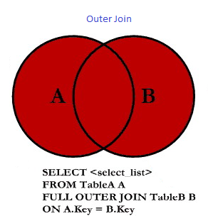
JOINS
Inner Join - returns all records from the left table that have a corresponding record in the right table
Outer Join - returns all records from both tables, joining records from the left table that correspond to records from the right table

Slide 7
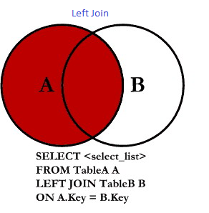
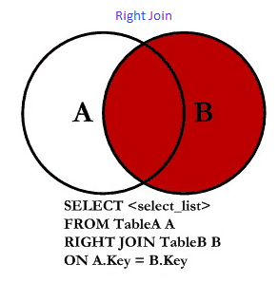
JOINS
Left Join - returns all of the records in the left table regardless of whether any of those records have a match in the right table. It will also return any matching records from the right table.
Right Join - returns all of the records in the right table regardless of whether any of those records have a match in the left table. It will also return any matching records from the left table.

Slide 8
SQL Server Management Studio
Used for configuring, managing, and administering components within Microsoft SQL Server
Allows connections to multiple databases on multiple servers
Quickly write queries and view results
Easy navigation between tables

Slide 9
Assignments
Create a table in table in the slingshot database named YourNamesContacts. It should have a primary key that auto increments as you add records named ContactId. It should be an integer. You should track the first and last name of the contact as well as their email and phone number.
Write the sql to insert 5 contacts into your contact list.

