Slide 1

Introduction to 3-Tier Architecture
CAPS

Slide 2
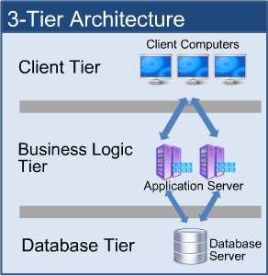
What is a 3-Tier Architecture?
Three-tier is a client-server architecture in which the user interface, business process (business rules) and data storage and data access are developed and maintained as independent modules or most often on separate platforms.
This architecture allows any one of the three tiers to be upgraded or replaced independently.

Slide 3
Presentation Tier
This is the top-most level of the application. It will commonly have the most direct interaction with the user.
Can implement an MVC structure
Routes tasks or requests down to other layers
Routes and translates results or responses into something the user can understand (like HTML)

Slide 4
Business Logic Tier
Also referred to as the middle tier, the business logic tier consists of business and data rules. It houses and controls the application functionality.
Accessed initially by the presentation tier
Will be handling the business logic, ie validations, calculations, etc.
Responsible for passing data to the next low level layer: data tier

Slide 5
Data Tier
The data tier houses the database server(s) where information is stored, managed, and retrieved. Data in this tier is kept independent of application servers and business logic.
Sits on its own server
Responsible for the storage and querying of application data
Should have very tight permissions so only the middle layer can securely communicate back and forth

Slide 6
Benefits
Resource allocation is more flexible which can improve network performance
Easier to develop because work can be parallel on separate tiers with minimal interaction
Physically separating tiers means improved security
Much more scalable
Drawbacks
Time consuming (which equates to being costly)
Very complex

Slide 7
Assignments
Open your AddressBook project.
Add your existing Service Project to the solution.
Create a new Class Library for your models. (Remove the classes from the Service and MVC projects)
Create a reference to the model project in both of the other projects.
Create a Service Reference in the MVC project to the Service.
Update ALL references (including those in your views) to the new models.

