Slide 1

Learning MVC Concepts : The Controller
CAPS

Slide 2
MVC Fundamentals
MVC is a design pattern for developing web applications
MVC aims to enforce clearly defined responsibilities
MVC isolates the application logic from the user interface layer and supports separation of concerns

Slide 3
Model View Controller
Model
The lowest level of the pattern which is responsible for maintaining data
These classes represent the data of the application and use validation logic to enforce business rules for that data
View
Responsible for displaying all or a portion of the data to the user
Made up of template files that your application uses to dynamically generate responses (commonly in HTML)
Controller
These classes handle incoming browser requests, retrieve model data, and then specify view templates that return a response to the browser.
Controls the interactions between the Model and View

Slide 4
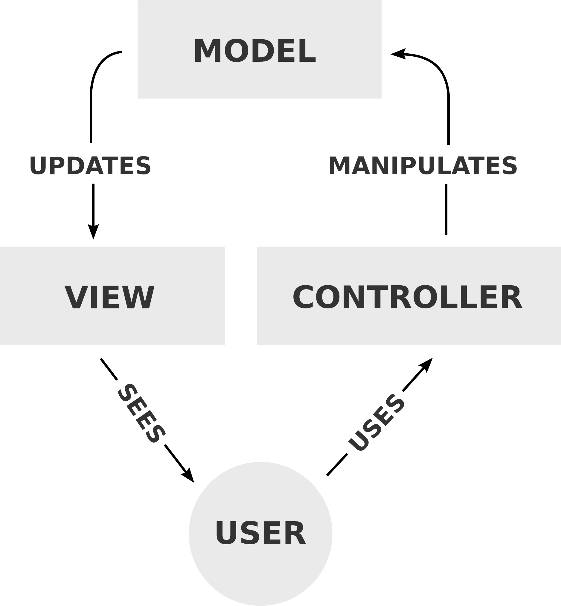
The Controller
Receives requests through request routing setup in global configuration
Responsible for sending the appropriate response
Communicates with the model layer depending on the request
Passes the raw response to the View for formatting and presentation
The base class for all controllers is the ControllerBase class, which provides general MVC handling

Slide 5
Request Routing
When a user enters a URL into the browser, the MVC application uses routing rules that are defined in the Global.asax file to parse the URL and to determine the path of the controller.
The name of the method and the parameters can be included in the query string.
The Default Route is:
routes.MapRoute(​
name: "Default",​
url: "{controller}/{action}/{id}",​
defaults: new { controller = "Home", action = "Index", id = UrlParameter.Optional }​
);​
The default values are used when a controller and action is not supplied in the URL.

Slide 6
Setting HTTP Methods
These define the action that the request is trying to make. They can be defined on a method by using attributes.
The GET method means retrieve whatever information is identified by the request
The POST method is used to request that the server accept the entity enclosed in the request
The PUT method requests that the enclosed entity be stored under the supplied request
The DELETE method requests that the origin server delete the resource identified by the request

Slide 7
Defining Attributes
Attributes are a way of associating declarative and static information
Attributes can be attached to classes, properties, enums, and methods
[HttpPost]
public JsonResult Create(object model)
{
return Json(model, JsonRequestBehavior.AllowGet);
}

Slide 8
Request Types
An ActionResult encapsulates the result of an action method and is used to perform a framework-level operation on behalf of the action method.
A few popular, derived Action Results include:
JsonResult
ViewResult
FileResult
ContentResult

Slide 9
Assignments
Create an MVC 5 application that allows the user to manage an address book. Ignore all aspects aside from the controller. Create methods in the controller to access pages for adding a new entry, displaying the entire address book, and searching for specific entries.

