Slide 1

Entity Framework and LINQ
CAPS

Slide 2
LINQ Revisited
LINQ - Language Integrated Query
  Method to query different types of datasets using the same syntax.
  Can be used to query a SQL database, XML documents or anything that implements IEnumerable
  Optimizes queries at runtime
  Intellisense and debugger support
  Compile time checking for syntax errors and type safety
Example of retrieving a list of odd numbers:
var numbers = new List<int> {1, 4, 7, 9, 11, 3, 8, 12};
List<int> oddNumbers = numbers.where(n => n % 2 == 1).ToList();

Slide 3
Without LINQ
LINQ Demonstration
var numbers = new List<int> {1, 4, 7, 9, 11, 3, 8, 12};
var rangeOfNums = new List<int>();
foreach (var n in numbers)
{
if (n > 3 && n < 11)
{
rangeOfNums.Add(n);
}
}
With LINQ
var numbers = new List<int> {1, 4, 7, 9, 11, 3, 8, 12};
var rangeOfNums = numbers.Where(n => n > 3 && n < 11).ToList();

Slide 4
Lamda Expressions
A lambda expression is an anonymous function that you can use to create delegates or expression tree types.
It is convenient because it allows you to write the method in the same place that you will use it.
Lambda expressions should be short. A complex definition makes the calling code difficult to read.
As a rule of thumb, if shorter syntax loses readability, stick with a loop

Slide 5
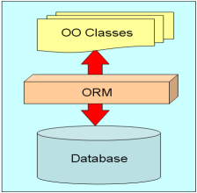
Object Relational Mapper
Object-relational mapping (ORM) is a programming technique for converting data between incompatible type systems in relational databases and object-oriented programming languages. It wraps your tables (or stored procedures) in classes so that you can interact with your database using methods and properties of objects rather than SQL statements.
Simply put, an ORM is a layer of abstraction over your database.

Slide 6
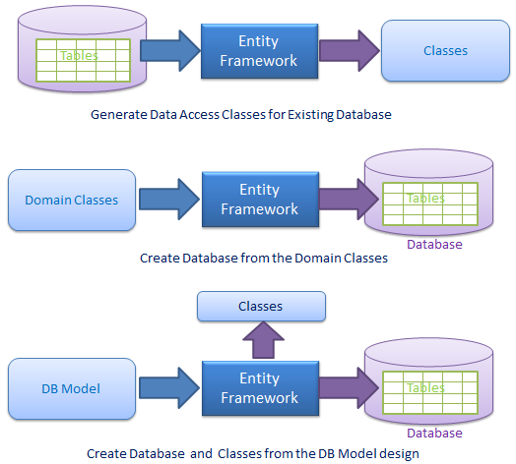
Entity Framework
Entity Framework (EF) is an object-relational mapper built for .NET
Issue queries using LINQ rather than SQL, then retrieve and manipulate data as strongly typed objects (not tables)
EF's implementation provides services like:
  change tracking
  identity resolution
  lazy loading
  query translation
Allows the developer to focus on their application-specific business logic rather than the data-access fundamentals

Slide 7
Connect to a DB with Entity Framework
We need to do some preliminary work to get up and running with Entity Framework.
Add a reference to Entity Framework inside your model project
Set your Service project as your start up project. To do so, right click on your Service project > Set as Startup Project
Add a connection string to the database in your Service project's web.config. To do this, go to project properties > Settings > Add Connection String.
Add a DbContext class and its DbSet properties to our model project in a folder named DAL (which stands for Data Access Layer).
namespace Vehicles.Model.DAL
{
public class VehicleContext : DbContext
{
public VehicleContext() : base("VehicleContext"){}
public DbSet<Vehicle> Vehicles {get; set; }
public DbSet<Person> Owners { get; set; }
}
}

Slide 8
Enable Migrations
Code First Migrations allow you to create a new database or update an existing database based on your model classes by using Package Manager Console.
Open up Package Manager Console. To do so, go to Tools > Nuget Package Manager > Package Manager Console
In the Default project dropdown, select your model project
Enable Code First Migrations by running Enable-Migrations. This will create a configuration class that allows you to configure how Migrations behaves for your context. For this walkthrough we will just use the default configuration.
Now that migrations are enabled, we need to add our first migration. To do so, run Add-Migration InitialMigration. This will create a migration class that Entity Framework will refer to when it goes to apply the changes to your database. Inspect this class.
We need to tell Entity Framework to apply our first migration to our database. To do so, run Update-Database.
Now you're ready to start querying the database with the help of Entity Framework!

Slide 9
Use Entity Framework
Any time structural changes are made to your model, you'll need to add a migration and update your database. Now that Entity Framework is configured, it's ready to use for querying.
In your service project, you can now use a DbContext to connect to your database.
public Vehicle GetVehicle(string vin)
{
using (var context = new VehicleContext())
{
return context.Vehicles.FirstOrDefault(v => v.VIN == vin);
}
}

Slide 10
Assignment
In your service project, make the three Operation Contracts that we implemented in Week 5 work correctly using Entity Framework.
  AddContact should accept a Contact and add it to the database
  GetContacts should return a list of all Contacts
  Search should accept an integer ID that represents a Contact ID and should return the correlating Contact or null if there isn't one

